Slide 1
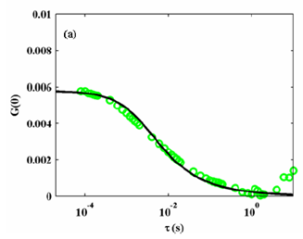
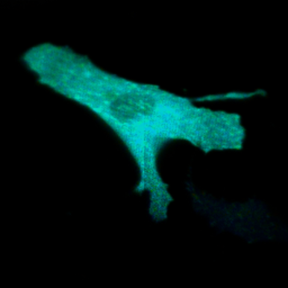
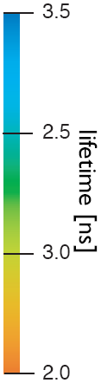
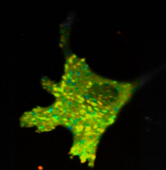
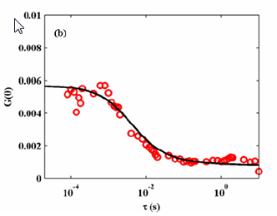
Advanced Fluorescence Microscopy I:
Fluorescence (Foster) Resonance Energy Transfer
FAT
Pax
3.0
GFP-Pax
2.5
GFP-Pax + FAT-mCherry
2.0
FAT
1.5
Average lifetime (ps)
Lifetime (ns)

Slide 2
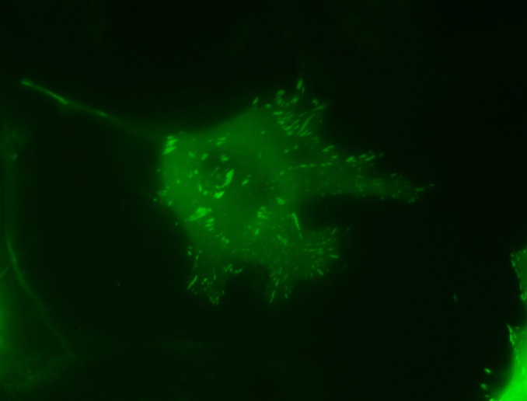
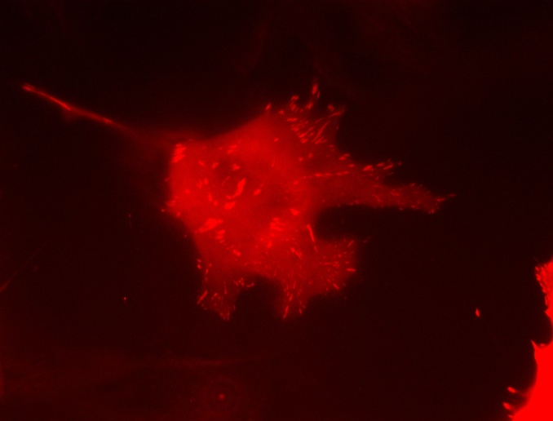
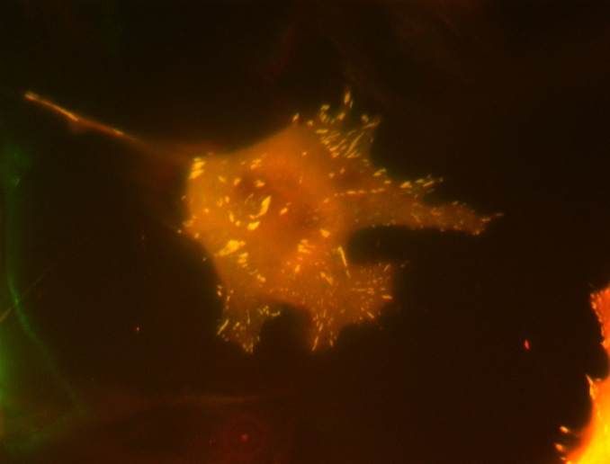
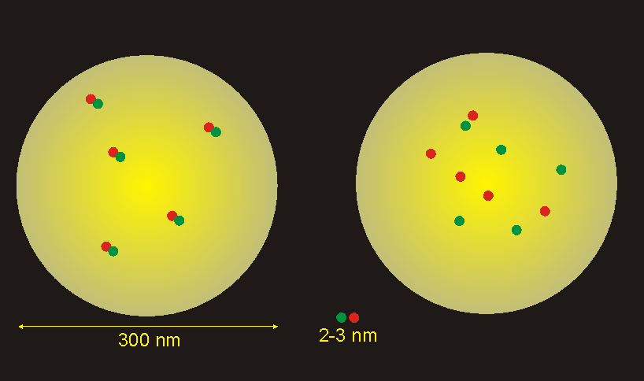
Paxillin-FAT in endothelial cells
GFP-Paxillin
FAT-mCherry
Spectral overlap

Slide 3
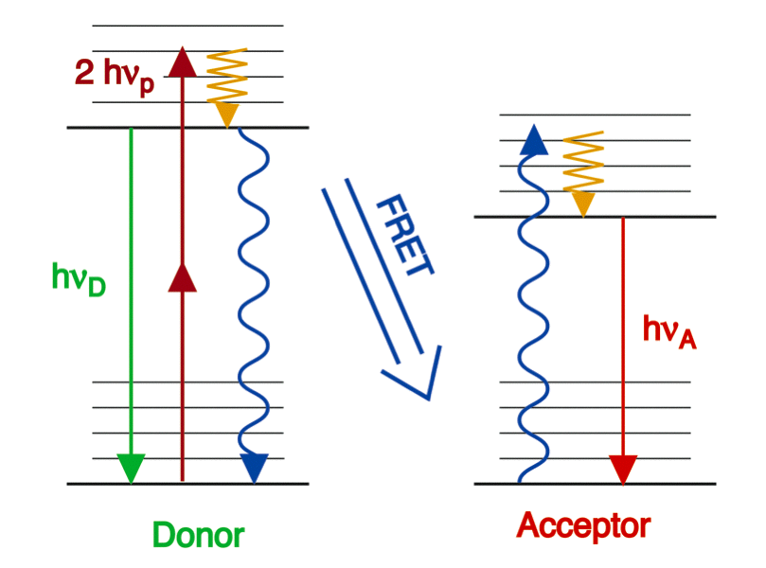
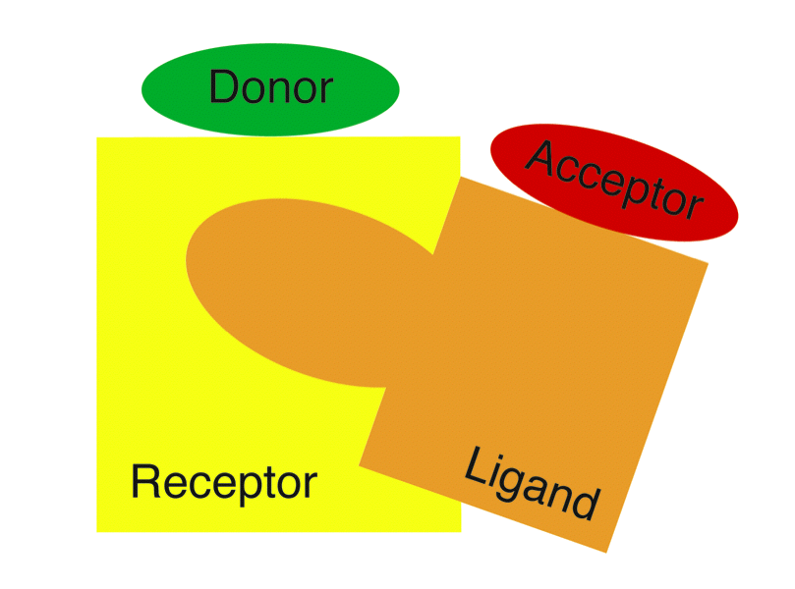
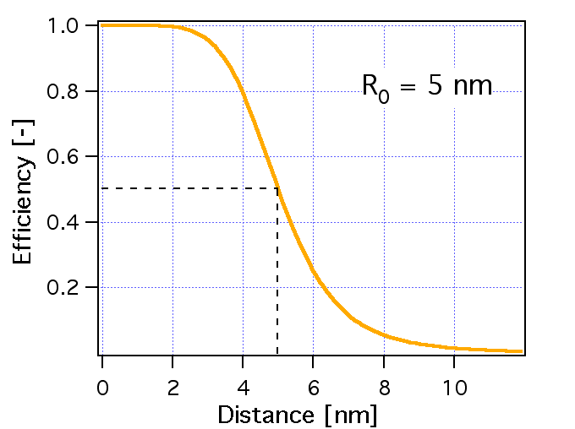
Fluorescence Resonance Energy Transfer (FRET)
Dipole - dipole interaction
r⁶ dependence
Efficiency
50% energy transfer
Förster distance
R₀ = 40 to 70 Å
Decrease donor intensity
Increase acceptor intensity
Decrease donor lifetime

Slide 4
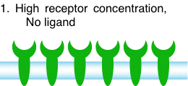
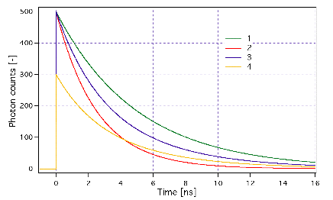
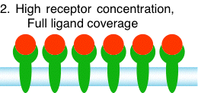
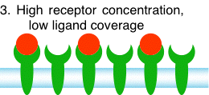
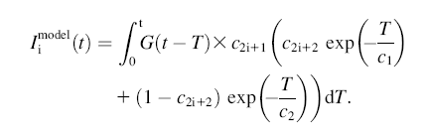
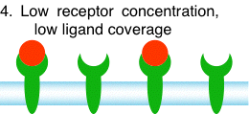
“Quantify” Signaling Pathway Using t-FRET

Slide 5
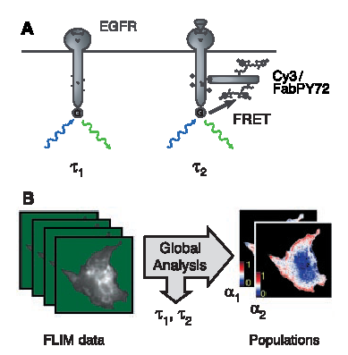
Apply Lifetime Resolved FRET
to Study Receptor Mediated Signaling I
Verveer, Science 2000

Slide 6
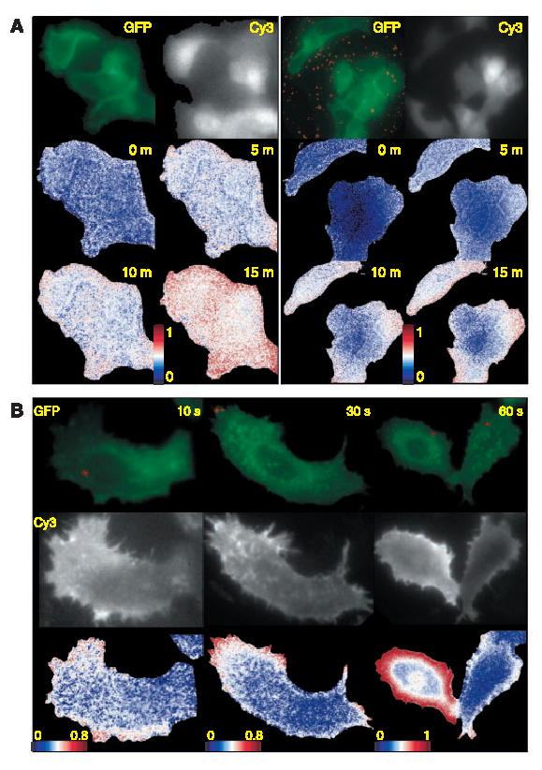
Apply Lifetime Resolved FRET
to Study Receptor Mediated Signaling II
Verveer, Science 2000
Verveer, Science 2000

Slide 7
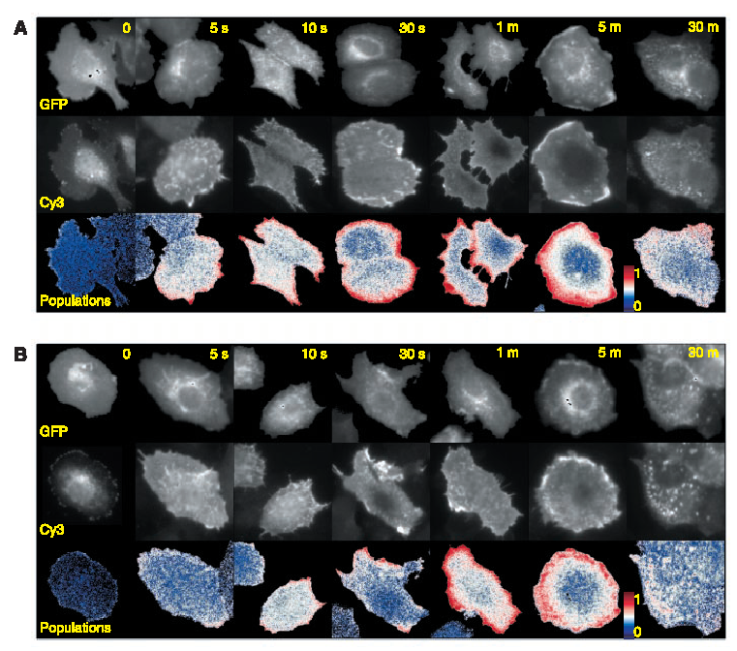
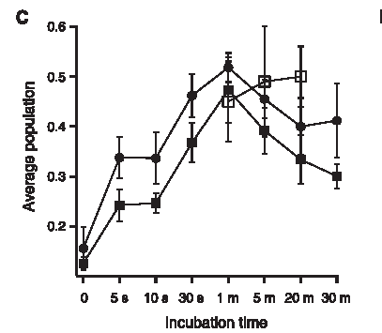
Apply Lifetime Resolved FRET
to Study Receptor Mediated Signaling III
Verveer, Science 2000

Slide 8
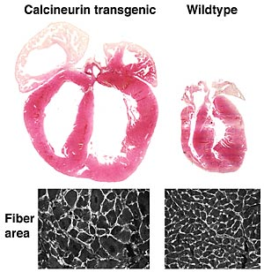
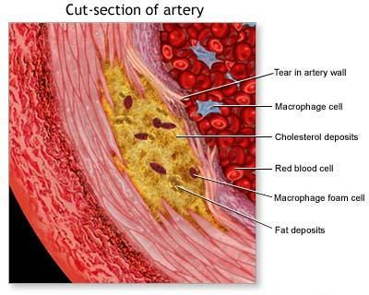
Mechanotransduction
Cardiac Hypertrophy
Intracellular signaling
cascade
Remodeling of
Cellular & Tissue
Phenotype
http://www.cincinnatichildrens.org
Arteriosclerosis
Mechanical Forces
(shear, stretch,
geometric confinement)
www.bodyrepairstore.com

Slide 9
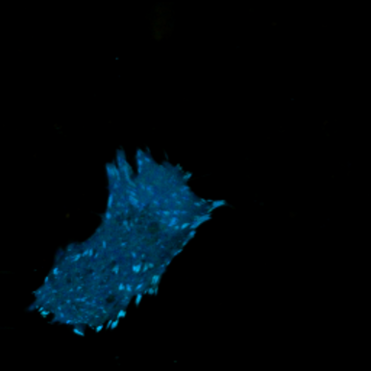
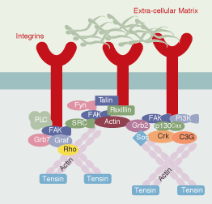
Focal adhesion complex
Focal adhesion complex serves as the adhesion sites of cells and mechano-signal
transduction center of the cell
Quantification of Paxillin-Focal adhesion kinase interaction

Slide 10
Fluorescence Resonance Energy Transfer (FRET)
Dipole - dipole interaction
r⁶ dependence
Efficiency
50% energy transfer
Förster distance
R₀ = 40 to 70 Å
Decrease donor intensity
Increase acceptor intensity
Decrease donor lifetime

Slide 11
“Quantify” Signaling Pathway Using t-FRET

Slide 12
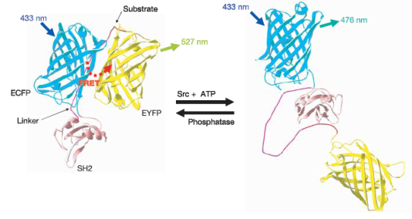
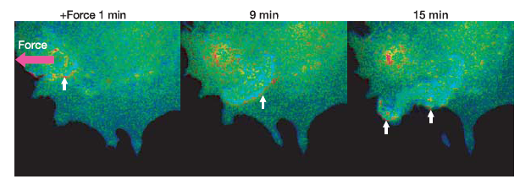
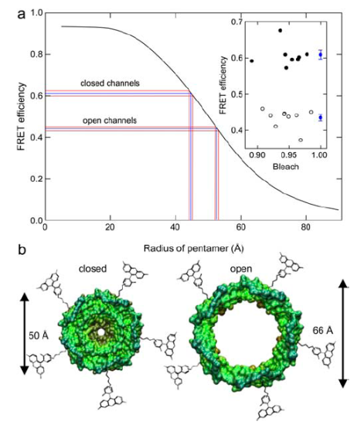
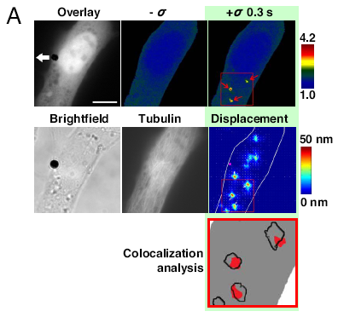
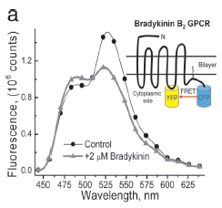
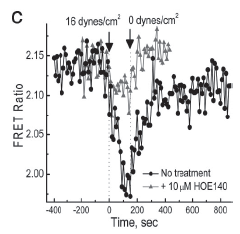
Quantification of Mechanotransduction with Foster resonance energy transfer (FRET)
Src phosphorylation dynamics
MscL activation
Wang et al., Nature 2005
Corry et al., BJ 2005
GPCR conformation change
Na et al., PNAS 2008
Chachivilis et al., PNAS 2008

Slide 13
What can we quantify?
Is there binding?
Presence or absence of FRET
What is the conformation of the bound molecule?
FRET Efficiency:
What is the fraction of molecule bound?
FRET ratio:
What is the thermodynamic constants of binding? Dissociation constant & Gibb’s free energy
Use fluorescence correlation spectroscopy to get [F]

Slide 14
Fluorescence Correlation Spectroscopy (FCS)
Poisson statistics:

Slide 15
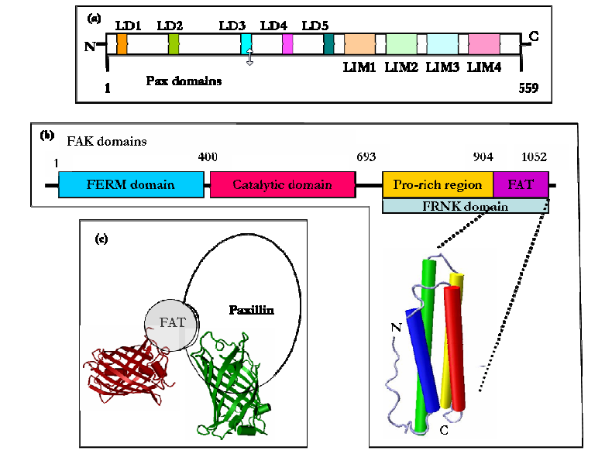
FAT and Paxillin Binding

Slide 16
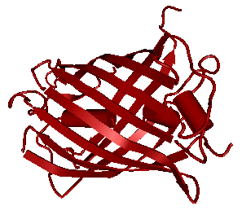
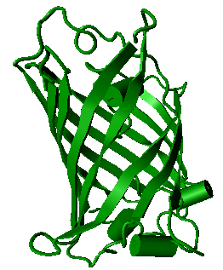
Thermodynamics of Pax/FAT Interaction
Bovine aortic endothelial cells (BAECs)
Co-transfected with Pax and FAT plasmids
F
P
F
P
F
P
Paxillin
F
P
FAT
F
F
F
P
P
F
P
F
F
P
P
P
F
P
F
P
F
F
P
F
P
P
F
F
P
P
actin
FAT-mCh_{cyto} + GFP-Pax_{cyto}
FAT-mCh---GFP-Pax_{cyto}
k_{on}
k_{off}
k_{on}
k_{off}
k_{on}
k_{off}
[FAT] * [Pax]
K_{d} =
Focal adhesion plaque
[FAT-Pax]
Cell membrane

Slide 17
How to measure k_{d} & ΔG spectroscopically
[FAT] * [Pax]
For a given cell, measure concentrations or
ratio of concentrations
K_{d} =
[FAT-Pax]
[Pax] = 1
FRET / FLIM
[FAT-Pax] 1 – FRETratio
η = 1 – FRETlifetime
non-FRETlifetime
B = Green molecule intensity/C_{gfp} = [Pax] +(1-η)[FAT- Pax]
C = Red molecule intensity/C_{mc} = [FAT] + [FAT-Pax] + B/γ
C_{gfp} is the brightness of gfp, C_{mc} is the brightness of m-cherry,
γ is a parameter characterizing bleedthrough from the green to the red channel
Solve simultaneous equations to obtain K_{d}. Calculate Gibbs free energy, ΔG = RT ln K_{d}
In vitro systems exist to measure K_{d} for purified protein pairs e.g. isothermal titration calorimetry (ITC) and surface plasmon resonance (SPR) but no in vivo methods exist.

Slide 18
Typical FLIM-FRET & FCS data
FAT
Pax
3.0
GFP-Pax
2.5
GFP-Pax + FAT-mCherry
2.0
FAT
1.5
Average lifetime (ps)
Lifetime (ns)

Slide 19
Quantification of a single cell
FRET
FCS
Calibration | Red ch | Green ch
Intensity | 0.3 | 5.2
Concentration | 18.2 nM | 21.8 nM
Cell image pseudo-colored by FRET ratio
Fixed τ₁ = 2.6ns, fit τ₂ = 1.9ns R ~ 56Ǻ
Cell intensity in green channel
η = 1 - τ₂/τ₁ = 0.2692
Solve simultaneous equations to obtain K_{d}
FRET / FLIM: [FAT-Pax] = A
FCS @ 890nm: [Pax] +(1-η)[FAT- Pax] = B
FCS @ 780nm: [FAT] + [FAT-Pax] + B/17 = C
[Pax] + [FAT-Pax]
Cell intensity in red channel

Slide 20
Thermodynamics of Pax/FAT Interaction in a single cell
[FAT] =
[FAT-Pax]
K_{d}
Histogram of K_{d} for cytosolic region
[Pax]
[FAT] vs [FAT-Pax]/[Pax]
[FAT]
Gradient = 209nM
Histogram peaks at K_{d} value ~200nM
[FAT-Pax]/[Pax]
.
[FAT] * [Pax]
Pixels within 3 bins on either side of histogram peak
Linear fit result
K_{d} =
[FAT-Pax]

Slide 21
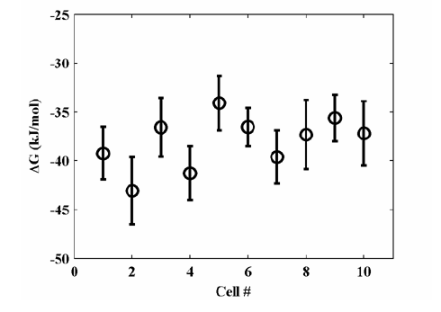
Variation of ΔG across different cells
Measurement of 10 distinct cells over three days
Error bars are std dev in one cell

Slide 22
Compare k_{d} & ΔG with in vitro system
Spectroscopic measurement: K_{d} = 367 ± 33 nM (S.E. 10 cells)
In vitro results:
Isometric Titration Calorimetry (ITC)
K_{d} ~ 10 μM for FAT + 1 LD domain of Pax
Gao et. al. J. Biol Chem. 2004
Surface Plasmon Resonance (SPR):
K_{d} ~ 4 μM for FAT + 1 LD domain of Pax
Thomas et. al. J. Biol Chem. 1999
K_{d} ~ 300 – 600 nM for FAT + both LD domains of Pax that bind FAT
Paxillin-FAT interaction shows significant allosteric effect both in vivo & in vitro

Slide 23
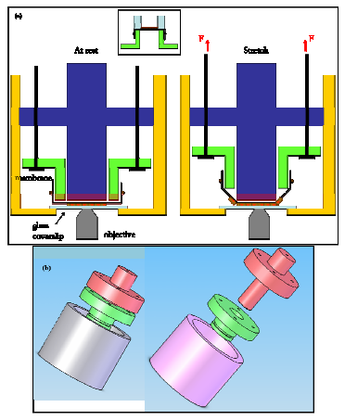
Is paxillin-FAT binding mechno-sensitive?
Apply bi-axial stretching (up to 10%)

Slide 24
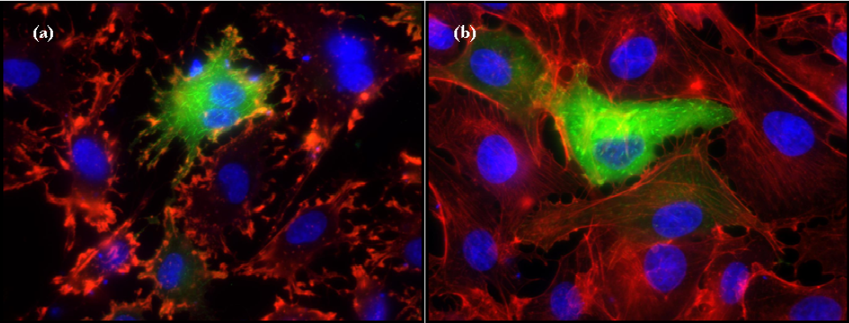
Chemical disruption to mechanotransduction
Cytochlastin D
Genistein
Blocks actin polymerization
Blocks protein tyrosine
phosphorylation

Slide 25
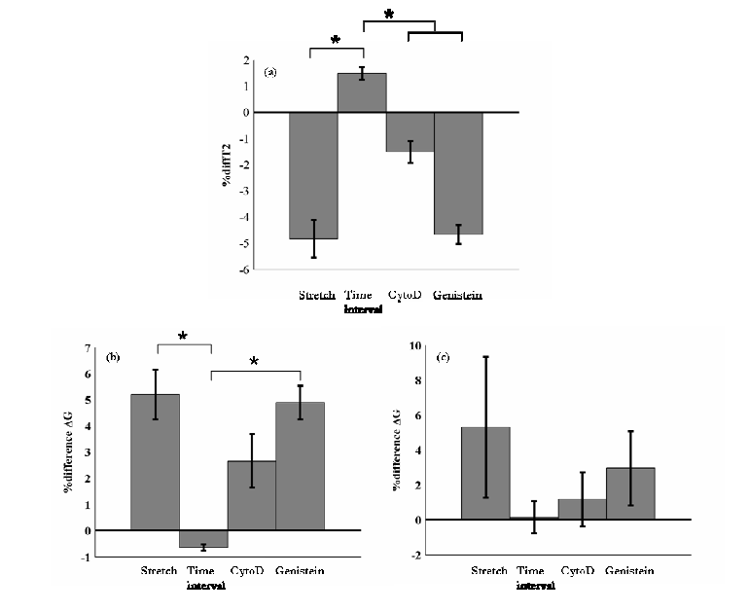
Blocking of stretch responses
Disruption of actin cytoskeleton (via cytoD) reduces mechanotransduction
Blocking tryosine phosphorylation does not block mechanotransduction

