Slide 1
Model for Nitrogen Metabolism for Saccharomyces cerevisiae based on ter Schure et al. paper
Alondra Vega
Departments of Biology and Mathematics
Loyola Marymount University
February 24, 2011

Slide 2
Outline
Purpose of Model
Background on Nitrogen Metabolism
-- Amino acids and enzymes used in reaction
-- Genes involved in nitrogen metabolism
Background on Michaelis-Menten model
-- Substrates vs. Products
Demonstrate the model
-- What plays a role and what was left out and why
Describe differential equations
-- State variables vs. Parameters
Show model runs and what they mean
Did the model work?
Conclusion
--What the model means
--Future Work

Slide 3
Outline
Purpose of Model
Background on Nitrogen Metabolism
-- Amino acids and enzymes used in reaction
-- Genes involved in nitrogen metabolism
Background on Michaelis-Menten model
-- Substrates vs. Products
Demonstrate the model
-- What plays a role and what was left out and why
Describe differential equations
-- State variables vs. Parameters
Show model runs and what they mean
Did the model work?
Conclusion
--What the model means
--Future Work

Slide 4
The purpose of this model is to see how nitrogen metabolism happens in the yeast cell. There are three main amino acids that were studied in this model, which are glutamine, glutamate, and alpha-ketoglutarate. They each have different enzymes that correspond to their respected reactions. The goal is to see how nitrogen behaves in this process. ter Schure et al. tries to demonstrate that ammonia concentration is responsible for nitrogen metabolism, which the model will try to demonstrate.

Slide 5
Outline
Purpose of Model
Background on Nitrogen Metabolism
-- Amino acids and enzymes used in reaction
-- Genes involved in nitrogen metabolism
Background on Michaelis-Menten model
-- Substrates vs. Products
Demonstrate the model
-- What plays a role and what was left out and why
Describe differential equations
-- State variables vs. Parameters
Show model runs and what they mean
Did the model work?
Conclusion
--What the model means
--Future Work

Slide 6
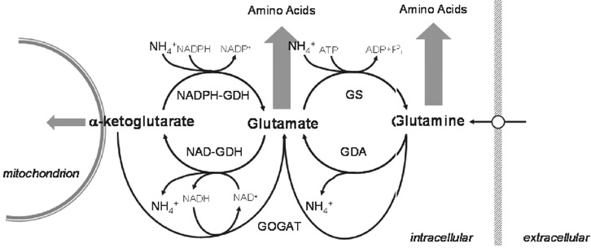
Background on Nitrogen Metabolism
van Riel & Sontag (2006) IEEE Proc.-Syst. Biol. 153: 263-274

Slide 7
Background on Nitrogen Metabolism
Amino Acids of Interest
1) Glutamine
2) Glutamate
3) alpha-ketoglutarate
Enzymes involved in reactions:
1) glutamine synthetase (GS)
2) GDA
3) NAD-GDH
4) NADPH-GDH
5) GOGAT

Slide 8
Background on Nitrogen Metabolism
Genes involved in nitrogen metabolism
1) HIS4: Multifunctional enzyme containing phosphoribosyl-ATP pyrophosphatase.
2) GDH1: Synthesizes glutamate from ammonia and alpha-ketoglutarate.
3) GLN1: Synthesizes glutamine from glutamate and ammonia.
4) ILV5: Mitochondrial protein involved in branched-chain amino acid biosynthesis.
5) GDH2: Degrades glutamate to ammonia and alpha-ketoglutarate.
6) GAP1: Localization to the plasma membrane is regulated by nitrogen source.
7) PUT4: Transcription is repressed in ammonia-grown cells.

Slide 9
Outline
Purpose of Model
Background on Nitrogen Metabolism
-- Amino acids and enzymes used in reaction
-- Genes involved in nitrogen metabolism
Background on Michaelis-Menten model
-- Substrates vs. Products
Demonstrate the model
-- What plays a role and what was left out and why
Describe differential equations
-- State variables vs. Parameters
Show model runs and what they mean
Did the model work?
Conclusion
--What the model means
--Future Work

Slide 10

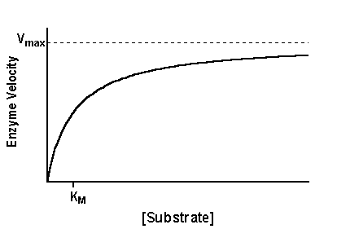
Background on Michaelis-Menten model
Why is the Michaelis-Menten model appropriate to use in this reaction?
- It is appropriate because it is a model of enzyme kinematics. This means that it relates the reaction rates and the concentration of the substrates.
A substrate is a substance that is acted upon an enzyme.
A product is anything that is produced.
Michaelis-Menten Equation
Figure 1.
Michaelis-Menten Graph

Slide 11
Outline
Purpose of Model
Background on Nitrogen Metabolism
-- Amino acids and enzymes used in reaction
-- Genes involved in nitrogen metabolism
Background on Michaelis-Menten model
-- Substrates vs. Products
Demonstrate the model
-- What plays a role and what was left out and why
Describe differential equations
-- State variables vs. Parameters
Show model runs and what they mean
Did the model work?
Conclusion
--What the model means
--Future Work

Slide 12
Demonstrate the model
van Riel & Sontag (2006) IEEE Proc.-Syst. Biol. 153: 263-274

Slide 13
Outline
Purpose of Model
Background on Nitrogen Metabolism
-- Amino acids and enzymes used in reaction
-- Genes involved in nitrogen metabolism
Background on Michaelis-Menten model
-- Substrates vs. Products
Demonstrate the model
-- What plays a role and what was left out and why
Describe differential equations
-- State variables vs. Parameters
Show model runs and what they mean
Did the model work?
Conclusion
--What the model means
--Future Work

Slide 14

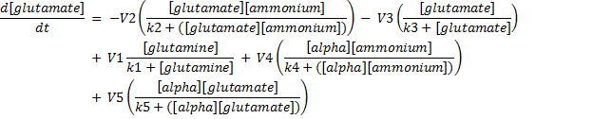


System of Differential Equations

Slide 15
State Variables vs. Parameters
A state variable is a variable who is independent, it does not rely on other variables.
A parameter is a variable whose quantity or function cannot itself be precisely determined by direct methods.
State Variables | Parameters
Glutamine | V1 = k1(GDA)₀
Glutamate | V2 = k2(GS)₀
Alpha-ketoglutarate | V3 = k3(NAD-GDH)₀
Nitrogen | V4 = k4(NADPH-GDH)₀
 | V5 = k5(GOGAT)₀
 | D = dilution rate (0.15 h⁻¹)
 | u = inflow of ammonium and glucose (10 mol/L)
Note: the k variables are also considered parameters.

Slide 16
Example
V4
V2
V3
V1
V5
van Riel & Sontag (2006) IEEE Proc.-Syst. Biol. 153: 263-274

Slide 17
Outline
Purpose of Model
Background on Nitrogen Metabolism
-- Amino acids and enzymes used in reaction
-- Genes involved in nitrogen metabolism
Background on Michaelis-Menten model
-- Substrates vs. Products
Demonstrate the model
-- What plays a role and what was left out and why
Describe differential equations
-- State variables vs. Parameters
Show model runs and what they mean
Did the model work?
Conclusion
--What the model means
--Future Work

Slide 18
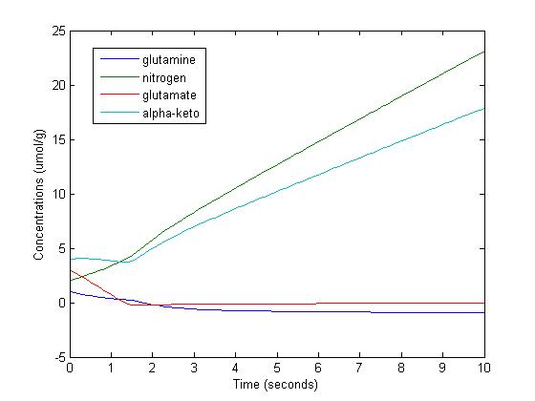
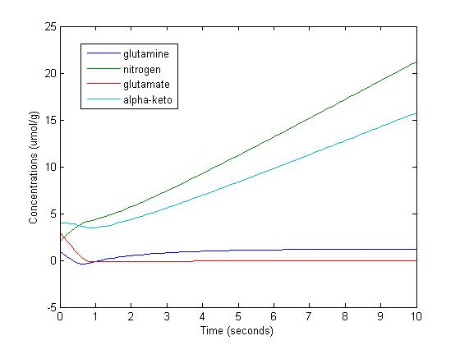
What does the model tell us?
Figure 2. This is what happens when all parameters are set to the same value. In this case 2. Nitrogen is increasing.
Figure 3. Shows what happens when V5 is changed from a value of 2 to 5. Nitrogen is still increasing, but it dips at a faster time interval, then when they were in initial state.

Slide 19
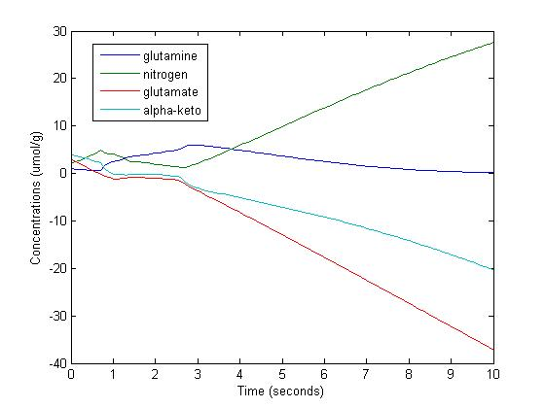
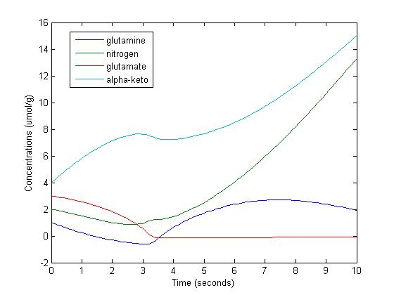
What does the model tell us?
Figure 3. Shows what happens to the system when V4 changes from 2 to 5. Nitrogen is increasing. Why do we have negative values?
Figure 4. Shows what happens to the system when V3 is changed from 2 to 5. Nitrogen takes a dip, but it does not reach zero. After about 4 seconds, it begins to increase.

Slide 20
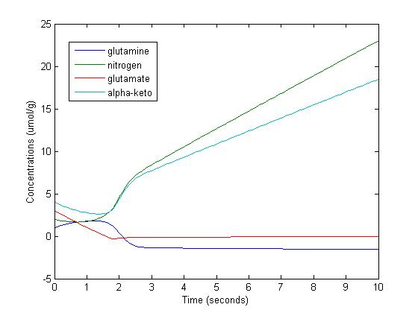
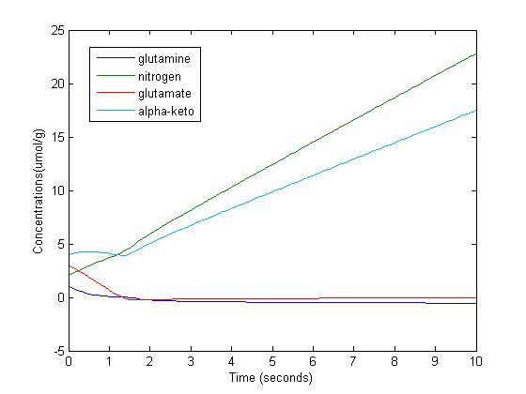
What does the model tell us?
Figure 5. Shows the effect that V2 has when it changes from 2 to a value of 5. We see that nitrogen still has a dip that gets close to zero, but then it begins to increase.
Figure 6. Shows how the system changes when V1 is changed from a value of 2 to 5. Nitrogen is still increasing in the system.

Slide 21
Outline
Purpose of Model
Background on Nitrogen Metabolism
-- Amino acids and enzymes used in reaction
-- Genes involved in nitrogen metabolism
Background on Michaelis-Menten model
-- Substrates vs. Products
Demonstrate the model
-- What plays a role and what was left out and why
Describe differential equations
-- State variables vs. Parameters
Show model runs and what they mean
Did the model work?
Conclusion
--What the model means
--Future Work

Slide 22
Did the model work?
Goal for ter Schure et al. was to prove that the concentration of ammonium is the main factor of nitrogen metabolism.
The system of differential equations, showed that nitrogen was increasing in all scenarios.
This means that it is possible that the concentration of ammonium is one of the main factors in this system.
There were a couple of discrepancies, such as getting negative values in some of the graphs. This is due to the way that the differential equations were set up. (example glutamine)

Slide 23
Outline
Purpose of Model
Background on Nitrogen Metabolism
-- Amino acids and enzymes used in reaction
-- Genes involved in nitrogen metabolism
Background on Michaelis-Menten model
-- Substrates vs. Products
Demonstrate the model
-- What plays a role and what was left out and why
Describe differential equations
-- State variables vs. Parameters
Show model runs and what they mean
Did the model work?
Conclusion
--What the model means
--Future Work

Slide 24
Conclusion
The model is trying to describe the nitrogen metabolism in yeast cells.
It does reach the goal of proving that ammonium is increasing, but we do not know with how much certainty this occurs by.
Future Work:
Check how “valid” the system of differential equations really is.
Look into how the model can be improved. An option would be to model with partial differential equations.
Look at the role that the genes play in the system, and try to model along with the amino acids.

Slide 25
Resources
ter Schure, E.G., Sillje, H.H.W., Verkleij, A.J., Boonstra, J., and Verrips, C.T. (1995) Journal of Bacteriology 177: 6672-6675.
ter Schure, E.G., Sillje, H.H.W., Verkleij, A.J., Boonstra, J., and Verrips C.T. (1995) Microbiology 141: 1101-1108.
Biology Dictionary http://www.biology-online.org
Geneome http://www.yeastgenome.org/cgi-bin/locus.fpl?locus=CIN5

