Slide 1
Mechanotransduction and Tensegrity
ChemEng 590B: Lecture 12
March 28th, 2013

Slide 2
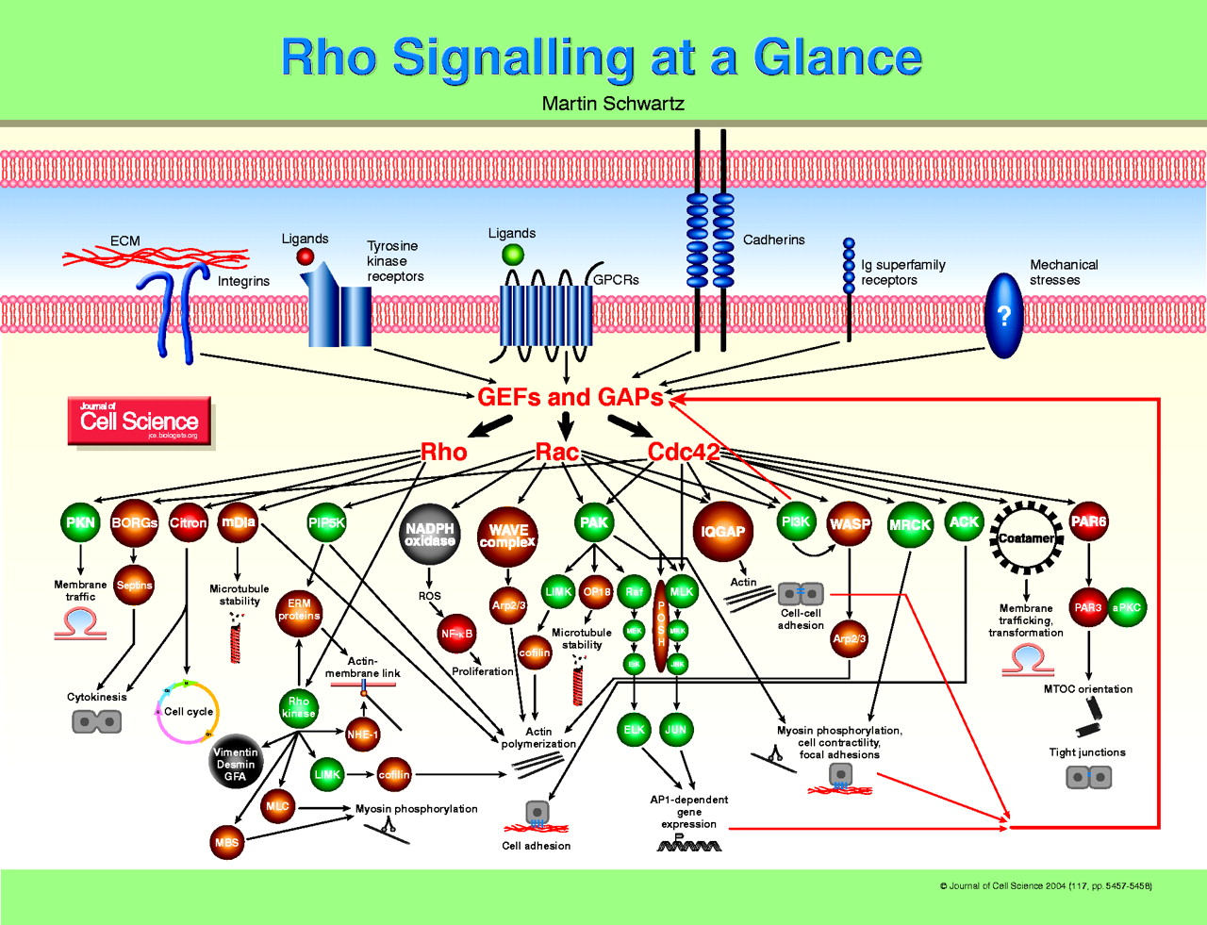
Mechanotransduction: Cell can translate Mechanical Information from the ECM to an intracellular biochemical signal
“Mechanotransduction”

Slide 3
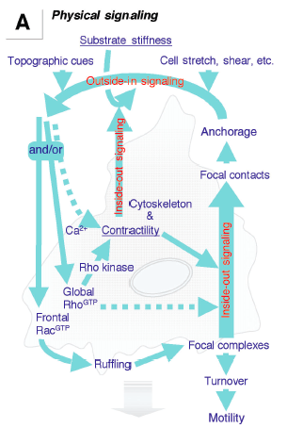
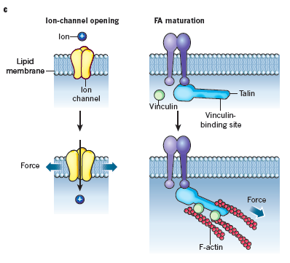
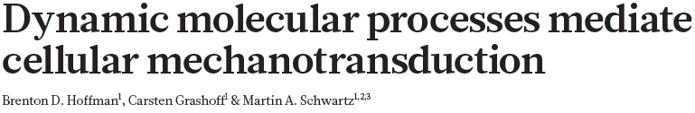

OUTSIDE-IN (ECM-initiated)
INSIDE-OUT (cell-initiated)

Slide 4
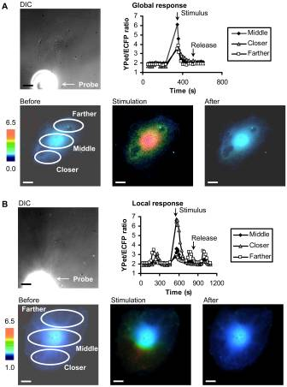
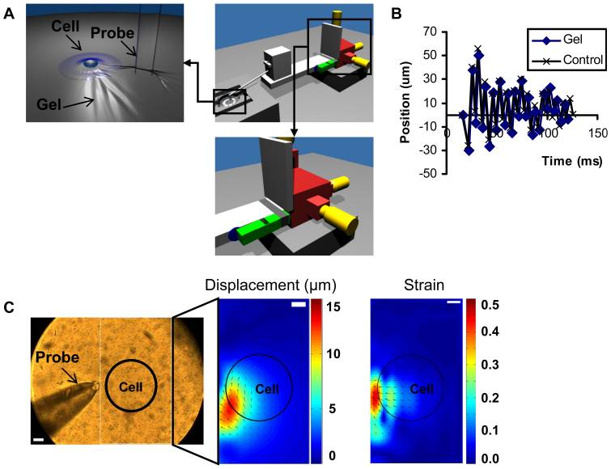
Example: outside in signaling
Using a probe to vibrate substrate under cell
Nishitani, PLOS 1

Slide 5
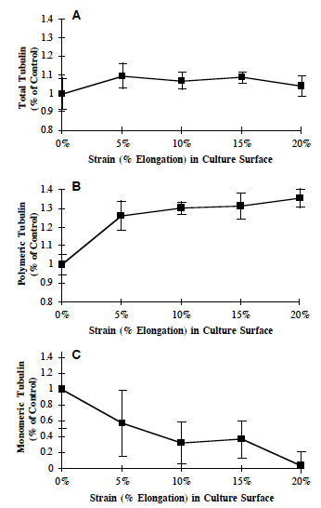
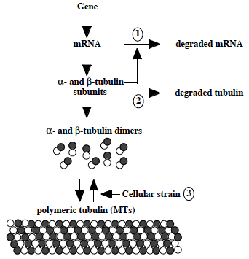
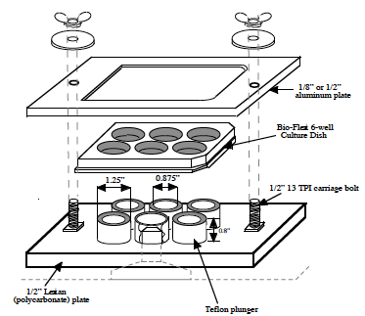
Outside-In. Cytoskeleton in response to stretch
Putnam et al., JCS, 1998

Slide 6
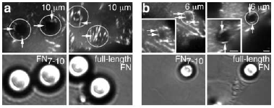
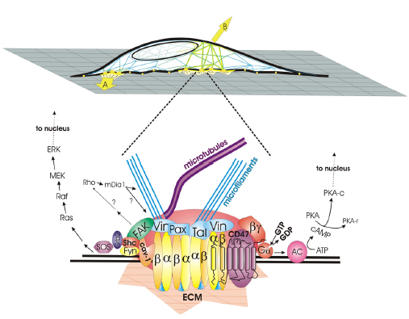
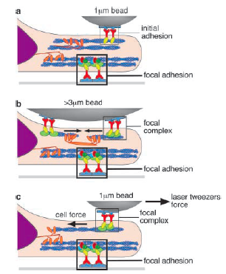


Outside-In. Forces directly on the cell or through the ECM are transduced through the cytoskeleton

Slide 7
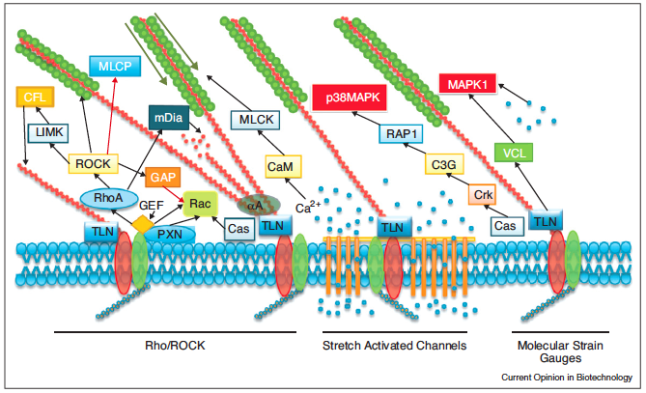

Inside-Out Signaling
Cell is constantly probing microenvironment by assembling and disassembling adhesions

Slide 8
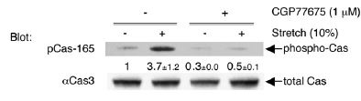
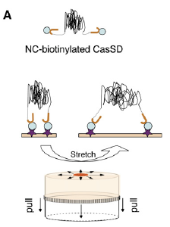
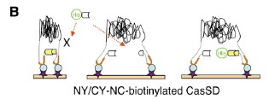
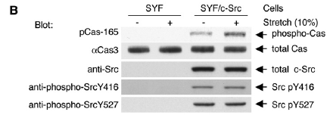
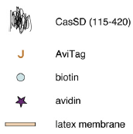
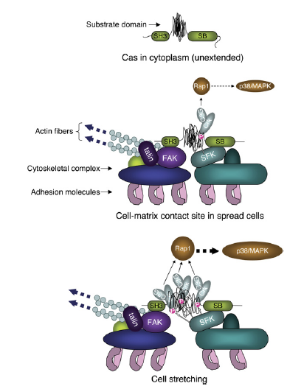
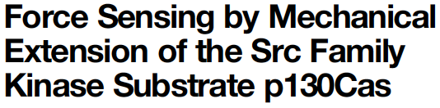
Matrix Stiffness and Focal Adhesions
Stretchable silicon dish (Flexcell)
Cas activated with stretch – is Src dependent
Cas activates Rap1 (GEF), previous work
Hypothesis: Cas is phosphorylated by SFK, only during stretch
COOH domain of Cas anchored to a FA (Talin and FAK)
NH2 end is connected to actin filament, and is stretched during actin force generation

Slide 9
Matrix Stiffness and Focal Adhesions
Cas activates Rap1 (GEF), previous work
Hypothesis: Cas is phosphorylated by SFK, only during stretch
One end connected to more static FA
SH3 domain of Cas anchored to a FA (Talin and FAK) and actin actin filament, and is stretched during actin force generation

Slide 10
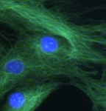
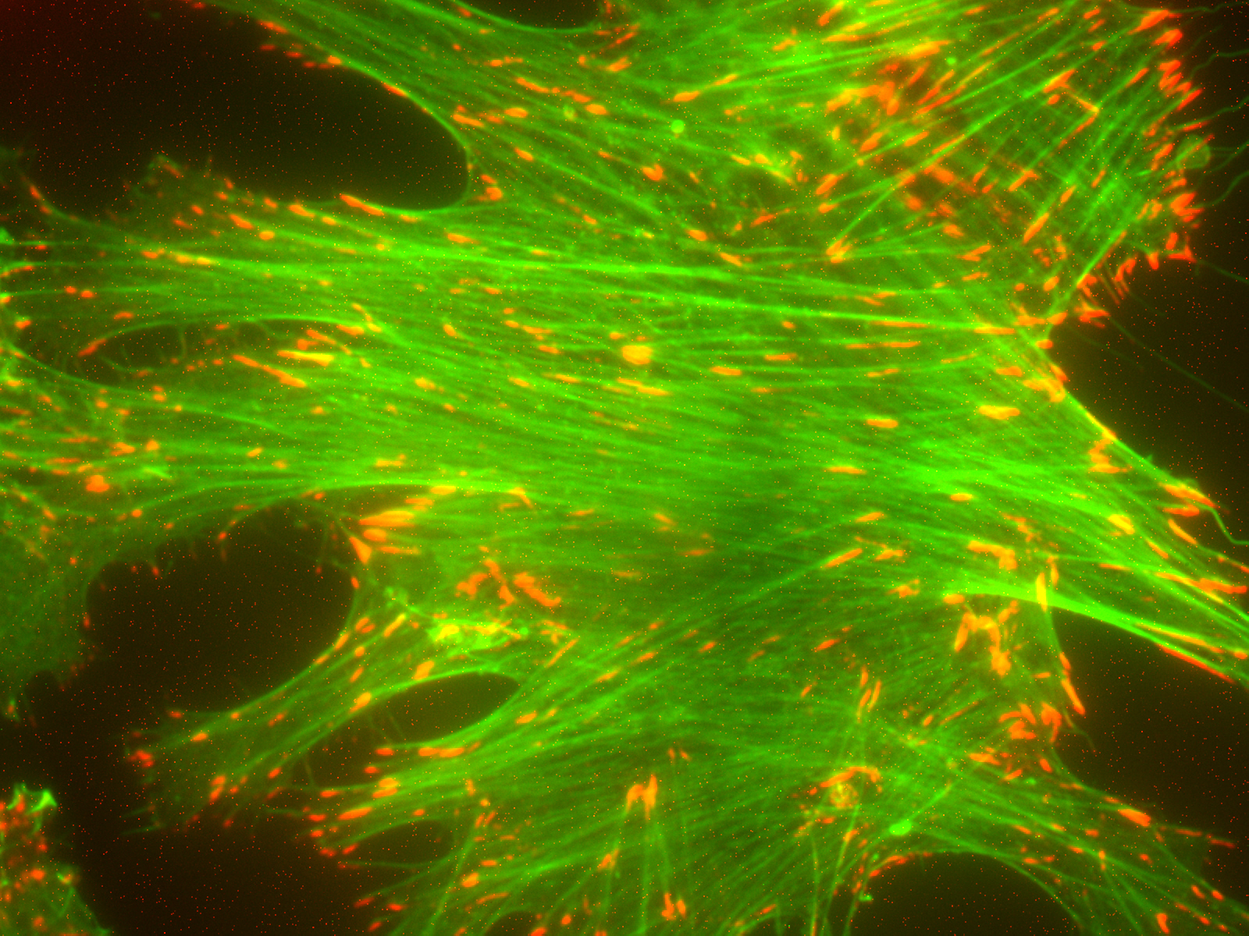
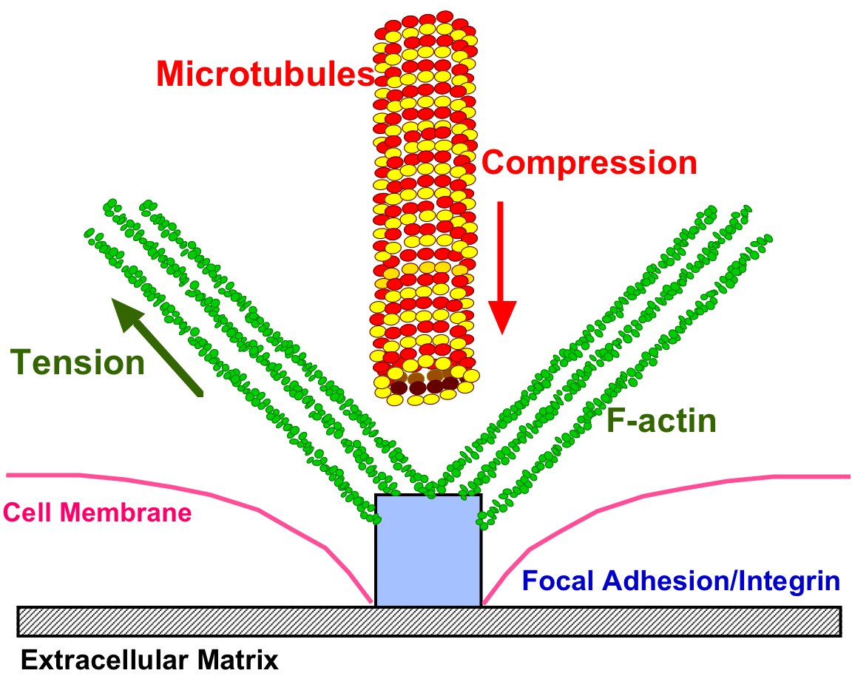
…Or, Behavior Could be Dictated by a Cell-ECM Force Balance…
Courtesy of A. Putnam
In response to extracellular stretch or an intrinsic ECM stiffness, F-actin microfilaments adjust in tensional resistance, and the microtubule network adjusts in compressive resistance.
Notes:
Apart from the direct biochemical signaling that mechanical changes may impart, a second theory exists that cells exist in a biophysical, homeostatic force balance between themselves and the ECM.
One theory on how a mechanical signal from the ECM could be translated into a cellular process or initiate signaling is through a presumptive Cell-ECM force balance. In this theory, the cell is able to adjust to a mechanical force from the ECM by adjusting to load-bearing cytoskeletal elements, setting up a force balance between itself and either a static or dynamic ECM. The F-actin network consists of cables in constant tension, while the microtubules can buckle and resist compressive loading.

Slide 11
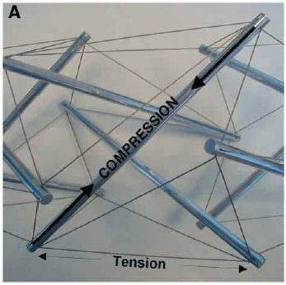
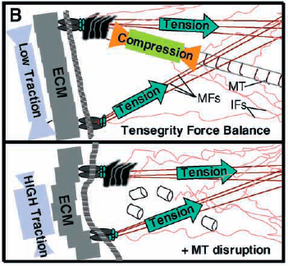
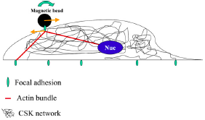
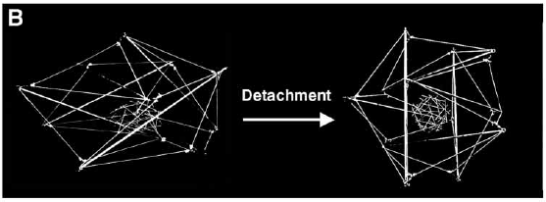

Tensegrity: a Physical Mechanism of Mechanotransduction
Hypothesis 1: tensegrity (Don Ingber) and pre-stress (Ning Wang)
Cytoskeleton connects from focal adhesions to nucleus.
Forces at focal adhesions can propogate to changes in shape of nucleus → affects transcription regulators → gene expression/phenotype

Slide 12
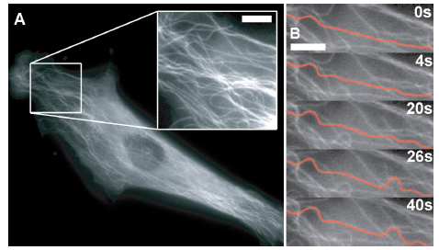

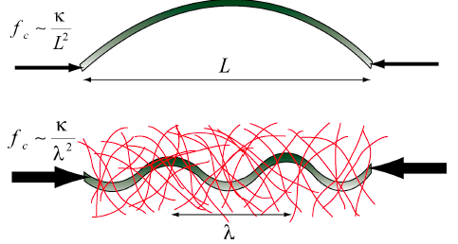
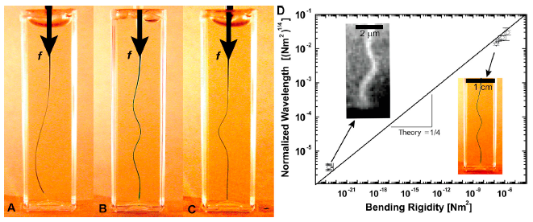
Microtubules Resist Compressive Forces

Slide 13
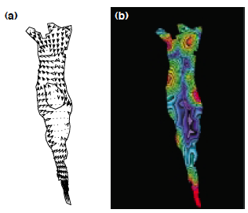
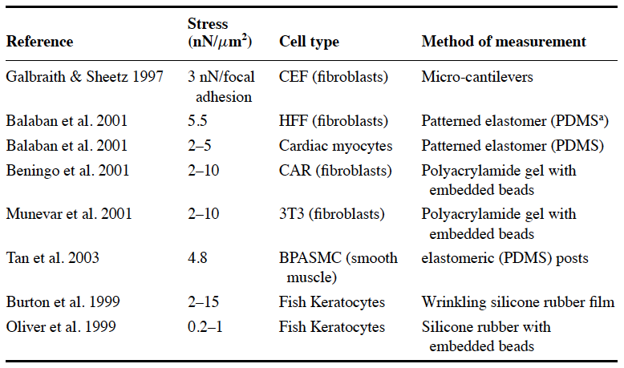



Traction Force Microscopy: Tool to Measure Cellular Forces Exerted on Substrate

Slide 14
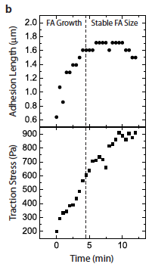
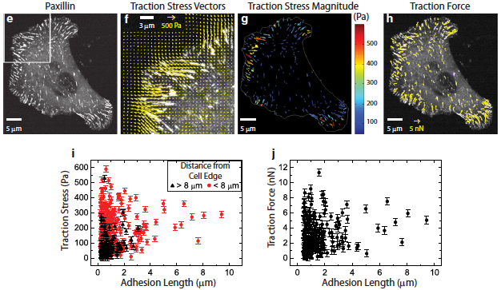
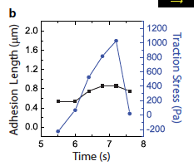
Matrix Stiffness and Focal Adhesions
Traction Force Microscopy
Traction stress increases even after FAs stop growing
With external pull, stable FAs don’t’ increase in size

Slide 15
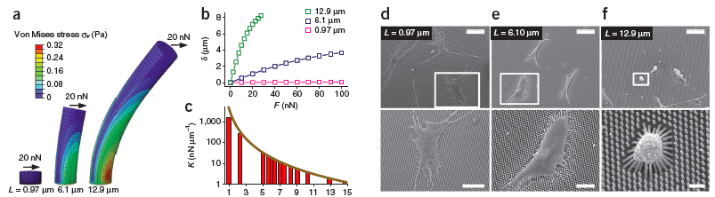

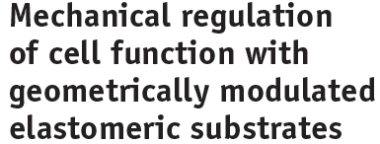
Elastomeric Posts

