Slide 1
σ^{B} is required for M. tuberculosis stress response in vitro, but has little effect on survival in vivo
Fontán P. A., Voskuil M. I., Gomez M., Tan D., Pardini M., Manganelli R., Fattorini L., Schoolnik G. K., Smith I. (2009 July 10). J. Bacteriol, 191, 5628-5633. doi:10.1128/JB.00510-09
Journal Club 3
Nicole Anguiano
November 19, 2014
BIOL 398: Bioinformatics Laboratory

Slide 2
OUTLINE
σ^{B} plays a role in the stress response of M. tuberculosis
In vitro, sigB mutants display higher sensitivity to all forms of stress outside of heat stress
DNA microarray results for σ^{B} show little overlap in regulated genes with σ^{E} and σ^{H}, but did confirm three new genes regulated by σ^{B}
In vitro growth does not follow the trends seen in the in vivo results

Slide 3
OUTLINE
σ^{B} plays a role in the stress response of M. tuberculosis
In vitro, sigB mutants display higher sensitivity to all forms of stress outside of heat stress
DNA microarray results for σ^{B} show little overlap in regulated genes with σ^{E} and σ^{H}, but did confirm three new genes regulated by σ^{B}
In vitro growth does not follow the trends seen in the in vivo results

Slide 4
Sigma factors bind to RNA polymerases and increase promoter specificity
A sigma factor (σ^{B}) allows the RNA polymerase to bind to the promoter and begin transcription
Different sigma factors are used when the cell is under different environmental stresses
More sigma factors → more adaptability to stress
M. tuberculosis has 13 sigma factors
σ^{B} is closely related to σ^{A}, the primary sigma factor

Slide 5
Transcription of sigB is induced during the stress response
σ^{B} is closely related to σ^{A}, the primary sigma factor
The structural gene for σ^{B}, sigB, is positively regulated by σ^{E}, σ^{H}, and σ^{L}
σ^{E} regulates the response to cell envelope stress, and σ^{H} regulates the response to heat and oxidative stress
σ^{B} is a member of both regulons
Due to sigB expression being controlled by many regulatory pathways, it likely plays a central role in the stress response

Slide 6
sigB importance in the stress response was tested both in vivo and in vitro
Three strains were used in the tests:
A wild type strain
A sigB mutant with a disrupted sigB gene
A complemented strain that re-introduces the sigB gene elsewhere in the DNA
In vitro, cell envelope, heat, and oxidative stress was tested:
Cell envelope stress: application of 0.05% SDS and 5mM diamide
Heat stress: heated to 45°C for 24 hours
Oxidative: sealed for 4 days
In vivo, the three strains were raised in mice, guinea pigs, and macrophage-like cells

Slide 7
OUTLINE
σ^{B} plays a role in the stress response of M. tuberculosis
In vitro, sigB mutants display higher sensitivity to all forms of stress outside of heat stress
DNA microarray results for σ^{B} show little overlap in regulated genes with σ^{E} and σ^{H}, but did confirm three new genes regulated by σ^{B}
In vitro growth does not follow the trends seen in the in vivo results

Slide 8
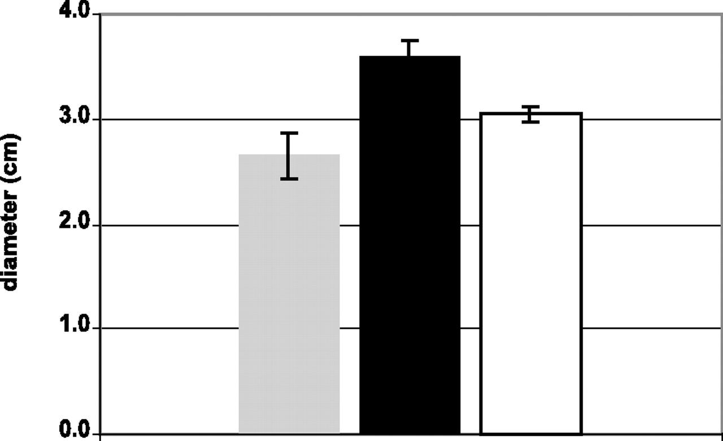
The sigB mutant was more sensitive to SDS than the complemented or wild type strains
Gray: wild type
Black: sigB mutant
White: complemented strain
Lower colony diameter seen in sigB mutant

Slide 9
Heat stress showed no difference in rolling cultures
Standing cultures showed decreased survival in the mutant strain
Due to discrepancy, low levels of oxygen in standing culture were suspected
Gradual loss of oxygen was tested to prove this hypothesis

Slide 10
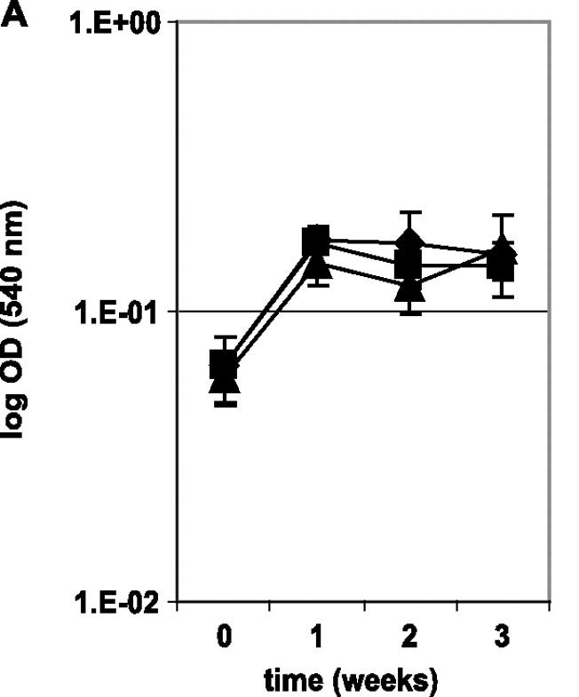
Effect of hypoxia on mutant survival is not apparent when represented as ODs
OD = optical density
Results not easily apparent initially

Slide 11
sigB mutants had significantly decreased survival in low oxygen
Proved hypothesis that low oxygen was the reason for the discrepancy in the heat stress test
sigB mutant has a 3-log-order lower survival

Slide 12
OUTLINE
σ^{B} plays a role in the stress response of M. tuberculosis
In vitro, sigB mutants display higher sensitivity to all forms of stress outside of heat stress
DNA microarray results for σ^{B} show little overlap in regulated genes with σ^{E} and σ^{H}, but did confirm three new genes regulated by σ^{B}
In vitro growth does not follow the trends seen in the in vivo results

Slide 13
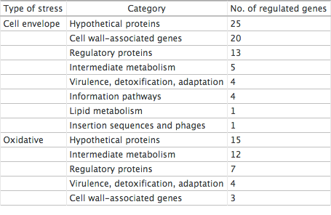
σ^{B} regulates genes relating to both cell envelope and oxidative stress
Used in comparing results with the wild type and the sigB mutant

Slide 14
There was little overlap between the genes regulated by σ^{E}, σ^{H}, and σ^{B} in the mutant
Only a single gene overlapped between the σ^{B} and σ^{E} regulons during the SDS and oxidative stress tests
Rv0465c, a putative transcriptional regulator
Under oxidative stress, 40 genes were found to be controlled by σ^{B}
Only 2 overlapped with the σ^{H} regulon
Rv0251c and Rv0384c, both heat shock proteins

Slide 15
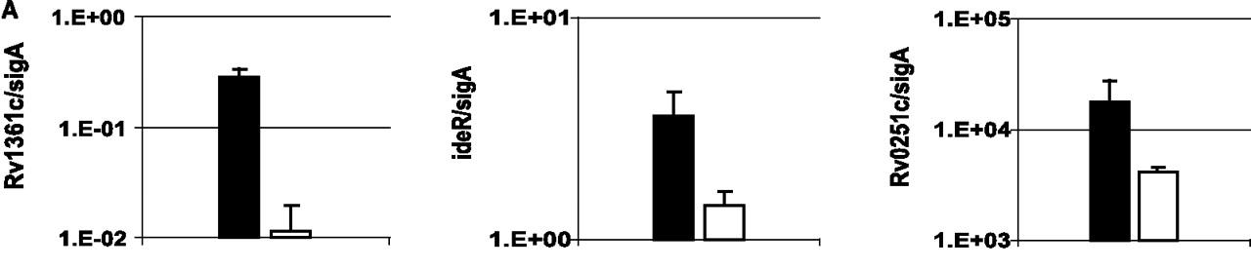
Decrease in expression of genes in the mutant indicates regulation by σ^{B}
All genes saw differences in expression during various tests with the exception of Rv1361c:
Rv1361c: non-stressed bacteria
ideR: SDS treatment
Rv0251c: diamide treatment
Confirmed by RT-PCR

Slide 16
The proposed σ^{B} consensus sequence is seen in genes regulated by σ^{B}
The putative promoter consensus sequence was seen in genes expressed by σ^{B} under stress conditions

Slide 17
OUTLINE
σ^{B} plays a role in the stress response of M. tuberculosis
In vitro, sigB mutants display higher sensitivity to all forms of stress outside of heat stress
DNA microarray results for σ^{B} show little overlap in regulated genes with σ^{E} and σ^{H}, but did confirm three new genes regulated by σ^{B}
In vitro growth does not follow the trends seen in the in vivo results

Slide 18
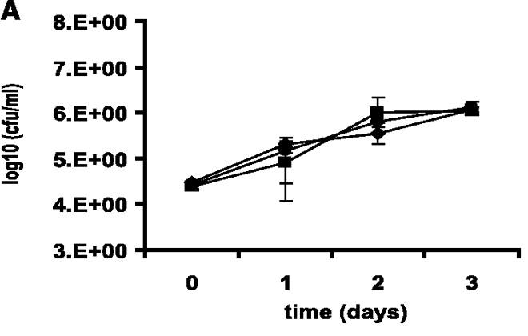
No differences are seen in vivo between strains in macrophages

Slide 19
No differences in growth between strains are seen in mice

Slide 20
No differences in growth are seen between strains in guinea pigs

Slide 21
The difference in in vivo and in vitro growth of mutants had been previously observed
In a study analyzing dosR, the same difference in in vivo and in vitro survivability was seen (Rustad)
Likely due to poor representation in available animal models
Indicates complexity in regulatory networks

Slide 22
Summary
σ^{B} plays a role in the stress response of M. tuberculosis
In vitro, sigB mutants display higher sensitivity to all forms of stress outside of heat stress, and results from heat stress were due to low oxygen
DNA microarray results for σ^{B} show little overlap in regulated genes with σ^{E} and σ^{H}, but did confirm three new genes regulated by σ^{B}
In vitro growth does not follow the trends seen in the in vivo results, which was also seen in previous studies

Slide 23
Citation
Fontán P. A., Voskuil M. I., Gomez M., Tan D., Pardini M., Manganelli R., Fattorini L., Schoolnik G. K., Smith I. (2009 July 10). The Mycobacterium tuberculosis sigma factor sigmaB is required for full response to cell envelope stress and hypoxia in vitro, but it is dispensable for in vivo growth. J. Bacteriol, 191, 5628-5633. doi:10.1128/JB.00510-09
Rustad, T. R., M. I. Harrell, R. Liao, and D. R. Sherman. (2008). The enduring hypoxic response of Mycobacterium tuberculosis. PLoS One 3:e1502.

Slide 24
ACKNOWLEDGMENTS
Dr. Kam D. Dahlquist
Stephen Louie
Loyola Marymount University

