Slide 1
Wild Type vs. Δcin5
Jeffrey Crosson and William Gendron

Slide 2
P-value Comparison
ANOVA | WT | STRAIN
p < 0.05 | 2378 (38.4%) | 2034 (32.86%)
p < 0.01 | 1527 (24.7%) | 1198 (19.36%)
p < 0.001 | 860 (13.9%) | 576 (9.31%)
p < 0.0001 | 460 (7.4%) | 288 (4.65%)
B-H p < 0.05 | 1656 (26.8%) | 1177 (19.02%)
Bonferroni p < 0.05 | 228 (3.68%) | 119 (1.92%)

Slide 3
NSR1 Comparison
ANOVA | WT | STRAIN
Unadjusted | 0.000000014
Bonferroni-corrected | 0.000089
B&H-corrected | 0.011
Average log fold change at t = 15 | 3.07
Average log fold change at t = 30 | 3.39
Average log fold change at t = 60 | 3.41
Average log fold change at t = 90 | -1.41
Average log fold change at t = 120 | -0.57

Slide 4
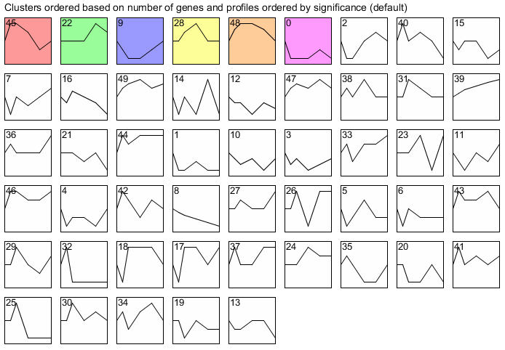
All Profiles

Slide 5
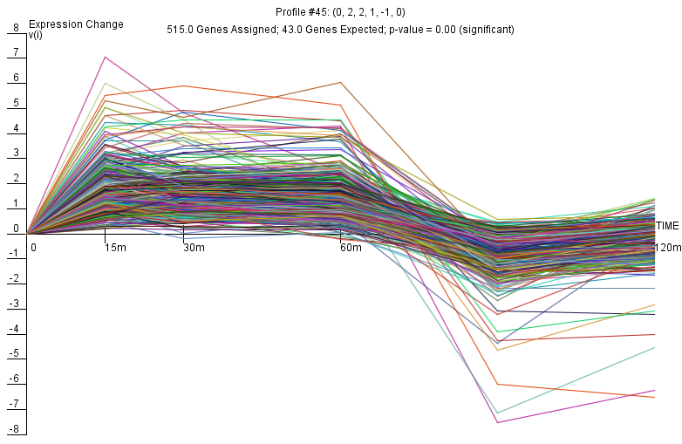
Profile 45

Slide 6
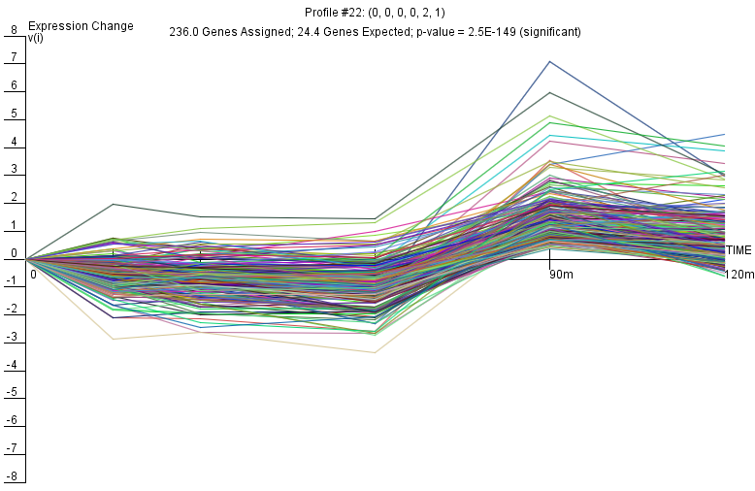
Profile 22

Slide 7
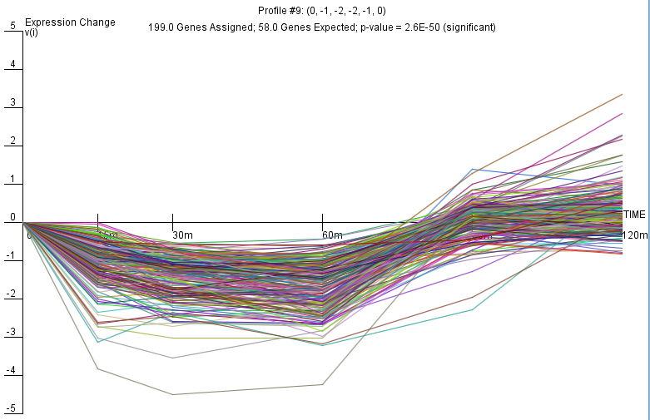
Profile 9

Slide 8
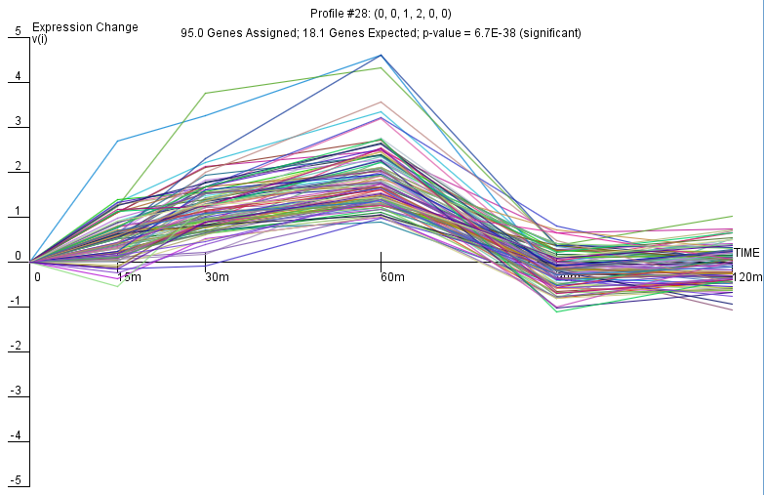
Profile 28

Slide 9
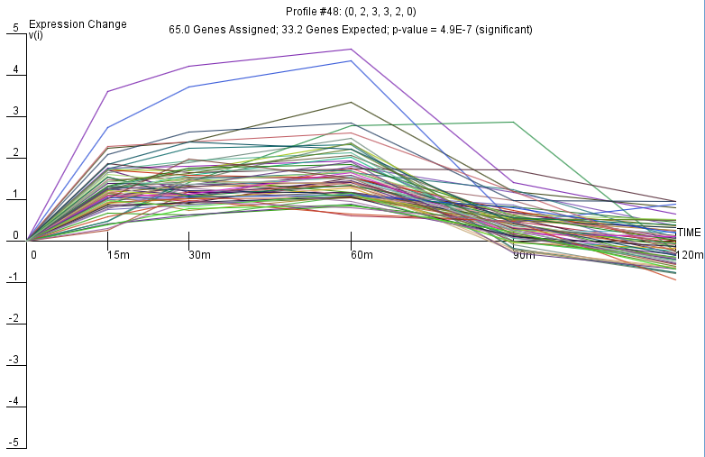
Profile 48

Slide 10
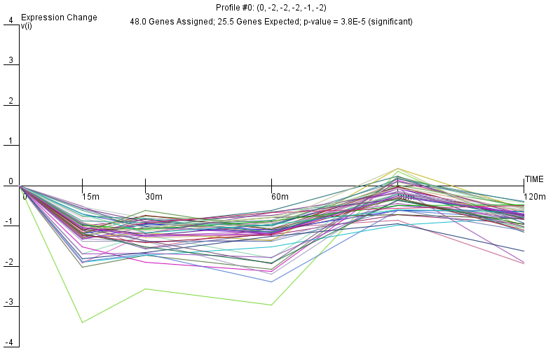
Profile 0

