Slide 1
Travelling-wave nuclear magnetic resonance David O. Brunner, Nicola De Zanche, Jürg Fröhlich, Jan Paska & Klaas P. Pruessmann
Pei-Ann Lin and PJ Velez
December 13, 2011
Notes:
Hi, my name is Pei and this is PJ. Today we will be presenting an innovative concept called travelling-wave nuclear magnetic resonance.

Slide 2
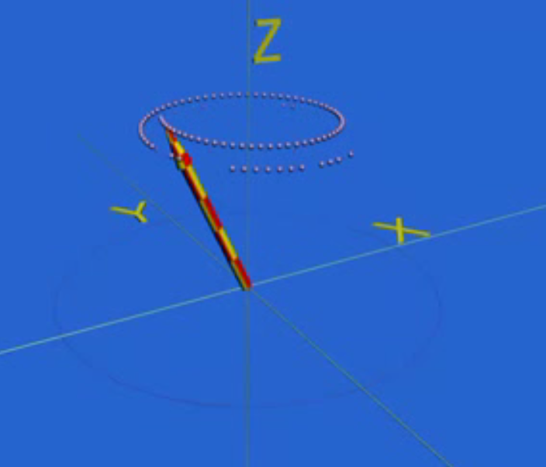
NMR Basics
NMR = Nuclear Magnetic Resonance
Notes:
First, I’d like to briefly go over the basics of NMR. NMR stands for nuclear magnetic resonance.
Hydrogen atoms or protons, which are abundant in the human body, will randomly spin (or precess) while in their natural state. However, when an external magnetic field is applied, the magnetic dipoles of the nuclei will line up either parallel or antiparallel to the applied field and result in a net internal magnetic field in the direction of the applied external field. In the picture shown, imagine a field B applied vertically, on the z-axis. The red and yellow arrow represents the net magnetization vector. Now when a RF signal is applied to perturb this alignment, say for example, off-axis by 90 degrees, the nuclei will precess off-axis relative to the axis of alignment. When the RF signal is turned off, the precessing nuclei will “relax” back towards the axis of alignment, giving off RF signals.

Slide 3
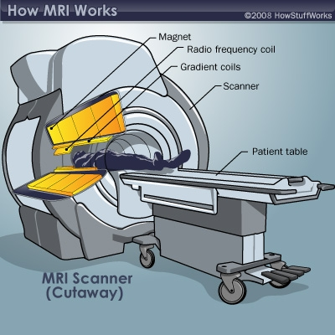
MRI basics – Main components
MRI = Magnetic Resonance Imaging
Main magnet creates intense, stable magnetic field to align nuclei
Magnetic field gradients are applied along three dimensions to give spatial information
One set of coils transmits radiofrequency (RF) pulses
Resonance frequency depends on the particular tissue being imaged and strength of main magnetic field
Another set of coils detects the resultant signal via Faraday induction
Notes:
Now for an overview of MRI:
MRI, or magnetic resonance imaging, is just nuclear magnetic resonance applied to imaging!
In an MRI scan, there are three important components.
First, there is a strong superconducting magnet that aligns the protons along the axis of the body.
Separate magnetic field gradients are also applied along each axis to give three dimensional spatial information. This is important to the imaging part of MRI.
There is one set of coils around the bore of the magnet that transmits RF pulses to knock the hydrogen atoms out of alignment. The required RF resonance frequency for this depends on the tissue being imaged and the strength of the magnetic field.
A second set of coils sit very close to the subject and detect RF signals given off by the perturbed protons via Faraday induction.

Slide 4
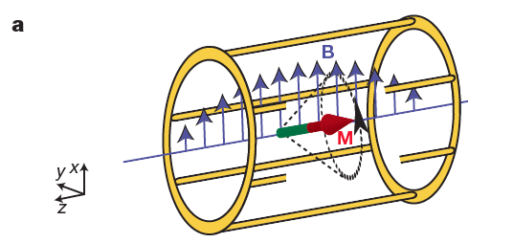
Traditional MRI- Limitations
Not much extra space surrounding imaging subject
Claustrophobia
Loud
Stationary RF fields are used to excite NMR
Higher field strength: trade-off between better SNR/spatial resolution and image uniformity
Magnetic Field Strength (T) | Required RF resonance (Larmor) frequency | Corresponding Signal Wavelength
1.5 | 64 MHz | ~70 cm
3 | 128 MHz | ~35 cm
7.4 | 300 MHz | ~12 cm
9 | 400 MHz | ~10 cm
Notes:
Ok now for the limitations of traditional MRI that are supposedly improved by the travelling wave system:
First, like I said earlier, traditional MRI is based upon near-field coupling and Faraday induction in RF resonators that must be in close proximity to the sample. This means that there is not a lot of extra space surrounding an imaging subject, which in humans results in many cases of claustrophobia. Also, MRI machines are extremely loud, and the clunking noise can be pretty unsettling.
Secondly, in a traditional MRI system, stationary RF fields are used to excite NMR. At field strengths of 1.5 or 3 T, image uniformity is pretty good. However, when you get to the strength level of modern wide-bore systems of 7 or 9 Teslas, image uniformity decreases. But, high field systems are desired because they generally provide improved SNR and spatial resolution.
The reason for greater non-uniformity with increased field strength can be seen in this chart. Higher field strength increases the RF resonance frequency required to perturb protons. Thus, the corresponding wavelength of RF signal decreases. At 1.5 tesla, the corresponding signal wavelength is 70 cm. This is well above the lengthscale of say, a human head if you imagine that length of the cavity in image A is 70 cm and a head is being imaged at the center of the standing wave. On the other hand, at 7.4 teslas, the corresponding signal wavelength goes to about 12 cm. This is roughly the lengthscale of a human head. Now there will be clear edge effects because the standing wavelength is equal to or less than the lengthscale of the tissue of interest!

Slide 5
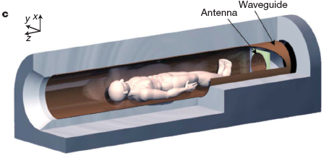
Travelling-wave MRI – Main Components
Improving on the space issue:
NMR can also be excited and detected at longer distances of up to a couple of meters!
Improving on the uniformity issue:
No standing RF waves! Use travelling waves instead.
Notes:
So, to review, traditional NMR implementations rely on close coupling between the signal detector and the object under investigation. What Brunner and his colleagues presented in this paper is that NMR can also be excited and detected at longer distances of up to a couple of meters by relying on travelling radio-frequency waves sent and received by an antenna.
The modified system improves on both the space issue and the uniformity issue in traditional MRI using high fields..
RF coils were removed entirely and a conductive lining was added to the bore of the magnet as a waveguide for travelling RF waves. An antenna for transmitting and receiving signals was placed at one end of the bore.
Now of course this new system has its own limitations: conductive surfaces surrounding a sample will admit travelling waves of frequencies higher than some cut-off frequency that is roughly inversely proportional to the bore width. So they needed the bore of the main magnet to be big enough to be less than the required resonance frequency of the system, which was accomplished with a 7 tesla magnet with bore of 58 cm. The cut-off frequency in this case was just under the required resonance frequency of about 300 MHz
Extra notes:
With just air in the bore, they got a cut off frequency of 303 MHz which was greater than the proton resonance frequency (Larmor frequency) of 298 MHz---Just a little too high. But, the human body contains a large amount of water, which is a strong dielectric, so having a body in the bore would reduce the cut-off frequency sufficiently to clearly enter the travelling-wave regime.
The antenna is used to circularly polarize signal placed on one end of the cylindrical, superconducting 7.0-T magnet with a 58 cm diameter bore. The bore is lined with an RF screen made from stainless-steel mesh designed to provide high conductance of travelling RF waves at ~300 MHz while blocking audio-frequency currents induced by the surrounding gradient coils.

Slide 6
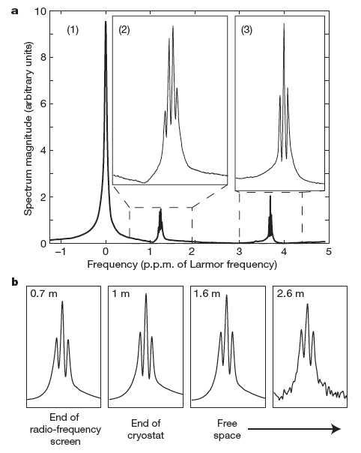
Results – Flexible detection distance
Spectroscopy of an aqueous 10% ethanol solution
Reliable detection possible at up to 2.6 m
Loss of sensitivity at larger distances reflects decrease in coupling between the antenna and the modes of the bore
Higher sensitivity can be achieved with antenna of greater directivity or using a longer waveguide
Notes:
With the system set up, they did an NMR spec of an aqueous 10% ethanol solution.
With the antenna placed 70 cm from the sample, the resulting spectrum showed an expected dominant water peak (1) as well as the methyl(3) and methylene(2) resonances of the ethanol molecule.
Detection of the methyl triplet was compared at increasing antenna distances showed consistent spectrum quality up to 2.6 m.
The apparent loss of sensitivity at larger distances reflects decrease in coupling between the antenna and the modes of the bore, so better sensitivity can be achieved with an antenna of greater directivity or using a longer waveguide.

Slide 7
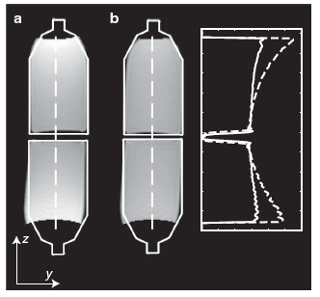
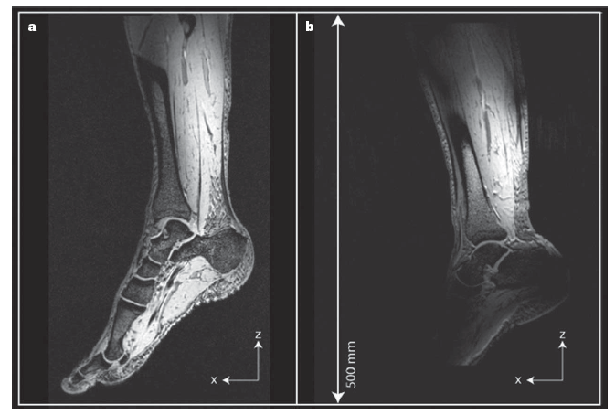
Results – Improved spatial uniformity
Residual non-uniformity: presence of standing RF wave superimposed on the intended travelling component
Notes:
Their second set of results shows improved spatial uniformity in a field of view of 50 cm compared to traditional MRI.
On the left part A, we see two adjacent bottles filled with mineral oil. Initially, non-uniformity can be clearly seen in the image intensity profile (dashed line). This non-uniformity can be attributed to the presence of standing RF waves superimposed on the intended travelling component caused by changes in wave impedence via slight reflections at the transitions between the bottles and the empty parts of the bore.
Reflections can be mitigated by wave impedance matching and additional loading. In part b on the left, Brunner used two more bottles added towards the open end of the bore containing a conductive water solution that dissipates incident wave energy.
Then on the right, we see in vivo results using this system. The field of view was 50 cm, but it was limited by the gradient system used and not the travelling wave detection system. No additional measures were necessary here to match wave impedence at the transitions.
Compared to an image taken with a traditional 7T system, the modified system clearly shows greater coverage and better uniformity.

Slide 8
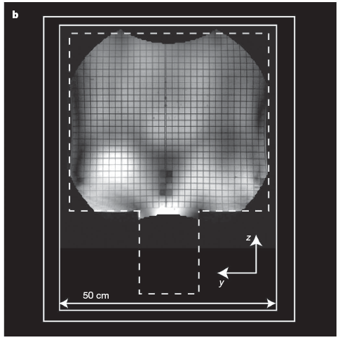
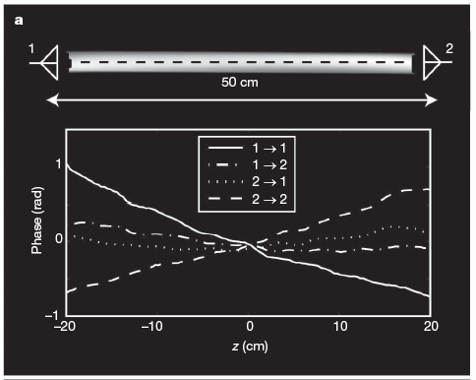
Results – Imaging of “large” sample
Notes:
Phase delay resulting from signal propagation to and from the resonant nuclei will give rise to significant phase differences between signals travelling different distances in larger samples.
On the left, they used a long water-filled cylinder flanked by two antennas on its ends. Using the same antenna for transmission and reception results in a linear distribution of the image phase. However, if the transmit and receive antennas are positioned so that the total phase delay is the same across the volume of interest, then you see a constant net phase delay. This was down by transmission and reception from opposite antennas.
On the right is an image of a human torso phantom. Use of propagating waves leads to material-dependent diffraction and attenuation. For example, dielectric perturbations are obvious in the image on the right. Like they did with the two mineral oil filled bottles, wave impedance matching can help tailor resulting RF field distributions.

Slide 9
Conclusion
Replaced a standing radio wave interaction in traditional MRI with traveling radio wave interaction, which has a range of meters
Frees up space around subject
More uniform coverage of larger samples with better resolution
Allows for exploration of the highest field strengths available
Possibly no need to replace existing equipment completely—just need to add waveguide and antenna

Slide 10
Questions?
Notes:
Alternative way to improve signal homogeneity in traditional MRI
Until now, methods for moderating the effect of RF inhomogeneity at high magnetic-field strengths have generally focused on using multiple RF coils in parallel³ for signal excitation. Although this approach shows promise, it is complex and expensive because it requires duplication of costly RF amplifiers and other circuitry.
Wave impedance matching problem in travelling wave MRI
To reap the benefits of the travelling-wave approach, it is important to minimize the reflection and refraction of radio waves that can occur at boundaries between regions of different wave impedance, such as tissue and air. Brunner et al. demonstrate the problems that arise from these effects, but also introduce potential solutions, including the use of wave-impedance matching and absorbers. These involve positioning materials with appropriate electrical properties in the bore of the scanner near to the subject.
Noise sensitivity problem in travelling wave MRI
One potential disadvantage of using the travelling-wave approach for signal detection is that of increased noise pick-up compared with the conventional approach, because the antenna is sensitive to resistive noise sources, such as tissue, or wave absorbers, positioned anywhere in the far field. The high premium placed on the signal-to-noise ratio in MRI means that the optimal technique may involve using the travelling-wave approach for signal excitation and multiple conventional coils for signal detection
What’s been done since 2009
“Cut-off free” travelling wave NMR Using a central conductor in the waveguide and thereby converting it to a transmission line (TL), which has no cutoff frequency.

Slide 11
Discussion POINTS
Nice resolution but 7 Tesla scanner—feasible for widespread use?
Waveguides have a cutoff frequency, which can be higher than some Larmor frequencies corresponding to the magnetic field strengths commonly used in MRI
They covered half of a leg uniformly—what about the length of an entire human body?
Absorber losses have negative effects on efficiency and sensitivity compared to resonators
Thermal noise via absorption of RF power during transmission will contribute to sensitivity loss
Is safety in human subjects a concern?
Notes:
7T expensive!; modifying existing systems also may not so easy?
Cutoff eliminated by inserting a central conductor in the waveguide and converting it into a parallel plate transmission line with no cutoff frequency.
Significant RF attenuation is expected to occur along the full length of a human body.
Question! Simulatiions showed that the body will absorb approximately 90% of the RF power coupled into the waveguide and thus only 10% makes it to the antenna. Shorter and slimmer subjects or a wider bore can help with this problem
Absorber losses→increase higher driving power
Well they point out that use of propagating waves replaces exposure to strong, short-range electric fields that come from the probes in near-field coupling.

