Slide 1
Tumor cells caught in the act of invading: their strategy for enhanced cell motility
Weigang Wang, Sumanta Goswami, Erik Sahai, Jeffrey B. Wyckoff, Jeffrey E. Segall and John S. Condeelis
Presented by:
Layla Barkal and Jessica Perez

Slide 2
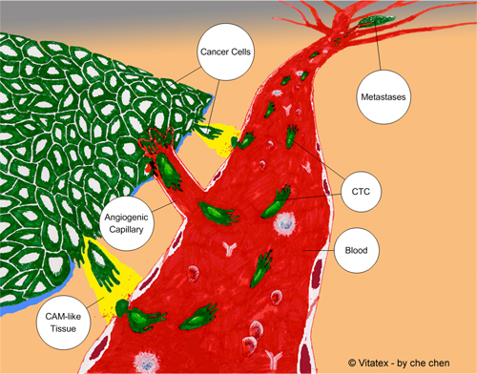
Understanding cell motility pathway is key to anti-cancer therapies
http://www.vitatex.com/patents.asp
Notes:
As many of you know metastasis, the process by which primary tumor cells invade the circulator and other parts of the body. There is a need to understand the metastasis mechanism to improve anti-cancer therapies.
Chemotherapy, for example, kills cancer cells that are over growing, but because metastasis cells are in a mobile not growing state, so chemotherapy does not kill off these actively invading, that are spreading cancer around the body.
In order to study metastasis we must isolate invading cells and perform a microarray analysis to reveal its genetic expression profile.
Currently, there are different techniques for collecting metastatic cells, with their share of problems.

Slide 3
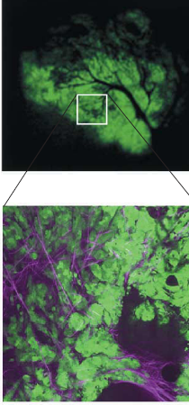
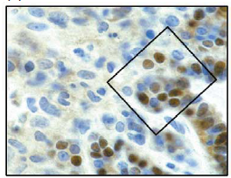
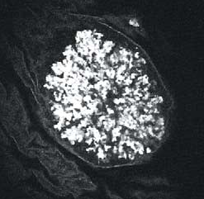
Methods for collecting cells for gene expression profiling of invasive and metastatic tumors
Bulk Analysis
Laser Capture Microdissection (LCM)
In vitro culture of metastatic tumors
Rat Breast Tumor
Notes:
The most popular methods for collecting cells for gene expression are listed, however they all have their down sides.
1)Bulk Analysis
involves performing a microarray analysis on a chunk of tumor. However, as you can see in this picture of a rat breast tumor many different cells types are included in the analysis. These expression patterns reflect the noninvasive cells that make up the bulk of the tumor mass and the expression signature of the invansive tumor cells (the most motile population essential for metastasis) might be masked
Insight into mechanism of mobility is less likely
2)LCM Laser Capture Microdisssection
, as shown to the top right, is the precise isolation of individual cells from a stained tissue using a microscope to guide laser transfer of group of cells to plastic film for futher studies.
This technique has the potential to be more informative than analyzing bulk samples
However, identification is based on morphology and location, not we don’t know if these cells are migratory and invasive. fixed
3) Growing cells up from metastatic tumors (images of lung tumor from beast tumor. Tumor cells labeled green, not shown)
must be expanded into culture for further cycle of tumor growth for array analysis
-:rely on culturing in vitro which may cause gene expression patterns to change during culturing
Wang uses a new technique that uses invasive cells’ chemotaxic properties to their advantage.

Slide 4
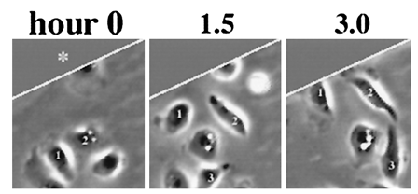
Exploiting Chemotaxis
Metastatic tumor cells undergo chemotaxis
Migration toward blood vessels makes chemotaxis a good model for invasion
Chemoattractants
EGF
10% FBS
Matrigel
Needle filled with Matrigel + EGF
Metastatic tumor cells
Cancer Res October 1, 2000 vol. 60 no. 19 5401-5404
Notes:
Wang’s group used the-EGF corelated with invasion, intravasation and metastasis in animal models
-EGF used to mimic tumor invasion induced at borders of tumor
-Overexpression of EGF receptor correlated with poor prognosis
-EGF gradient seen in tumor microenvironment

Slide 5
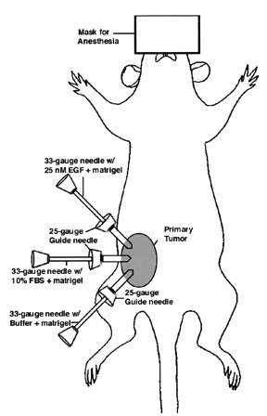
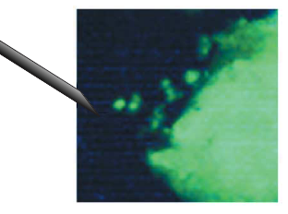
The in vivo Invasion Assay
Live mouse
Collecting motile cells from tumor
Only tumor cells: DAPI/GFP check
Non-metastatic tumors have low levels of invading cells
~100 invading cells in 6 hours
Cancer Res October 1, 2000 vol. 60 no. 19 5401-5404
Notes:
Chemotaxic agent

Slide 6
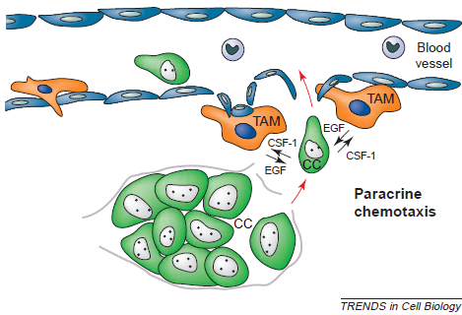
Results: Imaging during in vivo invasion assay
Intravital imaging during in vivo assay shows macrophages and breast tumor cells co-migrating towards microneedles
Carcinoma cells secrete CSF-1 ↔ Macrophages secrete EGF
Paracrine interaction – chemotaxis toward EGF or CSF-1
Notes:
As you can see from Layla’s discussion, the in vivo invasion assay is an amazing technique that holds so much potential for a greater understanding of the metastasis process.
Wang’s group have found some very interesting findings from analyzing the cells “caught in the act of invasion.”
-During the assay, there was a co-migration of tumor associated macrophages and carcinoma cells in breast tumor, suggesting a mechanism for how macrophages contribute to metastasis.
----------------------------------------------------------------------
-Paracrine interaction > their co-migration in vivo in breast tumors, suggesting a mechanism for how macrophages contribute to metastasis
-Model of the contribution of macrophages to metastasis.
-Tumorassociated macrophages (TAM) accumulate near blood vessels that are associated with carcinoma cells (CC) owing to the local secretion of CSF-1 by the carcinoma cells.
-Macrophages secrete EGF in response, which attracts the carcinoma cells to the vessels by chemotaxis, leading to intravasation.
-The recruitment of carcinoma cells and macrophages is predicted to be efficient over long distances, owing to the
self-propagating paracrine interaction between these cells that leads to relayed

Slide 7
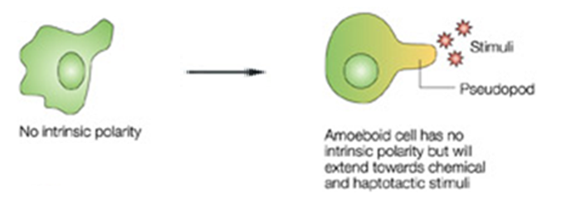
Results: Gene expression analysis of invading cells
“…the invasive cells constitute a population that is neither proliferating nor apoptotic but is highly motile…”
Compared to non-invading cells, pathways that regulate protrusion are present
ZBP1 essential for creating polarity of β-actin and is severely down-regulated in invading cells
Nature Reviews Cancer 3, 921-930 (December 2003)
Notes:
They also found that ZBP1, essential for forming cells polarity, is down regulated in invasive cells. This causes cells to lose its intrinsic polarity and tumor cells more often migrate towards an exogenous chemotatic signal, no matter the direction of the gradient. This provides a potential target for cancer therapies.
-----------------------------------------------------------------------------------------------------
-Array analysis examined theory that genes are differentially regulated in invasive cells
-ZBP1- zipcode-binding protein1- binds to mTNA zip code of beta-actin for crawling cells. (beta-actin: isoform of action, which is required for leading edge of cells)
-ZBP1 is downregulated in invasive cells- loss of intrinsic polarity, causing cells to more likely to migrate towards a exogenous chemotactic signal, no matter the direction of the gradient.

Slide 8
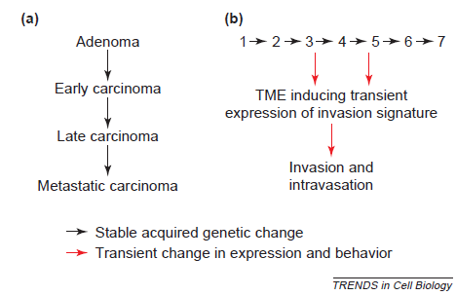
Results: Tumor microenvironment invasion model
Profiling of early whole tumors can suggest metastatic potential
Tumor progression creates microenvironments that elicit transient gene expression patterns that support invasion and micrometastases
Notes:
Previous patterns of expression also show that invasive and metastatic potential of primary tumors can be encoded early in the development of tumor and through out the bulk of the tumor, which seemingly contradicts the traditional view that tumor progression develops through a succession of stable genetic changes in tumor cells that are selected by growth and survival pressues.
-This caused by whole tumor profiling, stable averaging of expression pattern.
After Wang’s group analyzed these invasive carcinoma cells, they found gene patterns in grouped in functional pathways.
New tumor microenvironment model proposed. Tumor progression leads to the development of microenvironments encoded within the tumor that cause gene expression patterns that support invasion.
In other words, expression of gene are synergistic for inducing microenvironment that cause invasion could lead to random apearance.

Slide 9
Looking Forward
Prediction: localized patterns of gene expression in tumor cells will occur in areas of invasion – in situ hybridization
Functional protein measurements
Knock down of proteins
Identification of therapeutic targets
Notes:
New methods that involve analyzing live cells with invasion characteristics will be necessary to improve this model and understand its mechanism to improve anti-cancer therapies.

Slide 10
References
Weigang Wang, Sumanta Goswami, Erik Sahai, Jeffrey B. Wykoff, Jeffrey E. Segall, John S. Condeelis. “Tumor cells caught in the act of invading: their strategy for enhanced cell motility.” TRENDS in Cell Biology Vol. 15 No. 3 March 2005.
Jeffrey Wykoff, Jeffrey E. Segall, John S. Coneelis. “Th ecollection o fht emotile population of cells from a living tumor.” Cancer Research 60, 5401-5404.
John Condeelis and Jeffrey E. Segall. “Intravital imaging of cell movement in tumors.” Nature Reviews Cancer 3, 921-930 (December 2003)

Slide 11
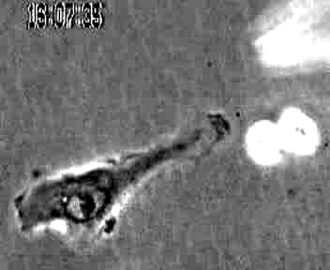
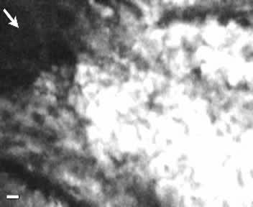
Invasion Movies
Chemotaxis in vitro
Invading a blood vessel
http://www.einstein.yu.edu/aif/intravital_imaging/introduction.htm

Slide 12
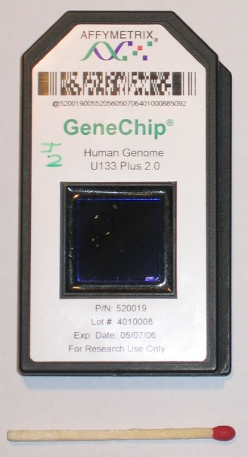
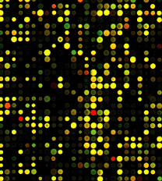
DNA Microarray Analysis
Consists of thousands of DNA oligonuleotides spots that hybridize to cDNA of sample
Generates gene expresion profile.
http://www.thefullwiki.org/DNA_microarray
Notes:
A DNA microarray is a technology used in molecular biology that consists of thousands of microscopic spots of DNA oligonuleotides. These short sections of a gene can hybridize to cDNA or cRNA of a sample, thus generating gene expression profiles. Hybridization is detected and quantified by detection of a fluorophore label targets.

