Slide 1
Week 14 Output Figures
Kristen Horstmann

Slide 2
With the following parameters:
fix_b to 1
fix_P to 0
iestimate to 1
alpha to 0.01

Slide 3
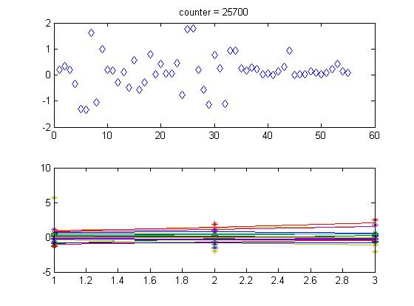
Overall expression with a non-estimated B-value

Slide 4
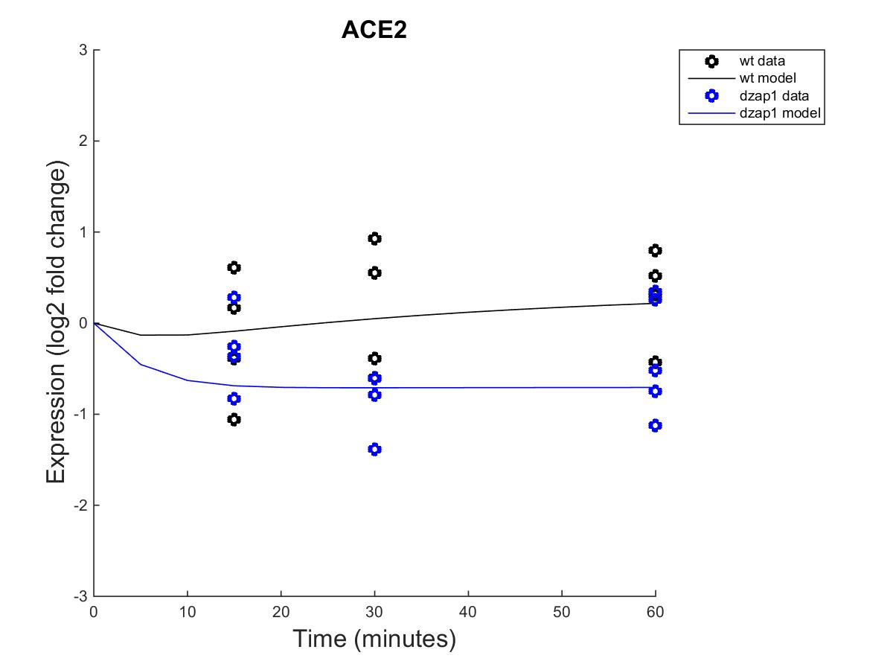
Effect of wild type and dzap1 on ACE2 expression with a non-estimated B

Slide 5
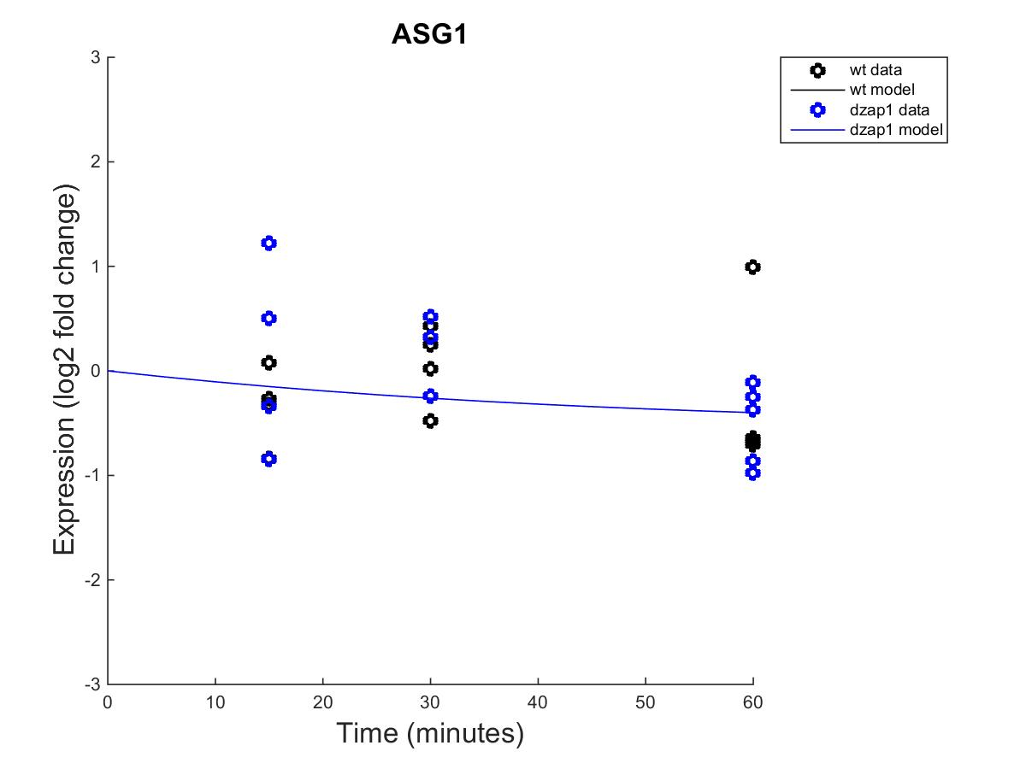
Effect of wild type and dzap1 on ASG1 expression with a non-estimated B

Slide 6
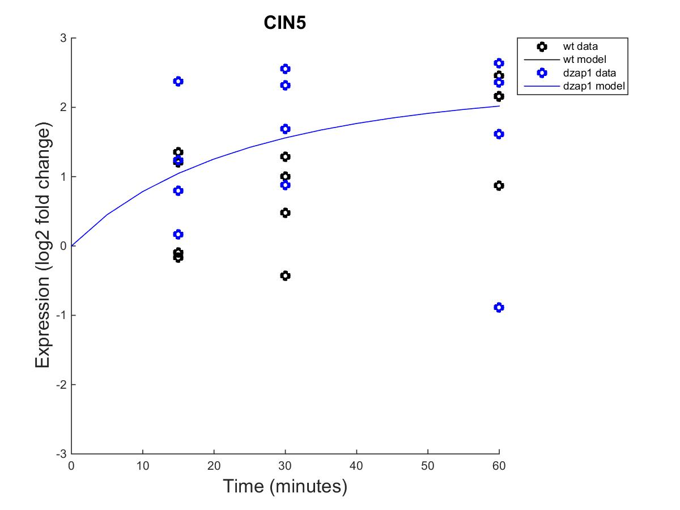
Effect of wild type and dzap1 on CIN5 expression with a non-estimated B

Slide 7
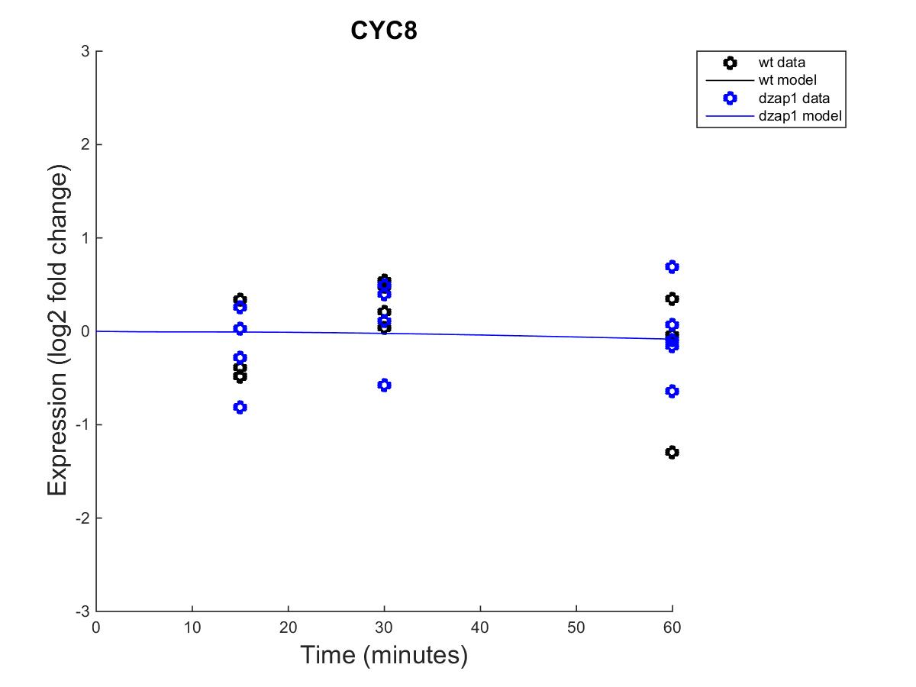
Effect of wild type and dzap1 on CYC8 expression with a non-estimated B

Slide 8
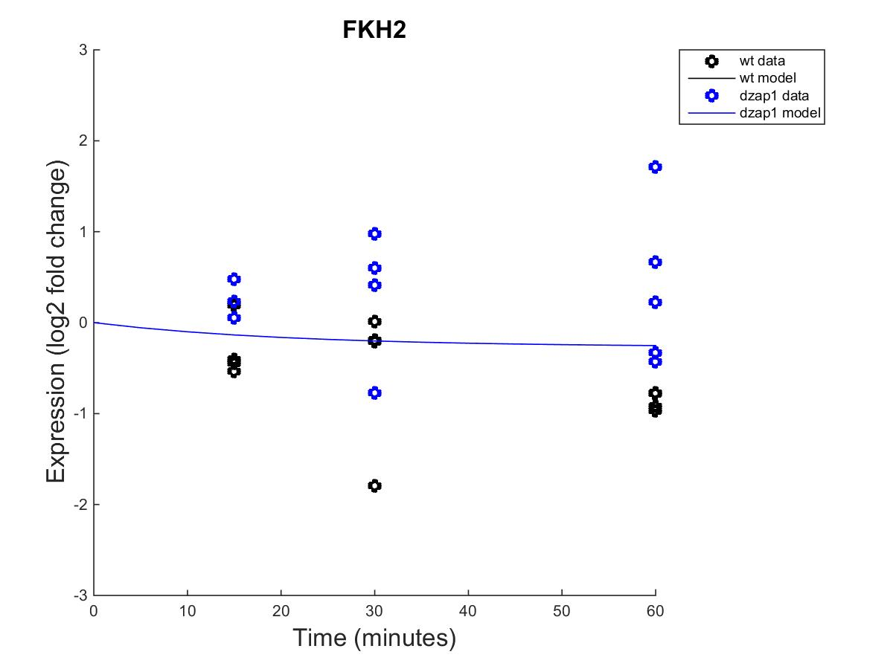
Effect of wild type and dzap1 on FKH2 expression with a non-estimated B

Slide 9
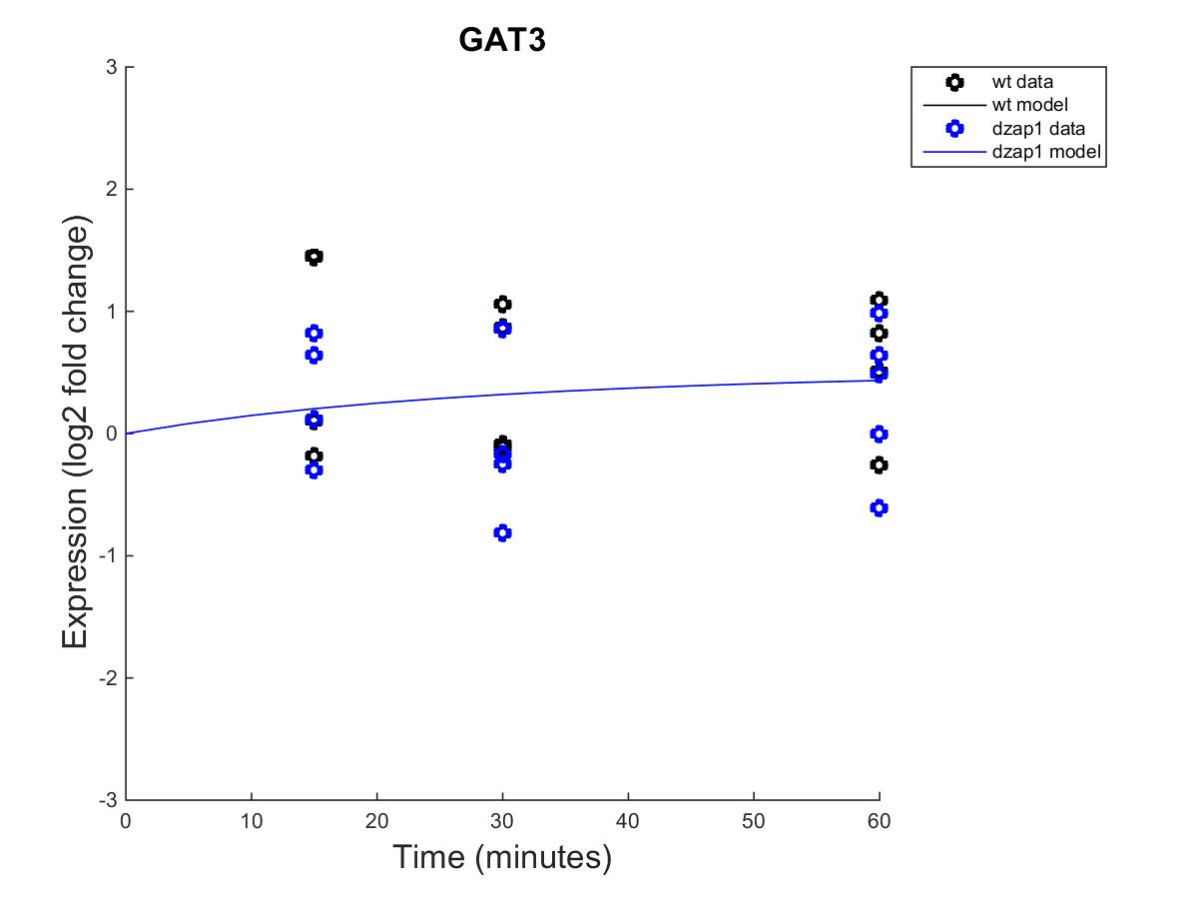
Effect of wild type and dzap1 on GAT3 expression with a non-estimated B

Slide 10
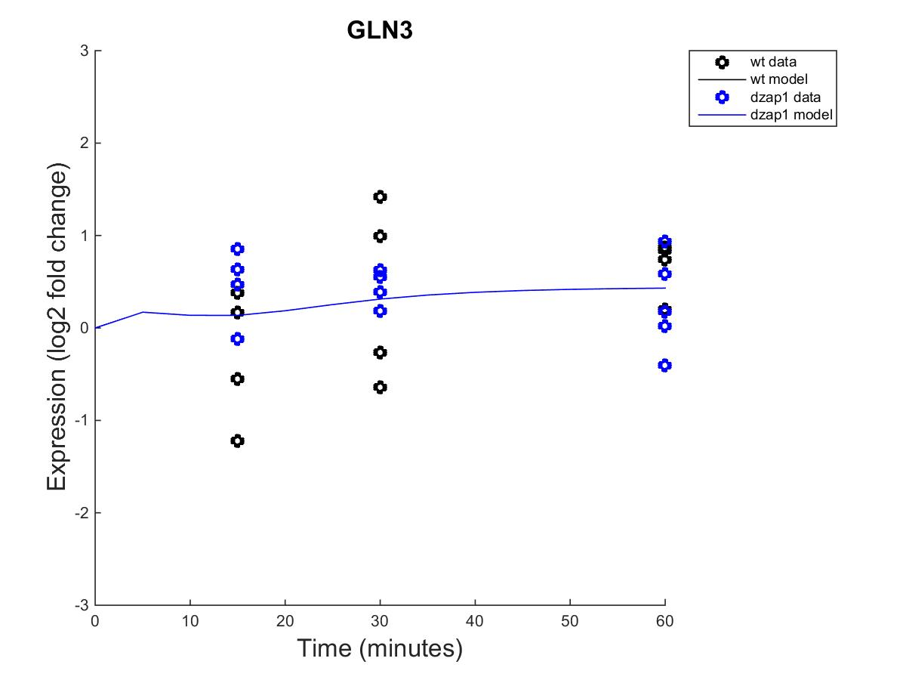
Effect of wild type and dzap1 on GLN3 expression with a non-estimated B

Slide 11
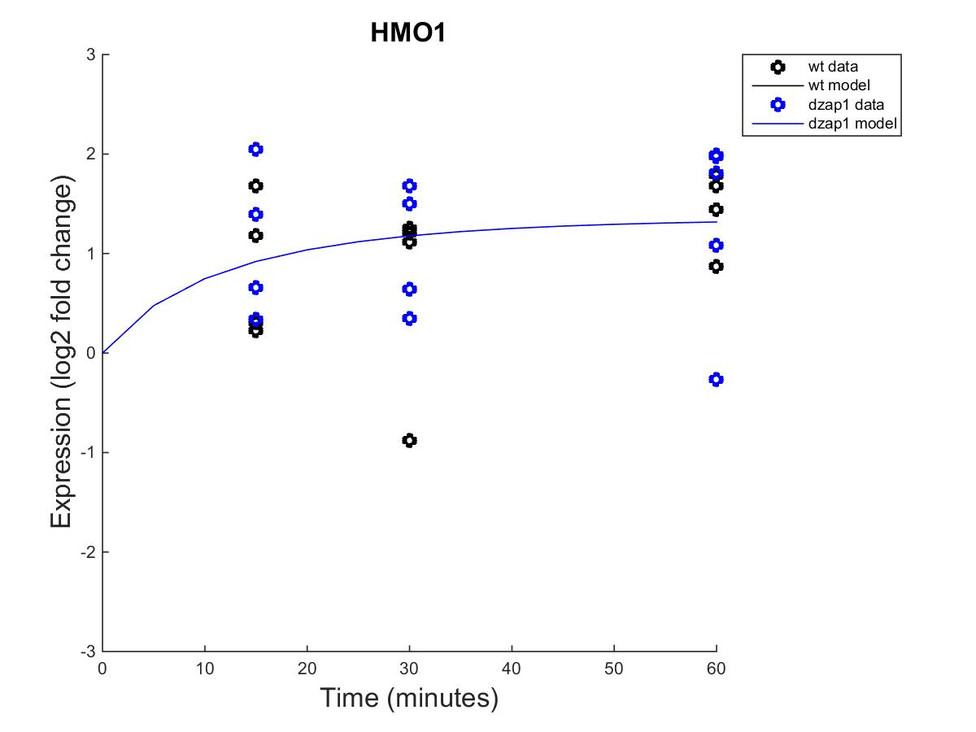
Effect of wild type and dzap1 on HMO1 expression with a non-estimated B

Slide 12
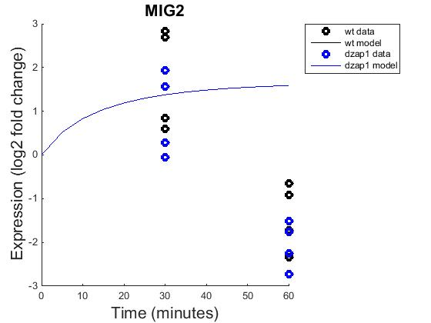
Effect of wild type and dzap1 on MIG2 expression with a non-estimated B

Slide 13
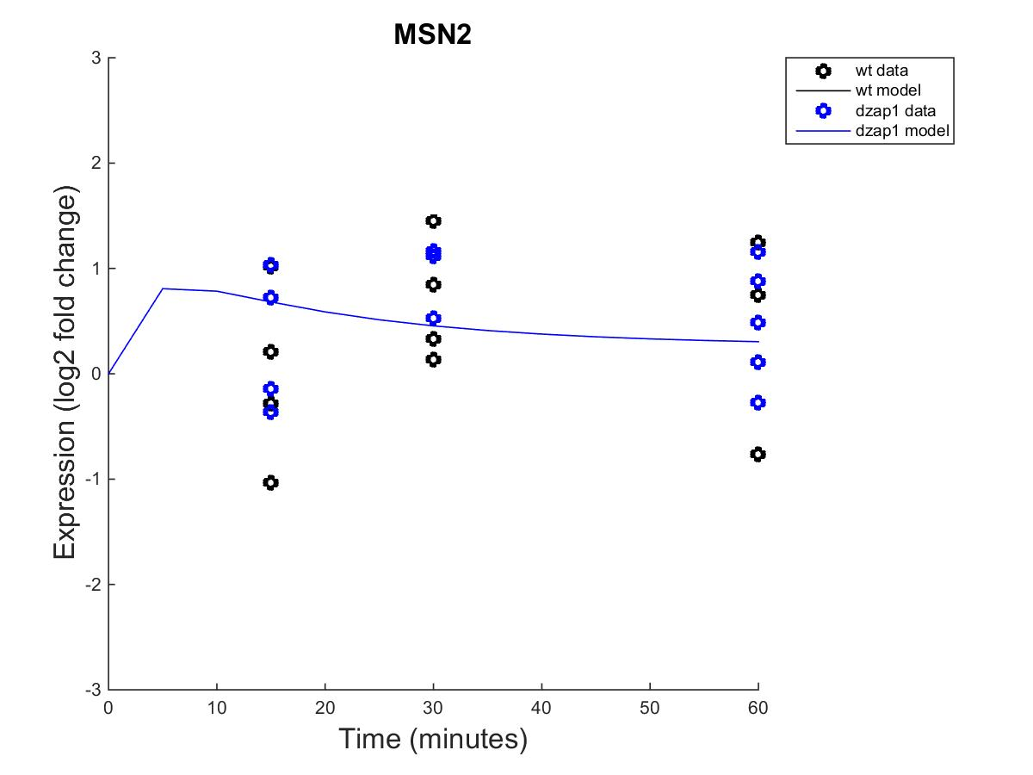
Effect of wild type and dzap1 on MSN2 expression with a non-estimated B

Slide 14
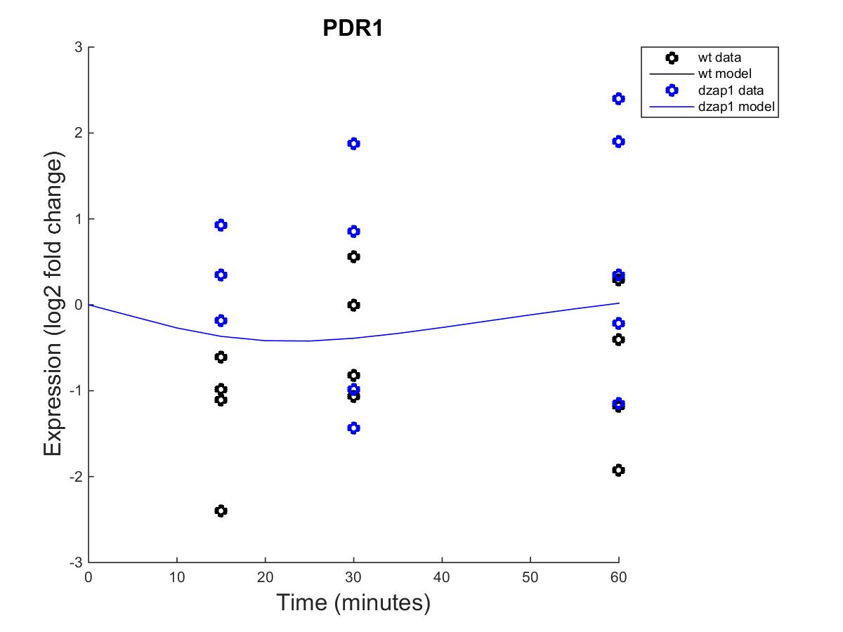
Effect of wild type and dzap1 on PDR1 expression with a non-estimated B

Slide 15
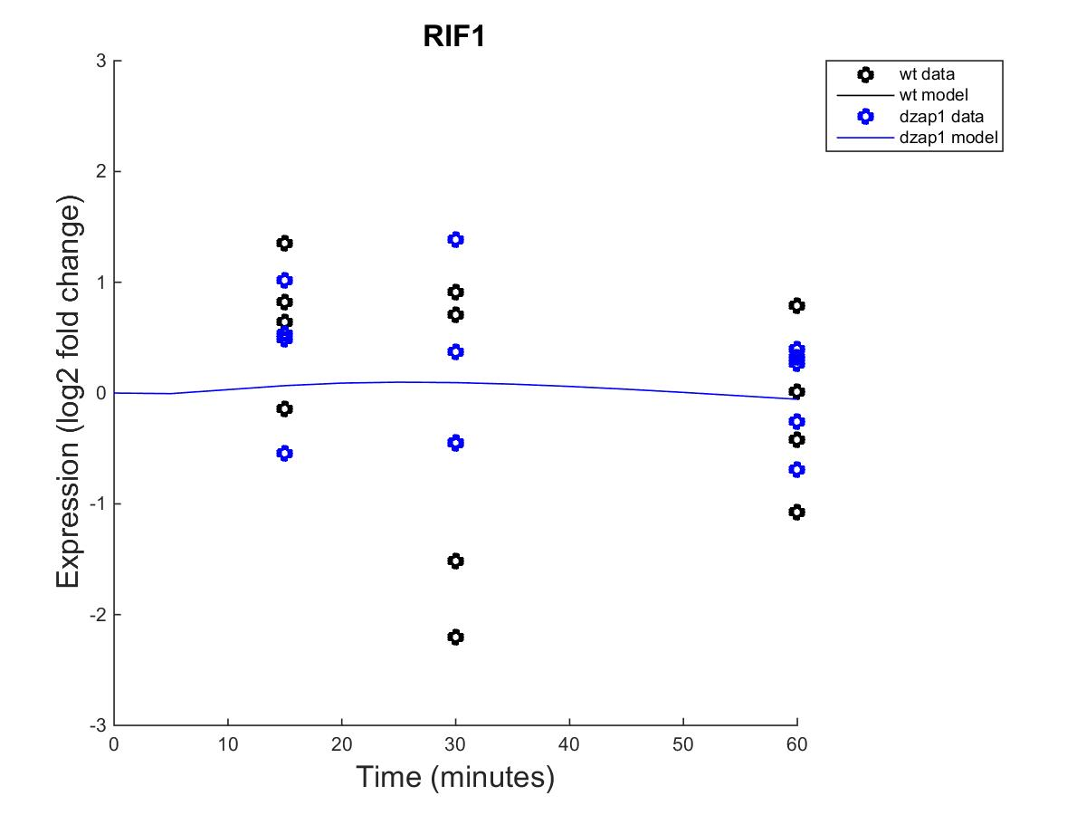
Effect of wild type and dzap1 on RIF1 expression with a non-estimated B

Slide 16
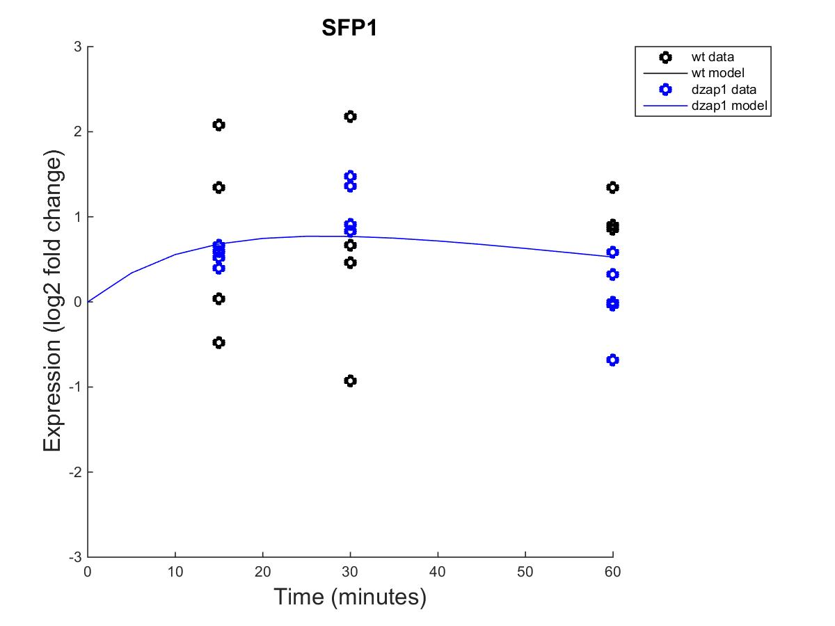
Effect of wild type and dzap1 on SFP1 expression with a non-estimated B

Slide 17
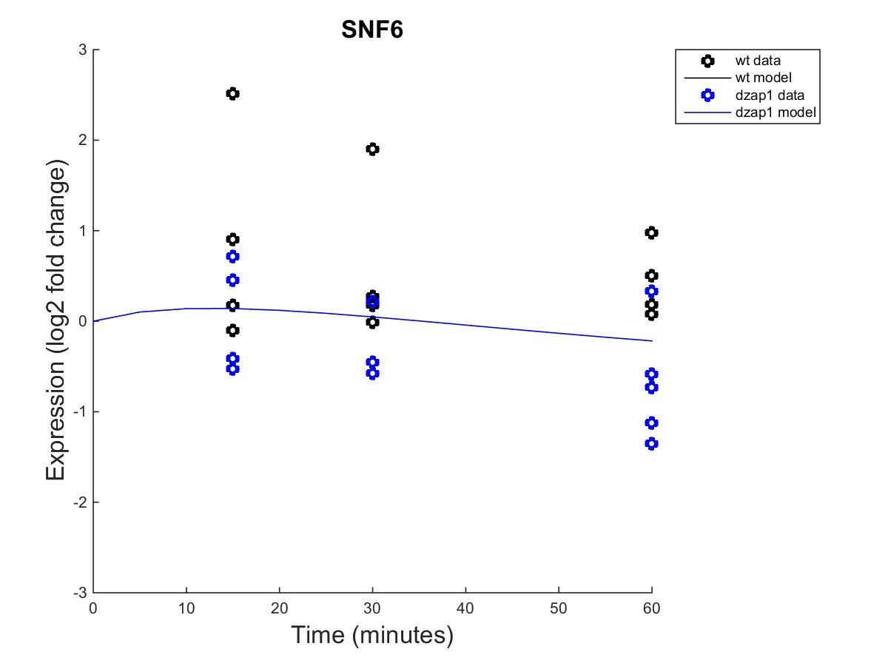
Effect of wild type and dzap1 on SNF6 expression with a non-estimated B

Slide 18
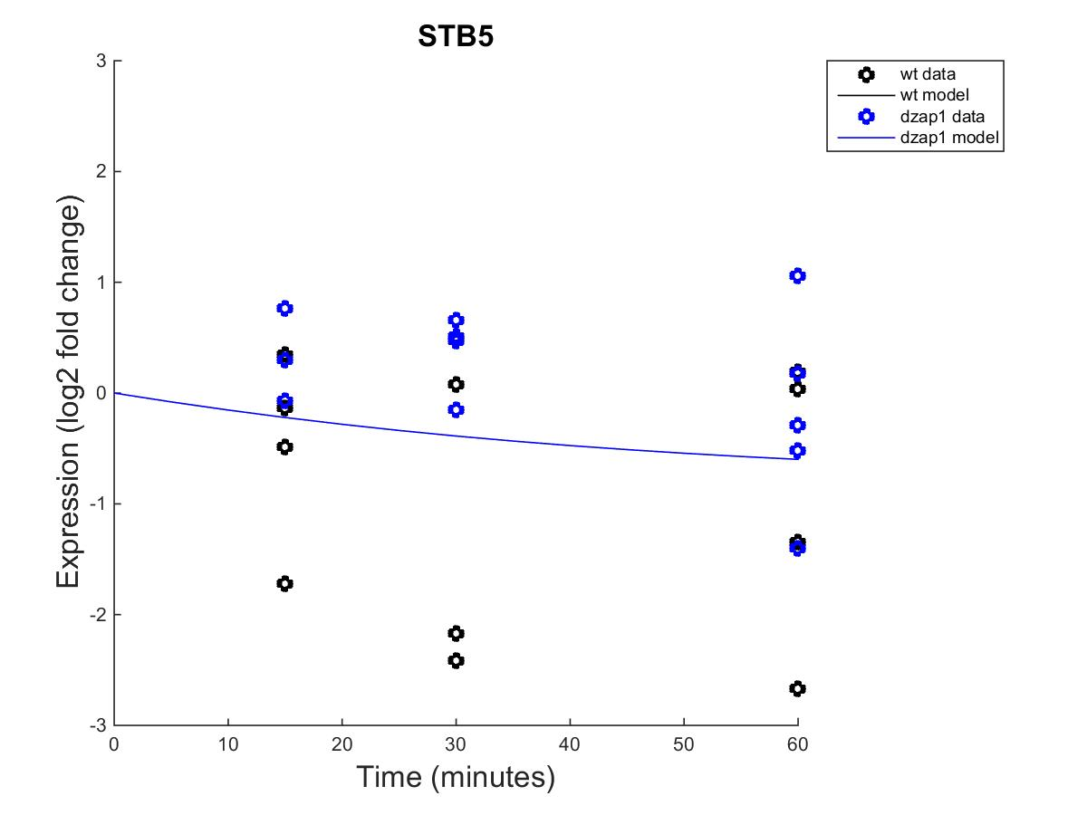
Effect of wild type and dzap1 on STB5 expression with a non-estimated B

Slide 19
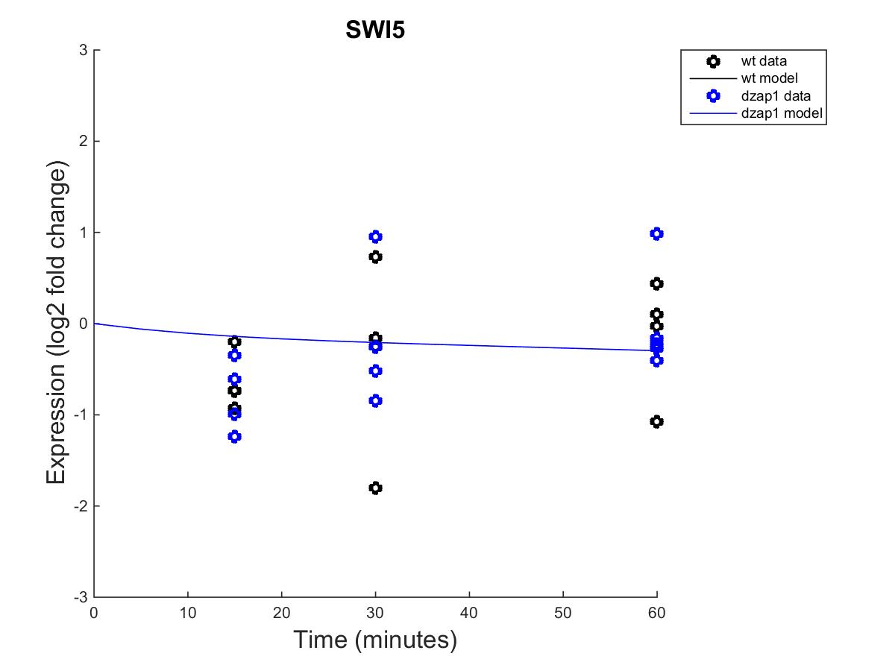
Effect of wild type and dzap1 on SWI5 expression with a non-estimated B

Slide 20
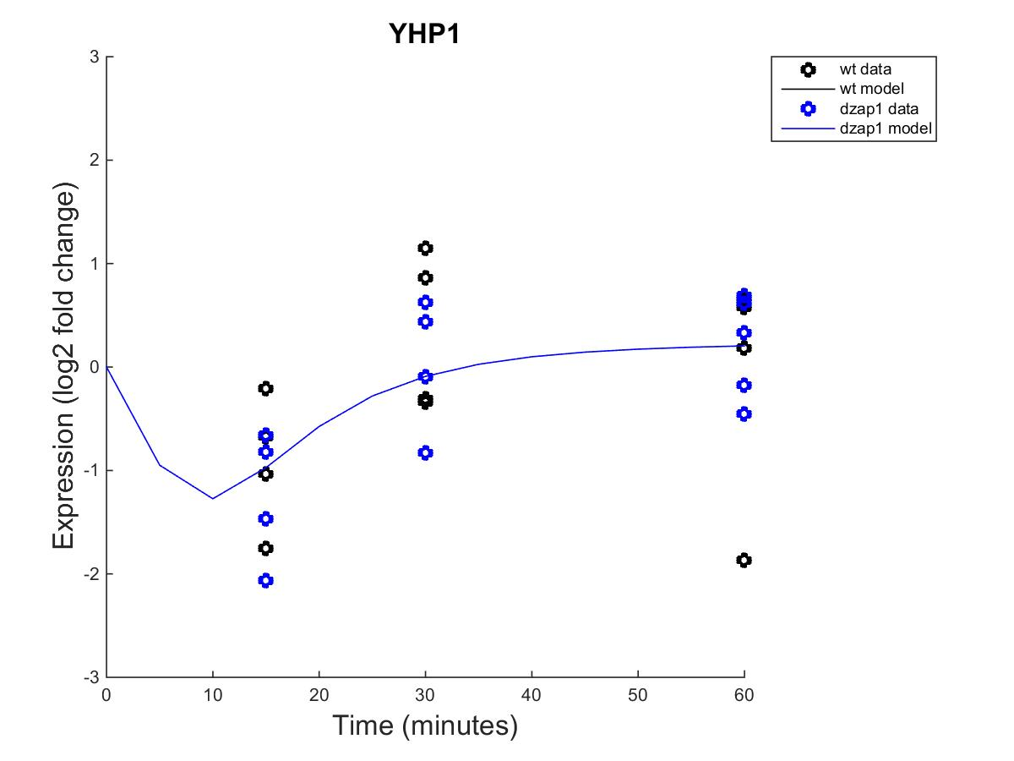
Effect of wild type and dzap1 on YHP1 expression with a non-estimated B

Slide 21
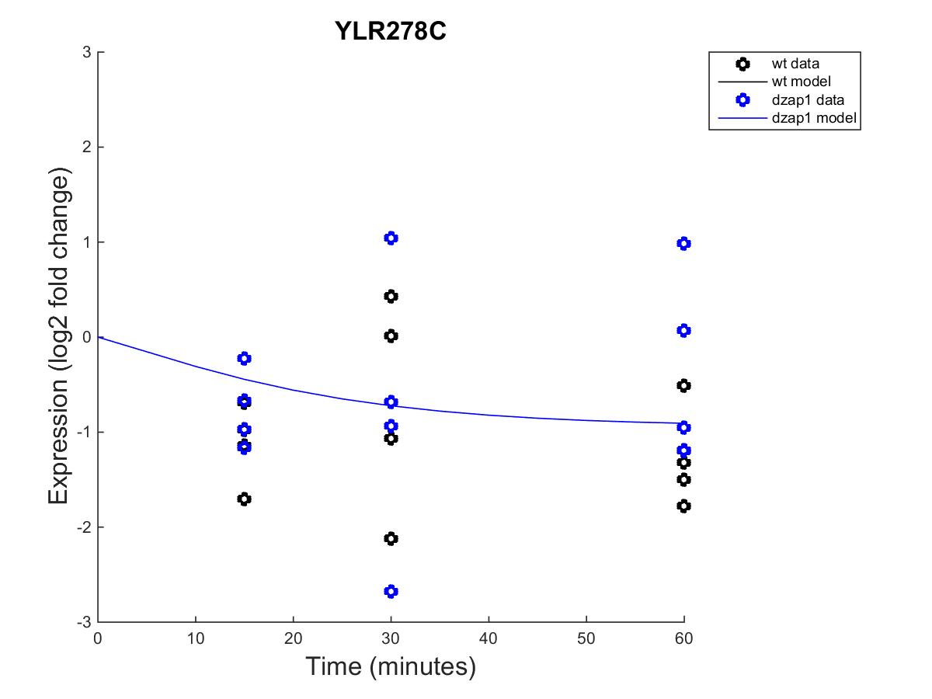
Effect of wild type and dzap1 on YLR278C expression with a non-estimated B

Slide 22
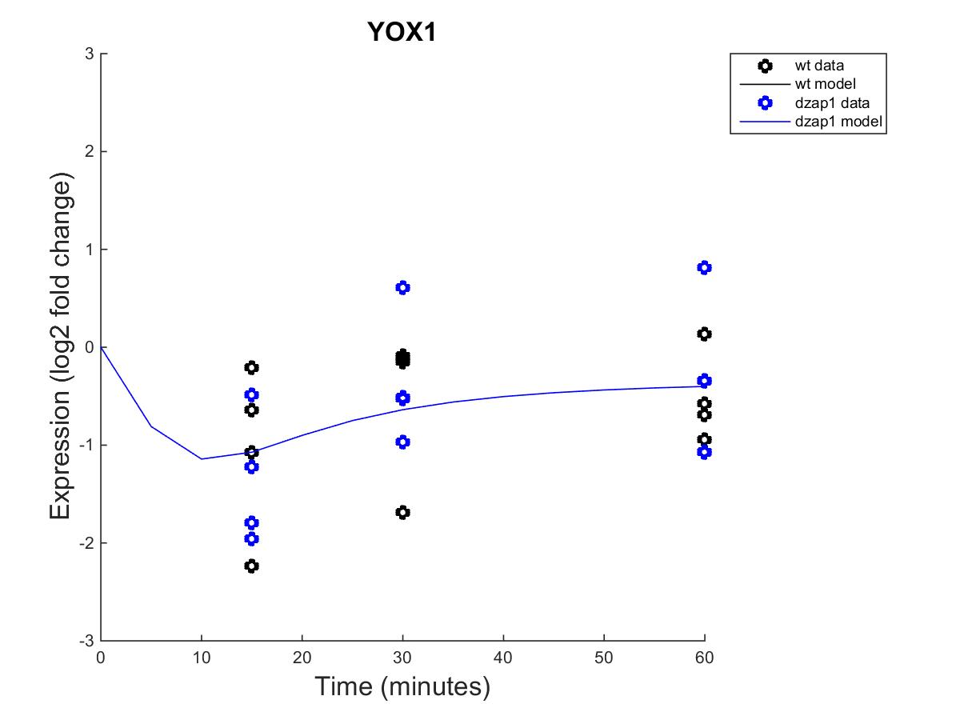
Effect of wild type and dzap1 on YOX1 expression with a non-estimated B

Slide 23
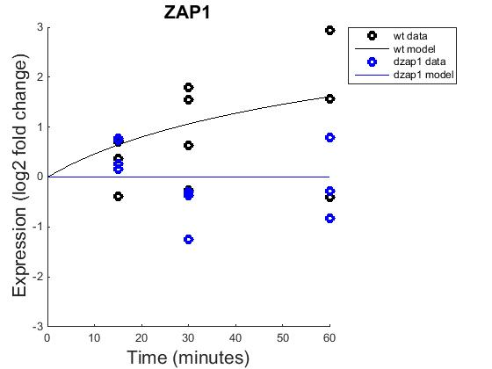
Effect of wild type and dzap1 on ZAP1 expression with a non-estimated B

Slide 24
With the following parameters
fix_b to 0
fix_P to 0
iestimate to 1
alpha to 0.01

Slide 25
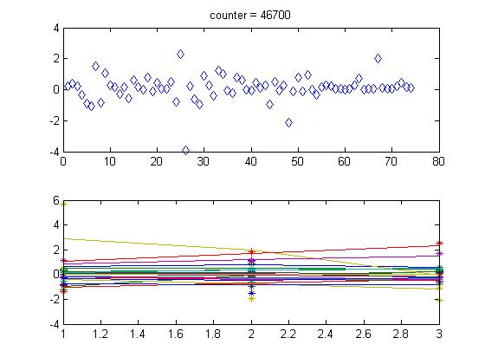
Overall expression with an estimated B-value

Slide 26
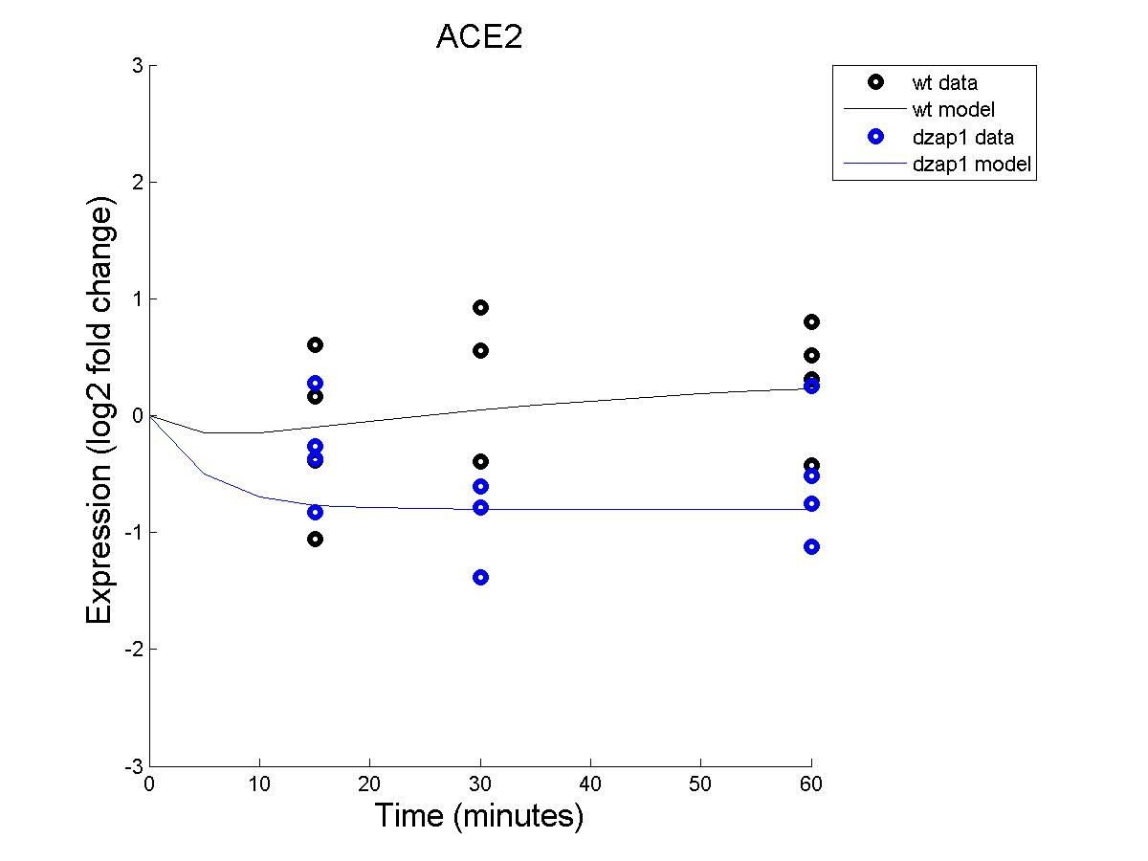
Effect of wild type and dzap1 on ACE2 expression with an estimated B

Slide 27
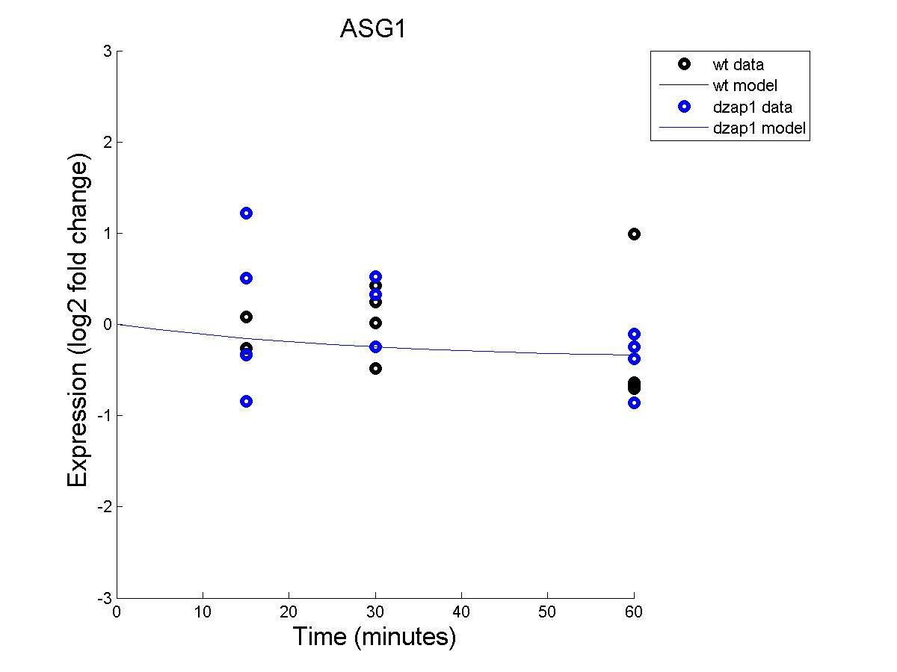
Effect of wild type and dzap1 on ASG1 expression with an estimated B

Slide 28
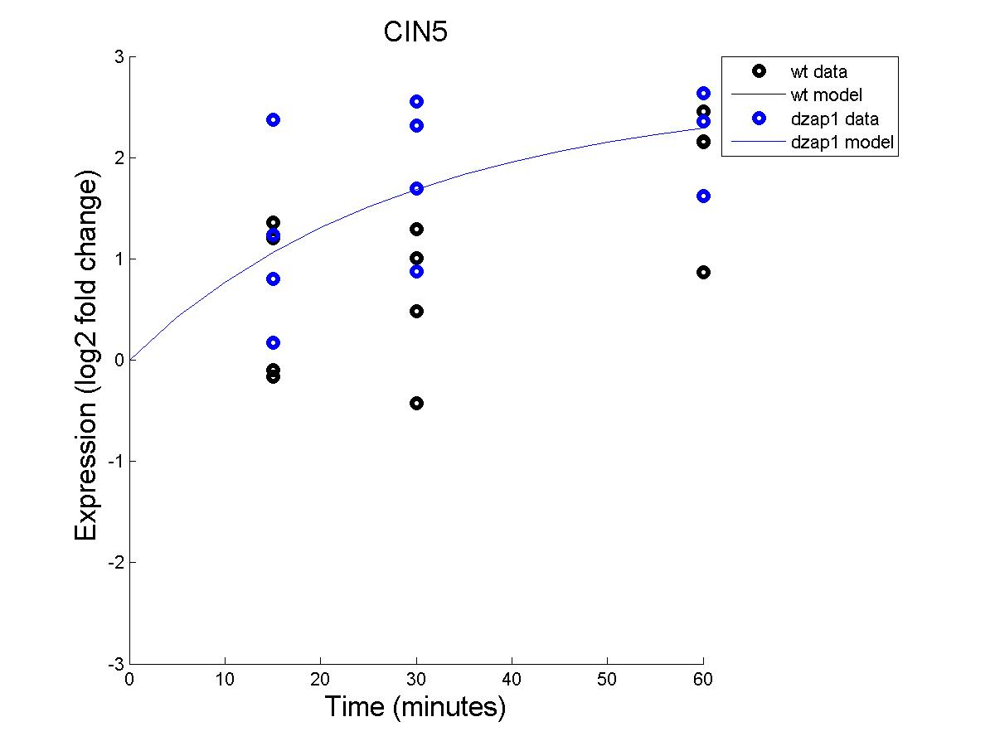
Effect of wild type and dzap1 on CIN5 expression with an estimated B

Slide 29
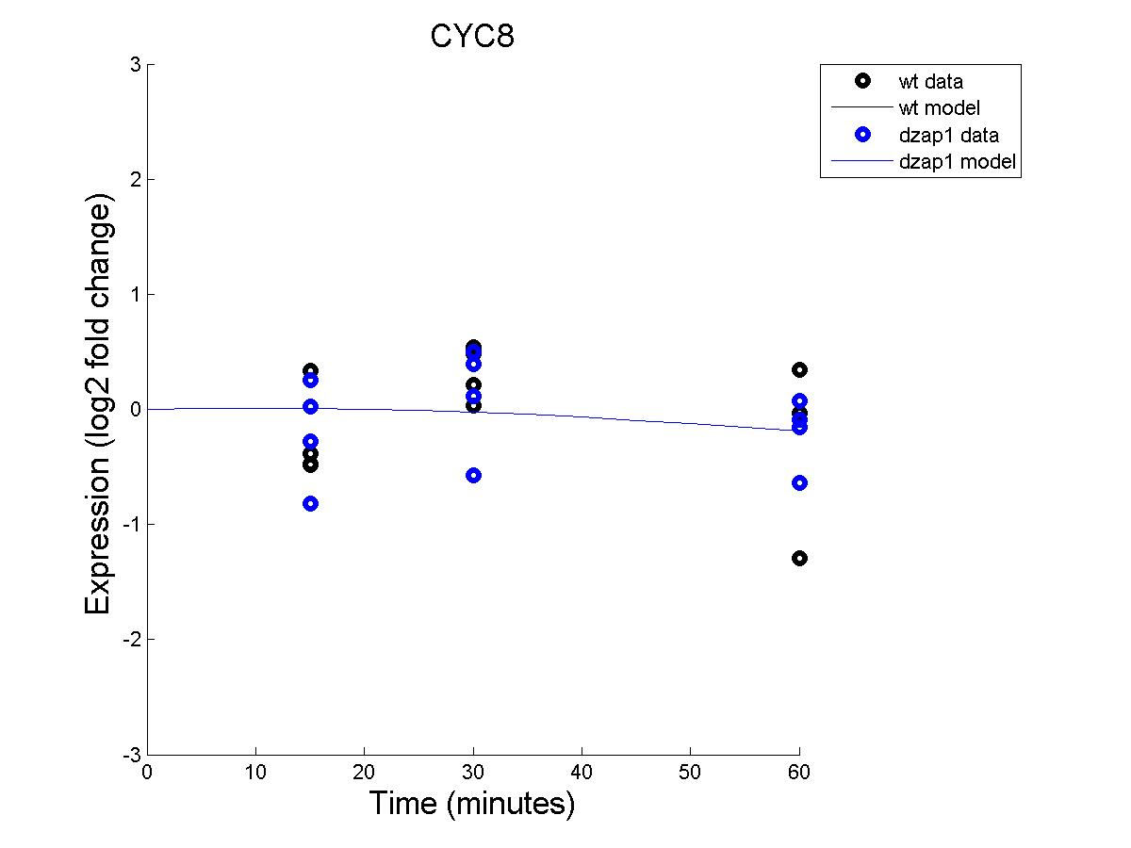
Effect of wild type and dzap1 on CYC8 expression with an estimated B

Slide 30
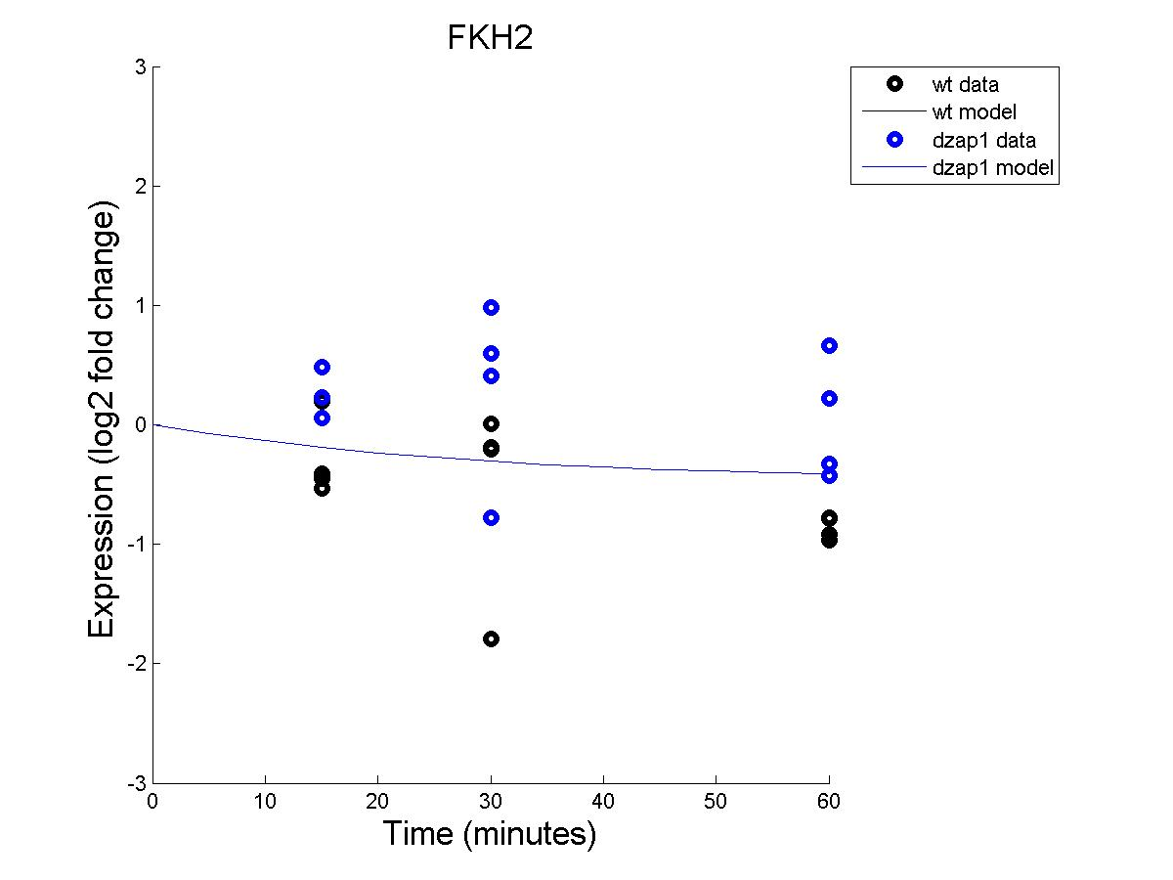
Effect of wild type and dzap1 on FKH2 expression with an estimated B

Slide 31
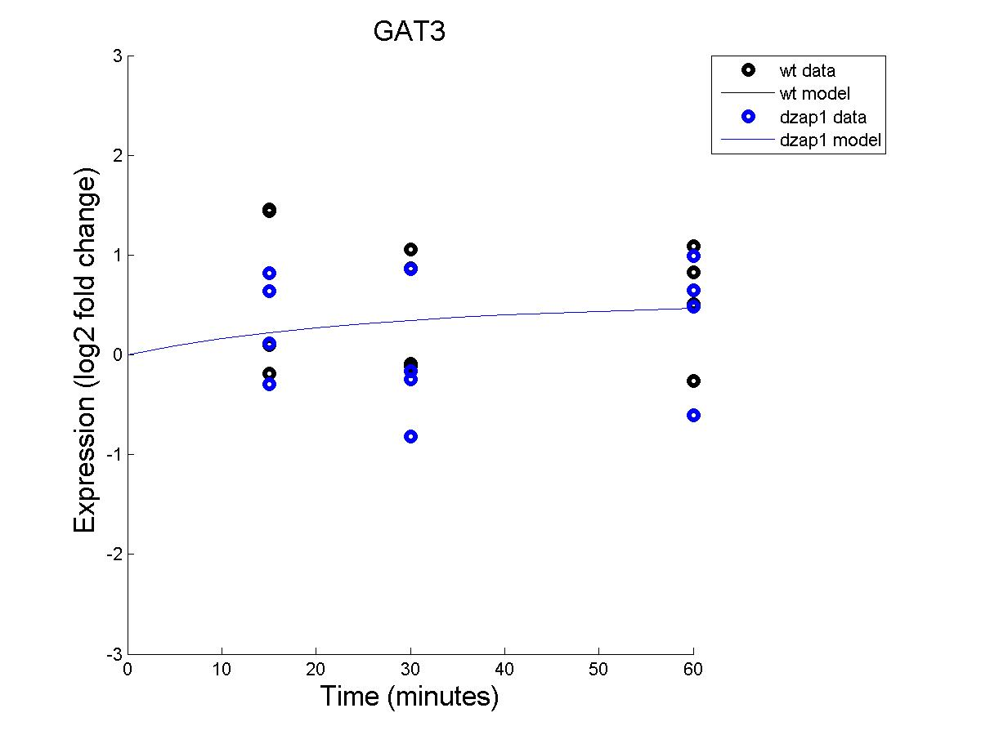
Effect of wild type and dzap1 on GAT3 expression with an estimated B

Slide 32
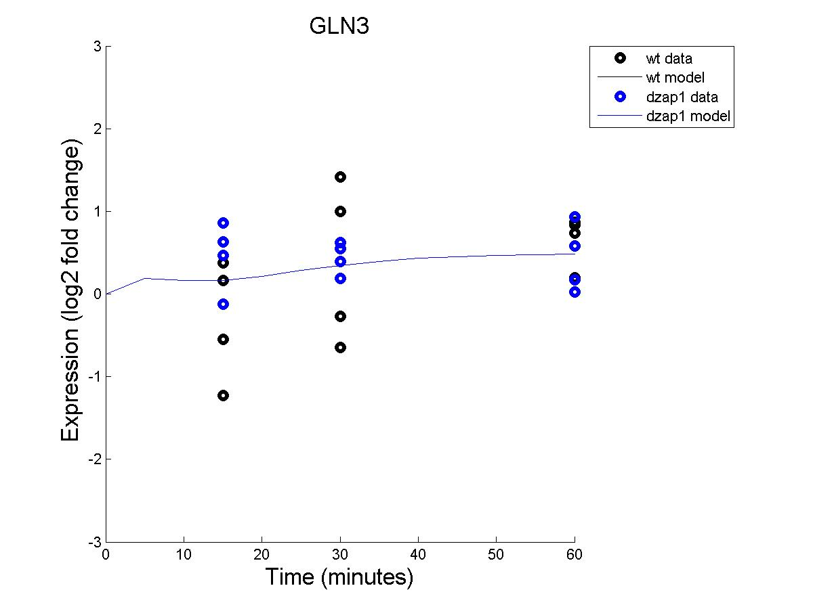
Effect of wild type and dzap1 on GLN3 expression with an estimated B

Slide 33
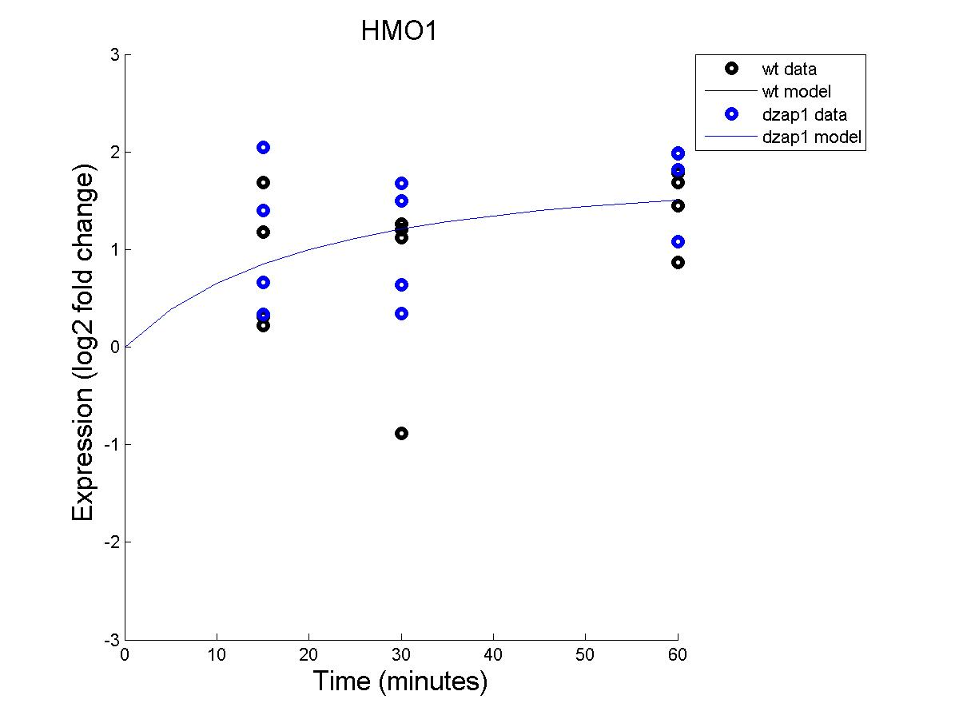
Effect of wild type and dzap1 on HMO1 expression with an estimated B

Slide 34
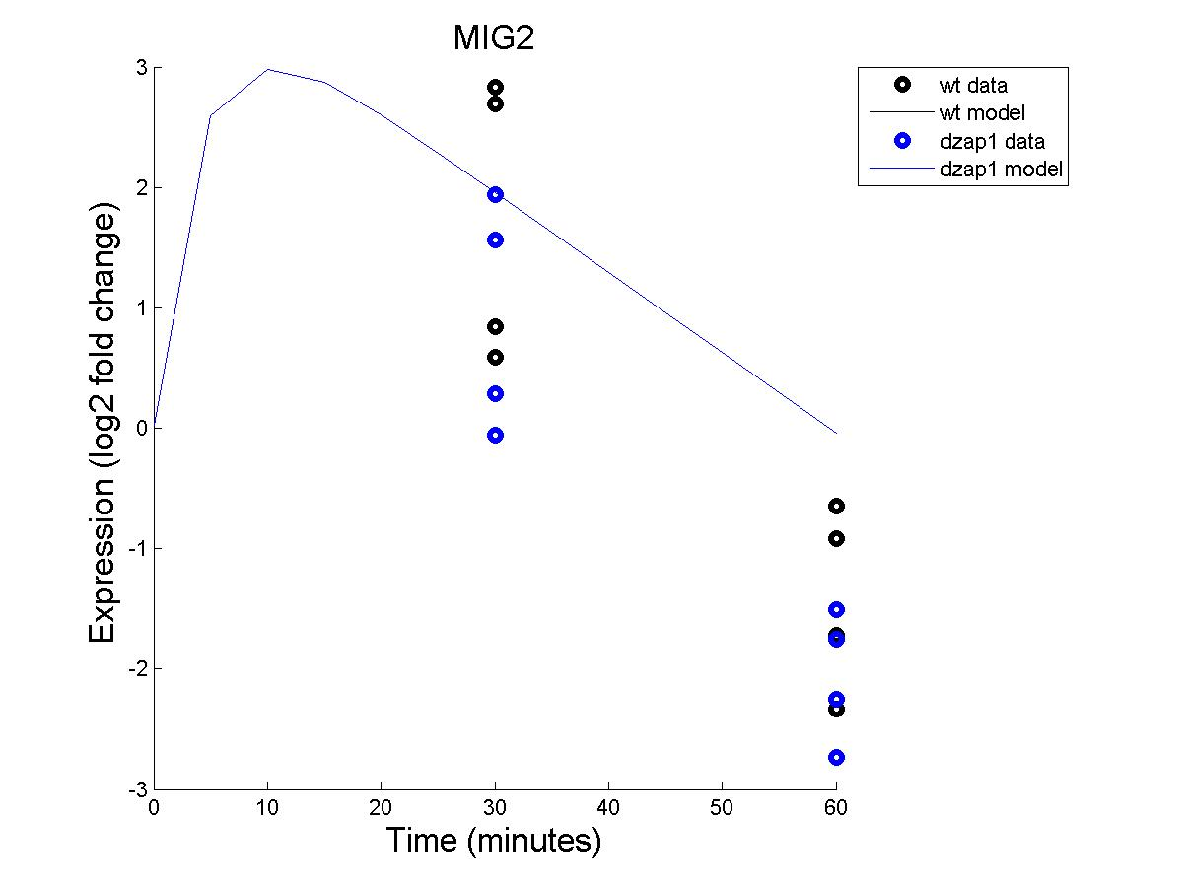
Effect of wild type and dzap1 on MIG2 expression with an estimated B

Slide 35
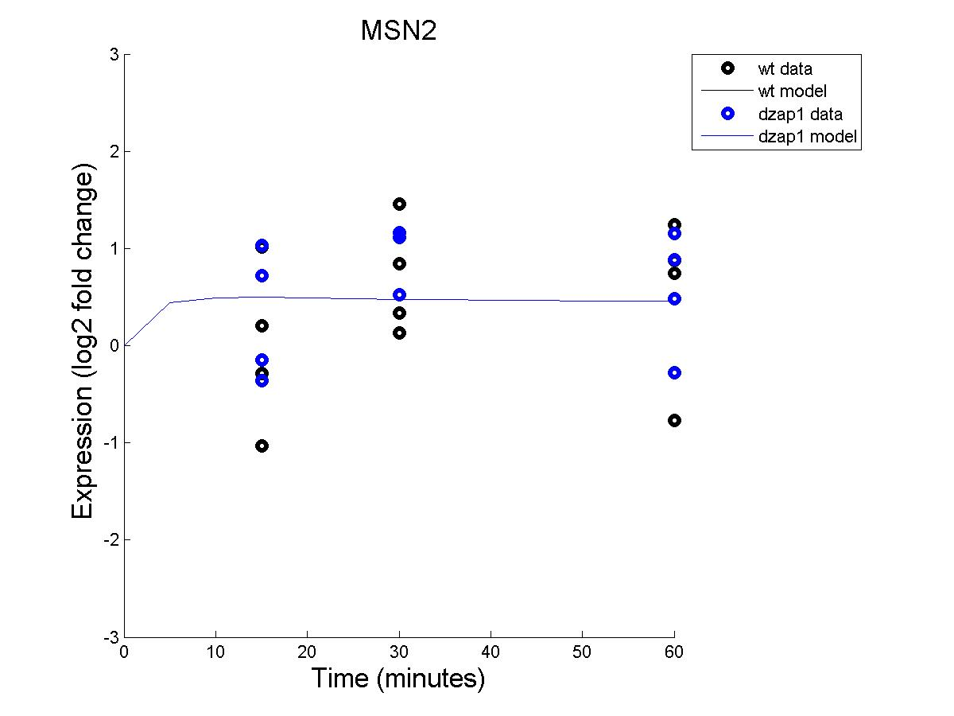
Effect of wild type and dzap1 on MSN2 expression with an estimated B

Slide 36
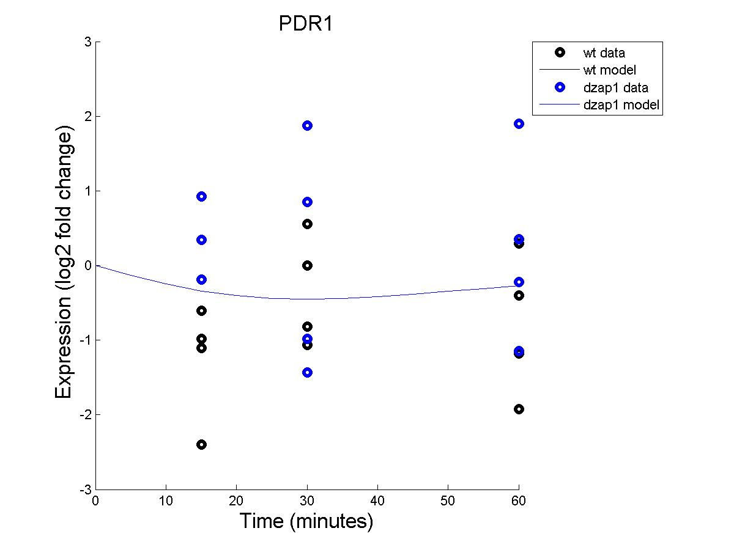
Effect of wild type and dzap1 on PDR1 expression with an estimated B

Slide 37
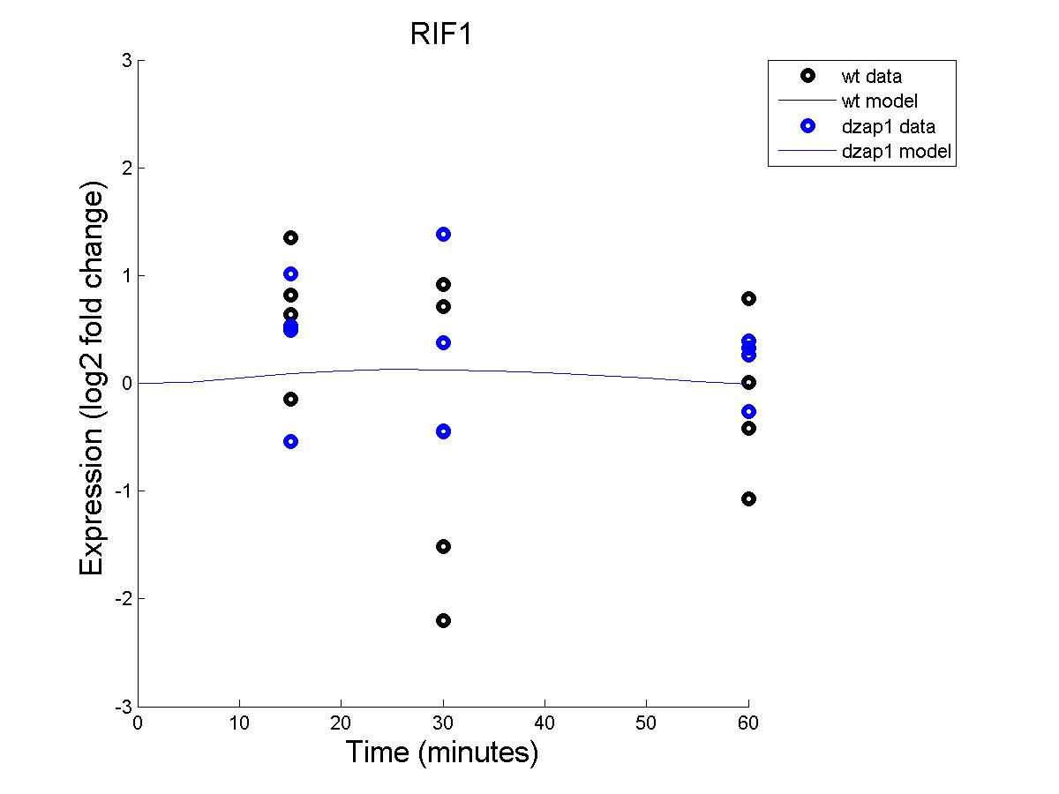
Effect of wild type and dzap1 on RIF1 expression with an estimated B

Slide 38
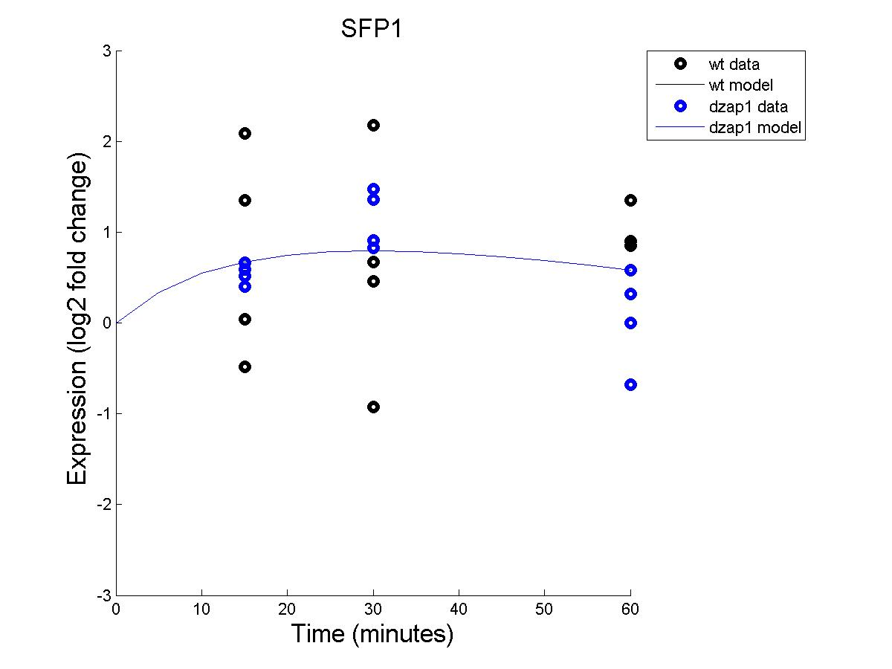
Effect of wild type and dzap1 on SFP1 expression with an estimated B

Slide 39
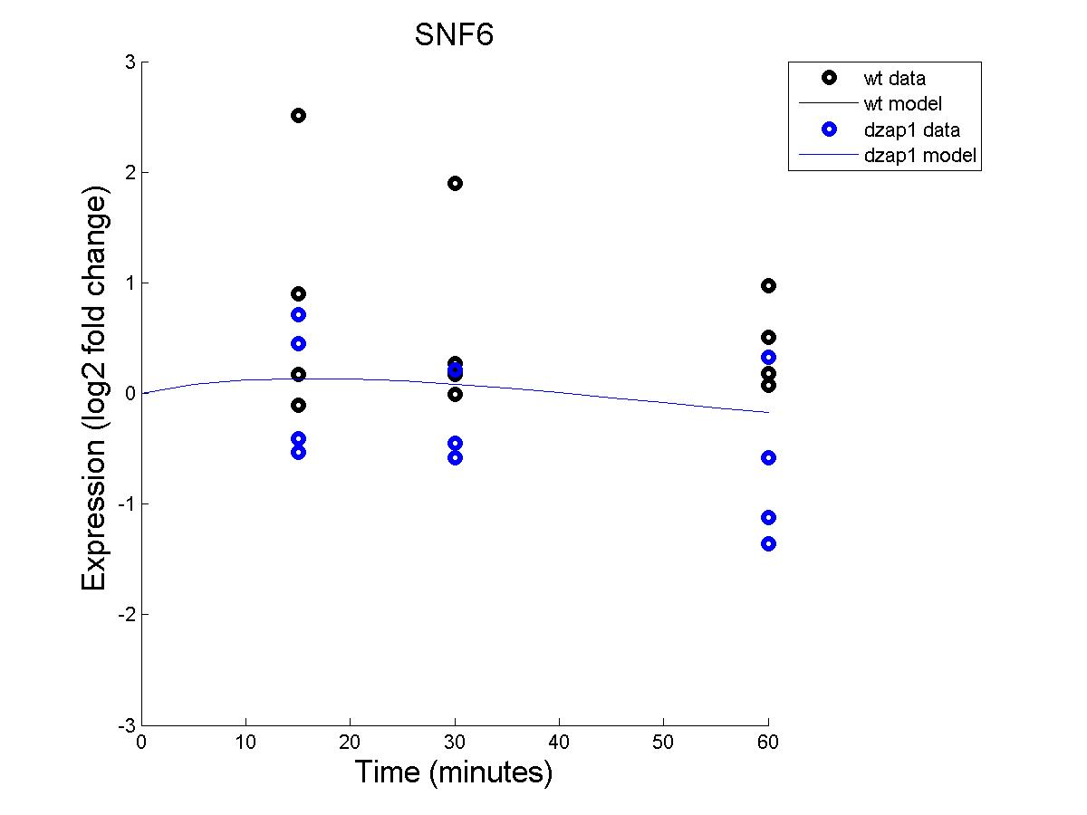
Effect of wild type and dzap1 on SNF6 expression with an estimated B

Slide 40
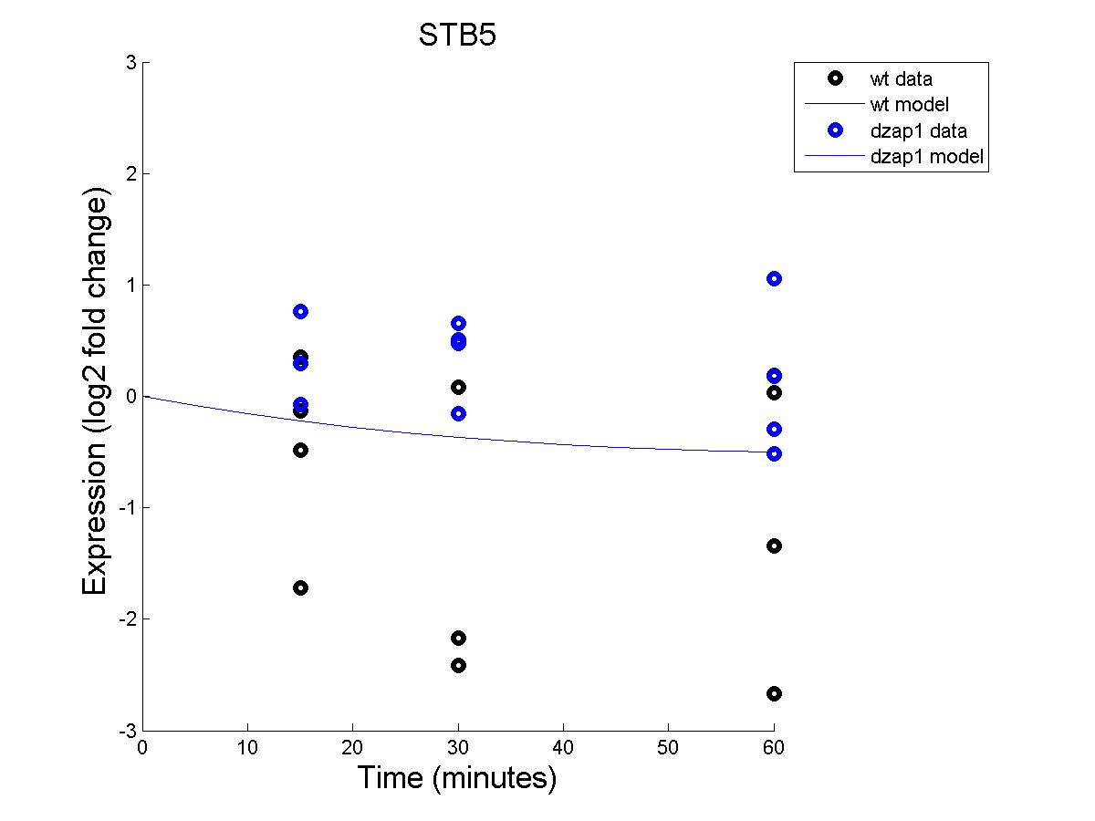
Effect of wild type and dzap1 on STB5 expression with an estimated B

Slide 41
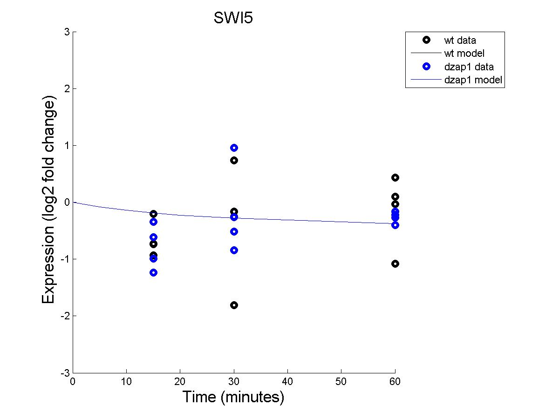
Effect of wild type and dzap1 on SWI5 expression with an estimated B

Slide 42
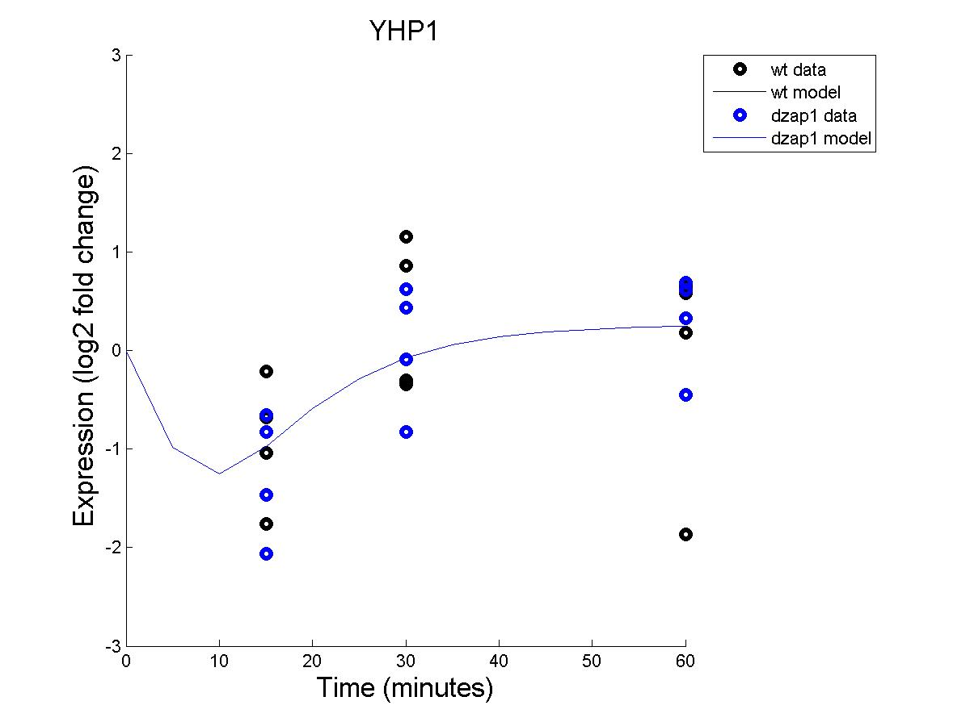
Effect of wild type and dzap1 on YHP1 expression with an estimated B

Slide 43
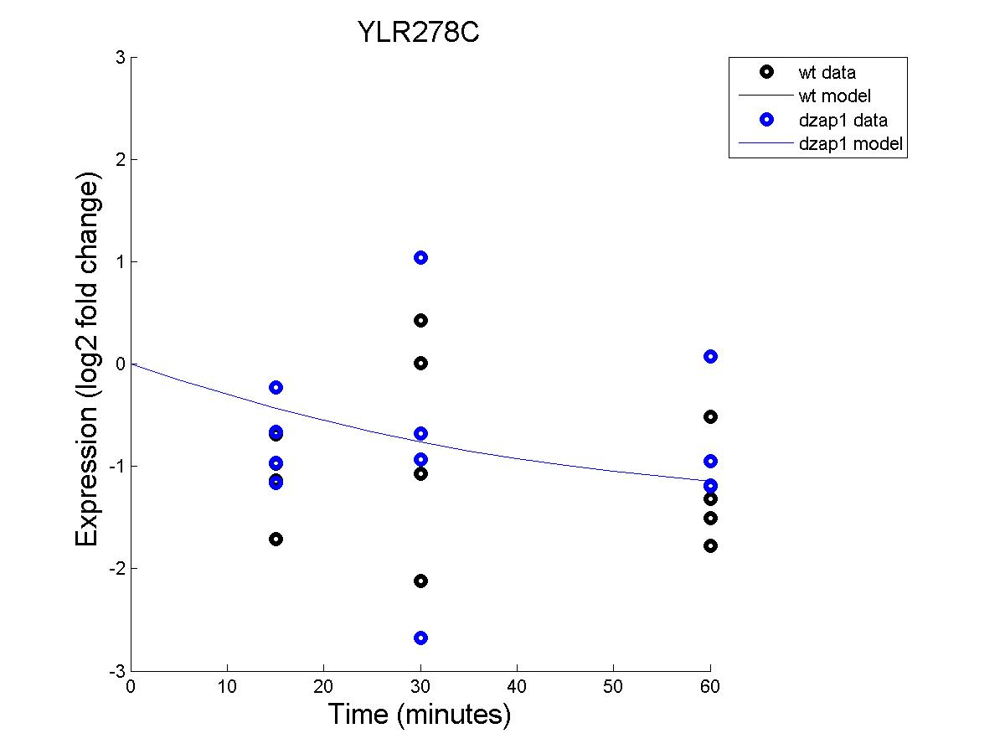
Effect of wild type and dzap1 on YLR278C expression with an estimated B

Slide 44
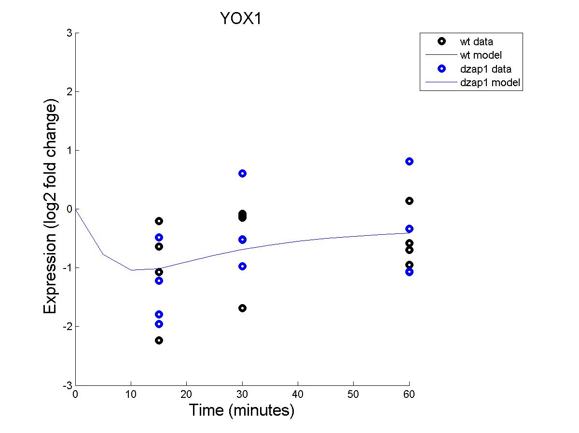
Effect of wild type and dzap1 on YOX1 expression with an estimated B

Slide 45

Effect of wild type and dzap1 on ZAP1 expression with an estimated B

Slide 46
Comparison of Weights between fixed and estimated b-values for each regulatory pair

Slide 47
Comparison of production times between fixed and estimated b-values for each transcription factor

Slide 48
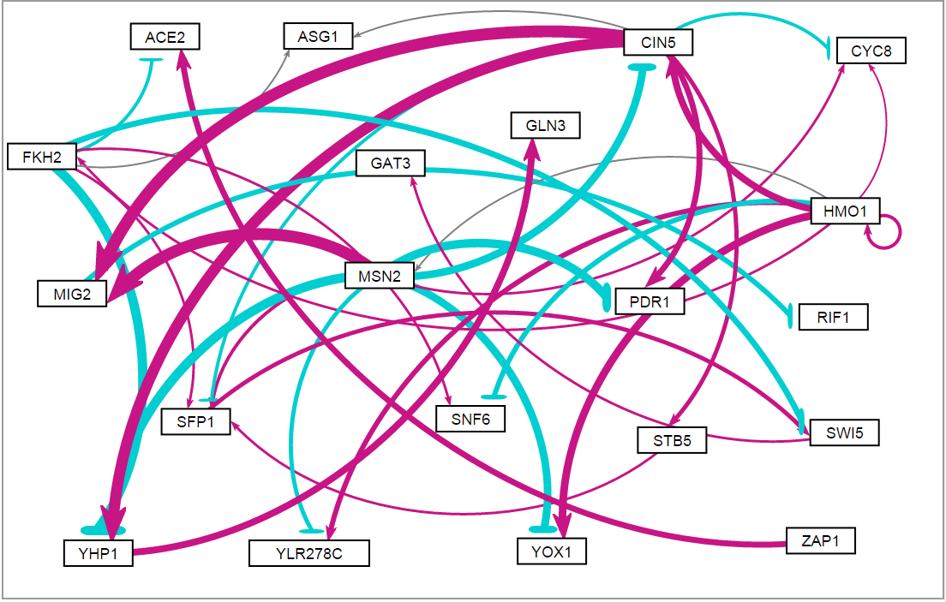
Transcription network shows CIN5 and MSN2 strongly controlling MIG2 and YHP1 in a fixed-b network

Slide 49
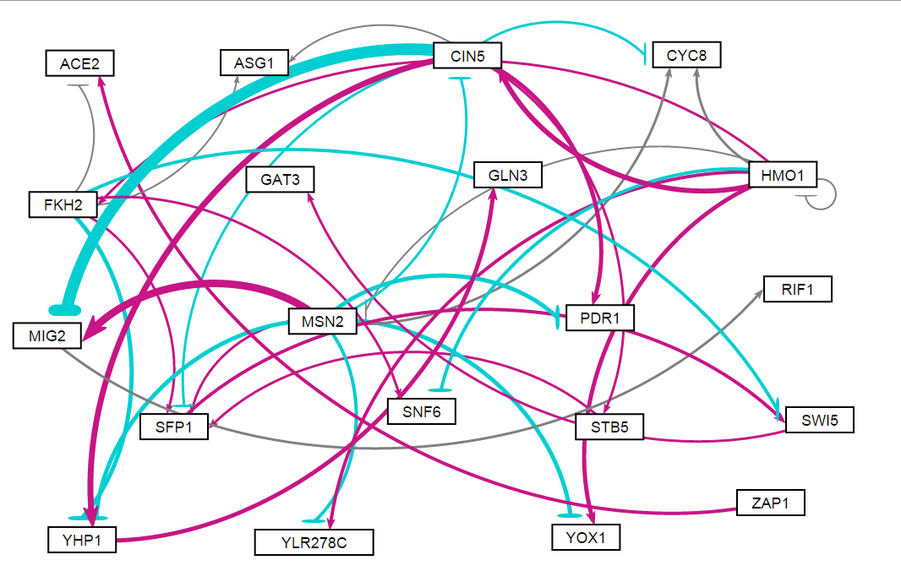
Transcription network shows CIN5 strongly repressing MIG2 in a estimated-b network

