Slide 1
An E.coli Cell-Free Expression Toolbox: Application to Synthetic Gene Circuits and Artificial Cells
Jonghyeon Shin and Vincent Noireaux
ACS Synthetic Biology, 2012
Presented by Hannah Johnsen
20.385
May 9, 2012

Slide 2
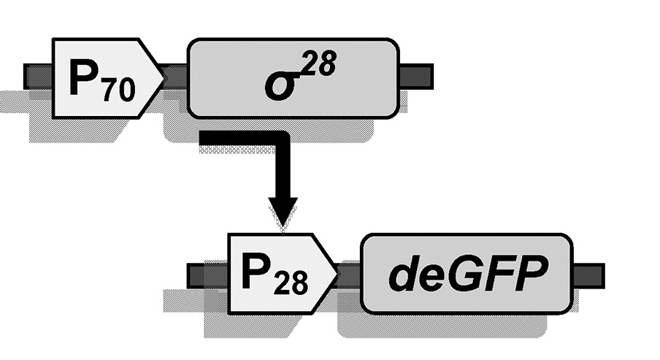
Background
Transcriptional activation unit
Transcriptional activation protein + specific promoter
deGFP: destabilized GFP
Batch reaction: carried out in a vesicle with all necessary components present
Notes:
Transcriptional activation unit can involve two plasmids, p70 followed by gene for sigma 28, plus plasmid with p28 followed by reporter gene
deGFP used for time dependent reactions because it goes away quickly

Slide 3
Overview
Purpose: Create genetic circuits, including cascades, AND gates, and negative feedback loops in a cell-free environment
Setup of system
Transcriptional activation units
Transcription Co-activation: AND gate system
Competition induced transcription regulation
Transcriptional activation cascade: series circuit
Parallel circuits
Transcriptional repression units
Long-lived cell-free expression

Slide 4
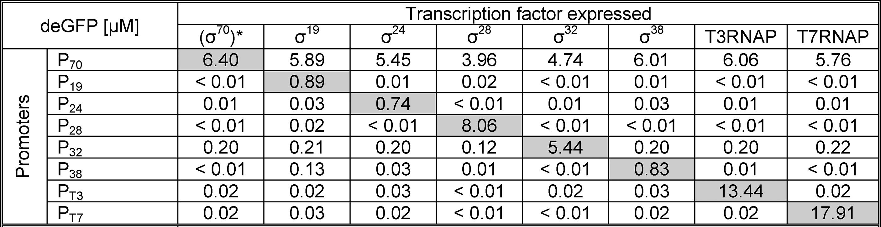
Setup of System
Notes:
Figure: two-stage transcription activation cascade. Made a two-stage cascade for each sigma factor they used
Table: looked at leakiness of each sigma factor → sigma 28 is strongest besides transcription factors that were expected to be very robust
sigma 32 also strong, but leakiest promoter
sigma 19 had most nonspecific binding

Slide 5
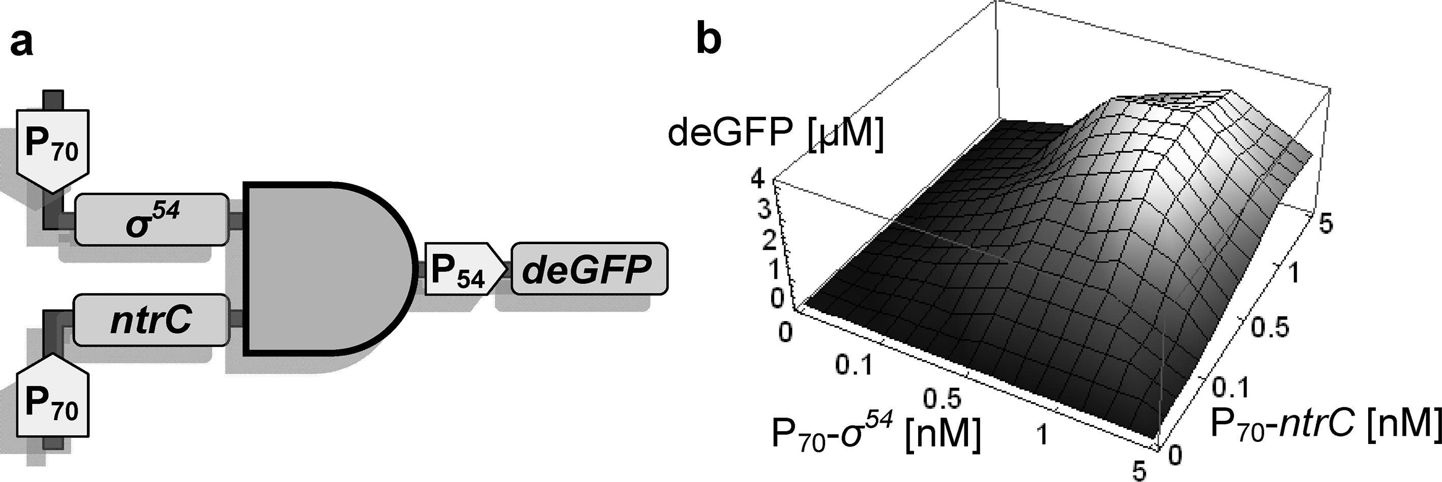
Transcriptional Activation Units Transcription Co-activation: AND Gate
Notes:
ntrC + sigma 54 = deGFP
Cloned ntrC and sigma 54 under p70
Strong response in presence of both

Slide 6
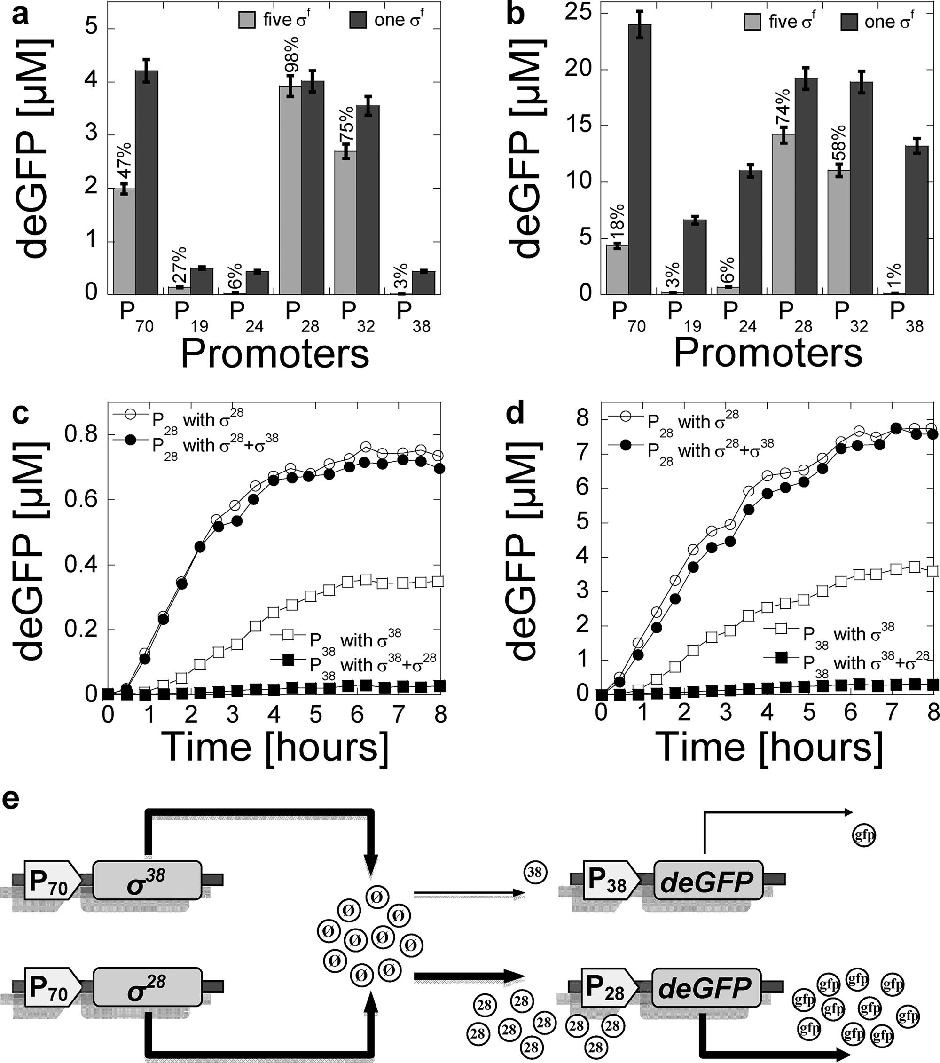
Transcriptional Activation Units Competition-Induced Transcription Regulation
Notes:
Each transcription activation unit tested with all other sigma factors → p28 least affected by competition, p38 most affected
P28 vs. p38: no difference b/n p28 with sigma 28 and 38, big difference b/n p38 with sigma 28 and 38
28 takes all the polymerase, so p38 can’t be expressed

Slide 7
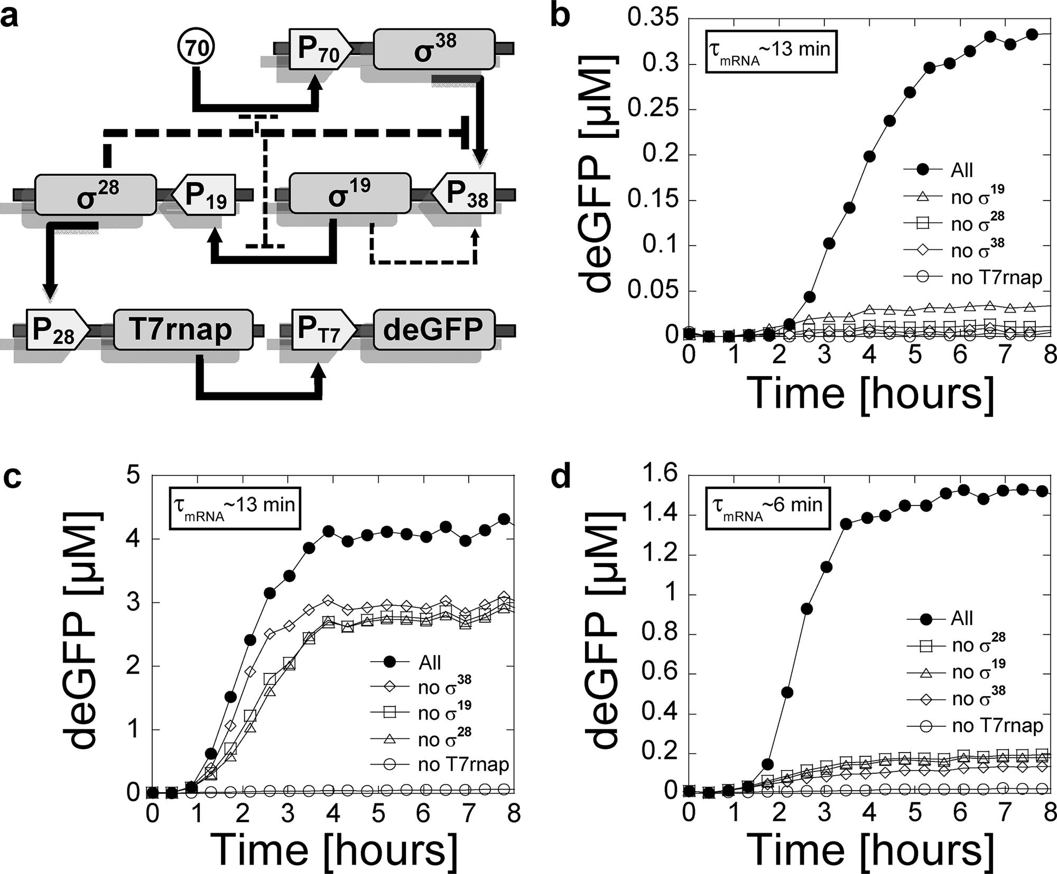
Transcriptional Activation Cascade: Series Circuit
Notes:
-P70 makes sigma 38, sigma 38 binds to p38, p38 makes sigma 19, sigma 19 binds to p19, p19 makes sigma 28, sigma 28 binds to p28, p28 makes transcription factor, transcription factor binds to promoter and makes deGFP
-Complications: Once sigma 28 is present, more competitive than sigma 38 and takes over, stopping sigma 38. also partial negative feedback stopping sigma 70 and sigma 19. positive regulation: sigma 19 also binds nonspecifically to p38.
-low plasmid concentration = low GFP, high plasmid concentration = high GFP but lost specificity so shorten mRNA life
-also tested parallel circuits, biggest thing was that adjusting gene concentration changed output

Slide 8
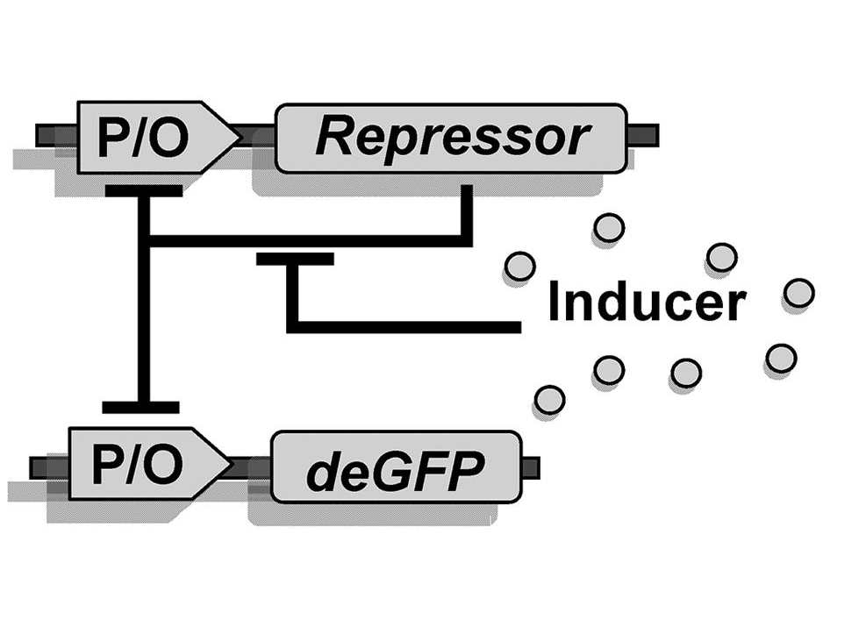
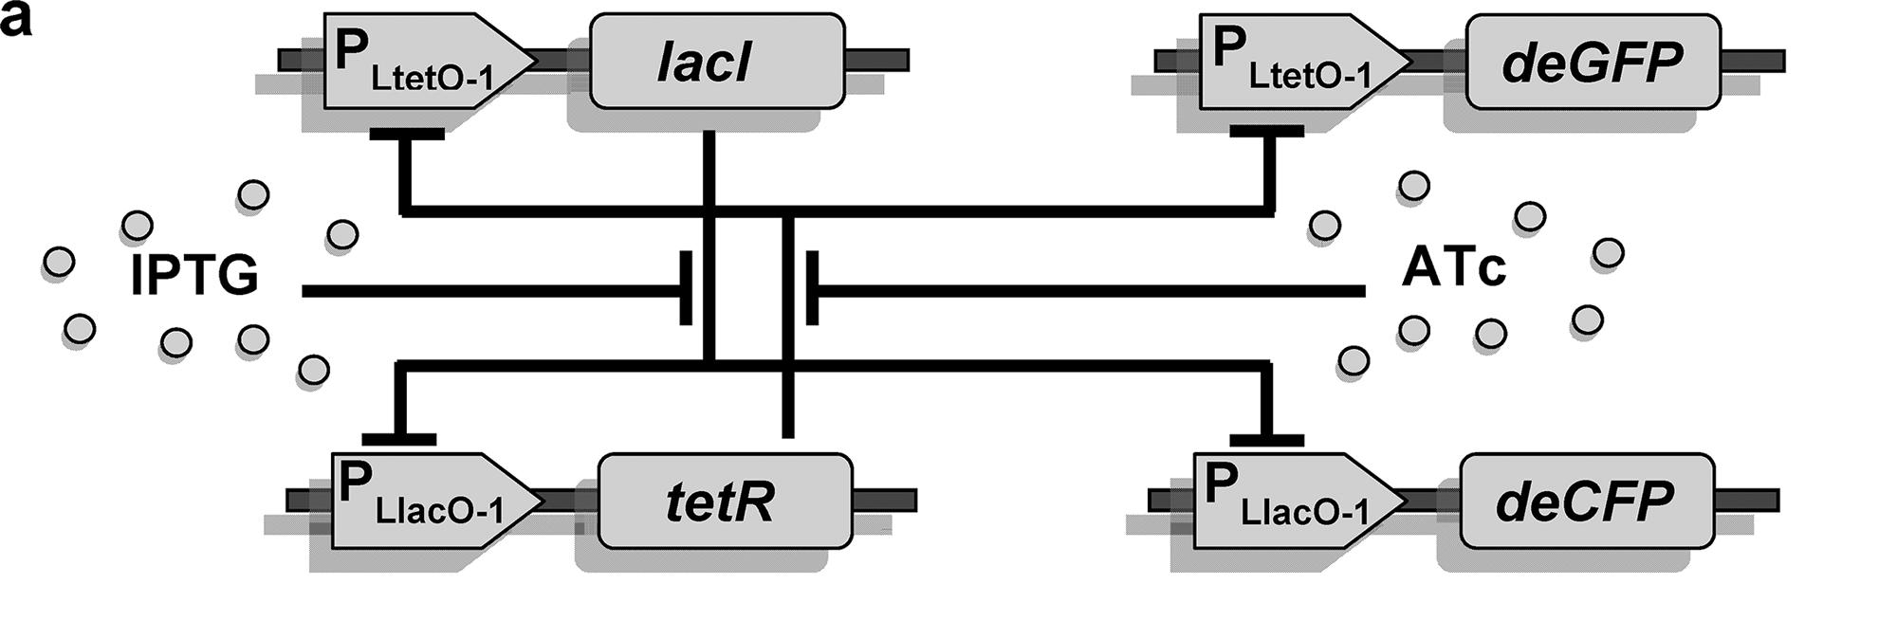
Transcriptional Repression Units
General Repression Unit
Toggle Switch
Inducer Present | Reporter Present
IPTG | deCFP
ATc | deGFP
IPTG + ATc | deCFP + deGFP
None | None
Notes:
Repressor inhibits promoter, inducer inhibits repressor
no inducer = no deGFP
inducer = deGFP

Slide 9
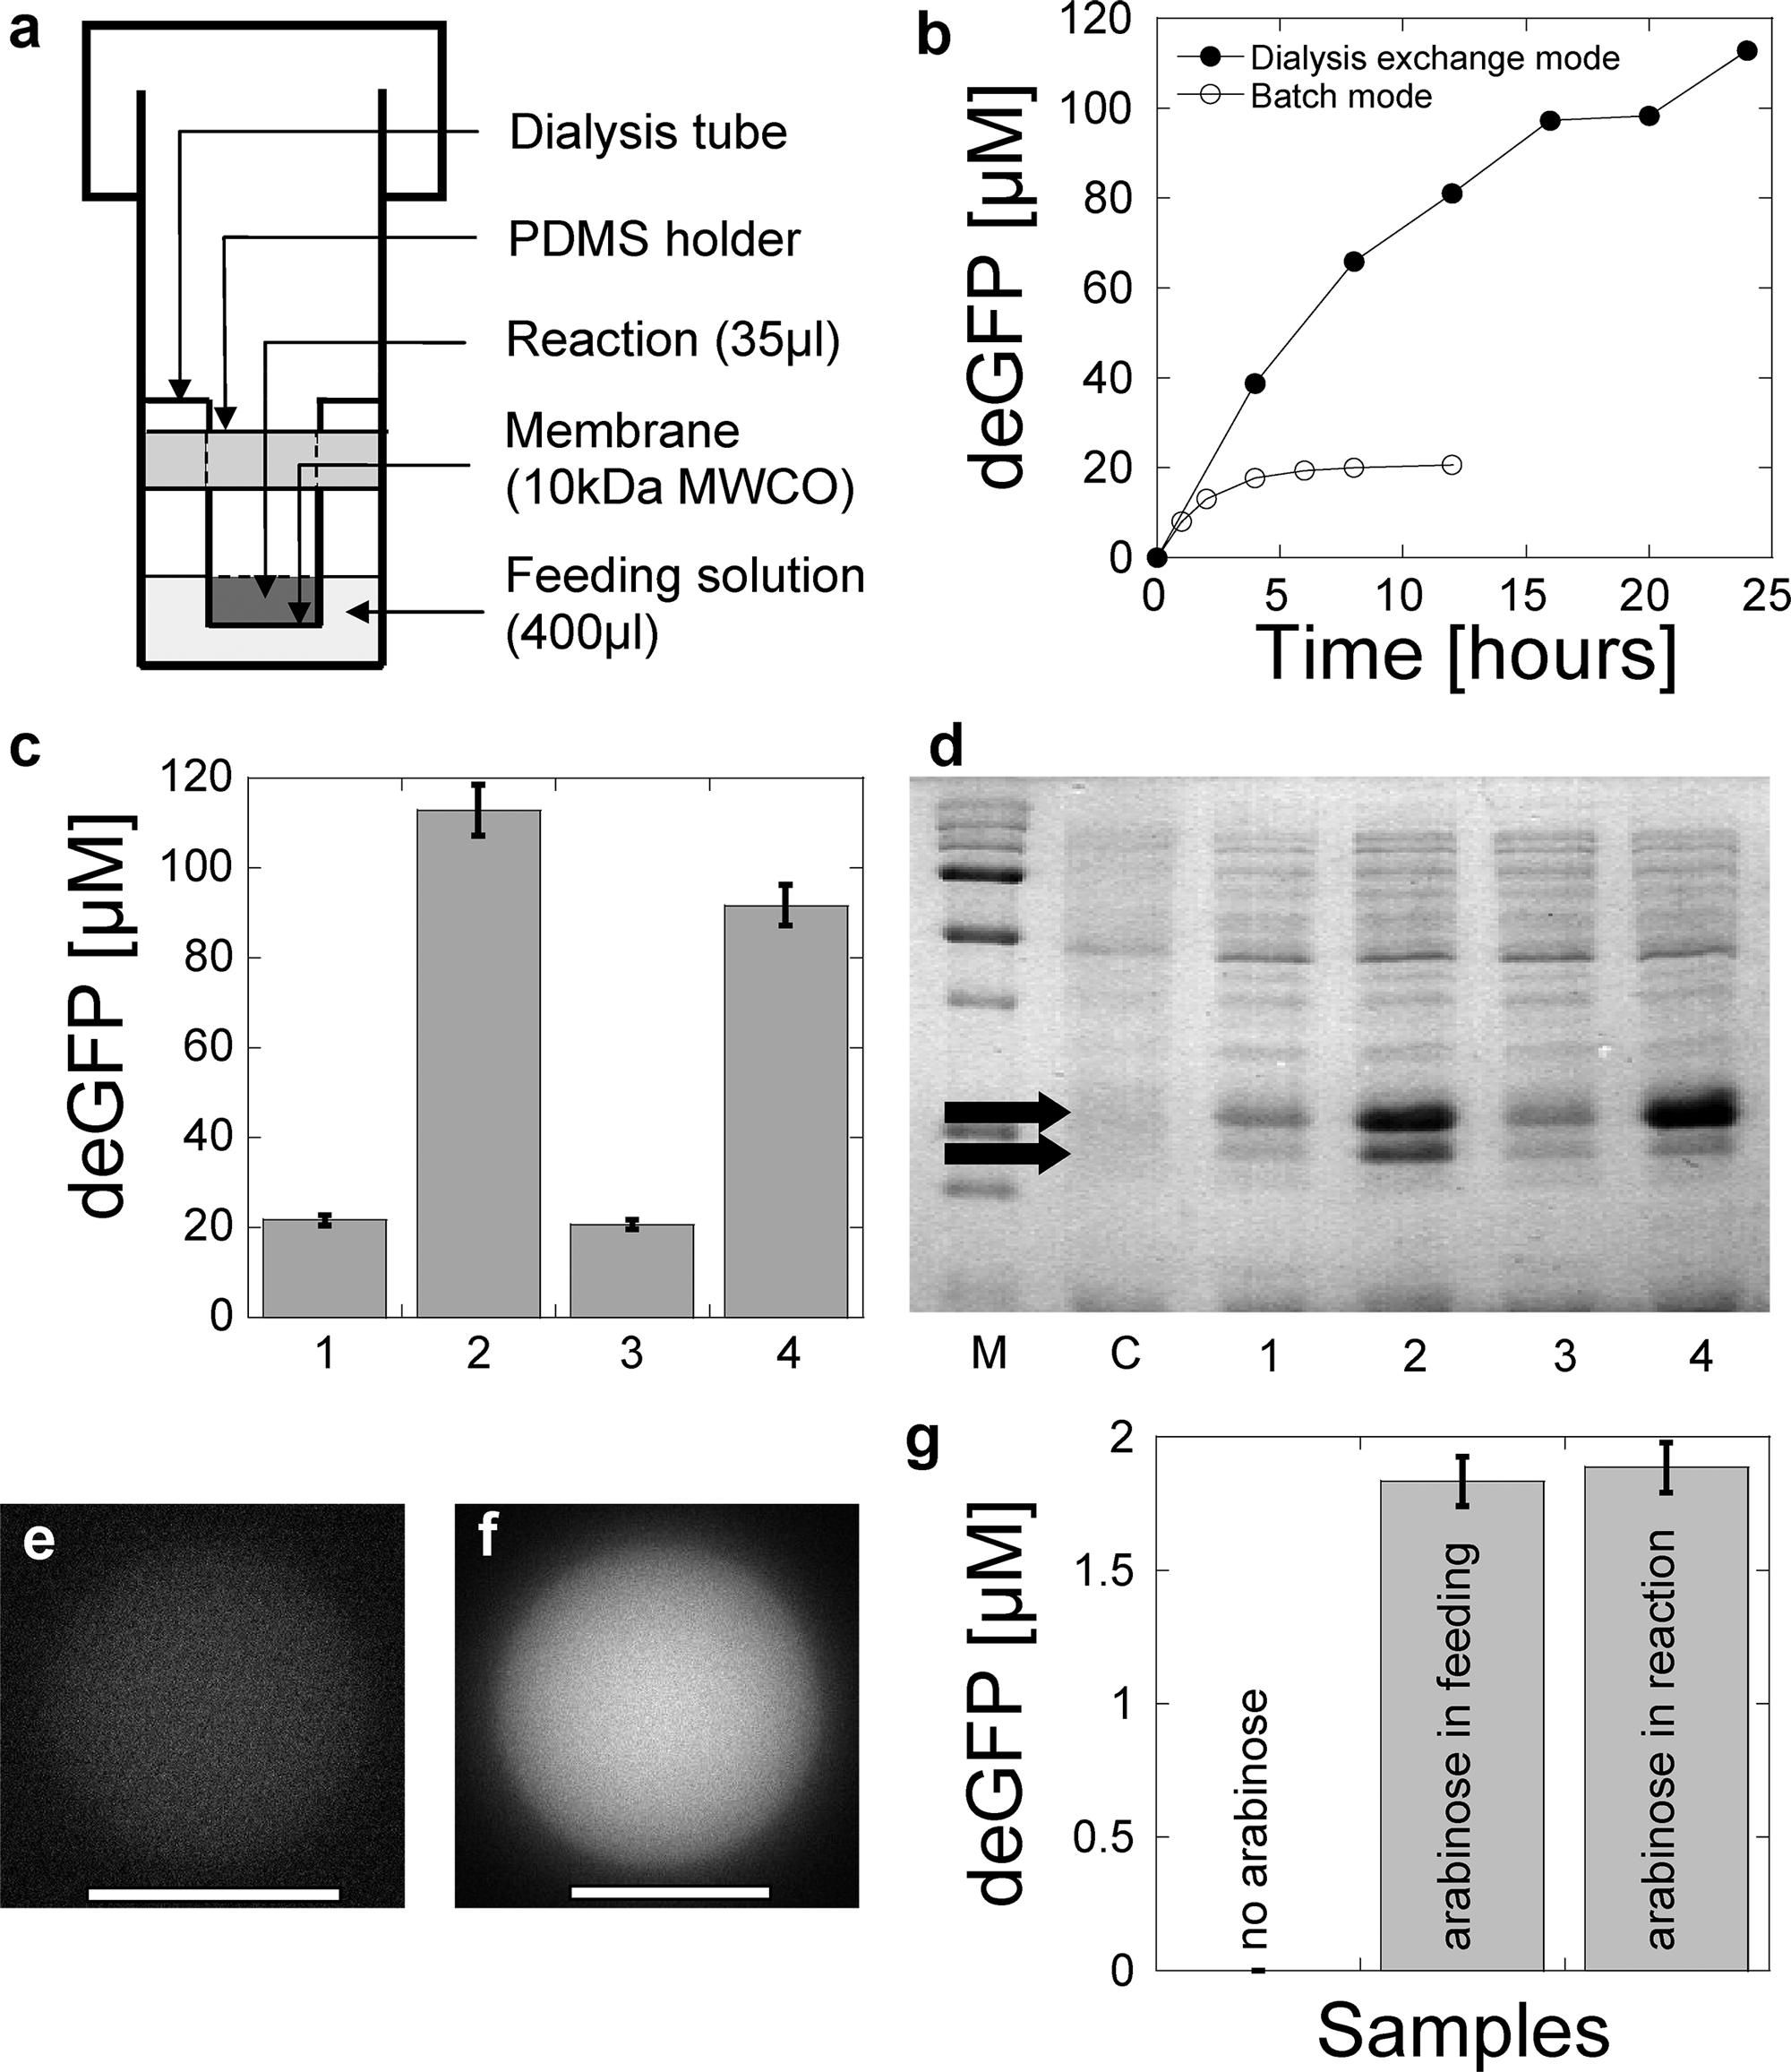
Long-lived Cell-Free Expression
Notes:
a. Dialysis reactor to test cell-free expression
b. Reactor had 4x more deGFP than batch
c. 1 and 2 are p70-GFP, 3 and 4 are cascade (p70-sigma 28 → p28-GFP, 1 & 3 are batch, 2 and 4 are dialysis reactor
d. C is cell-free w/o plasmid, 1-4 see above
e & f. Used a phospholipid vesicle in which to hold the rxn, performed same as test tube (arabinose = GFP, no arabinose = no GFP)

Slide 10
Conclusions
Cell-free toolkit can be made using multiple sigma and transcription factors, rather than more simple previous designs
Genetic circuits, including AND gates, repression units, and series and parallel circuits can be made from this cell-free toolkit
Cell-free expression time can be greatly increased through dialysis reaction
Cell-free expression can occur in phospholipid vesicles

Slide 11
Significance
Provides cell-free systems with greater diversity in expression
Lead to more complicated and fine-tuned circuits
Allows for more stable reactions to occur over longer periods of time
Potential for steady state systems, obtain more of desired product
Creation of artificial cells

Slide 12
Concerns
Didn’t show results of phospholipid vesicle reaction over time
Didn’t incorporate AND gate elements into other parts of the genetic circuit

Slide 13
Questions?

