Slide 1
Ahnert, S. E., & Fink, T. M. A. (2016).
Form and function in gene regulatory networks: the structure of network motifs determines fundamental properties of their dynamical state space.
Journal of The Royal Society Interface, 13(120), 20160179.
Margaret J ONeil
March 30, 2017
Department of Biology, Loyola Marymount University
BIOL-398-05/S17

Slide 2
Outline
Gene regulatory networks can be modeled and visualized in networks called graphs
Boolean networks can be used to study dynamic properties and capabilities of a network
Network motifs can be studied as Boolean functions and categorized based on their dynamical graph topologies
The basin entropy and distinct cycle lengths were used to characterize dynamical space states of motifs
Application to real-world networks suggests that fundamental topological properties of the state space are influencing evolution of regulatory networks

Slide 3
Outline
Gene regulatory networks can be modeled and visualized in networks called graphs
Boolean networks can be used to study dynamic properties and capabilities of a network
Network motifs can be studied as Boolean functions and categorized based on their dynamical graph topologies
The basin entropy and distinct cycle lengths were used to characterize dynamical space states of motifs
Application to real-world networks suggests that fundamental topological properties of the state space are influencing evolution of regulatory networks

Slide 4
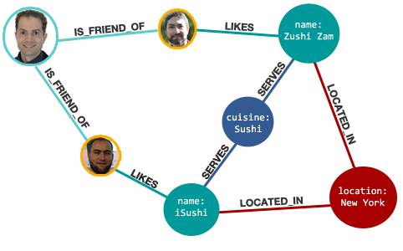
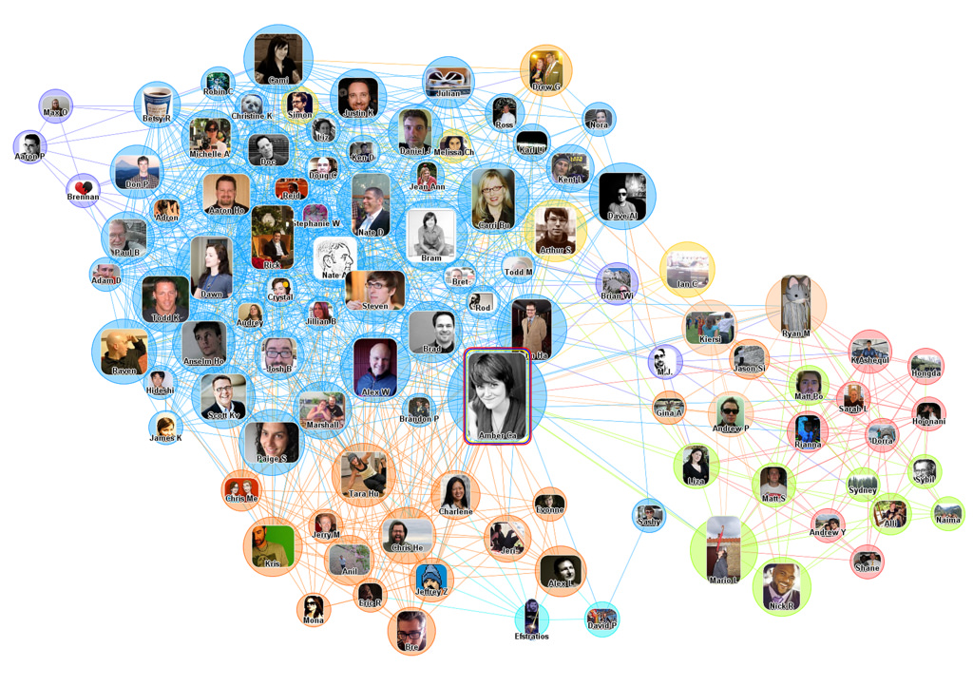
An Introduction to Networks
To better visualize relationships between groups, clusters showing connections between individuals can be created
These are called graphs or networks
Most common form is a social network
Individuals are represented as points called nodes
Connections between individuals are shown as lines called edges

Slide 5
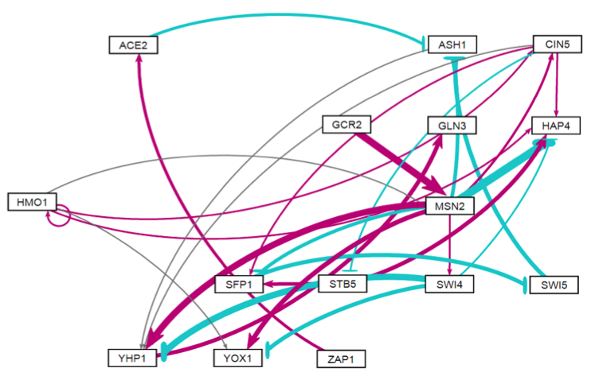
Networks can visualize biological relationships
Gene regulatory networks (GRNs) can be visualized in graphs
Nodes in these GRNs represent genes
Edges represent regulatory relationships between genes
Edges in GRNs are directed
When weights are put on the edges, indicates activation (+) or repression (-)

Slide 6
Outline
Gene regulatory networks can be modeled and visualized in networks called graphs
Boolean networks can be used to study dynamic properties and capabilities of a network
Network motifs can be studied as Boolean functions and categorized based on their dynamical graph topologies
The basin entropy and distinct cycle lengths were used to characterize dynamical space states of motifs
Application to real-world networks suggests that fundamental topological properties of the state space are influencing evolution of regulatory networks

Slide 7
Boolean networks can be used to explore relationships between dynamics, structure, form and function
Network motifs are small subgraphs of directed networks
Feed-forward loops are known to play an important role in gene regulatory networks
A Boolean network is a directed network where each node has a binary state (0 or 1), and each node with input k inputs is associated with a string of 2^{k} bits
This string is called an update step which updates each nodes according to their Boolean function
Authors of this paper note form and function of network motifs hasn’t been found to be related previously
This paper differs from previous work by defining function of motifs in terms of structural properties of their attraction basins

Slide 8
Outline
Gene regulatory networks can be modeled and visualized in networks called graphs
Boolean networks can be used to study dynamic properties and capabilities of a network
Network motifs can be studied as Boolean functions and categorized based on their dynamical graph topologies
The basin entropy and distinct cycle lengths were used to characterize dynamical space states of motifs
Application to real-world networks suggests that fundamental topological properties of the state space are influencing evolution of regulatory networks

Slide 9
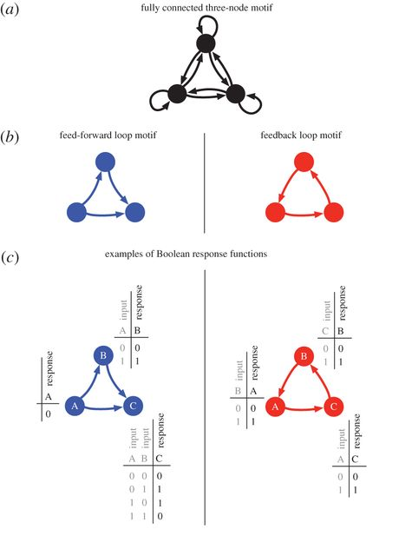
Network motifs can be expressed and measured as Boolean networks

Slide 10
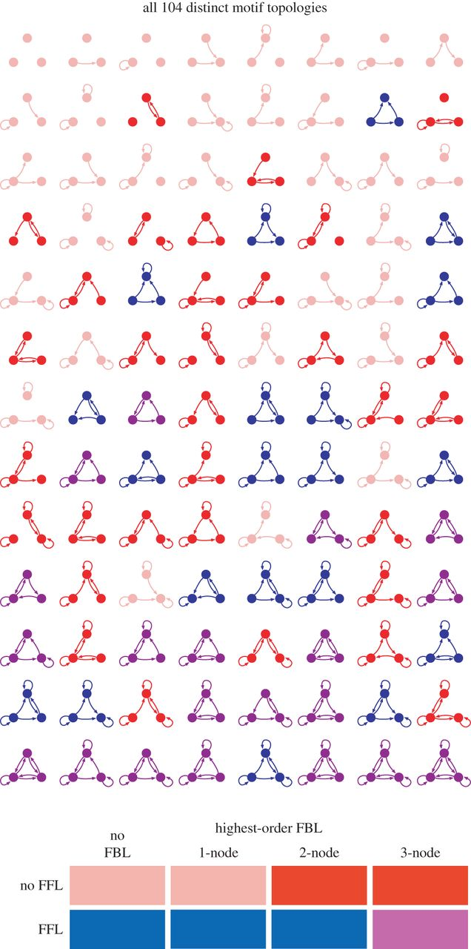
The topologically distinct motifs can be categorized based on number of feedback and feedforward loops
Based on the 3-node motif, there are up to 9 possible edge connections, which results in 512 ways of connecting the nodes
Eliminating repeats, this become 104 distinct ways
Feed-forward loops and feedback loops were counted in each motif
4 categories of motif -
No feed-forward, <2 feedback loops (pink)
No feed-forward, 2-3 feedback loops (red)
Feed-forward, <3 feedback loops (blue)
Feed-forward, 3 feedback loops (purple)

Slide 11
Outline
Gene regulatory networks can be modeled and visualized in networks called graphs
Boolean networks can be used to study dynamic properties and capabilities of a network
Network motifs can be studied as Boolean functions and categorized based on their dynamical graph topologies
The basin entropy and distinct cycle lengths were used to characterize dynamical space states of motifs
Application to real-world networks suggests that fundamental topological properties of the state space are influencing evolution of regulatory networks

Slide 12
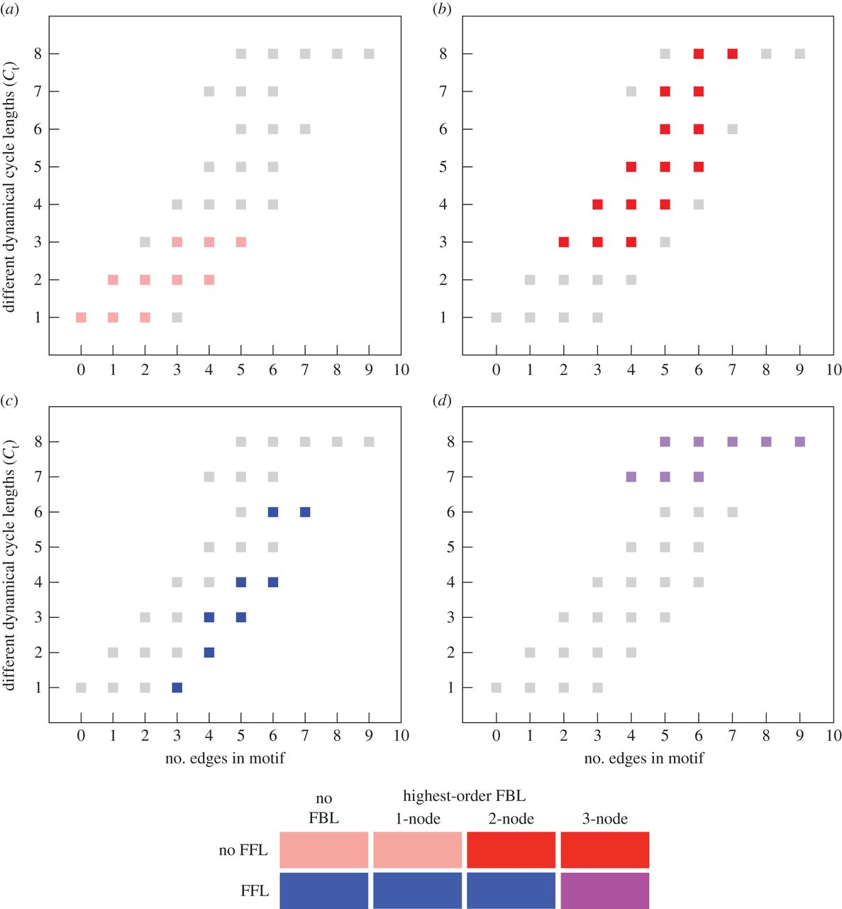
Network categorization shows motifs fall into distinct groups based on their different cycle lengths
Total different cycle lengths were found for each motif
The four graphs show the location of the 4 different categories
Motifs with a feed forward loop but without a 3-node feedback loop show the least cycle diversity
No feed-forward and 2-3 node feedback loops are capable producing different dynamical behaviors

Slide 13
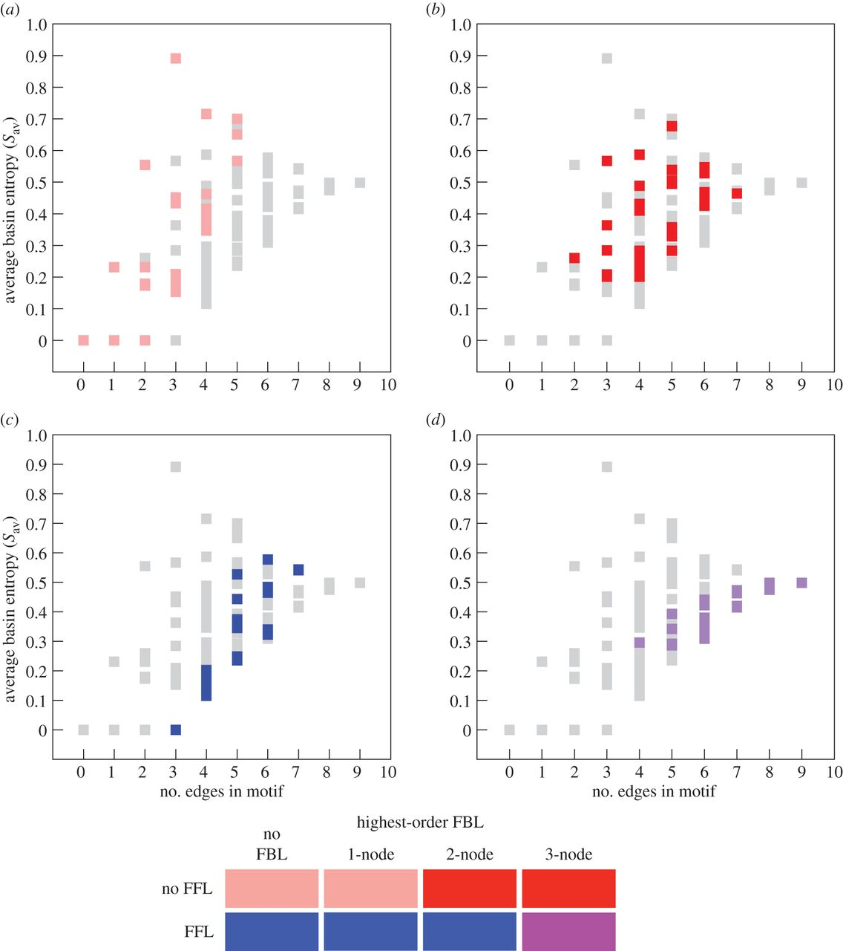
Network categorization shows motifs fall into distinct groups based on their average basin entropy
Average basin entropy measures the fragmentation of the dynamical graphs of a motif
Similar to the cycle lengths, when divided into categories, trends can be seen for each group
Between C and Sav there is strong connection between certain structural characteristics of a motif and its dynamical behaviour.

Slide 14
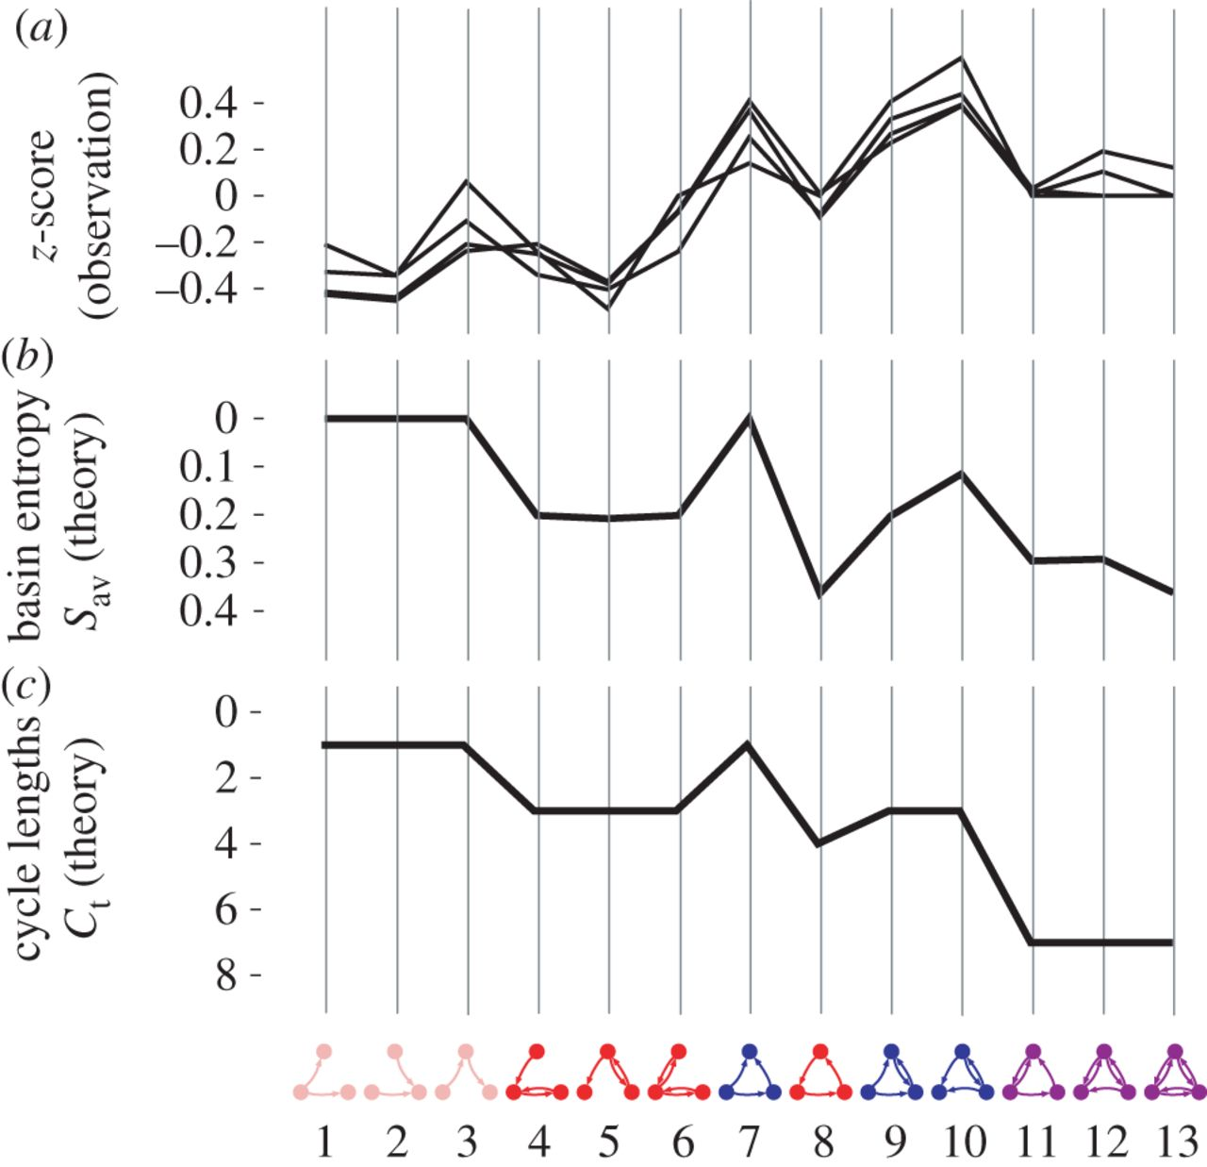
Real-world regulatory and neural networks show the importance of the feed-forward loop
The enrichment profiles for these networks are shown relative to a null model (a)
The values of basin entropy show similar results to Z scores
The total values of different cycle lengths follow a similar pattern to the z-scores and Sav
Both Ct and Sav are shown on an inverted scale

Slide 15
Outline
Gene regulatory networks can be modeled and visualized in networks called graphs
Boolean networks can be used to study dynamic properties and capabilities of a network
Network motifs can be studied as Boolean functions and categorized based on their dynamical graph topologies
The basin entropy and distinct cycle lengths were used to characterize dynamical space states of motifs
Application to real-world networks suggests that fundamental topological properties of the state space are influencing evolution of regulatory networks

Slide 16
Fundamental topological properties of the state-space influence the biological evolution of regulatory networks.
Networks with a two-node feedback loop exhibited different dynamics from those containing a three-node feedback loop
They had more in common with networks that had only a one-node feedback loop or none at all
Feedback loops have been shown to occur in some regulatory networks, but only in small numbers in transcriptional networks
The values of Sav and Ct both show a slight downwards trend (on the inverted scale) with increasing edge number in the motifs, whereas the motif z-scores show a slight upwards trend

Slide 17
Summary
Gene regulatory networks can be modeled and visualized in networks called graphs
Boolean networks can be used to study dynamic properties and capabilities of a network
Network motifs can be studied as Boolean functions and categorized based on their dynamical graph topologies
The basin entropy and distinct cycle lengths were used to characterize dynamical space states of motifs
Application to real-world networks suggests that fundamental topological properties of the state space are influencing evolution of regulatory networks

Slide 18
Acknowledgments
Dr. Dahlquist and Dr. Fitzpatrick for their guidance in this class and on the GRNmap project
Colleagues from BIOL-398-05/S17

Slide 19
References
Ahnert, S. E., & Fink, T. M. A. (2016).
Form and function in gene regulatory networks: the structure of network motifs determines fundamental properties of their dynamical state space. Journal of The Royal Society Interface, 13(120), 20160179. DOI: 10.1098/rsif.2016.0179
Dahlquist, Kam D. (2017) BIOL398-05/S17:Week 10. Retrieved from http://www.openwetware.org/wiki/BIOL398-05/S17:Week_10 on 28 March 2017.

