Slide 1
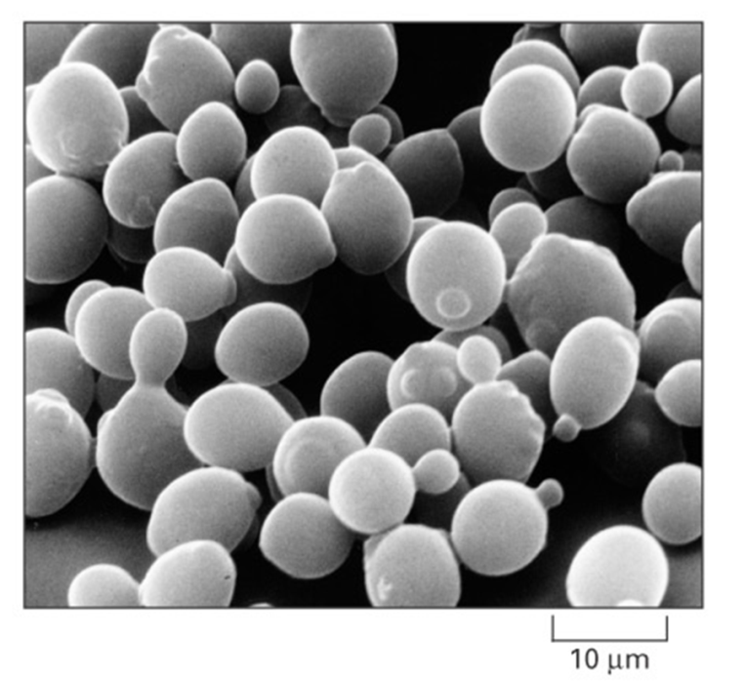
Budding Yeast, Saccharomyces cerevisiae is an Ideal Model Organism for Systems Biology
Budding yeast has a small genome of approximately 6000 genes.
These 6000 genes are regulated by roughly 250 transcription factors.
Deletion strain collections and other molecular genetic tools are readily available.
Alberts et al. (2004)

Slide 2
Cold Shock Is an Environmental Stress that Is Not Well-Studied
Heat shock
Cold shock
  response less well-characterized
  decrease fluidity of membranes
  stabilize DNA and RNA secondary structures
  impair ribosome function and protein synthesis
  decrease enzymatic activities
  no equivalent set of cold shock proteins that are conserved in
  all organisms
  response very well-characterized
  proteins denature due to heat
  induction of heat shock proteins (chaperonins), that assist in protein folding
  conserved in all organisms (prokaryotes, eukaryotes)

Slide 3
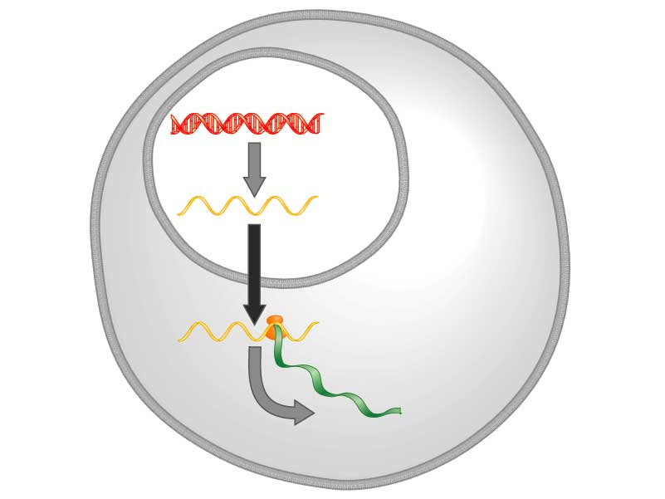
Yeast Respond to Cold Shock by Changing Gene Expression
DNA
Transcription
mRNA
Translation
Protein
Freeman (2003)
Notes:
Figure: 11.6
Caption:
In the cells of some organisms, DNA is found only in a membrane-bound structure called the nucleus. In these cells, proteins are manufactured outside the nucleus. Biologists proposed that the information coded in DNA is carried from inside the nucleus to ribosomes outside the nucleus by a molecule called messenger RNA (mRNA). Question: Why was the choice of the term messenger appropriate?

Slide 4
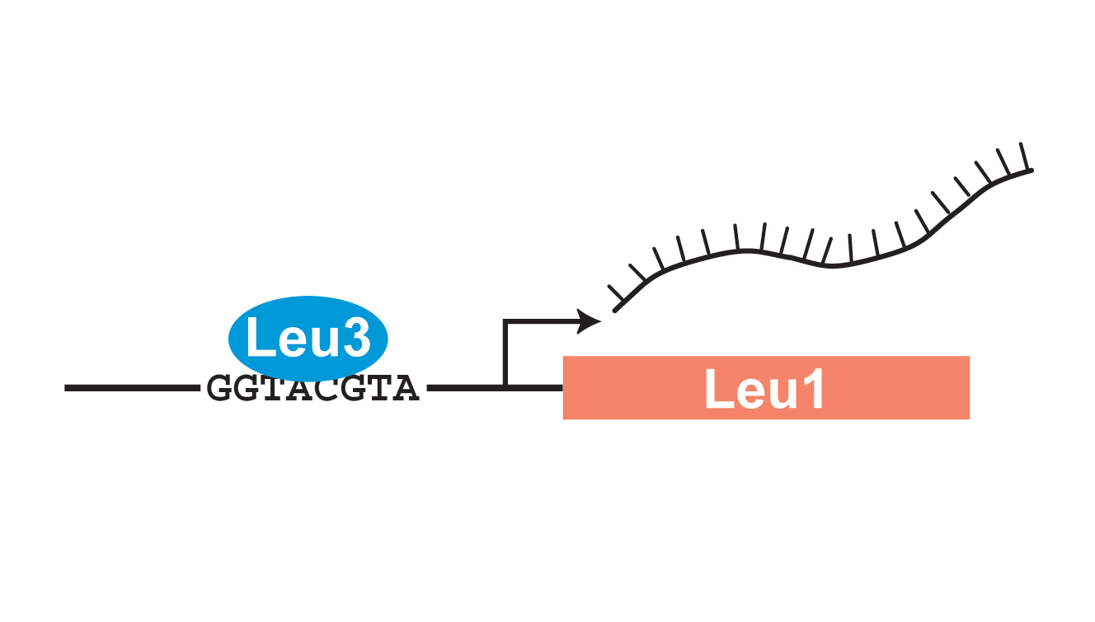
Transcription Factors Control Gene Expression by Binding to Regulatory DNA Sequences
Activators increase gene expression
Repressors decrease gene expression
Transcription factors are themselves proteins that are encoded by genes

Slide 5
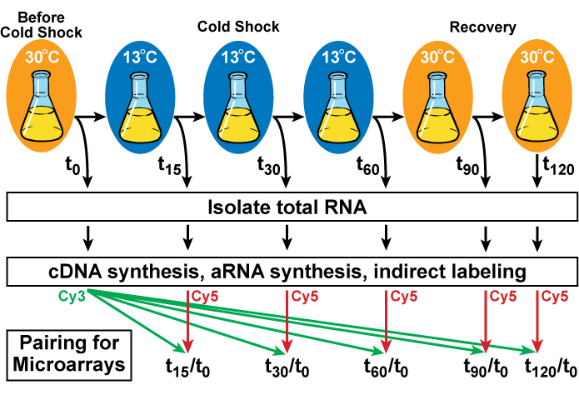
Yeast Cells Deleted for a Particular
Transcription Factor are Harvested Before,
During and After Cold Shock and Recovery

Slide 6
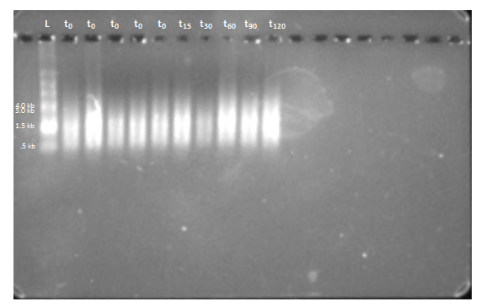
Gel Electrophoresis Can be Used to Show the High Quality of Purified aRNA Samples
Gel Electrophoresis Results for ∆yap1, Flask 4 aRNA
aRNA shows up as a smear because it is derived from genes of different lengths.

Slide 7
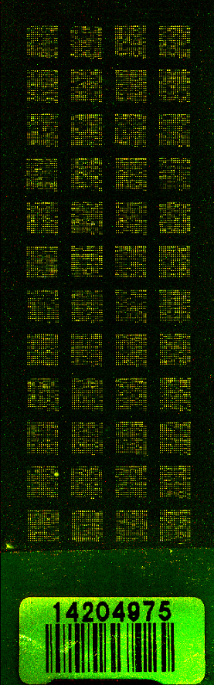
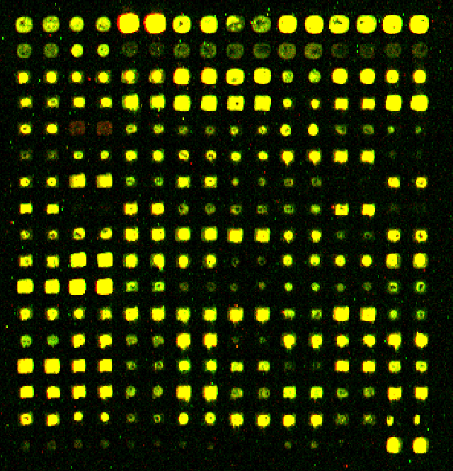
DNA Microarray Results Show Changes in Expression of Individual Genes
Each spot contains DNA from one gene, which hybridizes to the fluorescently-labelled aRNA.
Red spots indicate an increase in gene expression relative to the control (t₀).
Green spots indicate a decrease in gene expression relative to the control (t₀).
Yellow spots indicate no change in expression.
Δyap1, replicate 1, 06/23/15

Slide 8
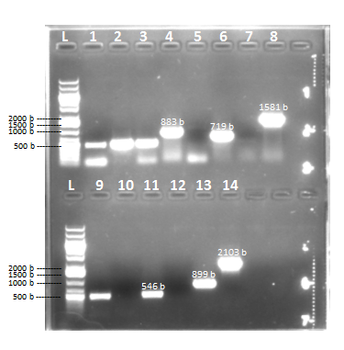
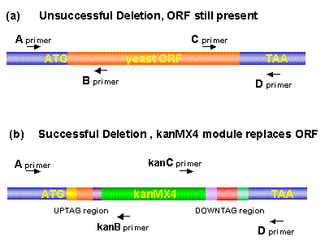
Genotype of Strains Confirmed by PCR and DNA Sequencing
The mutant strains genotyped include: Δnrg1, Δphd1, Δrsf2, Δrtg3, Δyhp1, Δyox1
Genotyping of ∆yhp1 by Colony PCR

Slide 9
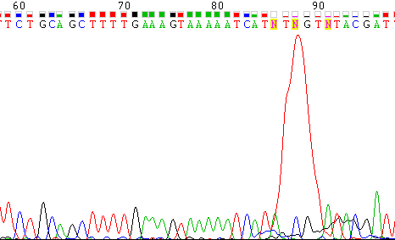
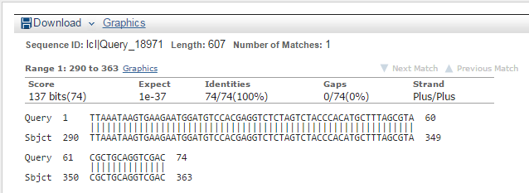
Genotype of Strains Confirmed by PCR and DNA Sequencing
Sequencing data for Δnrg1 A-kanB Primer A
BLAST Alignment for Δrtg3 A-kanB Primer A

Slide 10
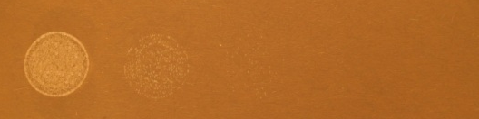
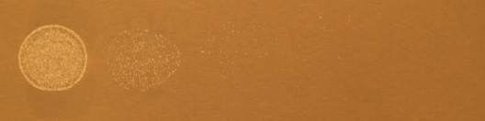
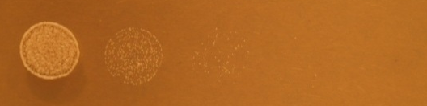
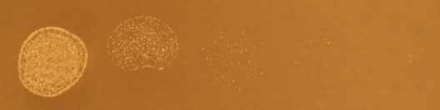
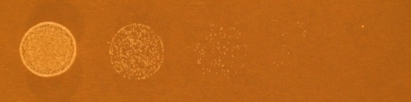
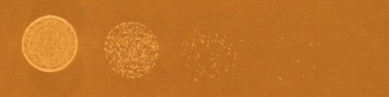
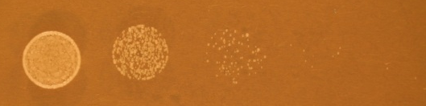
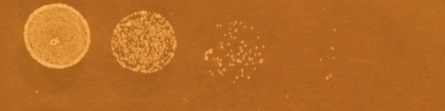
Δphd1 is Impaired for Growth at All Temperatures
Δphd1
wild-type
15ºC
day 4
20ºC
day 3
30ºC
day 1
37ºC
day 1

