Slide 1
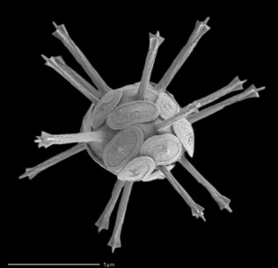
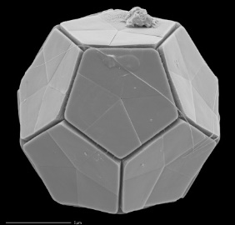
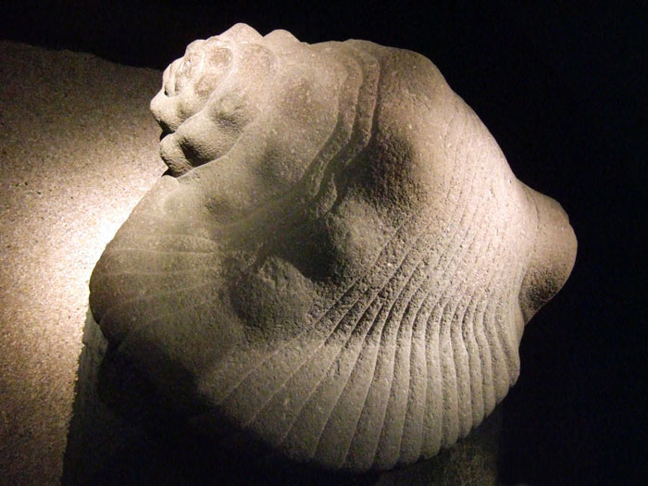

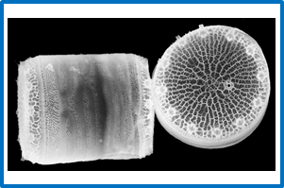
Oceans are full of unicellular artists
Man-made stone sculpture of a marine shell.
Microscopic shells (biominerals) naturally sculpted by marine microorganisms.
Source.
Marine microorganisms use biomolecules such as proteins instead of a chisel and a hammer to sculpt their mineral shells.

Slide 2
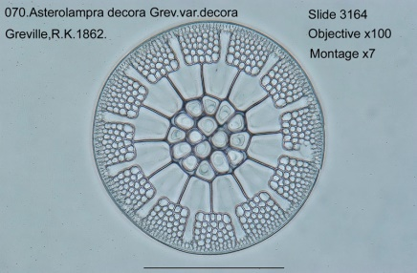
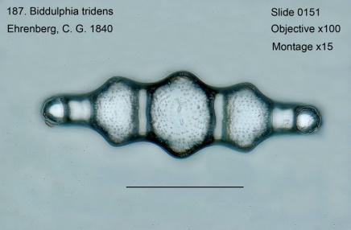
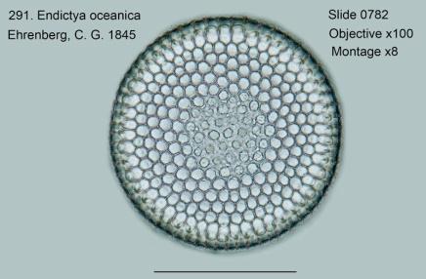
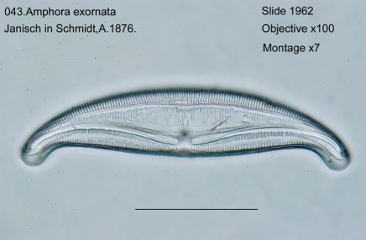
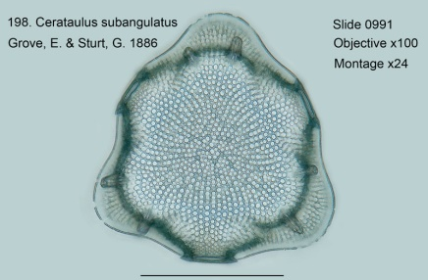
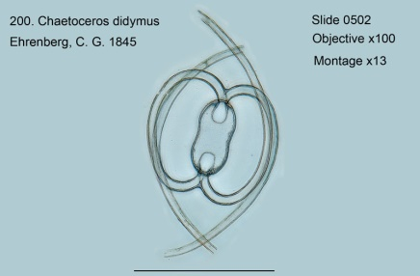
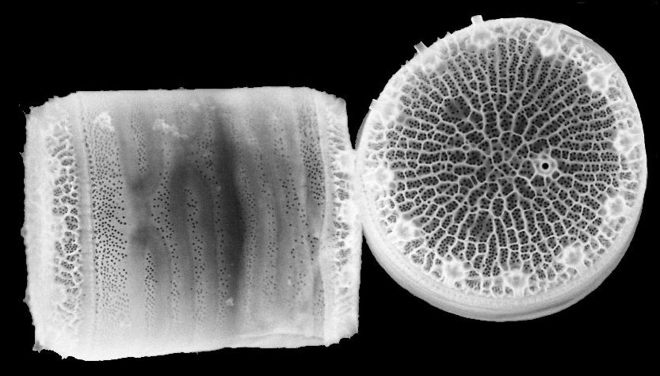
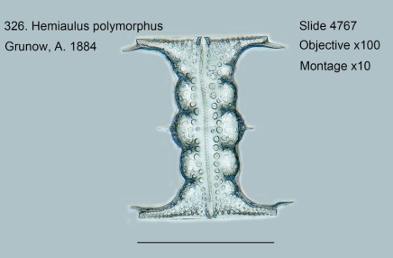
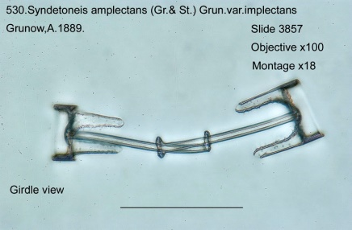
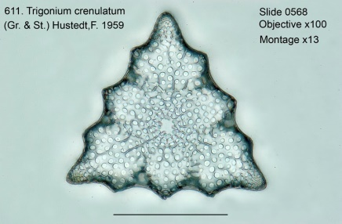
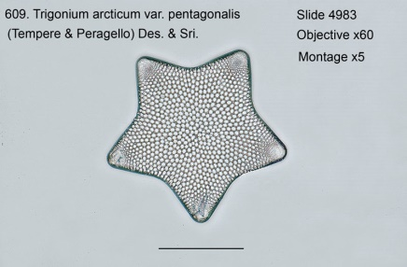
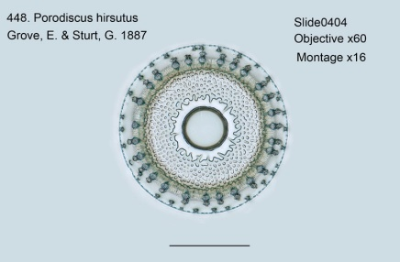
Diatoms: Nature’s Nanotechnologists
What are the proteins responsible for this
diversity of shapes and patterns?

Slide 3


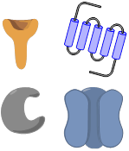

Silver Lab is using genetic engineering
to reveal my secrets.
Dylan Diatom a.k.a. DD
Step 1
DD is genetically modified.
Step 2
Important shell-related
proteins in DD are identified.
Step 3
Materials with defined shape
and pattern can be made.

