Slide 1
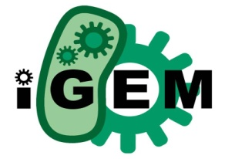

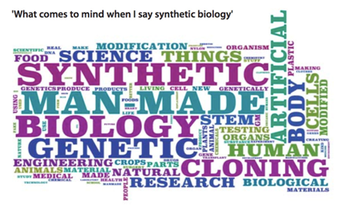
Key Concepts of Synthetic Biology & The Central Dogma
IGEM Presentation 1
7th July 09
Dineka Khurmi
James magA Field

Slide 2
Synthetic Biology
Last century & SB potential
US leads with:
- $16m funding of SynBERC (UC Berkeley)
- Bill & Melinda Gates Foundation $43m investment
- $500m Energy Biosciences Institute
SB development over the last few years due to:
- advances in biology, genetics & genome sequencing
- coupled to vast increase in the speed & storage capacity of computers & internet.
- researchers understanding of living organisms (at all levels)

Slide 3
What is Synthetic Biology?
“The design and fabrication of biological components and systems that do not already exist in the natural world”
“The re-design and fabrication of existing biological systems”
Definition:
- maintains level of simplicity
- expresses key aspects of SB
- consistent with the views of most researchers in the field
SB strives to make the engineering of biology easier & more predictable.

Slide 4
What is Synthetic Biology?
The Driving Concepts
To enable the systematic engineering of biology
To promote the open and transparent development of tools for engineering biology
And to help construct a community that can productively apply biological technology

Slide 5
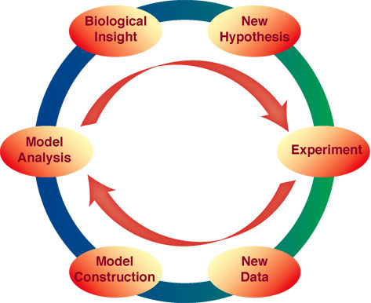
Systems Biology & Components
Systems biology has 3 components:
Experimentation
Computation
Theory
The application of genome-scale measurement technologies to construct computational & mathematical models of cells
The essence of systems biology is the quantization & dynamics on whole genome scale (systems level)

Slide 6
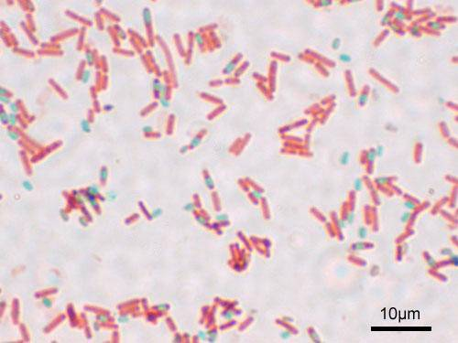
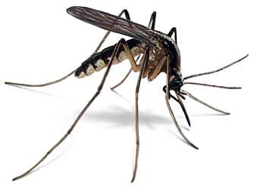
Four Main Approaches to SB
Bottom Up
Metabolic Engineering
Chassis
Engineering Approach - Parts, Devices & Systems

Slide 7
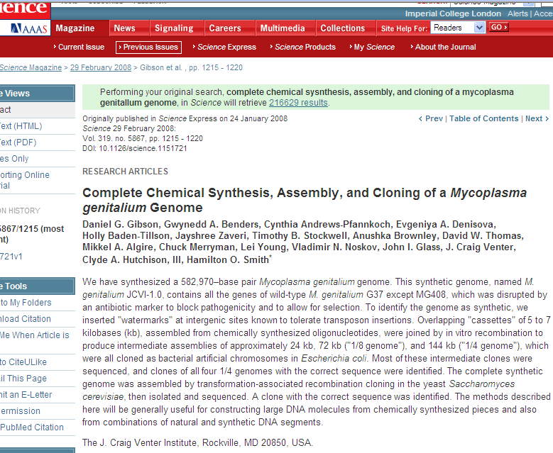
1. Bottom Up Approach
Lower organisational levels used to explain higher levels
Problem: little room left for higher level feedback
Physics - quark
Biology - gene
Eg: Complete Chemical Synthesis, Assembly and Cloning of a Mycoplasma genitalium Genome

Slide 8
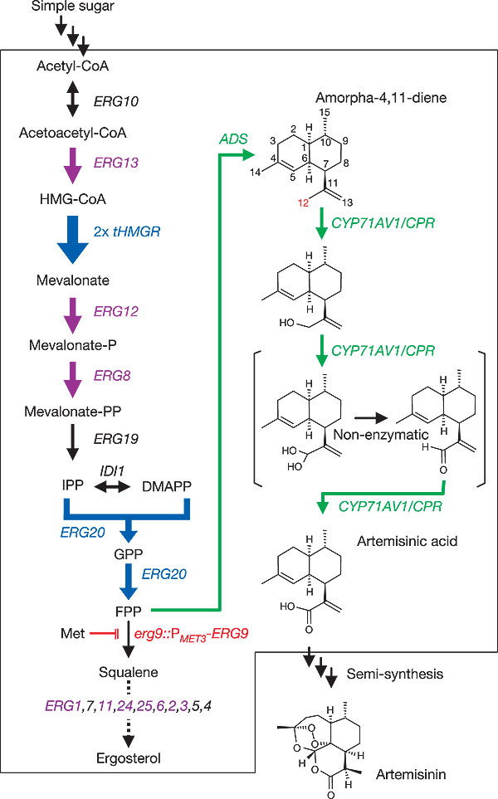
2. Metabolic Engineering
Jay Keasling
Artemisinin
Malaria

Slide 9
3. Chassis
Natural chassis
E. Coli
B. Subtilis
Mycoplasma
Yeast
Minimal Cells
Achieving control

Slide 10
Opportunities
Biotechnology: Re-programming cells for bio-catalysis (pharmaceuticals, fine chemicals, bio-fuels)
Environment: Re-programming regulation; engineering microbial communities, biodegradation, etc.
Biomedicine: Re-programming stem cells, smart delivery of chemicals/antimicrobials, cancer therapy
Plants: re-programming plants for antibiotic production, food production
Biosensors: toxins, pollutants etc.

Slide 11



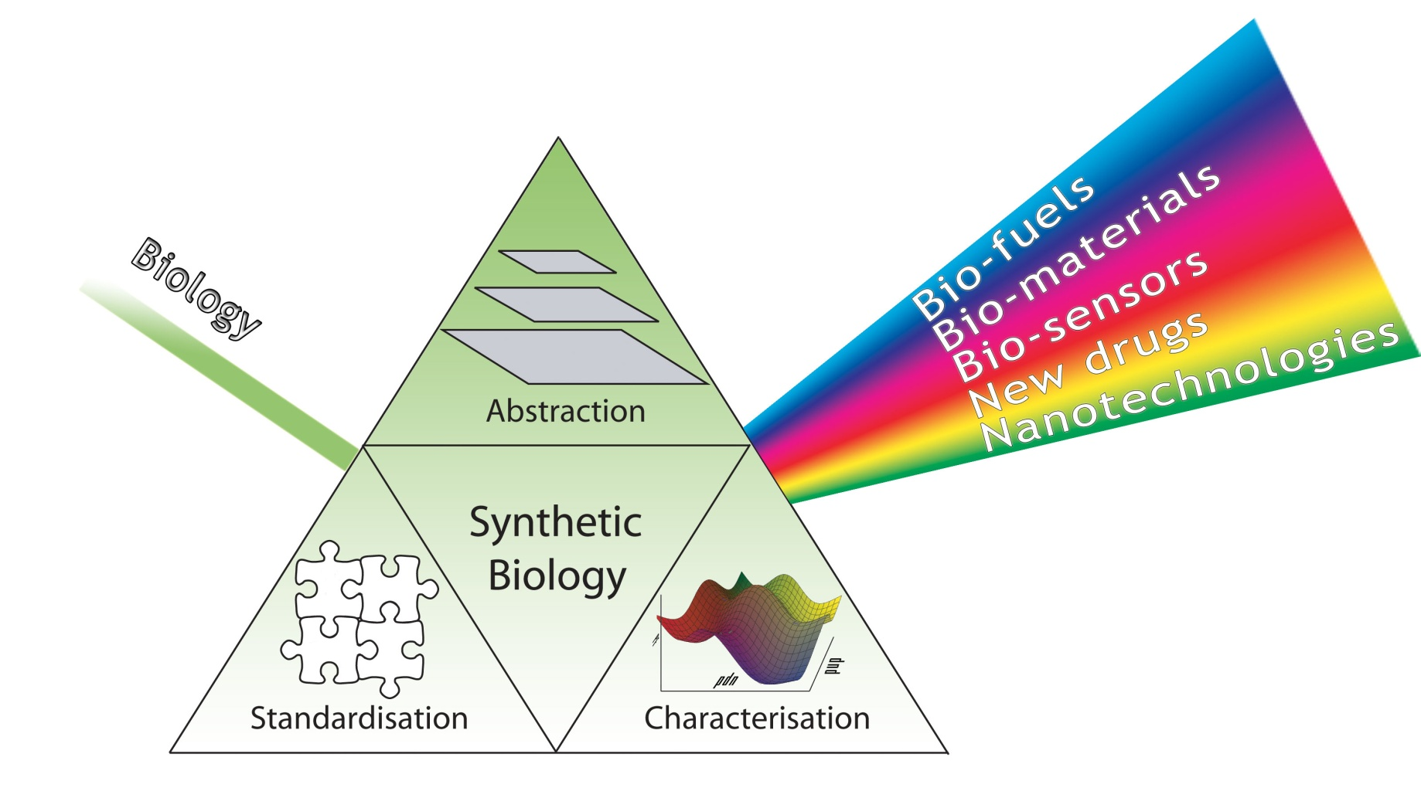
4. Engineers Approach to SB
Standard
Interchangeable
Parts
Abstraction
Standardisation
Quality Control

Slide 12
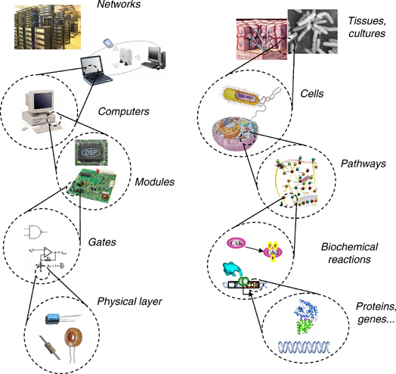





4. Engineers Approach to SB
Break down
complexity
Modularity
Inputs / Outputs
Abstraction
Hierarchy
Decoupling
Abstraction
Layer
Andrianantoandro et al, 2006

Slide 13
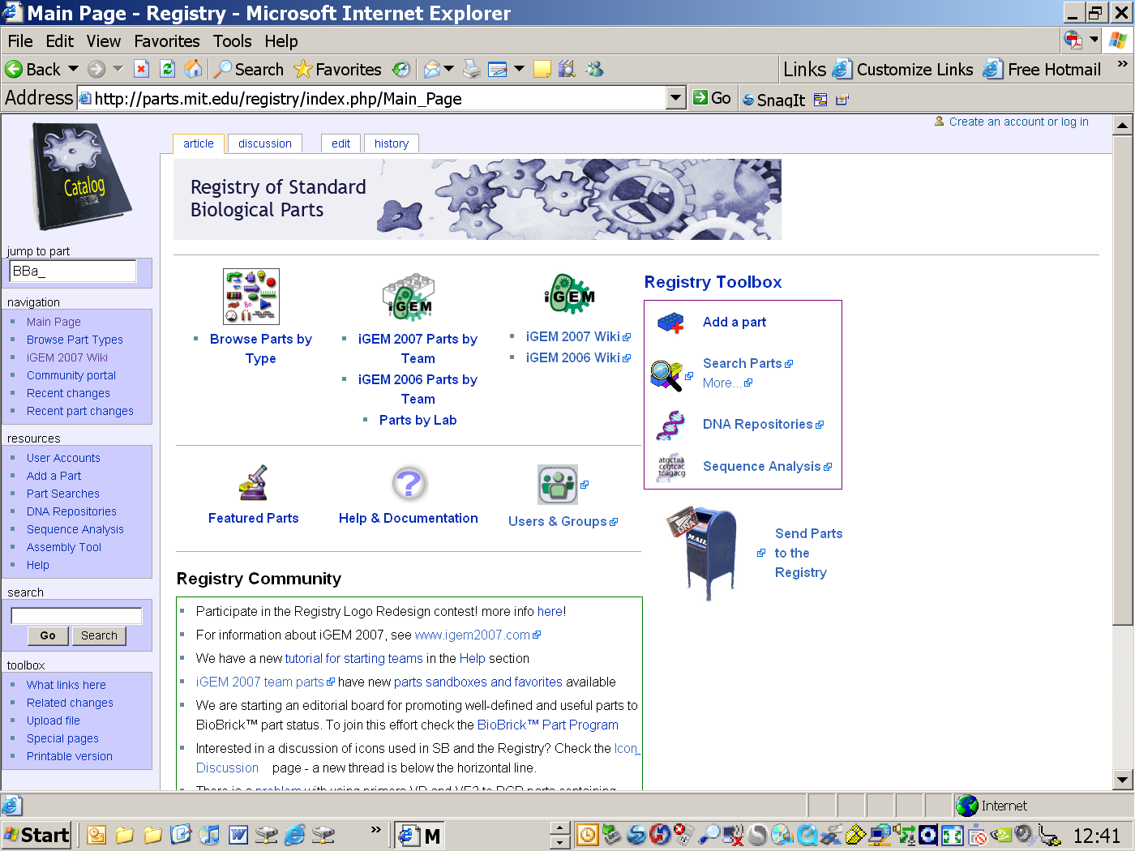
4. Engineers Approach to SB
Standard Parts – encode biological functions (eg. modified DNA)
Standard Devices – made from a collection of parts & encode human defined functions (eg. logic gates)
Standard Systems – perform tasks (eg. counting)
But, to achieve this you need:
Reliability
Robustness
Quality Control

Slide 14
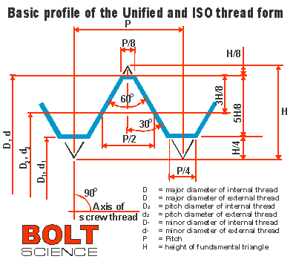
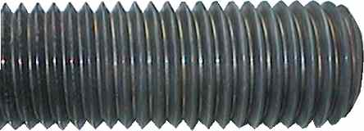


Standardisation
Uniform and agreed
Inter-operability
Re-usability
Economic Benefits

Slide 15
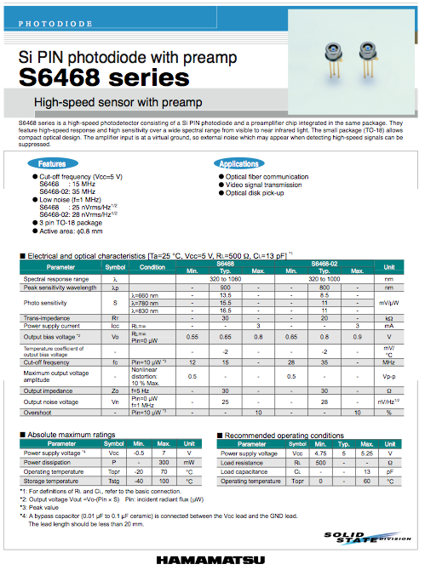
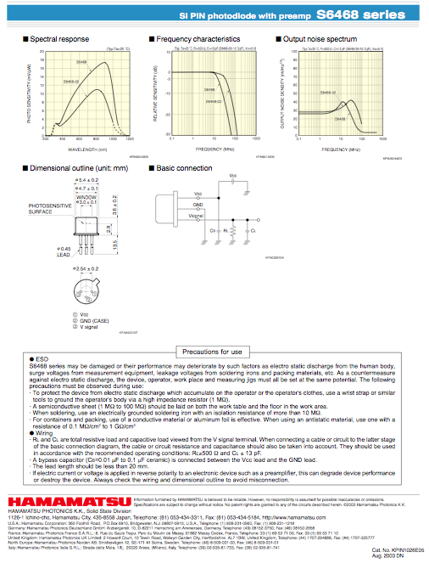
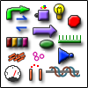




Quality Control
Registry of
Standard Biological Parts
Specification Sheet
Characterisation
under Standard Conditions
Tolerances / Reliability
Trust

Slide 16
The IGEM Perspective
Can simple biological systems be built from standard, interchangeable parts & operated in living cells?
How will parts function when brought together?
Or is biology simply too complicated to be engineered in this way?

Slide 17
Social, Ethical & Legal Issues
Bio-security
Regulations and policy
Intellectual property versus open source
Public engagement (GM debate)
Ethics
BBSRC report June 08 “Synthetic Biology – social and ethical challenges”
(www.bbsrc.ac.uk/organisation/policies/reviews/scientific_areas 0806_synthetic_biology.pdf)

Slide 18
Key Concepts of Synthetic Biology & The Central Dogma
IGEM Presentation 1
7th July 09
Dineka Khurmi
James magA Field

Slide 19
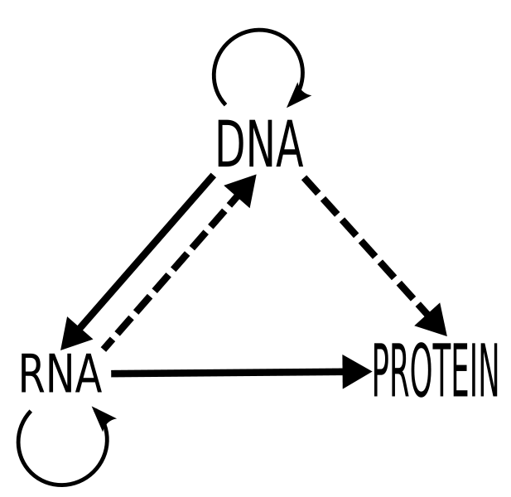
Regulation WHEN & HOW MUCH
Transcriptional control
Translational control

Slide 20
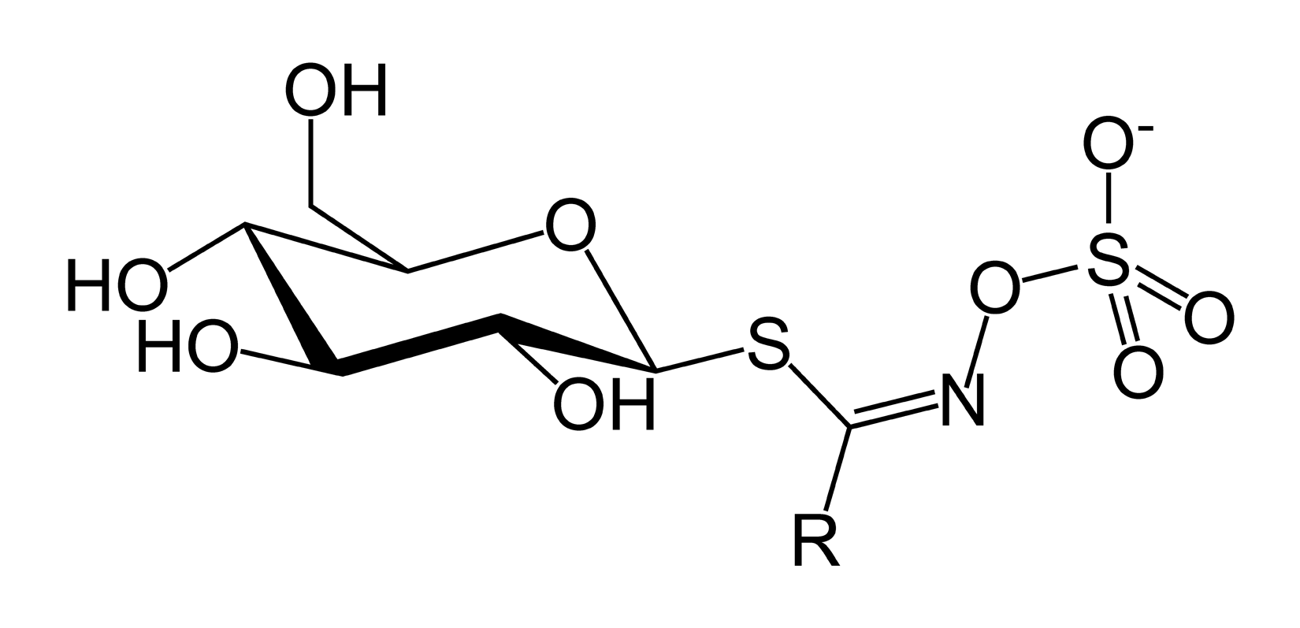
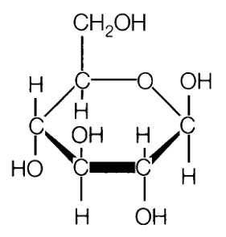
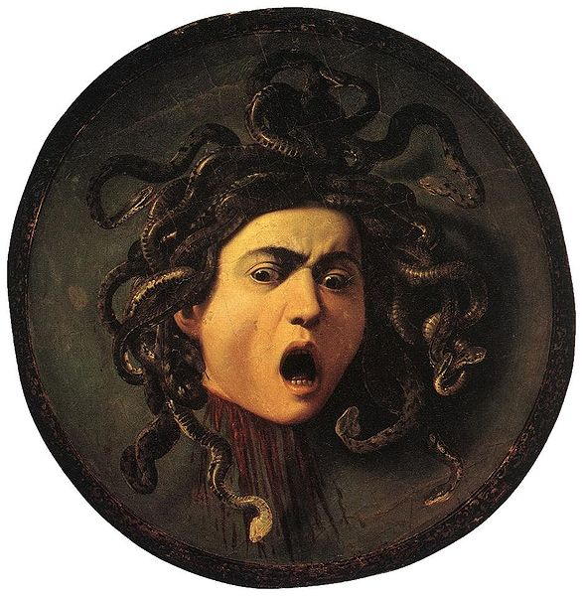
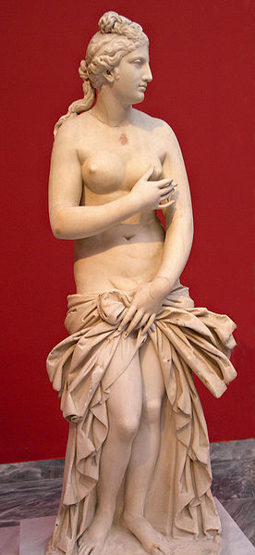
Why Regulate?
OR

Slide 21
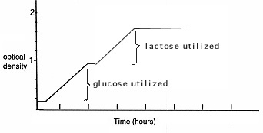
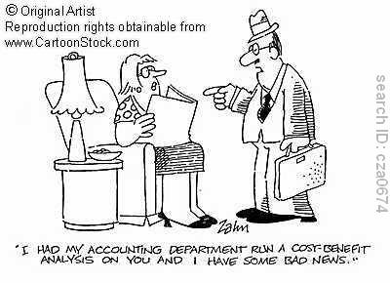

Slide 22
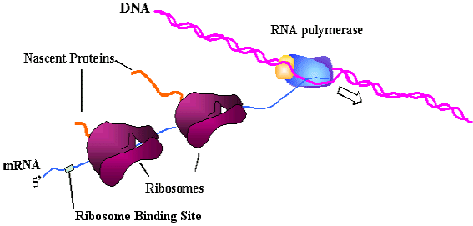
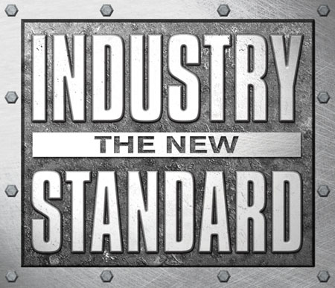
Gene Expression in Prokaryotes

Slide 23
PoPS & RiPS
Following the Registry, PoPS can be defined as the quantity of RNA polymerases that
passes a defined point on the DNA per time with unit molars per second (M/s).
An analogous definition is valid for RiPS.
FaPS are the quantity of transcription factors (activators or repressors) produced per
second inside their corresponding coding regions.
SiPS represent the amount of environmental signals (inducers or corepressors) that enters
the cell per time unit.
Thus, every flux is just a derivative of a concentration with respect to time so that it is
straightforward to integrate it into an ODE-based model.

Slide 24
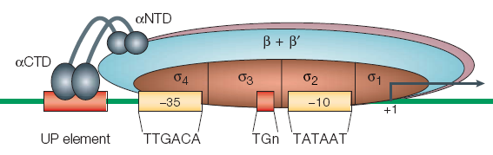
RNA Polymerase
Transcription
Regulation of initiation:
Sigma factors
Small ligands
Transcription factors
DNA Packaging

Slide 25
Sigma Factors
Element | Tinkering
σ factor | When: Match promoter with appropriate σ factor. How Much: Increase promoter affinity for σ factor. Reduce number of competing σ factors. Increase σ factor expression. Reduce anti σ factor expression. Increase anti anti σ factor expression.

Slide 26
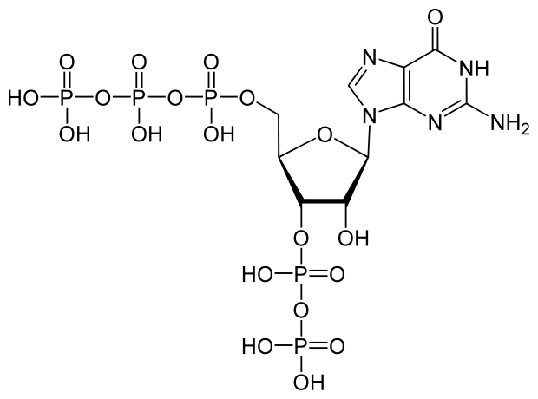
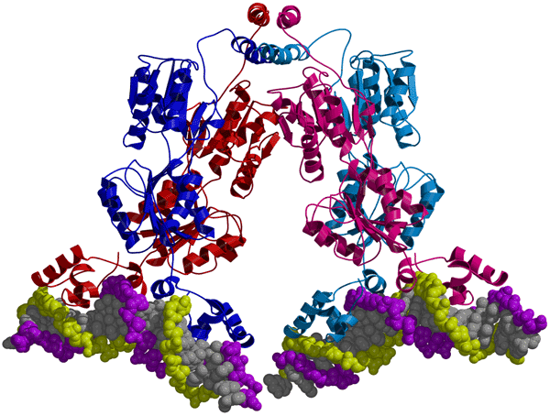
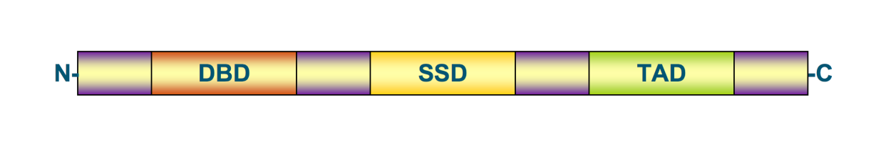
Local or Global
Global = ppGpp
Local = Modular transcription factor
Notes:
(p)ppGpp, guanosine pentaphosphate or tetraphosphate is an alarmone which is involved in the stringent response in bacteria, causing the inhibition of RNA synthesis when there is a shortage of amino acids present. This causes translation to decrease and the amino acids present are therefore conserved. (p)ppGpp is an effector molecule which is produced as a result of amino acid starvation within a bacterial cell.
(p)ppGpp is created via pppGppp synthase, also known as RelA, and is converted from pppGpp to ppGpp via pppGpp phosphohydrolase. Rel A is associated with about every one in two hundred ribosomes and it becomes activated when an uncharged Transfer RNA (tRNA) molecule enters the A site of the ribosome, due to the shortage of amino acid required by the tRNA. If a mutant bacterium is relA- it is said to be relaxed and no regulation of RNA production due to amino acid absence is seen.
Targets of (p)ppGpp include rRNA operons, of which there are 7, all of which have 2 promoters. when (p)ppGpp associates with the promoter it stops the RNA polymerase enzyme from being able to bind and initiate transcription. It is thought that (p)ppGpp may affect the stability of the open complex of the RNA polymerase and DNA or it may affect promoter clearance. Its presence also leads to an increase in pausing during elongation and it competes with nucleoside triphosphate substrates.
When the amino acid balance in the cell is restored, (p)ppGpp is hydrolysed by SpoT.

Slide 27

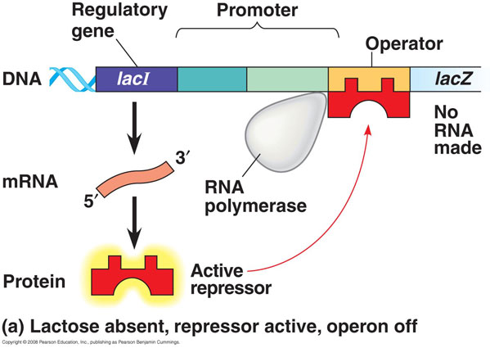
Transcriptional Control

Slide 28
Translational control
Codon bias
mRNA secondary structure….riboswitch
mRNA halflife
mRNA binding proteins

Slide 29
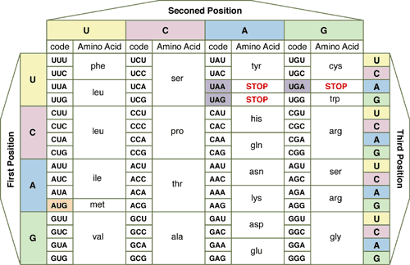

Slide 30
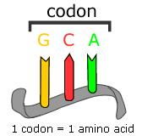
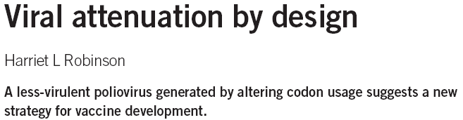
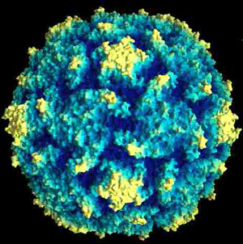
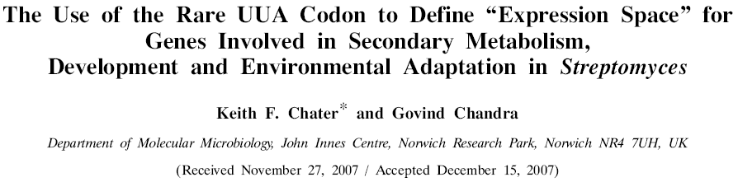
Plug & Play? Codon Bias

Slide 31
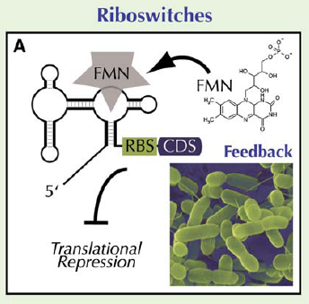

Riboswitch
Aptamer
Expression platform
FMN = flavin mononucleotide
Notes:
Expression platforms include:
The formation of rho-independent transcription termination hairpins.
Folding in such a way as to sequester the ribosome-binding site, thereby blocking translation.
3) Self-cleavage (i.e. the riboswitch contains a ribozyme that cleaves itself in the presence of sufficient concentrations of its metabolite)
4) Folding in such a way as to affect the splicing of the pre-mRNA.

Slide 32
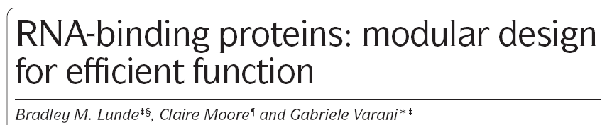
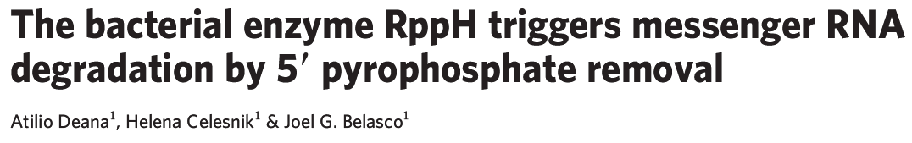
Translational Control
RNA-binding proteins
Highly modular structures with multiple repeats of a few basic domains.
Domain cooperativity not additive but determined by length of linker.
RNA stability & RNAi
Notes:
http://www.nature.com/nature/journal/v451/n7176/full/nature06475.html

Slide 33
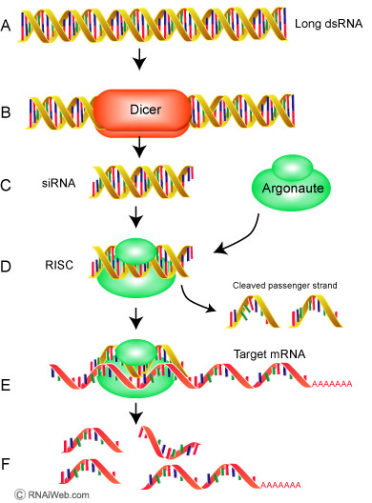
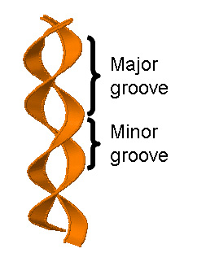
RNAi
Translational Control cont.
DNA

Slide 34

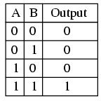
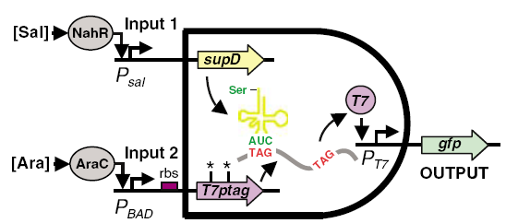
Boolean Logic

Slide 35
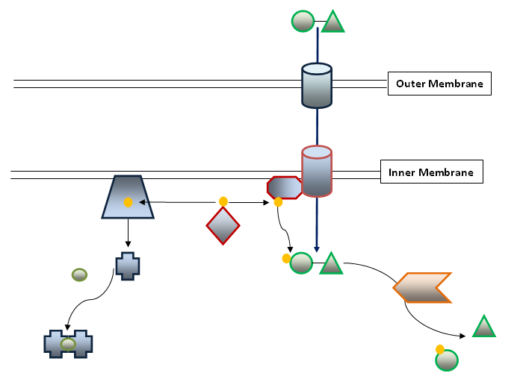
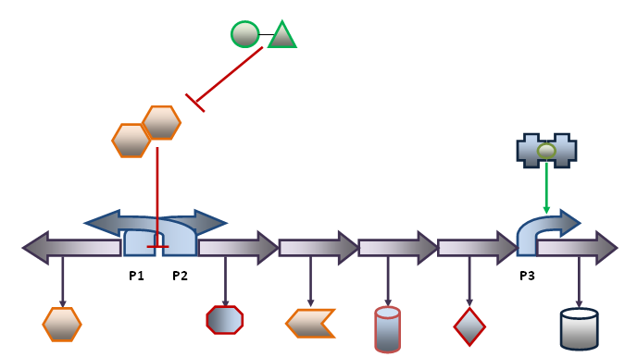

Slide 36
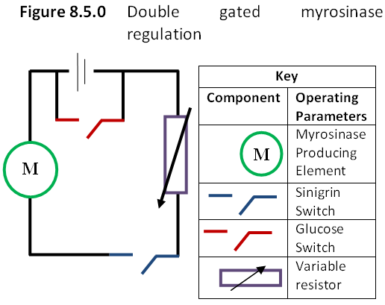
Abstraction

