Slide 1
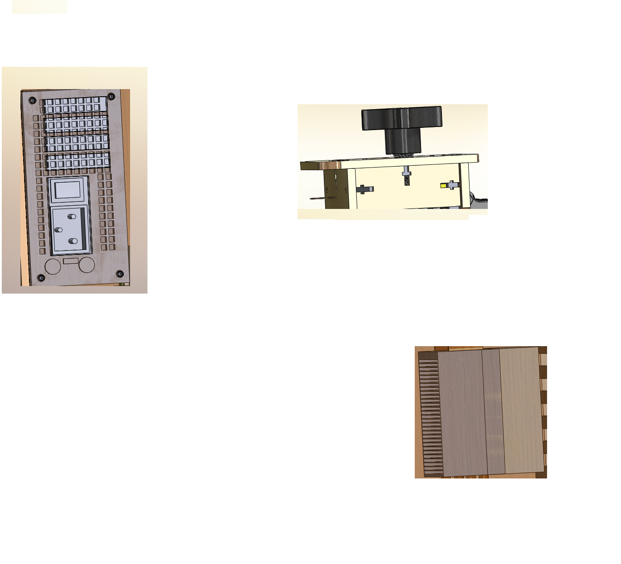
Well Plate
Rearrange framework of PCR to fit new well plate
Heat Sink
  Improved Cooling system
  Better material to retain heat
AC Adapter
Allow for battery option
Make it smaller and more compact
Portability

