Slide 1
Team Chemistry
Nathan Kipniss
Shambhu Koirala
Tyler Wagner

Slide 2
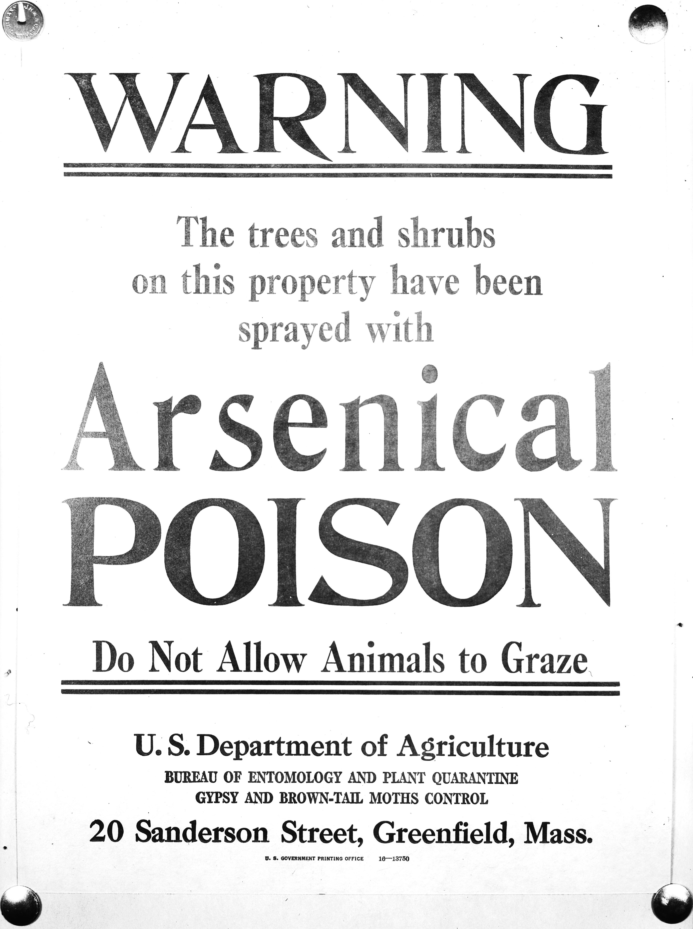
ArsenoBacto Filtration
http://www.fs.fed.us/ne/morgantown/4557/otis/arsenic.jpg
A method to remove arsenic from water to increase clean groundwater availability, especially in developing nations.

Slide 3
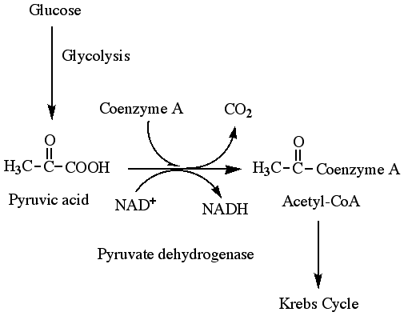
Water Filtration and its Importance
Arsenic and other metals can be naturally found in ground water.
They also come from industrial wastes.
Arsenic is toxic, and a mutagen.
Brunt et al, 2004a. Reproduced in Arsenic in Groundwater- A World Problem
Notes:
The world’s standards and the US’s standards for pollutant concentration are different. For example, Arsenic standards by the WHO are 50 micrograms per liter. US EPA- 10 Micrograms per liter.
Arsenic inhibits Pyruvate dehydrogenase- interrupting cellular metabolism! –> Apoptosis, which leads to nerve damage etc.
Mutagens- leads to cancer/ other problems. Can bind to DNA (which changes structure, thus changing function!
The chart only shows information from roughly 42 countries. Areas not colored demonstrate that info was not made available. Info not available doesn’t mean that there are issues with toxins in the water supply.

Slide 4
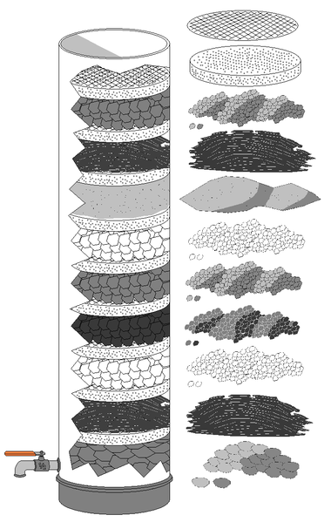
Proposed Methods
Engineering a spore system with Yeast Cadmium Factor 1 gene (YCF1)
Layer with existing carbon filter technologies.
Source: [http://en.wikipedia.org/wiki/Carbon_filtering]
Notes:
YCF1 gene, at the most basic level, transports Arsenic as well as Chromium and lead into vacuoles for storage.
A spore system is like bakers yeast- it gets activated in the persence of H20. This could then be used to manufacture something similar to a carbon filter. Then, the filter is thrown out/ replaced

Slide 5
Impact
Cleaner Usable water.
Looking beyond toxicity.
Availability and Cost
Brunt et al, 2004a. Reproduced in Arsenic in Groundwater- A World Problem
Notes:
Cleaner water leads to improved quality of life and health for those who live in areas of contamination.
Currently, all arsenic standards are based on being toxic, but not carcinogenenic. This implies that the legal amounts are still potentially cancer causing.
Existing technolgies work nicely if you have electricity. This would be an alternative method to filter arsenic out of water for developing nations.

Slide 6
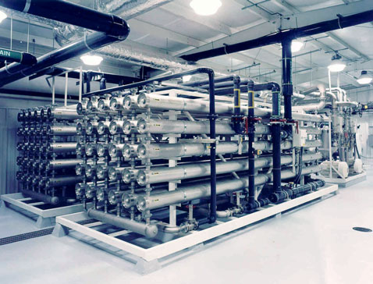
Competition
There are three main methods to remove Arsenic
Reverse Osmosis Filtration
Common Ion/ Ion Exchange
Source: [http://www.comptonengineering.com/pascagoula.html]
Notes:
Competition: Reverse Osmosis Filtration. Problem is they need to be cleaned, which becomes an issue for high concentrations of toxic material. Industrial units use a lot of power resources, and cost a lot.
Ion Exchange: Uses common ion effect in a way- exchanges ions for another, so having Chromium Chloride, I could swap out the chromium for sodium. Expensive because of materials used. All three of these competitors do not address how to “deactivated” the toxic sludge left over.
filtration through activated carbon will reduce the amount of arsenic in drinking water from 40 - 70%. Anion exchange can reduce it by 90 - 100%. Reverse Osmosis has a 90% removal rate, and Distillation will remove 98%. If the arsenic is present in organic form, it can be removed by oxidation of the organic material and subsequent coagulation.

Slide 7
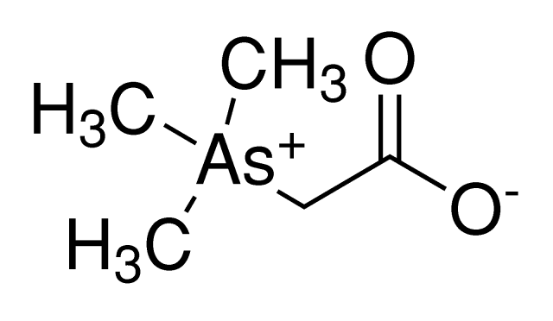
Knowns
Unknowns
Arsenic pathways do exist in cells.
How can pathways in the cell be controlled?
Spores are can be mass produced.
Cost
Both
Is there a limit to arsenic uptake?
How long could this filter last before it needs to be replaced.
Bacteria that use arsenic in place of phosphate.
Cell Food source?
Arsenic can exist in fairly non toxic compounds
Notes:
YCF1, ARR1, ARR2, ARR3 genes.
Arsenicals Resistance
ARR1- Transcritption factor
ARR2- Produces a reductase that can reduce Arsenic
ARR3- Pumps arsenites out of the cell
Arsenic does have one form in a compound that is naturally occurring and minimally toxic.
Arsenobetaine
Could we reverse the ARR3 controlled pump.
Arsenobetaine.

Slide 8
TREATMENT OF DEPRESSION WITH BACTERIA
Depression (Chemically):
[20m people are suffering in the US, 8% of the population]
  Lack of serotonin.
  Precursor of serotonin is HYDROXYTRYPTOPHAN.

Slide 9
5 - HYDROTRYPTOPHAN (5-HTP)
Metabolite made up of amino acid tryptophan.
Tryptophan is an essential amino acid and can be used to synthesize 5-HTP in the human body.
Tryptophan
From food (meat, fish, dairy products, eggs, grains,…)
From African shrub Griffonia simplicifolia.
From L-tryptophan (Left handed configuration, uses bacteria fermentation in tanks)
Use of genetically engineered bacteria

Slide 10
Engineering Bacteria
Use of bacteria to produce 5-HTP.
Culture them in colon.
Detect the level of 5-HTP from the blood.
Positive and negative feedback from the quantity of 5-HTP and regulate the bacterial growth accordingly.

Slide 11
NEGATIVE FEEDBACK
Reduce Bacteria
Level of 5-HTP
Increase Bacteria
POSITIVE FEEDBACK

Slide 12
Advantages
Constant level of chemicals in the body.
    No HIGHS and no LOWS
    Forgetting to take drug is no more problem.
Less probability of misuse.

Slide 13
Challenges
Introducing new organism to the body:
      Immunity reaction.
      Mutation
Implementation:
      Scare of biological organisms in the body.
      Is the world ready yet?

Slide 14
Impacts
Creating a hypothetical way of treating various neurological diseases.
Treatment to insomnia and other diseases caused by the lack of serotonin.

Slide 15
Competition
Selective Serotonin Reuptake Inhibitors (SSRIs): They have side effects.
Tricyclic antidepressant: Even more side effects.
Gamma-Hydroxybutyric acid: Banned now.
Devices:
    Electroconvulsive Therapy.
    Deep Brain Stimulation

Slide 16
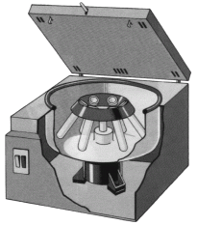
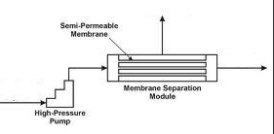
Bacterial Separation
A cheaper, energy-saving alternative to distillation.
Why bacteria?
  Can selectively target desired compounds
  Easy to extract from solution
    Centrifuge
    Permeable membrane
  Do not require electrical input → low operating costs
http://glossary.periodni.com/image/centrifuge.gif
portal.navfac.navy.mil

Slide 17
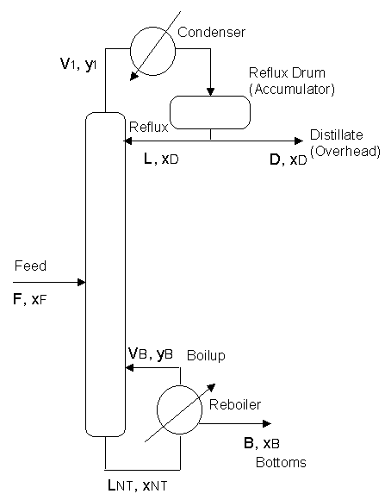
The Competition: Distillation
Pros:
  Very good separation depending on the mixture's components
Cons:
  Operating costs
    Approximately 3% of U.S. Energy consumption
  Inefficient if components have similar properties
http://www.cbu.edu/~rprice/lectures/figures/distill.gif

Slide 18
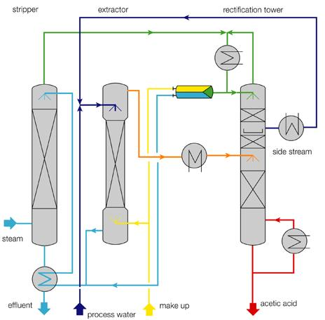
Acetic Acid – Water Separation
Global demand
  6 billion kg/year
  1.5 billion kg/year is recycled
Distillation
  Average Relative Volatility = 1.83
  40 Trays
Liquid-Liquid Extraction
http://www.qvf.com/en/processsystems_3/Recovery%20Units/acetic_acid.shtml

Slide 19
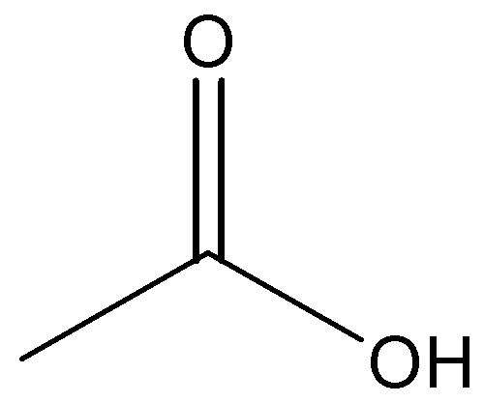
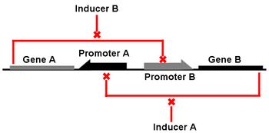
Bacterial Separation
Monocarboxylate Transport Proteins
  Influx – brain, heart, red skeletal muscle
  Removal – red blood cells, white skeletal muscle
Insertion and Amplification of protein genes
Switch on – acetic acid uptake
Separate – water removal
Switch off – pure acetic acid release
http://schaechter.asmblog.org/.a/6a00d8341c5e1453ef0147e1db2f00970b-350wi

Slide 20
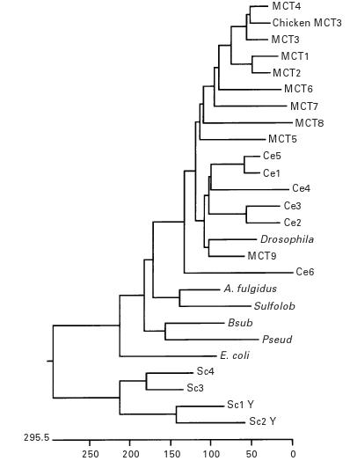
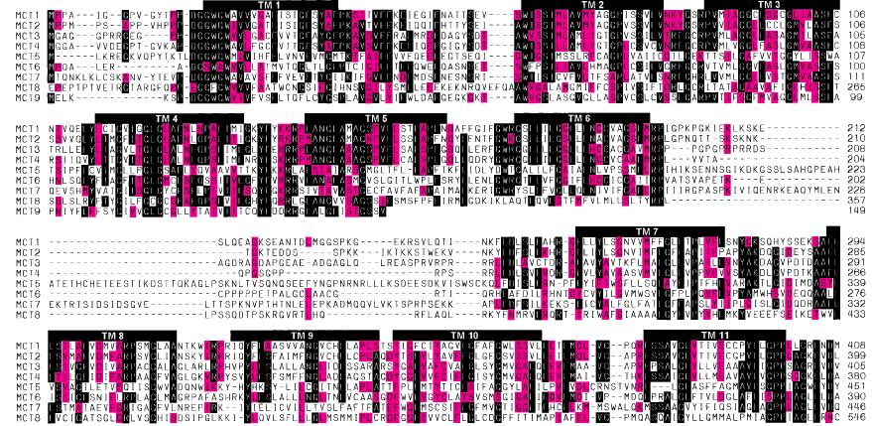
Unknowns
How much acetic acid can be taken in?
  Glacial acetic acid is corrosive
Can we limit natural cell waste products?
What type of cells and proteins should be used?
Halestrap, A.P. and Price, N.T. The Proton-linked Monocarboxylate Transporter (MCT) Family: Structure, Function and Regulation. Biochem Journal: 1999. 281-299

Slide 21

Impact
Save Energy
Inspire innovation
  New biological separation methods
  Characterize new transport proteins
Profit
  Lower Operating Costs
http://juicyestates.com/files/2009/04/dollar-tree-for-drop-279x300.jpg

Slide 22
References
http://www.raysahelian.com/5-htp.html
http://www.naturalremedies.org/5-htp/http://www.college.ucla.edu/webproject/micro7/studentprojects7/rader/asludge2.htm
http://www.remco.com/ro_quest.htm
http://www.onlinewatertreatment.com/literature/Nalco/docs/Tf-024.pdf
http://www.atsdr.cdc.gov/csem/arsenic/physiologic_effects.html
Arsenic in Groundwater- A World Problem, Proceedings Seminar, 11/29/2006
http://www.aquapurefilters.com/contaminates/107/arsenic.html
www.yeastgenome.org

