Slide 1
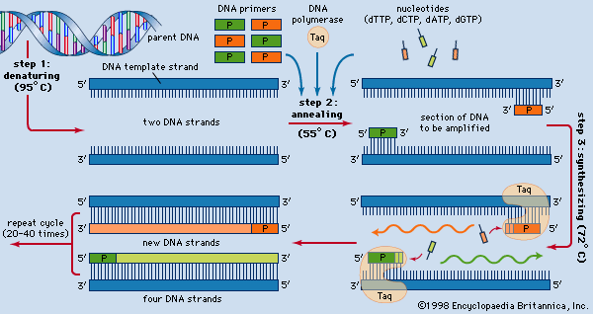
polymerase chain reaction: three-step process. Art. Encyclopædia Britannica Online. Web. 8 Nov. 2012. <http://www.britannica.com/EBchecked/media/18071/The-three-step-process-of-the-polymerase-chain-reaction>.

