Slide 1
dCIN5 and Wildtype Transcription Factor Mapping in Cold Shock
William Gendron and Jeffrey Crosson

Slide 2
Outline
Background: Yeast, Transcription Factors and Cold Shock
Results
GO Terms
GRN Weighting+Production
GRN Mapping
Comparison between our respective networks
Discussion and future plans

Slide 3
Background
Saccharomyces cerevisae is the eukaryotic model organism
Chemostat models have been used to limit the stress to one variable
Cold shock has not been as analyzed as other stressors (Tai et al, 2007)

Slide 4
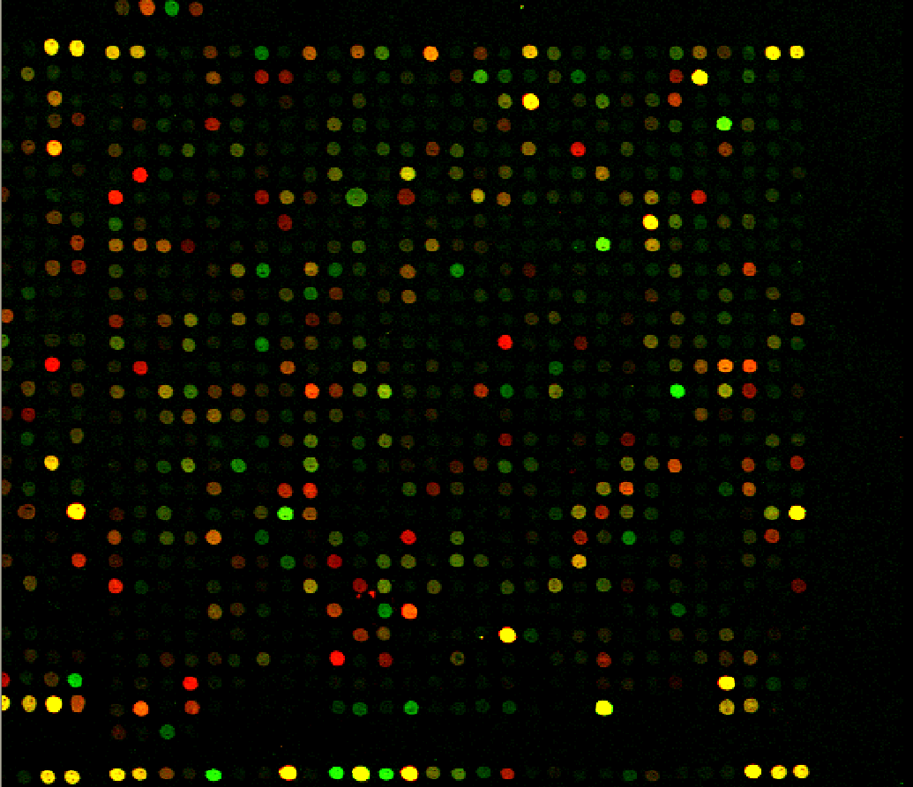
Novel Cold Shock Analysis with mutant dCIN5 and wildtype
Received microarray data
Purpose: to create a novel model of yeast under cold shock focusing on interactions in combination with dCIN5

Slide 5
GO Terms
GO:0031505 - fungal-type cell wall organization: This showed an increase in expression of the cell wall construction genes. This is a known response, probably to rebuild damage.
GO:0005654 - nucleoplasm: This is involved with regulating the genome and RNA, which is to be expected when the cell is reacting to new conditions.
GO:0006402 - mRNA catabolic process: Similar to the one above, this is involved in the breakdown of RNA molecules.
GO:1901361 organic cyclic compound catabolic process: This would break down organic cyclic compounds and therefore could be related to the RNA.

Slide 6
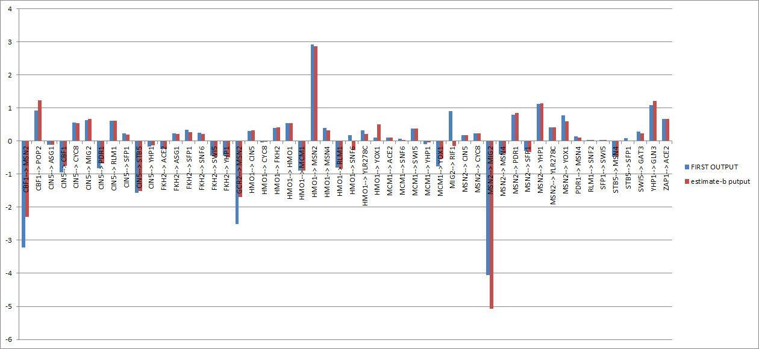
Wil’s Weight Comparison

Slide 7
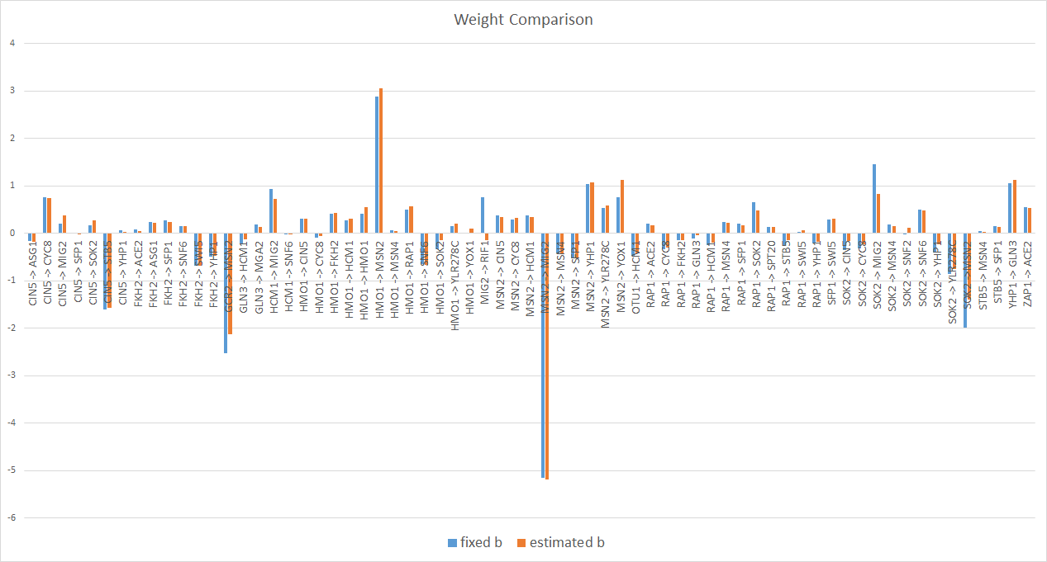
Jeff’s Weight Comparison

Slide 8
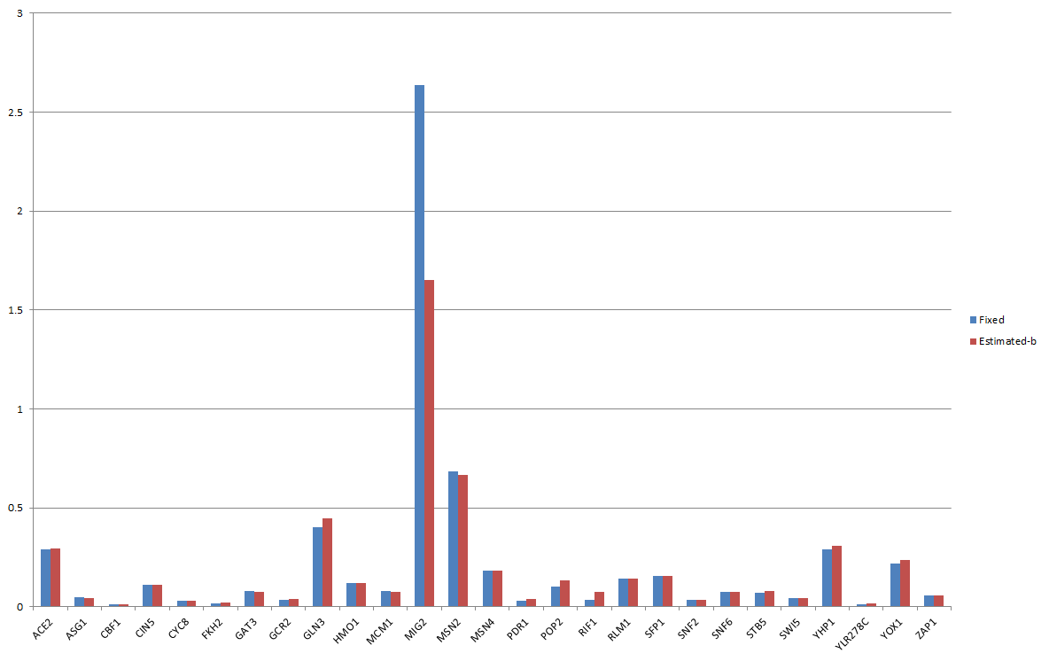
Wil’s Production Rate Comparison

Slide 9
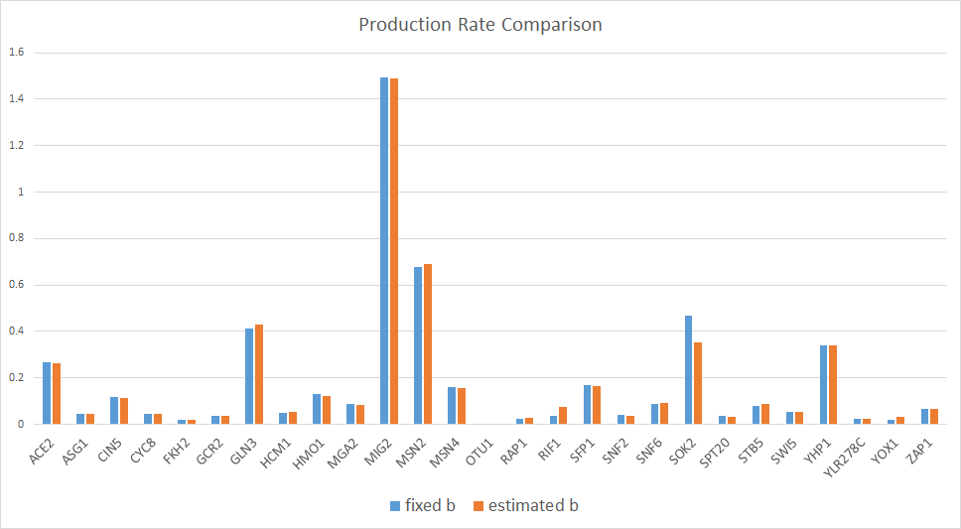
Jeff’s Production Rate Comparison

Slide 10
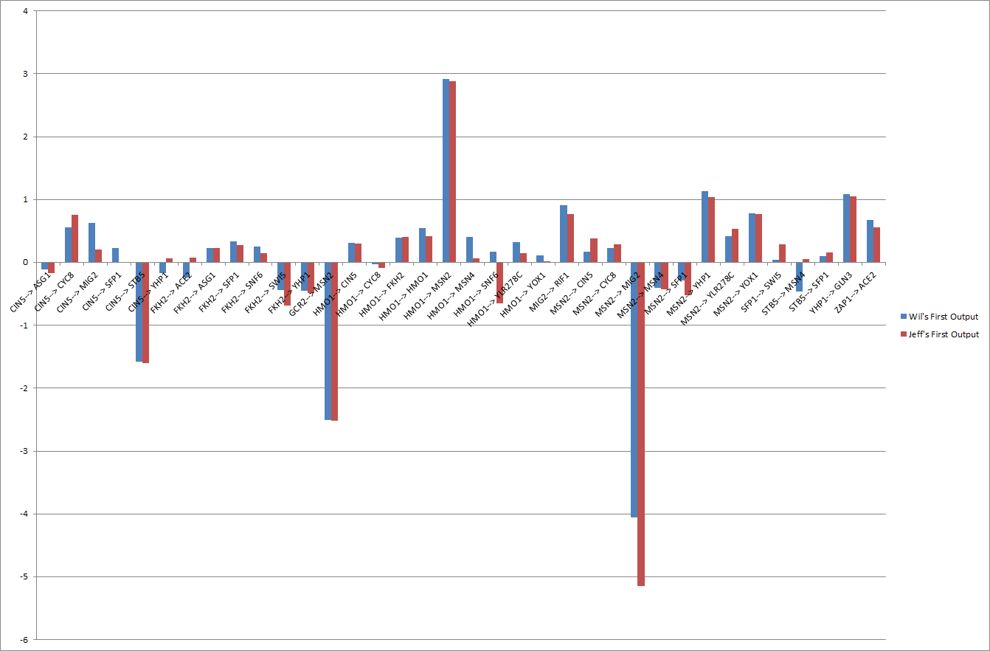
Fixed B Weight Comparison

Slide 11
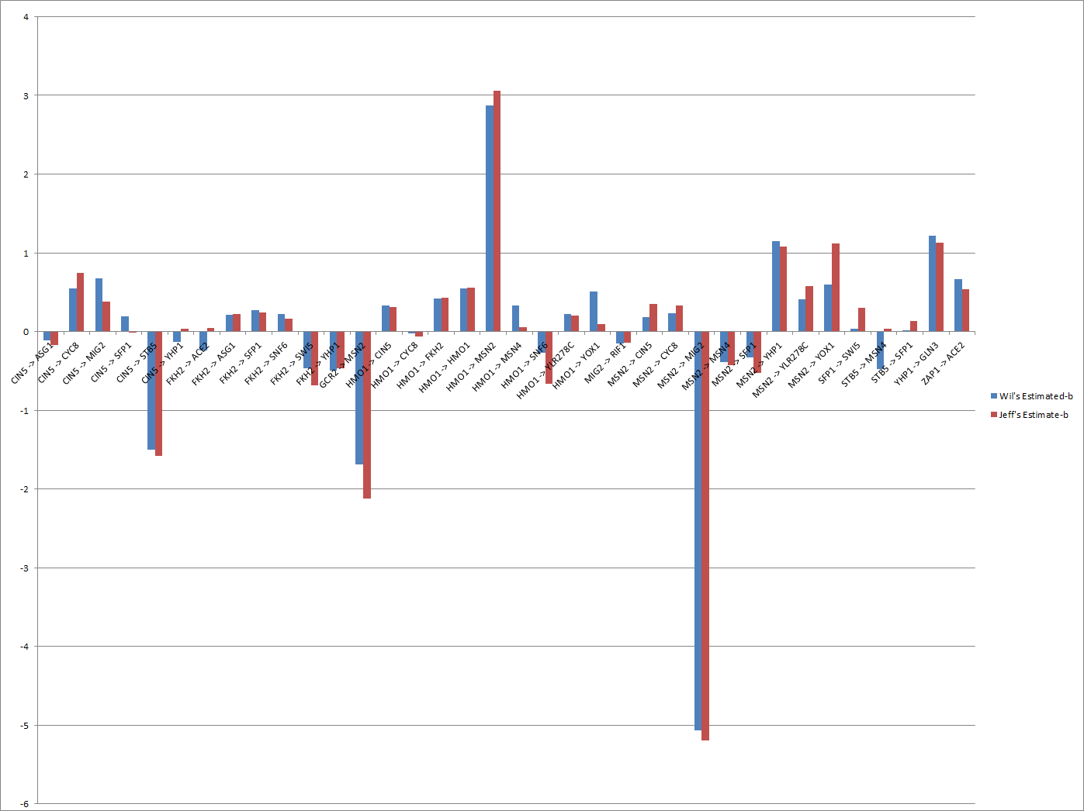
Estimated B Comparison

Slide 12
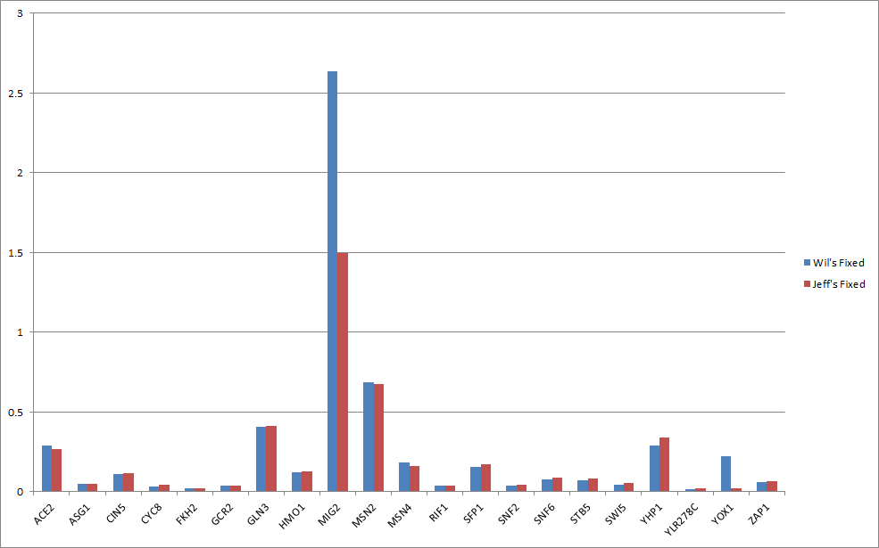
Fixed B Production Rate Comparison

Slide 13
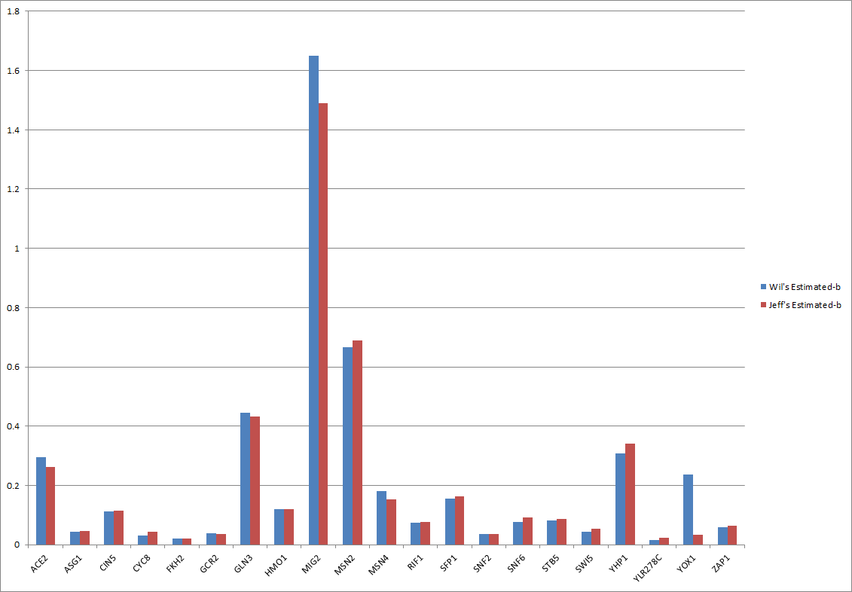
Compared Production: Estimated

Slide 14
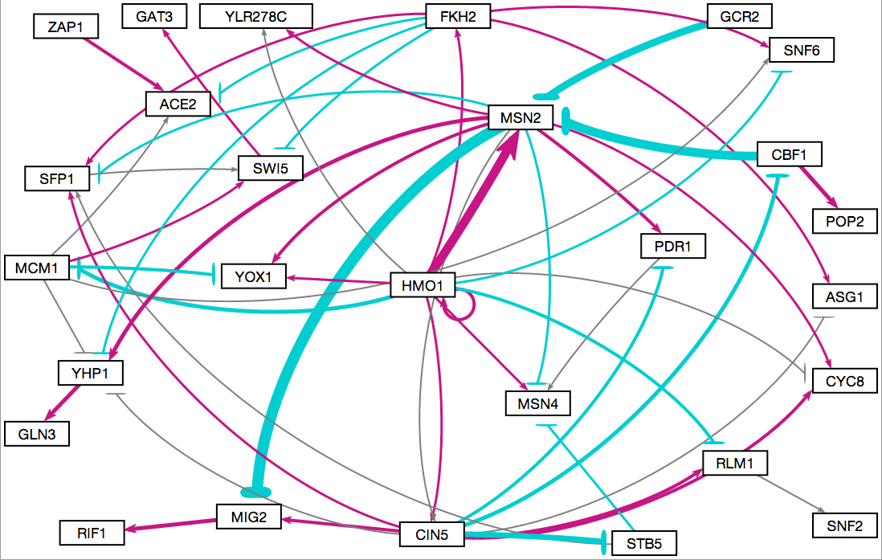
Wil’s Fixed B GRNsight Map

Slide 15
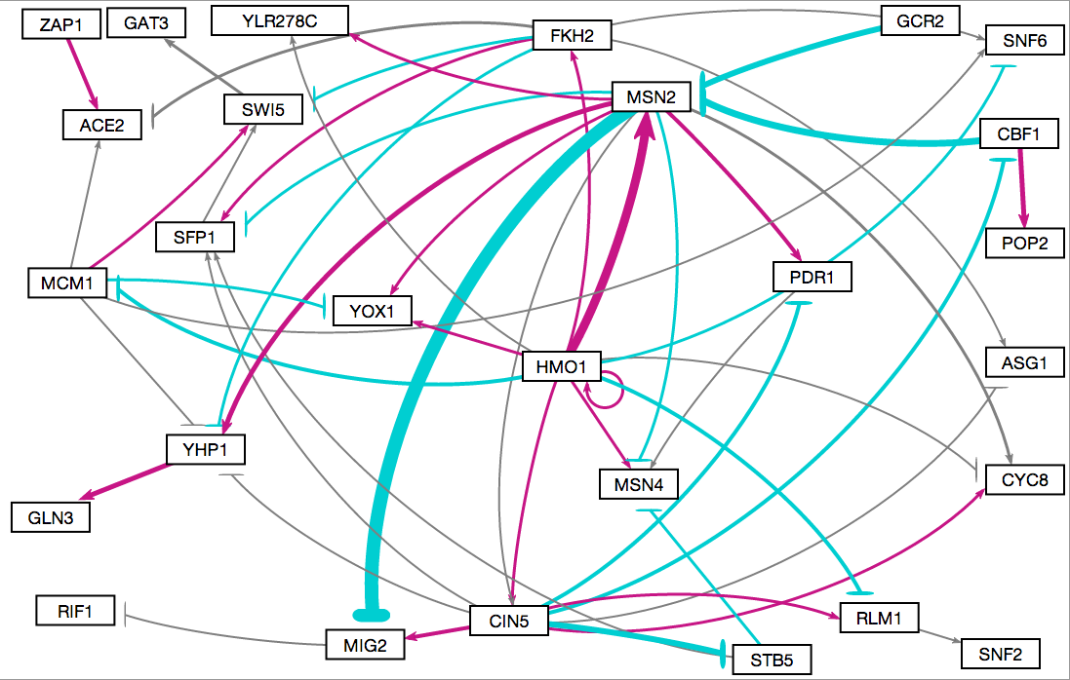
Wil’s Estimated B GRNsight Map

Slide 16
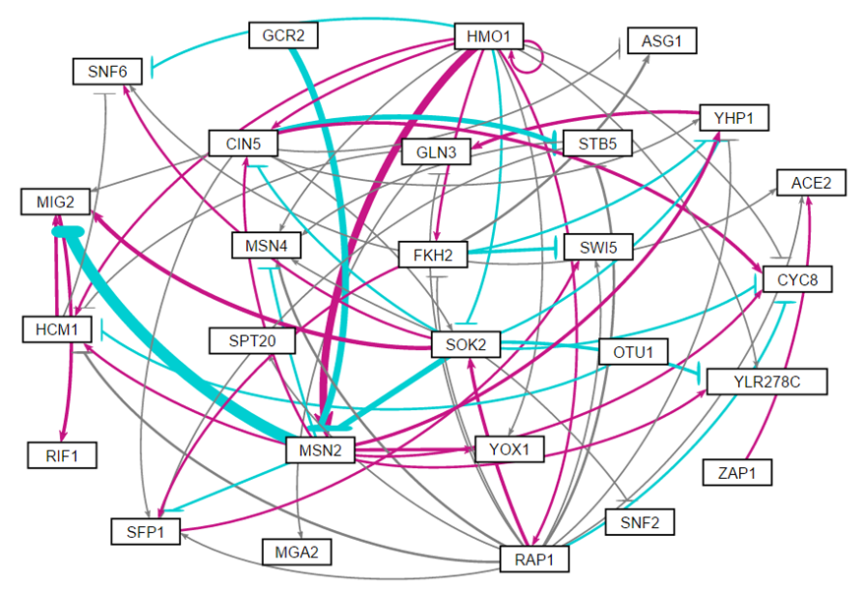
Jeff’s Fixed B GRNsight Map

Slide 17
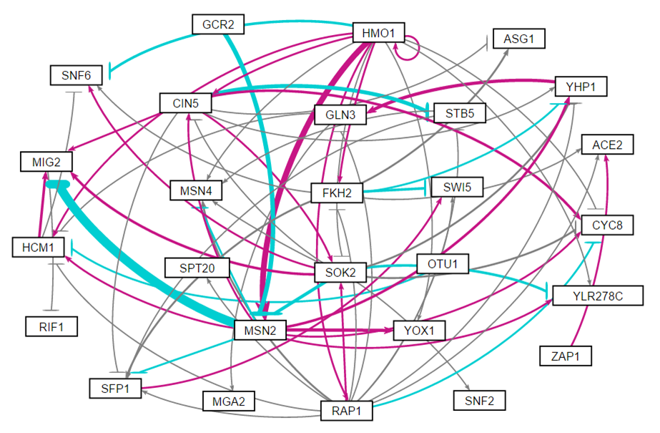
Jeff’s Estimated B GRNsight Map

Slide 18
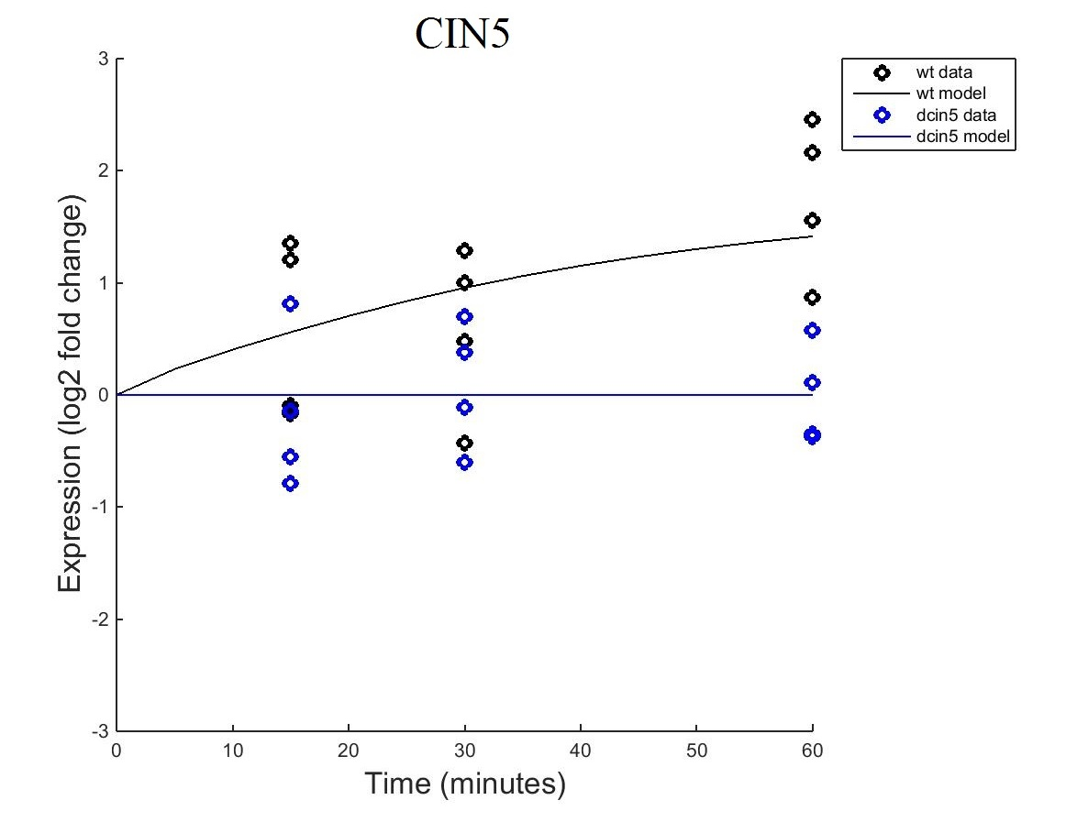
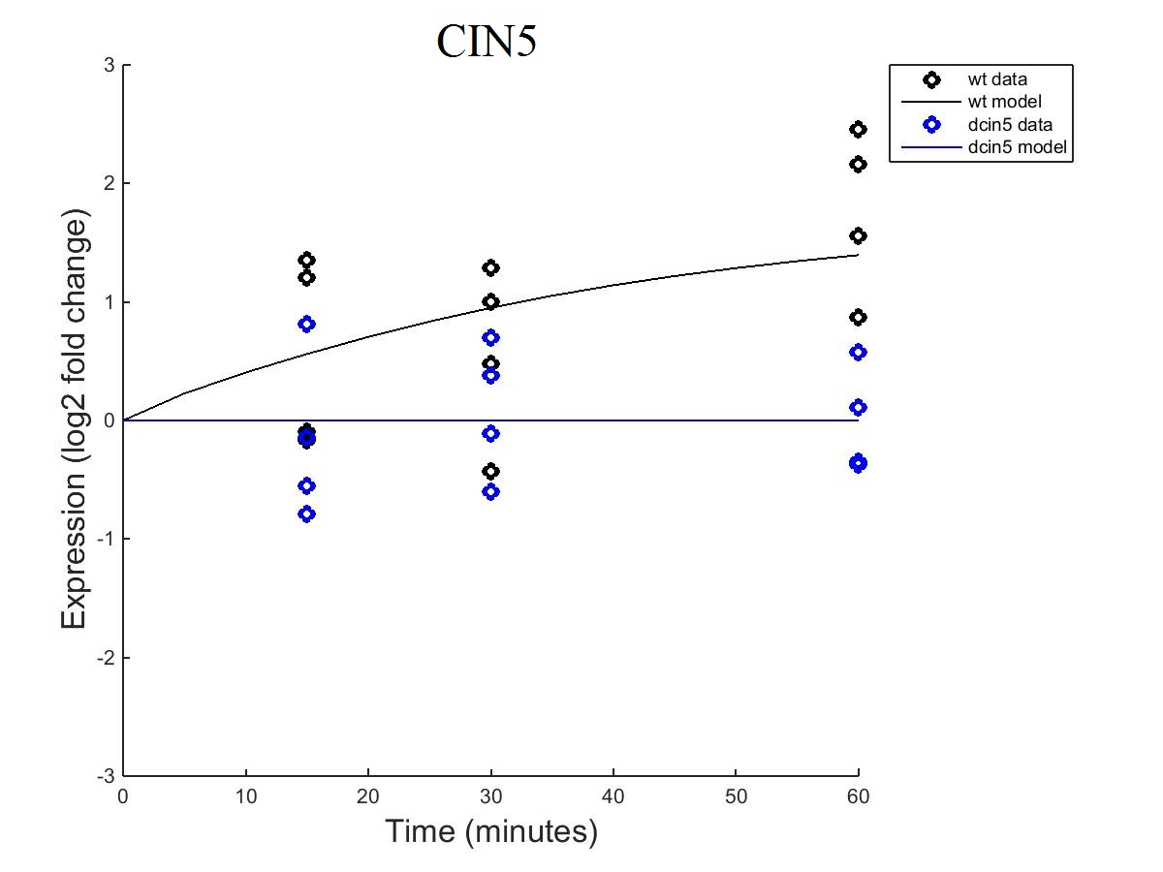
CIN5 Graph Comparison
Fixed B
Estimated B
Notes:
Wil

Slide 19
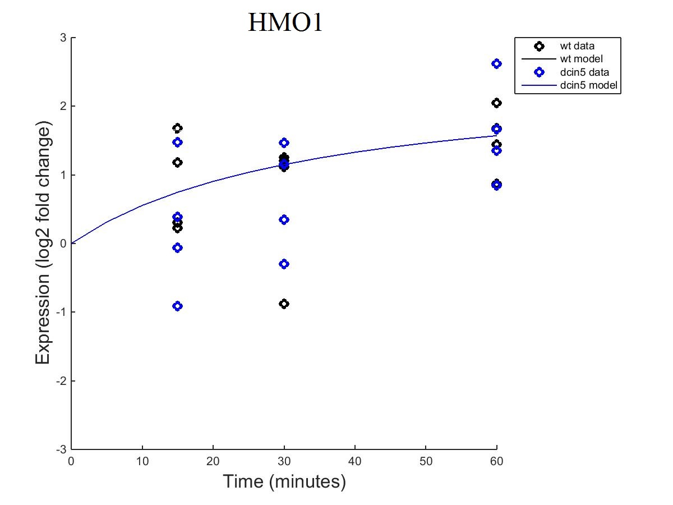
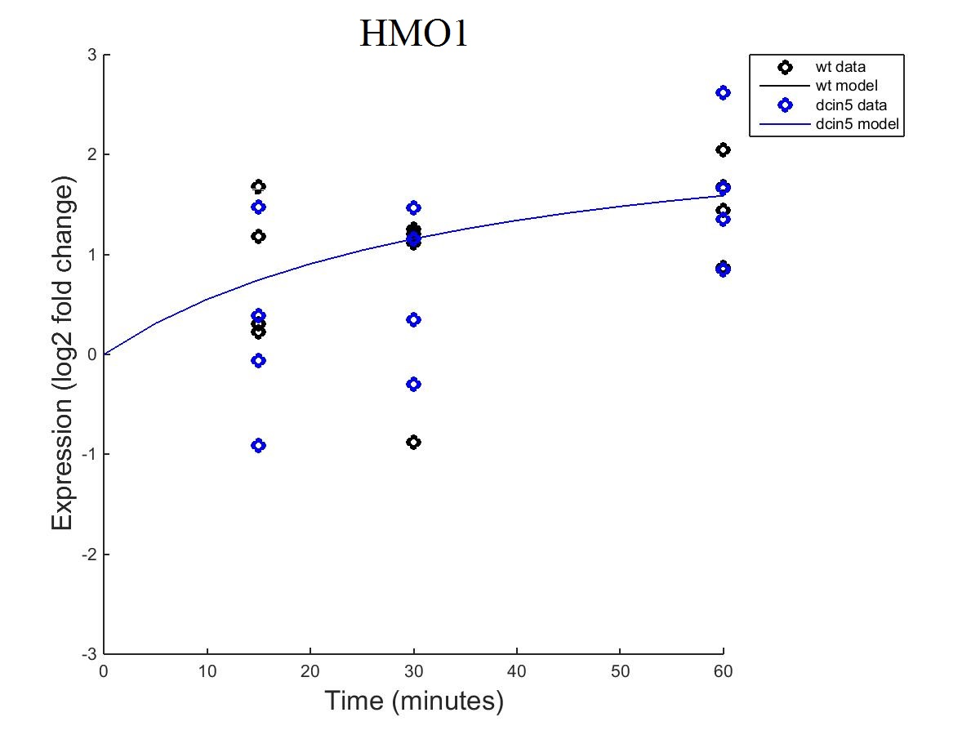
HMO1 Graph Comparison
Fixed B
Estimated B

Slide 20
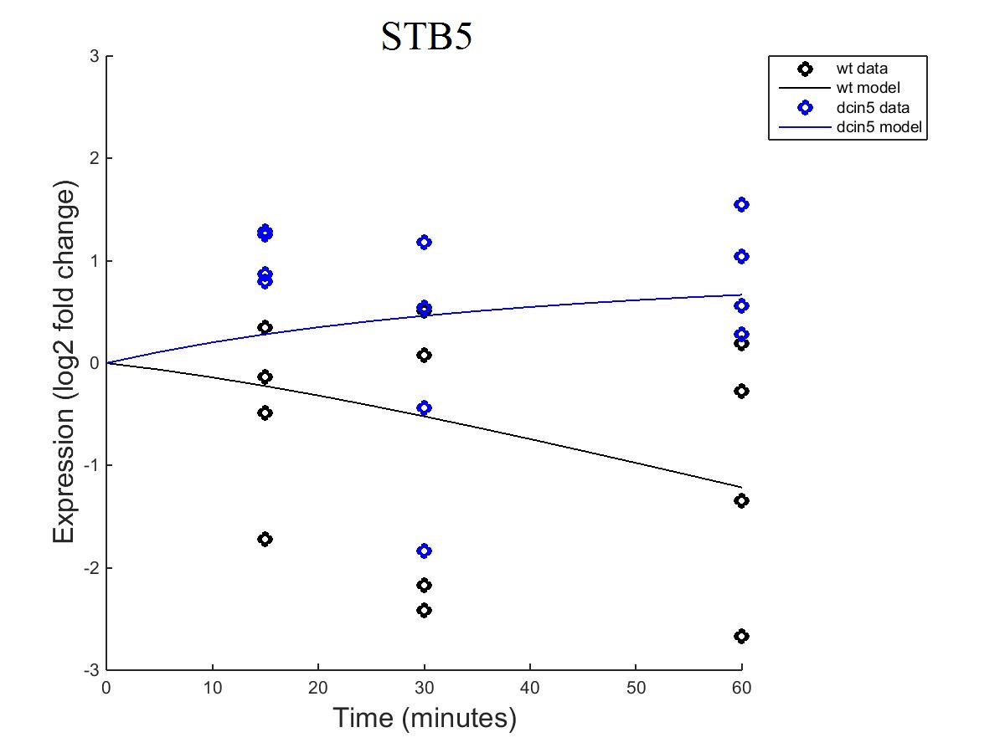
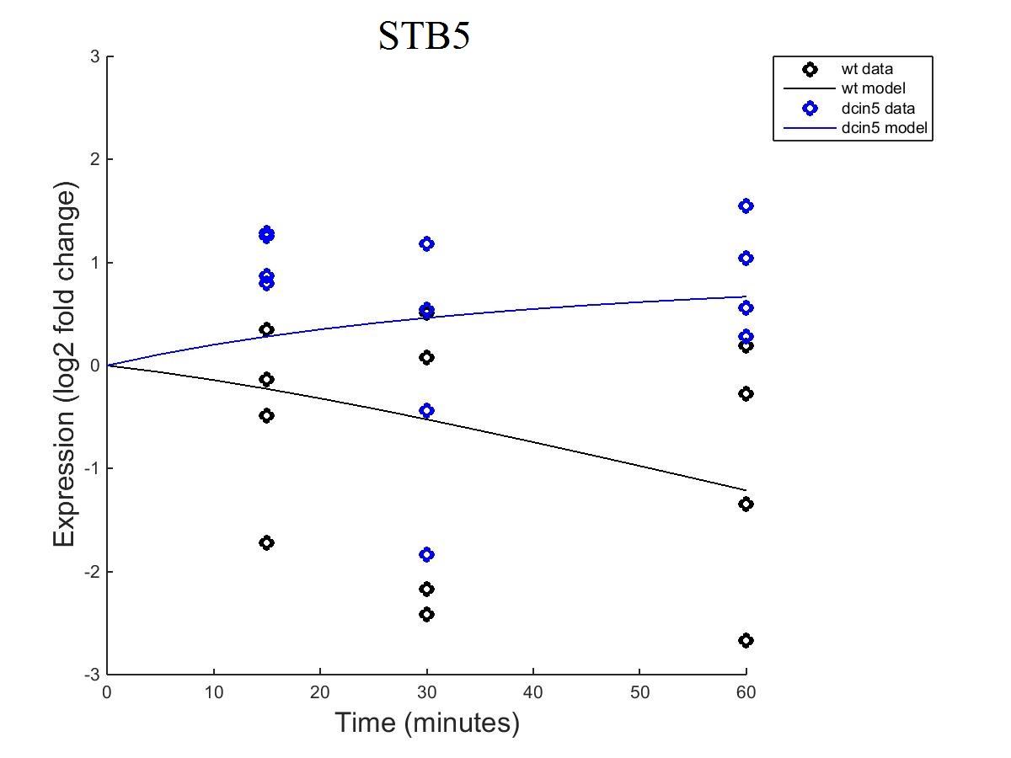
STB5 Graph Comparison
Fixed B
Estimated B
Notes:
Wil

Slide 21
Wil’s Estimated-b GRNmap

Slide 22
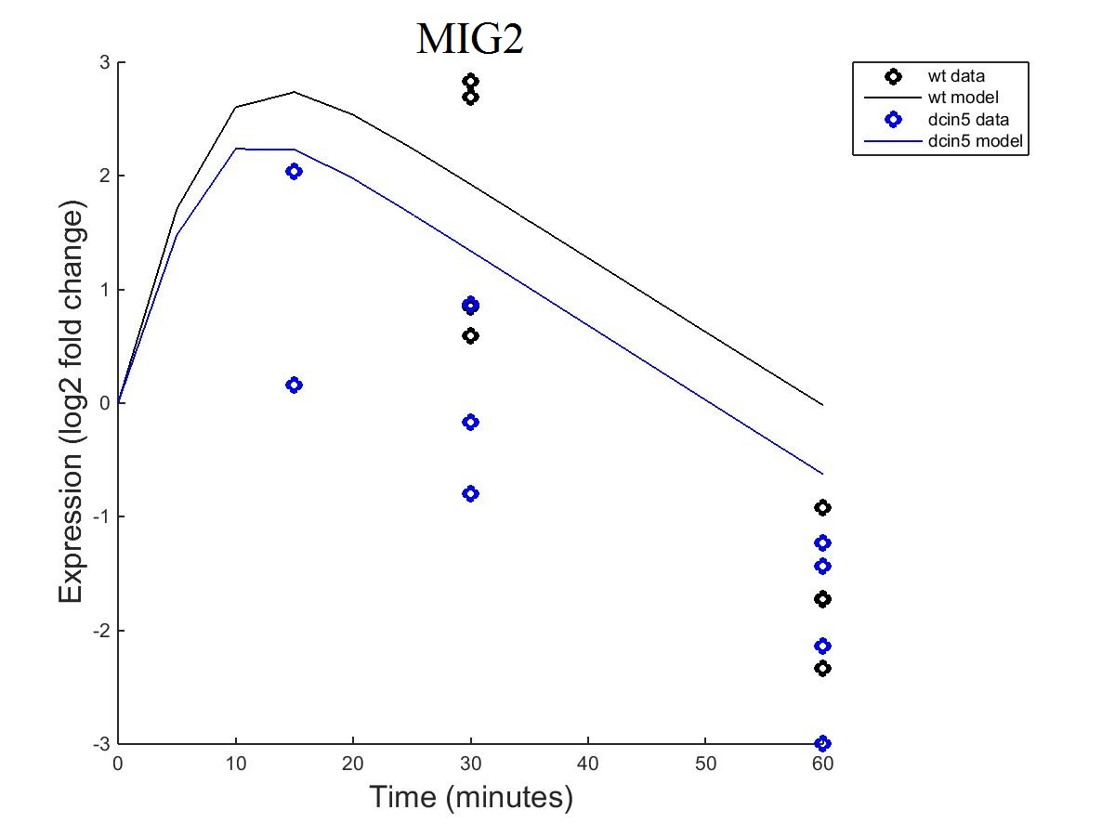
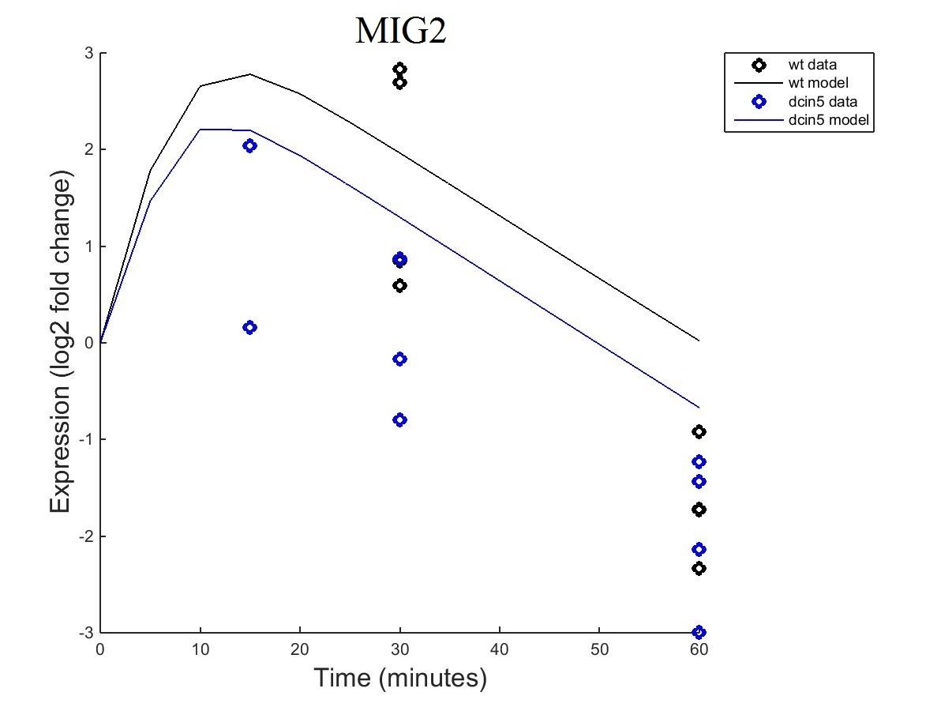
MIG2 Graph Comparison
Fixed B
Estimated B

Slide 23
Wil’s Estimated-b GRNmap

Slide 24
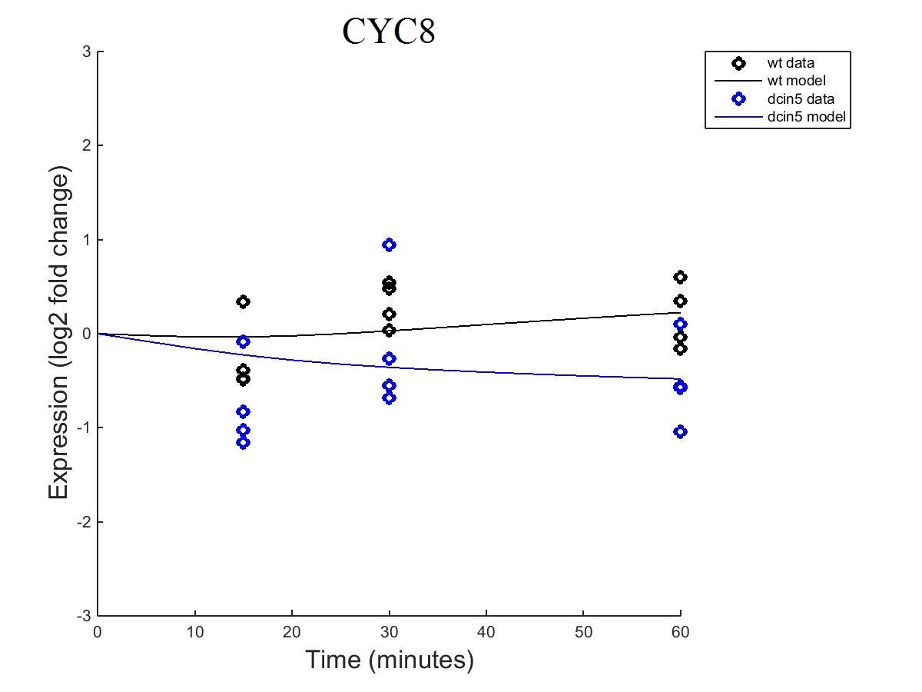

CYC8 Graph Comparison
Fixed B
Estimated B
Notes:
Wil

Slide 25
Concluding thoughts
Discrepancies between our weights
Even slight changes to the network composition will alter the genes expected effect
Can visualize alterations that result from deletion.
Can be seen in maps and plots.
Notes:
Wil

Slide 26
Overview
Background: Yeast, Transcription Factors and Cold Shock
Results
GO Terms
GRN Weighting+Production
GRN Mapping
Comparison between our respective networks
Discussion and future plans

Slide 27
Ideas for the future
Larger maps
Is this possible?
Will this create the most representative/accurate values?
Find which gene is temperature sensitive?
Can we use these networks to find genes that are the first to react to the temperature change?
Notes:
Wil

Slide 28
Acknowledgements and References
Dr. Kam Dahlquist
Dr. Ben Fitzpatrick
The class: MATH 388-01: Survey of Biomathematics
2014, Gene Ontology Consortation, http://geneontology.org/, 7 April 2015
Tai, Siwe L. "Acclimation of Saccharomyces Cerevisiae to Low Temperature: A Chemostat-based Transcriptome Analysis."Http://www.molbiolcell.org/. The American Society for Cell Biology, 1 Dec. 2007. Web. 1 May 2015. <http%3A%2F%2Fwww.molbiolcell.org%2Fcontent%2F18%2F12%2F5100.full>
Coller, John. Sample Microarray. Digital image. Microarray.org. The Board of Trustees of Leland Stanford Junior University, 2008. Web. 1 May 2015. <https://microarray.org/sfgf/>.

Slide 29
QUESTIONS?
?

