Slide 1
ANOVA | dGLN3
p < 0.05 | 2393 (38.7%)
p < 0.01 | 1453 (23.5%)
p < 0.001 | 696 (11.2%)
p < 0.0001 | 320 (5.2%)
B & H p < 0.05 | 1549 (25.0%)
Bonferroni p < 0.05 | 155 (2.5%)

Slide 2
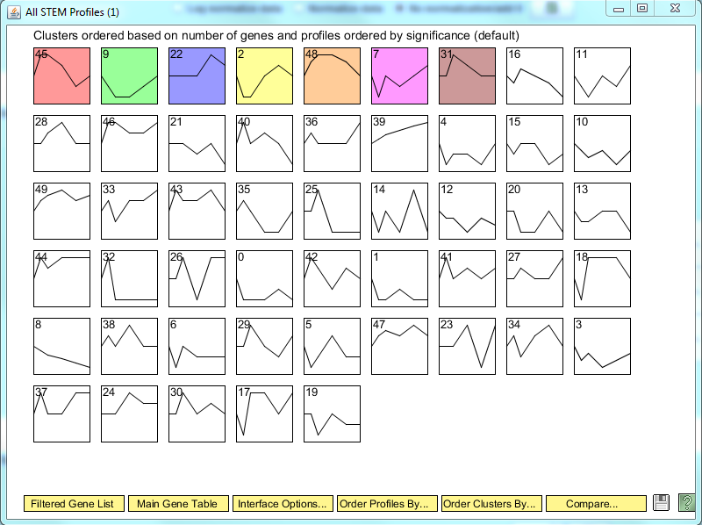

Slide 3
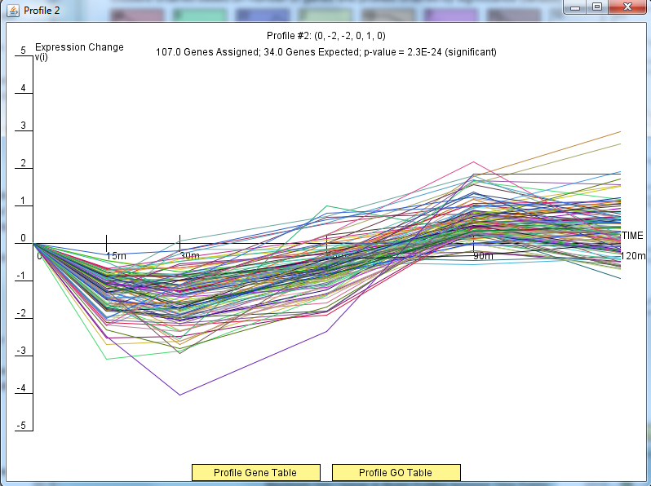

Slide 4
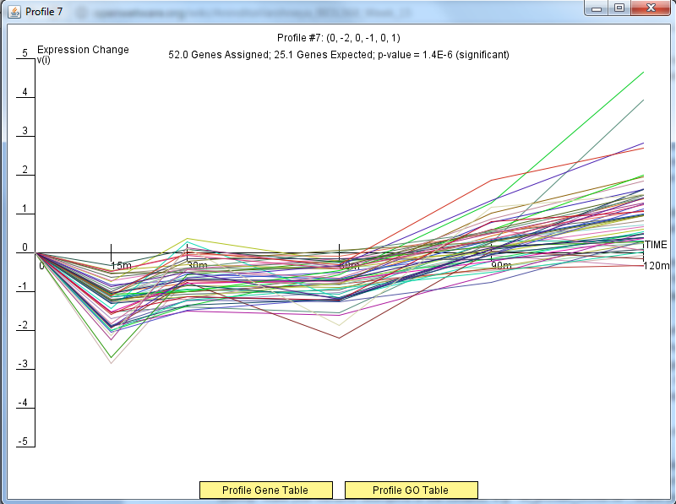

Slide 5
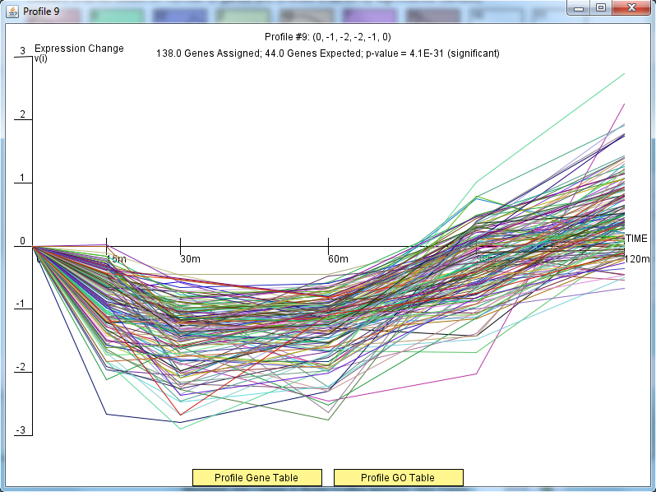

Slide 6
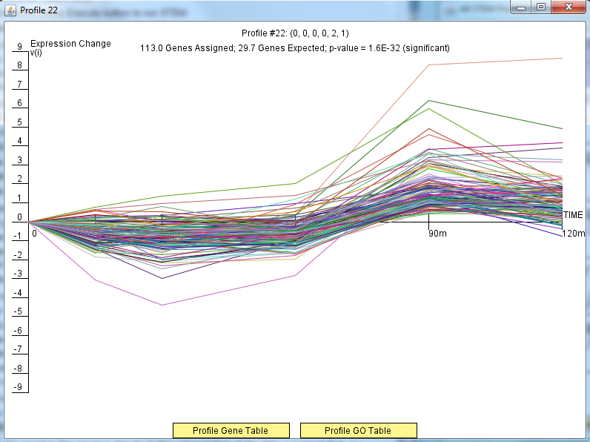

Slide 7
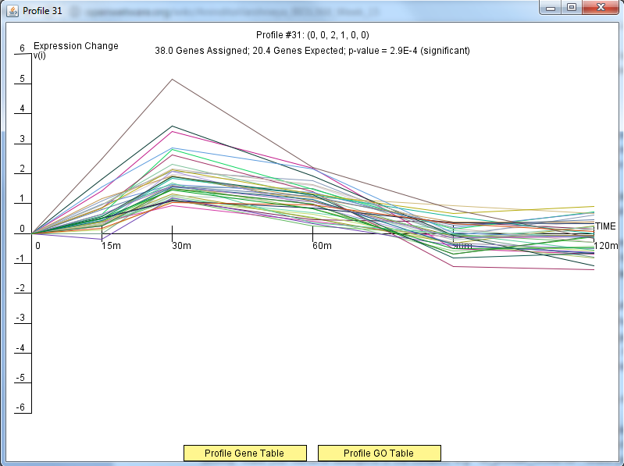

Slide 8
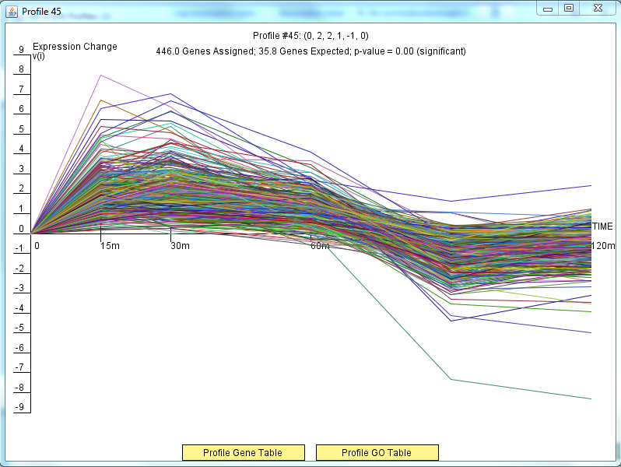

Slide 9
