Slide 1
The ECM, Cell Adhesion, and Integrins
2/7/13
Lecture 6, ChE 290B

Slide 2
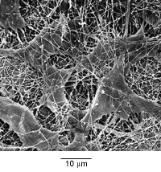
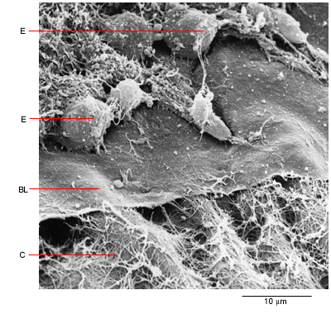
Natural Cell Microenvironment: ECM
The extracellular matrix:
is made and remodeled by cells that reside within it.
is a well-defined composite of proteins and polysaccharides (sugars).
regulates cell function (adhesion, survival, migration, etc).
contains unique chemical and physical features in each tissue
Fibroblasts in connective tissue
Molecular Biology of the Cell
Epithelial, basal lamina, connective tissue
Molecular Biology of the Cell

Slide 3
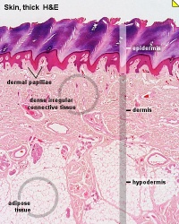
Fibroblasts: Skin ECM

Slide 4
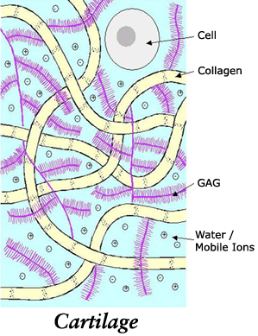
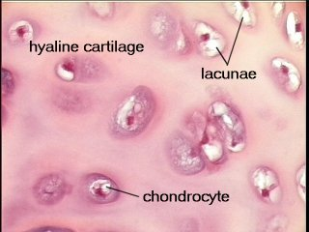
Chondroblast: Cartilege

Slide 5
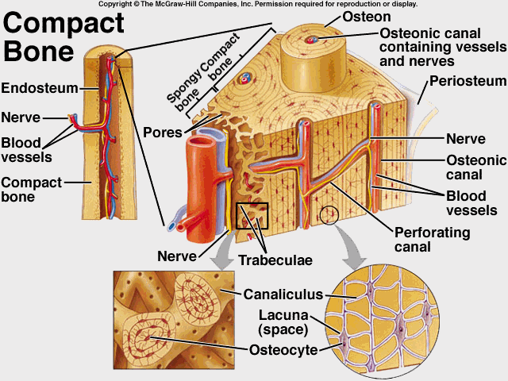
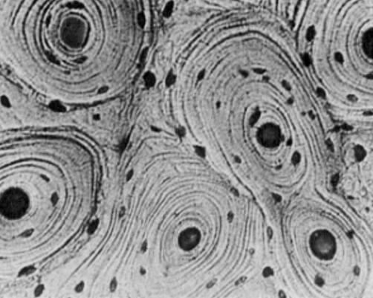
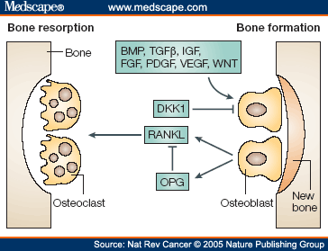
Ostoblasts and clasts: Bone

Slide 6
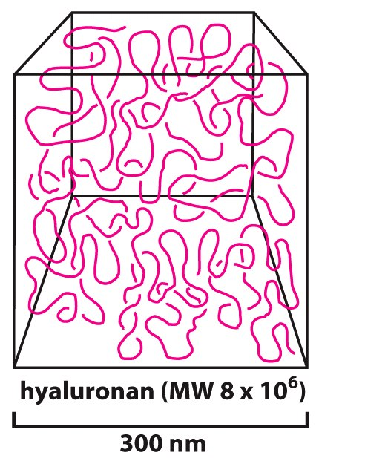
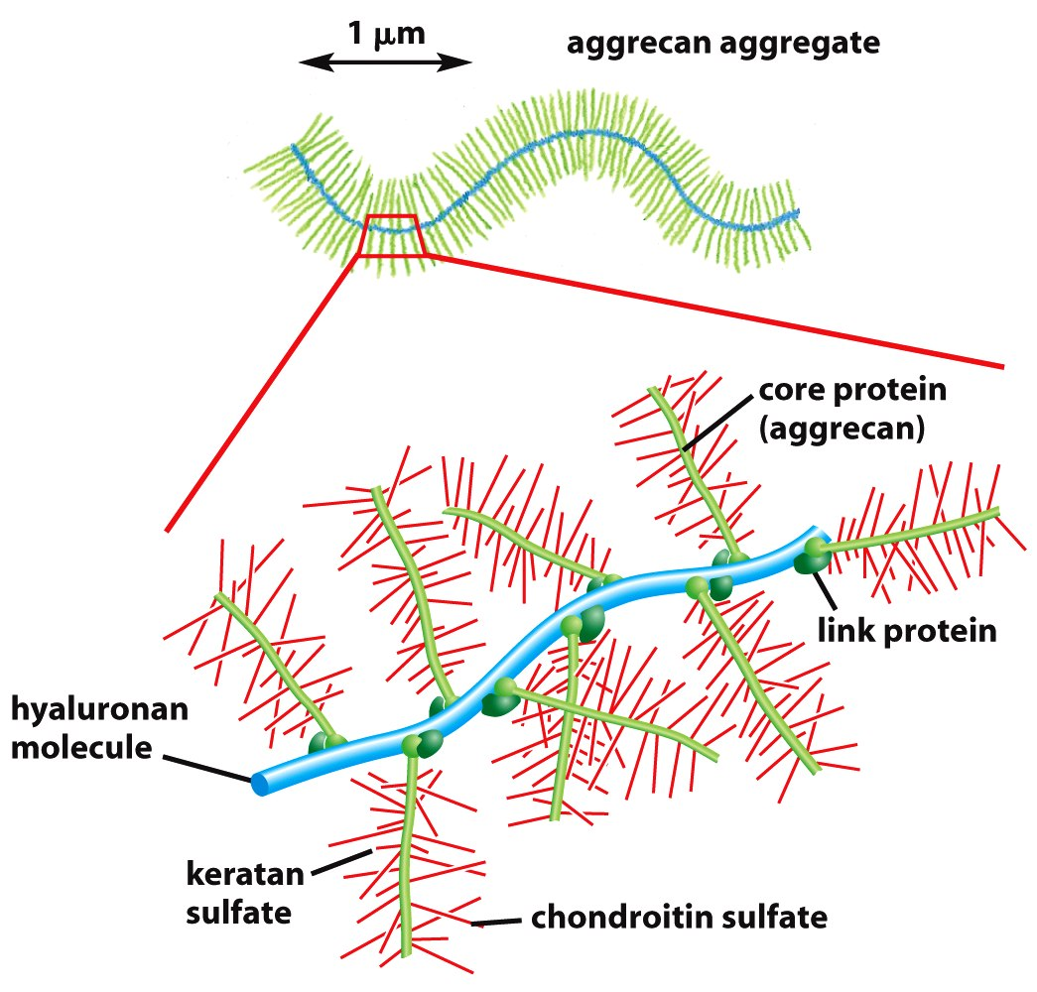
Sugars (such as hyaluronan) resist compressive forces
As well as connect to proteins to provide an organizing structure for cell-ECM signaling

Slide 7
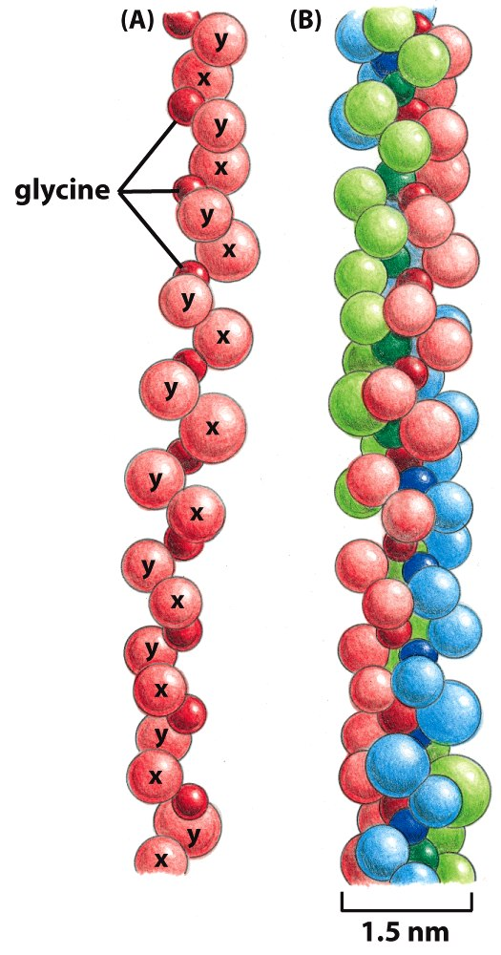
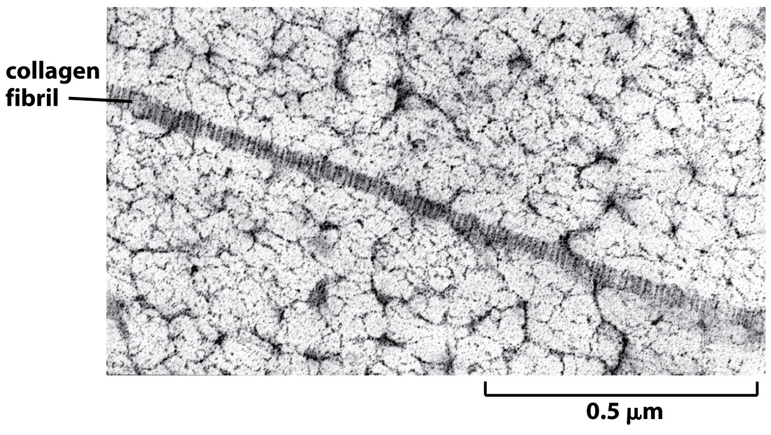
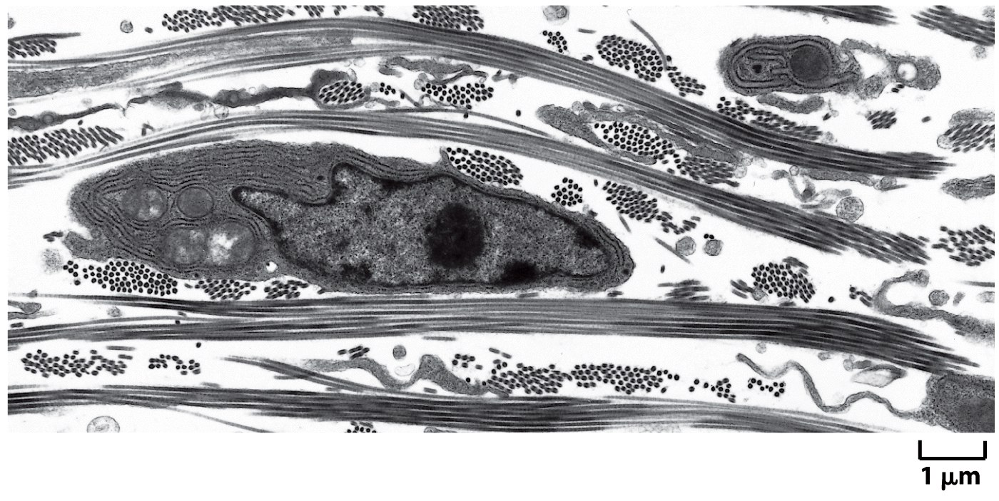
Collagen

Slide 8
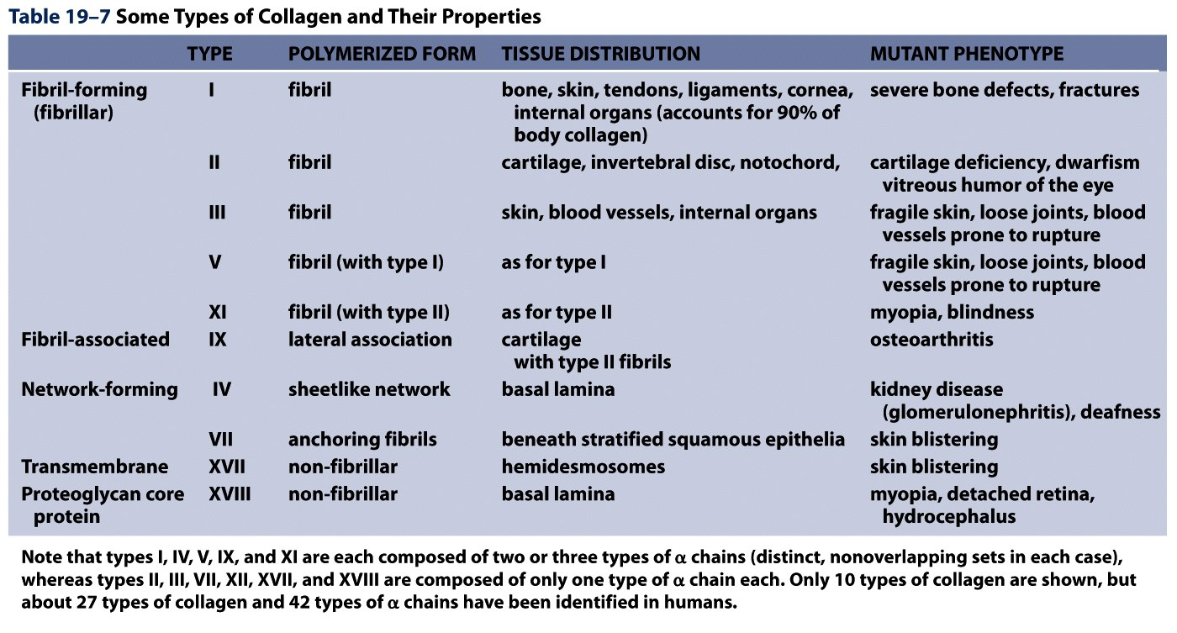
Collagens are Chemically and Structurally Diverse
Table 19-7 Molecular Biology of the Cell (© Garland Science 2008)

Slide 9
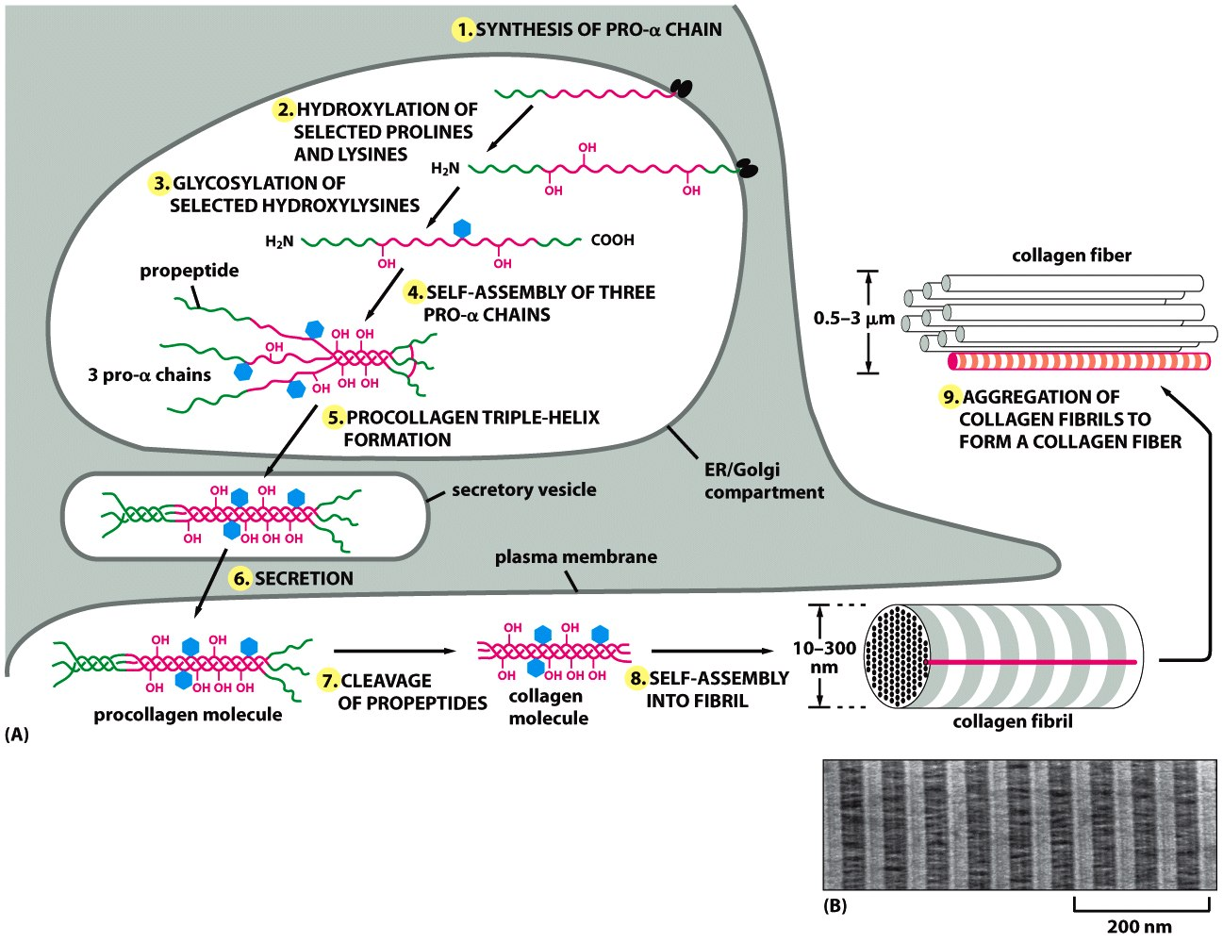
Collagen Fiber Formation is Extracellular

Slide 10
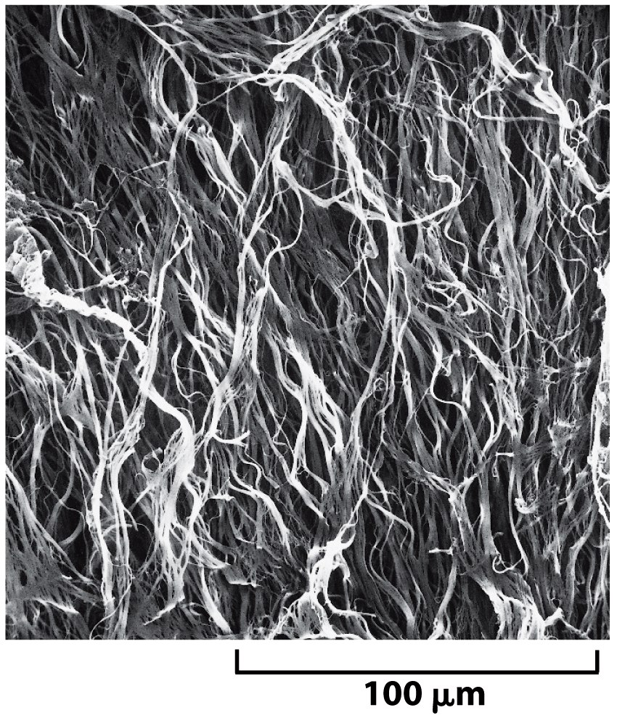
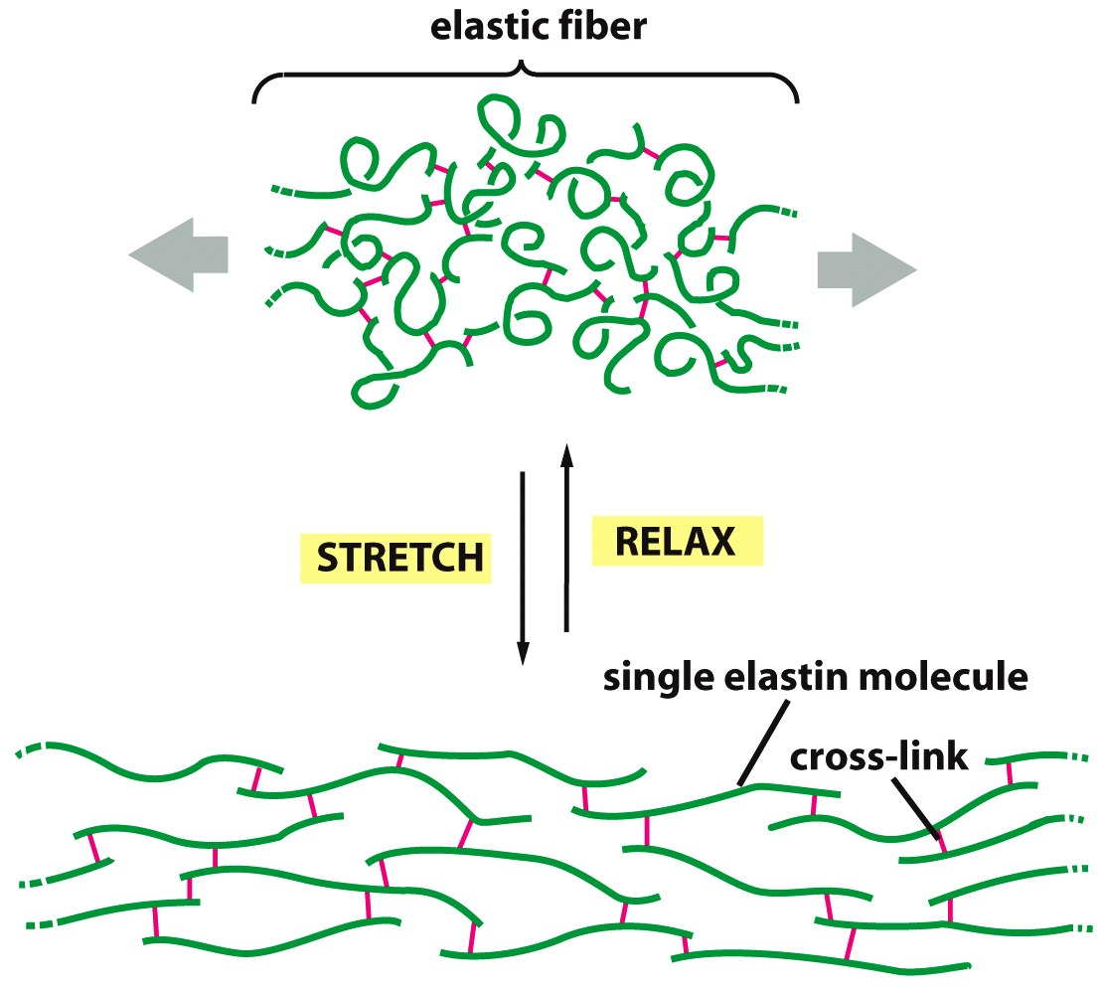
Elastin: five times more extensible than rubber!

Slide 11
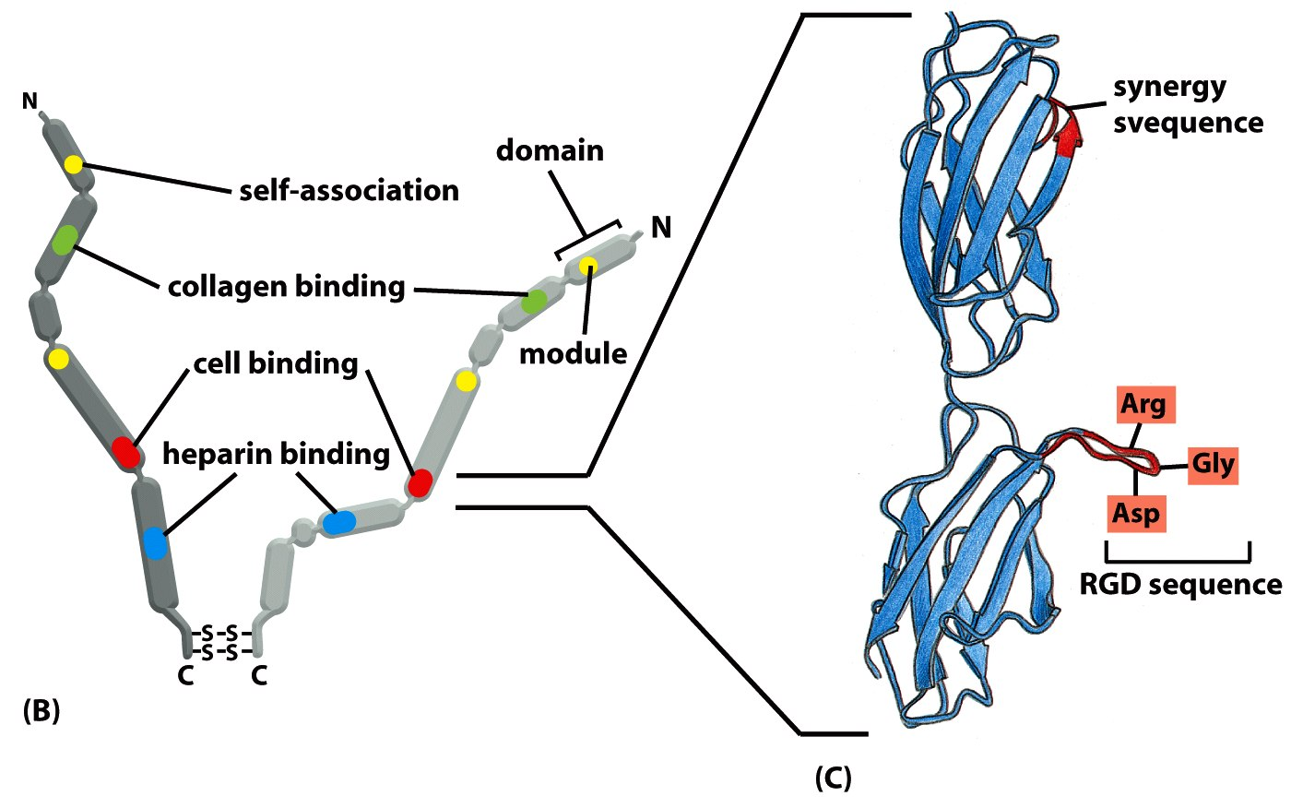
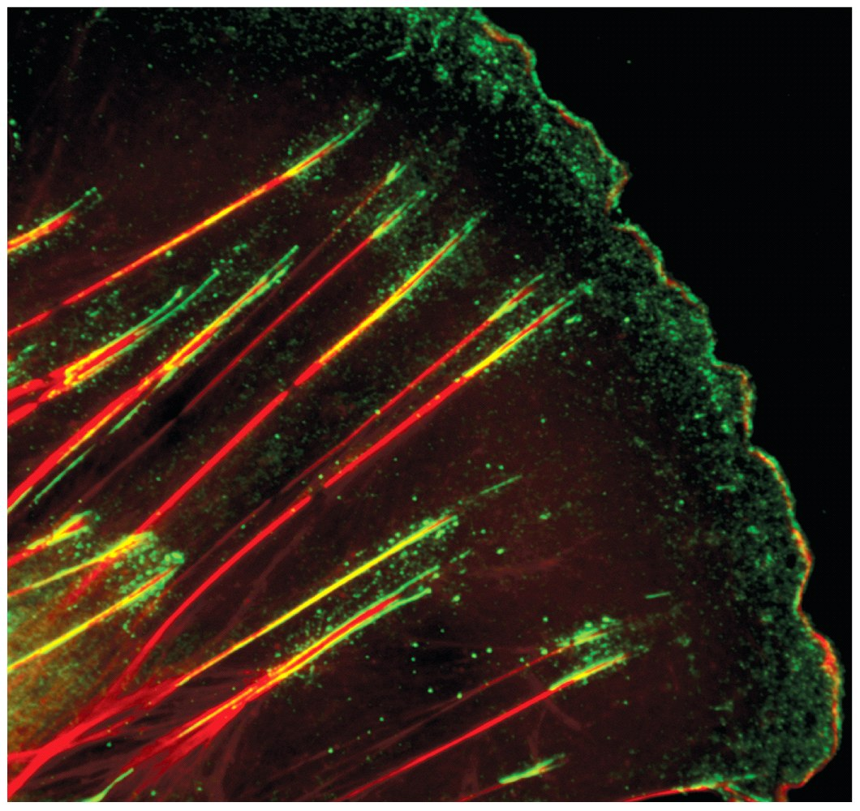
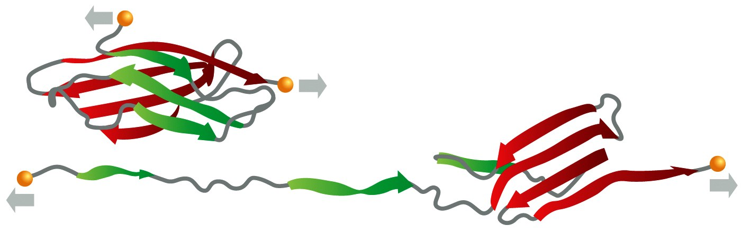
Fibronectin
Small fibronectin adhesive spots
Fibronectin fibers at fibrillar adhesion sites
Red: actin microfilaments

Slide 12
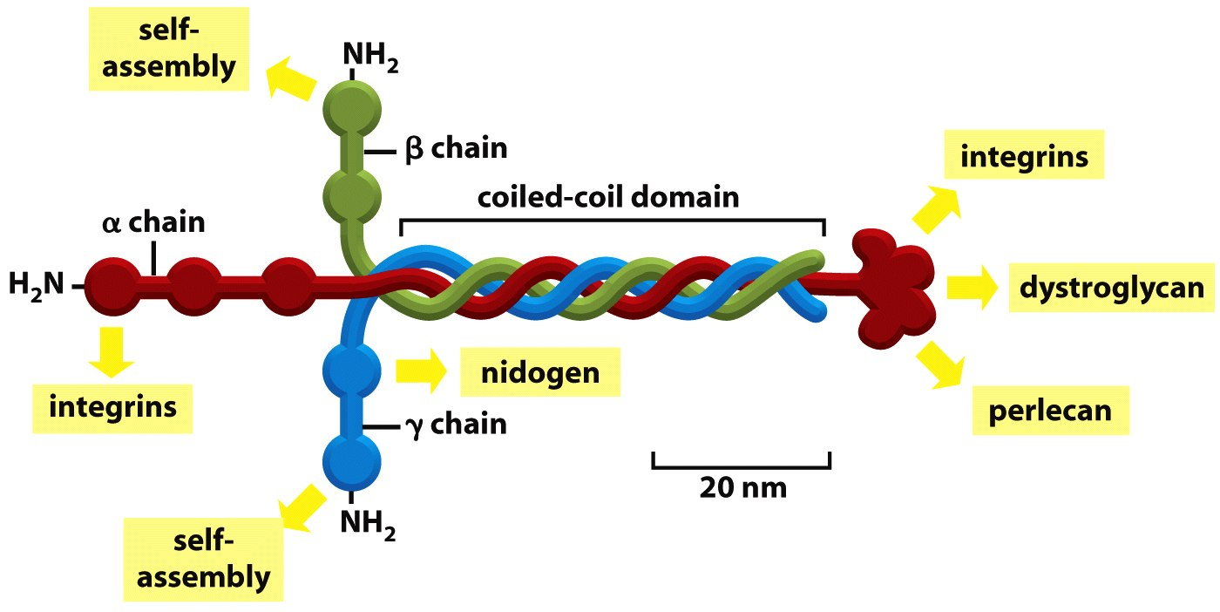
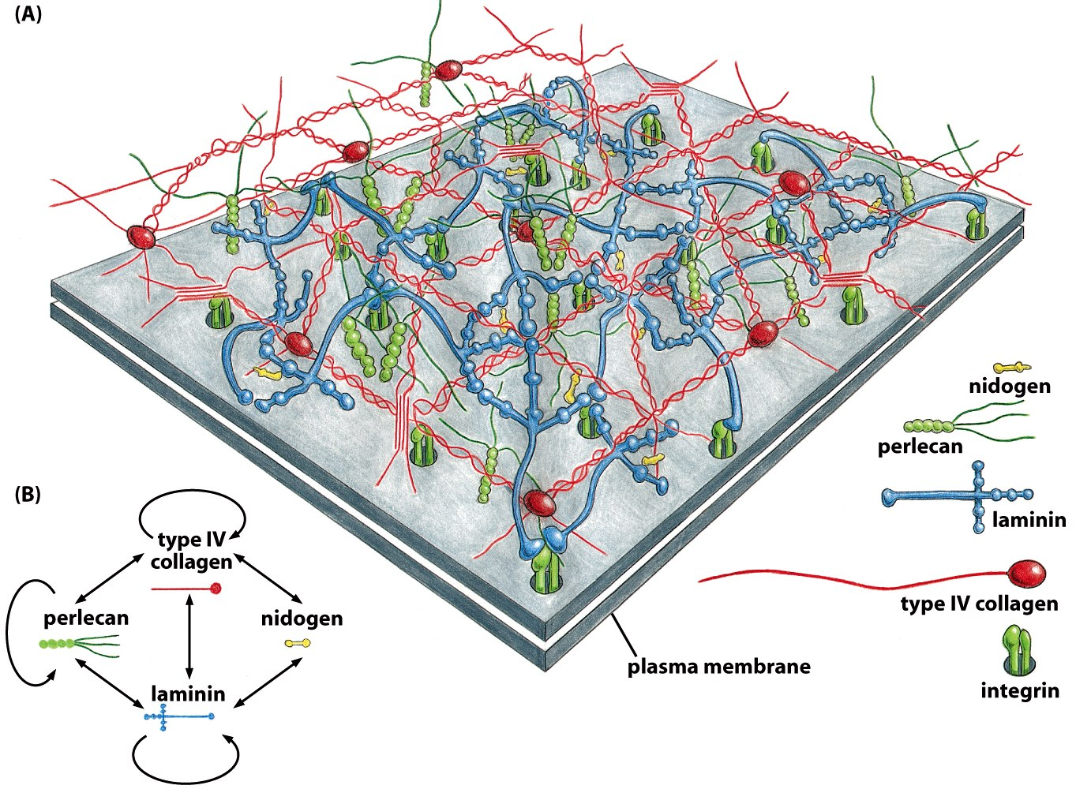
Laminin: Critical Organizer of Basal Lamina

Slide 13
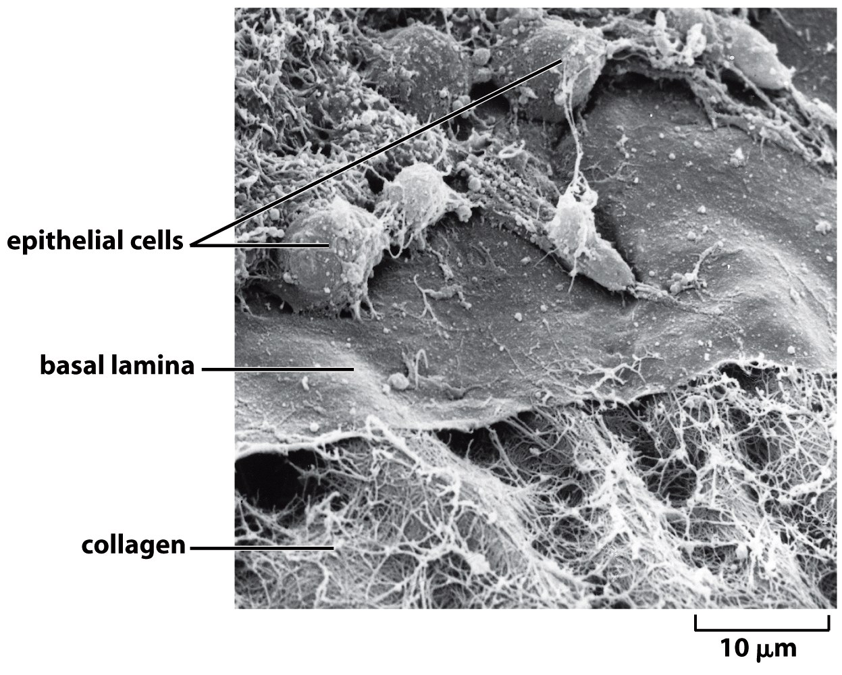
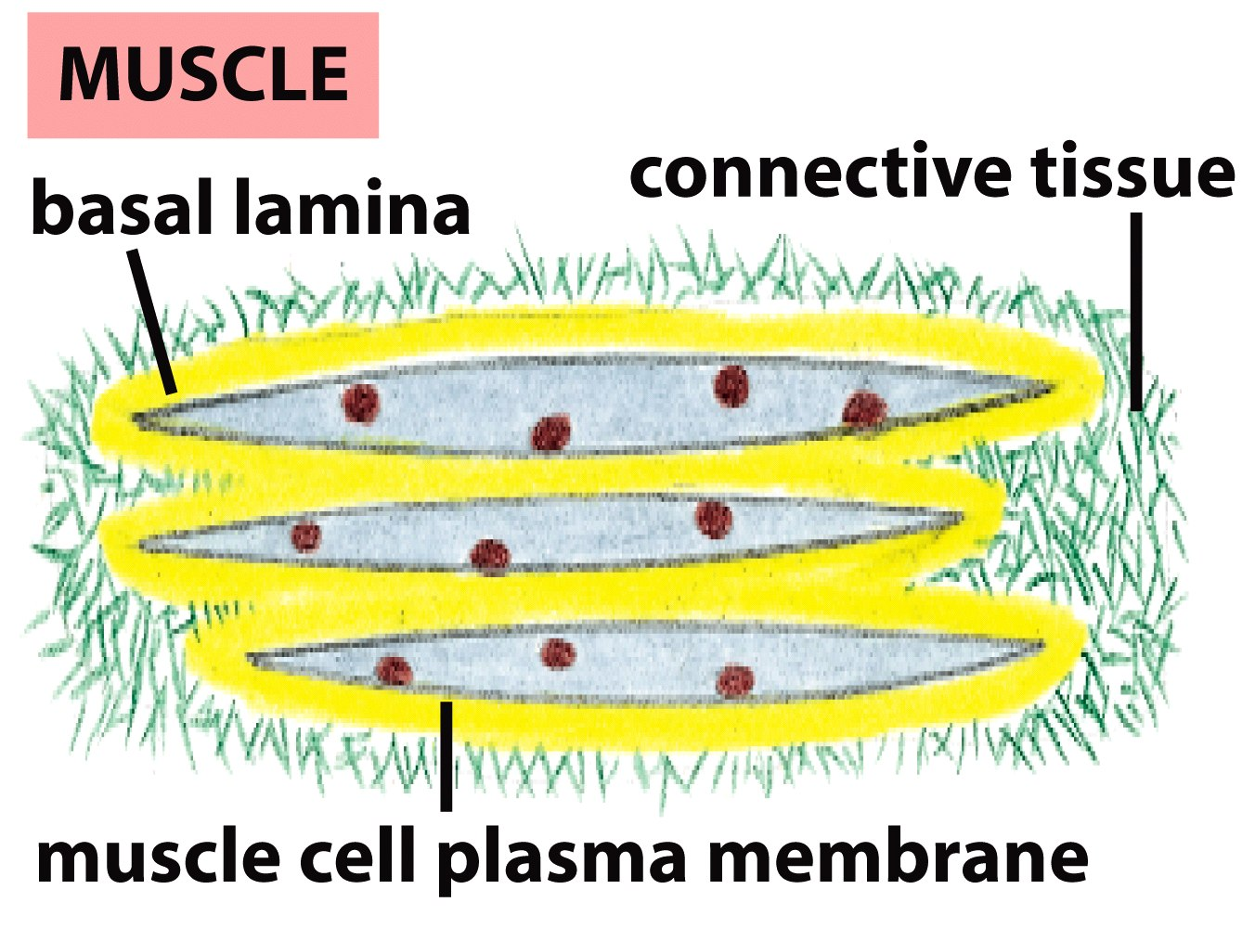
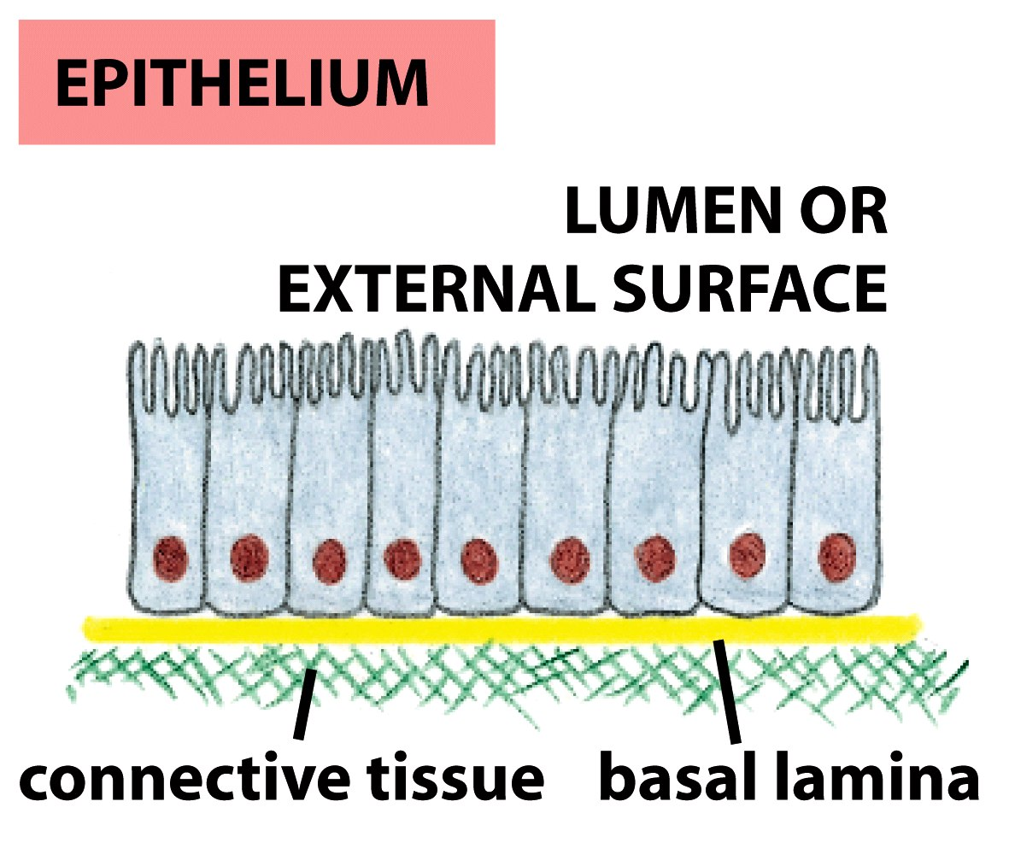
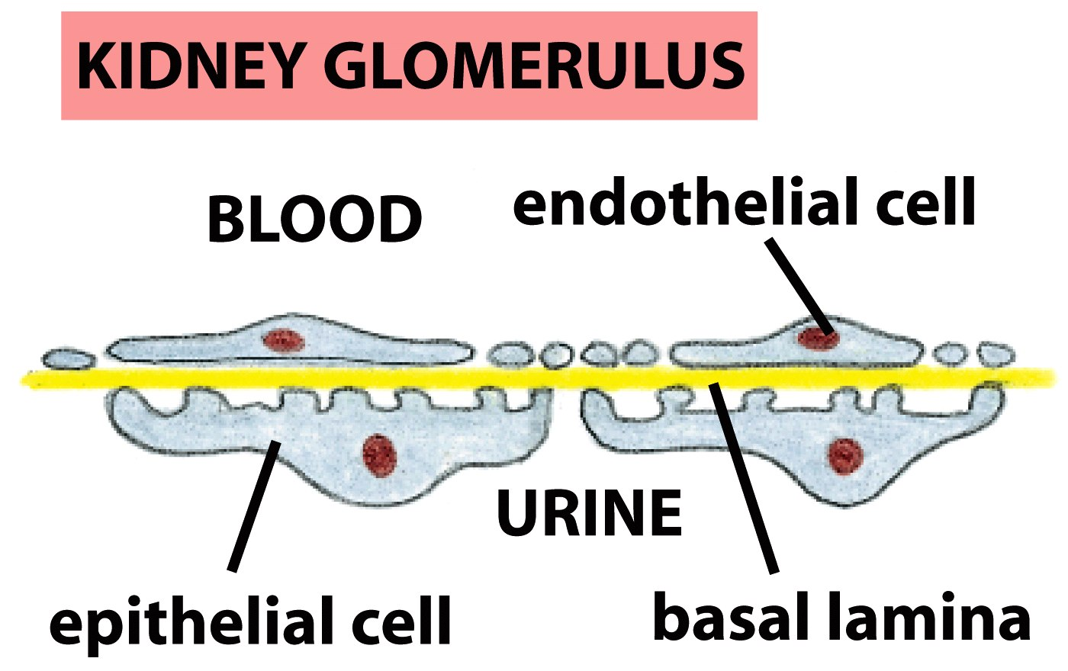
The Basal Lamina: architecture of all epithelia

Slide 14
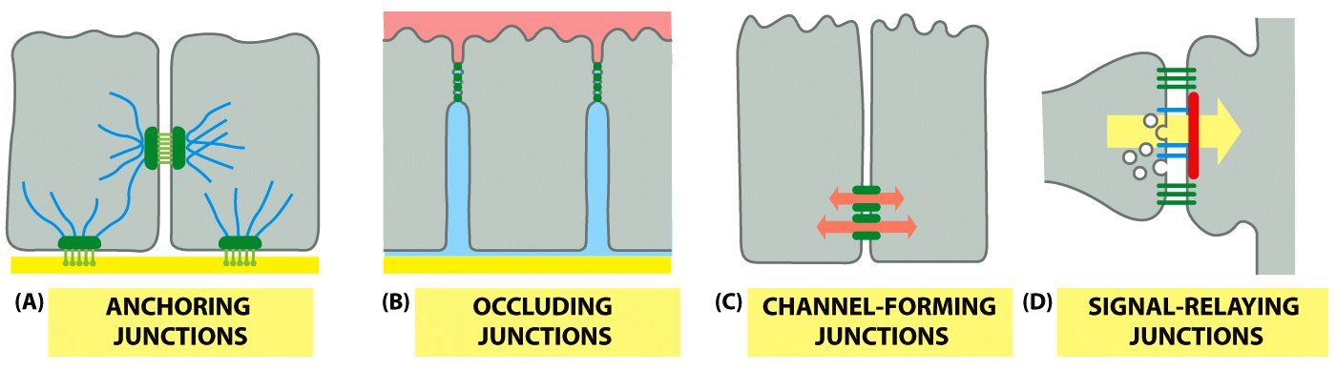
Cells have many different types of receptors

Slide 15
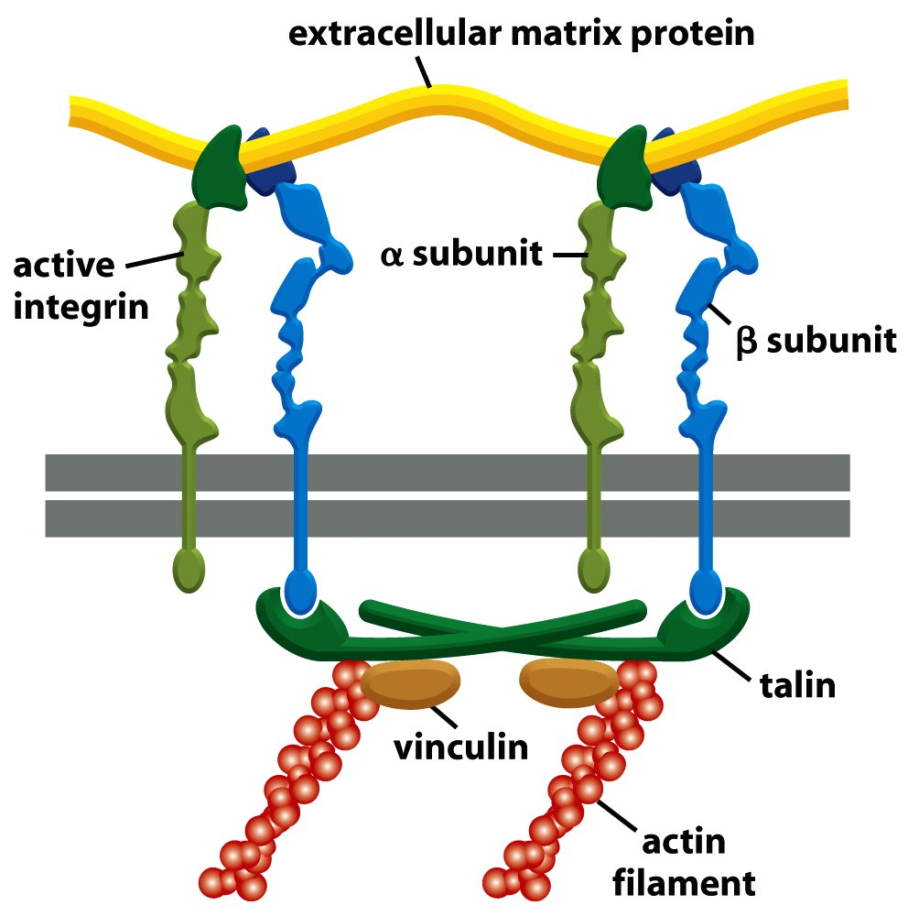
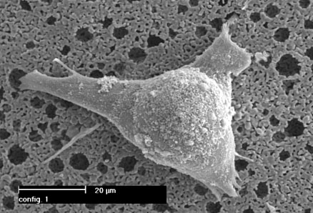
Integrin Structure
Integrins are one type of anchoring junction: anchor the cells to the matrix

Slide 16
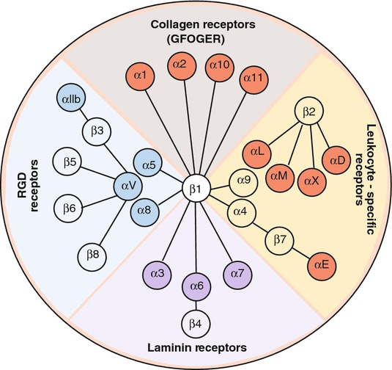
Many different heterodimers of integrins
Heterodimers are specific to the ECM proteins in tissue: matching cell type to tissue
8 betas, 18 alphas = 24 combinations (even though 8x18 = 144)

Slide 17
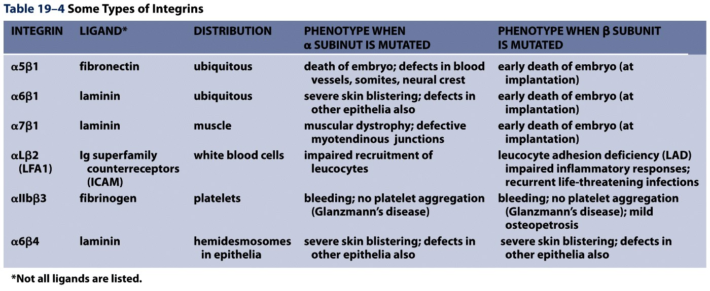
Not all cells express all integrin pairs!
Differential expression of integrins helps isolate cell types to different tissue areas
Epithelia: attach to laminin.
  Carcinoma (epithelial cancer) cells: begin to express fibronectin and collagen-binding integrins, so they can invade the surrounding tissue and metastasize.
Tissue engineered material: coat these with proteins that will ONLY BIND the cells you want there!

Slide 18
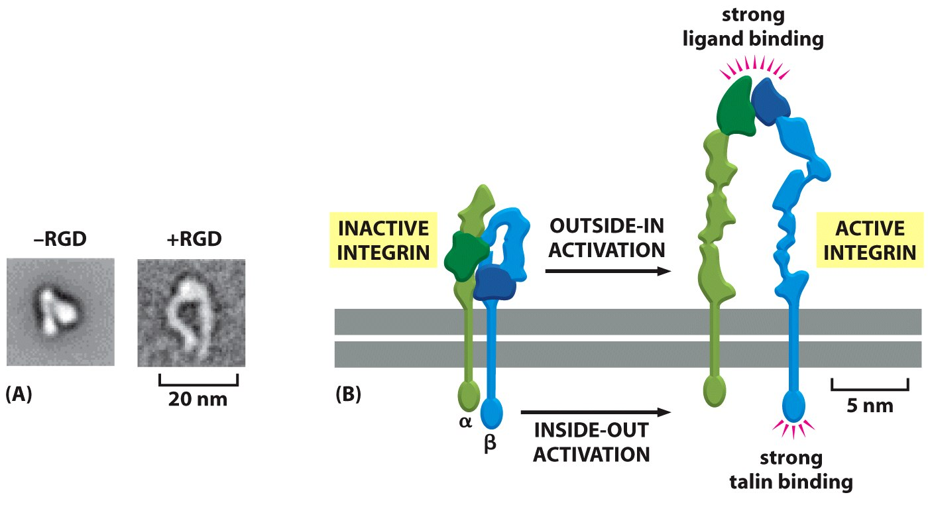
Integrins undergo conformation changes upon binding
RGD: short amino acid sequence that is part of Fibronectin, Vitronectin, Collagen
Focal Adhesion Formation
Signal!!! Survive, migrate, etc.

Slide 19
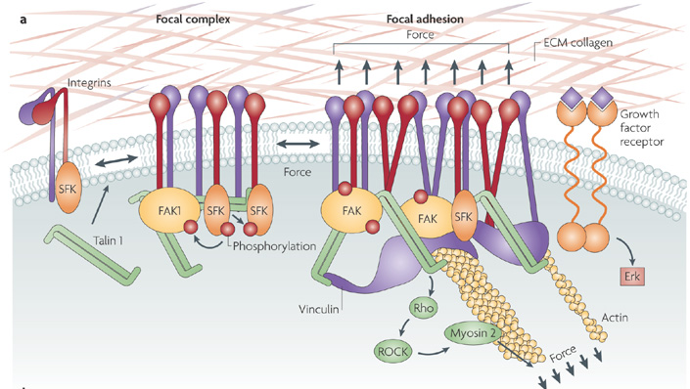
Stable bonds: 3-5 Integrins

Slide 20
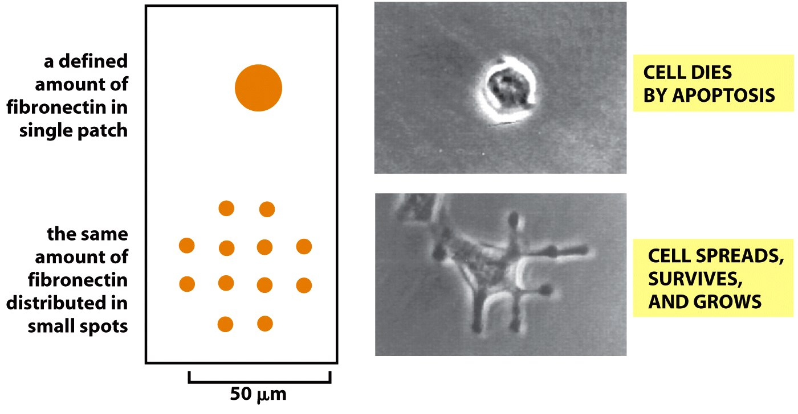
Anoikis on Engineered Substrates

Slide 21
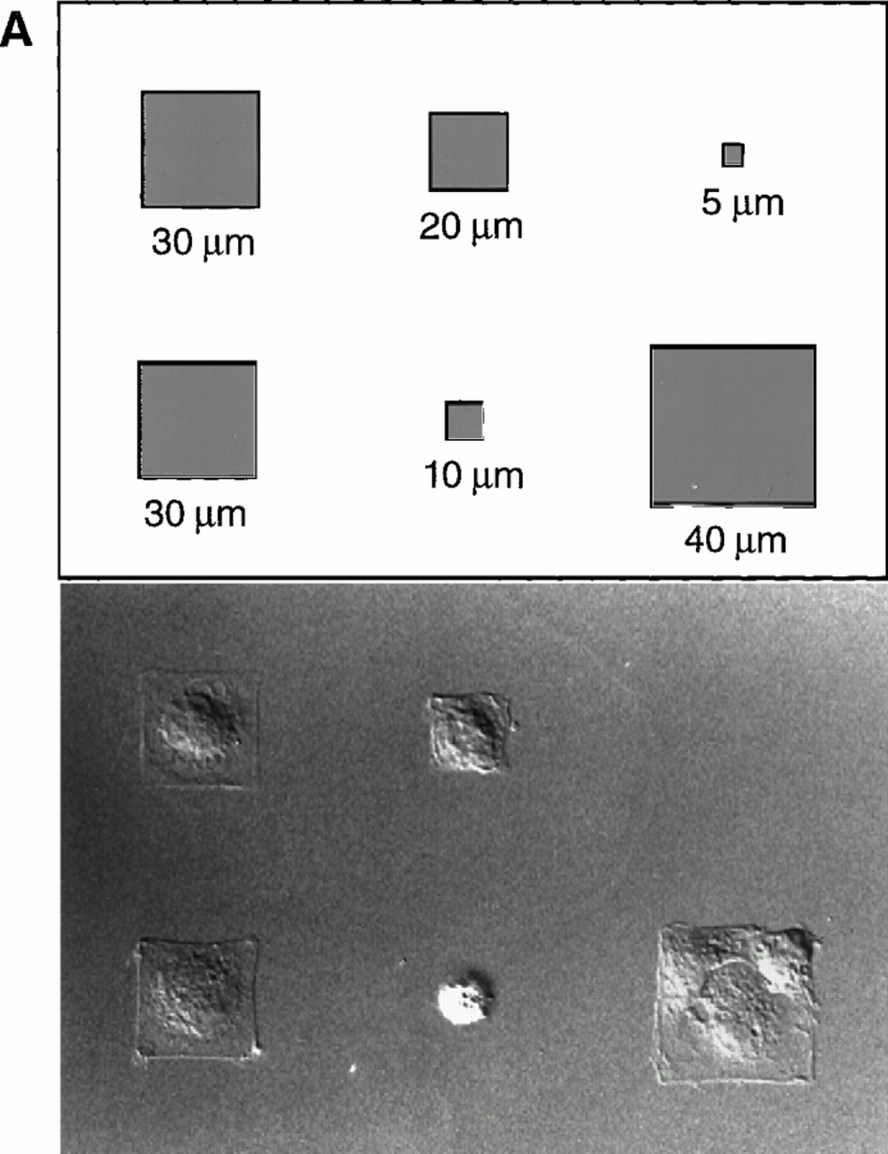
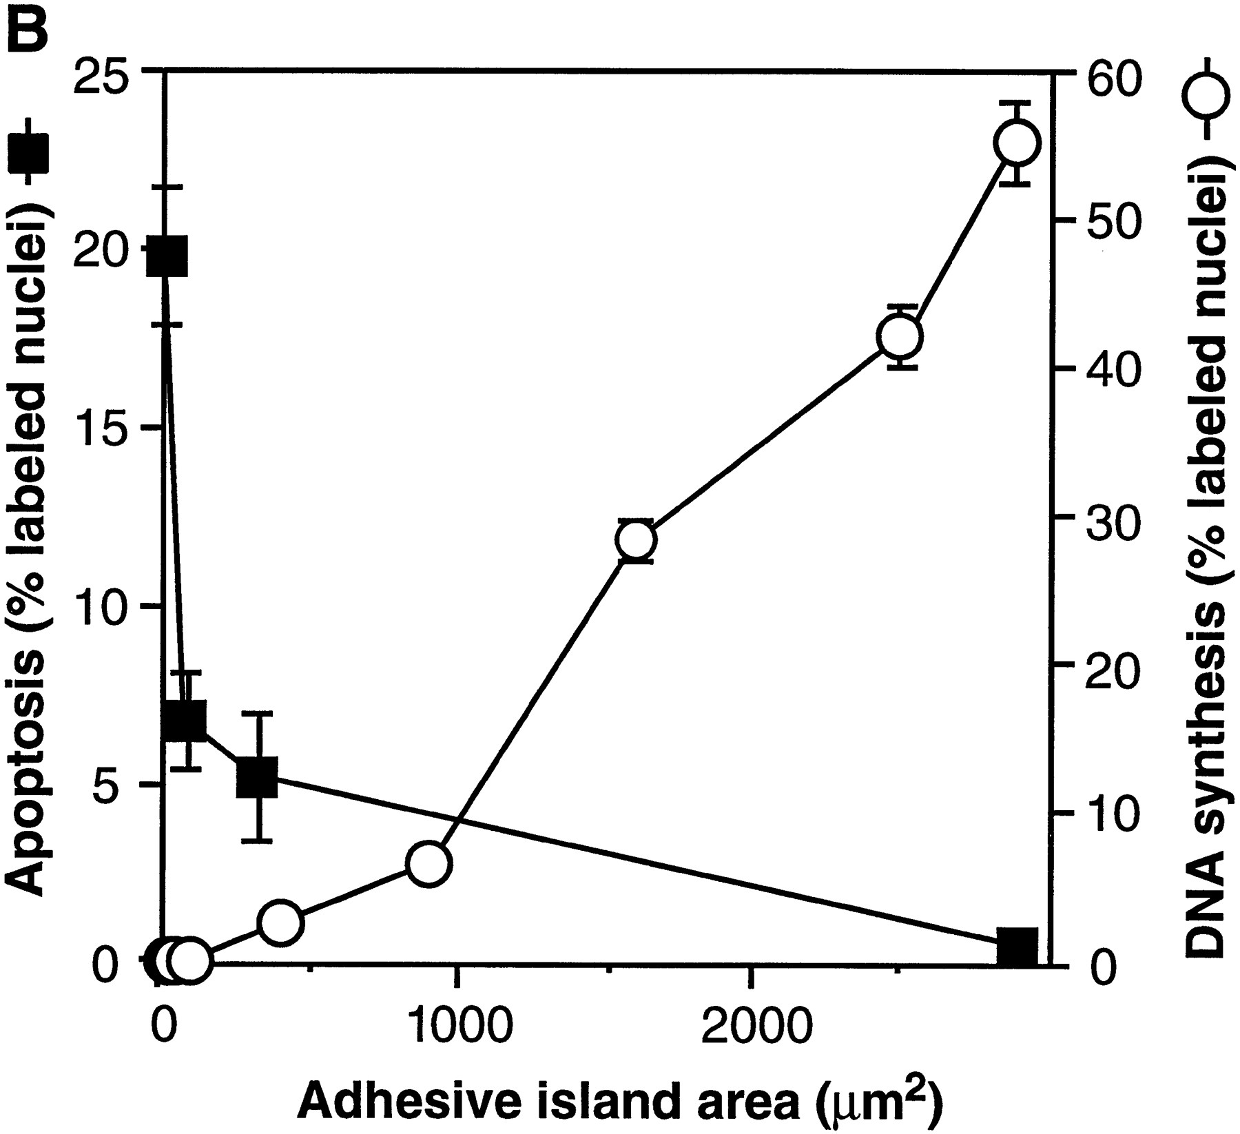
Adhesive Spot Size Dictates Survival
Geometric Control of Cell Life and Death
Christopher S. Chen, et al.
Science 276, 1425 (1997);

Slide 22
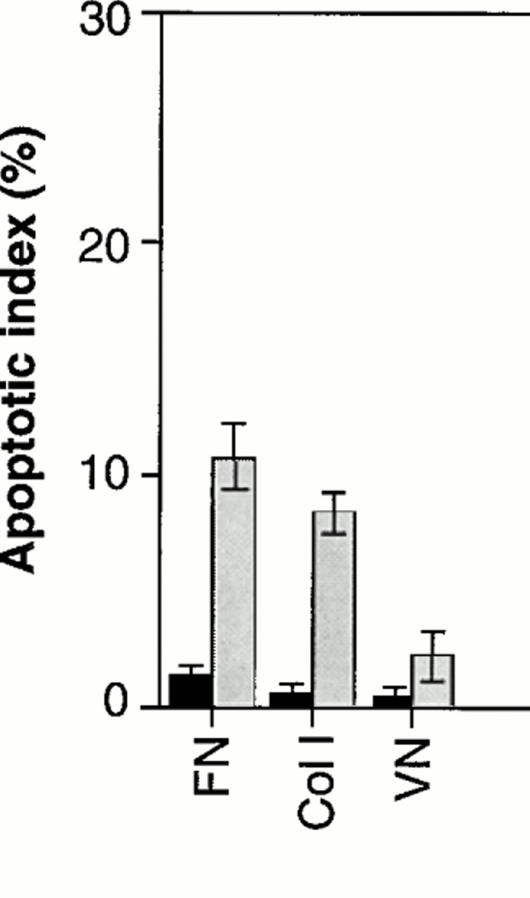
Cell-Shape regulated apoptosis is Integrin-Specific
Black: Unpatterned
Gray: 20um circle patterns
ECM protein coating
C S Chen et al. Science 1997;276:1425-1428
Notes:
Role of different integrin ligands in cell shape–regulated apoptosis. Apoptotic indices (percentage positive TUNEL staining) for cells cultured for 24 hours on unpatterned substrates (black bars) or on 20-μm circles (gray bars) coated with FN, type I collagen (Col I), vitronectin (VN), anti-β1, anti-αVβ3, or antibodies to both integrin β1 and integrin αVβ3 (29).

Slide 23
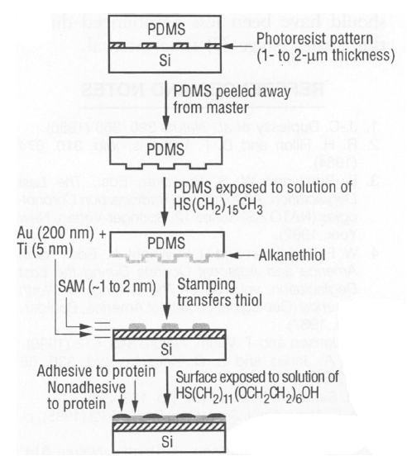
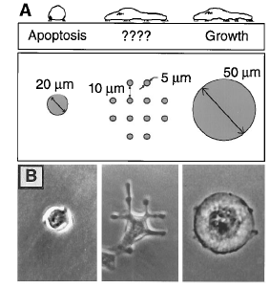
Traditional: Photolithography contact printing
R. Singhvi, A. Kumar, G. P. Lopez, G. N. Stephanopoulos, D. Wang, G. M. Whitesides and D. E. Ingber, Science, 1994,264,696-698
C.S. Chen, M. Mrksich, S. Huang, G. Whitesides and D.E. Ingber, Science 1997, 276, 1425-1428

Slide 24
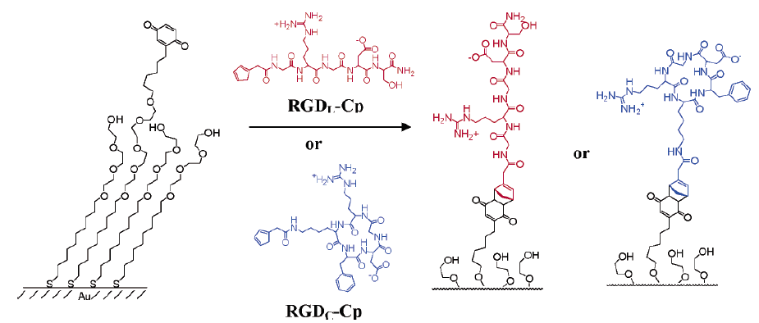
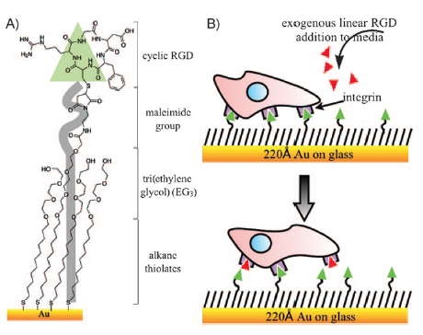
Self-assembled Monolayers
Chemical method directly on glass surface to modify cell adhesion
Use this method, like lithography, to control which peptides on surface
Use soluble integrin binding motifs to compete off bound integrins/cells.
linear
cyclic
Kato and Mrksich, Biochemistry 2004

Slide 25
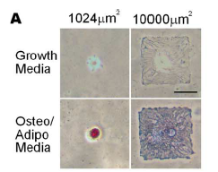
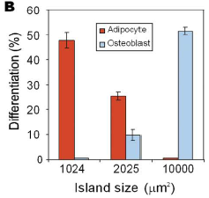
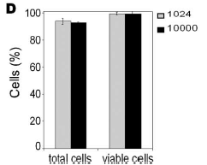
Stem Cell Differentiation regulated by controlling adhesion sites
Cell adhesive protein patterned on nonadhesive substrate
Large enough to not initiate anoikis
Small cells → fat
Large cells → bone
McBeath et al., Dev Cell, 2004

