Slide 1
Project 6: Strawberry
Nick Broadbent, Kelsey Lees
and Tami Reuter

Slide 2
Objective
To construct a system containing the Fragaria x ananassa quinone oxireductase gene (FaQR) gene that is testable through a green fluorescent protein (GFP) marker
To create a system containing the Strawberry alcohol acyltransferase gene (SAAT) testable through scent or gas chromatography.

Slide 3
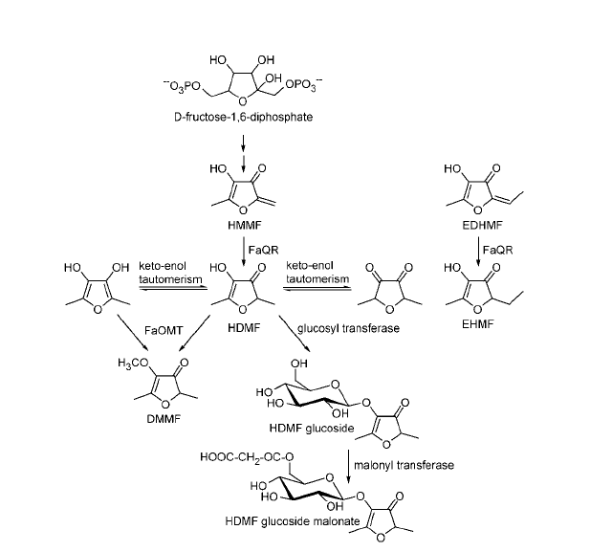
Strawberry Scent
Combonation of terpenes
FaQR synthesizes 4-hydroxy-2,5-dimethyl-3(2H)-furanone (HDMF)
SAAT synthesizes fruity esters

Slide 4
Parts Available
FaQR
  DNA accession number AY048861
  mRNA accession number AY048861
SAAT
  mRNA accession number AF193789
Tetracycline repressible promotor
  Bba_R0040
Inducable pBad/araC promotor
  Bba_I0500
Green fluorescent protein
  Bba_E0040

Slide 5
FaQR Protocol
DNA extracted from Fragaria x ananassa (Weston) Duchene ex Rozier tissue
  Fruit vs leaves
  Protocol: Mercado et al (1999)
Amplified through a PCR reaction using mRNA
  Protocol: Kiefer et al (2008)
mRNA PCR products made into using reserve transcriptase
Products ran on agarose gel, bands cut out and purified

Slide 6
FaQR Protocol
FaQR fused with a tetracycline promotor and GFP
Device put into a plasmid then into E. coli
System tested through use of GFP
(R0040) TetR Repressable Promotor
FaQR Gene
(E0040) GFP

Slide 7
SAAT Protocol
SAAT amplified using mRNA
  Protocol of Mercado et al (2008)
Made into DNA with reverse transcriptase, run on a gel, bands cut out and purified
Two promotors
  Tetracycline
  Arabinose
Put into plasmid, then E. coli
Bacteria grown in gradient mediums containing specific promotor inducer and Acyl-CoA

Slide 8
SAAT Protocol
Tested using scent
  25 individuals will smell plates
Tested using gas chromatography

Slide 9
References
Aharoni, A., A.P. Giri, F.W.A. Verstappen, C.M. Bertea, R. Sevenier, Z. Sun, M.A Jongsma,W. Schwab, and H.J Bouwmeester. Gain and Loss of Fruit Flavor Compounds Produced by Wild and Cultivated Strawberry Species. The Plant Cell 16: 3110-3131.
Elowitz, M.B. and S. Leibler. 2000. A Synthetic Oscillatory Network of Transcriptional Regulators. Letters to Nature 403: 335-338.
Kiefer, E., W. Heller and D. Ernst. 2008. A Simple and Efficient Protocol for Isolation of Functional RNA from Plant Tissues Rich in Secondary Metabolites. Plant Molecular Biology Reporter 18(1): 33-39.
Klein, D., B. Fink, B. Arold, W. Eisenreich, and W. Schwab. 2007. Functional Characterization of Enone Reductases from Strawberry and Tomato Fruit. Journal of Agricultural and Food Chemistry 55: 6705-6711.
Mercado, J., I. el Mansouri, S. Jimenez-Bermudez, F. Pliego-Alfaro and M.A. Quesada. 1999. A Convenient Protocol for Extraction and Purification of DNA from Fragaria. In Vitro Cellular Developmental Biology: Plant 35: 152-153.
Raab, R., J.A. Lopez-Raez, R. Klein, J.L. Caballero, E. Moyano, W. Schwab, and J. Munoz-Blanco. FaQR, Required for the Biosynthesis of the Strawberry Flavor Compound 4-Hydroxy-2,5-Dimethyl-3(2H)-Furanone, Encodes an Enone Oxidoreductase. The Plant Cell 18:1023-1037.

