Slide 1
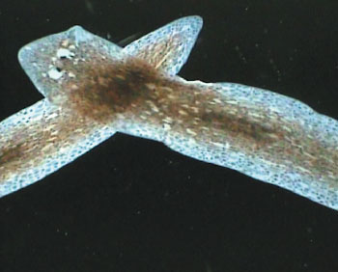
G.tigrina Hox gene DthoxC insertion into prokaryote E.coli
– by UNIamCloning

Slide 2
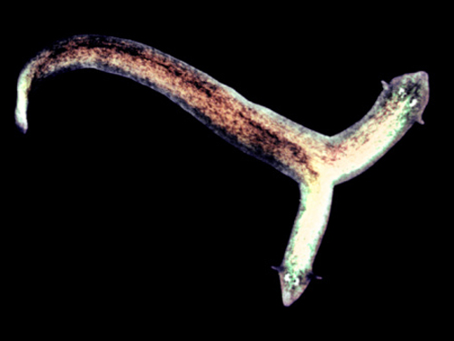
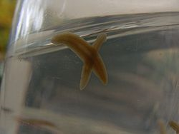
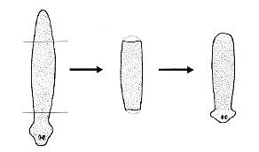
G.Tigrina & the Hox genes
G. tigrina – (also known as Dugesia tigrina) – are free-living flatworms found in still fresh water. Commonly used in biology teaching labs, these planarians show a profound capability to regenerate bidirectionally from cuts made at nearly any point in their bodies.
http://users.rcn.com/jkimball.ma.ultranet/BiologyPages/D/DugesiaRegeneration004.jpg
http://biomessecond09.wikispaces.com/file/view/250px-Dugesia_subtentaculata.jpg
http://www.newscientist.com/data/galleries/regeneration/00494937c40.jpg

Slide 3
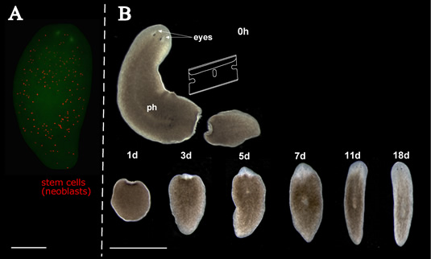
G.Tigrina & the Hox genes
The Hox genes comprise a homeobox in the homeotic gene complex (HOM-C). They are involved in the anteroposterior axial patterning of animal embryos and relay positional identity along this axis for regeneration in platyhelminthes.
Dthox genes regulate
the anterior positioning
of blastemas. When
Dthox expression is
prematurely terminated,
the cells seem to no longer
be able to distinguish
between the head and tail
end of the organism.
http://www.nottingham.ac.uk/biology/resources/gonzalez-estevez/images/Figure1.jpg

Slide 4
G.Tigrina & the Hox genes
DThoxC contains 942 base pairs, no introns, and three internal restriction sites.
The full sequence can be found at NCBI accession number: X95416
More information concerning its expression and function in G.tigrina can be found in “Planarian Hox genes: novel patterns of expression during regeneration”, (Bayascas et al.)

Slide 5
Overview of Cloning Process
1) Extract DNA using methodology from Balavoine et Telford, 1995.
2) Amplify entire DthoxC gene using polymerase chain reaction
(PCR) and primers without BioBrick extensions. Check nucleotide
sequence for matching DthoxC gene.
3) Remove internal restriction sites (EcoRI) using site-directed
mutagenesis. Two of the three sites are only 18 base pairs apart
and will be removed with two nucleotide adjustments on one
primer. Thus the gene will be fragmented into three segments,
each of which must be amplified via PCR.
4) The three amplified gene fragments will then be inserted into pGEM-T
vectors and recombined via ligation.
5) The pGEM-T vectors will be placed into E.coli, amplified, and sequenced
to determine if the gene fragments properly recombined and the
restriction sites were removed.
6) Enzymatically remove recombined gene from pGEM-T vector. Next, the BioBrick
extensions will be tagged onto the DthoxC gene primers and amplified for
placement into BioBrick-compatible protein expression vectors. This will be placed
into E.coli and cloned, sequenced, and tested via SDS page for expression.

Slide 6
1) Extract DNA using methodology from Balavoine et Telford, 1995.
Planarians will be starved for 1 week (group A) and 2 weeks (group B), cut along the medial-lateral axis, and placed in darkness overnight.
Buffer and proteinase K will then be added to the tissue samples and allowed to lyse overnight.
The DNA sample will be purified before PCR.

Slide 7

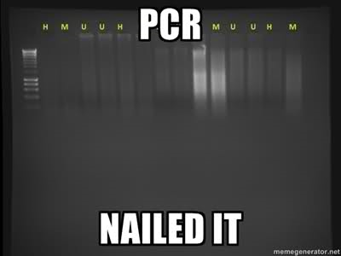
2) Amplify entire DthoxC gene using polymerase chain reaction (PCR) and primers without BioBrick extensions.
Primers:
5'-ATG CAT GTC GAT CCT AAC GT-3'
5'-CTC GCA GCA GTA CAA TTA G-3'
http://i53.tinypic.com/rlypi0.jpg

Slide 8
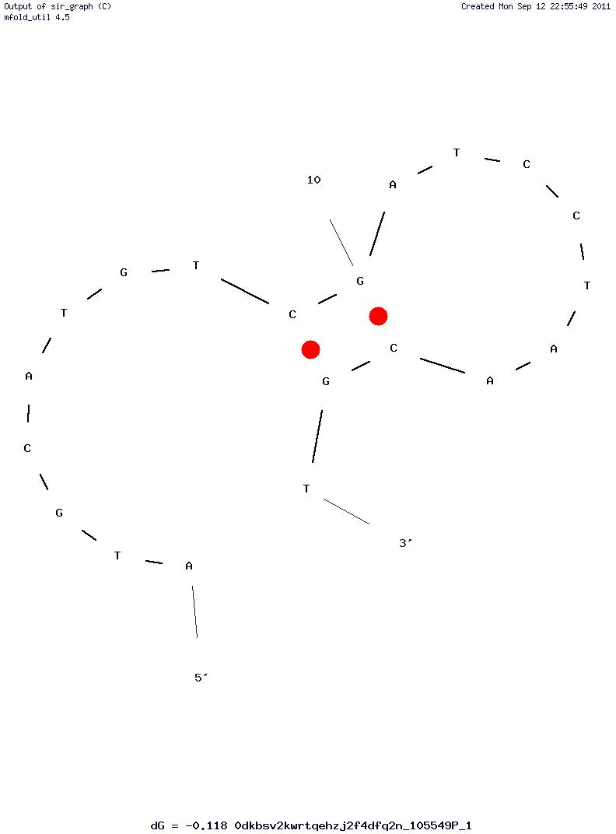
2) Amplify entire DthoxC gene using polymerase chain reaction (PCR) and primers without BioBrick extensions.
Primers:
5'-ATG CAT GTC GAT CCT AAC GT-3'
^ The forward primer
LENGTH: 20 bp
GC CONTENT: 45.0 %
MELT TEMP: 54.0 ºC
Hairpin
∆G (kcal.mol-1): -0.12
http://www.idtdna.com/Scitools/Applications/UNAFold/Extras.ashx?img=0dkbsv2kwrtqehzj2f4dfq2n_105549P_1/0dkbsv2kwrtqehzj2f4dfq2n_105549P_1_1_thm.jpg&cdnblocker=true

Slide 9
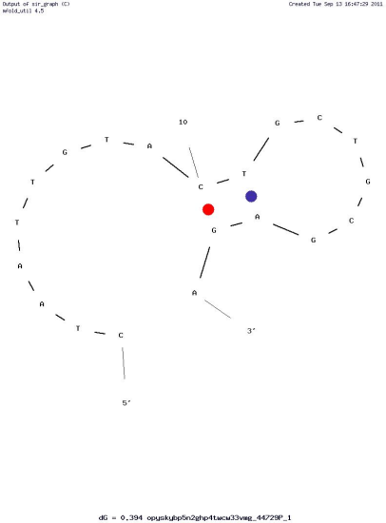
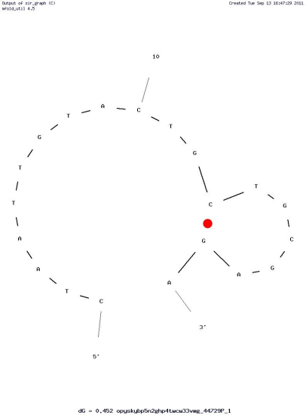
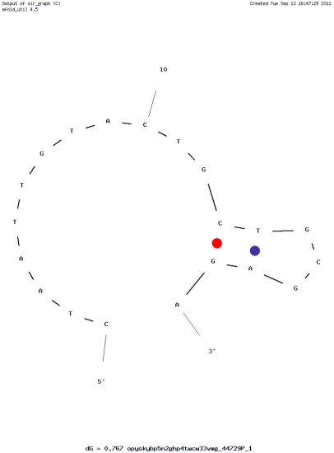
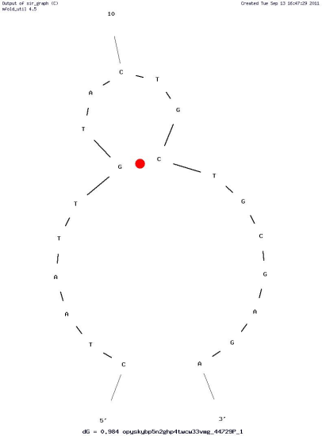
2) Amplify entire DthoxC gene using polymerase chain reaction (PCR) and primers without BioBrick extensions.
Primers:
5'-CTA ATT GTA CTG CTG CGA GA-3'
^ The reverse primer
LENGTH: 20 bp
GC CONTENT: 45.0 %
MELT TEMP: 52.1 ºC
Hairpins
∆G (kcal.mol-1): 0.39 0.77
0.45 0.98
http://www.idtdna.com/analyzer/applications/oligoanalyzer/

Slide 10
3) Remove internal restriction sites (EcoRI) using site-directed mutagenesis.
5’ – atgcatgtcg atcctaacgt tccaaatcca ctgcaaaatt cccctagtaa acttctgtcc …
5’ – atgcatgtcg atcctaacgt →
… atcaattaga gctagtgaaa acctacaata tctcgcagca gtacaattag – 3’
<– agagcgtcgt catgttaatc – 3’
Ordered as: 5’ – ctaattgtac tgctgcgaga – 3’
2nd set of primers with the BioBrick extensions:
BioBrick prefix: gaattcgcggccgcttctag
BioBrick suffix: tactagtagcggccgctgcag

Slide 11
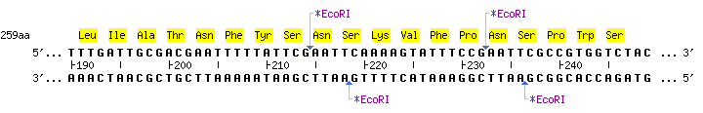
3) Remove internal restriction sites (EcoRI) using site-directed mutagenesis.
“Two of the three sites are only 18 base pairs apart and
will be removed with two nucleotide adjustments on one primer.”

Slide 12
3) Remove internal restriction sites (EcoRI) using site-directed mutagenesis.
“…Thus the gene will be fragmented into three segments,
each of which must be amplified via PCR.”
http://tools.neb.com/NEBcutter2/showdig.php?name=3e75c6dd-

Slide 13
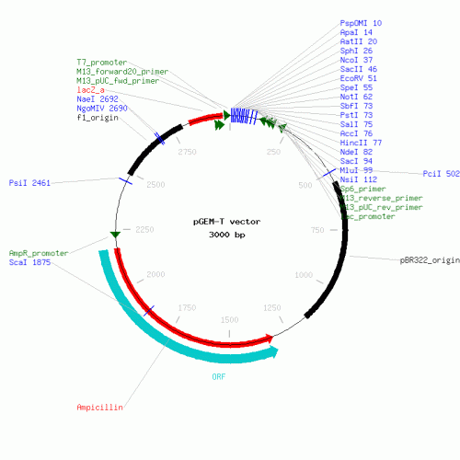
4) The three amplified gene fragments will then be inserted into pGEM-T vectors and recombined via ligation.
https://www.lablife.org/g?a=seqa&m=draw_circular_map&id=vdb_g2.48w4wHQFn40rkTg94kOG0HueJzk-_sequence_e6f4465c63819993d305510f9ed3878baddb8f37_10&mtime=1271612854

Slide 14

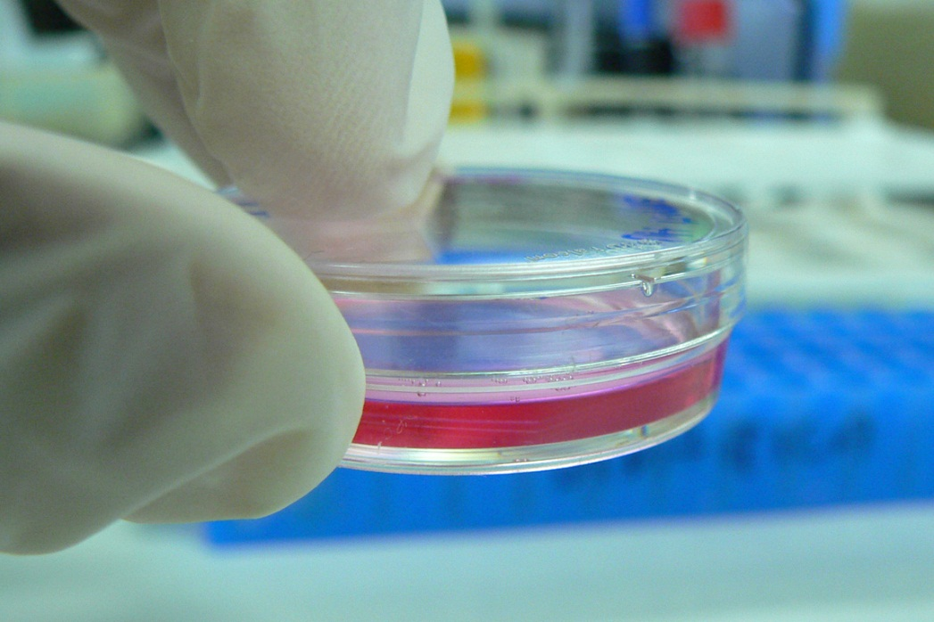

5) The pGEM-T vectors will be placed into E.coli, amplified, and sequenced to determine if the gene fragments properly recombined and the restriction sites were removed.
https://www.lablife.org/g?a=seqa&m=draw_circular_map&id=vdb_g2.48w4wHQFn40rkTg94kOG0HueJzk-_sequence_e6f4465c63819993d305510f9ed3878baddb8f37_10&mtime=1271612854
http://upload.wikimedia.org/wikipedia/commons/6/68/Cell_Culture_in_a_tiny_Petri_dish.jpg
http://www.easterndrafting.ca/includes/imgs/process/arrow.jpg

Slide 15
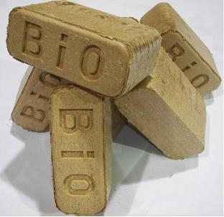
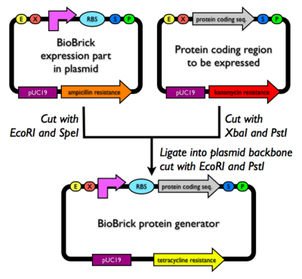
6) Next, the BioBrick extensions will be tagged onto the DthoxC gene primers and amplified for placement into BioBrick-compatible protein expression vectors.
http://www.biopellet.net/sitebuilder/images/good2-312x302.jpg
http://partsregistry.org/wiki/images/thumb/c/c6/BioBrickexpressionvector.png/400px-BioBrickexpressionvector.png

Slide 16
6) Next, the BioBrick extensions will be tagged onto the DthoxC gene primers and amplified for placement into BioBrick-compatible protein expression vectors.
The (Strong) Promoters:
R0011+B0034
(IPTG-inducible promoter
R0011 w/ strong RBS B0034)
Part:BBa_K320002
(constitutive)
Part:BBa_K137029
(constitutive)
http://partsregistry.org/wiki/images/thumb/c/c6/BioBrickexpressionvector.png/400px-BioBrickexpressionvector.png

Slide 17
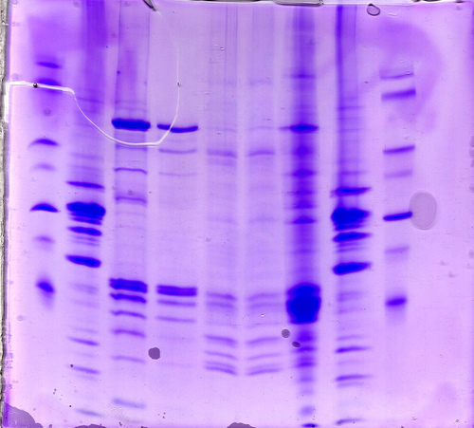
This vector will be placed into E.coli and cloned, sequenced, and tested via SDS page for expression.
SDS-page
1) Functionality testing not an option for regenerative gene in E.coli, so a sodium dodecyl sulfate-polyacrylamide gel electrophoresis will be performed to check expression.

Slide 18
This vector will be placed into E.coli and cloned, sequenced, and tested via SDS page for expression.
SDS-page
2) In order for this test to be super-effective, especially strong promoters were sought in the Registry of Standard Biological Parts.
The (Strong) Promoters:
R0011+B0034
Part:BBa_K320002, Part:BBa_K137029

