Slide 1
Introduction to Biomaterials
590B: Lecture 7
2/12/13

Slide 2
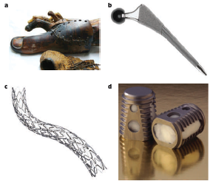
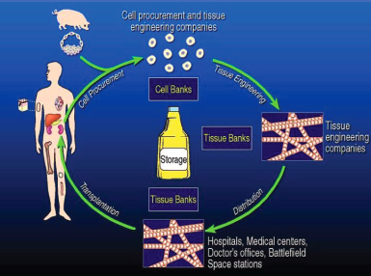
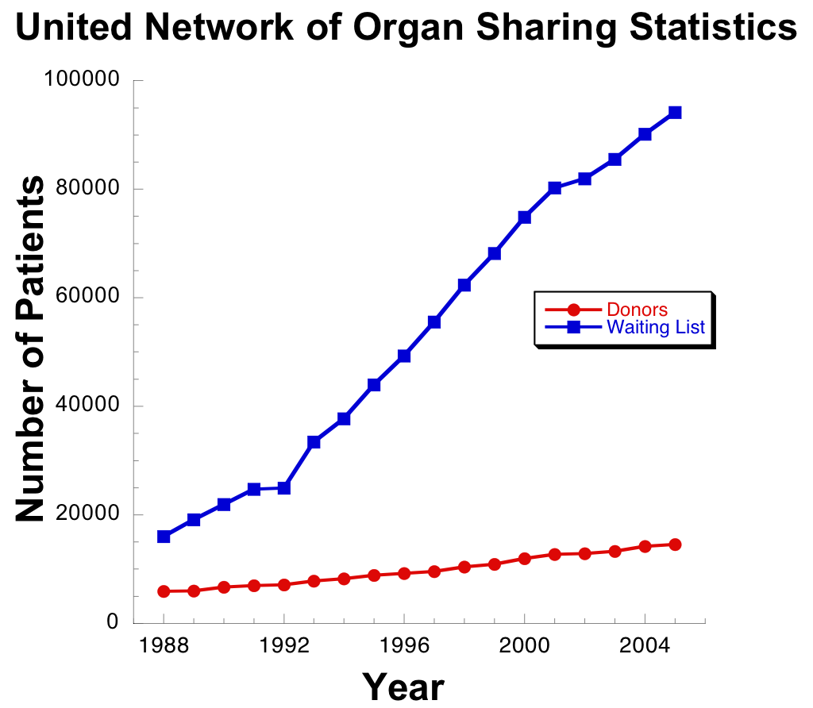
History of biomaterials
Biomaterials range from prosthetics, to stents, to implantable scaffolds
Biomaterials developed, at least initially, for tissue engineering
Huebesch and Mooney, Nature, 2009
Mikos et al., Tissue Engineering 2006

Slide 3
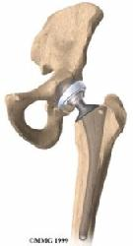
Bioinert materials
Purposes:
1) do not entice an immune response once implanted into the body.
2) Have incredible mechanical toughness withstand physiological loading
3) Long lasting in the body (won’t degrade over time)
Applications:
1) Skeletal tissue prosthesis (hip, knee replacement)
2) Vascular stents, heart valves
3) Tooth caps, replacements, other dental applications

Slide 4
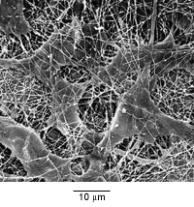
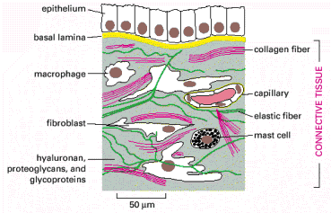
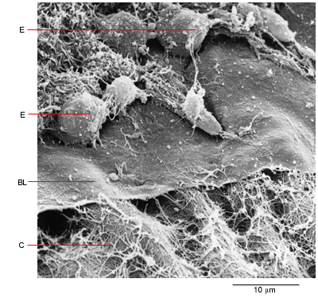
Natural biopolymers
Taken straight from body: are native proteins found in the ECM
Fibrous, instructive, soft (in bulk): the opposite of bioinert examples
Regulate cell function, act as a physical scaffold, can be remodeled by cells
Not very controllable (lumped parameters)
Images taken from Molecular Biology of the Cell
Examples: Type I Collagen, Fibrin, Matrigel

Slide 5
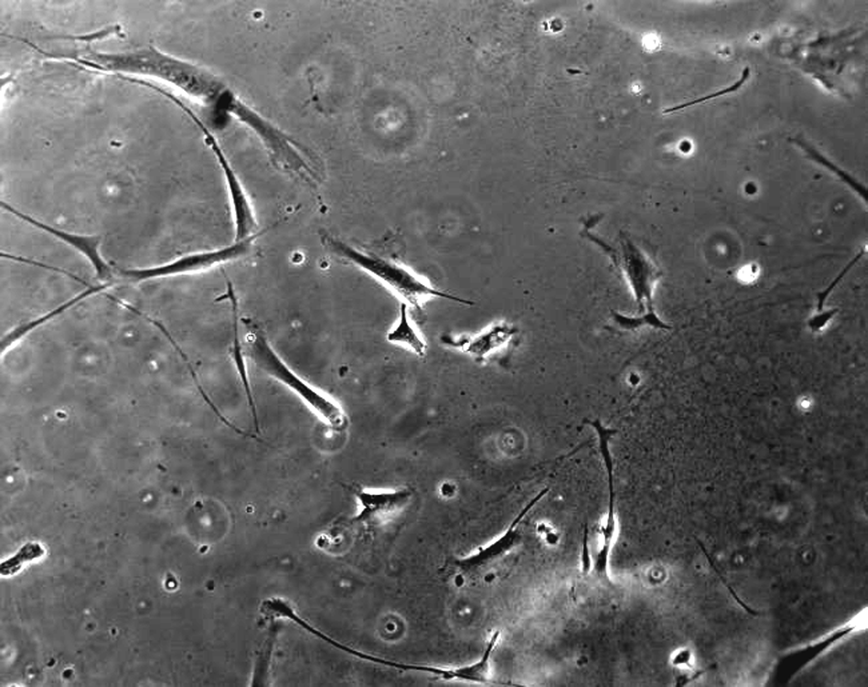
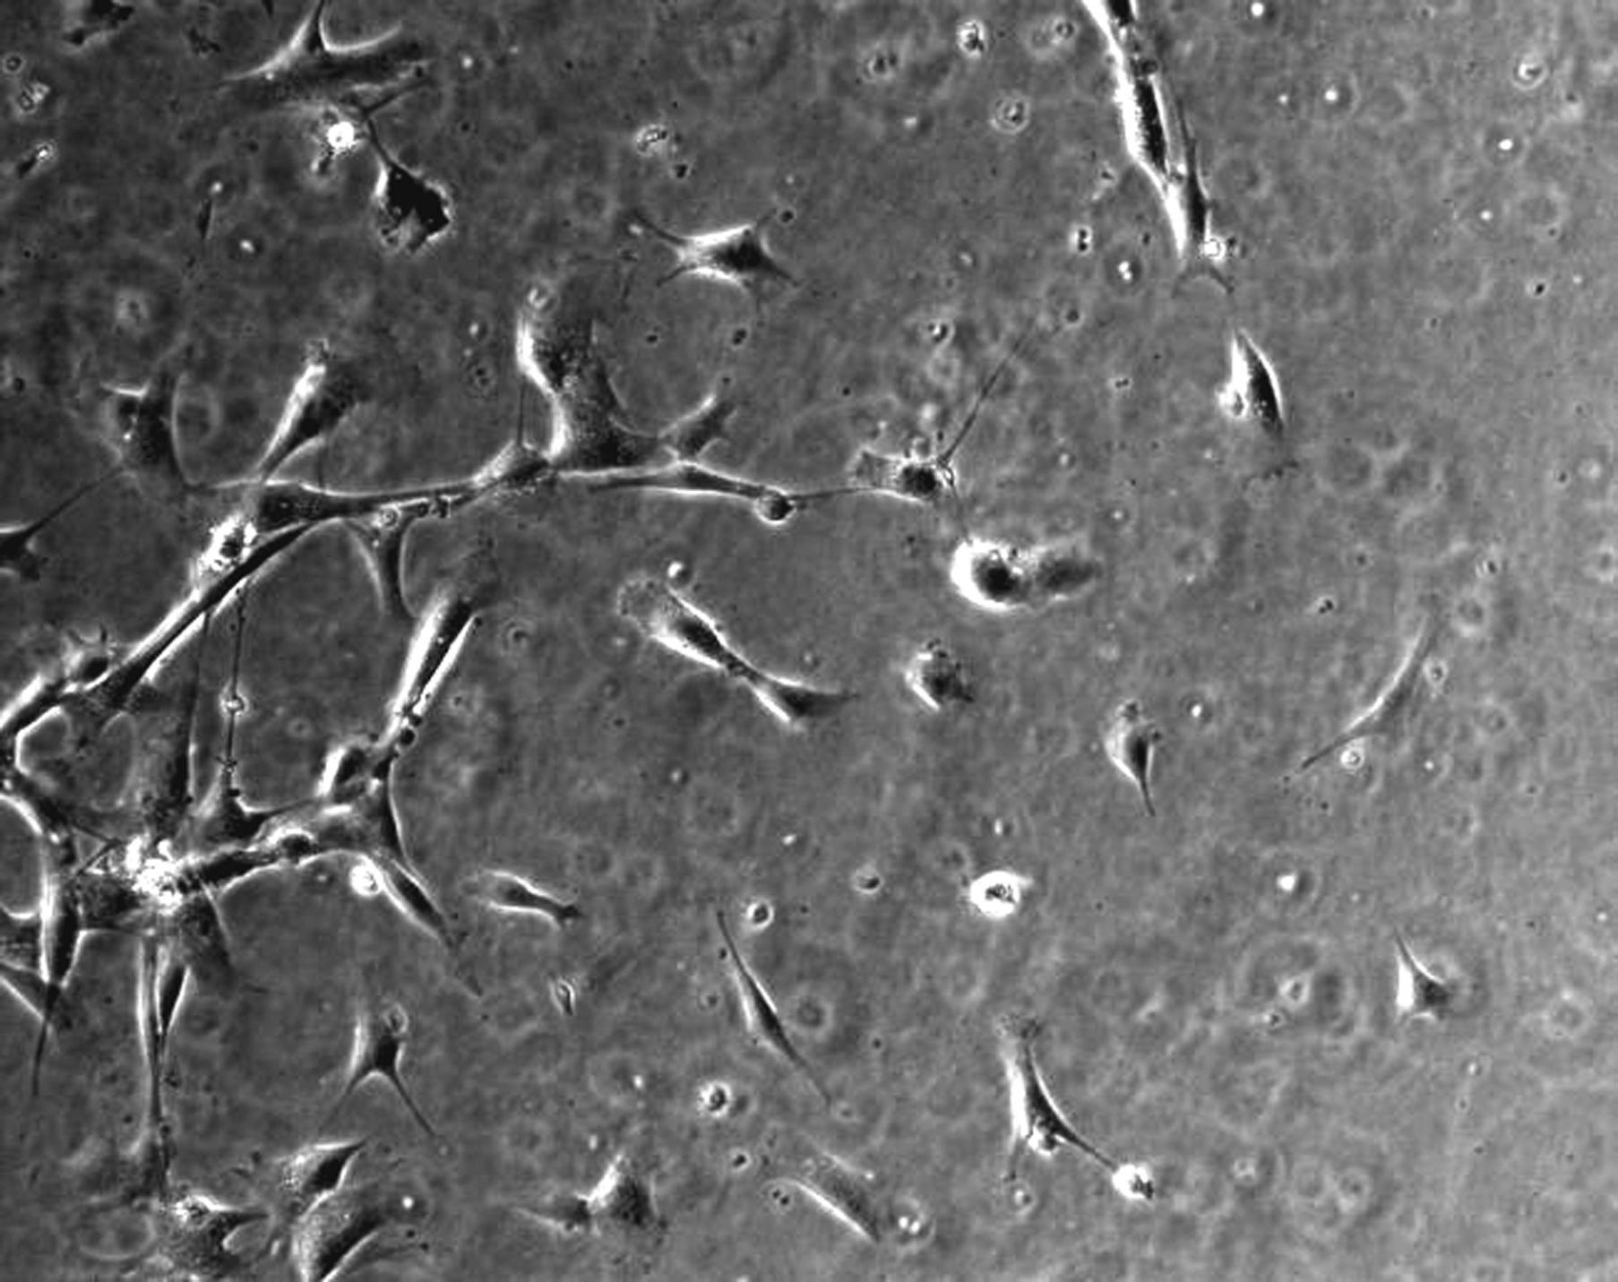
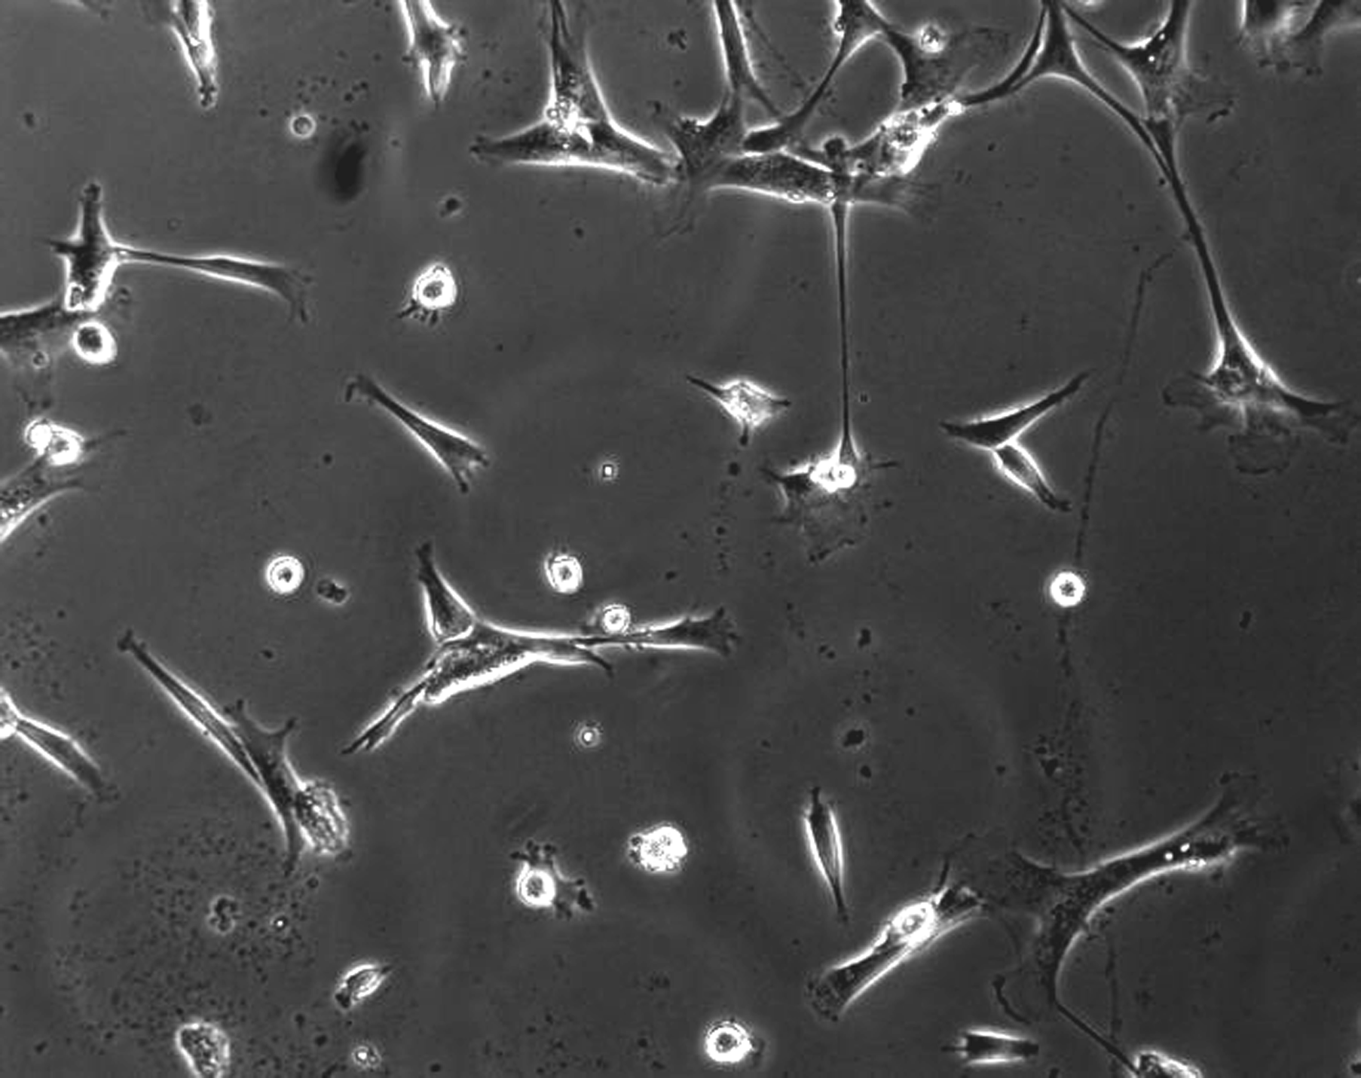
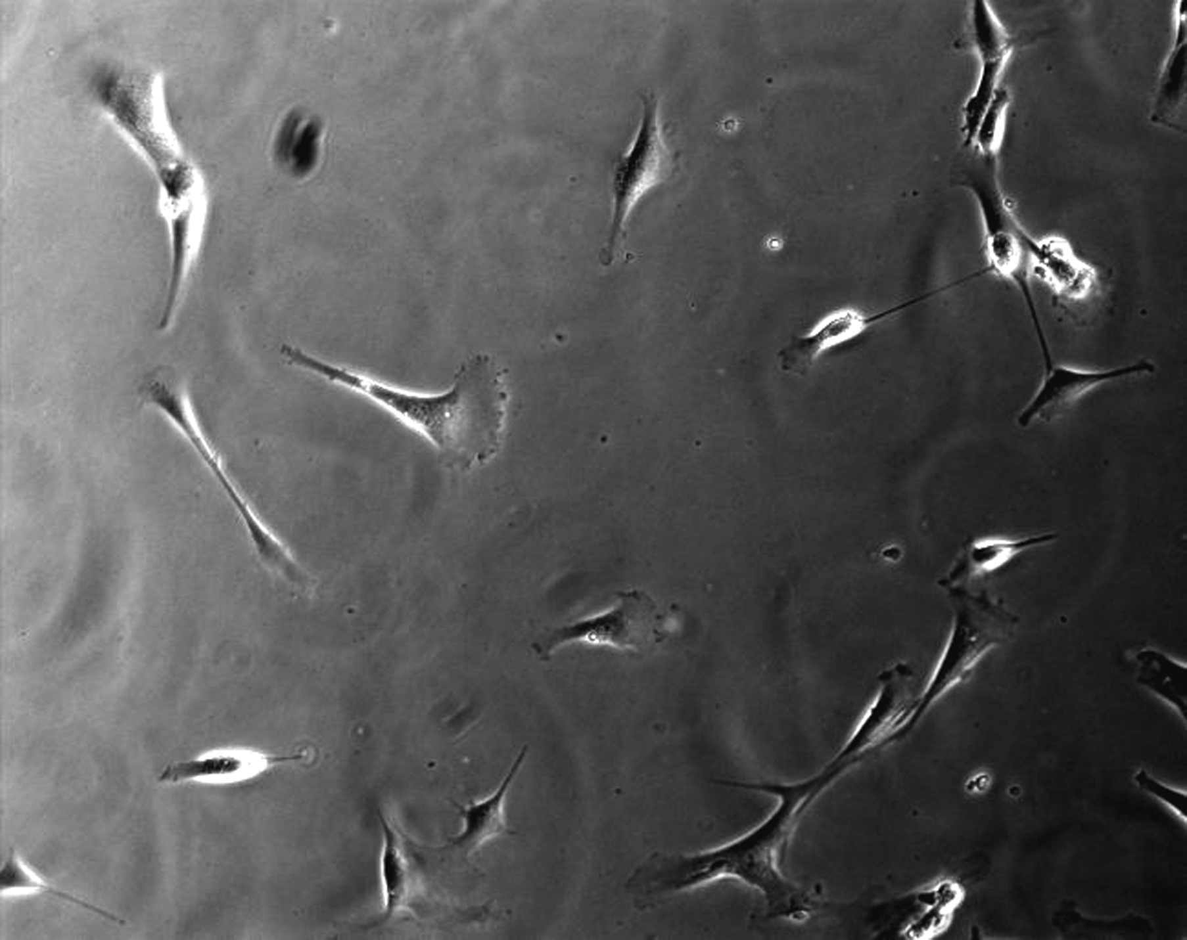
Can Functionalize inert surfaces with many cell-binding proteins
Attack amines, thiols on proteins, or biotinylate them
No treatment
Type I Collagen
RGDS
Hydrophilic surface, so no protein will stick
Fibronectin
KQAGDV

Slide 6
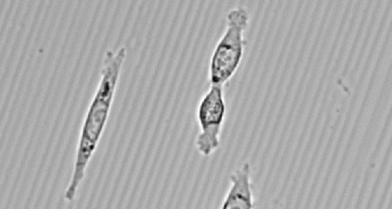
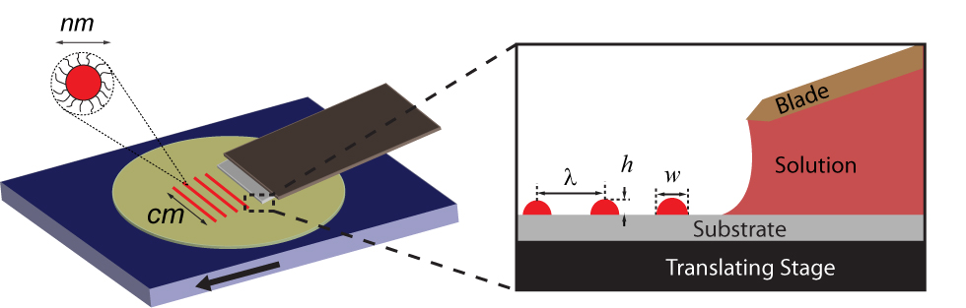
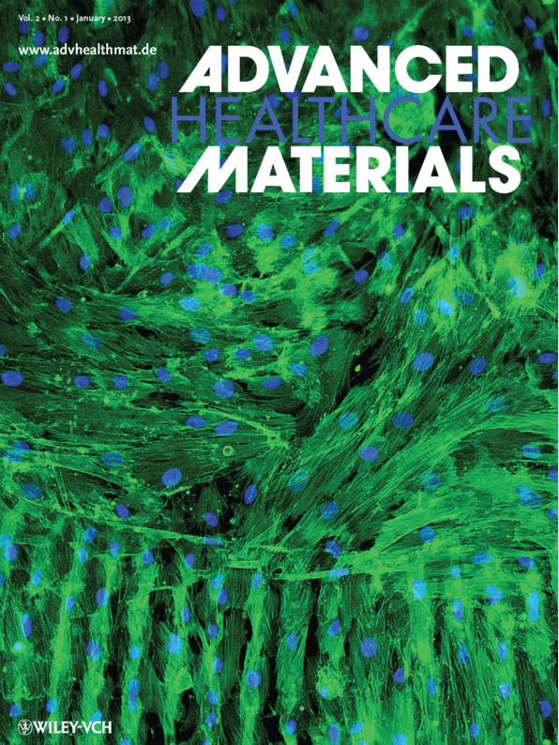
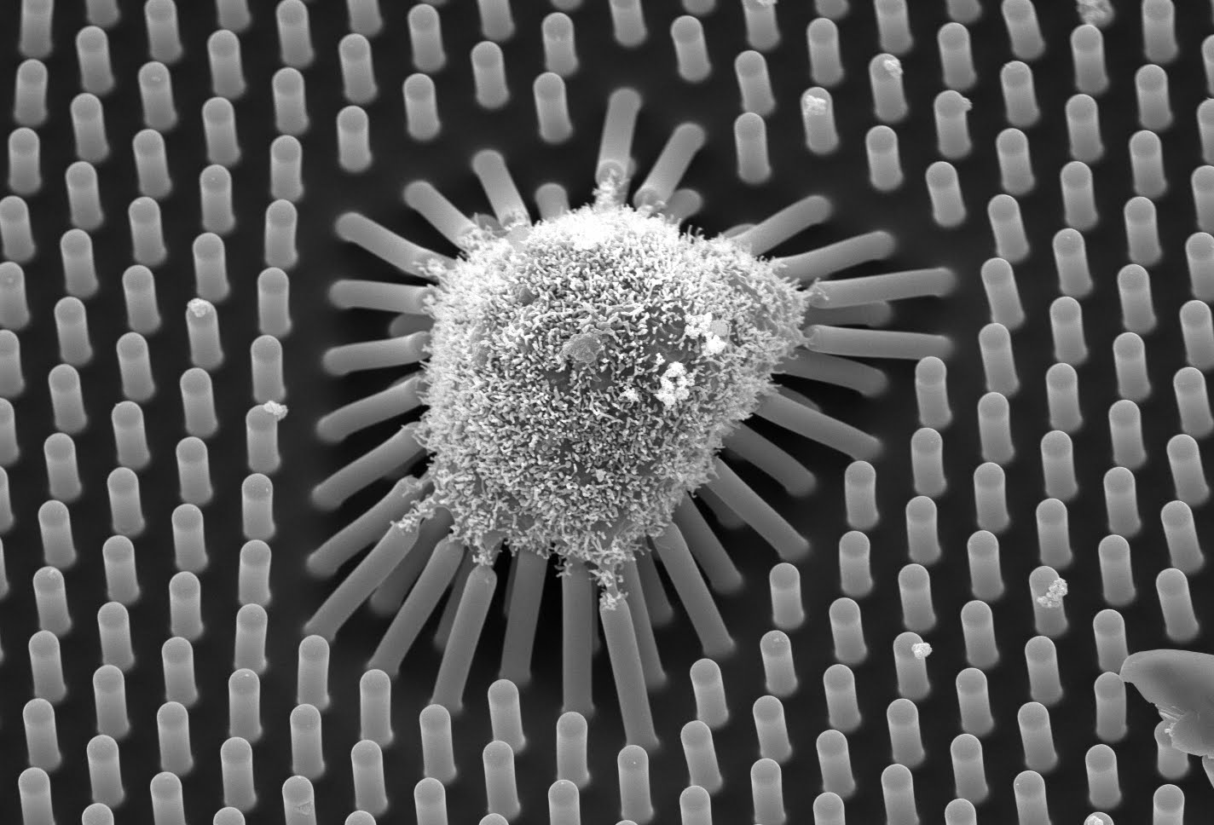
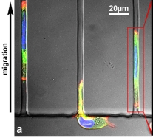
Patterning surfaces to control cell alignment, shape
Crosby, Emrick, Peyton
Courtesy Chen Lab, Penn
Plos One, 2012

Slide 7
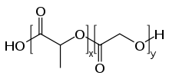
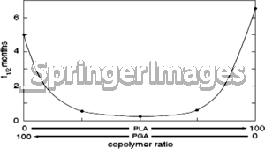
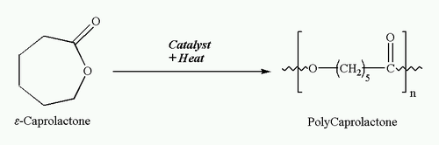
Degradable polymers
Purposes:
Temporary space holder for tissue replacement
Not entirely bioinert – meant to degrade away while being replace by native tissue in vivo
Is adhesive to matrix proteins
Tune biodegradation to match body’s kinetics (rate of tissue production/replacement)
Degradation can be either hydrolytic (PLGA), or biospecific/enzymatic (via MMPs)
Unstable.
Applications:
Both Hard and Soft tissue repair
where vascularization is needed

Slide 8
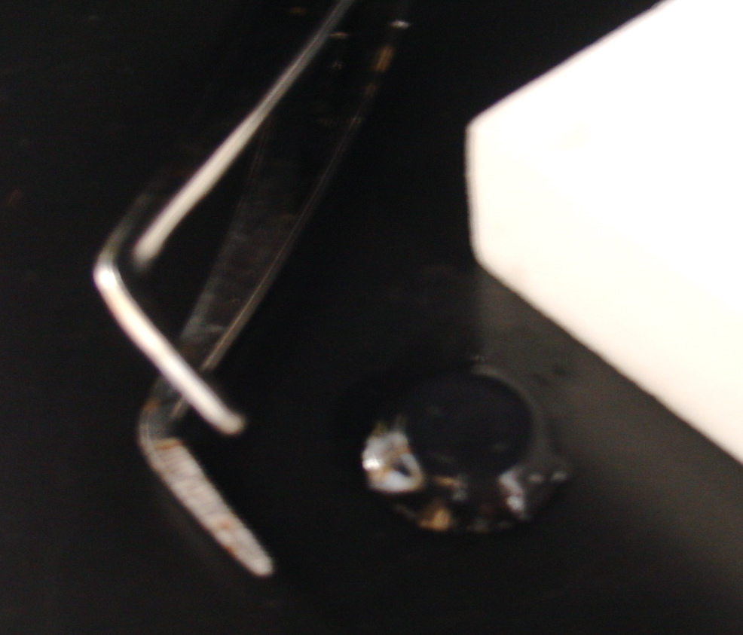
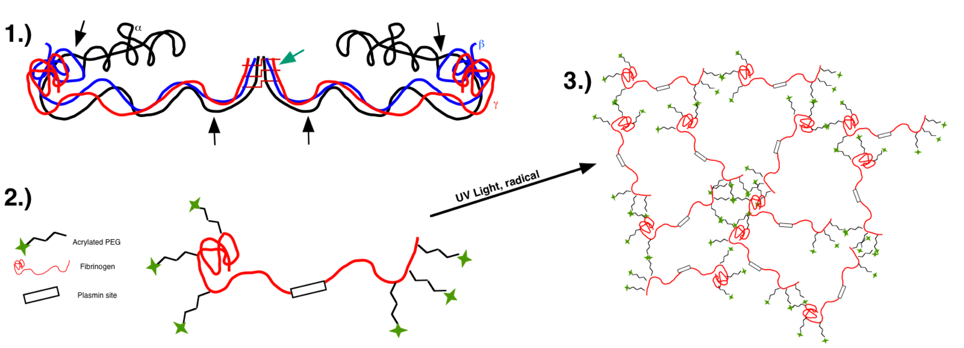
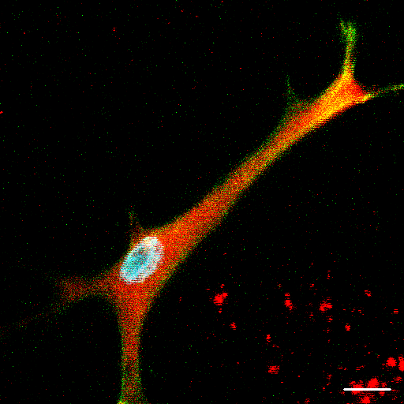
Degradable, Bioinstructive Polymer
PEG-fibrinogen
For 3D culture, need to make PEG degradable

Slide 9
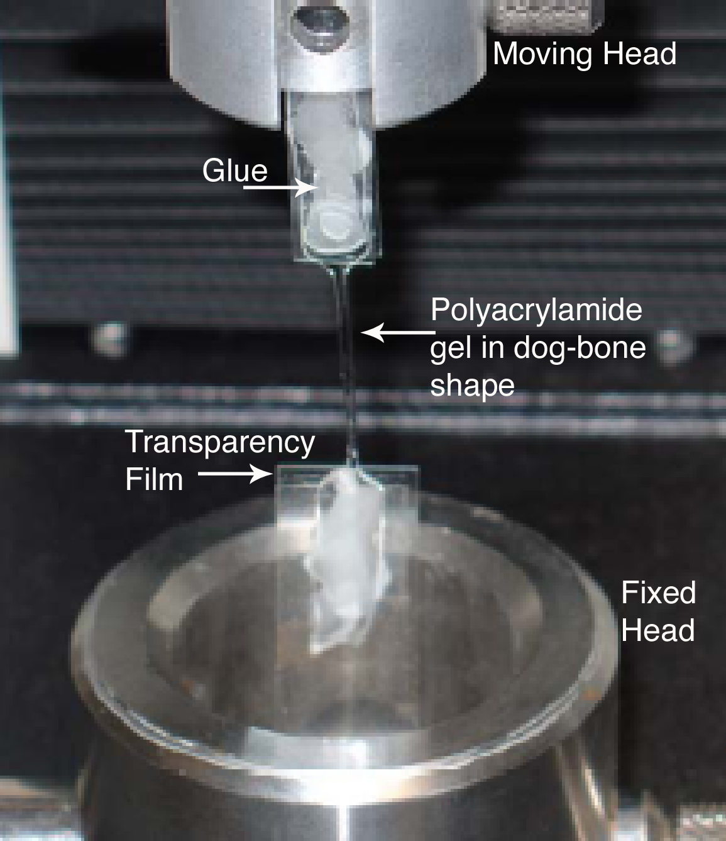
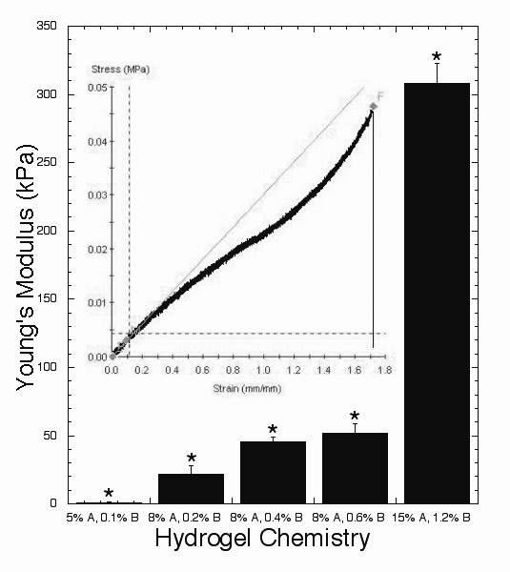
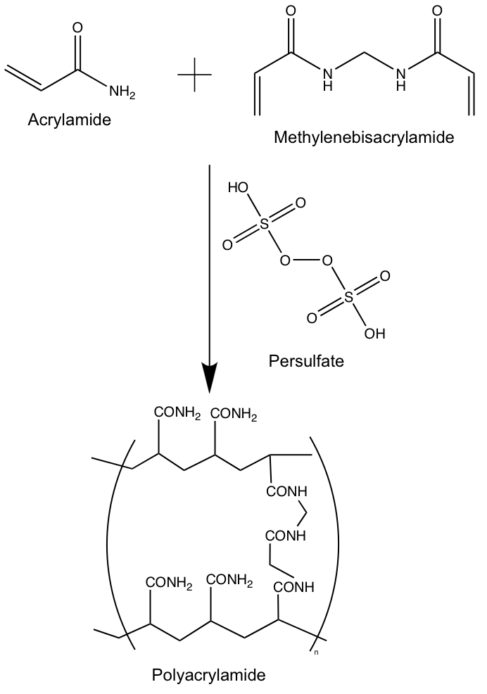
Biomaterial Stiffness
Polyacrylamide
Peyton, S.R. and Putnam, A.J. J. Cell. Phys. 2005 Jul;204(1):198-209.

Slide 10
Overview
There’s a biomaterial out there for every need
Establish design criteria from biological purpose
Some are easier than others to modify
Some are cheaper than others
Some, but not many, (PAA) are starting to be used by biologists.

