Slide 1

IGEM Journal Club Final Project
Glast—based on blast
小组成员：
潘登 张梦诗
荆水 沈刘行

Slide 2
Abstract
Nucleotide sequence
interface
Assembly view
Discontiguous megablast
Sequence identify
Amino sequence
DELTA-blast
View protein structure （3D)

Slide 3
database
FASTA database files need to be formatted by formatdb before they can be used in local blast search. Following is an example of command lines:
formatdb -i input_db -p F -o T for nucleotide
formatdb -i input_db -p T -o T for protein
Biobricks →FASTA→database
More functions: Cloud server
Cloud server allows authorized groups to upload new data to update the database. The data include several types below:
Valid or invalid combinations of biobricks;
New biobricks;
Survival&function environment
……

Slide 4
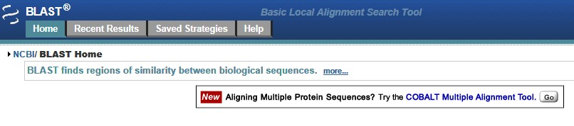
http://www.ncbi.nlm.nih.gov/nucleotide/14705914?report=genbank&log$=nucltop&blast_rank=7&RID=XSGFMJ5G012
http://www.ncbi.nlm.nih.gov/nucleotide/168149049?report=genbank&log$=nucltop&blast_rank=90&RID=XSJ14636016
http://blast.ncbi.nlm.nih.gov/

Slide 5
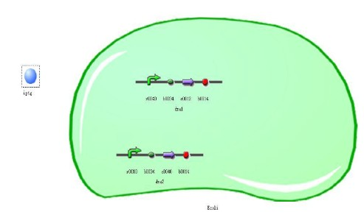
PART 3
First of all, the biological components are the basic units that are used to construct models .Every biological component has its own ID and every biological component has its own symbol.
Second, after finding all these biological components we should draw it in a right direction, according to the query sequence. Then string all these biological component in a line.

