Slide 1
Examining Subjects of HIV-1 With Possible Predominant Viral Strains
Samantha Hurndon
Isaiah Castaneda

Slide 2
What’s to Come…
HIV-1 Briefing
What provoked our question?
Methodology
Results
  Narrowing it down
What does it all mean?!

Slide 3
Hiv-1
Viral disease contracted through
  Sexual Intercourse
  Intravenous drug usage
  Blood transfusions
High mutation and replication rates

Slide 4
Markham’s Findings
Markham & his group studied HIV evolution patterns in 15 subjects
10 of 15 subjects showed no evidence of a predominant viral strain
Higher diversity = more rapid CD4 T cell decline ☹

Slide 5
Markham’s Findings cont.
Observed 3 different types of progressors
  Non-progressor
  Moderate
  Rapid

Slide 6
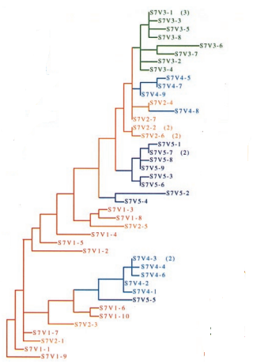
Markham’s Findings
10 of 15 of Markham’s subjects fit
this pattern
- No predominant strain at any
point in time

Slide 7
Which Five Subjects Didn’t fit Markham’s Pattern?

Slide 8
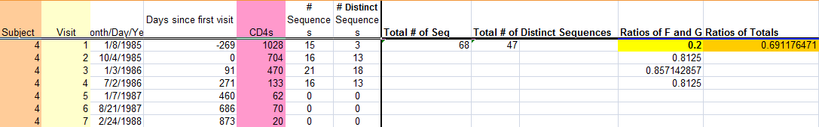
Determining Which Five
We took the ratio of the amount of unique sequences to total amount of sequences
  The lowest ratios were the ratios of interest
  Subjects with the lowest ratios:
    Subjects: 2, 3, 4, 6, 12, 13

Slide 9
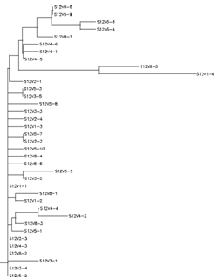
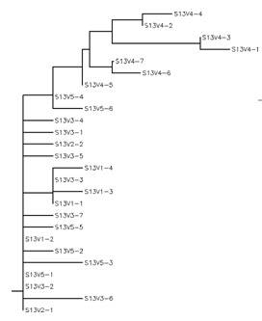
A Look at the Subjects with the Lowest Ratios
Subject 13
Subject 12
Ratio: 0.52
8 instances of branching
Visits: 11
Non-progressors
0.65
15 instances on branching
Visits: 19
Non-progressors

Slide 10
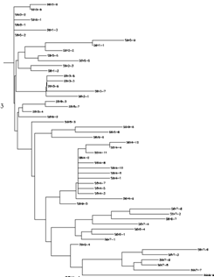
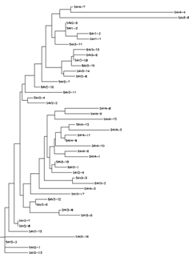
Increased Ratios Show More Diversity
Subject 6
Ratio: 0.71
37 Instances of branching
Visits:16
Moderate- Progressor
Visit 4 possible predominant strain
Subject 4
Ratio: 0.69
38 Instances of branching
7 Visits
Rapid Progressor

Slide 11
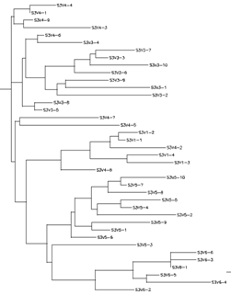
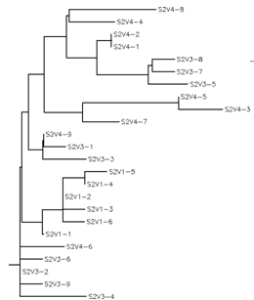
The Highest Ratios of Our Suspects
Subject 3
Ratio: 0.78
Visits: 8
Horrendous branching
Rapid Progressor
Subject 2
Ratio: 0.75
Visits: 4
Non-progressor

Slide 12
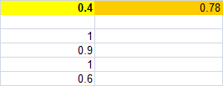
Narrowing Down The Results…
Subject 3
  Most diverse
    Lots of branching
    No evidence of predominance anywhere
    Only 1st visit had a relatively low amount of unique sequences
    The rest were quite variant

Slide 13
What Relationships, If Any, Can be Seen Among the Progressor Groups of These 5 Subjects?

Slide 14
Relationship Between Progressors and Predominance of Viral Strain
Non-progressors (subjects 2, 12, 13) show clear predominant strain
  Follows model that Markham et. al observed
  Subject 2 is worst example of these 3
    Could be due to low data content

Slide 15
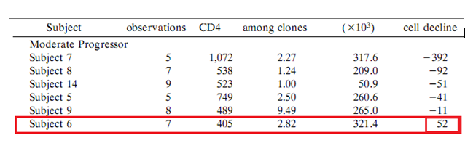
Subject 6: A Moderate Progressor
Visit four shows possibility of a predominant strain
Of the moderate progressors and the rapid progressors subject 6 is the only subject without a negative cell decline

Slide 16
Subject 4: Rapid Progressor
0.69 ratio of unique sequences to total sequences
Data compared to other rapid progressor did not serve as significantly different
The phylogenetic tree and data left us inconclusive

Slide 17
Possible Issues
Our method was not fool proof
  Worked with the limited data we had
There was not as much data from subjects 2 & 4
Our time was limited to two weeks of work

Slide 18
References
Markham, Richard B et. al. "Patterns of Hiv-1 Evolution in Individuals with Differing Rates Od CD-4 T Cell Decline." Proc. Natnl. Acad Sci USA 95 (1998): 12568-2573. Print.

