Slide 1
Single-step assembly of a gene and entire plasmid from large numbers of oligodeoxyribonucleotides
Stemmer WP, et al.
Gene(1995)
Presented by: Andrew C. Yang
3/30/2011

Slide 2
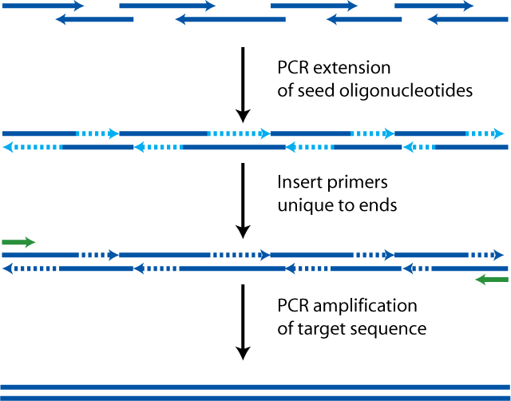
Introduction to Assembly PCR
Initial
Oligos
Add
PCR mix, Taq Polymerase
Regular PCR reaction
Final
Target DNA Sequence
Notes:
method for the assembly of large DNA oligonucleotides from shorter fragments.
Allows for the production of synthetic genes and even genomes

Slide 3
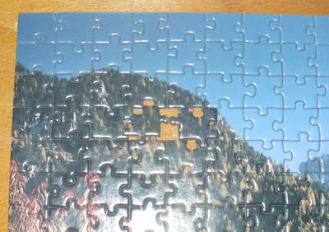

Features of Assembly PCR
4 steps: Oligo synthesis, gene assembly, gene amplification (PCR), cloning
Each oligo part of top or bottom strand of target sequence
Must have complementarity
between oligo fragments or
target sequence impossible
Add end primers to amplify target
sequence
No ligase required for assembly

Slide 4
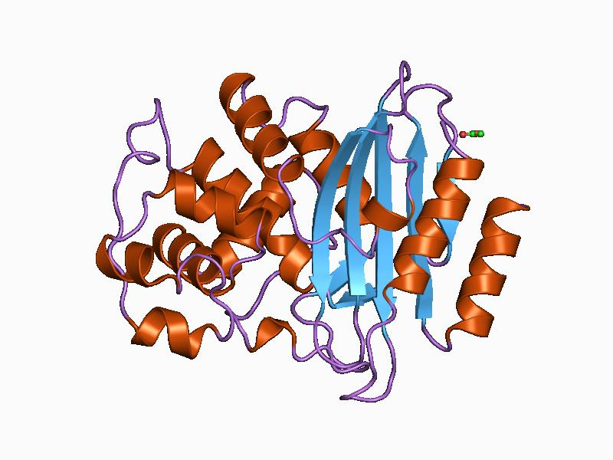
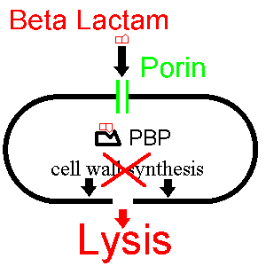
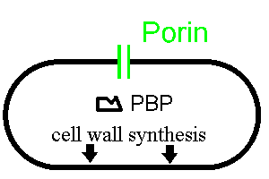
Quick Overview: bla
Bla (Beta-lactamase-encoding gene) provides resistance to Beta-Lactam antibiotics like ampicillin
Inhibits cell wall synthesis

Slide 5
Overview: Assemble bla Gene (1.1 kb)
Goal: 1. Assemble bla gene (encoding Ampicillin resistance)
2. Clone into backbone plasmid
3. Transform into E. coli
Details: Backbone is pUC322 with Tetracycline resistance. Introduced 5 point mutations (5 synthetic restriction sites) in bla. 20 nt overlap for oligos.
Assay: Plate cells on Tetracycline. Screen colonies for Ap^{R}. Of viable colonies, restriction digest for 5 synthetic point mutations.
Notes:
TEM1-Beta lactamase encoding gene
Spot tests. Colonies pick

Slide 6
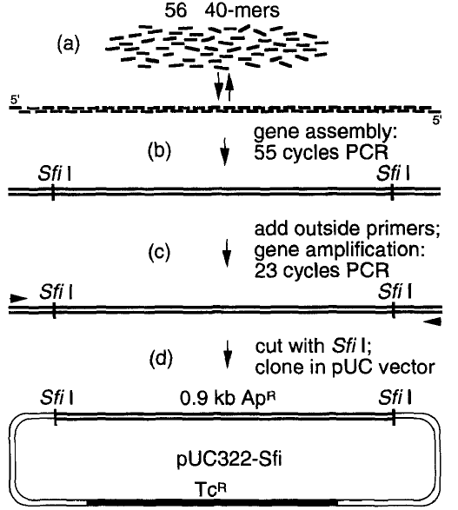
Oligos:
28 top, 28 bottom
Flanking bla for cloning
No ligase.
Anneal
Amplifies only complete target sequence
Ligate bla into backbone

Slide 7
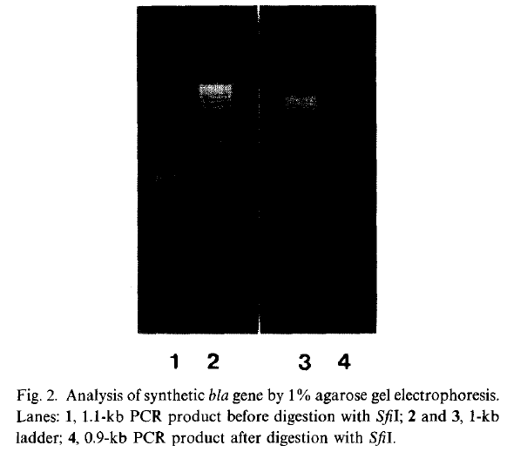
Results: Assemble bla Gene (1.1 kb)
102 Colonies on Tet Plate
78 Ap^{R} colonies (76%)
6 arbitrary colonies’ plasmids analyzed by digest
All 5 point mutations present by restriction digest.
1 arbitrary analyzed plasmid sequenced.
Found 3 PCR/oligo mutations.
No cut
SfiI cut
~0.9 kb
~1.1 kb
Notes:
Oligo mutations

Slide 8
Critiques
Really 1 step?
  “The assembly PCR protocol consists of 4 steps: oligo synthesis, gene assembly, gene amplification and cloning.”
Reliable?
  1.1 kb contained 3 PCR/oligo point mutations.
  More analysis of mutations. Methods of proofreading?
Same PCR limitations
  Oligos must have ~same T_{m}
  Hairpin free
  GC content not too high
Alternative outputs to bla?
Step from 1.1kb gene to 2.7kb plasmid significant?
Notes:
Options,

Slide 9
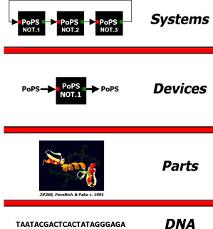
Relevance to 20.385
Modularity and standardization at all abstraction hierarchies requires flexible, reliable construction techniques
“the tedious and unreliable construction…of synthetic biological systems…greatly limits the engineering of biology.”
–Drew Endy
Notes:
Electronics spurred on by novel fabrication techniques. We need those for biology.
Introduce new functionality. Write dna de novo. Building from scratch

Slide 10
Conclusions
Write DNA de novo
Novel biological functionality
Facilitates numerous applications
Stemmer: prolific inventor and entrepreneur.
Founded several companies based on DNA shuffling technology
Assembly PCR
Artificial Gene Synthesis
Gene Therapy
Synthetic Biology
Vaccine Development
Synthia
MAGE Technology

Slide 12
Overview: Assemble Plasmid p182Sfi (2.7 kb)
Goal: 1. Assemble larger p182Sfi plasmid (~pUC18 except 2 Sfi sites flanking bla). Skip insert-backbone ligation.
2. Transform into E. coli XL1-blue
Details: 3-stage PCR produces DNA multimer, requiring extra BamHI digest for linear product. 5 introduced mutations (5 synthetic restriction sites) in bla still present. 20 nt overlap for oligos.
Assay: Plate cells on IPTG+Xgal+Ap plates. Look for blue colonies. Miniprep and check for 5 synthetic restriction sites.

Slide 13
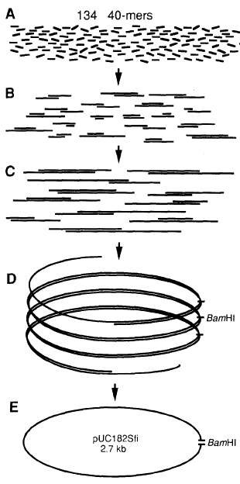
And one 47-mer and one 56-mer complete circle
Oligos:
66 top, 66 bottom
PCR programs. Each program begins with 3-fold dilution with fresh PCR and polymerase mix
DNA multimer. Cut with BamHI for linear product
Gel purify, ligate, transform

Slide 14
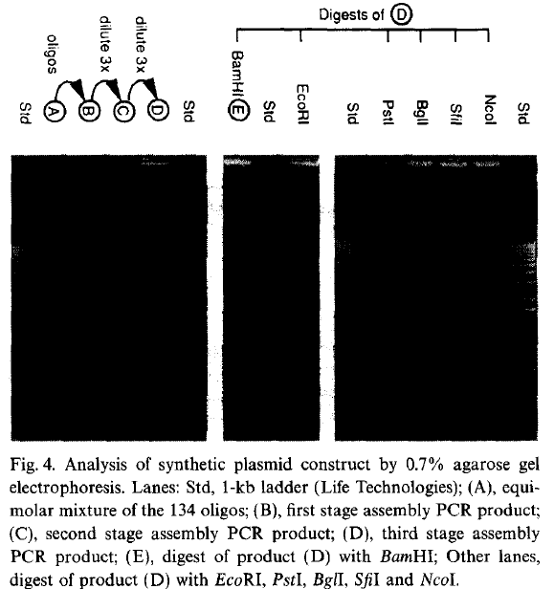
Results: Assemble Plasmid p182Sfi (2.7 kb)
Restriction digests of DNA multimer yielded expected unit-lengths (2.7kb)
“A large number of blue colonies were obtained on IPTG+Xgal+Ap plates.”
“Minipreps of 4 colonies showed that all plasmids had the expected restriction digest pattern, including the five sites which were introduced in the bla gene.”
~2.7kb
Notes:
Efficiency.

