Slide 1
Acclimation of Sacchoromyces cerevisiae to Low Temperature: A Chemostat-based Transcriptome Analysis
Siew Leng Tai, Pascale Daran-Lapujade, Michael C. Walsh, Jack T. Pronk, and Jean-Marc Daran
Molecular Biology of the Cell Vol. 18, 5100–5112, December 2007
Presentation by: Lauren Magee, Karina Alvarez, William Gendron and Alyssa Gomes
Biology 398/S15

Slide 2
Outline
Objectives and significance of this experiment
Background Information
Methods and Procedure
Transcriptome Responses and Results
Comparisons: Chemostat vs. Batch cultures
Implications
Works Cited

Slide 3
Outline
Objectives and significance of this experiment
Background Information
Methods and Procedure
Transcriptome Responses and Results
Comparisons: Chemostat vs. Batch cultures
Implications
Works Cited

Slide 4
Objectives and Significance
Objective: Study the steady-state acclimatized growth of Saccharomyces cerevisiae cultures and its transcription, under temperatures of 12°C and 30°C and at a growth rate of 0.03 h⁻¹
Significance: All eukaryotes have some similarities on a cellular level so yeast serves as a model organism
  Knowing what transcription factors affect what genes can help us predict the effect of temperature on possibly a variety of organisms

Slide 5
Questions to Consider:
Although this has previously been studied by Sahara, Homma, Schade and Murata:
Why did prior studies differ in their answers about growth of expression ribosomal protein genes?
Why did cold shock bring out reserve carbohydrate while trehalose only only arose in near freezing temperature?
Is there any way to bring out the Ms2p/Msn4p complex that is previously suggested to be a transcriptional factor in cold temperature?
How can we study and describe the difference between acclimation and shock responses in S. cerevisiae?

Slide 6
Outline
Objectives and significance of this experiment
Background Information
Methods and Procedure
Transcriptome Responses and Results
Comparisons: Chemostat vs. Batch cultures
Implications
Works Cited

Slide 7
Background
Saccharomyces cerevisiae is a yeast exposed to many external and environmental changes that may affect chemical processes and structures
There is a difference in sudden exposure and gradual exposure because sudden exposure is stress-response and gradual will lead to acclimation
Chemostat cultures allow many factors to remain stable in acclimatized environments

Slide 8
Outline
Objectives and significance of this experiment
Background Information
Methods and Procedure
Transcriptome Responses and Results
Comparisons: Chemostat vs. Batch cultures
Implications
Works Cited

Slide 9
Methods and Procedures
Strain: Saccharomyces cerevisiae
Growth rate: 0.03 h⁻¹
Volume: 1.0 L
Temperatures: Set to 12°C initially then 30°C
3 culture replicates
Anaerobic growth, biomass dry weight, metabolites and steady-state (regulated by growth) set stable

Slide 10
Analytical Methods
Supernatants (soluble liquid part of sample after centrifugation/precipitation) collected with rapid sampling
Liquid chromatography used to analyze concentrations of glucose and metabolites
Cuvette tests used to examine ammonium concentrations
Measured trehalose amounts (3x)
Roche kit used to examine amount of glucose from breakdown

Slide 11
Microarray Analysis
Results came from 3 culture replicates
Microsoft Excel used to examine analyses on microarray add-ins
Venn Diagrams used to compare difference in Glucose and Ammonium limiting anaerobic growth
Database for Annotation, Visualization, and Integrated Discovery, and online genome sets used for comparisons

Slide 12
Outline
Objectives and significance of this experiment
Background Information
Methods and Procedure
Transcriptome Responses and Results
Comparisons: Chemostat vs. Batch cultures
Implications
Works Cited

Slide 13
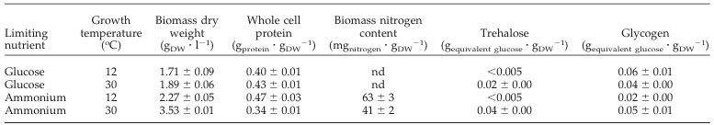
Table 1: Physiological characteristics of S. cerevisiae in chemostat cultures
S. cerevisiae grew less on ammonium-limiting cultures compared to glucose-limiting cultures.
There were slight differences in biomass between different temperatures in the same cultures.

Slide 14
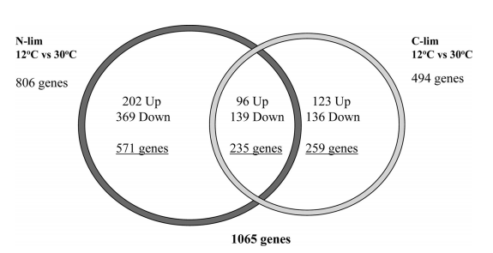
Fig. 1: Different transcription levels in different nutrient-limited cultures
More differences in transcription levels in ammonia-limited cultures than in glucose-limited cultures
235 genes showed regulation in both conditions

Slide 15
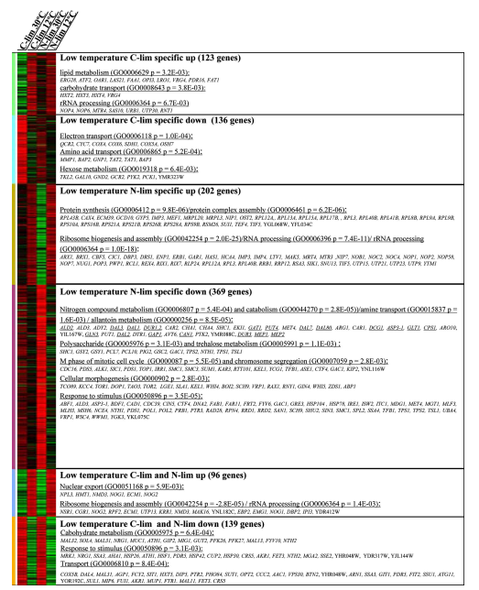
Figure 2: Heat map of transcript level ratios
The change in transcription levels depended on the temperature of the environment and the limiting conditions.
Genes have lower transcription rates in lower temperatures in both glucose-limited and ammonium-limited conditions

Slide 16
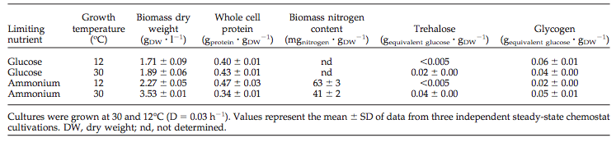
Table 2: Protein and carbohydrate contents of S. cerevisiae in anaerobic cultures
The cultures had higher biomass dry weights in ammonium-limited cultures compared to glucose-limited cultures.

Slide 17
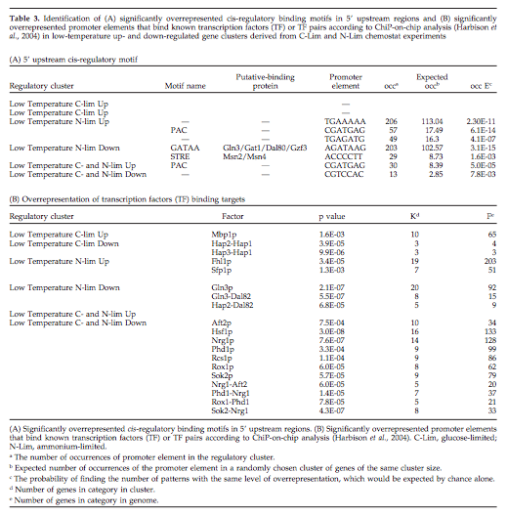
Table 3: Overrepresented binding motifs and promoter elements
More transcription factors were overrepresented in the different cultures.

Slide 18
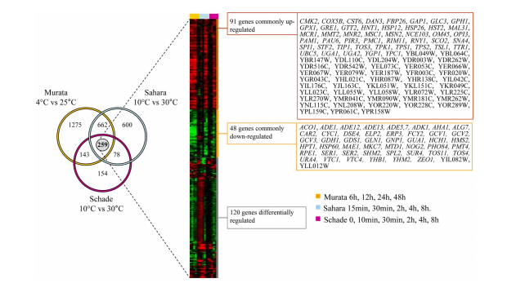
Figure 3: 259 genes were common to three-batch culture studies
91 genes were commonly up regulated, while 48 genes were commonly down regulated
Three different low temperature batch cultures differing in conditions.

Slide 19
Outline
Objectives and significance of this experiment
Background Information
Methods and Procedure
Transcriptome Responses and Results
Comparisons: Chemostat vs. Batch cultures
Implications
Works Cited

Slide 20
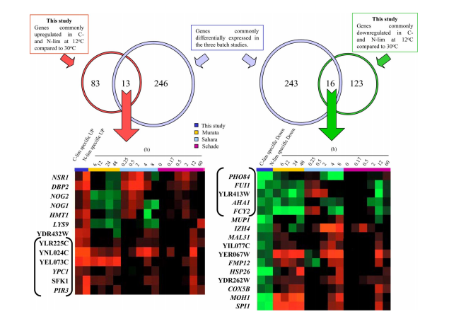
Figure 4: Comparison of Studies
Shows overlapping genes
Isolates those actually related to shock
  Other genes related to other conditions

Slide 21
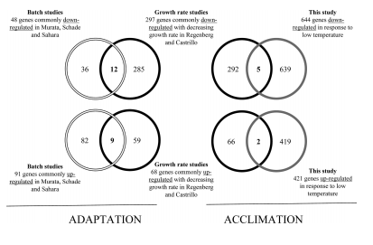
Figure 5:Finding Growth Rate Genes
Shows that there are overlaps with growth rate
Shows other gene changes involved

Slide 22
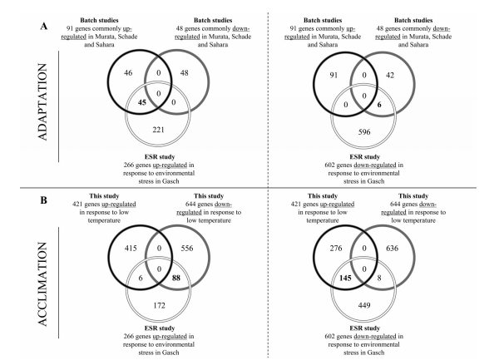
Figure 6: Identifies ESR Genes
Eliminates ESR genes
Specifies which ones are a result from shock

Slide 23
Outline
Objectives and significance of this experiment
Background Information
Transcriptome Responses and Results
Comparisons: Chemostat vs. Batch cultures
Implications
Works Cited

Slide 24
Implications
Able to find more specific genes by testing the same changes under different conditions
Changing the system shows the real reason behind certain changes in a complex system

Slide 25
Answered Questions:
Why did prior studies differ in their answers about growth of expression ribosomal protein genes?
Differences in regulation of batch and chemostat constants and cultures
Why did cold shock bring out reserve carbohydrate while trehalose only arose in near freezing temperature?
Transcription values of trehalose not affected by temperature shocks. Trehalose transcript amounts lower at 12°C while glycogen higher (by 50%)
Is there any way to bring out the Ms2p/Msn4p complex that is previously suggested to be a transcriptional factor in cold temperature?
Ms2p/Msn4p both regulate storage carbohydrate synthesis. But results indicated that low temp acclimation does not involve Ms2p/msn4p but based on different regulation method
How can we study and describe the difference between acclimation and shock responses in S. cerevisiae?
Compare chemostat studies with batch studies.

Slide 26
Outline
Objectives and significance of this experiment
Background Information
Transcriptome Responses and Results
Comparisons: Chemostat vs. Batch cultures
Implications
Works Cited

Slide 27
Works Cited
Tai, Siew L., Pascale Daran-Lapujade, Michael C. Walsh, Jack T. Pronk, and Jean-Marc Daran. “Acclimation of Saccharomyces Cerevisiae to Low Temperature: A Chemostat-based Transcriptome Analysis.” Molecular Biology of the Cell 18 (200): 5100-112. The American Society for Cell Bioloy, 27 Sept. 2007. Web.

