Slide 1
Global network analysis of drug tolerance, mode of action and virulence in methicillin-resistant S. aureus
Bobby Arnold
Alex Cardenas
Zeb Russo
Loyola Marymount University
Biology Department
16 November 2011

Slide 2
Outline
Staphylococcus aureus – human pathogen.
Treatments are important and antimicrobial peptides seem promising.
Responses modules when exposed to ranalexin showed varying regulation in genes.
Virulence factors inferred from experiments are collected.
Where scientists go from here.

Slide 3
Staphylococcus aureus is a human pathogen
Also referred to as MRSA (Methicillin Resistant Staphylococcus aureus) causes morbidity and mortality.
Strains are becoming resistant to treatments and is becoming a global problem.

Slide 4
Antimicrobial peptides fight against MRSA
AMPs seem to be a source of treatment to fight resistant bacteria (MRSA).
Produced by all living creatures for defense.
  Ranalexin – 20 a.a. peptide that has potent activity against Staphylococcus aureus.
Understanding transcriptome and proteome profiling is crucial to understanding mechanisms for antimicrobials.
  As these alter cell function by differing mRNA and protein profiles.
MRSA-252 genes studied by taking wide approach.

Slide 5
Outline
Staphylococcus aureus – human pathogen.
Treatments are important and antimicrobial peptides seem promising.
Responses modules when exposed to ranalexin showed varying regulation in genes.
Virulence factors inferred from experiments are collected.
Where scientists go from here.

Slide 6
Responses of MRSA when exposed to ranalexin
Upon ranalaxin exposure, genes downregulated secretion system components, which are vital to pathogenesis for MRSA.
  MRSA-252 ESAT-6 systems.
Genes associated with cell wall secretion and anchorage were also RanaDown.
Exposure results in repression of virulence factor expression

Slide 7
Microarray Data
Three replicates of control culture and ranalexin were used in the microarray experiment with two technical replicates of each type. Six total arrays were used in analysis.
2 microarray chips were used.
Ranalexin (A1) was paired with MRSA-252(A2), and MRSA-252(A1) was paired with Ranalexin(A2).
Ranalexin (A1) and MRSA-252(A2) were labeled red (Cy5). Ranalexin (A2) and MRSA-252(A1) were labeled green (Cy3).

Slide 8
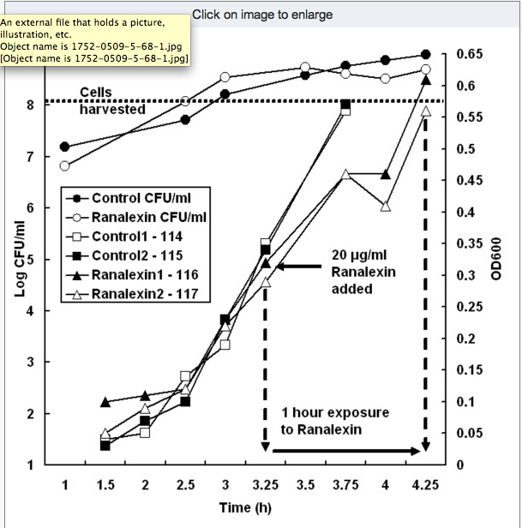
Impaired growth of MRSA when exposed to ranalexin

Slide 9
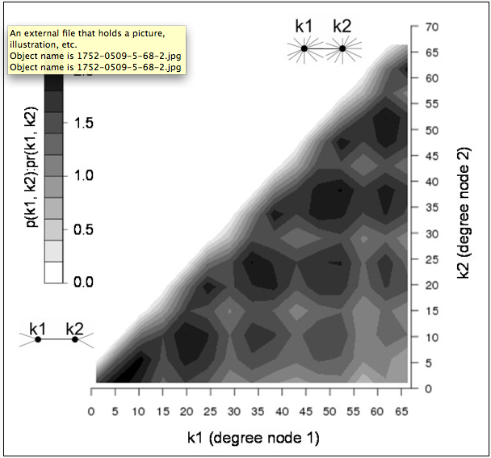
Gene functional association network
Probability of observing interacting pair of nodes in MRSA network.
Varying degrees are seen – k1, k2 and pr(k1,k2)
Bottom left shows low degree values.
Top right shows high degree values.

Slide 10
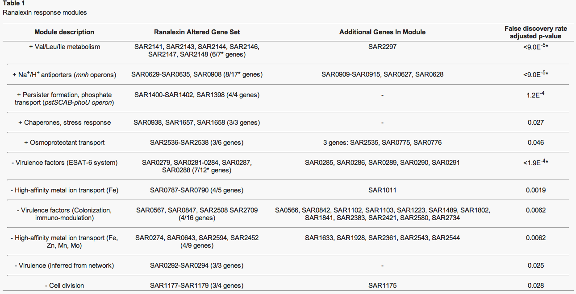

Slide 11
Outline
Staphylococcus aureus – human pathogen.
Treatments are important and antimicrobial peptides seem promising.
Responses modules when exposed to ranalexin showed varying regulation in genes.
Virulence factors inferred from experiments are collected.
Where scientists go from here.

Slide 12
Ranalaxin shows impact on virulence and novel determinants
Significant module included 5 ESAT-6 components → the 6th gene not being assigned to a module.
SAR0288 predicted 6 transmembrane regions; SAR0287→ secreted or cell wall anchored. These two genes matched virulence-associated families.
Correspondence with operon structure that was predicted showed that genes may be co-regulated with ESAT-6 system.

Slide 13
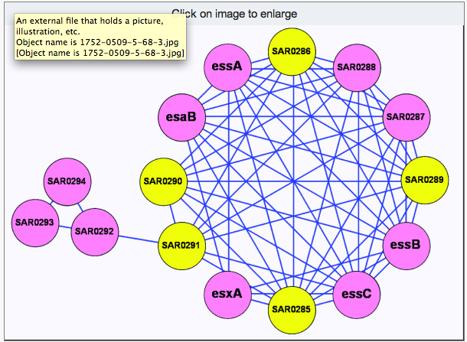
ESAT-6 downregulated virulence factors
Significantly downregulated genes are shown in pink, others genes are shown in yellow.

Slide 14
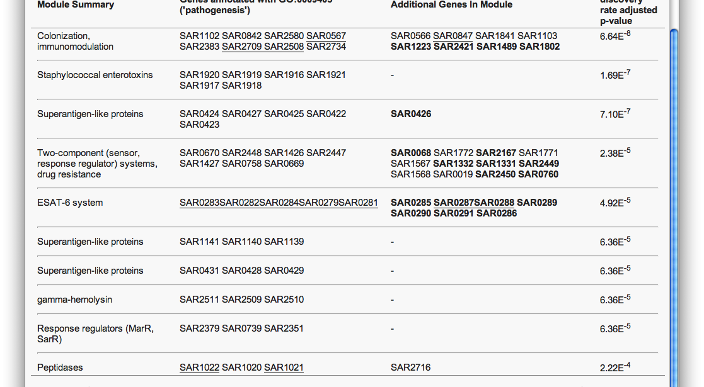
Table 2 – Significant virulence modules

Slide 15
Virulence functions
Two RanaDown modules showed high-affinity metal ion transport which is crucial for establishment of infection
12 genes in 16 node module show virulence functions
  12 showed colonization and immuno-modulation
  All 16 genes encode transmembrane/secreted proteins anchored to cell wall

Slide 16
Pathogenesis – mechanism of how disease is caused
Ranalexin treatment showed repression of MRSA-252, including ESAT-6 system and 22 virulence factors
Decrease in the ability of MRSA to infect
Ranalexin induces cell wall stress by affecting proteins involved in cell wall synthesis

Slide 17
Ranalexin induces cell wall stress
Affects VraSR, which controls gene expression is cell wall synthesis
  Genes regulated this were RanaUp
    SAR1461, SAR1964, SAR1030, SAR2442
Affects FtsH – key role in cell wall behavior and MRSA response to AMPs, in this case ranalexin
  Potential drug target

Slide 18
Ranalexin effects on cell wall continued
Transcriptional regulatory proteins that are RanaUp were induced when cell wall antibiotics present
  SAR1689 and SAR0625
Cell wall stress response induced by exposure to ranalexin

Slide 19
Ranalexin exposure inducing cell wall changes
Enhanced production of craR and tcaA observed in ranalexin exposure
Induction of expression seen after 15 minutes, peaked after 30, declined after 60
Genes from MRSA-252 identified in RN 4220 as being disrupted
Dose responses showed loss from vraR mutant and increasing concentrations and duration of exposure compared to parent strains

Slide 20
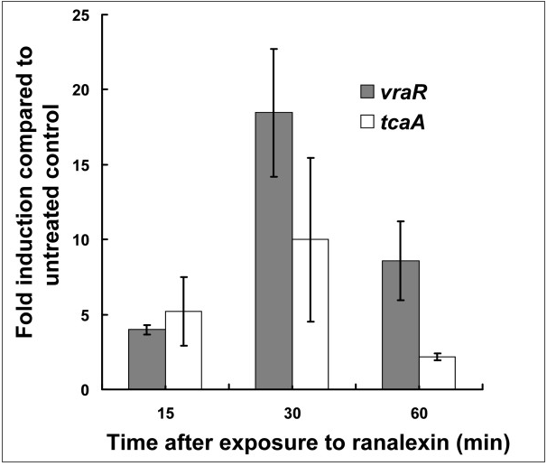
Figure 4 – Ranalexin to cell wall

Slide 21
Osmotic fragility and membrane disruption
MRSA cells treated with ranalexin were tested for osmotic fragility to gauge AMP effects
Cells treated with sublethal doses of vancomycin and ranalexin induced sensitivity to hypo-osmotic stress, when treated with both, similar degree of osmotic fragility
Ranalexin inhibits at the staphylococcal cell wall

Slide 22
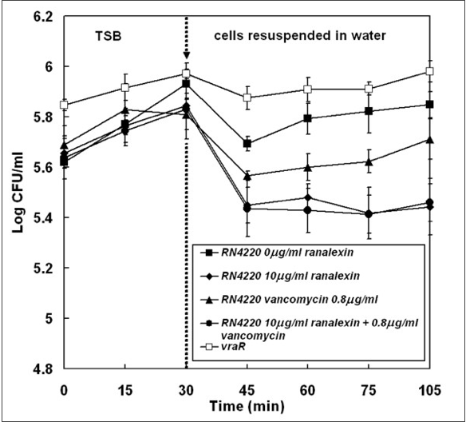
Figure 5 – ranalexin exposure inducing sensitivity to hypo-osmotic stress

Slide 23
MRSA drug tolerance
When exposed to ranalexin, strong upregulation of proteins encoded by pstSCAB-phoU operon seen
  PstS, PstC, PstA, PhoU, PstB
MRSA adopts a PhoU-mediated persister phenotype to gain antimicrobial tolerance
Persister bacteria exhibit thickening of cell wall and loss of virulence factors

Slide 24
Multiple actions in MRSA killing due to inhibatory actions of ranalexin
Major effects of ranalexin exposure
  Membrane permeabillisation leading to cation influx and dissipation of transmembrane electrochemical gradient
  Increase positive cell wall charge at surface, decreased peptide binding
  Cation antiport upregulated, increased influx of cations

Slide 25
Where Scientists Go from Here
Evidence showed effects of ranalexin on bacterial cell wall and action at cell membrane.
Evidence for PhoU-mediated persister switching as mechanism of drug tolerance
Further investigation is needed to find more mechanisms of drug tolerance for different antimicrobial peptide.

Slide 26
BREAK

Slide 27
Decreasing GO Terms
Pathogenesis
Multi-organism process
External-encapsulating structure
High-affinity iron ion transport
Extracellular region
Membrane part
Protein Complex binding

Slide 28
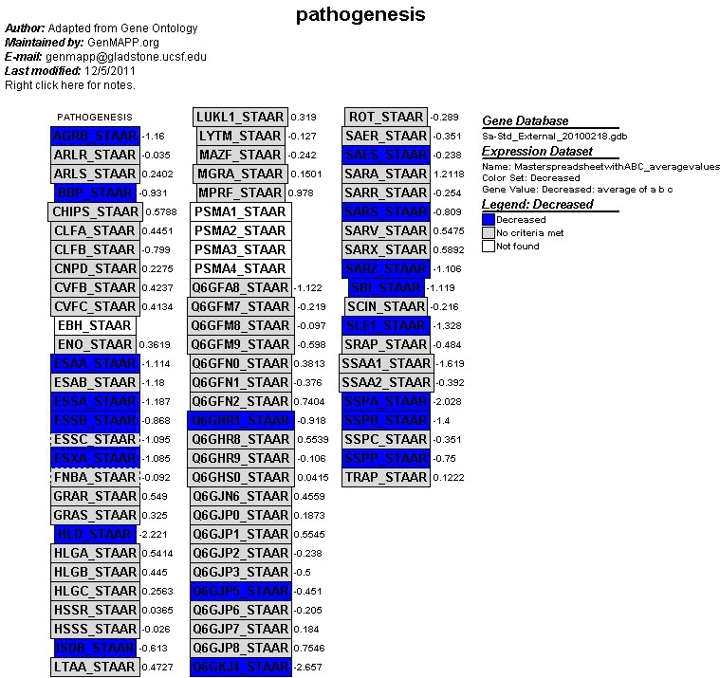
Pathogenesis
Picked out a few genes that were RanaDOWN
SSPA_STAAR - Involved in colonization and infection of human tissues.
ISDB_STAAR – Involved in hemoglobin binding. RanaDOWN (inactivation) inhibits biding of S.aureus hemoglobin.

Slide 29
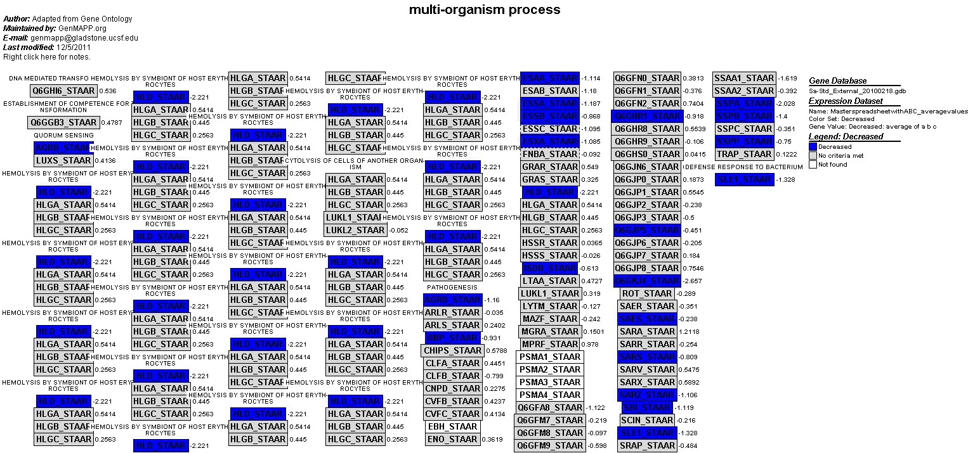
Multi-Organism Process
BBP_STAAR – involved in staphylococcus arthritis and osteomyelitis.
HLD_STAAR – lyses many mammalian cells including erythrocytes.

Slide 30
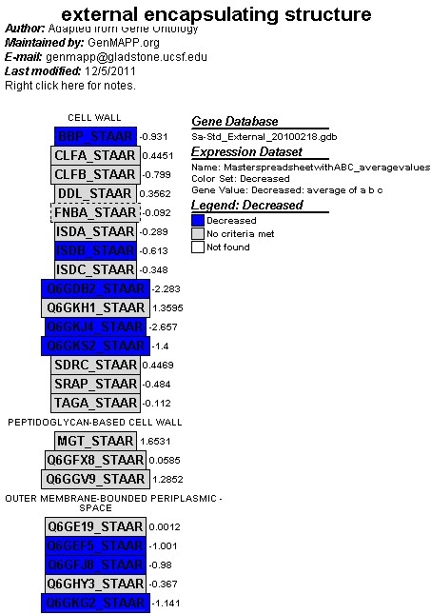
External-encapsulating structure
ISDB_STAAR and BBP_STARR as mentioned earlier does not allow binding of hemoglobin to S. aureaus along with involvement in staphylococcus arthritis and osteomyelitis respectively.

Slide 31
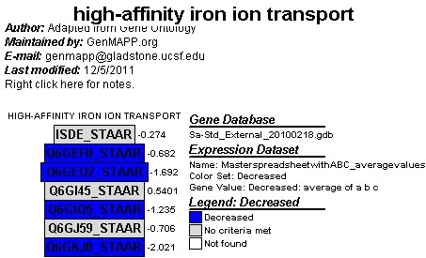
High-affinity ion transport

Slide 32
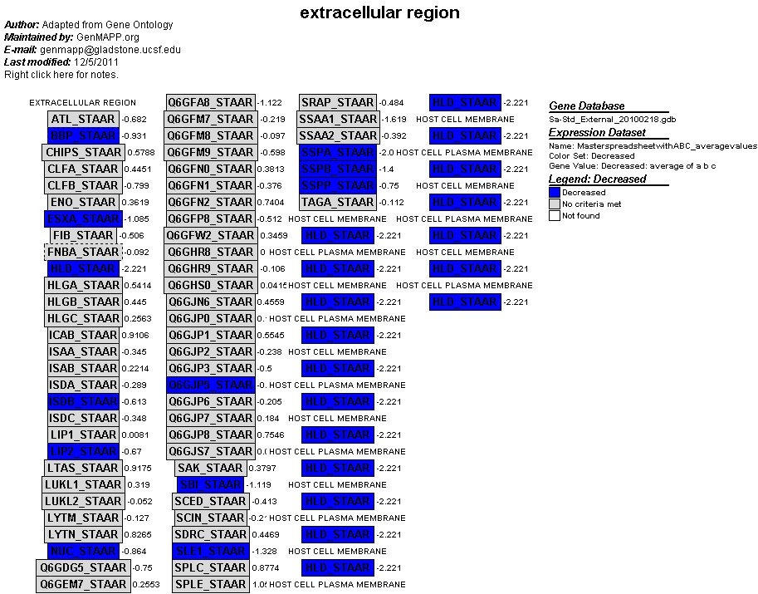
Extracellular Region
SBI_STAAR – interacts with both the adapt and innate immune system of the host cell → protects the cell against immune response from the host cell.
SLE1_STAAR – involed in the splitting of the septum during cell division.

Slide 33
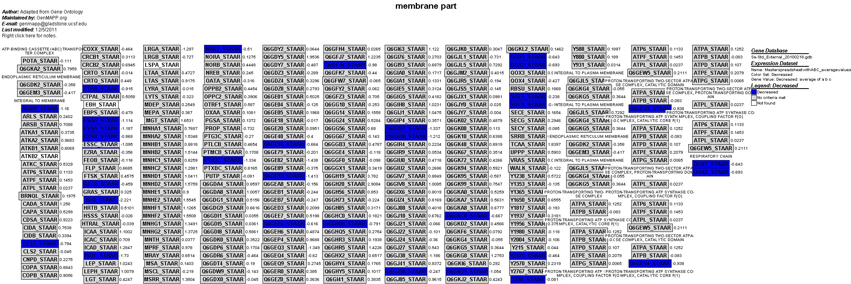
Membrane Part
ISDF_STAAR – part of the biding-protein dependent transport system for heme iron → responsible for movement of substrate across the membrane.
CLS1_STAAR – catalyzes one molecule to another

Slide 34
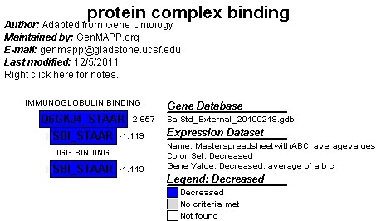
Protein Complex Binding
SBI_STAAR – interacts with both the adapt and innate immune system of the host cell → protects the cell against immune response from the host cell.

Slide 35
Decreasing GO Terms contiued
Immunoglobulin binding
Respiratory chain
Periplasmic space

Slide 36
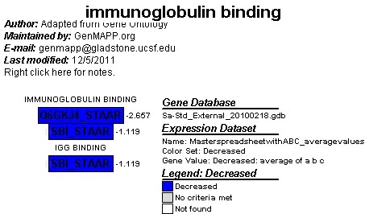
Immunoglobulin binding – SAME AS PREVIOUS SLIDE? SAVED THE SAME?

Slide 37
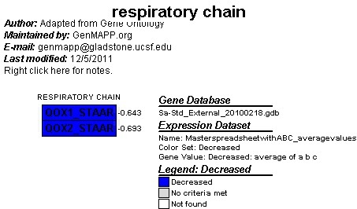
Respiratory Chain
QOX1_STAAR - Catalyzes quinol oxidation with the concomitant reduction of oxygen to water
QOX2_STAAR – same function as above but → subunit II transfers the electrons from a quinol to the binuclear center of the catalytic subunit I

Slide 38
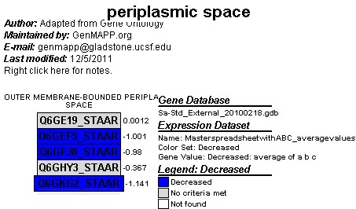
Periplasmic Space
Couldn’t find any description for these genes.

Slide 39
Increasing GO Terms
  Amine biosynthetic process
  Cellular amino acid biosynthetic process
  Cellular nitrogen compound biosynthetic process
  Antiport activity
  Branched chain family amino acid metabolic process
  Aspartate family amino acid metabolic process
  Threonine metabolic process
  Oxidation reduction
  Vitamin binding
  Oxidoreductace activity

Slide 40
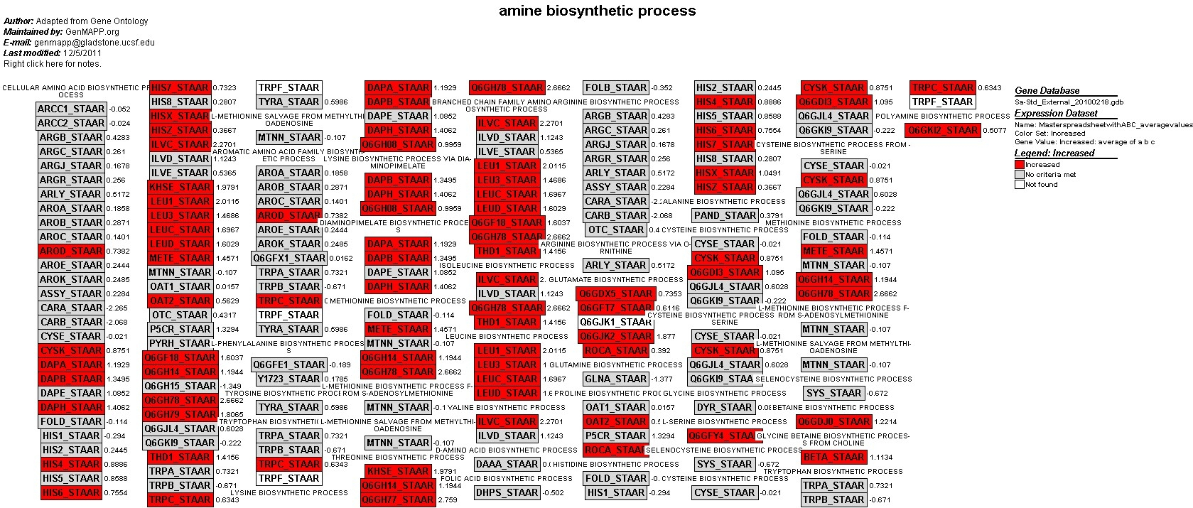
DAPH_STAAR – catalyzes transfer of acetylCoA to tetrahydrodipicolinate
LEUC_STAAR – catalyzes isomerization to form 2-isopropylmaleate.

Slide 41
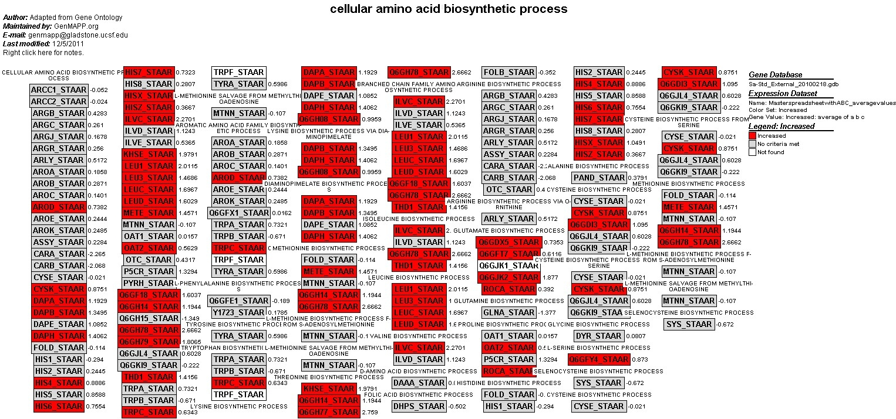
HISX_STAAR – Catalyzes the sequential NAD-dependent oxidations of L-histidinol → L-histidinaldehyde →L-histidine
OAT2_STAAR – Catalyzes the interconversion of ornithine to glutamate semialdehyde.

Slide 42
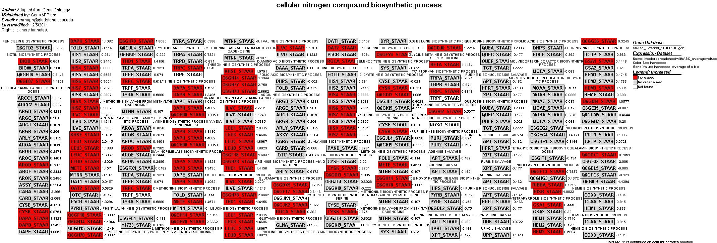
METE_STAAR – Catalyzes the transfer of a methyl group from 5-methyltetrahydrofolate to homocysteine resulting in methionine formation.
HEM3_STAAR – Tetrapolymerization of the monopyrrole PBG into the hydroxymethylbilane pre-uroporphyrinogen in several discrete steps.

Slide 43
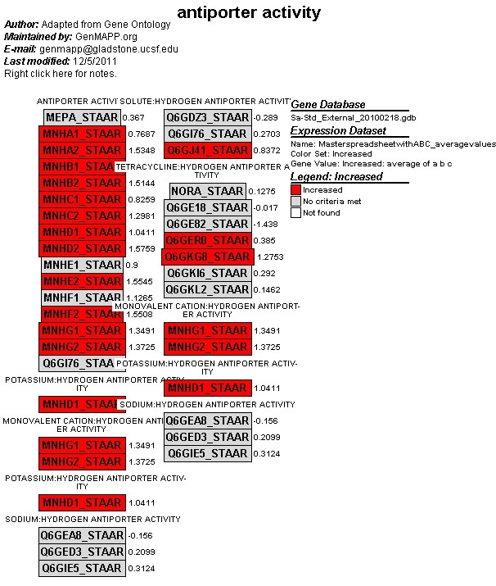
Antiporter Activity
MNHD1_STAAR – Mnh complex is a Na⁺/H⁺ antiporter involved in Na⁺ excretion.
MNHG1_STAAR – involved in Na⁺ transport

Slide 44
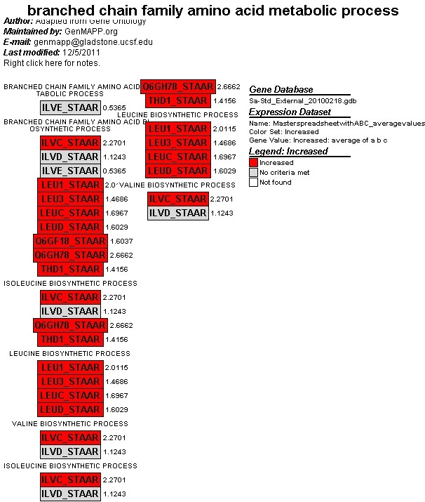
Branched chain amino acid family metabolic process
A lot of conversion from NADP⁺ → NADPH
Converison of substrates into energy process to drive the cell in order to carry out metabolic processes.

Slide 45
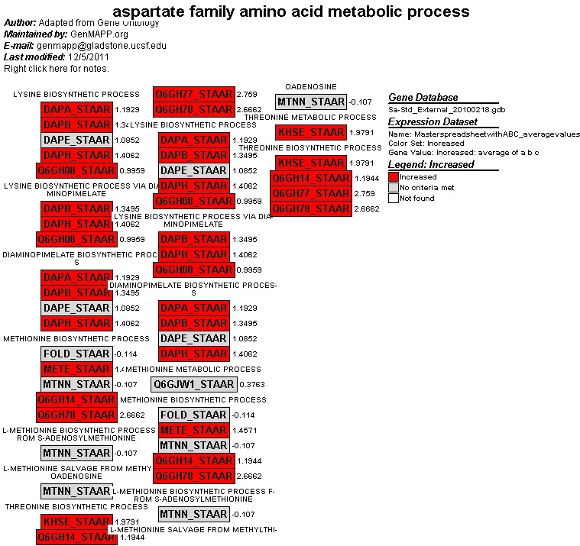
Aspartate family amino acid metabolic process
DAPH_STAAR – Catalyzes the transfer of an acetyl group from acetyl-CoA to tetrahydrodipicolinate.
KHSE_STAAR – Catalyzes the ATP-dependent phosphorylation of L-homoserine to L-homoserine phosphate.

Slide 46
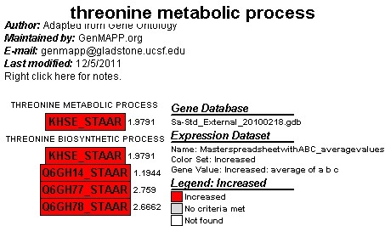
Threonine Metabolic Process
KHSE_STAAR – Catalyzes the ATP-dependent phosphorylation of L-homoserine to L-homoserine phosphate.

Slide 47
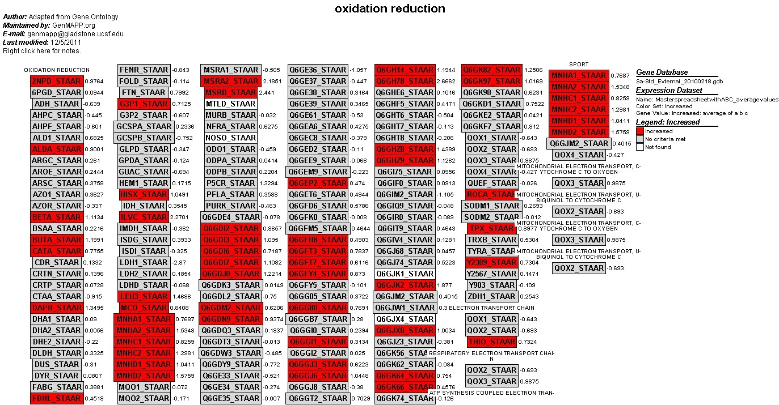
Oxidation Reduction
MSRA2_STAAR – important function as repair enzyme for proteins that have been inactivated by oxidation → catalyzes the reversible oxidation-reduction of methionine sulfoxide in proteins to methionine
THIO_STAAR – involved in redox reactions through reversible oxidation of dithiol → disulfide and then catalyzes exchange reactions of dithiol-disulfide.

Slide 48
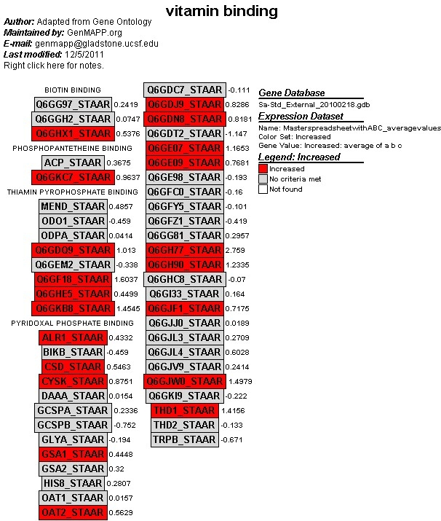
Vitamin Binding
CSD_STAAR – catalyzes removal of selenium and sulfur atoms from various vitamins in order to produce L-alanine.
THDI1_STAAR – catalyzes formation of threonine → keobutyrate. Dehydration and rehydration & liberation of ammonia are the respected steps.

Slide 49
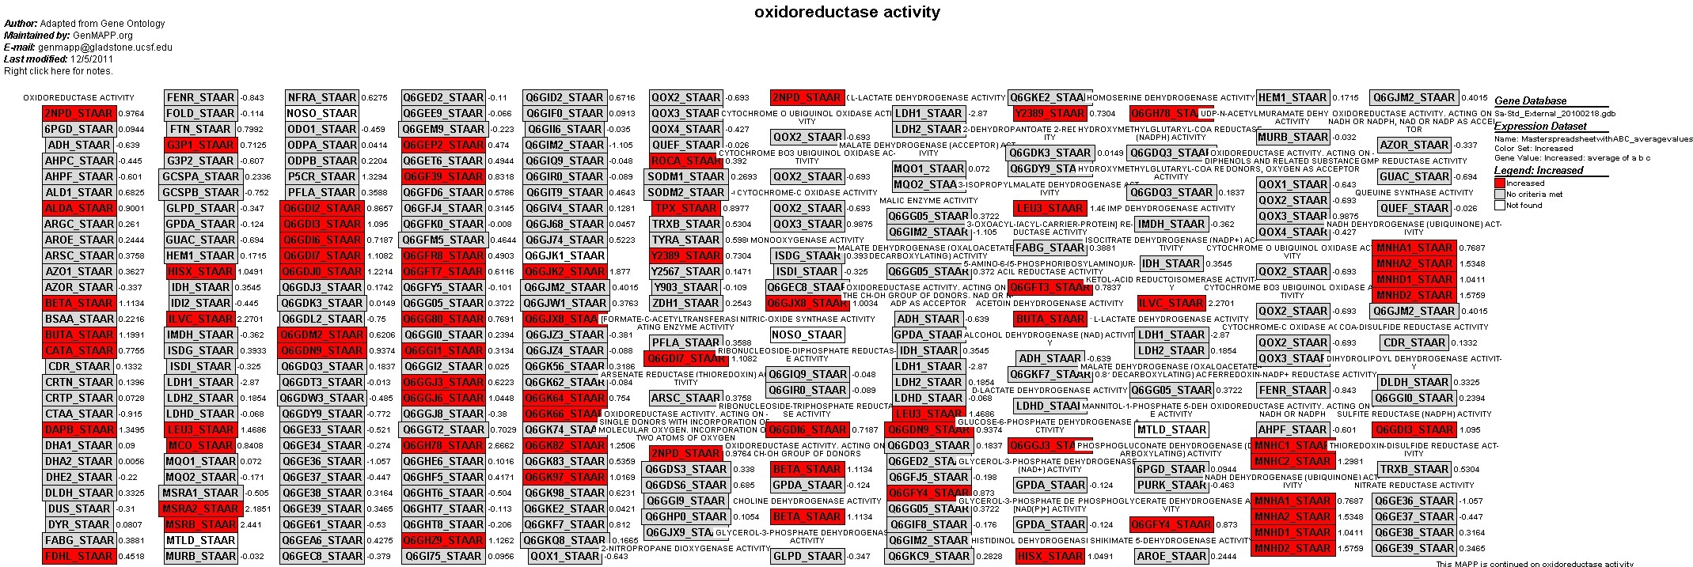
Oxidoreductase Activity
BETA_STAAR – catalyze oxidation of choline → betaine aldehyde and then → glycine betaine.
BUTA_STAAR – in the preseence of NADH, catalyzes reduction of 2,3-butanediol to acetoin.

Slide 50
Acknowledgements
Dr. Dahlquist
Ian M Overton, Shirley Graham, Katherine A Gould et. al.

