Slide 1
Amino Acid Sequences in V3 Loop Conformation
Alex Cardenas, Bobby Arnold and Zeb Russo
Loyola Marymount University Department of Biology
BIO 398 11/02/11

Slide 2
Outline
CD4 T cell count is a trait in developing AIDs ( >200 safe, <200 AIDs).
Differing CD4 T cell count is correlated with conservation in amino acid sequences.
Multiple sequence alignments (for V3 region) were run against controlled subjects and AIDs subjects.
Results obtained from multiple sequence were observed and analyzed.
Discussion and thoughts of our findings are shared.

Slide 3
Outline
CD4 T cell count is a trait in developing AIDs ( >200 safe, <200 AIDs).
Differing CD4 T cell count is correlated with conservation in amino acid sequences.
Multiple sequence alignments (for V3 region) were run against controlled subjects and AIDs subjects.
Results obtained from multiple sequence were observed and analyzed.
Discussion and thoughts of our findings are shared.

Slide 4
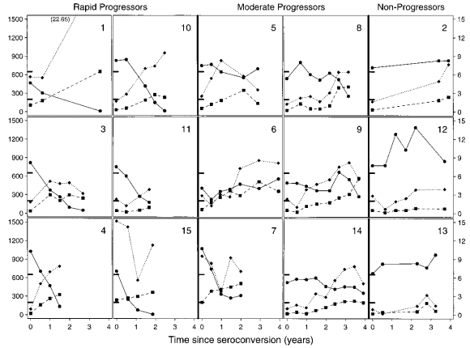
CD4 T cell count is an trait in developing AIDs ( >200 safe, <200 AIDs)
Observations led us to conclude that CD4 T cell counts were crucial in developing AIDs.
Rapid Progressors – 1, 3, 4, 10, 11, 15.
Controls
Moderate progressor – 6.
Non Progessor – 13.

Slide 5
Outline
CD4 T cell count is a trait in developing AIDs ( >200 safe, <200 AIDs).
Differing CD4 T cell count is correlated with conservation in amino acid sequences.
Multiple sequence alignments (for V3 region) were run against controlled subjects and AIDs subjects.
Results obtained from multiple sequence were observed and analyzed.
Discussion and thoughts of our findings are shared.

Slide 6
CD4 T cell count and relationship to V3 loop amino acid sequence
We were interested in the amino acid sequences of AIDs subjects.
Our question
Is there a conserved region in the V3 loop sequence that led the subject to develop AIDs?

Slide 7
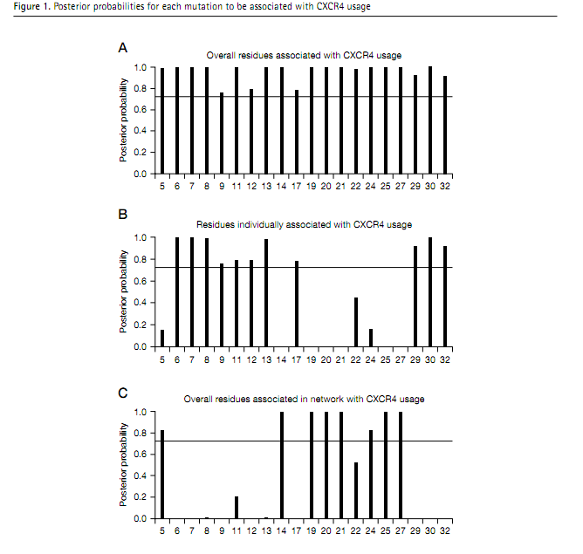

Slide 8
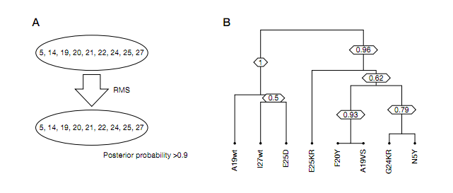

Slide 9
