Slide 1
Tissue Engineering
Lecture 13, 3/26/15
Paper Review
3D gels for ischemia

Slide 2
What is the motivation of this study?
Much of current cell therapy relies on dosing cells at the site – many of which are lost during delivery.
One mechanism to improve cell therapy is to encapsulate cells into a biomaterial – keeping the cells alive during the harsh delivery.
The authors propose to deliver adipose(fat)-derived mesenchymal stem cells in very small injectable gels to protect them during delivery.

Slide 3
Show supplementary video 1

Slide 4
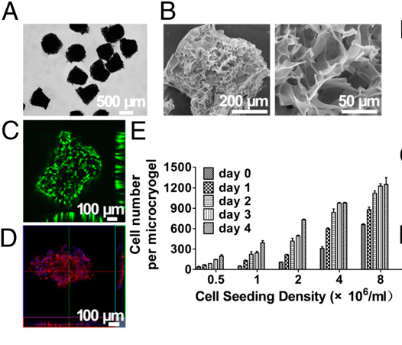
Figure 1a-e: Jemima Lamothe
Notes:
Fig. 1. Characterization of 3D injectable cellular microniches
based on GMs. (A) Photographs of harvested GMs. (B) SEM
images of GMs showing interconnected and macroporous
structures. (C and D) Fluorescence microscopic and 3D reconstructed
confocal images of GMs autoloaded with hMSCs
stained by live/dead and rhodamine phalloidin. (E) Quantification
of hMSCs autoloading and proliferation in GMs with
different initial loading densities.

Slide 5
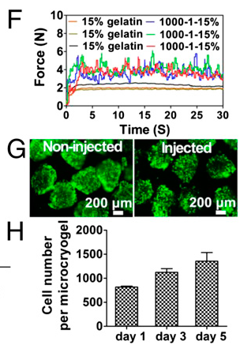
Figure 1f-i: Jonathan Hummel
Notes:
(F) Real-time injection
force measurement curves for triple injections of 1,000 GMs
in 1 mL of 15% (wt/vol) gelatin solution at 1 mL/min injection
rate (1,000–1–15%). (G) Live/dead cell viability assay of
hMSCs loaded GMs preinjection and postinjection. (H) Proliferation
of hMSCs loaded in GMs postinjection after 1, 3,
and 5 d of culture (n = 3).

Slide 6
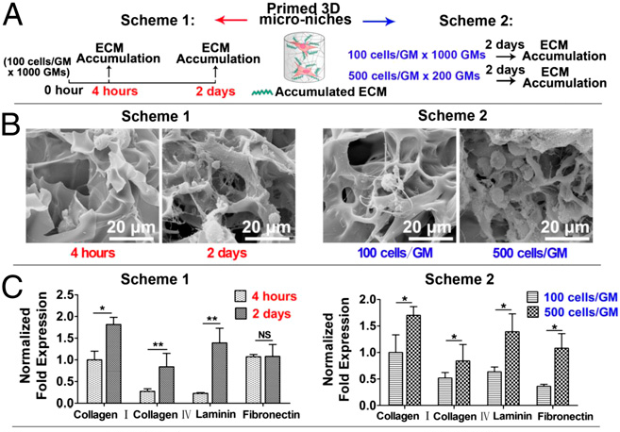
Figure 2a-c: Michael Mulroy
Notes:
Fig. 2. Cell priming in GMs to constitute the 3D microniches. (A) Two
schemes for priming hMSCs in GMs. (B) SEM images of ECMs of hMSCs in GMs
under two scheme conditions. (C) Gene expression of major ECMs of hMSCs in
GMs under two scheme conditions.

Slide 7
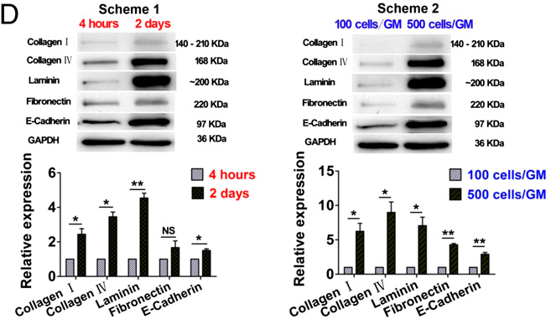
Figure 2d: Ezra Aurian-Blajeni
Notes:
(D) Protein expression of representative
ECMs and cell adhesion protein of hMSCs under two scheme conditions. *P <
0.05; **P < 0.01 (n = 3).

Slide 8
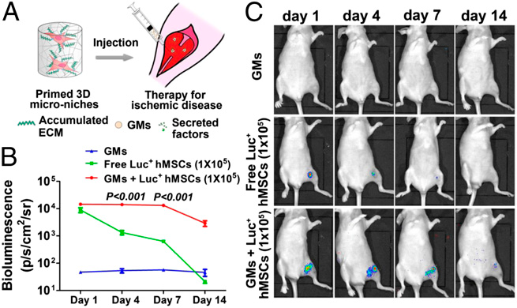
Figure 3: Sarah Johnson
Notes:
Fig. 3. Bioluminescence imaging (BLI) for tracking cell retention based on
injectable GMs. (A) Schematic of the primed 3D microniches injected into the
mouse hindlimb. (B) Measurement of the average radiance in standardized
regions of interest from hindlimb of mice in different experiment groups on
days 1, 4, 7, and 14. Luminescence signal is presented as photons per second
per square centimeter per steradian (photons/s/cm2/sr). (C) BLI of mice from
different groups for 1, 4, 7, and 14 d (n = 3).

Slide 9
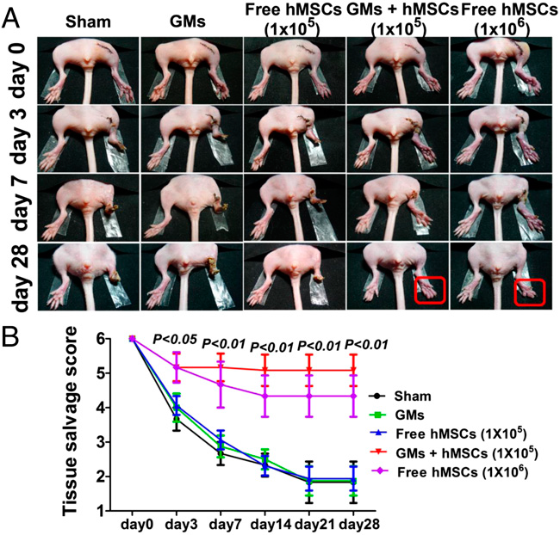
Figure 4a-b: Kyle Pariseau
Notes:
Fig. 4. Improved salvage and enhanced angiogenesis in ischemic hindlimbs
based on the 3D injectable microniches. (A) Representative photographs of
sham (n = 4), blank GMs (n = 4), free hMSCs (105) (n = 8), hMSCs (105) within
GMs (GMs+hMSCs) (n = 8), and free hMSCs (106) (n = 4) at 0, 3, 7, and 28 d
after treatment. (B) Tissue salvage sore of ischemic hindlimbs in different
treatment groups.

Slide 10
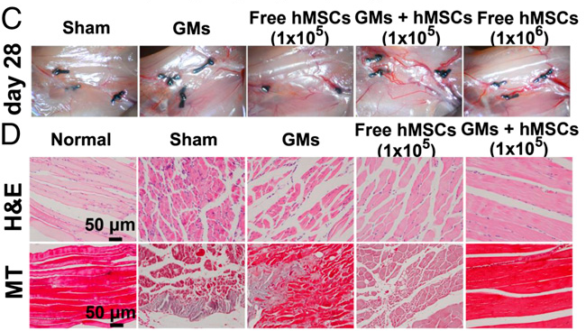
Figure 4c-d: Ronen Zeidel
Notes:
(C) Photographs showing new vessel formation across
ligation sites of the ischemic hindlimbs 28 d after treatment. (D) H&E
staining and Masson’s trichrome staining of histological ischemic hindlimb
sections 28 d after surgery. Light blue staining for collagen indicates fibrosis
in Masson’s trichrome staining.

Slide 11
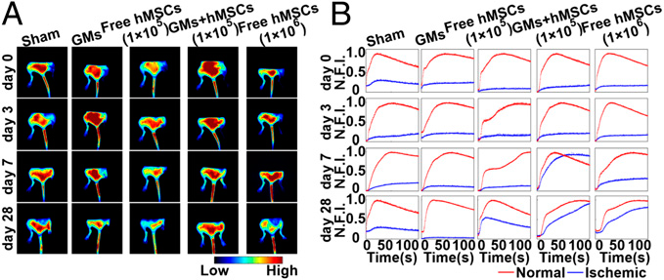
Figure 5: Matt Tiller
Notes:
Fig. 5. Monitoring blood perfusion in ischemic hindlimb with fluorescence
imaging. (A) Fluorescence images obtained 100 s after ICG injection on days
0, 3, 7, and 28, respectively. (B) Fluorescence intensity–time curves of the
ankle region (indicated by the boxes in the white light images in Fig. S6; red,
normal hindlimb; blue, ischemic hindlimb). Fluorescence intensities were
normalized to the maximal fluorescence intensity in the ankle region of
normal hindlimb. N.F.I., normalized fluorescence intensity.

Slide 12
Show supplementary movies 2-4

Slide 13
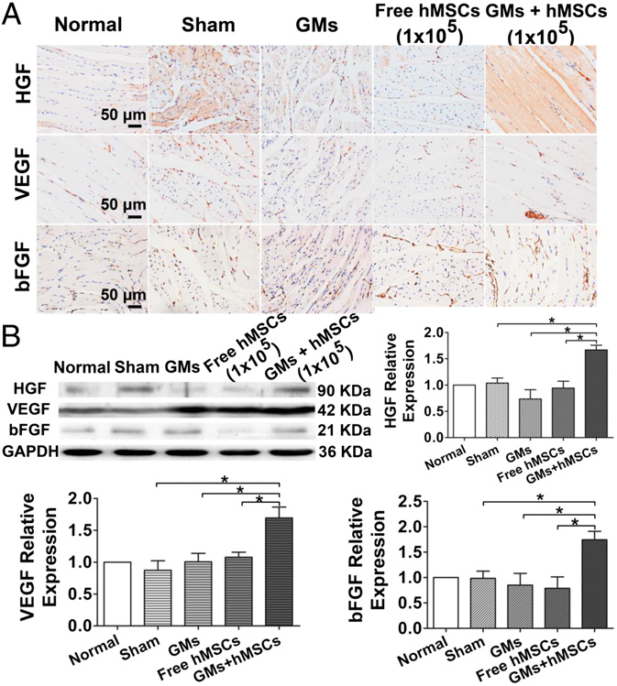
Figure 6: Christine Davis
Notes:
Fig. 6. Enhanced expression of angiogenic factors in ischemic hindlimbs
treated with the 3D injectable microniches. (A) Immunohistochemical staining
of ischemic muscle tissue sections 28 d after cell therapy for HGF, VEGF, and
bFGF. (B) Images and semiquantitative analysis of Western blot for expressions
of HGF, VEGF, and bFGF of ischemic muscle tissue 28 d after cell therapy. Relative
expression of each protein was normalized to GAPDH, and results of each
group were normalized to the result of the normal group. *P < 0.05 (n = 3).

Slide 14
Conclusions, Perspectives
By encapsulating cells in 3D microniches, they could use a dose more than 10 times lower than previous cell based therapies.
Accumulation of ECM and paracrine signaling in the niches likely provided survival signals to cells.
Priming was a key step to improving MSC differentiation prior to delivery.

