Slide 1


The Biological Preparation of Shotgun DNA Mapping
I made this…
Presents:
By Anthony
…and this

Slide 2
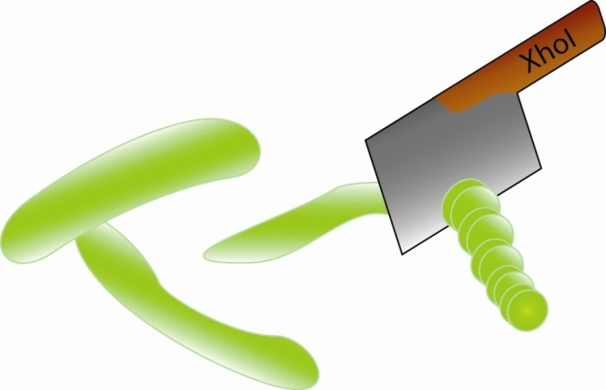
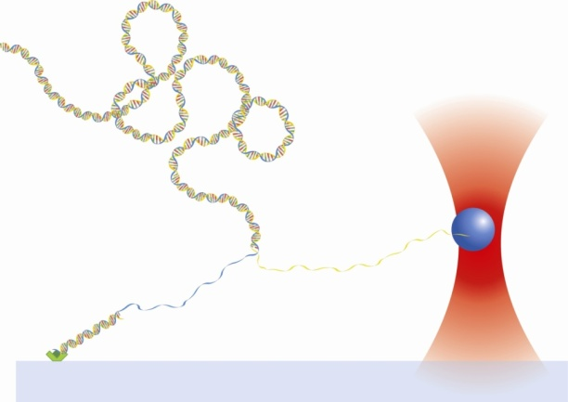
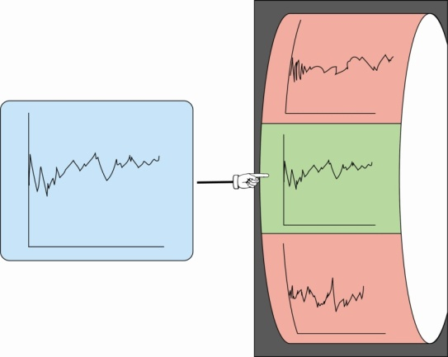
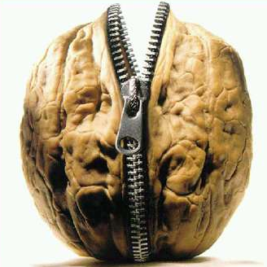
Shotgun DNA Mapping in a Nutshell
Procedure
Library of Simulated Curves
Endonuclease
Random fragment
Experimental Force
Genomic DNA
Correct Match
dsDNA anchor
Step 1: Digest genome into fragments
Step 2: Unzip fragment and record forces
Step 3: Compare experimental forces to a library of simulated curves
What this talk is about
Austin is in there too

Slide 3
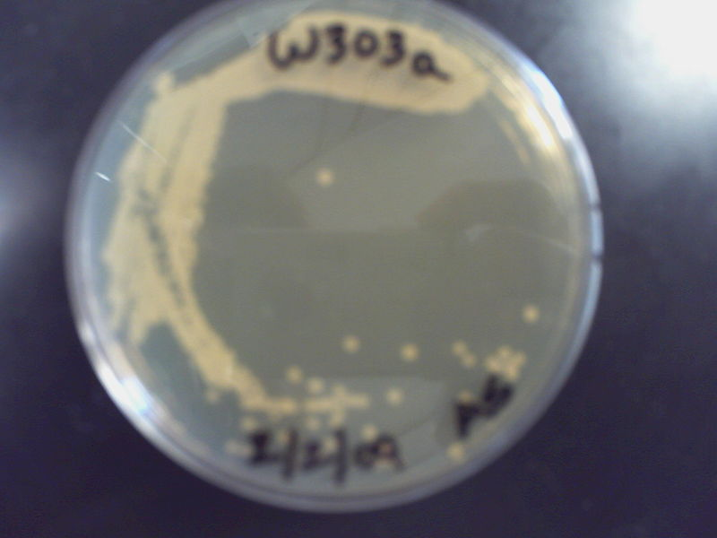
Where do you start?
Need genomic DNA from yeast
Grow some yeast
Extract the DNA
Now we’re Koching
A blurry image of yeast cells

Slide 4
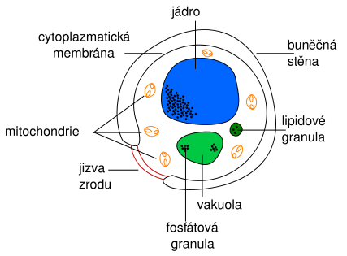
Yeast Cell
Spheroplasting
RNaseA-ing
Phenol/Chloroform Extraction and Ethanol Precipitation
It’s foreign so it’s gotta be evil

Slide 5
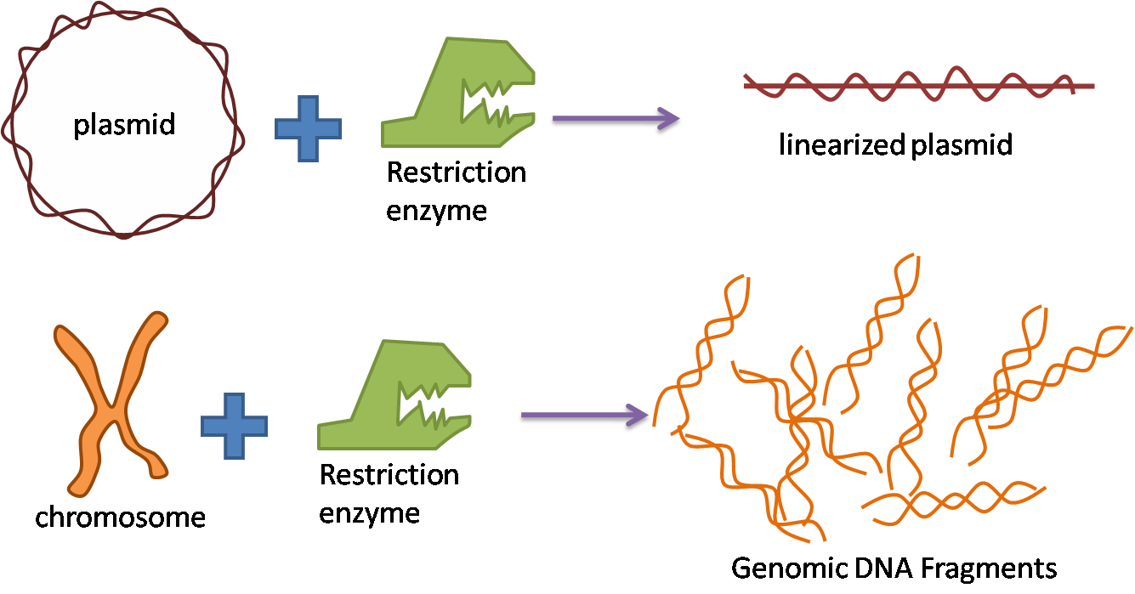
Next Step
Need digested plasmid DNA and digested genomic DNA
Want to clone fragments
For sequencing
So we can unzip a lot of fragments
Michael Bay’s next film… too late I already sold the rights

Slide 6
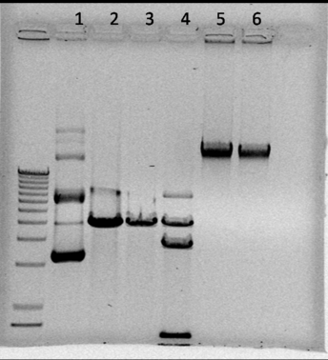
The first of many gels
Lanes:
1: pRS413 uncut
2: pRS cut with XhoI
3: pRS cut with NotI
4: pRS cut with BstXI
5: genomic uncut DNA (gDNA)
6: gDNA cut with XhoI
10kb length
My archnemesis

Slide 7
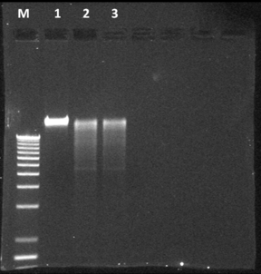
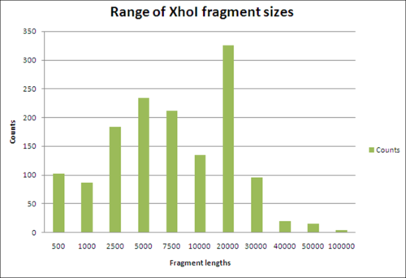
Digested gDNA
Lanes:
1: Uncut gDNA
2: gDNA cut with XhoI
3: gDNA cut with XhoI (for redundancy)
Get used to this, there is a lot more coming
Making this was really annoying

Slide 8
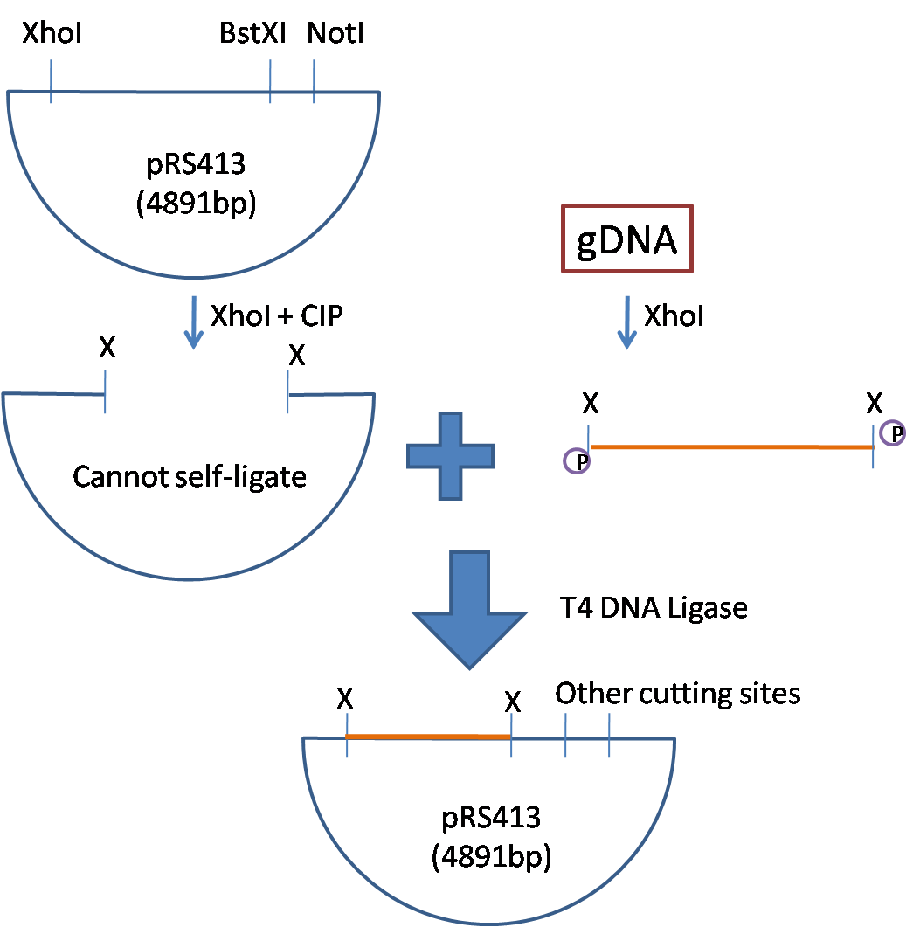
Inserting DNA
CIP – Calf Intestinal Phosphatase
T4 DNA Ligase - ??? DNA Ligase
Terminators can’t self terminate.

Slide 9
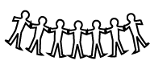
Making Clones
Mix Competent E. coli cells with plasmid DNA
E. coli readily replicates plasmid
Grow cells on petri dish
Cells grow into individual colonies
If plasmid has inserts then each colony is a separate insert
One of them likes pizza

Slide 10
1st and 2nd Transformation Tries
A whole blown wad

Slide 11
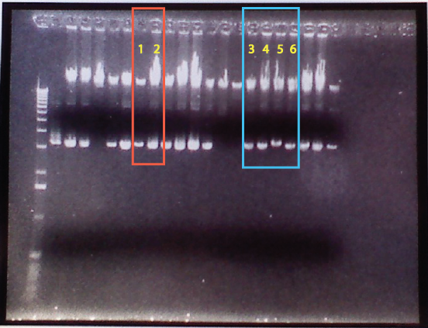
Transformation Success?
E. Coli DNA
Extracted plasmid DNA
This is all Koch’s fault

Slide 12
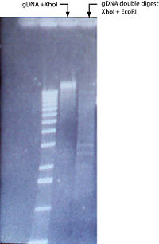
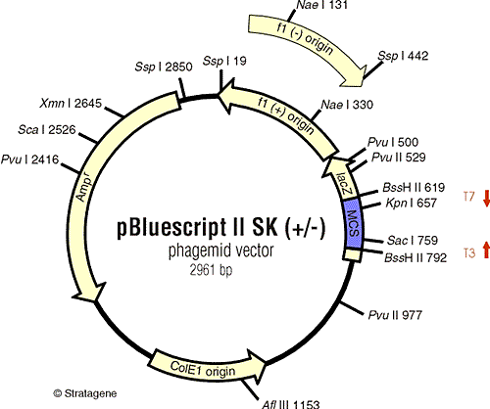
Double Digest and pBluescript
I was drunk when I took this picture
I was drunk when I slept with this one

Slide 13
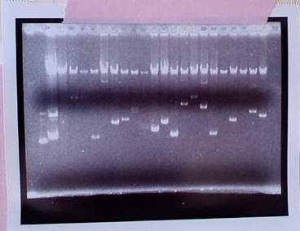
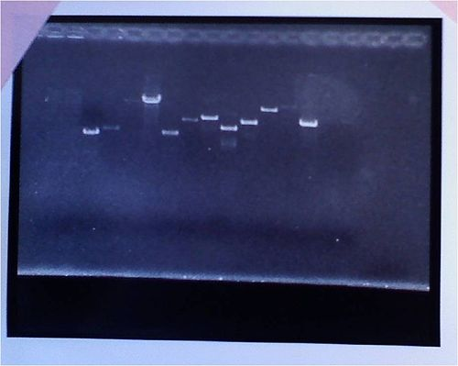
Redoing with pBS
Now that is definitely some random genomic fragments
Top Image quick extraction
Bottom Image is good extraction
I like pink tape

Slide 14
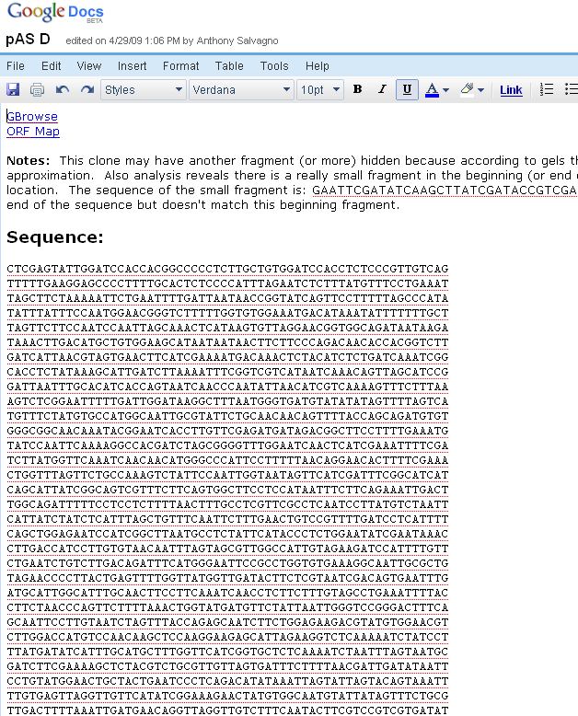
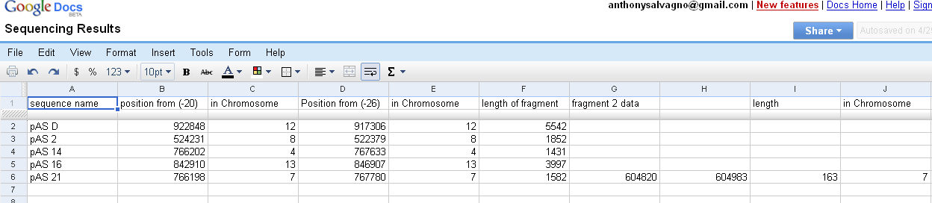
Sequencing
Involves some steps I don’t know
Need to sequence so that when we unzip we can know what the correct match is
Larry look away
Not for Larry’s Eyes
I thought it would be funny if I used a print screen of this slide for this slide.

Slide 15
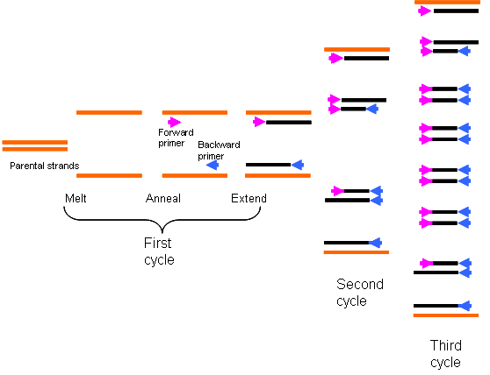
Development of Tether Construct Part 1: PCR
Need:
Template DNA
Forward Primer
Reverse Primer
We use pRL574, F834, and R1985
The F834 primer has DIG (for glass attachment)
There is a BstXI site in amplified sequence.
Works just like rabbit mating

Slide 16
Tether Construction Part 2
BstXI
pRL fragment
Make an oligo that has BstXI site and is Biotinylated
We made 2:
One is a hairpin with a NotI site
The other is two single stranded oligos with a SapI site
Remember our fragments have both NotI ends and SapI ends
NotI
NotI hairpin
or
SapI
Top and bottom
Annealed oligos
NotI end
SapI end
The sequel to Michael Bay’s movie
Rights also already sold

Slide 17
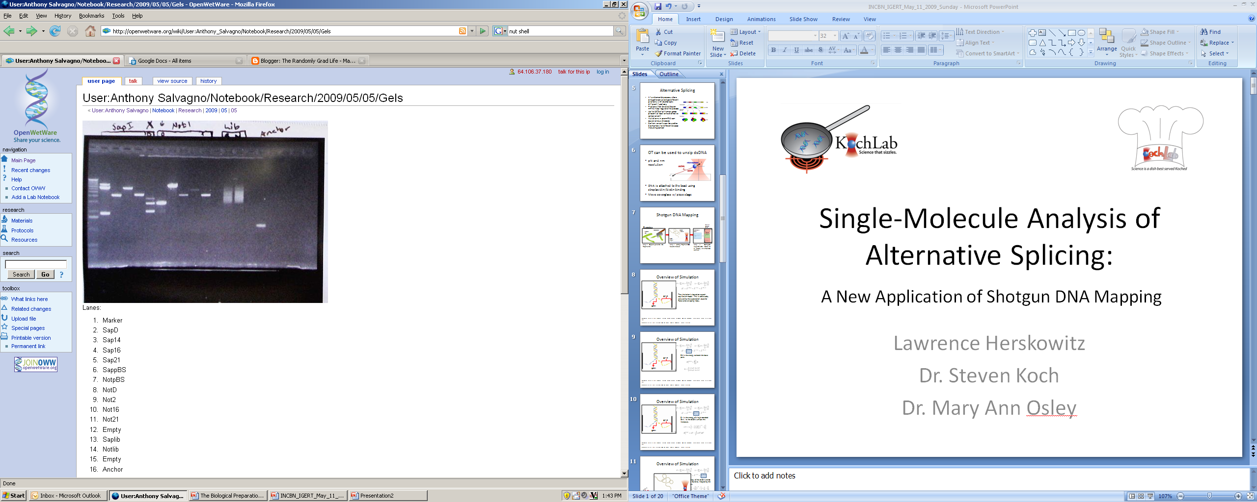
When it’s all done
More on next slide
gDNA
plasmid
Biotinylated fragment
Digitylated fragment
…
Gel of Digested Fragments
This is what skittles does to your DNA
The quality of this image is a direct result of a computer from 1991

Slide 18
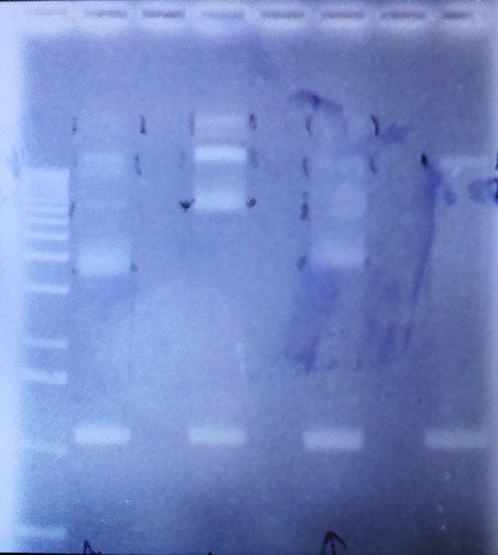
What I have now
What it looks like
What it should look like
both
fragment
anchor
1991 strikes again
2009 artist rendition

Slide 19
Combine with Fragments
Ligate the plasmid random fragments to the tethering construct
Use flow chamber fluidics to prepare sample for tweezing
Wait 3 years for tweezer
Tweeze
The bastard child of a koch and a wang
Pronounced incorrectly

Slide 20
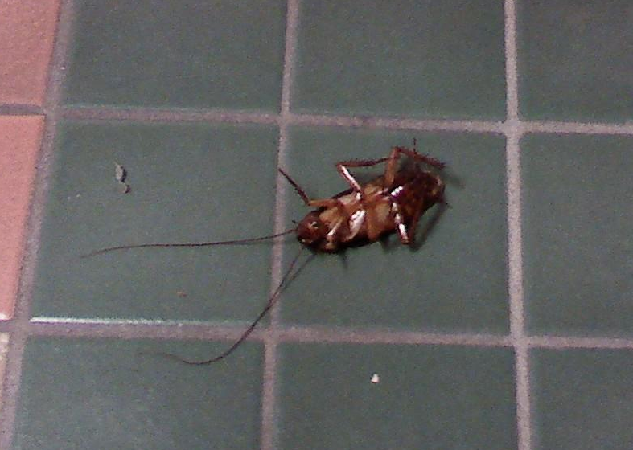
No Mas
None of you better look like this guy

