Slide 1
Nitric oxide induces Mycobacterium tuberculosis stress response beyond dormancy regulon
Isabel Gonzaga
BIOL 368: Bioinformatics Laboratory
December 10, 2014

Slide 2
Outline
Tuberculosis latency period is crucial for disease control
Dormancy regulon determined by NO, dormancy and hypoxia response
Additional analyses conducted to verify dormancy regulon in its response to NO
NO exposure induces stress response pathways
Voskuil et al (2003)’s dormancy regulon findings were incomplete, but mechanism is supported

Slide 3
Outline
Tuberculosis latency period is crucial for disease control
Dormancy regulon determined by NO, dormancy and hypoxia response
Additional analyses conducted to verify dormancy regulon in its response to NO
NO exposure induces stress response pathways
Voskuil et al (2003)’s dormancy regulon findings were incomplete, but mechanism is supported

Slide 4
Tuberculosis infection has three developmental stages
TB is a pulmonary infection caused by Mycobacterium tuberculosis
3 stage pathogenic sequence
Inhalation of infectious aerosol
Latency period
Unimpeded bacterial replication (onset of disease)
1/3 of the world is latently infected
The most aggressive TB cases exist in latent form
Latency promotional factors not widely investigated

Slide 5
O₂ depletion promotes M. tuberculosis latent period
Gradual O₂ depletion leads to:
Nonreplicating, persistent state
Structural, metabolic and chromosomal changes to the bacteria
Reduced O₂ tension leads to resistance to antimicrobials
Reintroduction of O₂ converts bacteria to active form

Slide 6
Nitric oxide (NO) controls M. tuberculosis growth by inhibiting aerobic respiration
Voskuil et al. (2003) investigated role of NO in inducing latent period program in M. tuberculosis
High doses of NO is toxic for bacteria
NO inhibits aerobic respiration in mitochondria and bacteria
NO is an important signaling agent for eukaryotes

Slide 7
Outline
Tuberculosis latency period is crucial for disease control
Dormancy regulon determined by NO, dormancy and hypoxia response
Additional analyses conducted to verify dormancy regulon in its response to NO
NO exposure induces stress response pathways
Voskuil et al (2003)’s dormancy regulon findings were incomplete, but mechanism is supported

Slide 8
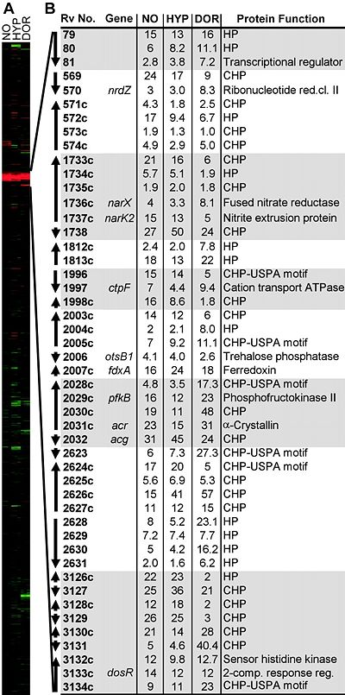
Dormancy regulon determined by coinduction by NO, low O₂ and adaptation to an in vitro dormant state
Red: induced
Green: repressed
Black: no change
Genes organized based on
average linkage clustering
NO: Mtb 1254 exposed to 50mM of DETA/NO for 4hrs
HYP: Mtb 1254 0.2% O₂ for 2 hrs
DOR: Mtb 1254 4 days gradual adaptation to lower O₂

Slide 9
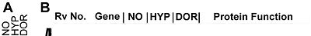
Dormancy regulon determined by coinduction by NO, low O₂ and adaptation to an in vitro dormant state
Red: induced
Green: repressed
Black: no change
Genes organized based on average linkage clustering
NO: Mtb 1254 exposed to 50mM of DETA/NO for 4hrs
HYP: Mtb 1254 .2% O₂ for 2 hrs
DOR: Mtb 1254 4days gradual adaptation to lower O₂

Slide 10
Control of the dormancy regulon important for M. tuberculosis survival in latent periods
Dormancy regulon induction inhibits aerobic respiration and slows replication – crucial for bacteria to survive
Predicted gene roles have been supported by previous research of physiological properties in dormant state
Low NO concentrations induce 48 gene regulon using the DosR regulator
Dormancy regulon induction increases in vivo fitness in latency
NO and low O₂ induce dormancy regulon expression
Both reversible by removal of NO or provision of O₂
Molecular sensor for O₂ and NO levels likely to be heme-containing molecule (ie. Cytochrome oxidase)

Slide 11
Outline
Tuberculosis latency period is crucial for disease control
Dormancy regulon determined by NO, dormancy and hypoxia response
Additional analyses conducted to verify dormancy regulon in its response to NO
NO exposure induces stress response pathways
Voskuil et al (2003)’s dormancy regulon findings were incomplete, but mechanism is supported

Slide 12
Data analysis was used to corroborate Voskuil et al. (2003) findings
Voskuil et al. (2003) methodology
Cy3 and Cy5 normalization (Excluding top and bottom 5%)
Accounted for noise
Calculated average intensity for lowest 20%
Raised values below this to average value
No mention of log based calculations or statistical analysis
Present analysis methodology
Scaled and centered data
Log fold change ratios were normalized
P-value, Bon p-value and BH p-value were used to determine significance in results

Slide 13
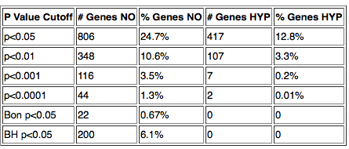
Sanity check of significant values validates calculation methodology
Increasing significance stringency reduces number of significant gene response
Hypoxia: less significance
NO: P<.0001 in 44 genes, not 48

Slide 14
Dormancy regulon calculation comparisons showed consistency, despite lacking data
All 48 genes from dormancy regulon were compared to calculated fold induction and significance for NO and HYP conditions
Consistencies
All genes included in dataset were induced
Normalized fold values relatively consistent
Discrepancies
10/48 genes missing from dataset
5 induced HYP genes insignificant at p < .05

Slide 15
Dormancy regulon omitted significant genes
RV3133C
dosR/devR
Transcriptional regulatory protein
RV1996
Universal stress protein
RV1998C
Uncharacterized
RV0574C
uncharacterized
RV0082
Oxidation/reduction process; iron sulfur cluster binding
RV2005c
Universal stress protein; response to hypoxia
RV2958c
PGL/p-hBAD biosynthesis glycosyltransferase; evasion of immune response
RV0330C
Transcriptional regulatory
RV2620c
Transmembrane protein
RV2624c
Universal stress protein
Red: not included in dormancy regulon
Many genes involved in stress response, transcription regulation
Notes:
Brings the total of .0001 p value significant genes to 40 that may be included in regulon – at least 8 genes must be missing
Looking at induction and repression pathways can gain a better sense

Slide 16
Outline
Tuberculosis latency period is crucial for disease control
Dormancy regulon determined by NO, dormancy and hypoxia response
Additional analyses conducted to verify dormancy regulon in its response to NO
NO exposure induces stress response pathways
Voskuil et al (2003)’s dormancy regulon findings were incomplete, but mechanism supported

Slide 17
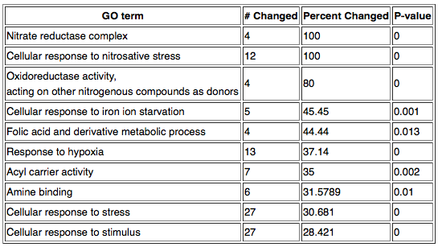
NO induces hypoxia and stress response pathways
Gene Ontology GenMapp analysis determined top pathways significantly affected by gene changes
Stress responses induced
Notes:
Pathway used to mitigate the nitric oxide stress – attempts to reduce
Induces cell stress responses as expected
Hypoxia response – consistent with dormancy

Slide 18
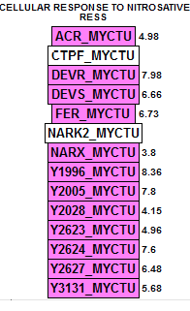
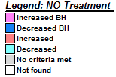
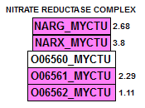
Highly significant induction of nitrosative stress supports Voskuil (2003) findings
Tb has response mechanism to mitigate NO
Nitrate reductase complex reduces nitrate to nitrite
Notes:
* All found closeby, able to initiate quick response times

Slide 19
Outline
Tuberculosis latency period is crucial for disease control
Dormancy regulon determined by NO, dormancy and hypoxia response
Additional analyses conducted to verify dormancy regulon in its response to NO
NO exposure induces stress response pathways
Voskuil et al (2003)’s dormancy regulon findings were incomplete, but mechanism is supported

Slide 20
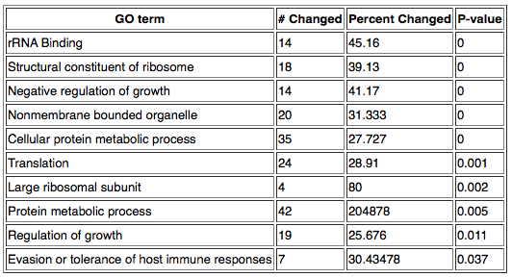
NO exposure significantly represses many protein production pathways
Gene Ontology GenMapp analysis determined top pathways significantly affected by gene changes
Gene expression inhibition consistent with dormant state
Notes:
In dormancy, dod not need tolerance for host immune responses
Consistent with a stress response pathway, as well as dormancy

Slide 21
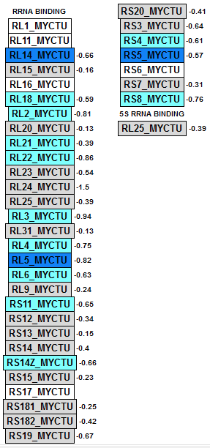
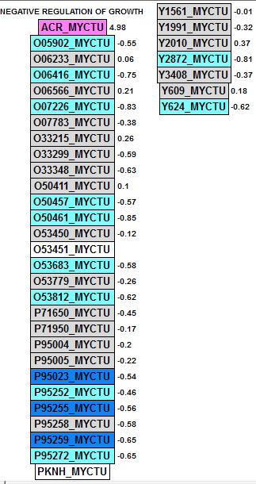
rRNA binding and negative growth regulation repressed by NO response
High repression of protein expression activity
Transcription
Translation
Supports dormant activity
ACR: induced chaperone, slows growth of Mtb
Part of dormancy regulon

Slide 22
Dormancy regulon provides framework for understanding M. Tb dormancy response program
Overall, secondary analysis supports Voskuil et al. findings
Inconsistencies in calculation relatively minor
Insignificant HYP genes still induced
Incomplete dataset provides greatest difficulty in establishing validity
NO exposure induces hypoxia stress response genes, consistent with Voskuil et al. (2003)
Support for the heme-binding molecular sensor shown by induction of heme-containing molecules in NO exposure
Further analysis and data scrutiny necessary in understanding validity of the dormancy regulon
Notes:
- Experimental methods description poor – hwo did they determine which genes were significant enough across all three stimulus to be included in the regulon?
Despite this, and the incomplete data set, it was surprising to find that secondary analysis supported the data
Certainly, greater stringency methods in sharing bioinformatics would have made this process much arduous. Better/more conclusions would have been able to be drawn if data was consistent and stored in a more meaningful manner

Slide 23
Acknowledgments
Loyola Marymount University
Kam Dahlquist, Ph. D
TA: Stephen Louie

Slide 24
References
Voskuil, M.I., Schappinger, D., Visconti, K.C., Harrell, M.I., Dolganov, G.M., Sherman, D.R., and Schoolnik, G.K. (2003). J. Exp. Med. 198(5), 705-713. doi:10.1084/jem.20030205.

