Slide 1
There are 16 Different Combinations for the Test Inputs
Sigmoidal
Michaelis Menten
Estimate + Forward
Forward Only
Fix p
Estimate p
Graph
No Graph
Graph
No Graph
Graph
No Graph
Estimate + Forward
Estimate b, Estimate p
Graph
No Graph
Estimate b, Fix p
Graph
No Graph
Fix b, Estimate p
Graph
No Graph
Fix b, Fix p
Graph
No Graph
Forward Only
Graph
No Graph

Slide 2
There was little difference in the values of the Network Optimized Weights for Graph and No Graph
Difference Between Graph and No Graph
Sigmoidal: Estimate and Forward | Fixb-0 and FixP-0 | 9.5E-18
 | Fixb-0 and FixP-1 | -3.5E-08
 | Fixb-1 and FixP-0 | 0
 | Fixb-1 and FixP-1 | 0
Sigmoidal: Forward only |  | 0
Michaelis Menten: Estimate and Forward | FixP-1 | 8.8E-08
 | FixP-0 | -9.0E-08
Michaelis Menten: Forward only |  | 0

Slide 3
Network Optimized Weights for Sigmoidal and Michaelis Menten Estimate + Forward
ControllerGeneA -> TargetGeneB

Slide 4
ACE2

Slide 5
ARG80

Slide 6
CIN5

Slide 7
FKH2

Slide 8
GLN3

Slide 9
HAP4

Slide 10
HMO1
Note that the scale is from -6 to 6, rather than -3 to 3

Slide 11
MIG2
Note that the scale is from -6 to 6, rather than -3 to 3

Slide 12
MSN2
Note that the scale is from -6 to 6, rather than -3 to 3

Slide 13
PDR1

Slide 14
PIB2

Slide 15
RIF1

Slide 16
SFP1

Slide 17
SNF6

Slide 18
STB5

Slide 19
SWI4

Slide 20
SWI5

Slide 21
YHP1

Slide 22
YLR278C

Slide 23
YOX1

Slide 24
Network b Output Comparison for Sigmoidal Model

Slide 25
There is an Issue with the Production Rates for Estimating P (fixP-0)

Slide 26
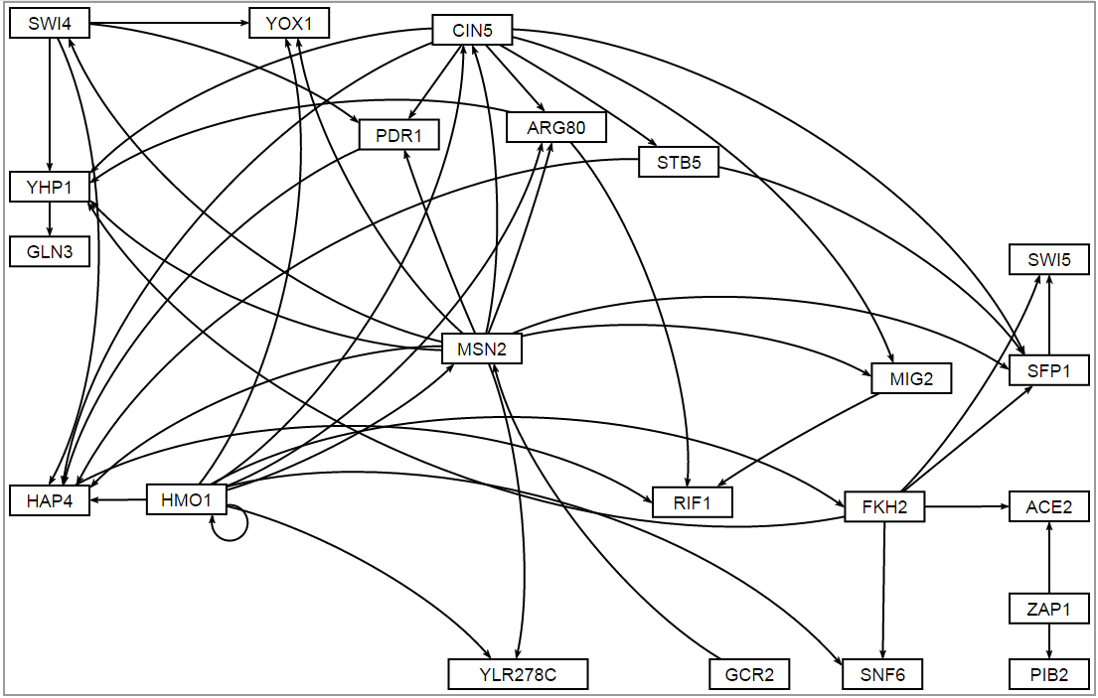
Input GRNsight

Slide 27
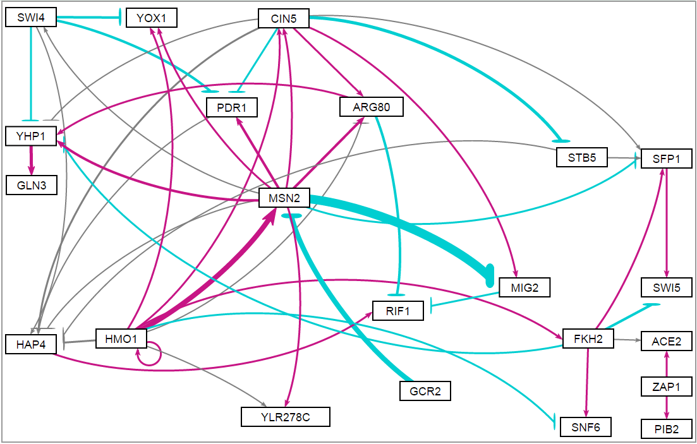
Sigmoidal_estimation_fixb-0_fixP-0_graph_output GRNsight

Slide 28
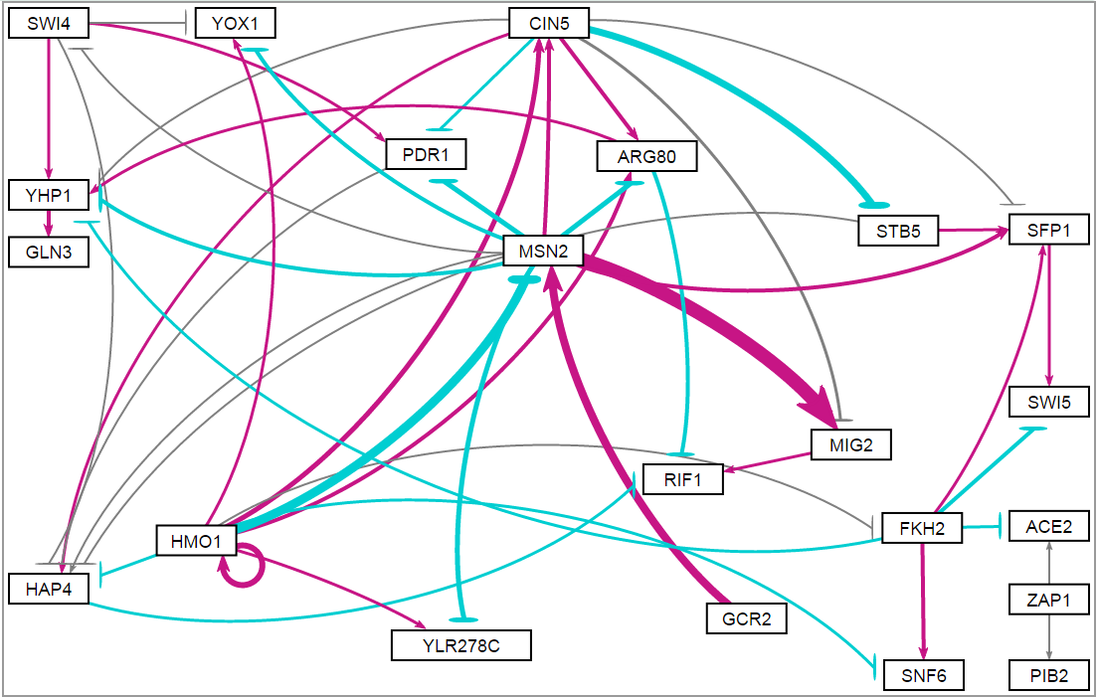
Sigmoidal_estimation_fixb-0_fixP-1_graph GRNsight

Slide 29
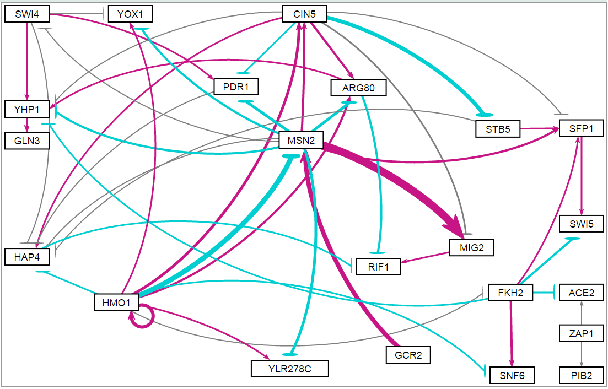
Sigmoidal_estimation_fixb-1_fixP-0_graph GRNsight

Slide 30
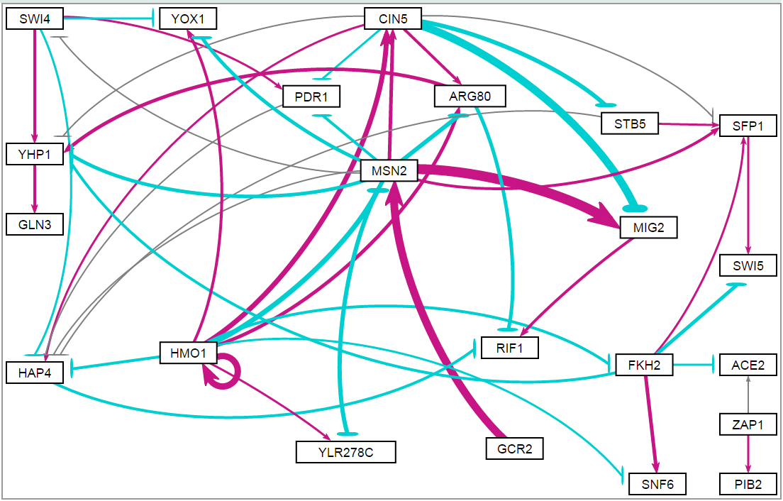
Sigmoid_estimation_fixb-1_fixP-1_graph GRNsight

Slide 31
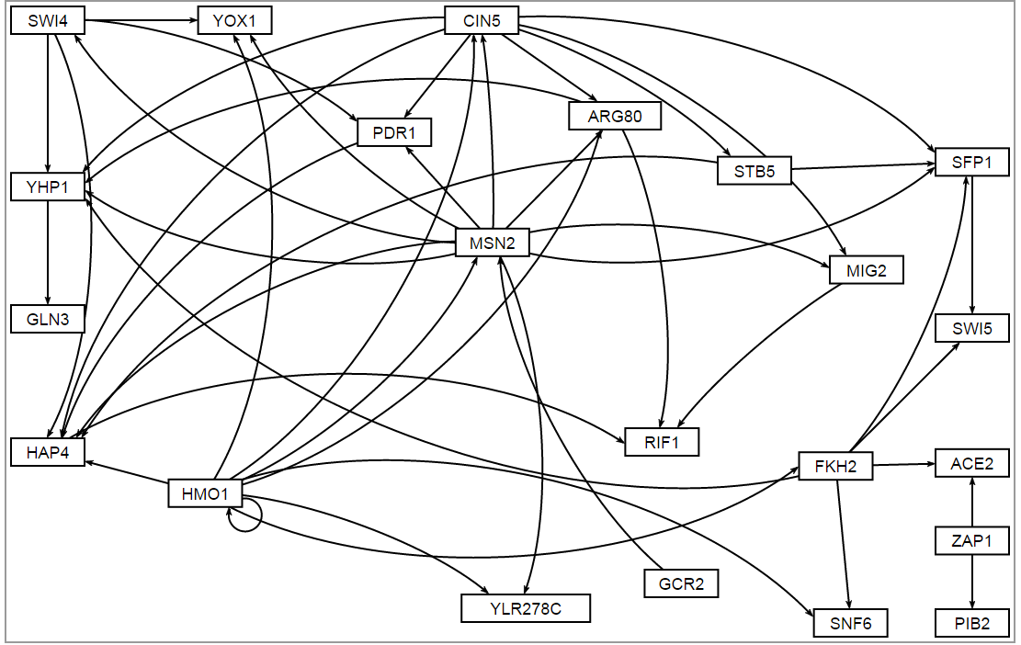
Sigmoid_forward_graph GRNsight

Slide 32
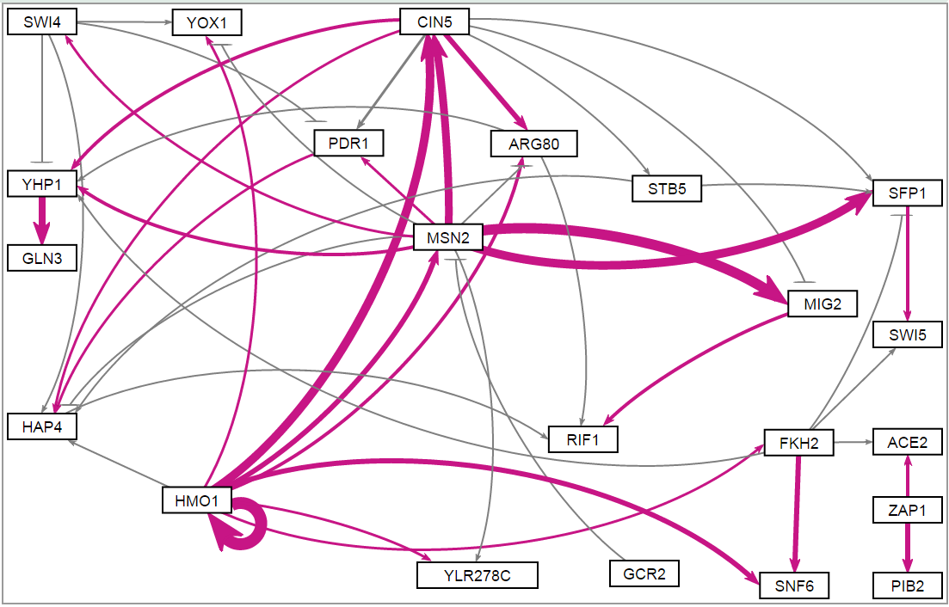
MM_estimation_fixP-1_graph GRNsight

Slide 33
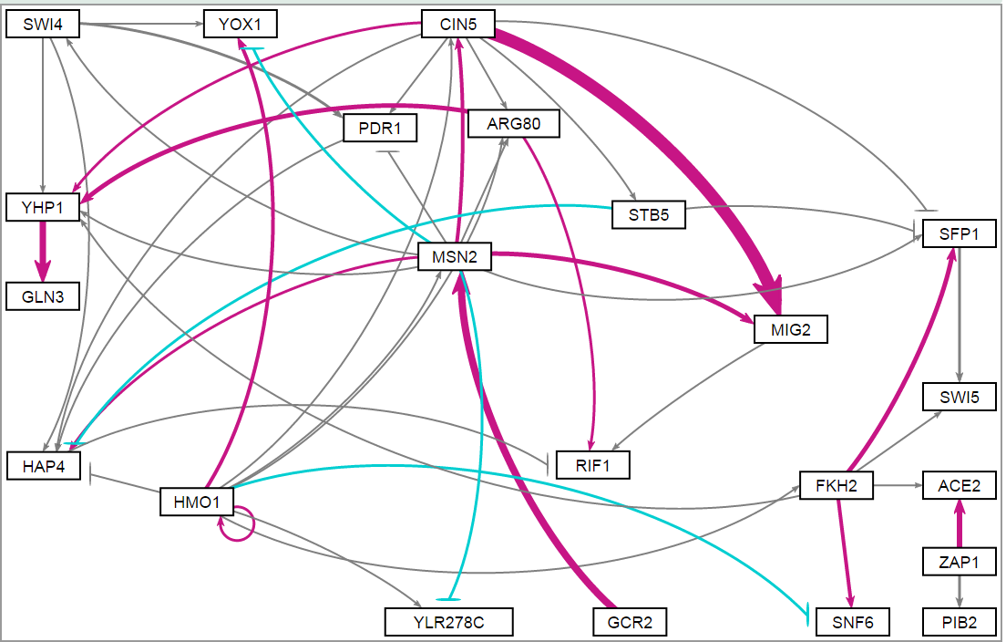
MM_estimation_fixP-0_graph GRNsight

Slide 34
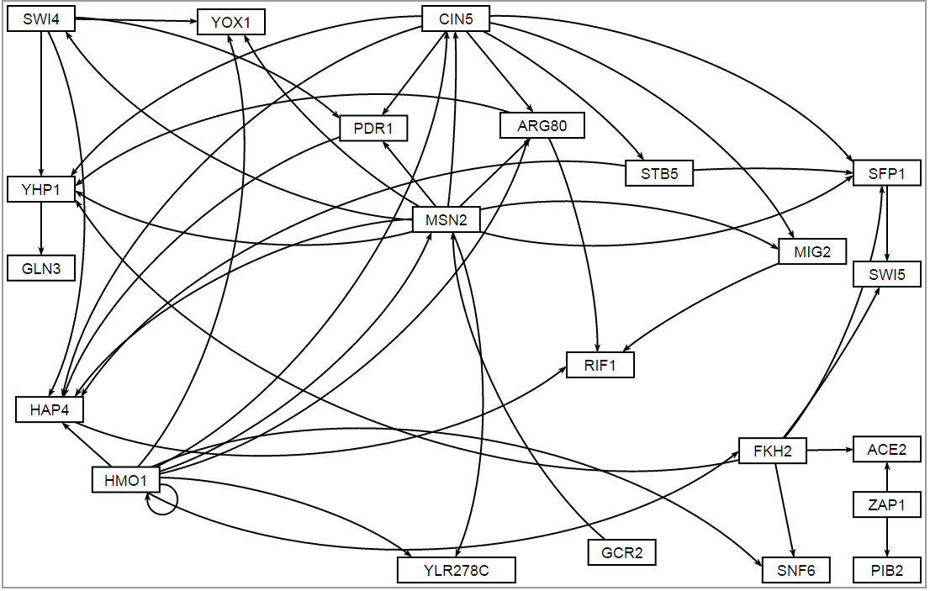
MM_forward_graph GRNsight

