Slide 1
De Novo Designed Proteins from a Library of Artificial Sequences Function in Escherichia Coli and Enable Cell Growth
Michael A. Fisher, Kara L. McKinley, Luke H. Bradley, Sara R. Viola, Michael H. Hect
20.385
March 7, 2012
Hannah Johnsen and Sabina Sood

Slide 2
Background
De novo - starting from the beginning, from scratch
Binary code strategy - specific sequence pattern of polar and non-polar residues
Four-helix bundle - four helices packed in a coiled-coil arrangement
Auxotroph - unable to synthesize compounds required for growth
Notes:
Hannah
-De novo proteins designed without any template from other existing proteins or with a particular function in mind
-Used binary code - pattern of polar and non-polar residues, folds into stable four-helix bundle
-Four-helix bundle: 4 helices in coiled-coil, known very stable formation for biological functions
-Auxotroph: deleted for a gene needed to grow on minimal medium; can grow on rich media

Slide 3
Overview
Purpose: Determine if de novo proteins can replace growth function in cells
I. Design of novel proteins
II. Rescue by de novo proteins
III. Binary pattern design
IV. Testing of E. coli strains
V. Rescue of knockout E. coli
Notes:
Hannah
-Purpose: can de novo proteins replace growth function of other genes in cells? without being based on other proteins or designed for a specific function?
-Design of novel proteins: how they made the library
-Rescue by de novo proteins: show proteins rescue function
-Binary pattern design: sequence of proteins that rescued cells
-Testing of E. coli strains: tested de novo proteins in vivo
-Rescue of knockout E. coli: show de novo sequences can replace E. coli genome

Slide 4
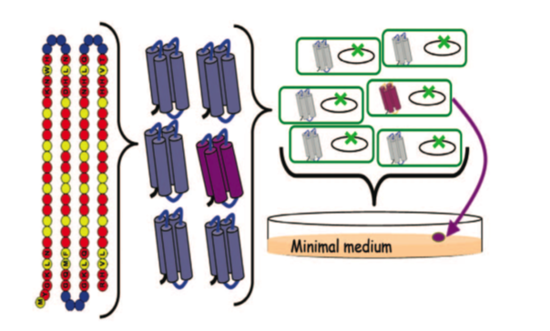
Design of novel proteins
Red: Polar residue
Yellow: Non-polar residue
Figure 1: Design of a collection of novel proteins and rescue of E. coli auxotrophs.
Notes:
Used binary pattern of polar and nonpolar residues --> fold into 4-helix bundles
Circles with letters: fixed; empty circles: amino acids they changed
Experimental library transformed into E. coli with endog. gene deleted
colony formation, minimal media --> novel seq enables cell growth

Slide 5
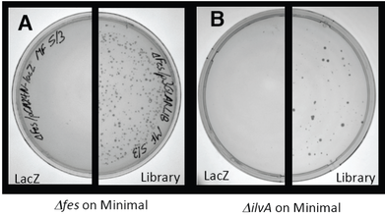
Rescue by de novo proteins
Figure 2. Rescue of E. coli auxotrophs by de novo proteins
Notes:
Tested 27 auxotrophs, grow on rich not minimal media
transformed library of synthetic genes or control lacZ plasmid, spread on minimal media
most novel genes failed to produce colonies, but 4 auxotrophs did: serB, gltA, ilvA, fes
-fes and -ilvA cells transformed with library, growth suggests novel gene carried by plasmid complements deletion
similar result for serB and gltA

Slide 6
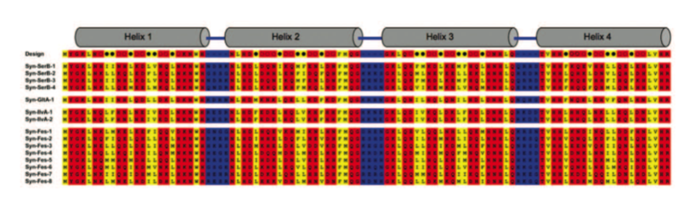
Binary pattern design
Four auxotrophs were able to be rescued:
serB
gltA
ilvA
fes
Figure 3. Designed amino acid sequences that enable growth of E. coli auxotrophs
Notes:
Hannah
-Sequenced 4 auxotrophs saved
-Followed designed pattern
-some auxotrophs with multiple proteins saving

Slide 7
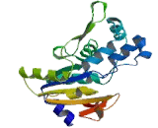
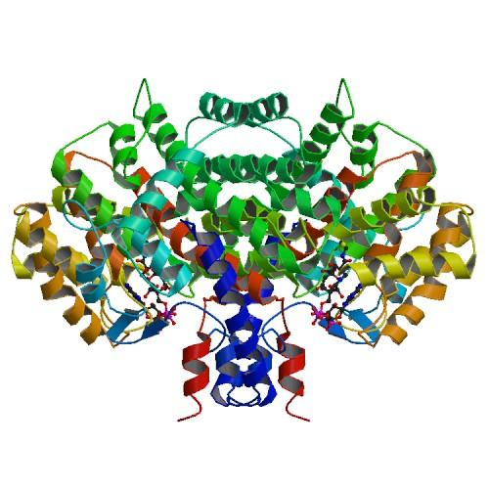
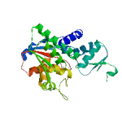
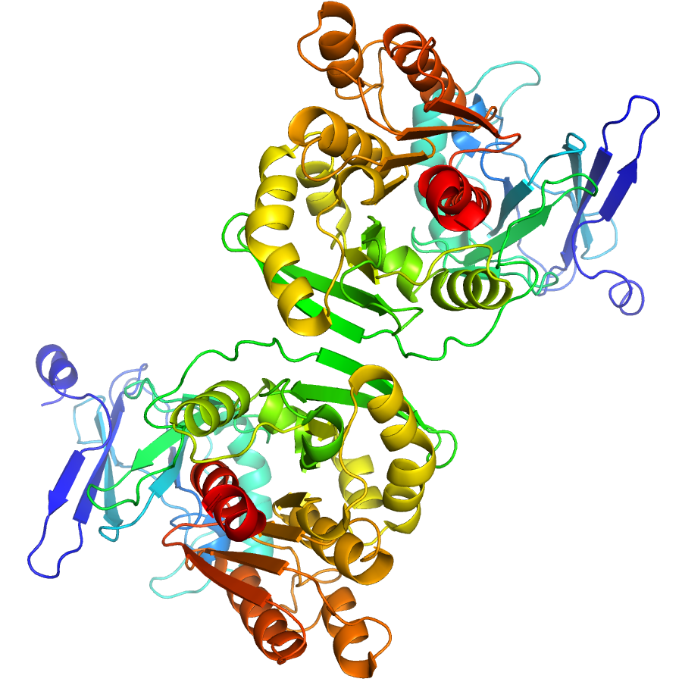
Biological functions of de novo proteins
serB: phosphoserine phosphatase
gltA: citrate synthase
ilvA: threonine deaminase
fes: enterobactin esterase
Notes:
Hannah
-serB: final step in serine biosynthesis
-gltA: catalyzes early step in glutamate synthesis
-ilvA: catalyzes first step in production of isoleucine from threonine
-fes: cleaves iron from iron-chelating compound so cells can get iron in iron limited environments
*note crazy structures, and how they were all simplified into four helix bundle

Slide 8
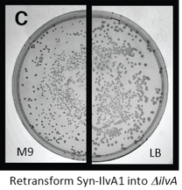
Verification of de novo proteins
Auxotroph survived by mutation
  New auxotrophs transformed
  Saw similar growth
Auxotroph survived by uptake of other plasmid DNA
  Isolated sequence
  Recloned into new vector
Notes:
Hannah
-Mutation: retransformed into new auxotrophs to make sure they were plasmid linked mutations, not adaptive mutation on chromosome
-Other natural plasmid DNA: natural sequence might have been picked up during plasmid library construction, so isolated de novo protein sequence, recloned into a new vector, and showed it could save the auxotrophs

Slide 9
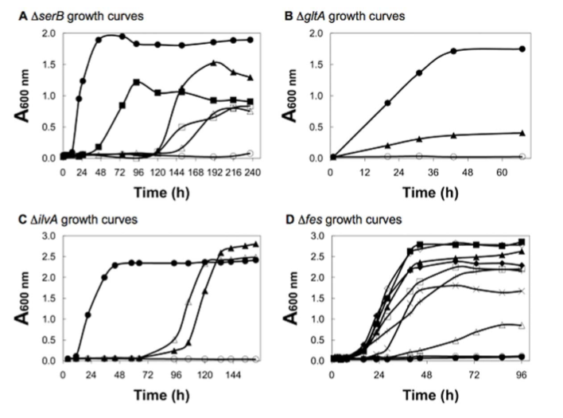
Testing of E. coli strains
Figure 4. Growth of auxotrophic strains of E. coli in selective liquid media
Notes:
Tested each de novo protein for ability to sustain cell growth in cultures grown in minimal media
growth rates compared for deletion strains expressing neg ctrl, natural prot, or de novo prot
open circle: lacZ, closed circle: natural prot, overexpression of fes is toxic
novel prot enable growth but at significantly slower rate, except ilvA

Slide 10
Possible mechanisms for rescue
1. Encode bypass pathways:
  De novo sequences transformed into cells with enzyme deletion
  Discovered: sequences did not rescue cells
2. Alter expression or activity of endogenous protein:
  Screen to identify overexpression of natural genes
  Transformed double deletion strains
  Discovered: novel sequences rescue double deletions
Notes:
1. deleted an enzyme responsible for different step in pathway and saw if they still got the same end product
therefore, de novo seq do not enable bypass pathways for synthesis of end products
2. rescue deletion of genes
double deletion strain: deletion of novel protein and overexpressed gene associated with it
of proteins known previously to enable rescue

Slide 11
Possible mechanisms for rescue
3. Cause unfolded sequences that induce a stress response:
  Purified proteins and measured circular dichroism spectra
  Discovered: structures are predominantly alpha-helical
Notes:
3. similar to spectra of designed 4-helix bundles

Slide 12
Possible mechanisms for rescue
Do mediate rescue of specific chromosomal deletions
Do rescue expression by sequence-specific features
Notes:
Hannah
-Rescue specific deletions: de novo protein for serB didn't rescue ilvA, Syn-Fes didn't rescue gltA, etc.
-Rescue by sequence-specific features: as opposed to generic cellular response to foreign protein; mutated de novo protein for ilvA by finding conserved residue in all proteins found to rescue ilvA and mutating Lys42->Ala, resulting protein expressed at same levels as de novo but didn't save ilvA
*Didn't find exact mechanism

Slide 13
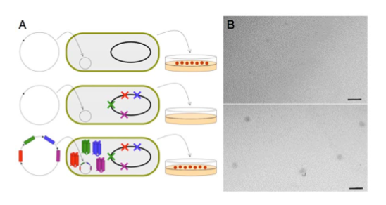
Rescue of knockout E. coli
Figure 5. Rescue of a quadruple knockout E. coli by co-expression of 4 de novo proteins
Notes:
Hannah
-Created quadruple knockout, transformed with vector co-expressing all artificial genes
-Transformed colonies with artificial genes plasmid grew on minimal media, didn't grow with empty vector
-of the ~400 genes essential for E. coli growth, they replaced 4 and saw growth

Slide 14
Concerns
De novo protein showed very low levels of protein activity
De novo proteins were not specifically engineered, just random library
Never mentioned how the de novo proteins rescue the auxotrophs
Notes:
compared growth rates of deletion strain expressing high (400X) de novo versus low (1X) natural
theoretical diversity of library 5 x 10^52; used experimental library of 1.5 x 10^6 genes
narrow scope of library lead to limited results
but instead ruled out other possiblities

Slide 15
Conclusions
Sequences designed de novo can provide necessary functions for growth
Cell growth can be sustained by simpler structures
De novo proteins exhibit lower levels of biological activity
Notes:
S

Slide 16
Significance
Toolkit for synthetic biology is no longer limited to genes and proteins that already exist in nature
Could lead to novel evolutionary trajectories
Future work: Initial step towards the construction of artificial genomes
Notes:
Hannah

