Slide 1
Hypotheses
NH4 up -> yield of yeast constant
Ter Schure et al 1995
Rate of Nitrogen consumption governs fermentation
Ter Schure et al 1995
Yeast pop up -> Nitrogen consump, CO2 prod up
Albertin et al 2011
alpha-ketoglutarate up with the ammonia pulse
Van Riel et al + ter Schure et al
Limiting nutrient switch -> ferm/resp switch
Albertin et al 2011, van den Brink et al 2008, Brauer et al 2005

Slide 2
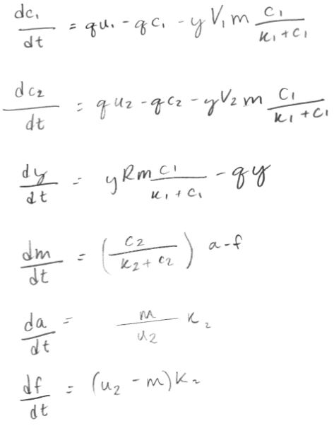
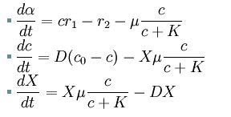
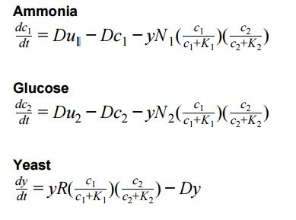
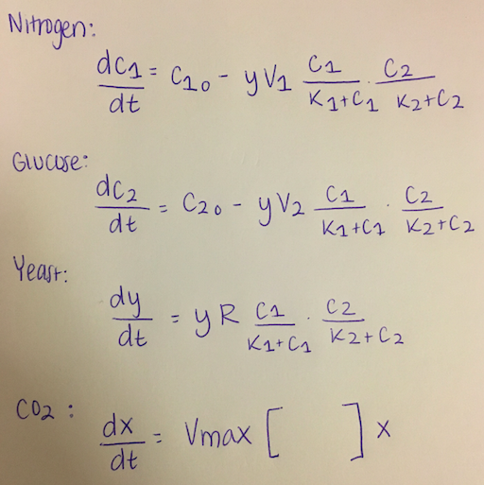
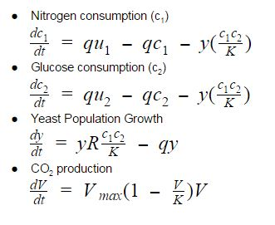
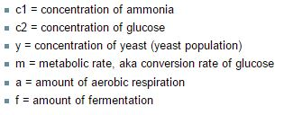
Models

