Slide 1
Toward Single-Molecule Nanomechanical Mass Spectrometry
A.K. Naik et al.
Nature Nanotechnology, 2009
Presented by:
Nigel Chou and Vivian Hecht
20.309 December 9, 2011

Slide 2
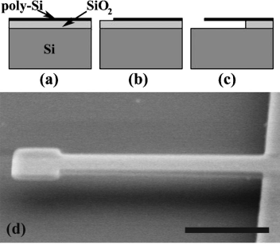
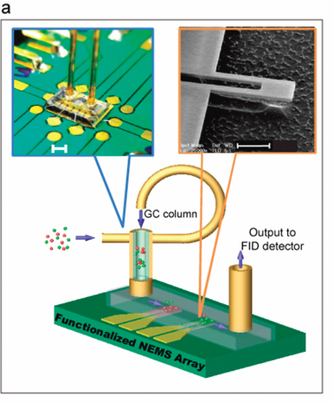
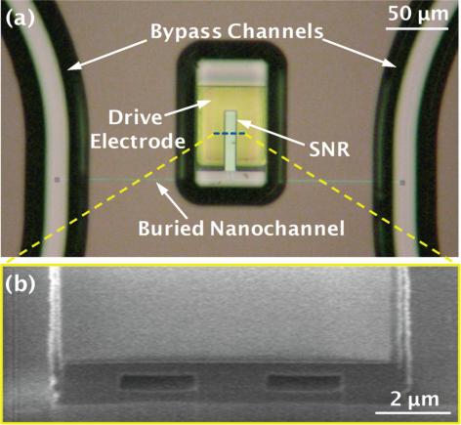
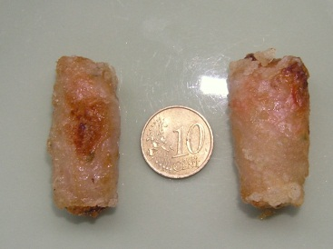
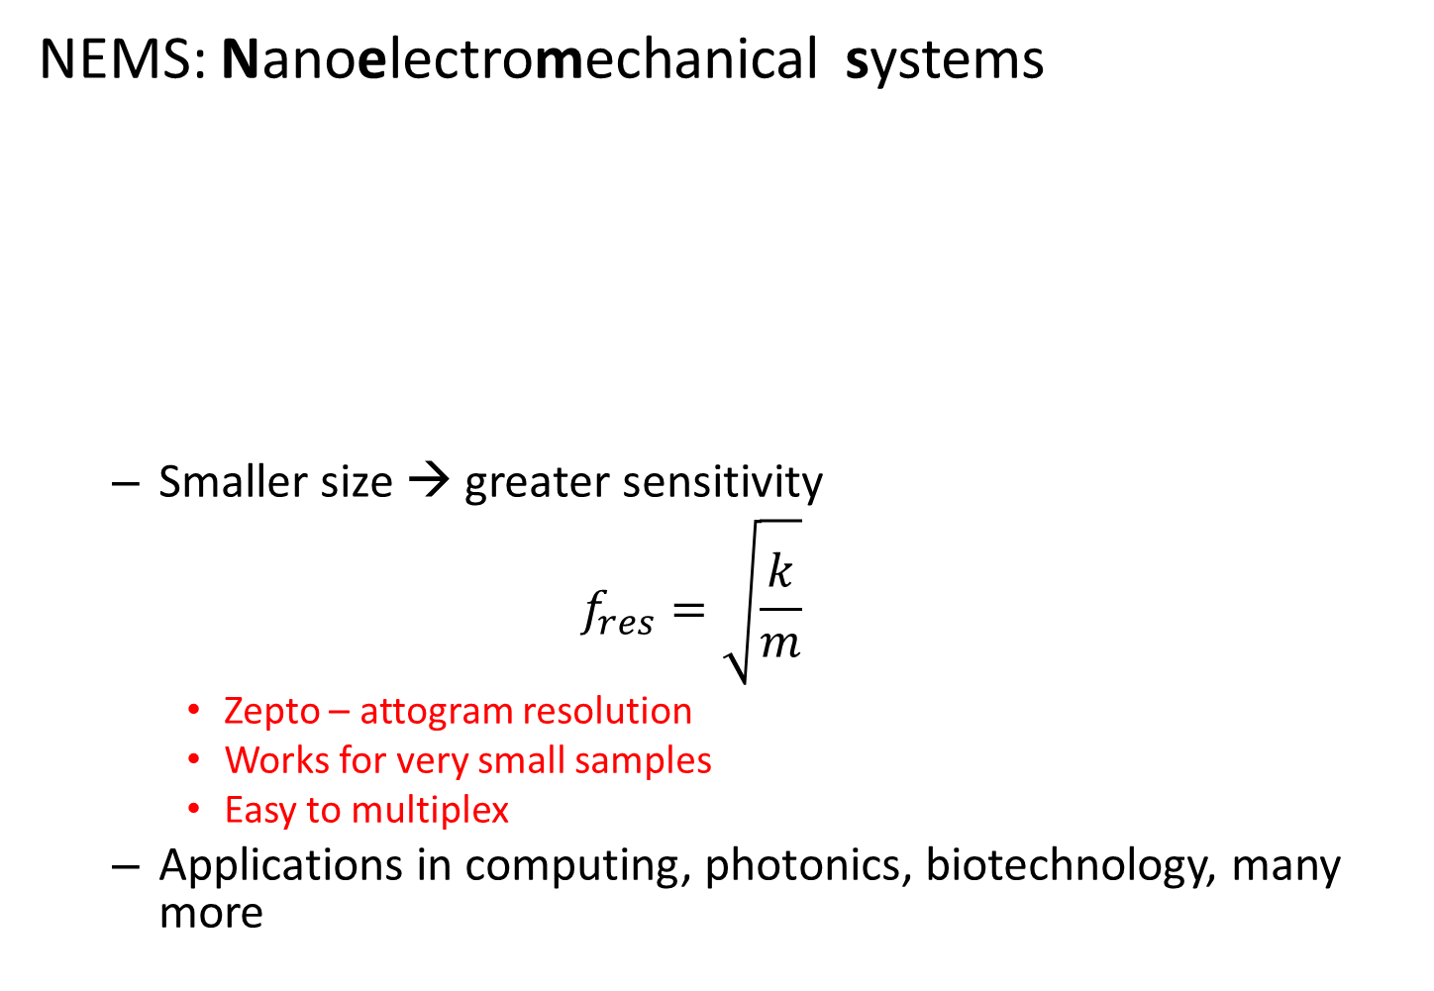
NEMS Resonators
NEMS: Nanoelectromechanical systems
  Smaller size → greater sensitivity
  $$f_{res}=\sqrt{\frac{k}{m}}$$
    Zepto – attogram resolution
    Works for very small samples
    Easy to multiplex
  Applications in computing, photonics, biotechnology, many more
Delicious Vietnamese dumpling
Ilic+, APL 2004
Virus detection
Lee +, Nano Letters 2010
Lit +, Nano Letters 2010
Mass measurements
Gas chromatography
~ ng/pN
~ MHz
~ ng

Slide 3
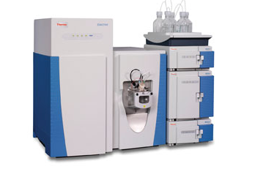
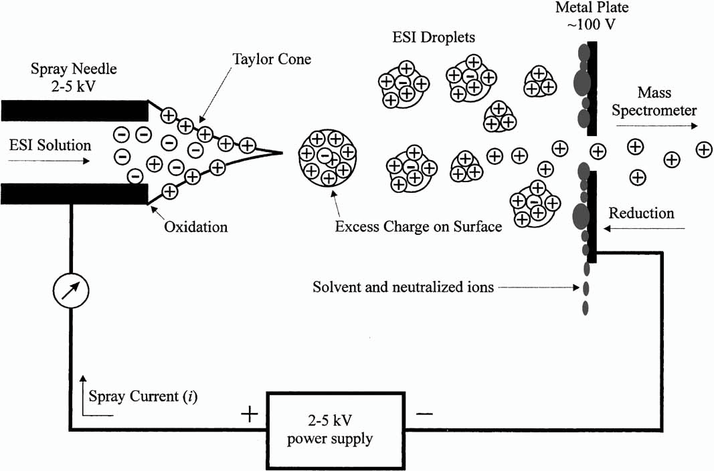
Mass Spectrometry
Traditional:
Ionize and fragment analyte
Separate fragments
Detect fragments
Vary by ionization source, detector:
Source: ESI, MALDI
Detector: TOF, MS/MS, etc.
www.thermoscientific.com
Orbitrap: ~ $1,000,000
Highly sensitive

Slide 4
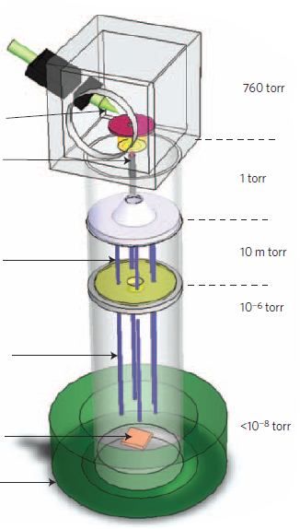
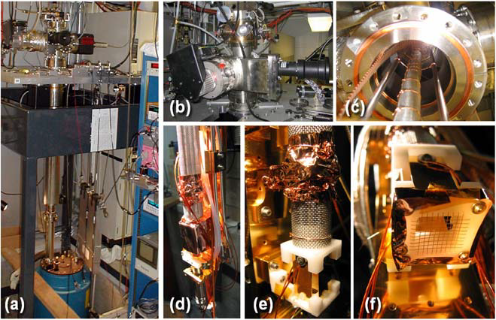
Essence of Measurement
Goal: apply NEMS towards MS:
1. Conventional ionization with ESI
2. Ions travel down capillary
3. Hexapoles non-selectively guide ions to sample stage
*Vacuum helps direct ions to stage
2 m
4. Sample reaches stage (40K = -233 °C)
*Low temp to minimize effect of thermal fluctuations on f_{res}
Magnet

Slide 5
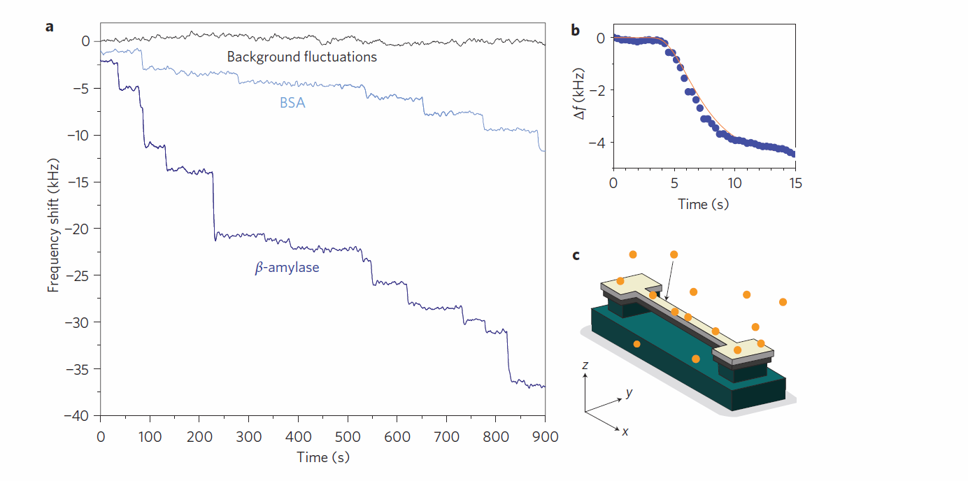
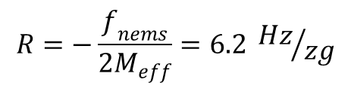
Essence of Measurement – con’t
Molecules adsorb → decrease in f_{res} ∝ position, mass:
$$R=−\frac{f_{nems}}{2M_{eff}}=6.2 {Hz}/{zg}$$

Slide 6
Theoretical distribution of frequency shifts for gold nanoparticles
Perfect sensitivity
Distributions for particles with increasing dispersion in radius
Minimum frequency shift
Maximum frequency shift
Minimum frequency shift
Frequency shift

Slide 7
Experimental data from gold nanoparticles
theoretical curve for particles with:
mean radius: 2.15 nm dispersion: 0.375 nm

Slide 8
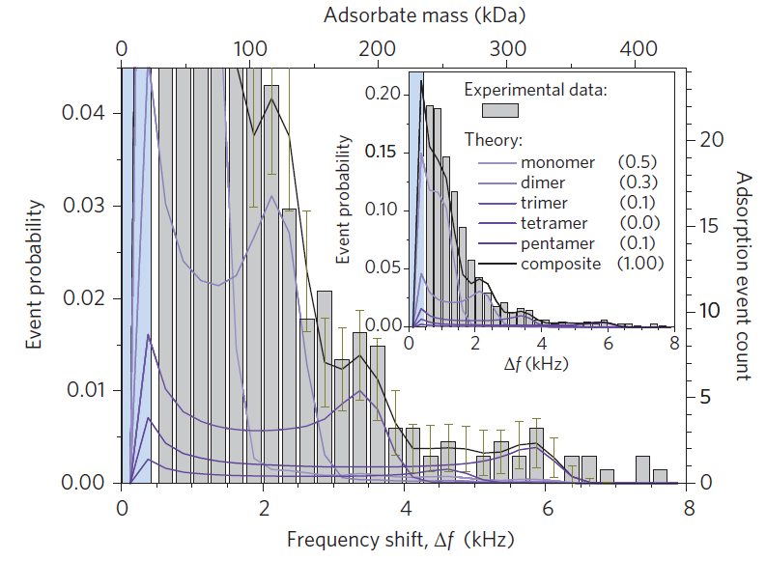
Measurement of BSA
Fractions estimated by fitting expected distributions to data
2 resolvable peaks

Slide 9
Advantages of NEMS-MS
Separation/detection combined
  Less space required
  Higher efficiency of capture
Large dynamic range:
  sensitivity/resolution does not decrease with size of molecule
  Mass accuracy (in ppm) increases with size of molecule
Parallelizable
  Arrays of detectors

Slide 10
Future improvements to NEMS
Simultaneous mass/position sensing by simultaneous excitation & measurement of multiple vibrational modes
  No need for histogram analysis
Large arrays of sensors to measure multiple molecules in parallel
Improve efficiency of transfer of molecues from aqueous phase to detector
  Reduce distance between source and detector

