Slide 1
Unit 2
Molecular Genetics
Recombinant DNA Technology

Slide 2
Lesson 1
Group Discussions and Review: DNA synthesis, transcription, translation, gene regulation, and mutations.
The topics of DNA synthesis, transcription, translation, gene regulation, and mutations will be discussed. This lesson is, for the most part, is a review and refresher for previously learned content.
Teacher will assign individuals to an “expert” group. Each group will have an assigned topic.
Work in “expert” groups to review teacher powerpoint on assigned section of content. Develop review questions for content.
Teacher will approve all review material.
Reassign one “expert” from each group assignment to a new grouping.
New group will review powerpoint together, discuss content and review questions. Each expert will lead this discussion and review in the new group to help clarify the content.
We will have a written quiz at the end of the assignment.

Slide 3
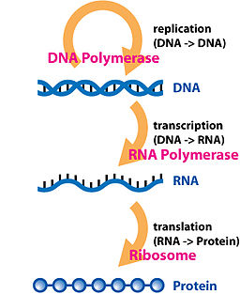
Central Dogma
The direction of the flow of genetic information is from DNA to RNA to polypeptide.

Slide 4
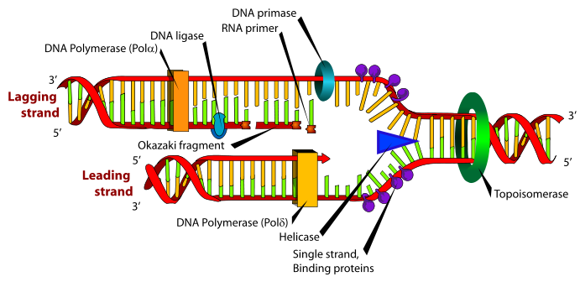
DNA Replication
Initiation and Unwinding of DNA
DNA gyrase (topoisomerase) unwinds the DNA coil.
DNA helicase splits the hydrogen bonds between complimentary bases.
This starts at the origin of replication site and two replication forks move in opposite directions to separate the two strands of DNA

Slide 5
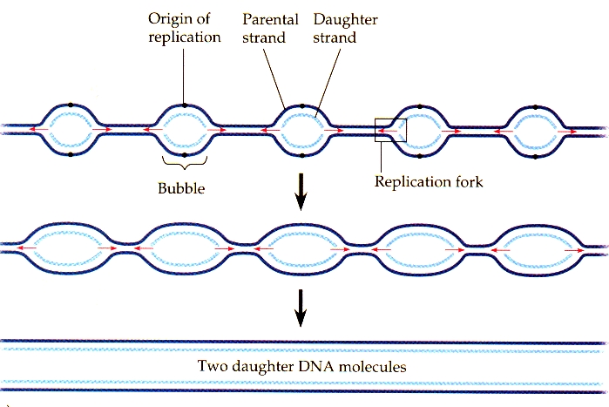
DNA Replication
There are multiple replication bubbles formed in the initiation of DNA replication.

Slide 6
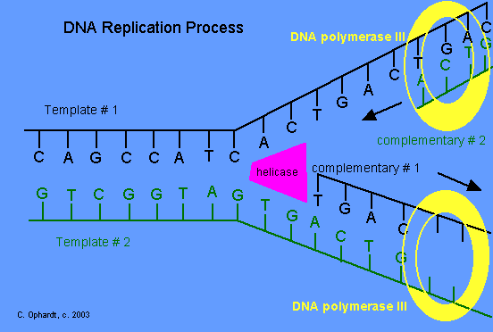
DNA Replication
Synthesis
The enzyme primase lays down a 10-15 nucleotide RNA primer sequence to start replication.
RNA primers serve as the binding sites for DNA polymerase.
DNA polymerase moves along the strand of DNA, using it as a template, to lay down nucleotides and creates a new complimentary strand of DNA for each of the original DNA strands.

Slide 7
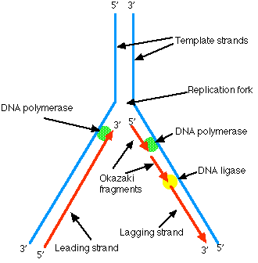
DNA replication
Synthesis
DNA polymerase is a uni-directional enzyme.
DNA polymerase reads the template DNA in a 3’ to 5’ direction, while synthesizing the new strand in a 5’ to 3’ direction.
DNA polymerase moves toward the replication fork on the leading strand and away from the replication fork on the lagging strand.

Slide 8
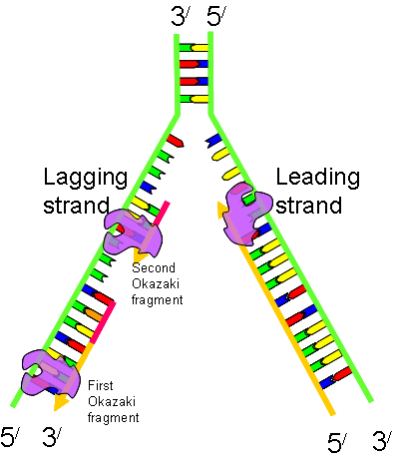
DNA Replication
Synthesis
On the lagging strand, DNA synthesis occurs in short, discrete stretches called Okazaki fragments.
The Okazaki fragments are connected into one long molecule by DNA ligase.
http://highered.mcgraw-hill.com/sites/0072943696/student_view0/chapter3/animation__dna_replication__quiz_1_.html

Slide 9
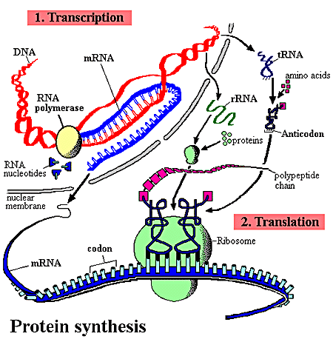
Protein Synthesis
There are 2 processes in photosynthesis.
Transcription – Genes on DNA are transcribed into an RNA code.
Translation – RNA code is used to make a polypeptide.

Slide 10
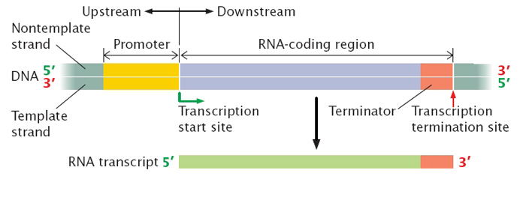
Protein Synthesis
Transcription
Transcription begins when RNA polymerase binds to a specific sequence called a promoter.
Promoters in prokaryotic cells are simple. One RNA polymerase binds to one promoter.
Eukaryotic promoters require the use of 3 types of RNA polymerase, the use of proteins called transcription factors to initiate transcription, and regulatory proteins to modulate transcription.

Slide 11
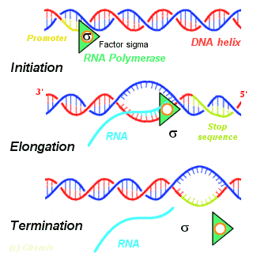
Protein Synthesis
Transcription
Initiation- DNA helicase unwinds the DNA molecule and RNA polymerase begins the synthesis of messenger RNA (mRNA).

Slide 12

Protein Synthesis
Transcription
Elongation – RNA polymerase moves along the DNA strand in the 3’ to 5’ directions adding RNA nucleotides.
The RNA elongates by the addition of ribonucleotides to the 3’ end of the newly synthesized mRNA.

Slide 13
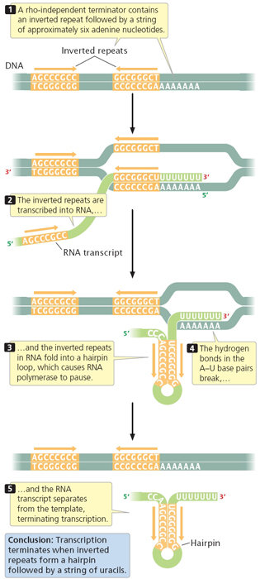
Protein Synthesis
Transcription
Termination – occurs when the end of the gene is reached. RNA polymerase disengages the DNA, and the new mRNA molecule is released.

Slide 14
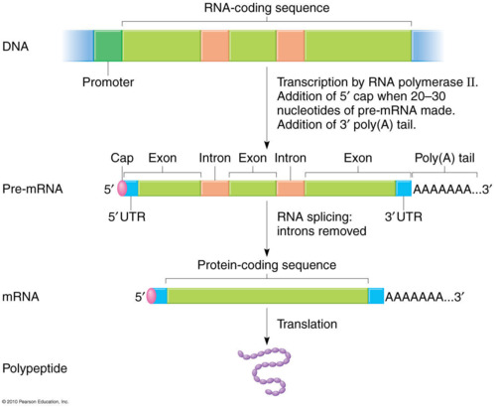
Protein Synthesis
RNA Processing
Prokaryotic cells do not undergo RNA processing.
In eukaryotic cells, a newly synthesized mRNA primary transcript must be modified before it is fully functional.
3 modifications are necessary:
Addition of a 5’ cap structure- nine methylated guanines are added to the 5’ end of the mRNA.
Addition of 3’ poly-A-tail. A string of adenine nucleotides called a poly- A-tail is added to the 3’end of mRNA.

Slide 15
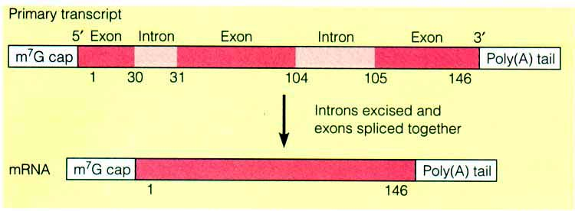
Protein Synthesis
RNA processing
Non coding sequences called introns intervene between the coding sequences called exons. Introns are spliced out so that exons are adjacent to each other.
The 5’ and 3’ modifications:
Facilitate transport of mRNA out of the nucleus.
Prevent degradation of mRNA in the cytoplasm.
Maintain stability for translations

Slide 16
Transcription
http://highered.mcgraw-hill.com/sites/0072507470/student_view0/chapter3/animation__mrna_synthesis__transcription___quiz_1_.html
Transcription

Slide 17
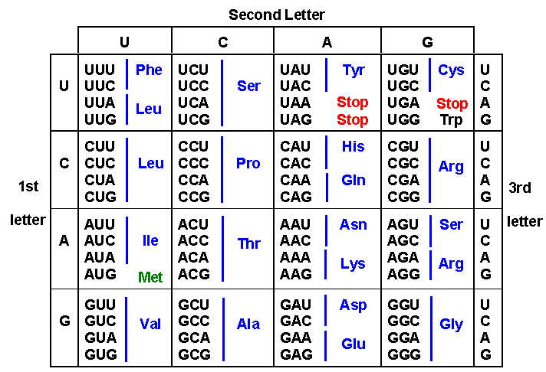
Protein Synthesis
Genetic Code
mRNA nucleotides are read in 3 base sequences called codons. Each codon represents a particular amino acid.

Slide 18
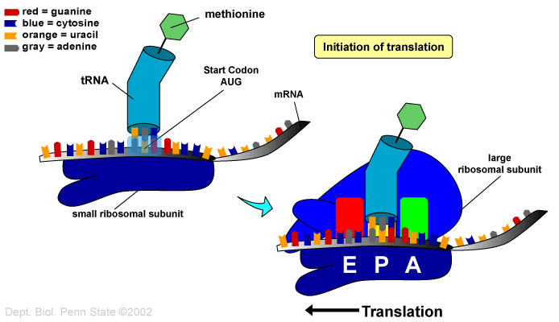
Protein Synthesis
Translation
Initiation
Small ribosomal unit binds to initiator tRNA with its methionine.
The small ribosomal unit and tRNA bind to the 5’ end of the mRNA.
Small subunit moves along mRNA until AUG start codon is found. Anticodon of tRNA and codon of mRNA pair.
Large ribosomal unit is added.

Slide 19
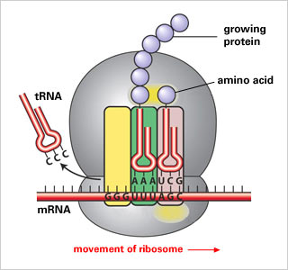
Protein synthesis
Translation
Translocation
The initiator tRNA is located at the Psite on the ribosome.
A second tRNA with its amino acid is transferred to the A site on the ribosome.
The methionine on the initiator tRNA is removed and bonded to the second amino acid on the A site tRNA via peptide bond.
The ribosome moves and the A site tRNA is moved to the P site.
The initiator tRNA moves to the E site and is released into the cytoplasm.
A new tRNA with an amino acid is brought to the A site.
The process continues as the mRNA is read in the 5’ to 3’ direction and a polypeptide is formed.

Slide 20
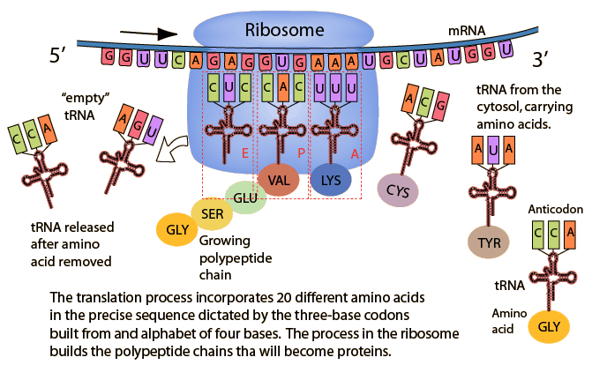
Protein Synthesis

Slide 21
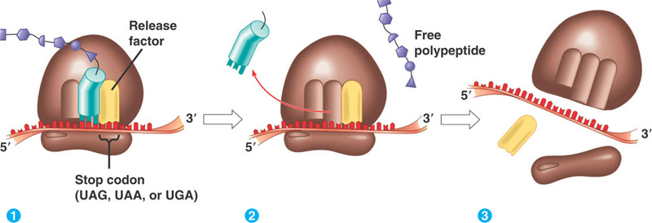
Protein Sythesis
Translation
Termination
Elongation of the polypeptide chain continues until a stop codon (UAA,UAG,UGA) is reached.
A protein release factor interacts with the stop codon to terminate translation.
The ribosome dissociates and the mRNA is released and can be used again.

Slide 22
Translation
http://highered.mcgraw-hill.com/sites/0072507470/student_view0/chapter3/animation__how_translation_works.html
Translation

Slide 23
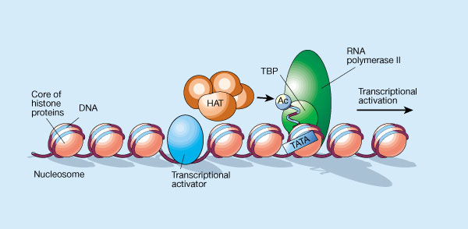
Regulation of Gene Expression
Cells usually synthesize only proteins that are required.
Turning genes “off” and “on” is highly controlled in cells.
In prokaryotes, control occurs at the level of transcription initiation.
Eukaryotes are more complex. There are many regulatory proteins and controls occur at many levels in the cell.

Slide 24
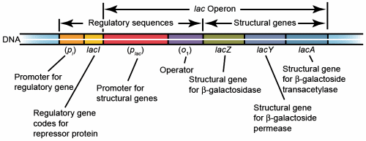
Regulation of Gene Expression
Prokaryotic Gene Expression
Microorganisms must respond rapidly to the environment and proteins or enzymes my be required for a brief time.
A single promoter often controls several structural genes or coding regions called cistrons.
The arrangement is called an operon.
Genes in the same operon have related functions.
An operon specifically consists of a promoter, structural (coding) genes and a repressor binding site called an operator.
Repressor proteins are synthesized and bind to the operator to block transcription

Slide 25
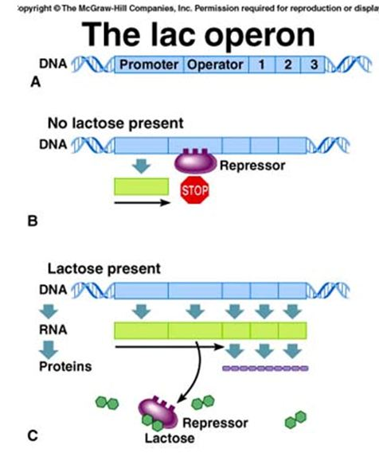
Regulation of Gene Expression
Prokaryotic Gene Expression
Lac Operon – has a promoter region, an operator, 3 structural genes, and a repressor binding site.
If no lactose is present, the lac repressor protein bind to the operator and prevents transcription by not allowing RNA polymerase to bind to the promoter.
If lactose is present, lactose binds to the repressor protein and the protein cannot bind to the operator. RNA polymerase is free to bind to the promoter and transcription is initiated.
http://www.sumanasinc.com/webcontent/animations/content/lacoperon.html

Slide 26
Regulation of Gene Expression
Eukaryotic Gene Expression
Eukaryotic gene expression is much more intricate and variable than prokaryotes.
Eukaryotes control
Transcription
mRNA processing
Transport of mRNA to the cytoplasm.
Rate of translation
Protein processing

Slide 27
Regulation of Gene Expression
Eukaryotic Gene Expression
There are many reasons for the complexity of eukaryotic gene expression.
Larger genome size with many non-coding regions. Prokaryotes do not have non-coding regions.
Compartmentalization within the cell. Nuclear encoded gene products must be transported to organelles.
More extensive transcript processing; introns removed, 5’ cap and 3’ poly-A-tail.
Genes that perform similar functions are scattered around the genome and must be coordinated.
Transcription regulator sequences can be great distances from the genes they regulate.
Cell specialization means that specific sets of genes are activated or inactivated depending on cell type.

Slide 28
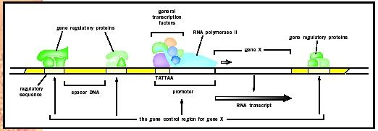
Regulation of Gene Expression
Transcription
Eukaryotic gene complexes have 3 basic parts:
Upstream regulatory enhancers
Upstream promoters
Coding gene sequence.

Slide 29
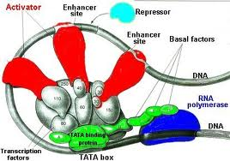
Regulation Gene Expression
Eukaryotic Gene Expression - Transcription
RNA polymerase does not act alone in eukaryotic transcription.
RNA polymerase needs to bind with proteins called transcription factors.
The RNA polymerase/transcription factor complex can bind to the promoter to initiate transcription.
In addition, upstream gene regulatory sequences called enhancers also bind to the RNA/protein/promoter complex.
Enhancers regulate the speed of transcription.
Then transcription of the coding gene can begin.

Slide 30
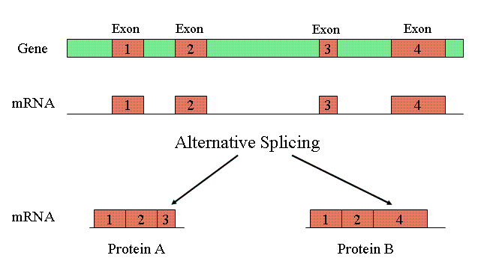
Regulation of Gene Expression
Eukaryotic Gene Expression
Regulation of RNA processing/transport out of the cytoplasm.
Two different cell types can process a primary mRNA transcript differently. This is called alternative splicing.
As a result, different proteins can be produced from the same type of primary transcript.

Slide 31
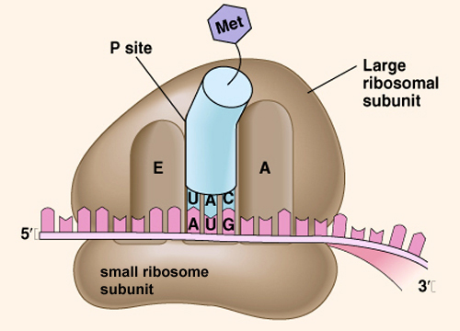
Regulation of Gene Expression
Eukaryotic Gene Expression
Translation Control
Initiation factors control the start of translation and repressor proteins can inhibit translation.
Different mRNAs have different degradation times. The stability of the mRNA controls how long the message is available.

Slide 32
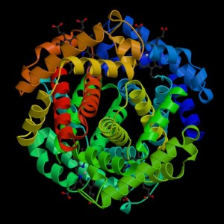
Regulation of Gene Expression
Eukaryotic Gene Expression
Posttranslational control
Protein products are altered after they are synthesized.
Alteration include
Protein folding
Modification with addition of sugars, lipids, phosphates.
Assembly with other proteins.
http://glencoe.mcgraw-hill.com/sites/9834092339/student_view0/chapter16/control_of_gene_expression_in_eukaryotes.html
Eukaryotic Gene Expression

Slide 33
Gene Mutations
Mutations can occur spontaneously during DNA replication or be caused environmental mutagens that mimic nucleotides and alter DNA structure.
Mutations can have no effect, a positive effect, or a negative effect.
There are two types of mutations
Point (gene) mutations
Chromosome mutations

Slide 34
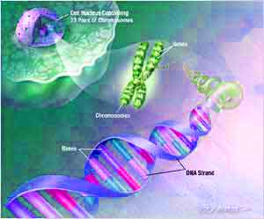
Gene Mutations
Point mutations are called single nucleotide polymorphisms (SNPs) and represent one major genetic variation in the human genome.
Point mutations are caused by:
Substitution of a base
Deletion of a base
Insertion of a base

Slide 35
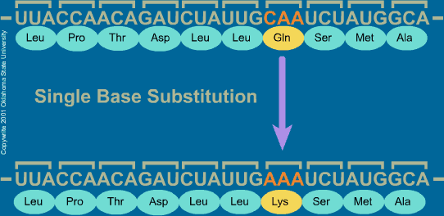
Gene Mutations
Substitution
One base is substituted for another.
Silent mutation – occurs when the base substitution does not change the amino acid.
Missense mutation - occurs when the base substitution results in a new amino acid to be inserted in a protein.
Nonsense mutation - occurs when the base substitution results in an early stop codon and a shortened protein.
http://highered.mcgraw-hill.com/sites/0072556781/student_view0/chapter11/animation_quiz_3.html

Slide 36
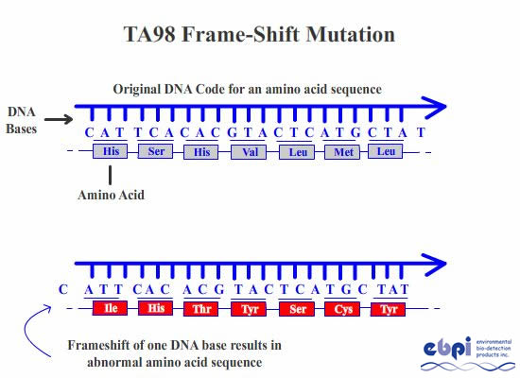
Gene mutations
Insertion and Deletion
Insertion is the adding of a single base to the nucleic acid sequence and deletion is the omitting of a single base.
Both insertion and deletion lead to frameshift mutations.
Frameshift mutations cause the reading frame for codons to be shifted changing the protein encoded by the mRNA.
http://highered.mcgraw-hill.com/sites/0072552980/student_view0/chapter9/animation_quiz_5.html

Slide 37
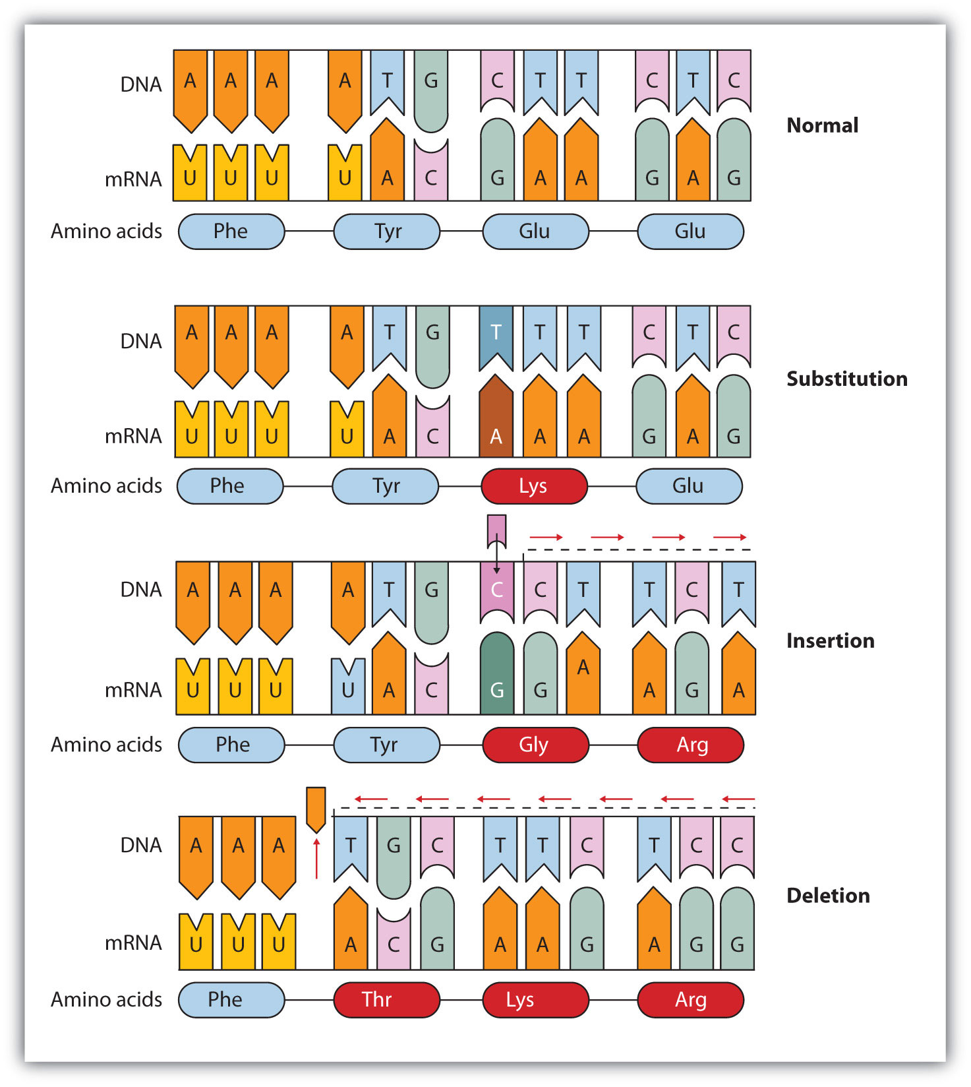

Slide 38
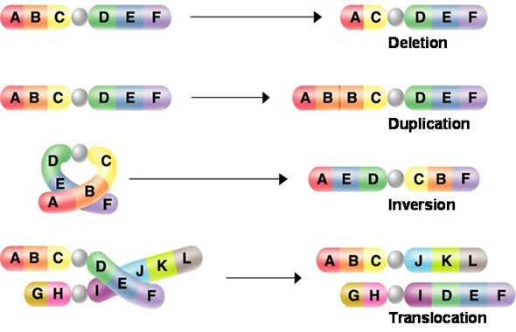
Chromosome Mutations
Chromosome Mutations affect large sections of a chromosome (many genes).
Deletion – Remove a large section of chromosome.
Duplication- Double sections of chromosome
Inversion - Invert sections of chromosome
Translocation – Remove sections of chromosome to transfer section to another location; either on the same or different chromosome.
http://highered.mcgraw-hill.com/sites/0070960526/student_view0/chapter18/animation_quiz_1.html

Slide 39
Mutations –Basis for variation
Humans have 99.9% of DNA sequence in common.
.1% variation due to SNPs. This .1% equals about 3 million bases..
Most genetic variation between humans are due to SNPs.
Most SNPs have no effect because they occur in introns or other non-coding sections of DNA.
Those that occur in coding sections of DNA can influence cell function, genetic disease, and behavior.

Slide 40
Lesson 2
Lecture: transposons
Read and respond to questions: transposons

Slide 41
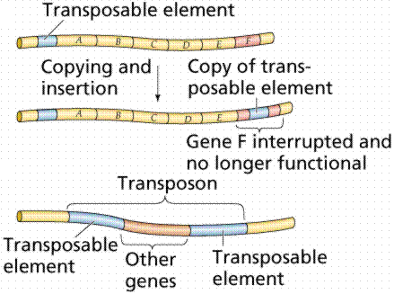
Transposable elements (transposons)
Transposons are known as jumping genes.
Can move within and between chromosomes.
Present in all organisms. Almost 50% of human genome is derived from transposons. (Coding sections of genome =1.5% of DNA)
Much of what was termed “junk” DNA (non-coding) is composed of transposons.
The movement of transposons may:
Have no phenotypic effect.
Create mutations.
Contribute to the evolution of some genes.

Slide 42
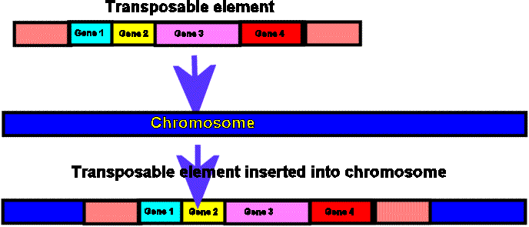
Transposons
Bacterial insertion sequences
There are 2 types:
Insertion sequences (IS)
Bacterial transposons (Tn elements)

Slide 43
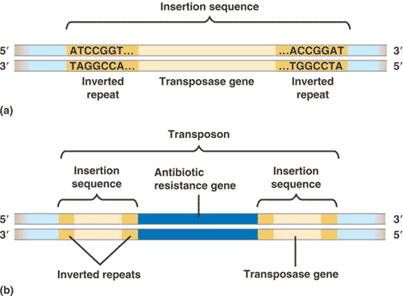
Bacterial Insertion Sequence
IS elements are short; not exceeding 2,000 base pairs.
IS elements only code for genes involved in the transposition activity.
There are 2 features in an IS element
A gene that encodes for transposase. This enzyme is responsible for making staggered cuts in chromosomal DNA into which the IS element inserts.
Inverted terminal repeats (ITRs) – short segments of DNA (40bp) at either end that have the same nucleotide sequence but oriented in opposite directions.
Can be inserted into plasmid or chromosome; can jump from plasmid to chromosome.
IS elements can cause mutations if inserted into an operon

Slide 44
Bacterial Transposons
Tn elements include
Transposase gene
ITRs
Protein coding gene unrelated to transposition.
Can be inserted in plasmid or chromosome.
Can cause mutations.
Can jump from plasmid to chromosome.
Of interest because they can introduce multiple drug resistance onto bacterial plasmid; also simultaneous resistance to drugs and heavy metals.
Used to deliver genes of interest into bacteria for biotechnology.

Slide 45
Transposons
https://highered.mcgraw-hill.com/sites/0072995246/student_view0/chapter23/mechanism_of_transposition.html
http://highered.mcgraw-hill.com/sites/0072556781/student_view0/chapter13/animation_quiz_5.html

Slide 46
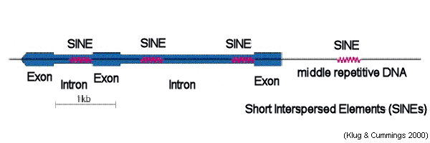
Human Transposons
Two major types of human transposons:
SINES (short interspersed elements)
LINES (long interspersed elements)
Both types are repetitive DNA sequences; SINES (500bp) and LINES (6,000bp)

Slide 47
Human Transposons
Most SINES and LINES are located in non-coding sections of DNA.
Those in coding sections of DNA have been implicated in genetic diseases such as hemophilia, Duchennes muscular dystrophy, colon and breast cancer, and neurofibromatosis.
http://www.dnatube.com/video/5574/Evolution-Genetic-Evidence-Transposons
Transposons_____________________________________________
http://www.broadinstitute.org/education/glossary/transposable-elements
http://www.sciencedaily.com/releases/2011/09/110925185434.htm
Some reading of interest on transposons.

Slide 48
Transposans - Review
What is a transposon?
What effects cans transposons have on the genome?
Explain the two types of bacterial transposons: a.) IS b.) Tn
What are the two types of human transposons?

Slide 49
Lesson 3
Epigenetics
Short lecture epigenetics
WEBQUEST: Research University of Utah genetics website on epigenetics and respond to questions.
Write a 5 paragraph persuasive essay addressing the following question:
“Why is nature vs. nurture no longer a debate?”

Slide 50
Epigenetics
Gene expression revisited.
Along with the many controls we discussed in gene expression, the epigenome also influences gene expression.
The term epigenome refers to modifications in chromatin structures which do not involve mutations.
In biology, and specifically genetics, epigenetics is the study of inherited changes in phenotype or gene expression caused by mechanisms other than changes in the underlying DNA sequence.

Slide 51
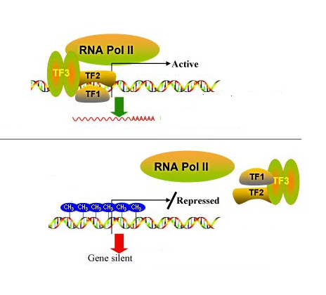
Epigenetics
Chromatin modifications controlling gene expression.
Methylation
The addition of methyl (CH3) groups to the cytosine bases of DNA, silences transcription and replication of transposable elements.
Methyl groups prevent the binding of transcription factors with cytosine. Transcription cannot be initiated.

Slide 52
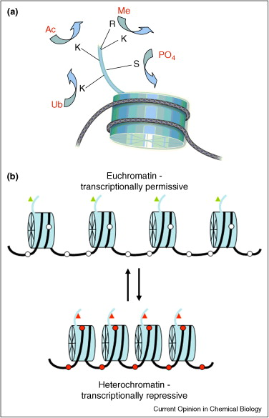
Epigenetics
Histone modifications
Chromatin is composed of DNA wound around histones.
Amino acids on the terminal ends of the histones can bond with methyl, acetyl, or phosphate groups.

Slide 53
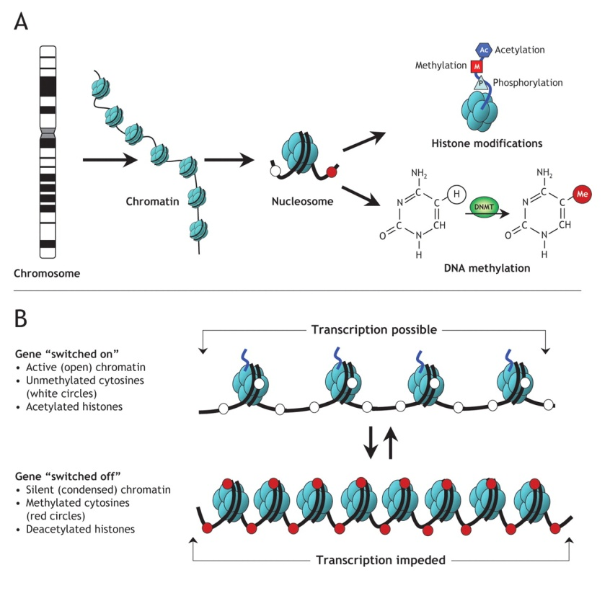
Epigenetics
Histone modifications
Acetylation, methylation, and phosphorylation affect the genome in different ways from one region to another; i.e. how much it loops and coils. (activates or deactivates transcription.)
Generally speaking, acetylation loosens the chromatin structure to make genes available for transcription. Deacetylation causes the chromatin to coil tightly and silences transcription.

Slide 54
Epigenetics
Some epigenetic modifications are inherited (imprinting).
Others vary from generation to generation.
Epigenetic changes can differ between cells types and in normal and diseased tissues.
Diet and environmental conditions can influence epigenetics and can change conditions.
Epigenetics plays a role in how embryos develop.

Slide 55
Review
Define the following :
epigenome epigenetics
What is methylation of DNA and what is the outcome?
How are histones modified and what are the outcomes?

Slide 56
Epigenetics
Visit the following website:
http://learn.genetics.utah.edu/content/epigenetics/
Respond to the questions on your handout.
http://video.pbs.org/video/1525107473
13 minute video on twins and epigenetics

Slide 57
Lesson 4
Lecture and discussion of DNA Recombinant Technology

Slide 58
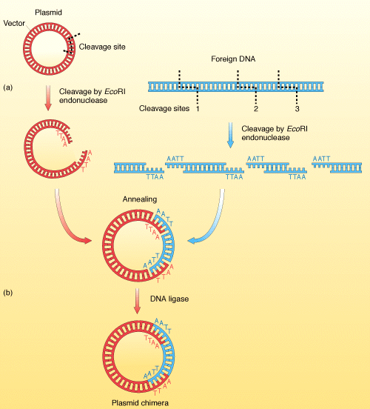
Recombinant DNA Technology
A gene must be isolated and well characterized before it can be used in genetic manipulations.
One method of isolating and amplifying DNA of interest is to clone the gene by inserting it into a DNA molecule that serves as a vehicle or a vector.
When cells divide, the recombinant DNA will be reproduced.

Slide 59
Recombinant DNA Technology
Steps in gene cloning
1. Isolation of DNA using restriction enzymes.
2. Ligating selected DNA to a vector.
3. Transformation of host cells with recombinant DNA (Vector with host insert)
4. Selection of host cells with the recombinant DNA.
5. Production of an appropriate proteins.

Slide 60
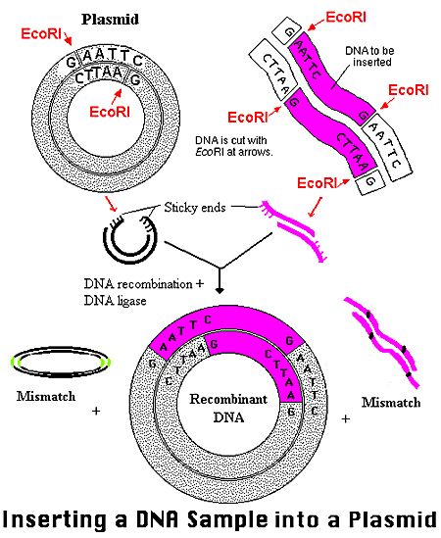
Recombinant DNA Technology – Isolating DNA
Restriction Enzymes and DNA Plasmids
Restriction enzyme = DNA cutting enzymes
Plasmid = Circular form of self replicating DNA.
Restriction enzymes are primarily found in bacteria.
They are given abbreviated names based on the genus and species of the bacteria from which they were isolated.
Ex. EcoRI was isolated from E.coli strain RY13

Slide 61

Recombinant DNA Technology- Isolating DNA
Restriction Enzymes
Restriction enzymes cut DNA by cleaving the sugar-phosphate backbone.
Restriction enzymes do not randomly cut, nor do they all cut DNA in the same location.
Like other enzymes they show specificity for certain sites.
Restriction enzymes recognize, bind to, and cut DNA within specific base sequences called restriction sites.

Slide 62
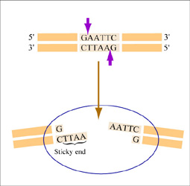
Recombinant DNA Technology - Isolating DNA
Restriction enzymes are called 4 or 6 base cutters because they typically recognize restriction sites with 4 or 6 nucleotides.
Each restriction site is a palindrome. The nucleotides read the same way backwards and forwards.

Slide 63
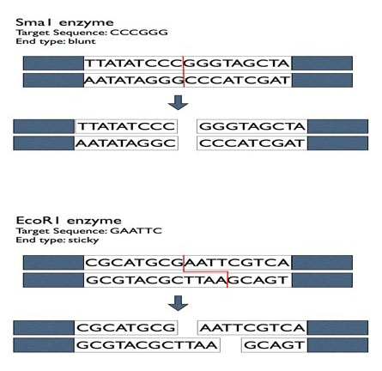
Recombinant DNA Technology- Isolating DNA
Restriction Enzymes
Some restriction enzymes cut DNA with fragments with overhanging single stranded ends called sticky or cohesive ends.
Other enzymes generate fragments with double stranded blunt ends.

Slide 64
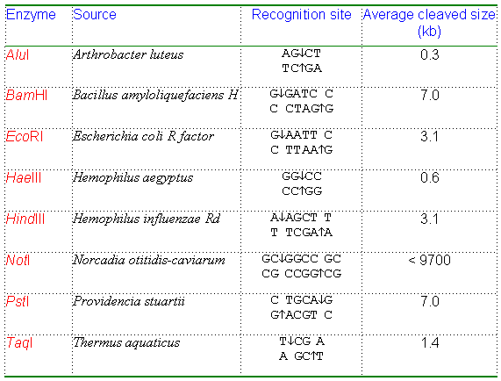
Common restriction enzymes with restriction sites

Slide 65
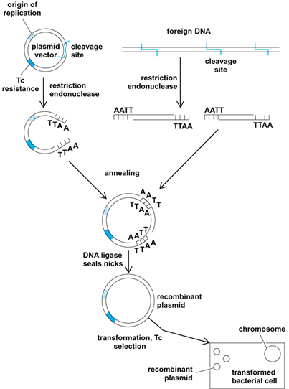
Recombinant DNA Technology - Ligating DNA
Biotechnologists prefer sticky ends over blunt end cutters because DNA fragments can be joined easily together.
When DNA from two sources is joined together, the enzyme DNA ligase is used to catalyze bonding between sugar and phosphate groups in the DNA backbone.
DNA from a “foreign” source (plant, animal, viral, bacterial, yeast) is generally bonded to vector DNA. Vectors can be bacterial plasmids (most typical), yeast, viruses, or artificial chromosomes and are used to transfer the recombinant DNA.

Slide 66
Recombinant DNA Technology
After cutting DNA with restriction enzymes , biotechnologists will sometimes check for molecular size to ensure recombinant DNA procedures have worked.
They will employ gel electrophoresis test to isolated restriction fragments of interest .
Let’s review what we learned last year:
http://www.dnalc.org/resources/animations/gelelectrophoresis.html
http://learn.genetics.utah.edu/content/labs/gel/

Slide 67
Review Questions
What are the steps in gene cloning?
Describe how restriction enzymes cut DNA.
Define a restriction site and a palindrome.
What is the difference between sticky and blunt ends?
Explain how the DNA recombinant technology procedure is accomplished.

Slide 68
Clone a Paper Plasmid Activity
Read the directions on the handout.
Complete the activity and respond to questions.
Submit your completed activity to the teacher

Slide 69
Intro Transformation - Webquest
http://www.phschool.com/science/biology_place/labbench/lab6/intro.html
Animation Cloning
http://highered.mcgraw-hill.com/sites/0072556781/student_view0/chapter14/animation_quiz_1.html
Bacterial transformation process
http://www.biotechlearn.org.nz/themes/dna_lab/bacterial_transformation

Slide 70
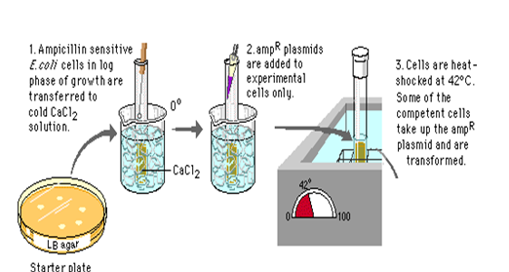
Recombinant DNA technology Transformation
Transformation – is the process of inserting foreign DNA into a bacteria reliably.
Lab transformation process
1. Host bacterial cells are treated with calcium chloride solution.
2. Recombinant plasmids are added to bacterial cells and chilled on ice.
3. Then the cells and DNA mixture are briefly heated.
The recombinant plasmids will enter the bacteria cell, replicate, and express the genes.

Slide 71
Recombinant DNA Technology-Transformation
When recombinant plasmids are added to cells, not all of the bacterial cells will take up the plasmids.
Those that are transformed need to be selected out from the others.
The process of selection is designed to select for the transformed bacteria.
One of the selection processes involves antibiotic/ beta galactosidase selection

Slide 72
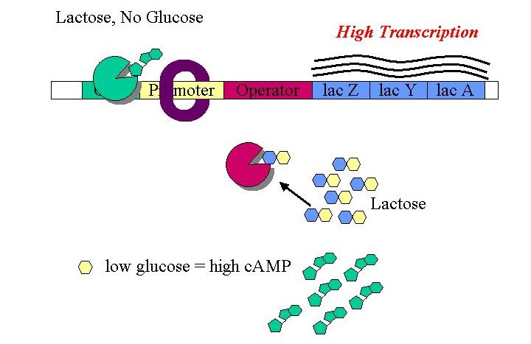
Transformation
The plasmid used as the original vector also contains an antibiotic resistance gene such as ampicillin.
The gene of interest is inserted into the lacZ gene.
The lacZ gene is one of the genes in the lac operon.
It codes for an enzyme beta galactosidase which breaks down lactose into glucose and galactose.
When the gene of interest is inserted into the lacZ gene, lac Z cannot produce beta galactosidase

Slide 73
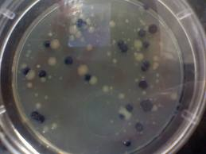
Transformation
The bacterial cells are plated onto agar that has ampicillin and X gal (galactose with a color indicator).
Cells that do not take up plasmids will not grow.
They do not have the ampicillin resistance gene and ampicillin in the agar inhibits their growth.
The bacteria with the plasmid that grow are of 2 types.
The white colonies represent bacteria that have taken up the gene of interest. Because it is inserted in the lacZ gene, galactose cannot be metabolized. The color indicator does not change.
The blue colonies represent bacteria that have the plasmid but not the gene of interest. Sometimes plasmids ligate back to themselves without picking up the gene of interest. These cells have a functional lacZ gene and metabolize galactose; turning the indicator blue.
The white colonies can be used in the production of proteins.

Slide 74
Review
Describe the transformation process using ampicillin resistance and the lacZ gene.

Slide 75
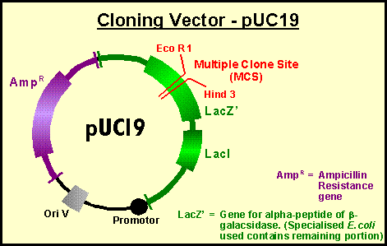
Vectors
A cloning vector must:
Have an origin of replication site so DNA can be replicated in the host cell.
Be small enough to be isolated without undergoing degradation during purification.
Have several unique restriction sites so the vector can be cut in several places.
Have selectable markers for determining whether the cloning vehicle has been transformed.

Slide 76
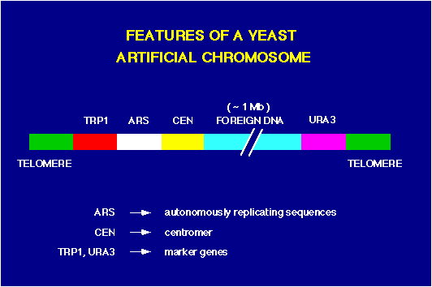
Vectors
Types of vectors
Bacterial plasmids
Bacteriophage vectors
Cosmid vectors
Expression vectors
Bacterial artificial chromosomes (BACs)
Yeast artificial chromosomes (YACs)
Plant vectors
Mammalian cell vectors

Slide 77
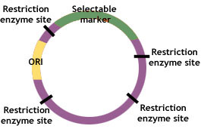
Vectors
Bacterial plamids
Are widely used.
Multiple copies of plasmids are in a cell.
Reproduce readily.
Variety of plasmids in cells
a. Antibiotic resistance
b. Pigment production
c. Resistance to heavy metals
Degradation of chemical compounds.
Will carry 10,000 base pairs of DNA.

Slide 78
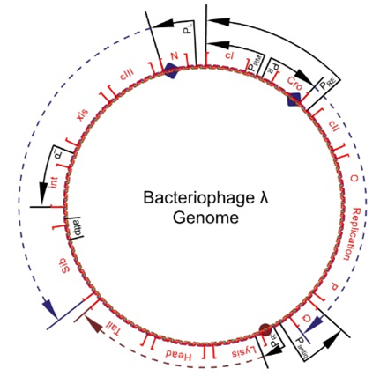
Vectors
Bacteriophage vectors (virus)
Lambda phage (inserted in E.coli) one of the first bacteriophages used.
Linear chromosome with a 12 nucleotide sequence at each end called cohesive sites (COS).
Cloned DNA inserted into restriction sites in the center of the chromosome.
Chromosomes are then packaged with protein coats (capsids)
Uses:
Carry larger cloned DNA fragment up to 25,000 base pairs.
More efficiently moved into bacterial cells than plasmids during transformation.

Slide 79

Vectors
Cosmids
Artificially made – part plasmid/part lambda phage.
Made of COS site, plasmid origin of replication site, genes for antibiotic resistance, and restriction sites.
Packaged in a capsid. Most viral DNA removed.
Behave like a plasmid in a bacterial cell.
Use:
Carry 40,000 to 45,000 base pairs of cloned DNA.
Important for storing large DNA sequences

Slide 80

Vectors
Expression Vectors
Allow for a high level of eukaryotic protein expression in prokaryotic or other eukaryotic cells.
A promoter sequence for high level transcription, cloned DNA, and a signal for a 3’ poly-A-tail are put into a virus vector.
The vector is introduced into, most commonly, Bacillus subtilis (bacteria) or into mammalian cells.
Uses
Base pair number varies
Proteins are “over expressed” which is beneficial in producing therapeutic proteins.

Slide 81

Vectors
Bacterial Artificial Chromosome (BAC)
Synthetic vector used for large cloning sequences; 100,000 to 300,000 base pairs.
Uses the F factor plasmid and inserts cloned DNA of interest.
F factor plasmid
Allows molecules to replicate.
Has the ability carry up to 25% of a bacterial chromosome
Useful in analyzing large portions of the genome.

Slide 82

Vectors
Yeast Artificial Chromosome (YAC)
YAC is a miniature version of a eukaryotic chromosome that can be introduced into yeast such as Saccharomyces cerevisiae.
YACs are made from E.coli plasmids and have:
Origin of replication
Selectable markers
Two telomeres (repetitive sequences on the ends of eukaryotic chromosomes that keep them from degrading or sticking to other chromosomes).
Centromere to allow for replication
Used for cloning very large DNA fragments from 200,000 to 2,000,000 base pairs.
They enable researchers to isolate and sequence large regions of the genome.

Slide 83

Vectors
Plant Cloning Vectors
Uses
DNA is being cloned into plants to
Generate resistance to disease, pests, and
herbicides.
b. Improve crop yields and nutritional value.
Develop new ornamental characteristics.
Improve shelf life for common fruits and vegetables.
Ti (tumor inducing) is a plasmid found in R. radiobacter (formerly A. tumefaciens).
Ti has eight genes that encode for disease characteristics causing the plant cells to enlarge/divide and form tumors.
Ti also has the capacity to insert itself into the host(plant) genome.
Disease genes are removed from the Ti plasmid
and cloned genes OF ANY SIZE and a variety of traits are inserted.
The Ti plasmid then inserts itself into the plant genome.
http://highered.mcgraw-hill.com/olcweb/cgi/pluginpop.cgi?it=swf::535::535::/sites/dl/free/0072437316/120078/bio40.swf::The%20Ti%20Plasmid

Slide 84

Vectors
Mammalian Cell Vectors
Viruses are used as vectors in mammalian cells.
Two common types used in gene therapy and pharmaceutical production are
Retroviruses - single stranded RNA viruses
Adenoviruses – double stranded DNA viruses
Viral vectors can hold 8-10 kb of DNA of interest

Slide 85
Review
Create a chart with 3 columns. In the first column, write the name of the vector. In the second column, note the use(s) of the vector. Finally, in the third column, note the # of base pairs (DNA of interest) that can be carried by the vector.

Slide 86
Lesson 5
Transformation Lab
Conduct an E.coli transformation.
Refer to your handout for instructions.

Slide 87
Lesson 6
Golden Rice Case Study
Problem and the solution
Research assigned websites defining the Golden Rice Project and discussing the pros and cons of the project
Respond to questions
Class discussion of problem/solution
Write a letter to the Rockefeller Foundation which funds the Golden Rice Project expressing agreement or disagreement with their decision.
Write a one paragraph explanation: Has your perspective on genetically modified foods changed since the debate? Why or why not?

