Slide 1
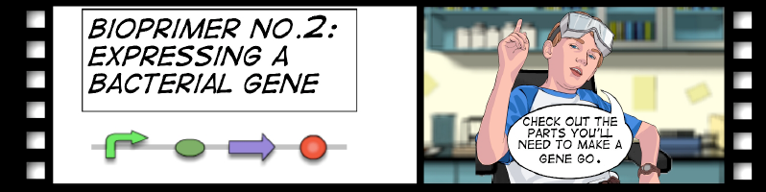
Lab 2: iTune
Itinerary:
Lab Introduction
Perform the student lab
-Use the McFarlane Standards and color chips
Analyze results
Teacher preparation: Creating overnight cultures
Homework

Slide 2
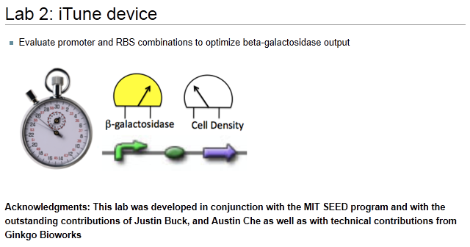

Slide 3
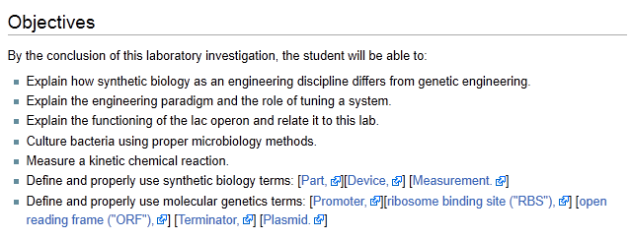

Slide 4
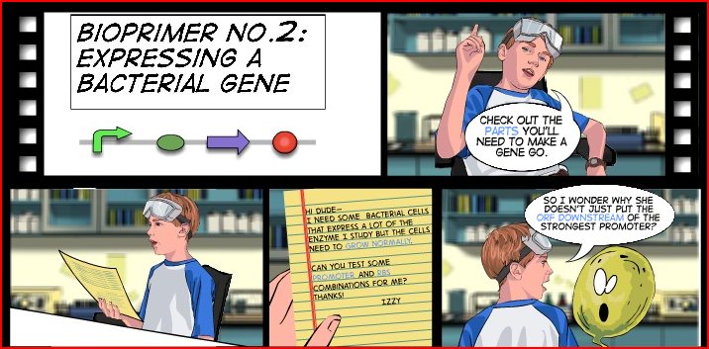

Slide 5
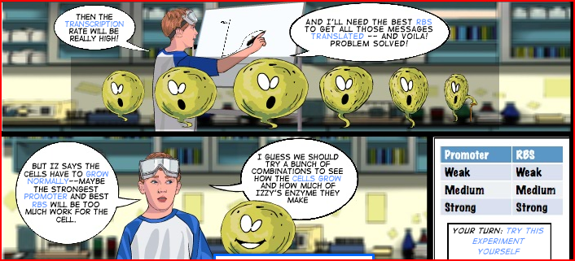

Slide 6
An engineering paradigm
Design
Build
Test
The focus of this lab

Slide 7
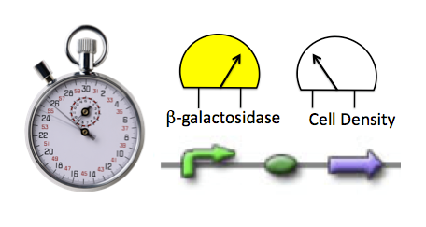
You will be characterizing the device:
Can we tune it to the output we want?
Why would we want to do this?

Slide 8
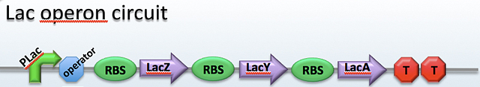
A well understood system. Might be good to use here…
Open Reading Frame
Promoter:
Ribosome binding site
Operator
What do each of these parts do?
What part(s) of the operon will control the rate of expression?

Slide 9
LacZ gene codes for Beta Galactosidase which converts lactose to glucose and galactose:
We could measure the production of galactose or glucose but is there a better way?
What if we could trick the operon into producing something we could see? Or measure easily?

Slide 10
Would we need the LacY and LacA genes if they are only involved after the lactose is metabolized?
Would we want the operator?
What if we could reconstruct this operon?

Slide 11
If given ONPG* as a substrate
(*o-nitrophenyl-β- D-galactoside)
LacZ will produce
Galactose
o-nitrophenol,
Which is yellow!
An indicator of enzyme activity
Promoter:
Strong
Medium
Weak
RBS:
Strong
Medium
Weak
LacZ
ORF
What if we mix and match the Promoters and RBS?

Slide 12
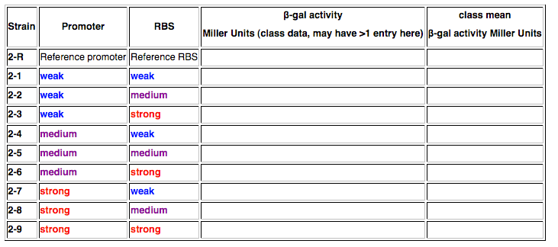

Slide 13
Your Assignments:
Team | Samples
Red | R, 2-1, 2-2, 2-3
Orange | R, 2-4, 2-5, 2-6
Yellow | R, 2-7, 2-8, 2-9
Green | R, 2-1, 2-2, 2-3
Blue | R, 2-4, 2-5, 2-6
Pink | R, 2-7, 2-8, 2-9
Violet | R, 2-1, 2-2, 2-3,
Grey | R, 2-4, 2-5, 2-6
White | R, 2-7, 2-8, 2-9

Slide 14
Summary of today’s procedure:
Obtain McFarland Standards
Make 3 mls of 1:10 dilution of your assigned samples
Compare the samples with the McFarland Standards—These are the OD 600 results
Lyse cells (CHCl₃ is in the hood)
Conduct the reaction—watch the time!
Compare the resulting yellow color with the paint chips—These are the OD 420 results.
Calculate Miller Units
Report data to us.

