Slide 1
Paper-based Synthetic Gene Networks
Keith Pardee, Alexander Green, Tom Ferrante, D. Ewen Cameron, Ajay DaleyKayser, Peng Yin, and James Collins
Presented by: Tushar Kamath
04/14/15

Slide 2
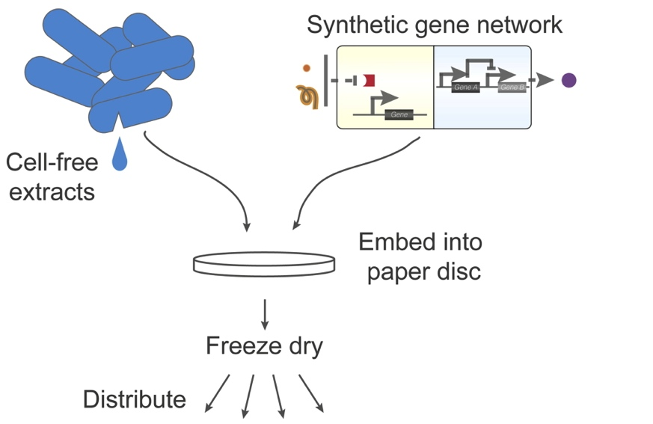
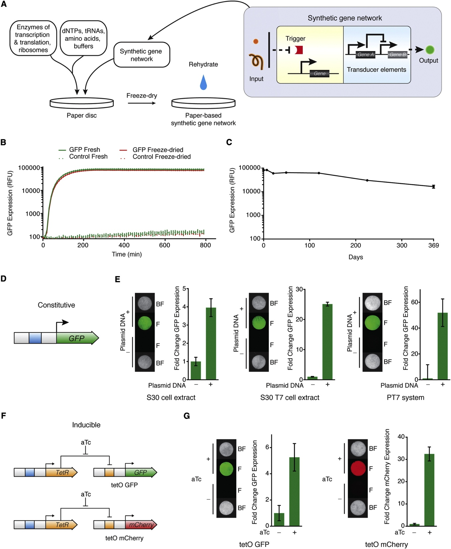
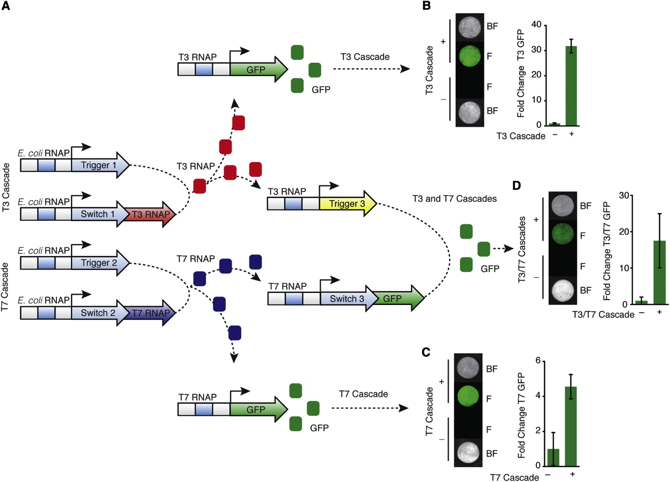
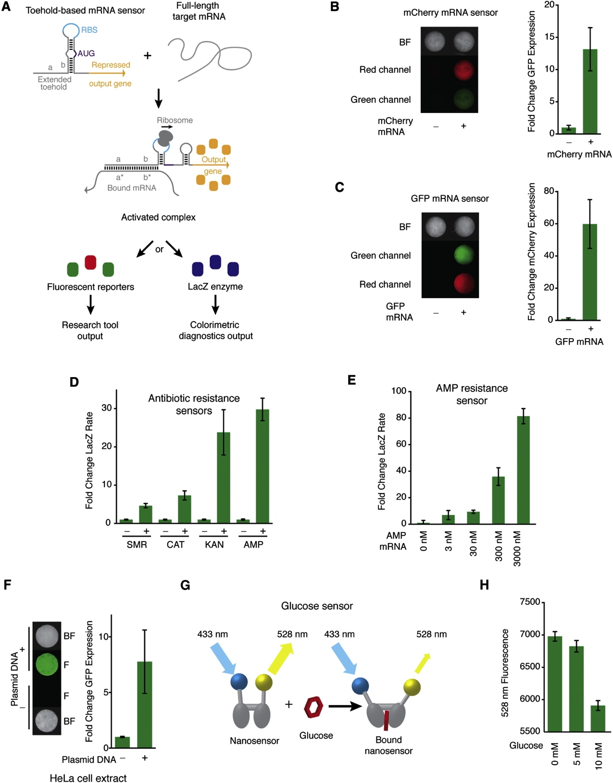
Synthetic gene networks function on a paper-based system and have various applications
Validation
Further enhancement
Applications

Slide 3
Freeze-dried discs containing cell-free gene networks can maintain expression and regulation

Slide 4
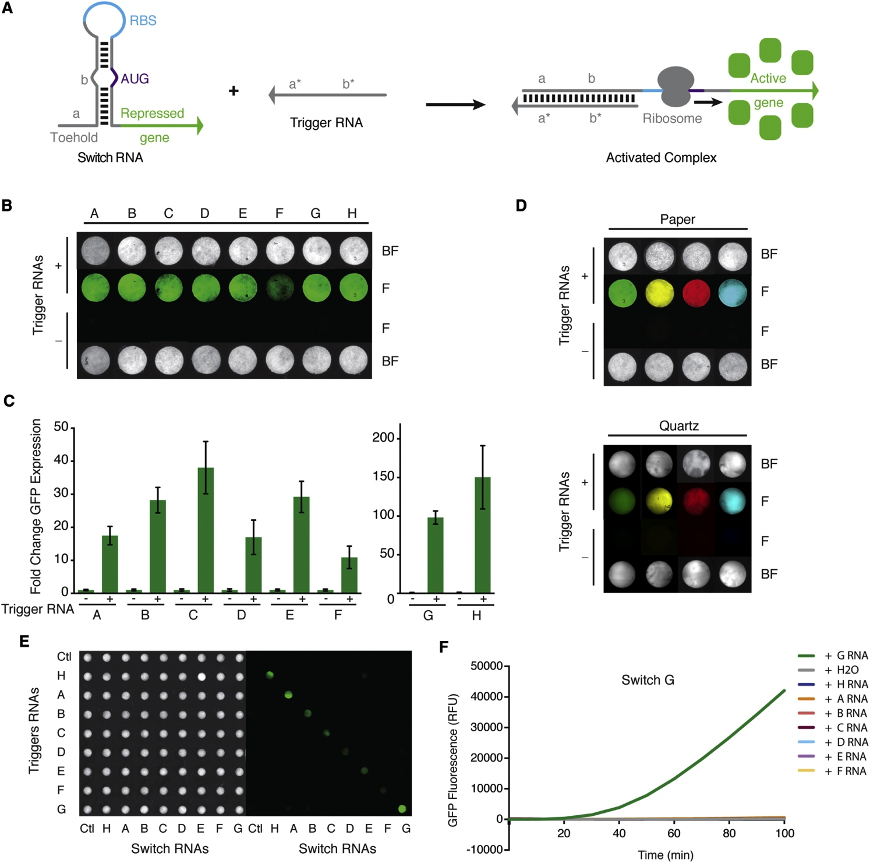
Freeze-dried toehold switches on paper discs exhibit functionality and orthogonal behavior

Slide 5
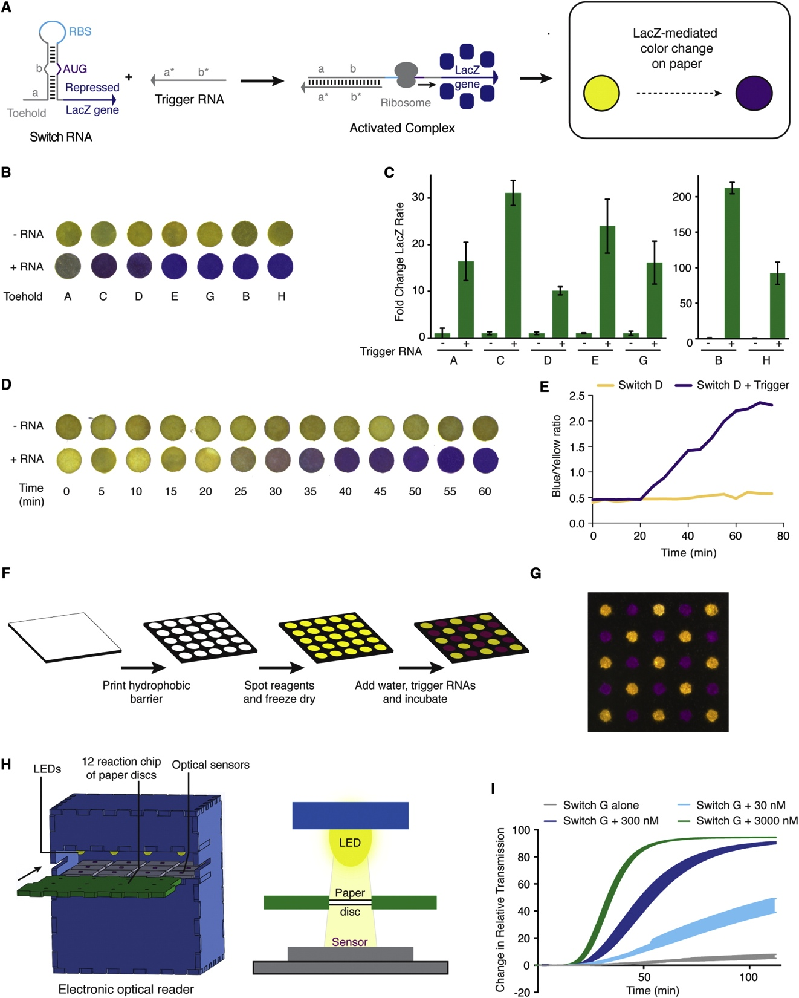
Paper-based platform allows for LacZ-mediated visible colorimetric output

Slide 6
Paper-based synthetic gene networks can sense antibiotic resistance genes and glucose levels

Slide 7
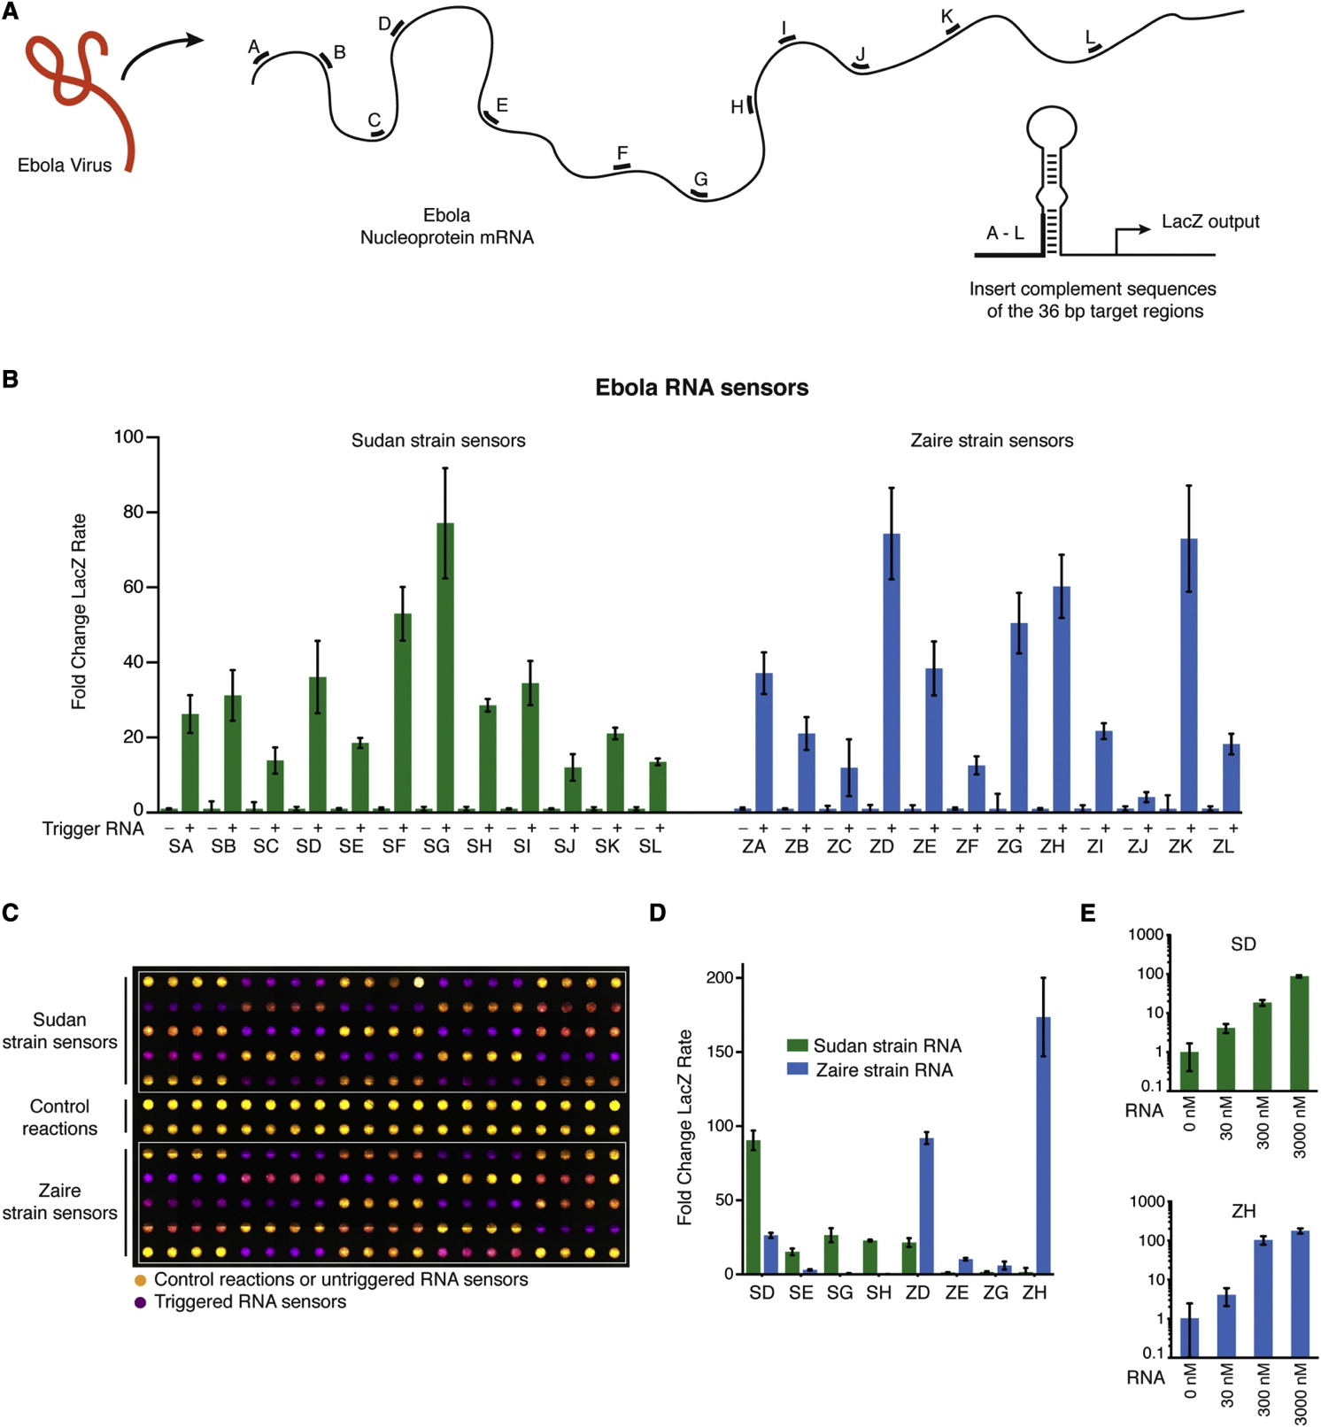
Freeze-dried synthetic gene network platform can be used as a diagnostic for Ebola strains

Slide 8
Toehold switches on paper-based system show functionality when assembled in series

Slide 9
Assumptions and concerns
Assumptions
Mixing different mRNAs will not change the output as the expression is similar to that found with the toehold switch
Expression of small gene circuits can scale to larger gene networks
Stability of RNA and other cell parts are constant
Concerns
GFP expression on graphs were at varying orders of magnitude
Cost and time of isolating/maintaining RNA and proteins for paper-based system could be prohibitive
Paper-based may not be the best way – “the cellulose fibers are definitely not required and apparently mitigate the reaction efficiency” (Felix Moser)

Slide 10
Future work
Commercialization current product as a low-cost, rapid diagnostic tool
Freeze dried pellets wrapped in plastic to manufacture vaccines
Biosensors for water quality detection

