Slide 1
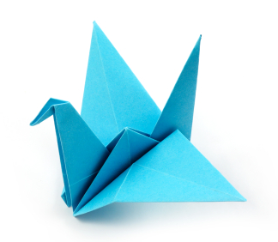
Folding DNA to create nanoscale shapes and patterns
Author: Paul Rothemund

Slide 2
Motivation
“Writing the Encyclopedia Britannica on the head of a pin”
--Richard Feynman, 1959
Why not use AFM and STM?
Slow, and require special conditions

Slide 3
DNA Origami
Watson-Crick base pairing allows for inexpensive parallel synthesis, under mild conditions (!)

Slide 4
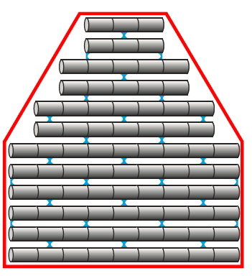
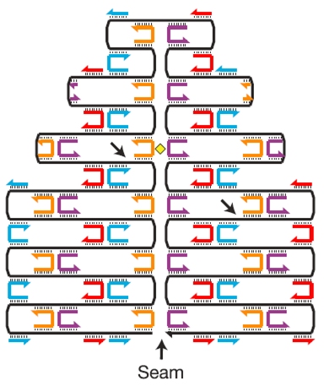
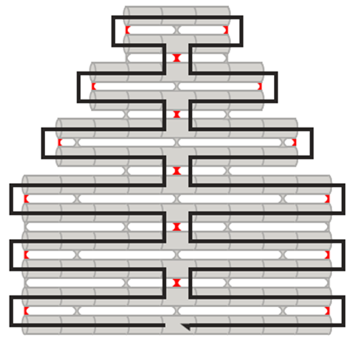
Synthesis
Notes:
5-step synthesis: manual and computer aided

Slide 5
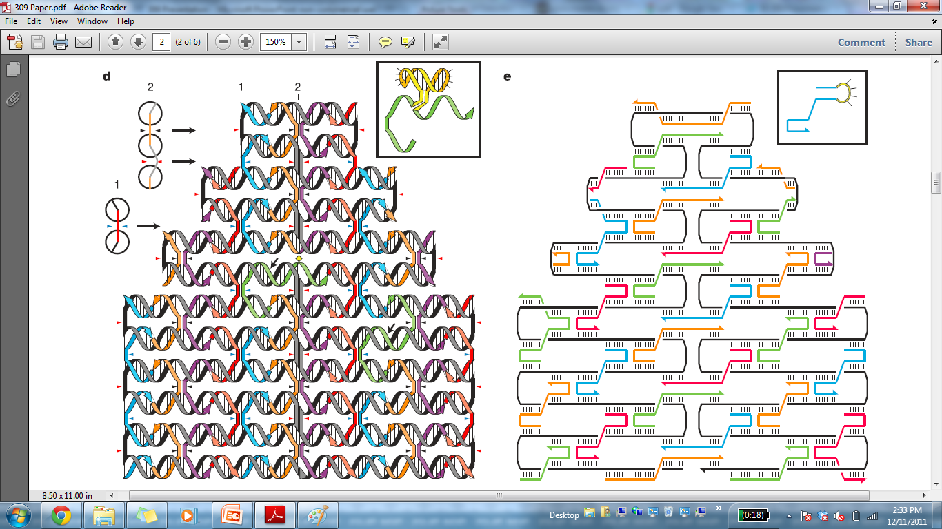
Synthesis
Notes:
5-step synthesis: manual and computer aided

Slide 6
Synthesis
Notes:
5-step synthesis: manual and computer aided

Slide 7
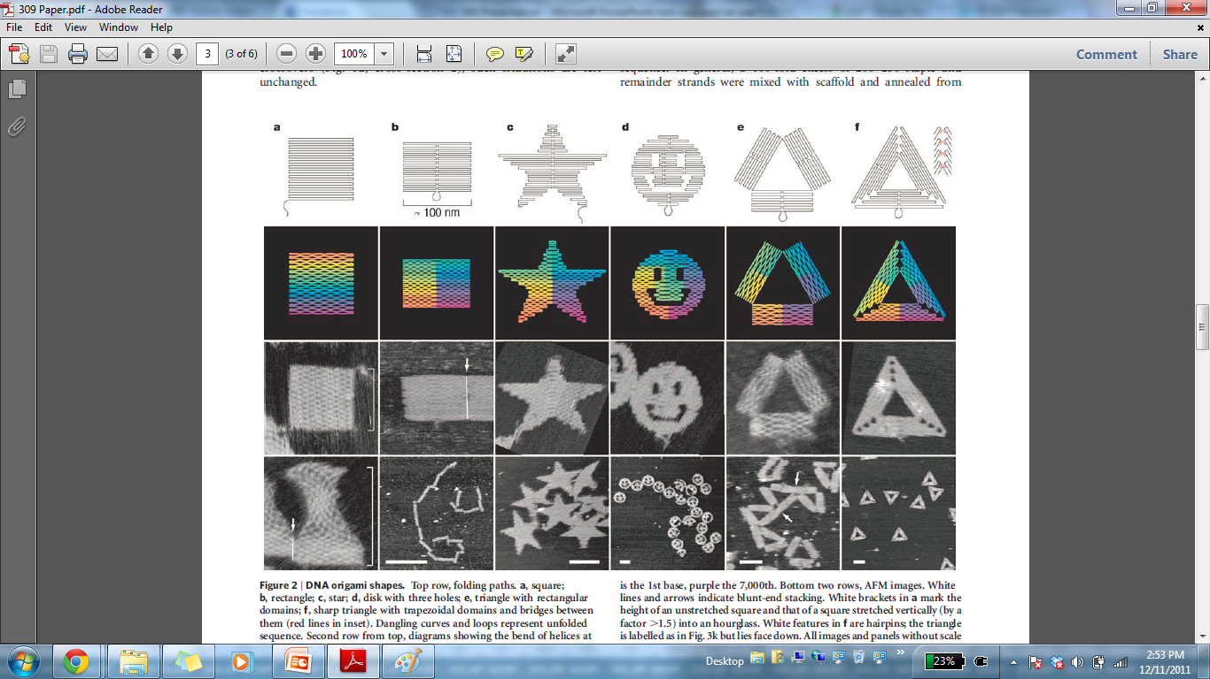
Selected Interesting Shapes

Slide 8
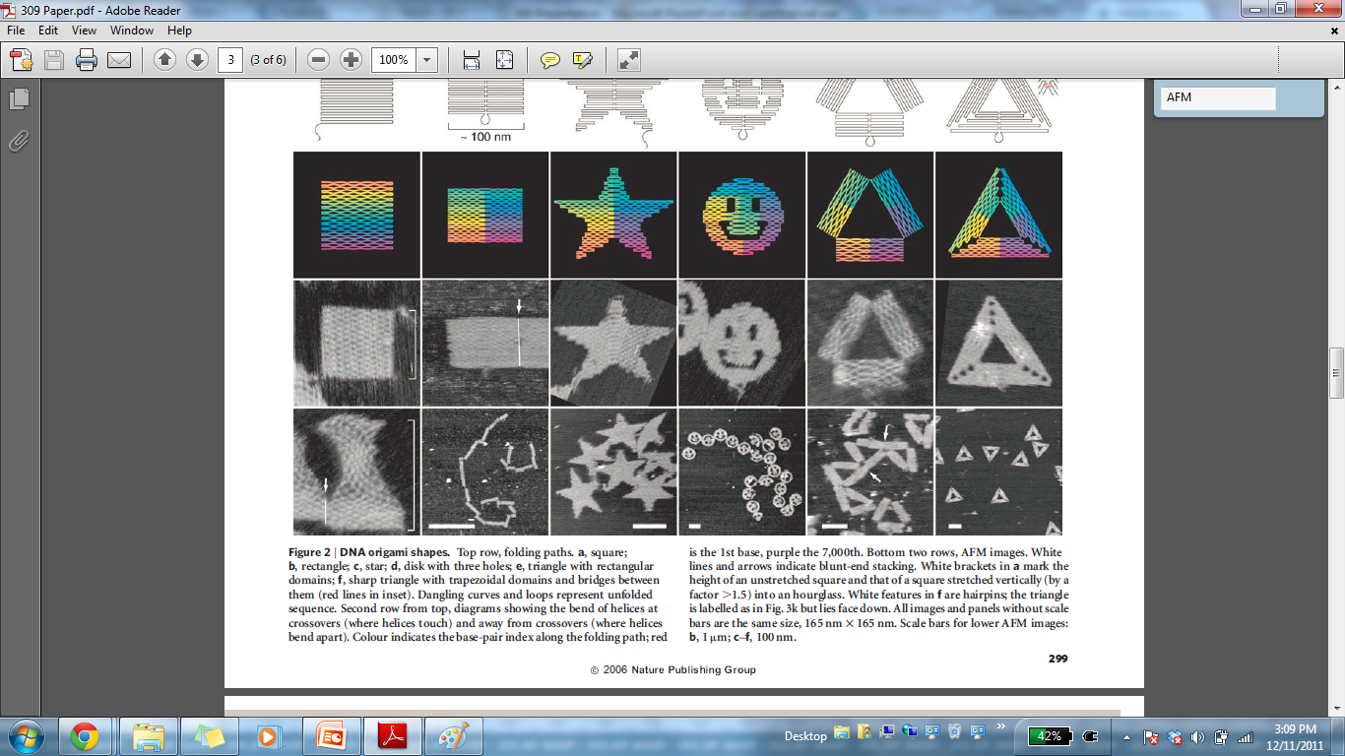
AFM Imaging Methodology
Probably contact mode AFM
Problems: destructive, difficult to quantify small defects (<15nm)

Slide 9
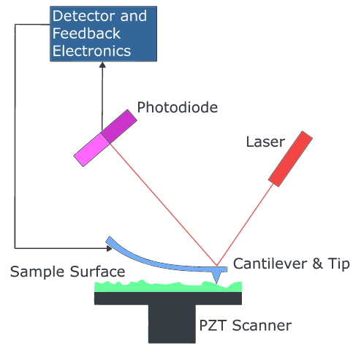
AFM Imaging Methodology

Slide 10
AFM Imaging Methodology
Probably contact mode AFM
Problem: destructive

Slide 11

Results

Slide 12
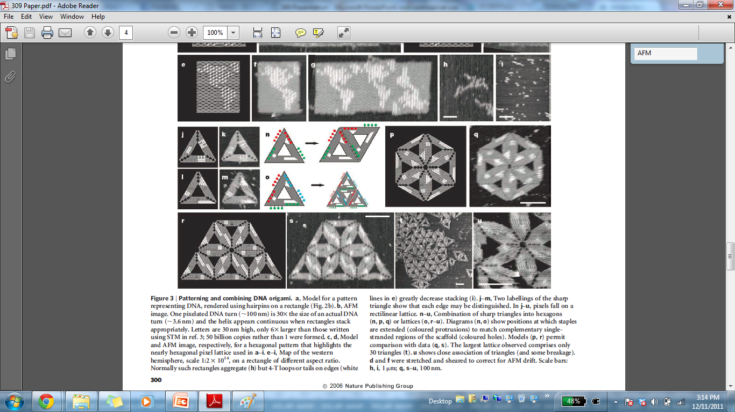
DNA Origami Patterning

Slide 13
Applications
Nano-breadboards
Attach proteins
Attach nanowires

