Slide 1
Index
Slide 2-5: Statistical testing results
6-14: Clustering results
15-17: GRNsight visualization of YEASTRACT results
18-20: GRNmap output visualization

Slide 2
ANOVA results
ANOVA | wt | dCIN5 | dGLN3 | dHAP4 | dSWI4
p < 0.05 | 2377 (38.41%) | 1195 (19.31%) | 1856 (29.98%) | 2387 (38.57%) | 2583 (41.74%)
p < 0.01 | 1531 (24.74%) | 1157 (18.69%) | 1007 (16.27%) | 1489 (24.06%) | 1679 (27.13%)
p < 0.001 | 850 (13.73%) | 566 (9.15%) | 398 (6.43%) | 679 (10.97%) | 869 (14.04%)
p < 0.0001 | 449 (7.25%) | 280 (4.52%) | 121 (1.96%) | 240 (3.88%) | 446 (7.21%)
B & H p < 0.05 | 1673 (27.03%) | 109 (1.76%) | 889 (14.36%) | 1615 (26.09%) | 1855 (29.97%)
Bonferroni p < 0.05 | 226 (3.65%) | 109 (1.76%) | 20 (0.32%) | 61 (0.99%) | 179 (2.89%)

Slide 3
Modified t-test results dGLN3
dGLN3 | Cold Shock |  | Recovery
t test | t₁₅ | t₃₀ | t₆₀ | t₉₀ | t₁₂₀
Average Log Fold Change > 0.25 and p < 0.05 | 559 (9.03%) | 897 (14.49%) | 319 (5.15%) | 265 (4.28%) | 190 (3.07%)
Average Log Fold Change < -0.25 and p < 0.05 | 458 (7.4%) | 711 (11.49%) | 304 (4.91%) | 289 (4.67%) | 207 (3.34%)
Total p < 0.05 | 1027 (16.59%) | 1622 (26.21%) | 628 (10.15%) | 558 (9.11%) | 403 (6.51%)
Total B & H p < 0.05 | 0 (0%) | 5 (0.08%) | 0 (0%) | 0 (0%) | 0 (0%)
Total Bonferroni p < 0.05 | 0 (0%) | 1 (0.016%) | 0 (0%) | 0 (0%) | 0 (0%)

Slide 4
Modified t-test results
p < 0.05 | t₁₅ | t₃₀ | t₆₀ | t₉₀ | t₁₂₀
wt | 1075 (17.37%) | 1587 (25.64%) | 1814 (29.31%) | 749 (12.1%) | 509 (8.22%)
dCIN5 | 1393 (22.51%) | 756 (12.22%) | 1250 (20.20%) | 634 (10.24%) | 351 (5.67%)
dGLN3 | 1027 (16.59%) | 1622 (26.21%) | 628 (10.15%) | 558 (9.02%) | 403 (6.51%)
dHAP4 | 1197 (19.34%) | 1772 (28.63%) | 2006 (32.41%) | 234 (3.78%) | 515 (8.32%)
dSWI4 | -- | 1497 (24.19%) | 1757 (28.39%) | 1075 (17.37%) | 705 (11.39%)

Slide 5
Between-strain ANOVA
 | p < 0.05 | B-H p < 0.05
wt vs dCIN5 | 563 (9.10%) | 4 (0.065%)
wt vs dGLN3 | 720 (11.63%) | 36 (0.58%)
wt vs dHAP4 | 640 (10.34%) | 23 (0.37%)
wt vs dHMO1 | 556 (8.98%) | 5 (0.081%)
wt vs dZAP1 | 553(8.94%) | 31 (0.5%)
wt vs Spar | 1498 (24.2%) | 703 (11.36%)

Slide 6
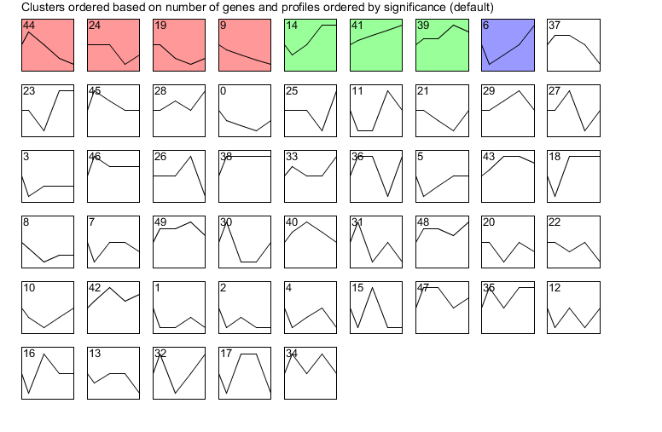
Clustering results

Slide 7
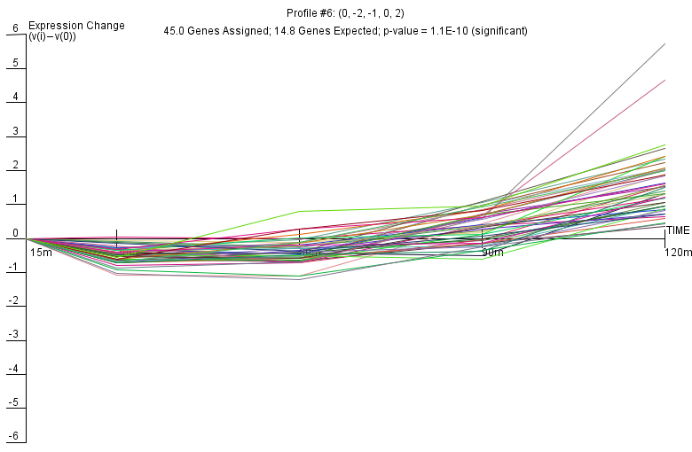
Profile 6

Slide 8
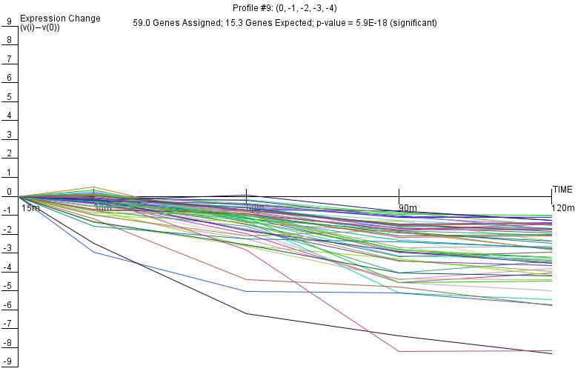
Profile 9

Slide 9
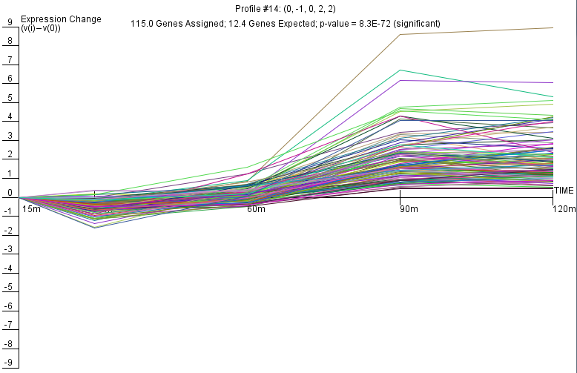
Profile 14

Slide 10
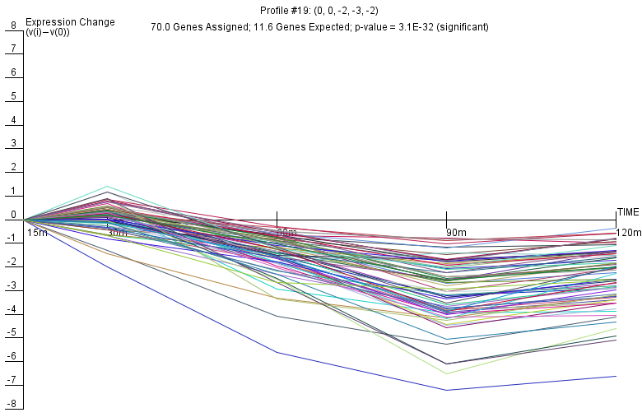
Profile 19

Slide 11
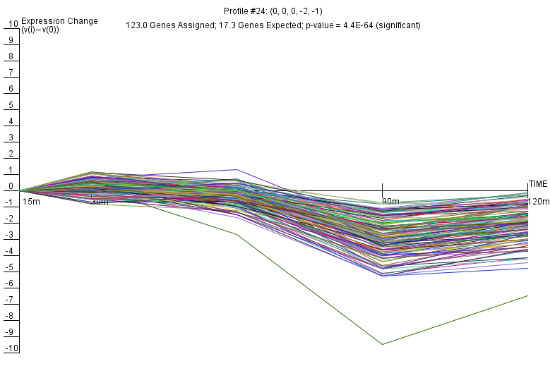
Profile 24

Slide 12
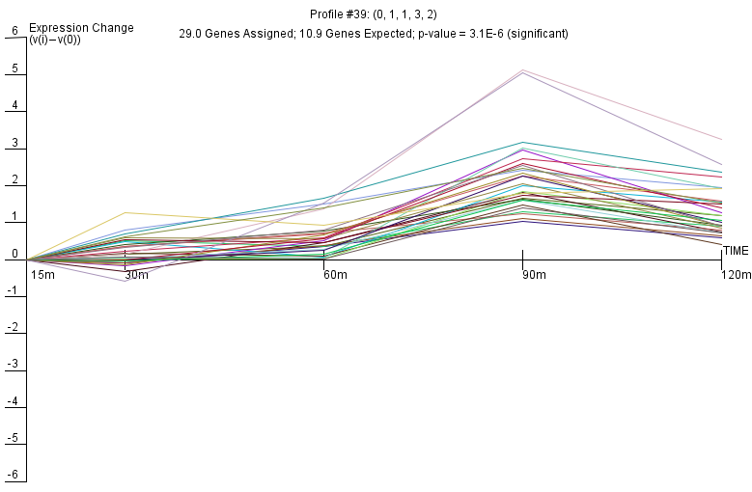
Profile 39

Slide 13
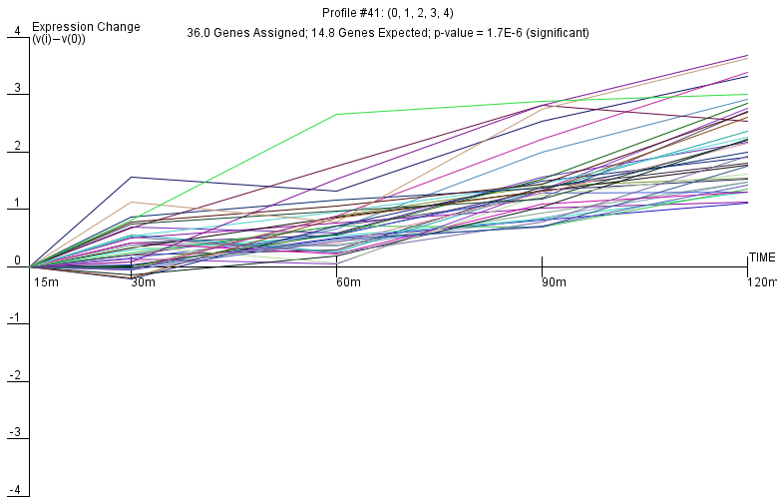
Profile 41

Slide 14
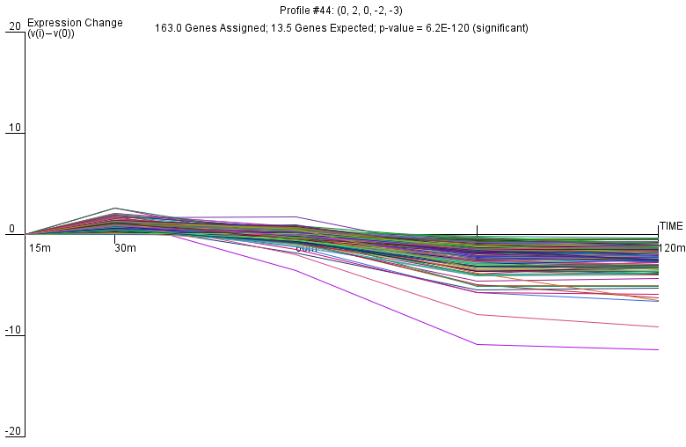
Profile 44

Slide 15
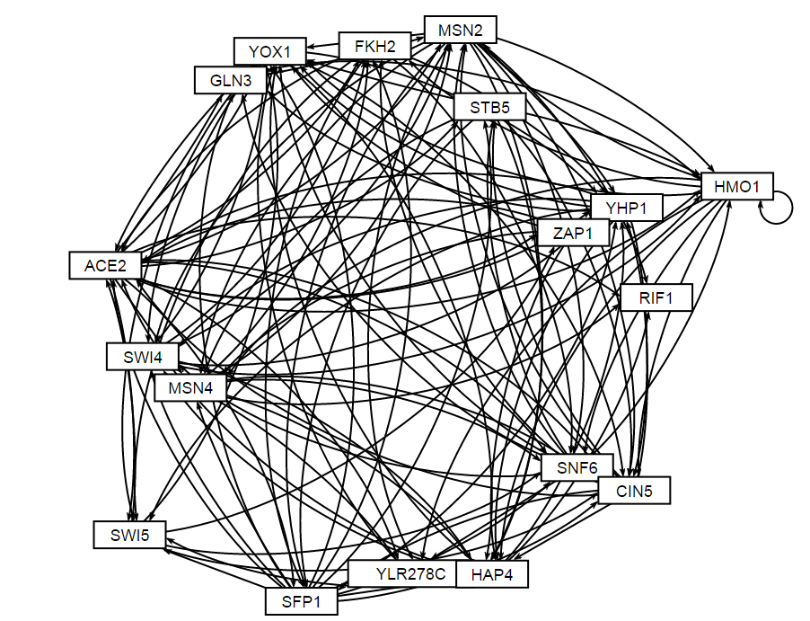
Profile 24: DNA Binding PLUS Expression Evidence

Slide 16
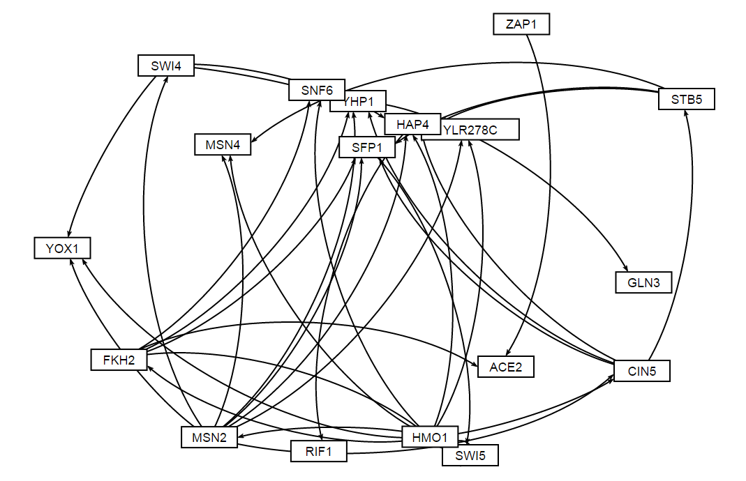
Profile 24: ONLY DNA Binding Evidence

Slide 17
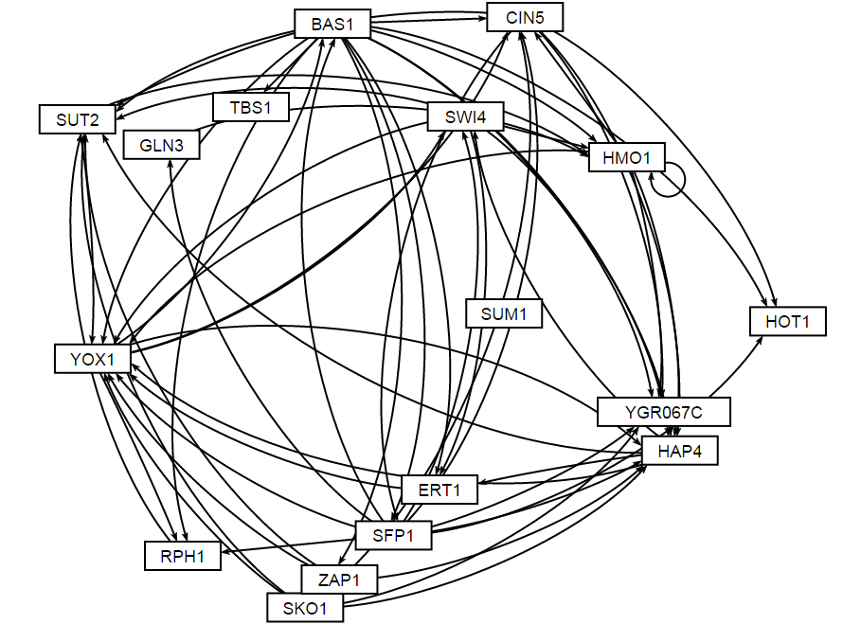
Profile 14: DNA Binding PLUS Expression Evidence

Slide 18
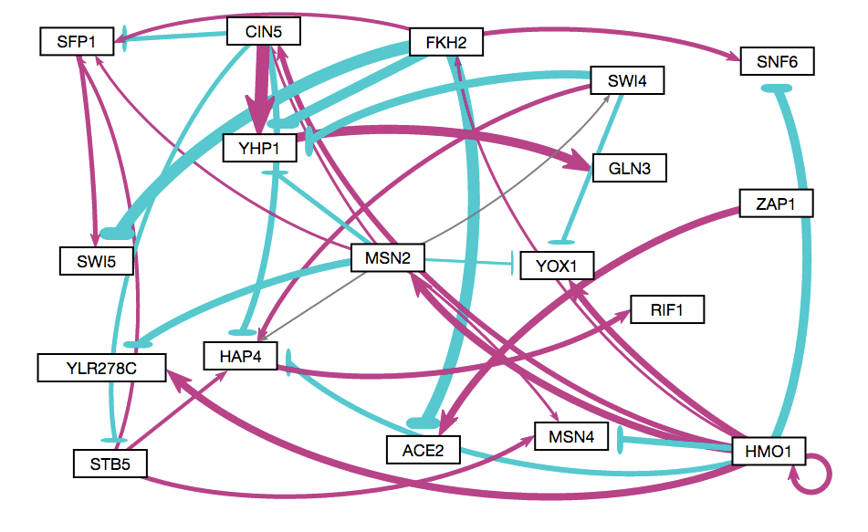
Profile 24: GRNmap Fixed b Output

Slide 19
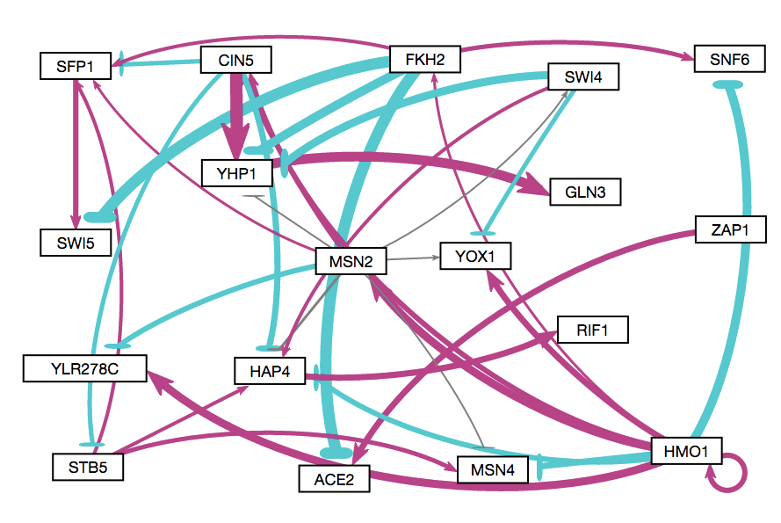
Profile 24: GRNmap Estimate b Output

Slide 20
Bar Graph comparing the Estimate b and Fixed b values

