Slide 1
Week 12 Slide Redos
Put in Alphabetical Order

Slide 2
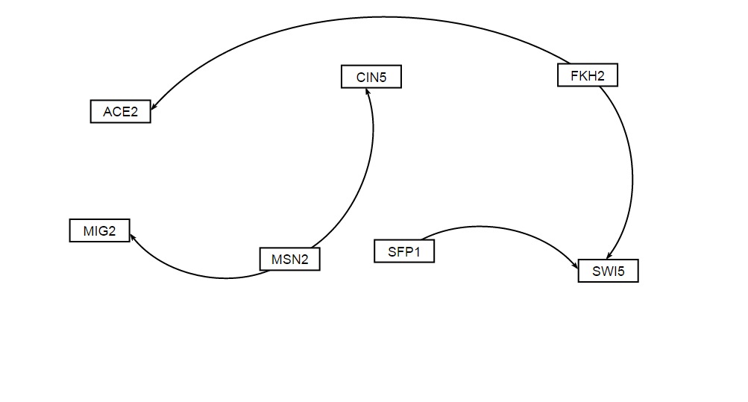
Week 12 Binding AND Expression

Slide 3
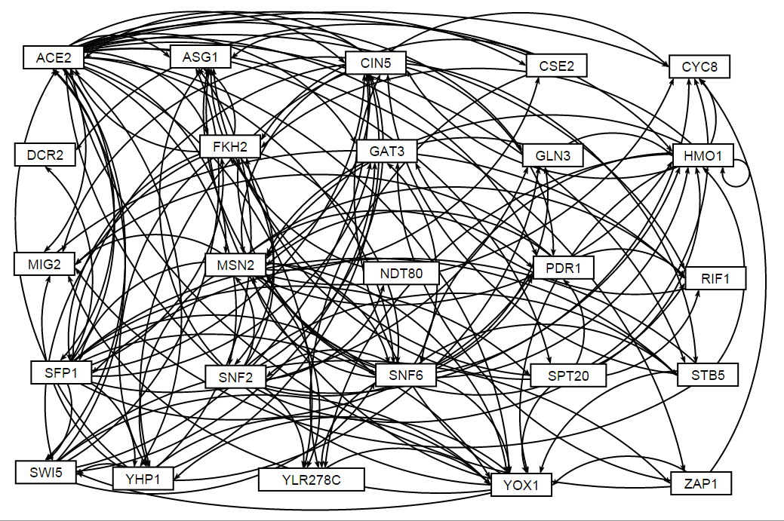
Binding PLUS Expression

Slide 4
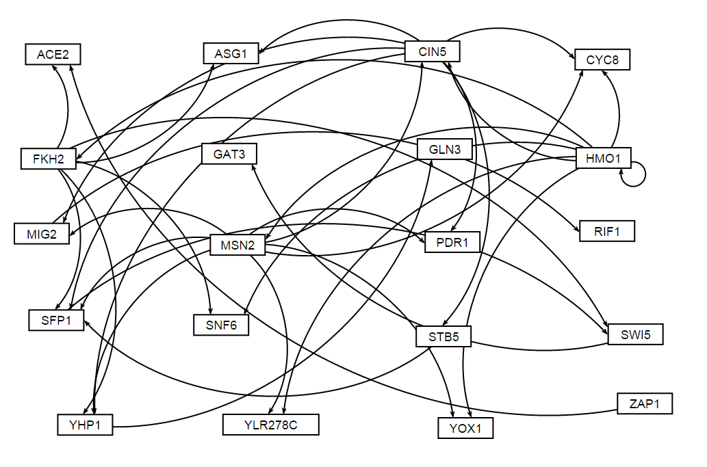
DNA Binding ONLY

