Slide 1
Cell Growth and Size Homeostasis in Proliferating Animal Cells
Amit Tzur, Ran Kafri, Valerie S. LeBleu, Galit Lahav, Marc W. Kirschner
Presented by: Amber Lin & Kevin Hu

Slide 2
Introduction
Models of Cell growth:
  Size Dependence
  Time Dependence
Growth measurements → resolution problems.
Statistical methods → growth problems
This paper used mathematical approaches along with “gentle” synchronization approaches to model cell growth.

Slide 3
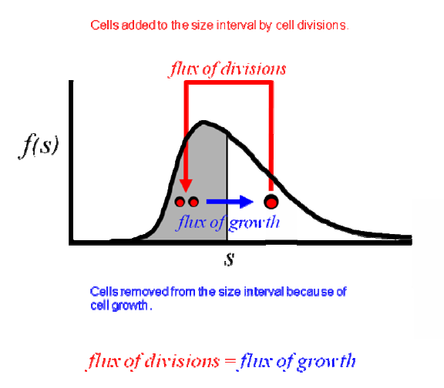
Size-Dependent Cell Growth
Collins-Richmond model:
f_{a} = size distribution of asynchronous cells
N_{t} = total number of cells
v(s) = growth rate of cells of size “s”
α = frequency of cell divisions
F₀(s) = cumulative distribution of newborn daughter cells
F_{m}(s) = cumulative distribution of mitotic cells
F_{a}(s) = cumulative distribution of asynchronous cells

Slide 4
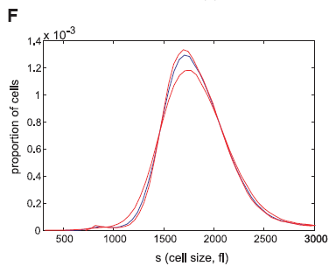
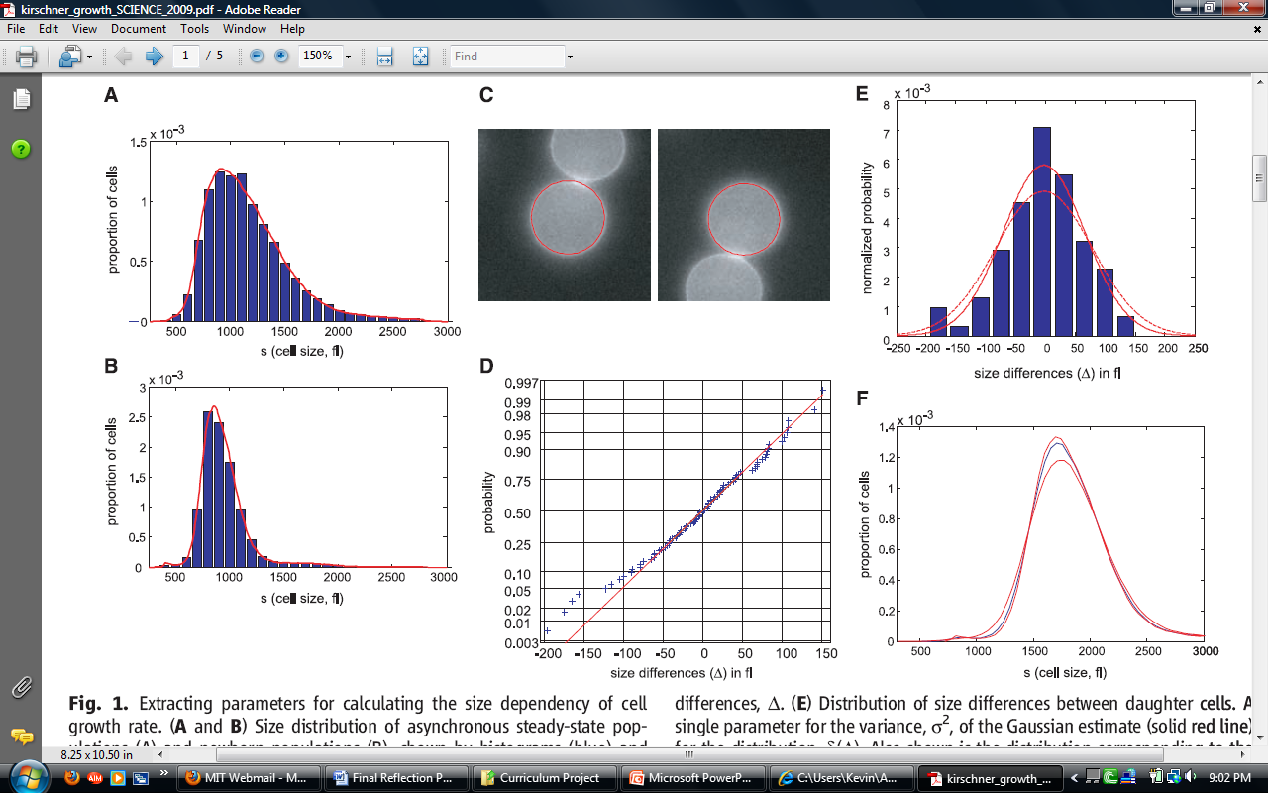
Calculation of mitotic distribution
Convolved size differences of new born cells with the population distribution of newborn cells:
*

Slide 5
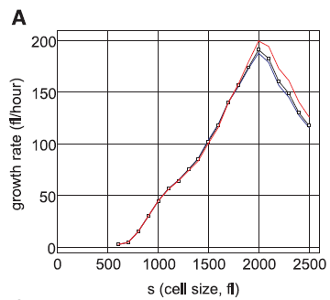
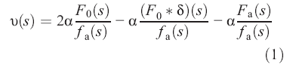
Results
Larger cells have a higher growth rate up until a certain cell size, then the trend reverses.
Model not completely accurate, need to examine how growth rate is affected with time.

Slide 6
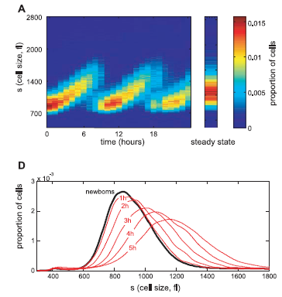
Time Dependency of Growth
Estimated cell growth using linear & exponential models
  Linear: s^{i}(t)=s^{i}_{o}+β^{i}_{n}(t-t_{n})
  Exp: s^{i}(t)=s^{i}_{o}exp[k^{i}_{n}(t-t_{n})]
Derived constants from convolution between newborn population and probability distribution of size differences

Slide 7
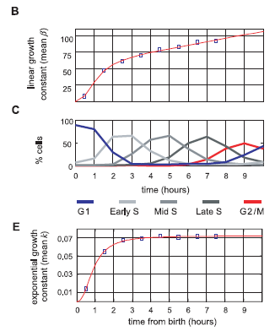
Results
linear & exp models gave approx. same results
  Growth rates: β^{i}_{o}; k^{i}_{o} *s^{i}_{o}
    Assumption that constants independent of size holds only for newborn cells
Both models show significant increase in growth rate occurs in G1
Must be control mechanisms to limit dispersion in sizes

Slide 8
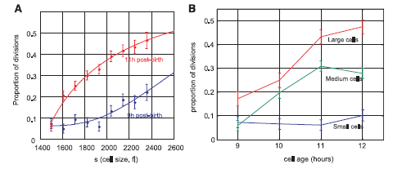
Cell Division Dependence on Size & Age
Examined interval of most divisions: 9-12hrs post-birth
    Compared proportion of divisions based on size
    Used data and growth constants to calculate the frequency of divisions vs. cell cycle time
Probability for cell division:

Slide 9
Discussion
The true growth function across the entire cell cycle neither a simple exponential nor a simple linear function, and it is size-dependent.
The correlation between size and division in mammalian cells cannot be a simple consequence of either “size gates” or a “timer.”
Mammalian cells must possess a cell-autonomous intrinsic size regulator that couples cell growth to the cell cycle.

