Slide 1
Tumor cells caught in the act of invading: their strategy for enhanced cell motility By: Weigang wang, sumanta goswami, Erik sahai, jeffrey b wyckoff, Jeffrey E. Segall and John S. Condeelis
Presented By: Lana Awad and Sebastian Lukjan

Slide 2
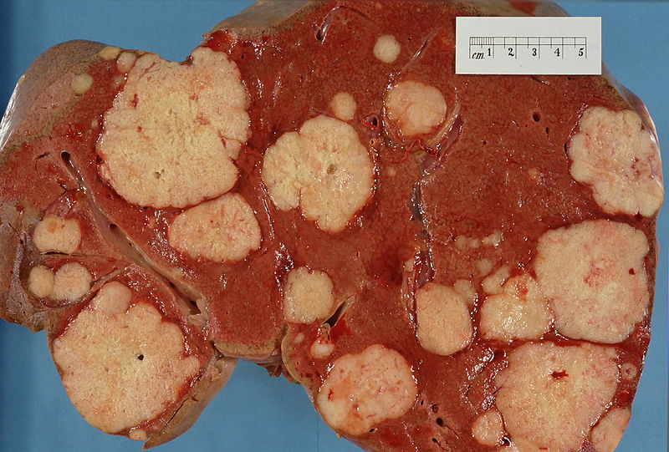
Motivation of research, why they did what they did…
Understand steps that cancer cells take to spread.
Want to relate gene expression pattern with likelihood of metastasis- diagnostics
Ultimate goal is to find strategies to slow spread of tumor cells - therapeutics
Current methods to study cancer metastasis had limitations
http://en.wikipedia.org/wiki/File:Secondary_tumor_deposits_in_the_liver_from_a_primary_cancer_of_the_pancreas.jpg#file
Notes:
Goal: understanding the cellular steps that cancer cells take to spread is useful for therapeutics and diagnostics.
Seek to find gene expression patterns in INVADING tumor cells to find startiegies to stop tumor spread.
Microarray based expression tumor analysis can be used to find gene expression patterns that can be associated with the likelihood of metastasis.
Spreading to other organs, metastasis of the tumor: relies on motility and invasion of connective tissue, lymph or blood, so of particular interest are the invading cells.

Slide 3
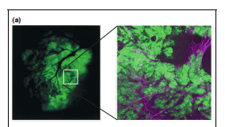
Analysis of Primary whole tumor
Problem: average expression patterns in all diverse tumor cells and isn’t indicative of invading cells.
Wang et al
Notes:
Previous methods and their limitations:
Analysis of whole bulk tumors: can include supporting stroma, microvessels and inflmaatory cells. The results from expression arrays derived from complete primary tumor are the average of the expression in all diverse cells, and not necessarily indicative of the invading cells, which are only a group of the whole.
We still need to isolate the pure invading cancer cells.
Collecting cells from metastatic tumors: as opposed to previous approach that collects metastisised cells after fixation.
Problem with this approach is that it requires cell culturing to get enough cells for microarray analysis.But in culture expression patterns can change due to culture conditions.
So analyzing expression in invading cells in vitro is not necessarily indicative of it invivo.
All previous methods showed a anltered expression in invading tumor cells.
Immunomagnetic selection from bone marrow and isolating populations by differential display analysis reference 18.
This was a failure they don’t explain why in details.

Slide 4
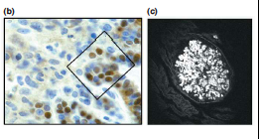
Analysis of cells isolated from fixed tumor
Problem: metastatic cells are identified by morphological characteristics in fixed tissue
Wang et al
Notes:
Collecting cells from a fixed tumor section using Laser capture microdisection: in this method, individual cells of interest are isolated from stained tissue under a microscope and using a laser.
Problem with this is that to decide if a cell is invading we look at the cells’ morphology and location, for instance, invasive cells would be expected to be in the invasion front. This is not a very reliable means of identifying invading cells since the cells are identified in a fixed tissue.

Slide 5
Analysis of metastases tumor
Problem: Needs to be cell cultured and In vitro conditions may affect gene conditions differently than in vivo conditions
Wang et al

Slide 6
Our Method, catching tumor cells red handed ….. while they are invading using chemotaxis
Chemotaxis toward blood vessels enhances metastasis
Growth Factor concentration gradient directs invasive cells to blood vessels
Tumor cells express more EGF receptors and respond to this gradient better
Notes:
Our method: catching tumor cells red handed… while they are invading
Using chemotaxis..
Chemotaxis towards blood stream inhances cancer invasion and spread into other tissue.
Normally epidermal growth factor diffusion from stromal cells and blood stream, are detected by EGF receptors on tumor cells. Thedetected concentration gradient activates intercellular pathways that promote motlity. So essentailly tumor cells move alogn the gradient to the blood stream.
Tumor cells, are observed to have increased EGF receptors, which makes them more responsive to this gradient.
To make use of that they proposed a new assay,….they called the invivo invsasion assay

Slide 7
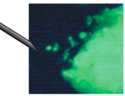
Their Method: In vivo Invasion Assay
Used chemotaxis
Chemotaxis to blood
vessels enhances metastasis
Used a microneedle with
known chemo attractants for metastasis
Then used microarrays to study gene experssion patterns
In particular looked for change in gene regulation with genes that affected motility
Notes:
… and this assay uses a microneedle containing chemoattractants such as EGF and extracellular matrix to mimic the chemotactic singlaing from the blood stream, and collect live primary tumor cells in the act of invading.
The method produced important results…

Slide 8
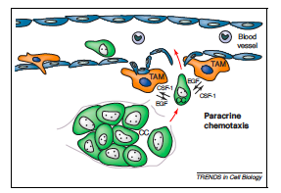
Paracrine Chemotaxis
Carcinoma cells (CC) produce CSF-1 to drive Tumor Associated Macrophages (TAM) to blood vessel
TAM procedures EGF to direct CC towards the blood vessel
Wang et al
Notes:
This invivo invasion assay provided strong evidence for paracrine interaction between macrophages and tumor cells, which makes them migrate together.
Figure 2 – Tumor associated macrophages accumulate near blood vessels that are associated with carcinoma cells. These carcinoma cells secrete CSF-I That attracts the macrophages. The macrophages secrete EGF that attracts in turn more carcinoma cells towards the blood vessels helping in intravasation. This relayed attraction allows the invasion to go for long distances, and it was observed during the assay by using intravital imaging.

Slide 9
Gene Expression Trends
mRNA levels for genes related to mobility affected
mRNA levels for genes related to cell polarity affected
Notes:
So the results from this method indicated and or confirmed two particular trends:
mRNA levels for genes related to cell mobility were up regulated… both genes that lead to protrusion of a cell and the breakdown of the protrusion. A result the authors stress since the result indicates an ability for cells to rotate and change direction quickly which could be advantageous in following a concentration gradient. In particular some examples of genes they found up regulated were cofilin, capping protein and Arp2/3.
Also, mRNA levels that stabilize polarity appeared to be down regulated… which makes cells more responsive to gradients, as it would allow the cells to turn and direct themselves more easily to the direction of a gradient. One particular example of a gene involved in cell polarity that was down regulated which the authors point out was ZBP 1. From previous studies conducted by the main author the authors knew that if the regulation of this gene is unaffected in cells, the ability of tumors to migrate is significantly decreased.

Slide 10
A key Discrepancy in Cancer Models
Gene expression results indicate the possibility that metastasis can occur in early tumors
Lead to the questioning of current model of cancer
Notes:
When the authors compared the gene expression results from invasive cells alone to early tumor cells the authors saw that early tumors had gene expressions which showed a similar expression to metastatic tumors. This comparison lead the authors to question the current model of cancer and formulate a new model for the formation of metastasis.

Slide 11
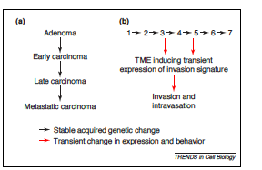
Hypothesis: Tumor Microenvironment Invasion Model
Wang et al
Notes:
The current model of cancer is that an adenoma progresses by a series of stable genetic changes and only after enough genetic changes occur does a tumor gain the ability to be metastatic.
However the more specific characterizations of invasive cells provided by the in vivo assay and other cancer studies, gives rise to the idea that it is not stable genetic changes that cause metastasis but rather transient micro environmental changes. The model suggests that it is transient gene expressions that occur from this transient micro environmental change which gives rise to a cells ability to migrate to the blood vessels via endogenous gradients. Thus, offering a possible explanation of why early tumor cells might have a potential to be metastatic.

Slide 12
Key Hypothesis Facets
Novel :
Transient gene expression changes
Metastasis can occur at earlier or later times
Microenvironments play a direct role in cell invasion
Hypothesis still needs to be tested
In situ hybridization
Notes:
What’s novel about this hypothesis is that
-it brings this idea of transient gene expression
-Allows for a higher likelihood that metastasis can occur early in cancer
-Places a much heavier emphasize on the microenvironment’s role in metastasis by making the environment play a more direct role
One aspect to note however is that this tumor microenvironment invasion model is still a hypothesis and still needs to be tested.
Which they suggest should be done with In situ hybridization. The authors note that if the hypothesis is true, then there should be localized gene expressions in tumors which indicate presence of invasive cells.
In situ hybridization (use a labeled complementary DNA or RNA strand to localize a specific DNA or RNA sequence in a part of the cell).

Slide 13
Significance to Cancer research
Potential therapeutic agents to prevent metastasis
characterize behavior of metastatic tumors on the cellular level.
Utilize this understanding to create better therapeutic agents
Notes:
The in vivo invasion assay offers the ability to better characterize the cellular behavior of invasive cells. Better cellular characterization leads to the potential to better understand the gene expression. With better understanding of gene expression of invasive cells, the protein activity related to cell migration pathways of invasive cells can be more throughally characterized which can help in the creation of better therapeutic agents that help prevent or delay metastasis.

Slide 14
The End

