Slide 1
Human Factor X
Jessica Kettleson, Jordan Smith, and Tracy Cronbaugh

Slide 2
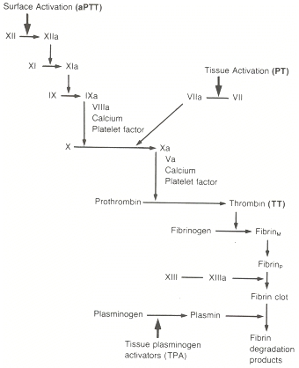
Coagulation Cascade

Slide 3
Human Factor X
Prothrombin → Thrombin
Fibrinogen → Fibrin
Fibrin → clot

Slide 4

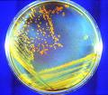
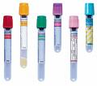
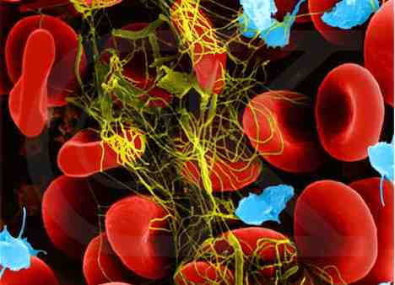

Slide 5
STEPS

Slide 6
Locate the gene sequence in GenBank. The gene of interest’s accession number is K01886. The sequence is:
ATCGTGGGAG GCCAGGAATG CAAGGACGGG GAGTGTCCCT GGCAGGCCCT GCTCATCAAT GAGGAAAACG AGGGTTTCTG TGGTGGAACC ATTCTGAGCG AGTTCTACAT CCTAACGGCA GCCCACTGTC TCTACCAAGC CAAGAGATTC GAAGGGGACC GGAACACGGA GCAGGAGGAG GGCGGTGAGG CGGTGCACGA GGTGGAGGTG GTCATCAAGC ACAACCGGTT CACAAAGGAG ACCTATGACT TCGACATCGC CGTGCTCCGG CTCAAGACCC CCATCACCTT CCGCATGAAC GTGGCGCCTG CCTGCCTCCC CGAGCGTGAC TGGGCCGAGT CCACGCTGAT GACGCAGAAG ACGGGGATTG TGAGCGGCTT CGGGCGCACC CACGAGAAGG GCCGGCAGTC CACCAGGCTC AAGATGCTGG AGGTGCCCTA CGTGGACCGC AACAGCTGCA AGCTGTCCAG CAGCTTCATC ATCACCCAGA ACATGTTCTG TGCCGGCTAC GACACCAAGC AGGAGGATGC CTGCCAGGGG GACAGCGGGG GCCCGCACGT CACCCGCTTC AAGGACACCT ACTTCGTGAC AGGCATCGTC AGCTGGGGAG AGGGCTGTGC CCGTAAGGGG AAGTACGGGA TCTACACCAA GGTCACCGCC TTCCTCAAGT GGATCGACAG GTCCATGAAA ACCAGGGGCT TGCCCAAGGC CAAGAGCCAT GCCCCGGAGG TCATAACGTC CTCTCCATTA AAG

Slide 7
First base pairs: ATCGTGGGAGGCCAGG Last base pairs: TAACGTCCTCTCCATTAAAG
Add XbaI (TCTAGA) and start codon (ATG) to first base pairs in gene sequence to create forward primer #1:
TCTAGATGATCGTGGGAGGCCAGG
Find the reverse complement to the last base pairs:
CTTTAATGGAGAGGACGTT
Add SpeI to reverse complement in reverse order to create reverse primer #1:
TGATCACTTTAATGGAGAGGACGTT
Plug gene sequence into IDT website to find two appropriate middle primers to help verify mRNA sequence:
Reverse Primer #2 (also found in middle of gene, but downstream from forward primer #2):
CTCCTTTGTGAACCGGTTGTGCTT
Forward Primer #2 (found in middle of gene):
TGGTGGAACCATTCTGAGCGAGTT
Add rest of prefix and suffix sequences to primers to make biobrick compatible:
Forward Primer #3: GAATTCGCGGCCGCTTCTAGATGATCGTGGA
Reverse Primer #3: TACTAGTAGCGGCCGCTGCAGCTTTAATAAG

Slide 8
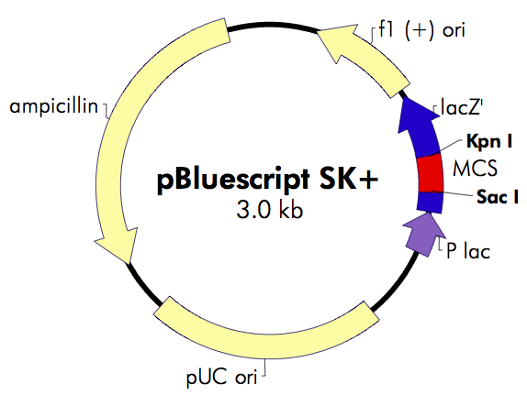
- Isolate and purify Human RNA from a blood sample
Run RT-PCR.
Run an Agarose gel to verify correct size of gene. Should be approximately 752 base pairs.
Set up the two restriction digests for your PCR product and vector using the XbaI
and SpeI restriction
enzymes.
Set up and complete the
ligation. We will be using
the pBluescript SK+ vector.

Slide 9
2nd PCR with 1st PCR product and Forward and Reverse Primers #3.
Set up another restriction digests using the EcoRI and PstI restriction enzymes.
Ligate with pBluescript SK+ vector.
Transform using the heat shock method.
Streak LB plates with the transformants.
Observe blue colonies.
- Extract proteins from E. coli.

Slide 10
TESTS

Slide 11
TIME TEST
Extract from untransformed E. coli
Extract from transformed E. coli

Slide 12
VISUAL TEST

Slide 13
Why Factor X?
Factor X / Stuart-Prower deficiency
  Frequent nosebleeds
  Easy bruising
  Soft tissue hemorrhages
  Bleeding of the joints
  Muscle bleeding
  Mucous membrane bleeding
1 in 500,000 people affected

