Slide 1
“Engineering modular and orthogonal genetic logic gates for robust digital-like synthetic biology”
Baojun Wang, Richard I Kitney,
Nicolas Joly & Martin Buck
Jamal Elkhader & Queenie Chan
22 February 2012

Slide 2
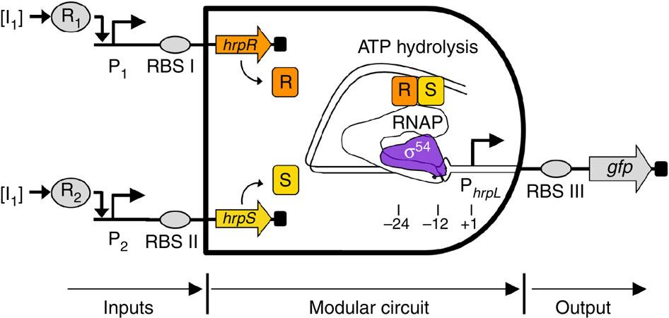
Background
AND gate:
Notes:
takes both R and S to bind to RNA for ATP hydrolysis and subsequent reactions
Second I1 should be an I2, according to the legend
R and S together both bind to the DNA which activiates the transciption of hrpL promoter, ans subsequently GFP.

Slide 3
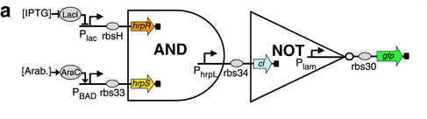
Background
NAND gate:
Notes:
When hrpR and hrpS bind together, it activates transcription of PhrpL, which transcribes cI. Which normally represses Plam. Once this is activiates, there is no gfp transcribed.

Slide 4
Background
Terms:
Digital system: on/off
Forward engineering: classifying/evaluating components before choosing the parts to build the system
Modular: can change inputs and outputs and logic gate will still work
Orthogonal: no cross-talk
Notes:
digital system: one response at "low" concentration (below some threshold), much different response at higher concentrations
- Should look like a step function
"...incorporate all of those ideas into..... the paper"

Slide 5
Project Overview
Purpose: to engineer a digital-like system using modular and orthogonal parts via forward engineering
Classification
Design AND gate
Test Modularity
repeat II and III for NAND gate
Compatibility

Slide 6
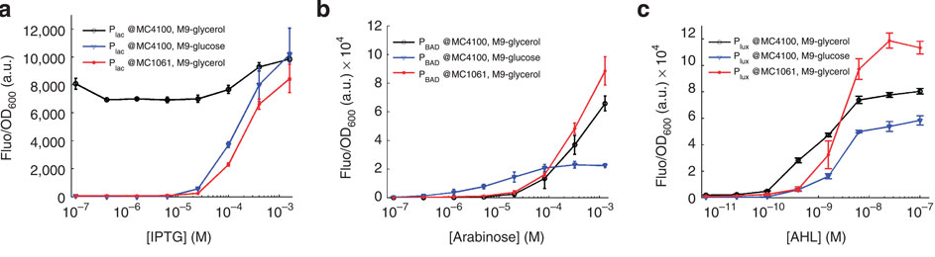
Classification: Forward Engineering
Classification
NAND gate
Compatibility
Design AND gate
Test Modularity
IPTG --> lac
Arabinose --> BAD
AHL --> lux
3 different promoters: P_{lac}, P_{BAD}, P_{lux}
3 test conditions:
promoters' responses, varying chassis (E. coli MC4100, E. coli MC1061)
Notes:
Chose MC1061 bc had switching characteristics for all 3 promoters

Slide 7
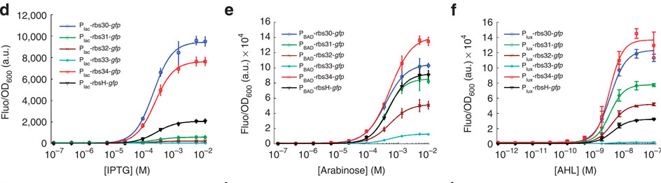
Classification: Forward Engineering
Classification
NAND gate
Compatibility
Design AND gate
Test Modularity
IPTG --> lac
Arabinose --> BAD
AHL --> lux
3 different promoters: P_{lac}, P_{BAD}, P_{lux}
3 test conditions:
promoters' responses, varying chassis (E. coli MC4100, E. coli MC1061)
promoters + RBSs responses with varying RBS's
Notes:
chose promoter/RBS pairs that had around the same fluorescence levels
(d – Plac-rbsH ; e – Pbad – rbs33 ; f – Plux – rbs33

Slide 8
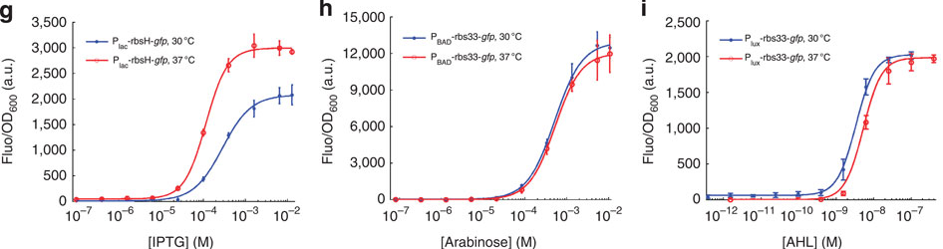
Classification: Forward Engineering
Classification
NAND gate
Compatibility
Design AND gate
Test Modularity
IPTG --> lac
Arabinose --> BAD
AHL --> lux
3 different promoters: P_{lac}, P_{BAD}, P_{lux}
3 test conditions:
promoters' responses, varying chassis (E. coli MC4100, E. coli MC1061)
promoters + RBSs responses with varying RBS's
Promoters + RBS's responses with varying temperatures
Notes:
- Varying shifts as a result of temperature change – due to shift on binding affinities btwn transcription factors and promoters

Slide 9
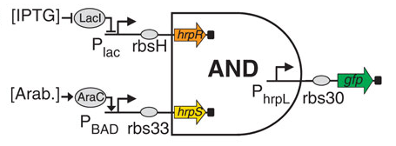
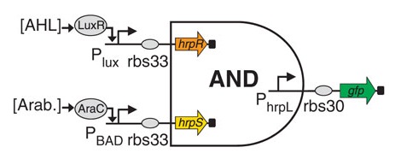
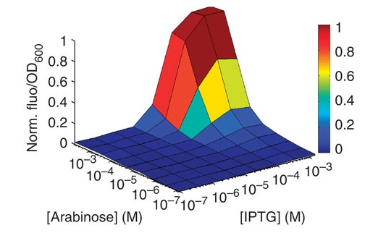
Circuit Design: AND Gates
Testing for Modularity
Classification
NAND gate
Compatibility
Design AND gate
Test Modularity
Gate 1
Gate 2
Notes:
designed two gates to test modularity
Plac --> Plux

Slide 10
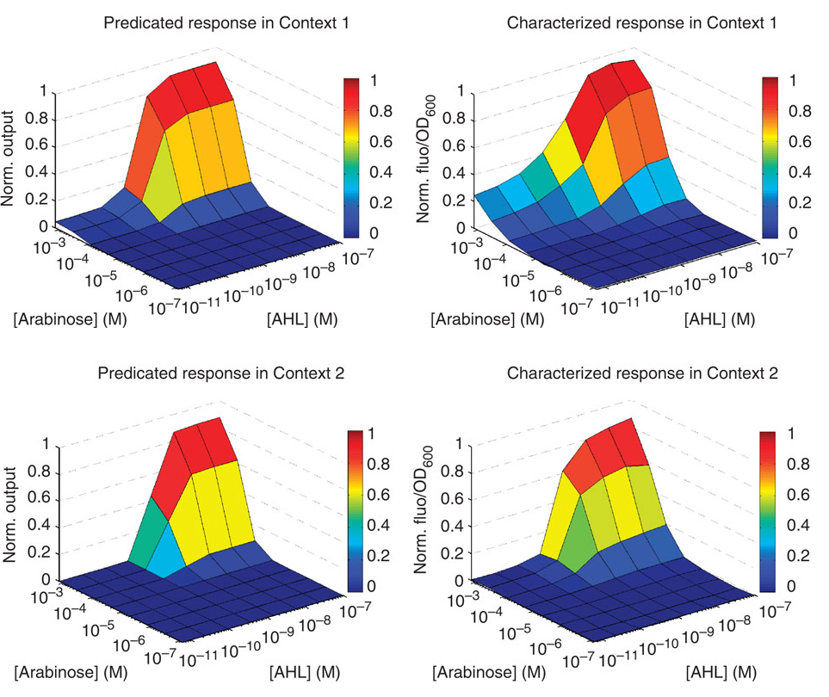
Gate 2
30ºC
37ºC
Notes:
top (Context1) = 30ºC
bottom (Context2) = 37ºC
greater "leakage" in gate 2 with Plux -- leakage = not as digital
- worked ----> inputs of AND gate are modular/exchangeable
- more leakage at 37º than 30º ----> context dependent

Slide 11
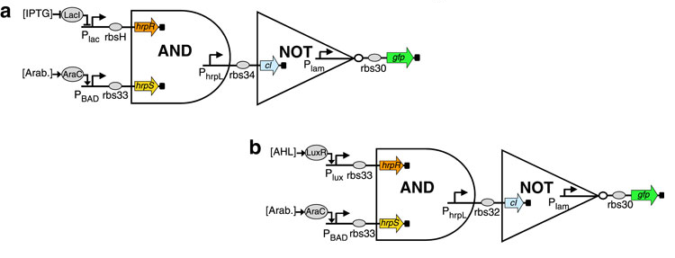
NAND gates: Design & Modularity Test
Classification
NAND gate
Compatibility
Design AND gate
Test Modularity
Gate 3
Gate 4
Notes:
two different pathways (modularity)
3) lac/rbsH + BAD/rbs33
4) lux/rbs33 + BAD/rbs33

Slide 12
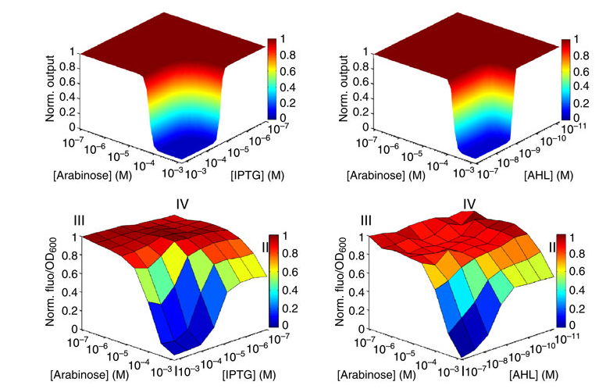
Gate 3
Gate 4
Predicted
Results
Notes:
gate 4 not as perfect - may be due to not fully induced cell population
or non-homogeneous input promotor, Pbad (bimodal activity) --> supplementary slide

Slide 13
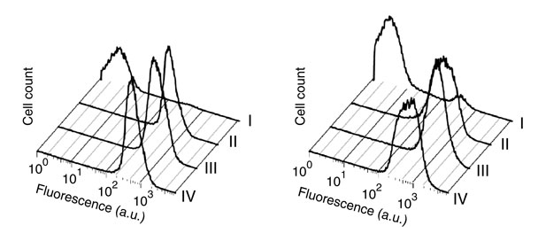
NAND gate FACS data
Classification
NAND gate
Compatibility
Design AND gate
Test Modularity
Both inputs added --> off

Slide 14
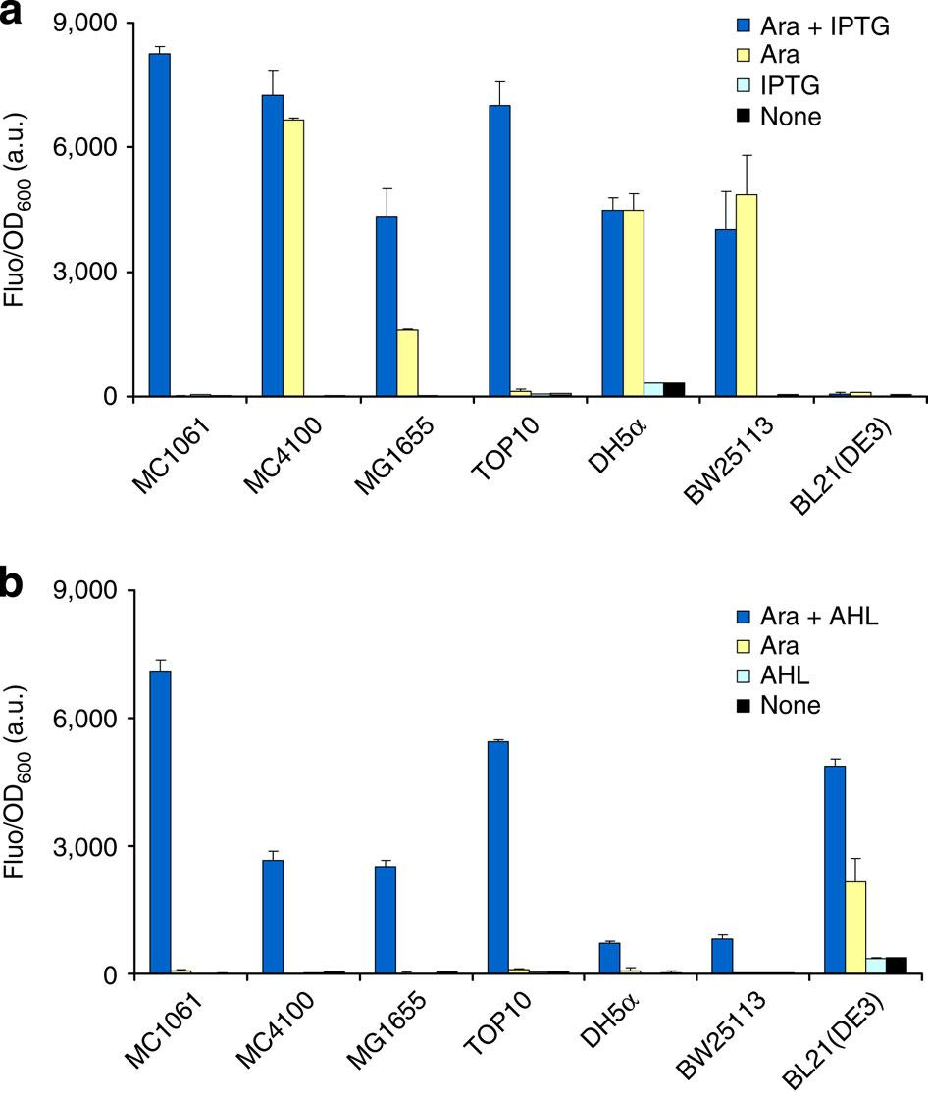
Compatibility
Classification
NAND gate
Compatibility
Design AND gate
Test Modularity
✗
✗
✗
✗
Compatibility of AND gate with chassis
Top: Gate 1 (P_{lac} + P_{BAD})
Bottom: Gate 2 (P_{lux} + P_{BAD})
✗
✗
Notes:
Ara + IPTG = on
Ara }
IPTG }= off
None }
Gate 1: only 2/7 worked
Gate 2: 6/7 worked, bc Plux not found in E coli, so no crosstalk
--> AND gate compatible with cell, but promoters have to be chosen carefully based on host chassis

Slide 15
Conclusions
AND and NAND gates are modular
Sigmoidal response property allows system to be robust (minimal background noise)
Forward engineering and engineering-by-parts works!
Crosstalk can be avoided by picking promoters that are not native to chassis
Notes:
modular - changed inputs/outputs while preserving the logic AND function
sigmoidal response - looks like __/```
Future potential tests:
- measure dynamics of reactions – how long do the systems take to switch on/off after adding input?

Slide 16
Significance
Modular:
Can use other inputs and outputs and AND / NAND gate will still work
Parts-based engineering approach
Control:
New genetic logic devices can be engineered predictably to generate desired behaviours in response to specific extra- or intra- cellular signalling inputs
Improves sensing specificity and accuracy of biological control
Notes:
control: similar to typical engineering (bringing parts together to perform desired function)

Slide 17
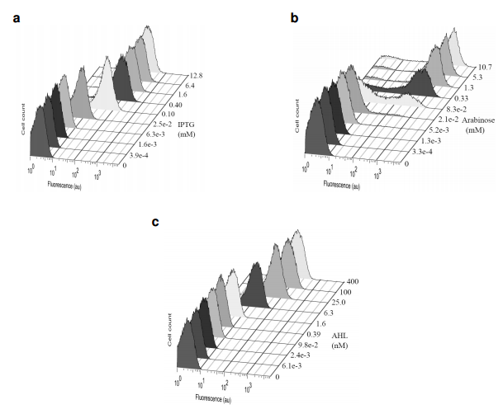
Supplementary Slides
P_{lac}
P_{BAD}
P_{lux}
Notes:
at diff concentrations, how many cells fluoresce? (on/off characteristics)
- should have single peaks. Pbad has bimodal characteristics.

