Slide 1
Proteomics of Tissue Tropism in Breast Cancer (mostly)
Lauren Barney
Peyton Lab
March 31, 2014

Slide 2
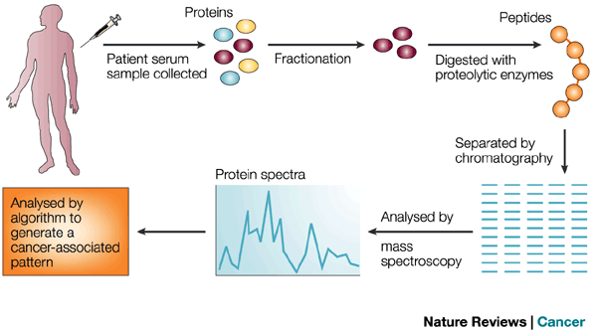
‘Omics’ Approaches
High throughput approaches: higher dimensionality data sets, requires bioinformatics approaches
Often reveals more questions than answers due to heterogeneity across samples and complexity of datasets
Success stories: targeted therapeutics such as Herceptin and gefitinib
Vucic et al., 2012; Sidransky 2002
Notes:
\Genomics, Proteomics, Epigenomics, transcriptomics, Metabolomics
Genomics: DNA copy number, DNA methylation, and transcriptome and whole-genome sequencing—technologies
Knowledge of such mutations has in the past led to the development of specific targeted therapies, such as trastuzumab for ERBB2-positive (alias HER2 or NEU) breast cancers [4], imatinib for KIT-positive gastrointestinal stromal tumors [5], and gefitinib for EGFR-positive small cell lung cancers [6], respectively.

Slide 3
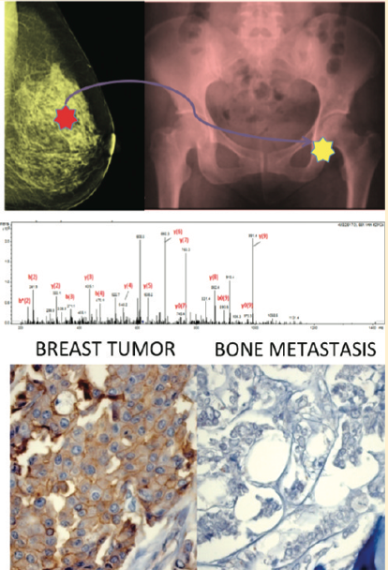
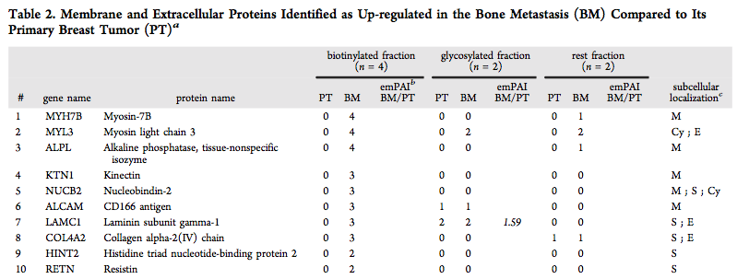
Large-Scale Example: Matched Primary and Bone Met from Patient
Many proteins identified as up- or down-regulated:
Up-regulated in bone met:
  Collagen IV, Cathepsin G, laminin subunits gamma1 and alpha4
Down-regulated in bone met:
  Vitronectin, beta1 integrin, collagen XIV, alpha2 integrin, alpha5 integrin
Dumont et al., 2012
Notes:
Cathepsin G: may participate in the killing and digestion of engulfed pathogens, and in connective tissue remodeling at sites of inflammation.

Slide 4
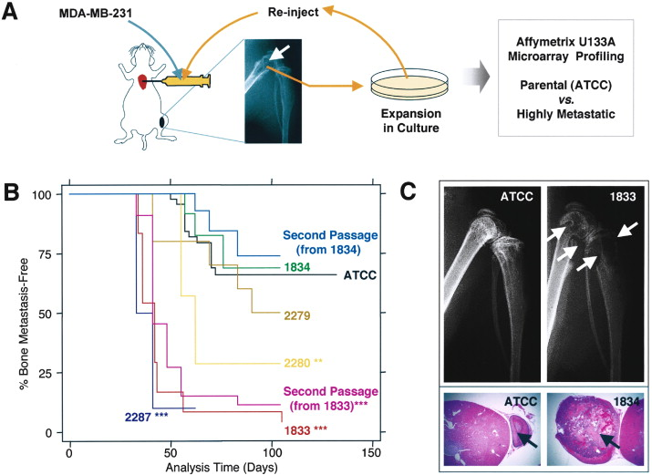
Proteomics of tropism generally studied on a smaller scale
One to tens of proteins, not whole proteome
  Immunohistochemistry staining, western blotting, functional assays (antibodies, siRNA, overexpression, etc)
Most studies focus on one site of metastasis, so it is still hard to know what is specific to bone, brain, or lung metastasis
Many studies use tropic selection in 231s or 4T1 mouse mammary carcinoma cells
Kang et al., 2003

Slide 5
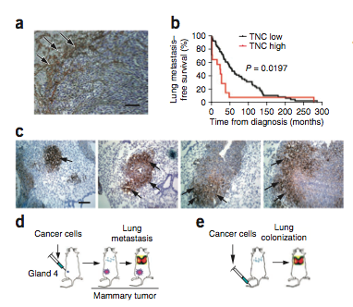
Tenascin C
Breast cancer cell production of Tenascin C supports lung metastasis, correlates with aggressiveness of tumors
TNC in human lung metastasis (brown)
Immunohistochemical analysis of TNC expression in lung metastatic foci of various sizes formed by MDA231-LM2 cells in mice. TNC accumulation at the invasive front in larger metastatic foci. Arrows, TNC expression. Scale bar, 50 μm
Oskarsson et al., 2011
Notes:
Oskarsson: tumor cells produce TNC first, then stroma takes over
Top: (a) Heterogeneous TNC expression in human lung metastasis.
TNC immunostaining (arrows) on lung metastasis section from an individual with breast cancer. Scale bar, 50 μm.
Bottom: (c) Immunohistochemical analysis of TNC expression in lung metastatic foci of various sizes formed by MDA231-LM2 cells in mice. TNC accumulation
at the invasive front in larger metastatic foci. Arrows, TNC expression. Scale bar, 50 μm
Kaplan met niche paper

Slide 6
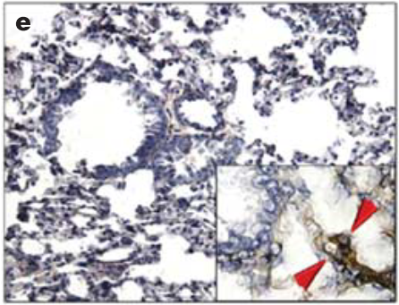
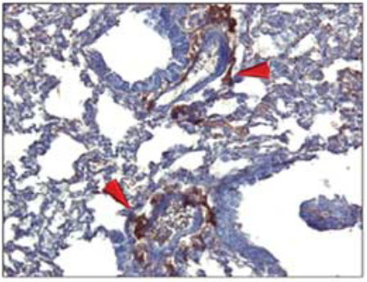
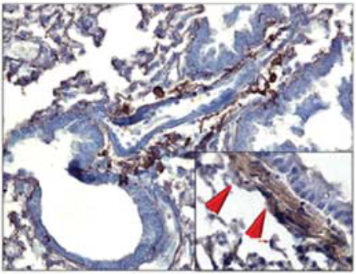
Bone marrow derived cells create a pre-metastatic niche in the lung
Tumor-specific growth factors upregulate fibroblast production of fibronectin to create a permissive niche for lung colonization
  Prior to arrival of BMDCs, but at future site of metastatic niche location
WT lung
Pre-metastatic lung, day 3
Before arrival of BMDCs
Maximal FN expression on day 14
Kaplan et al., 2005
Notes:
Baseline FN expression in WT lung (n=6) (left), increased stromal FN in peribronchial region of the pre-metastatic lung at day 3 (middle panel, arrows), with maximal expression on day 14 (right panel)
Insets, PDGFRalpha expression indicates resident fibroblasts laying down fibronectin

Slide 7
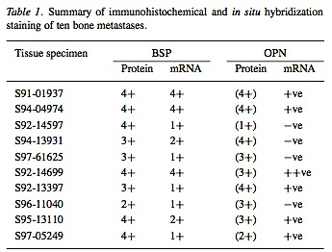
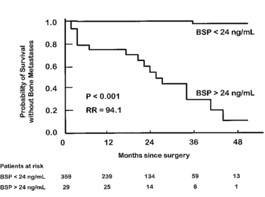
ECM Proteins in Bone Metastasis
Osteopontin (OPN) and bone sialoprotein (BSP) expression are both present in breast cancer bone metastasis
  OPN: promotes invasive behavior of breast cancer cells, recruits macrophages, initiates downstream signaling
  BSP: facilitates adhesion, survival, metastasis
  Potential “osteomimicry”
Ibrahim et al., 2001 Wai et al., 2004 Kruger et al., 2014 Diel et al., 1999
Notes:
BSP: glycoprotein produced by resident bone cells, involved in minearilization of hydroxyapatite; met breast cancer cells can produce it to facilitate adhesion, survival, ultimately metastasis
OPN is BSP-1; BSP is BSP-2
Table: Staining intensity +1 weak, +4 strong
OPN bracketed values refer to staining in bone, +ve values refer to detection of OPN mRNA in osteoclasts

Slide 8
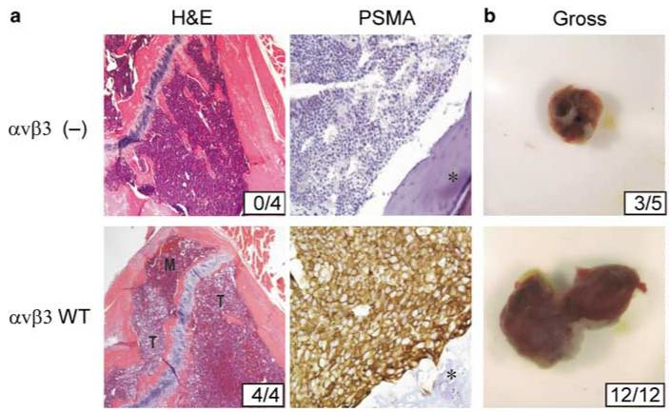
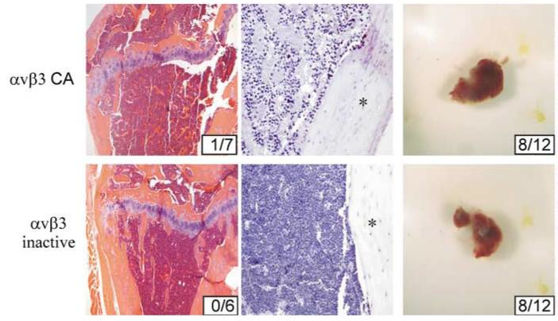
Integrins
α_{v}β₃ is required for bone metastasis in many types of cancer
Binds vitronectin, fibronectin, osteopontin, bone sialoprotein, others in present bone & bone marrow
Liapis et al., 1996 McCabe et al., 2007
Prostate cancer example
Notes:
PSMA: prostate membrane specific antigen
Avb3 also critical in angiogenesis – why people want to target it
Prostate: avb3 changes didn’t change sub-q tumor growth
(a) Left column: representative H&E histology of injected tibiae. Note that the majority of normal marrow (M) has been displaced by tumor (T) in the C4–2 avb3 WT injected tibia (second row). Tumor incidence is shown in insets. Original magnification of 􏰐20. Right column: tumor presence was confirmed immunohistochemically for the presence of PSMA. Asterisks indicate cortical bone. Original magnification of 􏰐40. (b) Left column. Gross tumor analysis 4 weeks following injection of C4–2 cells. Tumor incidence is indicated in the inset.

Slide 9
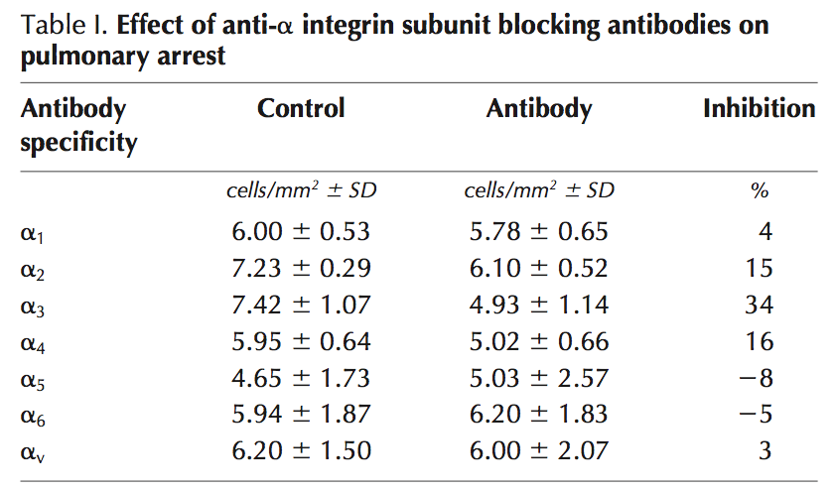
Integrins
α₃β₁ mediates initial pulmonary arrest of HT1080 cells (fibrosarcoma)
  Binds laminin and thrombospondin
Silencing α₃ integrin expression prevented lung metastasis in 4T1 cells
  Tail vein injection
Wang et al., 2004
Zhou et al., 2014
Notes:
~30min after injection # cells in lung were measured (injection into renal vein of rats – which drains the kidney)
For beta integrins, only anti-b1 had an effect
A3 only dimerized with b1, so a3b1 is what mediates this attachment
Fibrosarcoma: Fibrosarcoma (fibroblastic sarcoma) is a malignant mesenchymal tumour derived from fibrous connective tissue and characterized by the presence of immature proliferating fibroblasts or undifferentiated anaplastic spindle cells in a storiform pattern. It is usually found in males aged 30 to 40 .[citation needed] It originates in fibrous tissues of the bone and invades long or flat bones such as femur, tibia, and mandible. It also involves periosteum and overlying muscle.

Slide 10
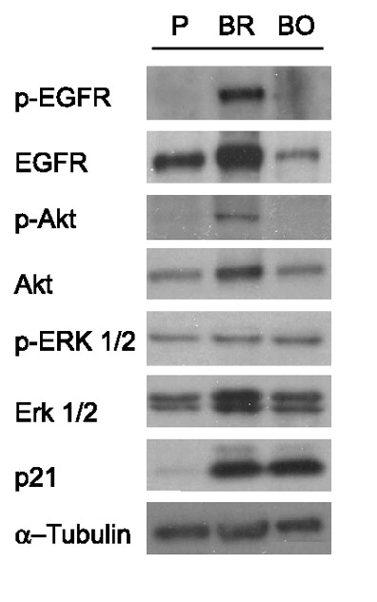
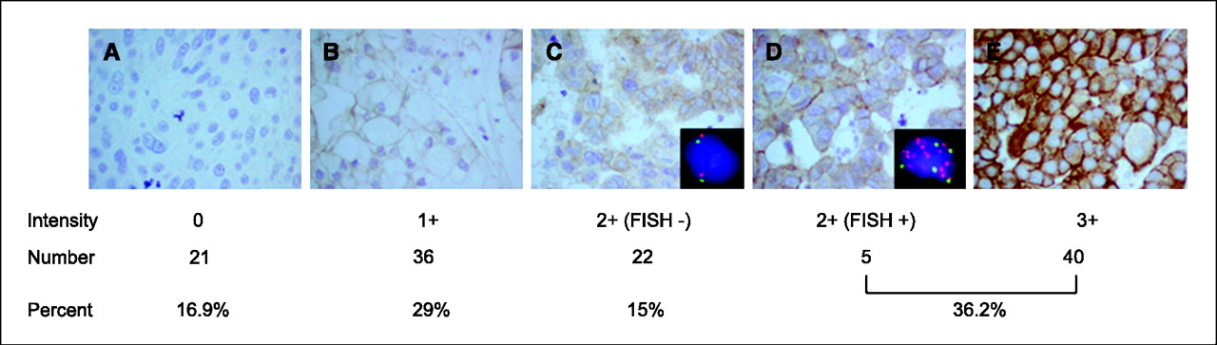
HER2 and Brain Metastasis
HER2 is a prognostic factor for brain metastasis clinically
  HER2+ tumors have a predisposition for brain metastasis
  Brain may be a “sanctuary” for Herceptin-treated tumor cells
HER2
Palmieri et al., 2007 Lin and Winer, 2007
Notes:
Palmieri brain met: Yoneda bo/br/parental 231 cells
IHC: clinical brain mets
WB: Yoneda cells
http://cancerres.aacrjournals.org/content/67/9/4190.long

Slide 11
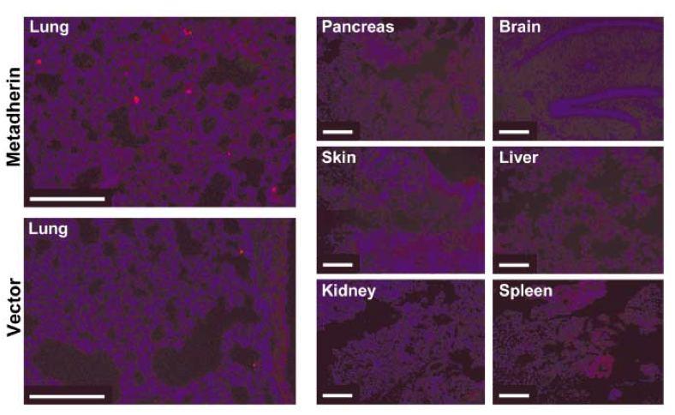
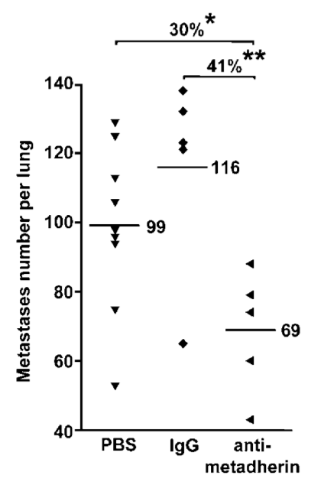
Metadherin
Cell surface protein involved in angiogenesis
  Known oncogene
  Mediates lung metastasis in 4T1 cells; initially identified via phage display to lung vasculature
Brown and Ruoslahti, 2004
Notes:
A: DAPI-stained (blue) lung sections from mice injected intravenously with HEK293T cells that were cotransfected with a DsRed2 expression vector (red) and either metadherin-pCMV or expression vector alone. Pancreas, skin, kidney, brain, liver, and spleen sections from mice injected with HEK293T cells that were transfected with a DsRed2 expression vector (red) and metadherin-pCMV. The scale bars correspond to 100 μm.
*2h after iv injection
Graph: metastasis number: Values are expressed as the number of tumor foci per 10,000 cells injected.
Tail vein, mice killed 7 days after injection

Slide 12
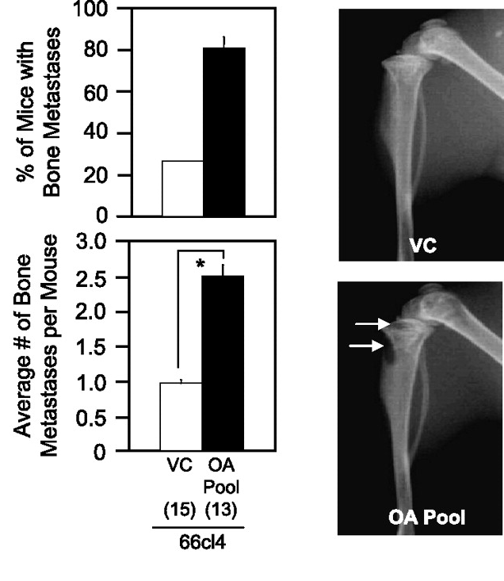
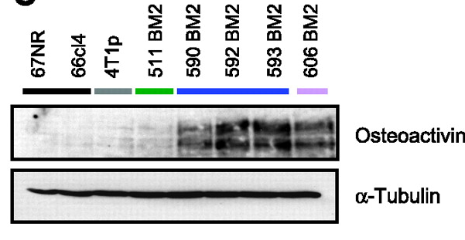
Osteoactivin
Cell surface glycoprotein
Upregulated in bone metastasis
Overexpression promotes bone metastasis in weakly bone metastatic cells
Rose et al., 2007
Notes:
http://mcr.aacrjournals.org/content/5/10/1001.full.pdf+html
*selection of bone met 4t1 cells
Green: weakly bone met (2nd round), blue: strongly bone met (2nd round) BOTH FROM MFP; purple: highly bone met, from intracardiac inj
Osteoactivin expression: increase in migratory and invasive behavior
OA depletion by siRNA decreased MMP3
Forced OA expression elevated MMP3
Cardiac injection of osteoactivin-expressing 66cl4 cells and vector controls. The percentage of mice developing osteolytic bone metastases (top left) and the average number of lesion per mouse (bottom left). Representative hind limb X-rays are shown from mice injected with either osteoactivin-expressing or vector control 66cl4 cells (right panels).
OA: expressed in various cell types, including: melanocytes, osteoclasts, osteoblasts, dendritic cells, and it is overexpressed in various cancer types.

Slide 13
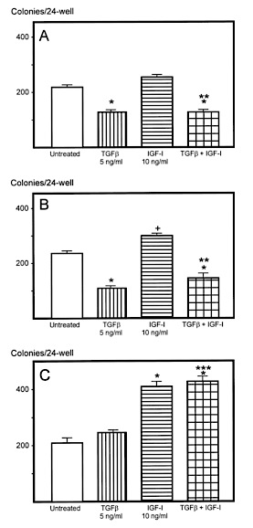
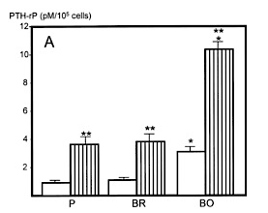
TGFβ is released during bone remodeling, stimulates “vicious cycle”
TGFβ stimulates bone metastatic cell growth
Blocking TGFβ signaling prevents PTHrP secretion by breast cancer cells and prevents bone metastasis
Parental
231-Br
231-Bo
Yoneda et al., 2001 Yin et al., 1999
Notes:
PTHrP is in mets too, even if not in corresponding tumor!
PTRhP stimulates bone remodeling
TGF-b released by bone remodeling
A: PTHrP production in response to TGFb stimulation
PTHrP acts as an endocrine, autocrine, paracrine, and intracrine hormone. It regulates endochondral bone development by maintaining the endochondral growth plate at a constant width. It also regulates epithelial-mesenchymal interactions during the formation of the mammary glands.
Left: cell growth assay
Top: parental
Middle: brain
Bottom: bone

Slide 14
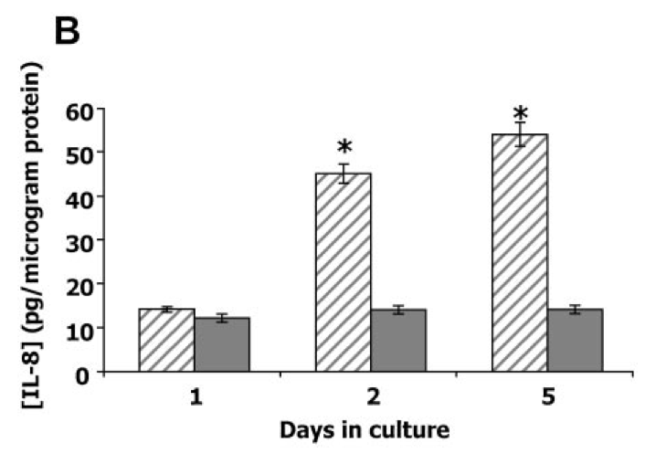
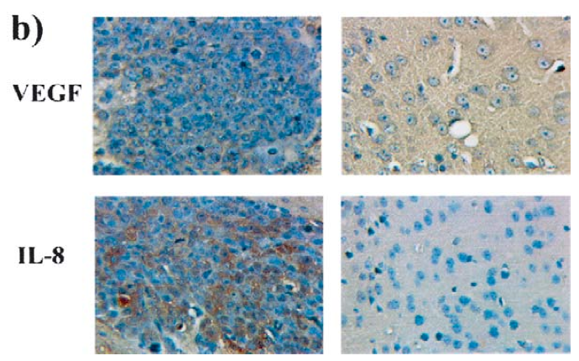
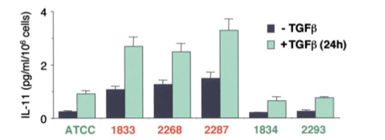
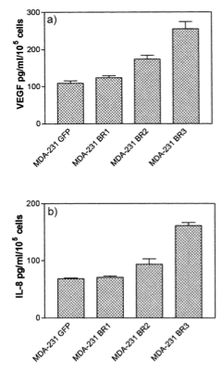
Interleukins
Solid: MDA-231
Dashed: MDA-MET
IL-8 in a 231 variant correlates with bone metastasis in mice
Bone tropic cells produce more IL-11
231 brain metastatic variants release more IL-8 and VEGF-A
Metastatic lesion
Normal brain
Bendre et al., 2002
Kim et al., 2004
Kang et al., 2003
Notes:
Interleukins: cytokines important in immune cell function
IL-8:Interleukin 8 (IL-8) is a chemokine produced by macrophages and other cell types such as epithelial cells, airway smooth muscle cells[1] and endothelial cells
IL-11:Interleukin 11 (IL-11) is a secreted protein that stimulates megakaryocytopoiesis, resulting in increased production of platelets, as well as activating osteoclasts, inhibiting epithelial cell proliferation and apoptosis, and inhibiting macrophage mediator production
VEGF-A: important for angiogenesis, chemotactic for macrophages and granulocytes (VEGF-C for lymphangiogenesis)
Bendre: 3 cycles through mice to select 231 variant to BONE
Kim: 3 rounds of selection (brain)

Slide 15
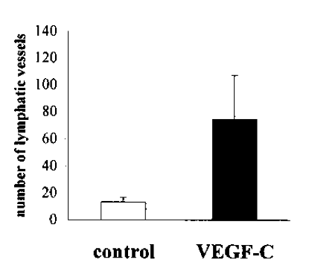
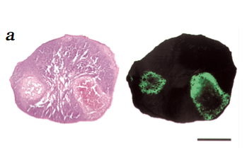
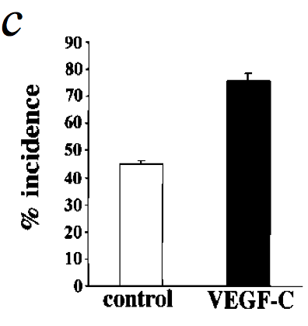
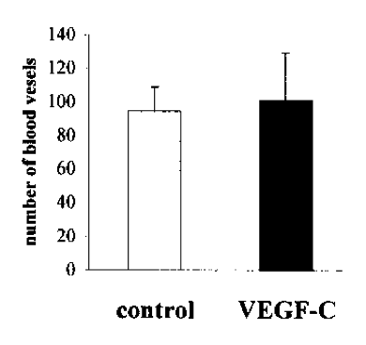
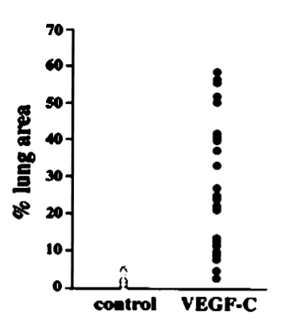
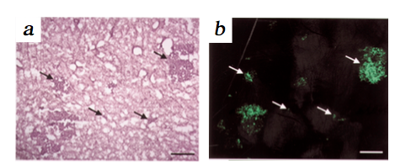
VEGF-C
VEGF-C overexpression increases lymph node and lung metastasis in breast cancer via increased lymphangiogenesis
Lymph node
Lung
Skobe et al., 2001
Notes:
Left: vessels in tumors
MFP injection, spontaneous tumors of mda-mb-435 cells (not breast cancer)
http://en.wikipedia.org/wiki/Vascular_endothelial_growth_factor VEGF a v c
Lymphangiogenesis is the formation of lymphatic vessels from pre-existing lymphatic vessels[1] in a method believed to be similar to angiogenesis (blood vessel development).
MDA-MB-435 cells though

Slide 16
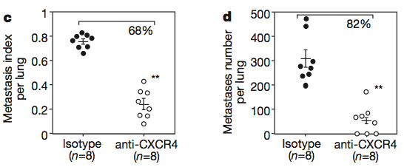

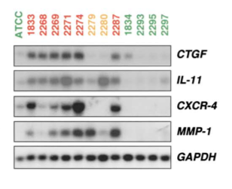
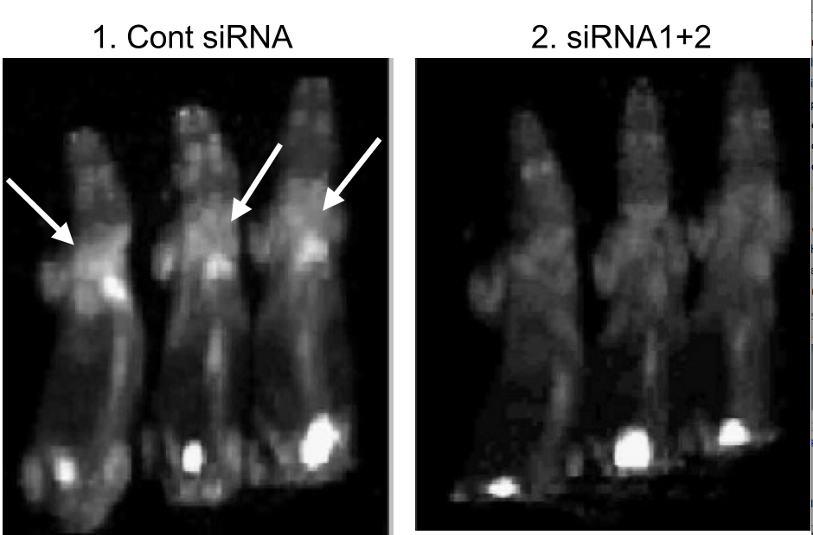
CXCR4
Inhibiting CXCR4 impairs ability to metastasize to lymph nodes and lung
Important in bone metastasis
  Bone homing (RNA quantification)
Muller et al., 2001
Kang et al., 2003
Liang et al., 2005
Notes:
CXCR-4 is an alpha-chemokine receptor specific for stromal-derived-factor-1 (SDF-1 also called CXCL12), a molecule endowed with potent chemotactic activity for lymphocytes.
MI: area tumor/area lung
Kang: Confirmation of expression pattern of various metastasis-associated genes by Northern blot in the indicated cell populations.
Mice: Figure 4.Effect of CXCR4 siRNAs on inhibition of breast cancer metastasis in vivo confirmed by FDG-PET. Representative images of FDG-PET of animals in group 1 (control siRNA) and group 2 (siRNA1+2). A, maximum-intensity projection of six representative mice from group 1 (left, three mice) and group 2 (right, three mice).
CTGF, also known as CCN2 or connective tissue growth factor,[1][2] is a matricellular protein of the CCN family of extracellular matrix-associated heparin-binding proteins (see also CCN intercellular signaling protein).[3][4][5] CTGF has important roles in many biological processes, including cell adhesion, migration, proliferation, angiogenesis, skeletal development, and tissue wound repair, and is critically involved in fibrotic disease and several forms of cancers

Slide 17
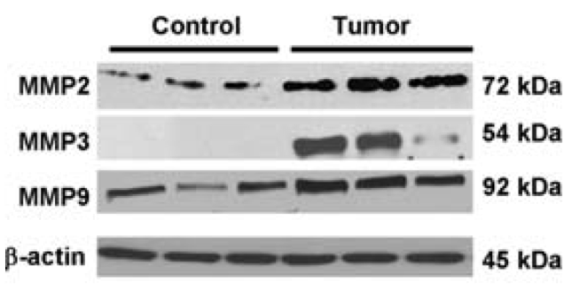
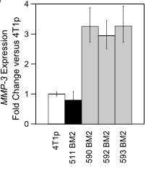
Proteases
MMP2, MMP3, MMP9 higher in brain metastasis than primary tumor in rat model
Cross-talk with astrocytes increases MMP2 expression and invasion in vitro
MMP3 is up-regulated in bone tropic variant of 4T1 cells
Mendes et al., 2005
Mendes et al., 2007 Rose et al., 2007
Notes:
MMP2: degrades collagen IV
MMP3: The MMP-3 enzyme degrades collagen types II, III, IV, IX, and X, proteoglycans, fibronectin, laminin, and elastin. In addition, MMP-3 can also activate other MMPs such as MMP-1, MMP-7, and MMP-9,
MMP9: The enzyme encoded by this gene degrades type IV and V collagens and other extracellular matrix proteins
The ENU1564 tumor cell line used in this study was developed in our laboratory and originated from an N-ethyl-N nitrosourea-induced mammary adenocarci- noma in a female Berlin–Druckrey IV (BD-IV) rat. T
Mendes: dec. brain met(and in vitro invasion) with with PD 166793, a selective synthetic MMP inhibitor. Quantified via WB and RT-PCR
http://download.springer.com/static/pdf/459/art%253A10.1007%252Fs10585-005-8115-6.pdf?auth66=1396194039_e4efb05c286ef67863e3b7286c15f6f0&ext=.pdf
Mendes 2007: http://link.springer.com/article/10.1007/s10585-007-9071-0/fulltext.html

Slide 18
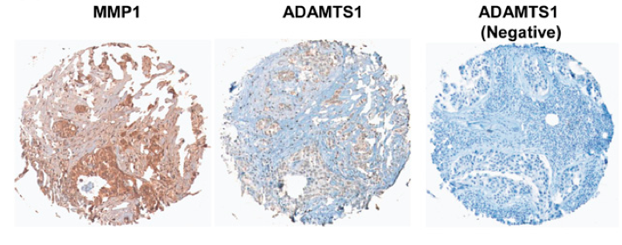
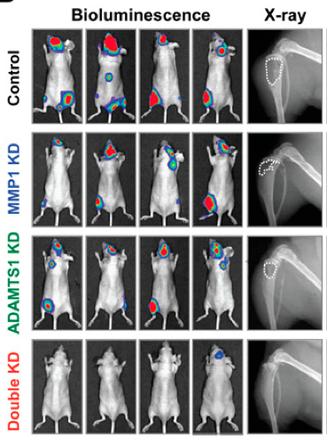
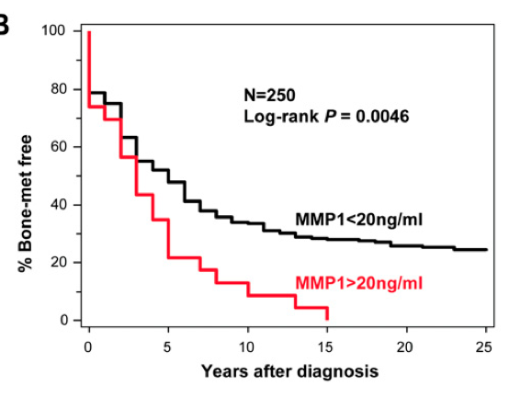
Proteases
ADAMTS1 and MMP1 together are required for bone metastasis
Paracrine signaling to modulate bone microenvironment and promote metastasis
Clinical IDC Tumor
Lu et al., 2009
Notes:
a disintegrin and metalloproteinase with thrombospondin motifs (ADAMTS1)
ADAMTS1, a member of the ADAMTS family (Kuno et al. 1997), has been shown to be capable of binding to and degrading ECM components, including the proteo- glycans aggrecan and versican (Porter et al. 2005). Over- expression of ADAMTS1 promotes pulmonary metas- tasis of TA3 mammary carcinoma and Lewis lung carci- noma cells (Liu et al. 2005).
MMP1: Specifically, MMP-1 breaks down the interstitial collagens, types I, II, and III.
Intracardiac injection
(D) Bioluminescent (BLI), radiographic and histological (H&E and TRAP staining) analyses of bone lesions in four representative mice of each experimental group at day 50 after cell injection. The BLI images are shown under the same color scale. In the radiograph images, white dotted lines show the contour of the bone lesions. Rare small bone metastasis observed in mice injected with double-knockdown cells has smooth tumor–bone interface and very few TRAP-positive cells. Bars, 200 μm. (E) Quantification of TRAP-positive osteoclasts along the tumor–bone interface. Data represent average ± SD. (**) P < 0.01; (***) P < 0.001 based on two-sided Student's t-test.
http://genesdev.cshlp.org/content/23/16/1882/F6.expansion.html

Slide 19
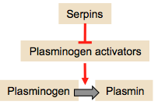
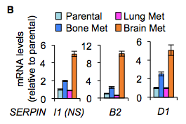
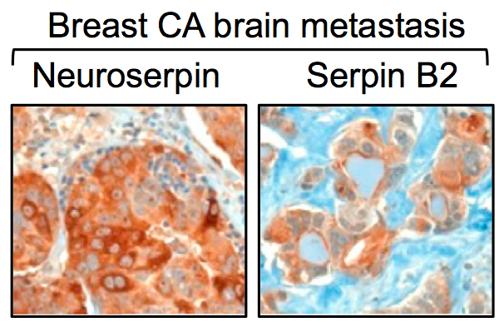
Serpins & Brain Metastasis
Metastatic cells rarely survive in the brain
  Plasmin (serine protease) from the reactive brain stroma is a defense against metastatic invasion
  Brain tropic cells express plasminogen activator (PA) inhibitory serpins to facilitate colonization
mRNA quantification, confirmed similar protein expression
Valiente et al., 2014
Notes:
Serpins: inhibit serine proteases
Plasmin: serine protease that dissolves blood clots (mainly)
Plasmin suppresses brain metastasis in two ways:
by converting membrane-bound astrocytic FasL into a paracrine death signal for cancer cells,
and by inactivating the axon pathfinding molecule L1CAM, which metastatic cells express for spreading along brain capillaries and for metastatic outgrowth.
Among 123 metastases from various subtypes of breast cancer, 77% scored positive for NS and 34% scored positive for serpin B2

Slide 20
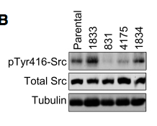
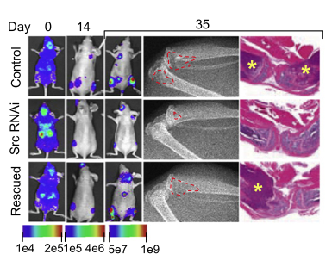
Src Activity Necessary for Bone Colonization
Mesenchymal signals in primary tumor select for bone metastatic seeds with high Src activity
Zhang et al., 2009 Zhang et al., 2014
Notes:
(B) Representative MDA231 derivatives were subjected to western immunoblotting with the indicated antibodies. Organ tropism: 1833, bone; 831, brain; 4175, lung; and 1834, adrenal.
Bioluminescent, radiographic, and H&E analysis of bone lesions from representative mice in each group at the indicated times after inoculation. In the X-ray images, areas of bone lysis are indicated by dotted lines. In the H&E staining, asterisks indicate tumor.

Slide 21
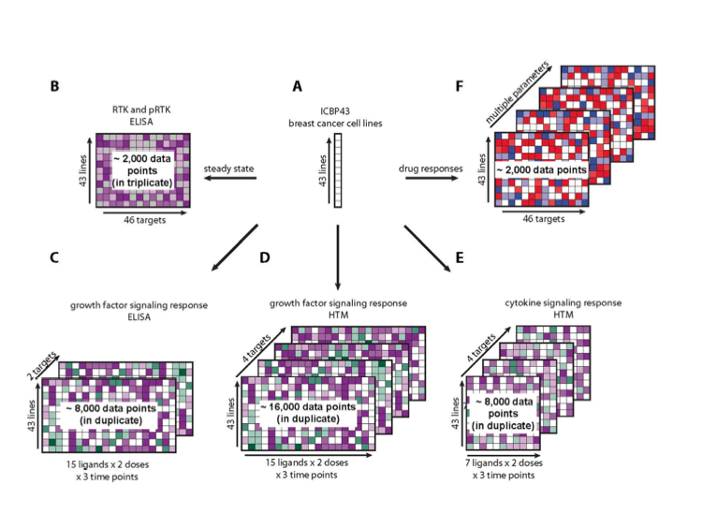
Where we are trying to fit in
Collaboration with Mario Niepel (Harvard Medical School)
  Connecting proteomics with cell phenotypes (large scale)
  Proteomics of bone, brain, lung tropic cells
  Connection between lapatinib-induced osteoactivin up-regulation with phenotype
Niepel et al., 2013

Slide 22
Conclusions
Tissue-specific metastasis is mediated, in part, by microenvironment-related proteins
  Mechanisms are largely unknown, likely complicated.
  Most studies do not compare sites, so it is impossible to know if many of these things are specific!
Large-scale proteomic analysis of metastases (in human patients) would give best insight.
  This could at least be done more easily in mice!

Slide 23
Questions?

Slide 24
Supplemental

Slide 25
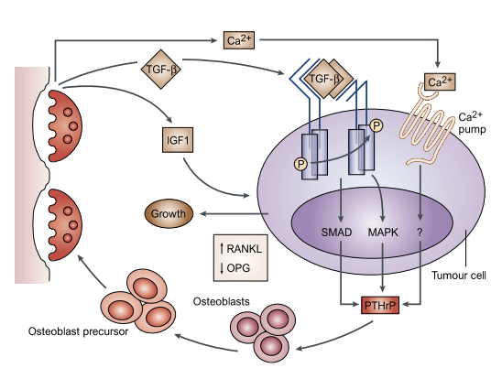
Bone Metastasis
Notes:
The ‘vicious cycle’ hypothesis of osteolytic metastases. Interactions between tumour cells and osteoclasts cause not only osteoclast activation and subsequent bone destruction, but also aggressive growth and behaviour of the tumour cells. Production of the parathyroid-hormone-related protein (PTHrP) by tumour cells enhances osteoclast activation and osteolysis (see FIG. 4). Osteolysis leads to the release of bone-derived growth factors, including transforming growth factor-β (TGF-β) and insulin-like growth factor 1 (IGF1), and raises extracellular calcium (Ca2+) concentrations. The growth factors bind to receptors on the tumour-cell surface and activate autophosphorylation (P) and signalling through pathways that involve SMAD (cytoplasmic mediators of most TGF-β signals) and mitogen-activated protein kinase (MAPK). Extracellular Ca2+binds and activates a Ca2+ pump. Signalling through these pathwayspromotes tumour-cell proliferation and production of PTHrP. Other cytokines might also be involved, such as interleukin (IL)-6, IL-1, IL-11 and IL-18 (not shown). There are many potential points to target in this cycle, including PTHrP, the growth-factor-receptor interactions, and the TGF-β signal-transduction pathway. Bisphosphonates are on the market at present, whereas osteoprotegerin and PTHrP antibodies are in clinical trials
http://www.nature.com/nrclinonc/journal/v8/n6/fig_tab/nrclinonc.2011.67_F1.html

Slide 26
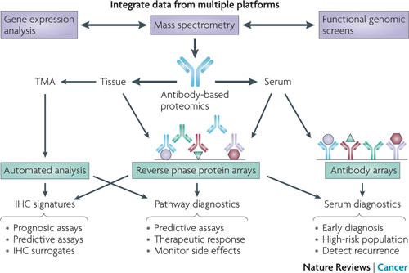
Methods
Mass Spectrometry
  Large number of proteins
  Sample prep, data analysis important; state-of-the-art MS required
Gel-based
  Low throughput
2DE DIGE
Tagging techniques
Protein microarrays
Immunohistochemistry Staining
Brennan et al., 2010
Notes:
Difference gel electrophoresis (DIGE) is a form of gel electrophoresis where up to three different protein samples can be labeled with size-matched, charge-matched spectrally resolvable fluorescent dyes (for example Cy3, Cy5, Cy2) prior to two-dimensional electrophoresis.[1] Then, the three samples are mixed and loaded onto IEF for first dimension and the strip is transferred to a SDS PAGE.
http://www.nature.com/nrc/journal/v10/n9/full/nrc2902.html
http://hgp.sagepub.com/content/1/1/239204.full **read me
http://link.springer.com/protocol/10.1007%2F978-1-60761-987-1_1 **read me

