Slide 1
Highly Efficient Reprogramming to Pluripotency and Directed Differentiation of Human Cells with Synthetic Modified mRNA
Authors: Warran L, Manos PD, Ahfeldt T, Loh Y, Li H, Lau F, Ebina W, Mandal P, Smith ZD, Meissner A, Daley GQ, Brack AS, Collins JJ, Cowan C, Schlaeger TM, and Rossi DJ
Presenters: Nicholas Swenson and Patrick Wu
MIT Department of Biological Engineering
Advanced Topics in Synthetic Biology (20.385)
March 16, 2011

Slide 2
Presentation Outline
Introduction/Background in iPSCs
Modification of mRNA
Achieving pluripotency using modified RNAs
Differentiation of RiPSCs

Slide 3
iPSCs and Yamanaka Factors
Induced pluripotent stem cells
Originally achieved by Yamanaka in 2006
  Transduction of 4 transcription factors:
  KLF4, c-MYC, OCT4, and SOX2
  Also known as KMOS
Previous methods
  DNA: adenovirus vectors, transposon vectors, etc.
  Protein: serial protein transduction
  RNA: trans-gene delivery via Sendai virus

Slide 4
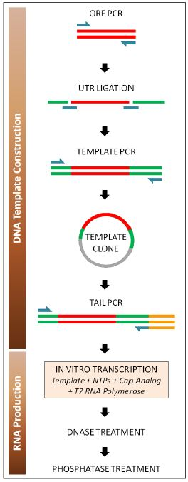
Modification of mRNA
Repeatedly administer RNAs resistant to targeting and degredation within human cells
  Modified mRNAs created through synthetic engineering
Extend lifespan of mRNA in cytoplasm
  5’ guanine cap
  PolyA tail

Slide 5
Modification of mRNA
Suppress interferon and NF-κB-dependent pathways
  Add phosphatase
  Modified nucleobases
  (5-methylcytidine and pseudouridine)
  (Supplement with recombinant B18R to competitively inhibit interferons)

Slide 6
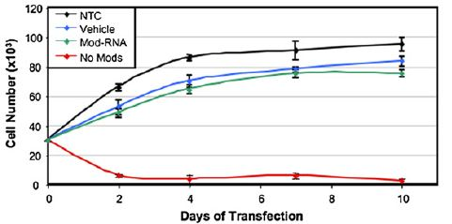
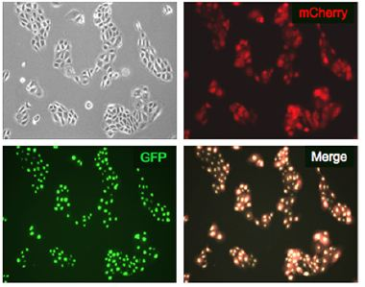
Testing Modified mRNA
Transfection of modified RNA over time, comparing cell population numbers
Transfection of modified GFP and mCherry RNA containing nuclear localization signal

Slide 7
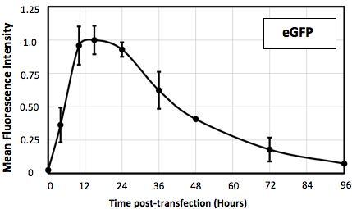
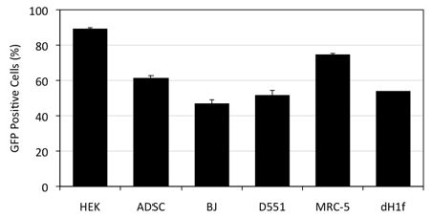
Testing Modified mRNA
Transfect modified GFP mRNA into six different human cell types
  Relatively high percentage of GFP positive cells, regardless of type
  Max fluorescence ~12 hours after transfection

Slide 8
Transfection of Modified KMOS mRNAs
Four human cell types tested: Detroit 551, MRC-5 fetal fibroblasts, BJ postnatal fibroblasts, fibroblast-like cells from cystic fibrosis patient
Modified LIN28 mRNA also transfected
Daily transfection of modified KMOSL mRNAs for 17 days
hESC-like colonies picked and expanded on day 20

Slide 9
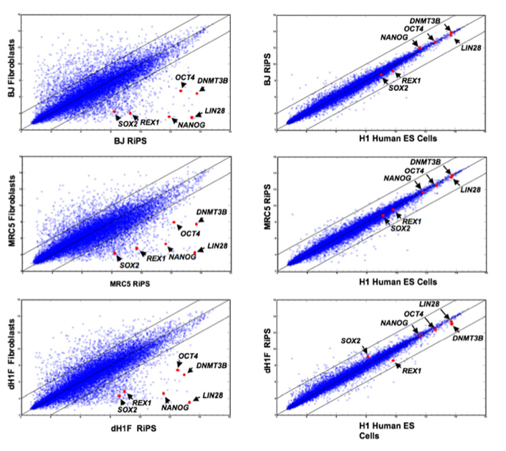
Gene Expression Profiles of the RiPSCs resemble hESC
Transcript expression for pluripotency markers SOX2, REX1, NANOG, OCT4, DNMT3B, and LIN28 for RiPSCs
Notes:
They used three methods to show that the cells they had induced to pluripotency were in fact pluripotent:
1. Transcript expression for SOX2, REX1, NANOG, OCT4, DNMT3B, LIN28 and hTERT (not shown) and showed that they had expression profiles
Gene expression levels were normalized with the Robust Multichip Average algorithm

Slide 10
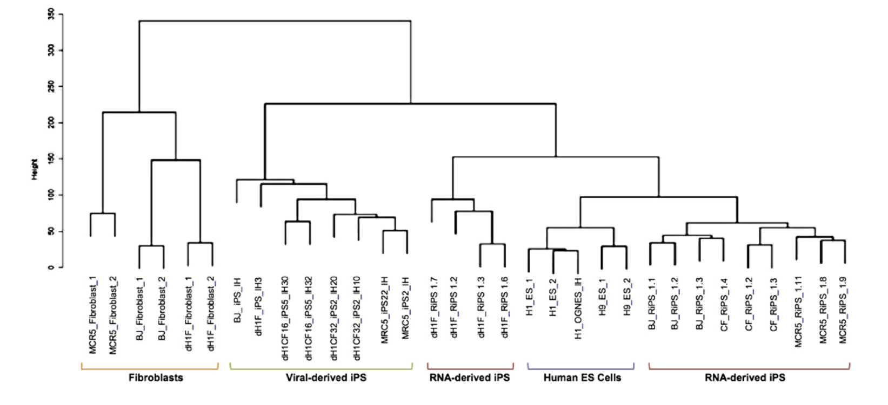
RiPSCs are are more similar to hESCs than viral-derived IPSs
Notes:
Used the genetic transcript expression profiles from their RiPSCs and mapped it to a dendrogram, which is hierarchical clustering perfomed by means of euclidean distance with average linkage method, and showed that the RNA-derived iPSCs were not only more similar to the hESCs than the fibroblasts but also more similar than virally derived iPSCs
-result suggests that the RNA derived IPSs more fully recapitulated the molecular signature
They also used two other methods to show that the cells were pluripotent:
2. Immunostaining for OCT4, NANOG, TRA-1-60, TRA-1-81, SSEA3, and SSEA4 and showed they exist in their pluripotent cells (not shown)
3. Showed that there was increased demethylation of the OCT4 locus, which is an epigenetic state characteristic of hESCs (not shown)

Slide 11
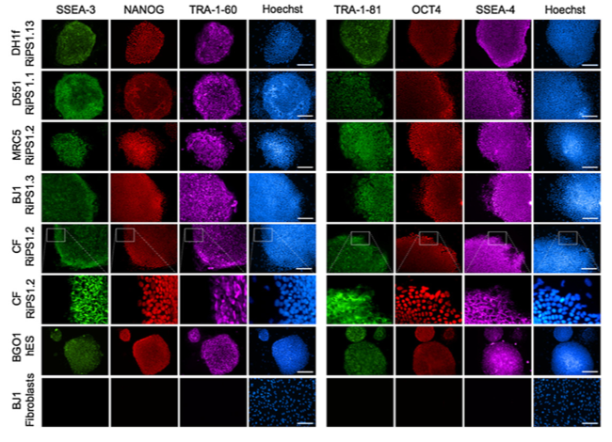
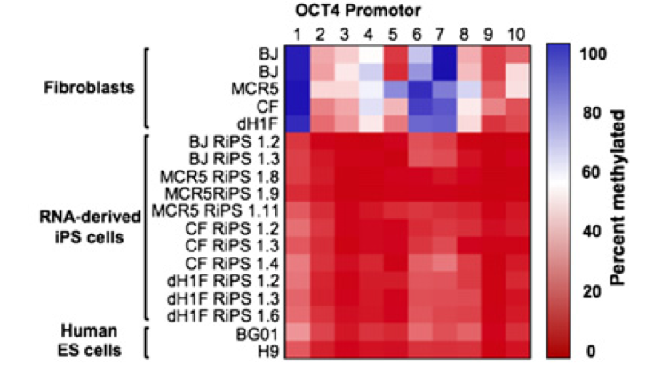
RiPSCs have similar genetic profiles to hESCs
Immunostaining for NANOG, TRA-1-60, SSEA3, Hoechst, OCT4, TRA-1-81 and SSEA4 and showed they exist in their pluripotent cells
Showed that there was increased demethylation of the OCT4 locus, which is an epigenetic state characteristic of hESCs

Slide 12
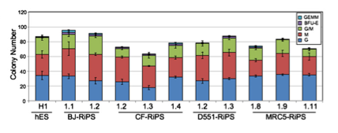
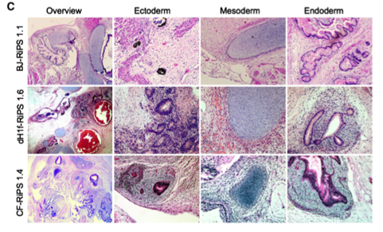
Differentiation profile of RiPSCs resemble hESCs and Tri-lineage potential
Upon directed differentiation by hematopoietic cytokines, RiPSCs differentiate into similar blood colony types and numbers
RiPSCs have the ability to be directed to three germ layer cell types
Notes:
After showing pluripotency of their RiPSCs, they had to show the differentiation capability of these cells. To this end they used hematopoietic cytokines in media to induce several strains of their RiPSCs to be induced to different blood colony types.
-They were induced by 5 different cytokines to cause differentiation
- shown in this figure that the RiPSCs that they chose had the capability to differentiate into all the cells that the hESCs could and did so in similar colony numbers
Furthermore, showed trilineage differentiation potential by formation of teratomas which were composed of the three germ layers
-as you can imagine being able to differentiate into 3 of the germ layers is a necessary component of stem cells

Slide 13

Method of Modified RNA transfection increases Efficiency to Pluripotency
The repeated transfection of modified RNA yields increased efficiency as compared to retroviral methods
The derivation fractions were 1.4% and 0.04%, for modified RNA and retroviral methods
Notes:
They then wanted to further quantify the benefit of their RiPSCs as compared to the PSCs derived from retroviral vectors
They compared the KMOS cocktail given through retroviral vector and with their modified RNA
- showed that the modified RNA allowed for much faster cultivation (17 days) as opposed to the viral method which was 32 days
-also showed that the modified RNA method increased the fraction of iPSCs as compared to the viral method (did not describe viral method they used)

Slide 14
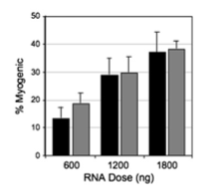
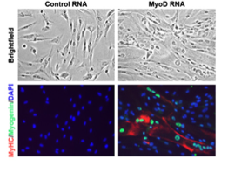
Fraction of Directed Differentiation is Dose Dependent
When RiPSCs transfected with MYOD modified RNA, the percent differentiated was dose dependent (black bars: 10⁴ cells/cm²; grey bars: 5*10³ cells/cm²)
Notes:
Then wanted to see if they could use their method of modified mRNA attached to a vehicle to induce differentiation of their RiPSCs
In first figure showed that the RiPSCs that were transfected with MYOD modified mRNA did in fact differentiate into myogenic cells based on the double positive MyHC and myogenin markers
Furthermore, they tested the differentitation of the cells with increasing RNA dosage and showed that the percent of differentiation was nearly linearly dependent (black bars are 10)

Slide 15
Conclusions
By use of RNA modification and soluble interferon inhibitor, developed highly efficient method of producing pluripotent cells
Because RNA based, eliminates risk of genomic integration
In the future, the RiSPCs can be used to model diseases or be implemented in therapy
Furthermore, the transient and non-mutagenic character of RNA-based protein expression can have clinical applications
Notes:
The pluripotent cells they developed were produced in nearly half the time from comparable retroviral vectors
Furthermore, they were able to produce cells with epigenetic landscape and development plasticity extremely similar to hESCs
The modified RNA can be used to target diseased cells to express surface proteins such as homing receptors for cellular therapy
Major enabling technology is applied usefully.

Slide 16
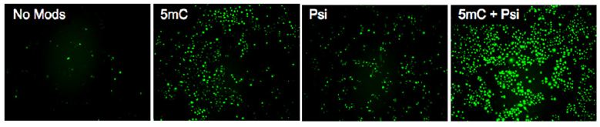
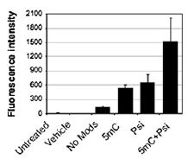
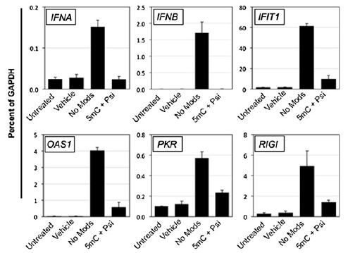
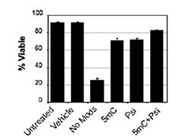
Testing Modified mRNA (More Figures)

Slide 17
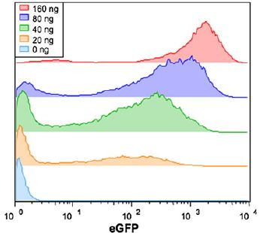
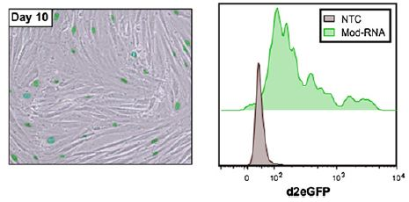
Testing Modified mRNA (More Figures)

Slide 18
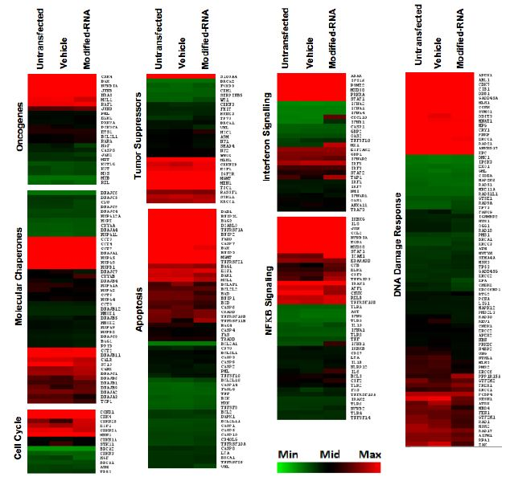
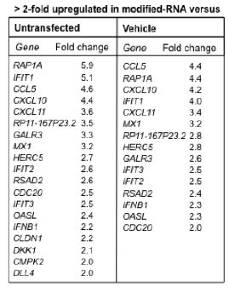
Testing Modified mRNA (More Figures)
Heat map of microarray analysis of BJ fibroblasts (10 days, modified GFP)
-no significant change except some upregulatrion of interferon/NFkB

Slide 19
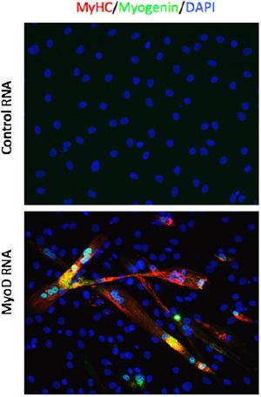
Testing Modified mRNA (More Figures)
MYOD – Myogenic transcription factor
Transfected into murine C3H10T1/2 cells for 3 days

Slide 20
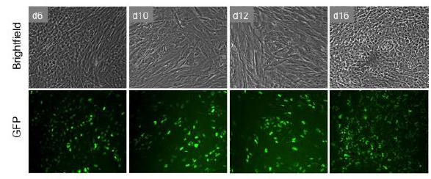
Testing Modified mRNA (More Figures)
Modified GFP mRNA added to modified KMOSL mRNA mixture (keratinocytes)

Slide 21
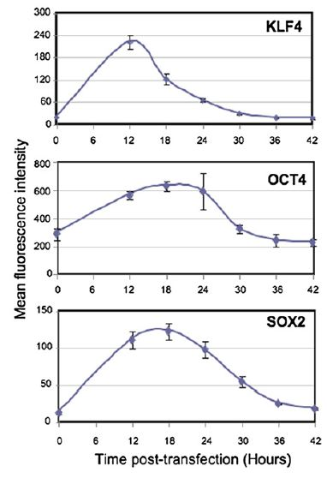
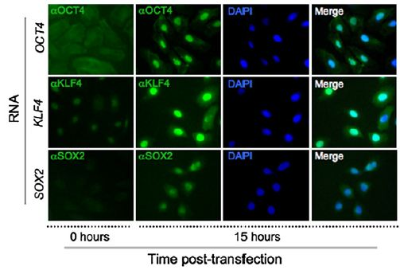
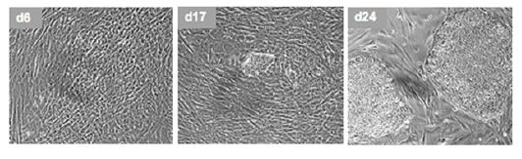
Testing Modified mRNA (More Figures)

Slide 22
Immunohistochemistry for Pluriopotent markers

