Slide 1
You will prepare a 10 minute PowerPoint presentation that will present your mathematical model of nitrogen metabolism in yeast. Please follow these guidelines when creating your presentation. You will need approximately 10 slides (1 slide per minute) for your presentation.
Your presentation should cover the following content:
Purpose and significance of the model
A list and explanation of the state variables needed to model the process of interest.
Your system of differential equations that model the dynamics.
An explanation of the terms in your equation(s) in order to justify your choices.
A list and explanation of all the parameters your model requires for numerical simulation.
The output (graphs) of your numerical simulation.
A discussion of your results and how they relate to the Journal of Bacteriology and Microbiology papers by ter Schure et al. (1995).
What future directions might you take.

Slide 2
The Effects of different parameters on a Nitrogen Metabolism of S. cerevesiae
Carmen Castaneda
Department of Biology
Loyola Marymount University
February 24, 2011

Slide 3
The purpose of the model is to model the concentration of different amino acids and ammonia at different parameters.
The model is significant because it will help us understand the behavior of glutamine, glutamate, alpha-ketoglutarate, and ammonia in our system as we pick different values for our parameters.

Slide 4
Outline
Components of the differential equations
State Variables
Parameters
System of Equations
Glutamine
Glutamate
Alpha-ketoglutarate
Ammonia
Output
Initial
Changing Parameters
Connections
Future

Slide 5
Outline
Components of the differential equations
State Variables
Parameters
System of Equations
Glutamine
Glutamate
Alpha-ketoglutarate
Ammonia
Output
Initial
Changing Parameters
Connections
Future

Slide 6
State Variables
In my system I declared glutamine, glutamate, alpha-ketoglutarate, and ammonia concentrations as my state variables. Glutamine, glutamate and alpha-ketoglutarate are all enzymes in the cell so there is an initial amount in the system which will fluctuate over the course of time while the reaction is occuring. Similarly the ammonia concentration is introduced into the reaction and as it goes through the reaction it’s concentration will fluctuate.

Slide 7
Parameters
The parameters of my model are v1, v2, v3, v4, v5, k1, k2, k3, k4, k5, D, and u. The v’s all refer to the v max of each reaction as developed through the Michaelis Mentis model and the k’s are constants at which the function is proportional to the rate of change. D is the dilution rate of the inflow of glucose and ammonia, while u is the concentration of glucose and ammonia.

Slide 8
Outline
Components of the differential equations
State Variables
Parameters
System of Equations
Glutamine
Glutamate
Alpha-ketoglutarate
Ammonia
Output
Initial
Changing Parameters
Connections
Future

Slide 9
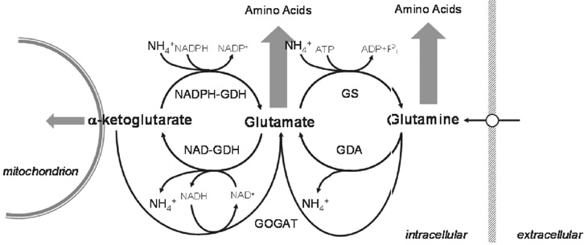
The rate of change of the glutamine concentration
dxdt(1) = -v1*mine/(k1+mine)+v2*(ate*nh4)/(k2+(ate*nh4))-v5*(mine*ak)/(k5+(mine*ak))
v4
v2
v4
v1
Legend
mine=[glutamine]
ate= [glutamate]
nh4=[ammonia]
ak=[alpha-ketoglutarate]
v5
van Riel & Sontag (2006) IEEE Proc.-Syst. Biol. 153: 263-274

Slide 10
The rate of change of the glutamate concentration
dxdt(2) = v1*mine/(k1+mine)-v2*(ate*nh4)/(k2+(ate*nh4)) -v4*(ate/(k4+ate))+v3*(ak*nh4)/(k3+(ak*nh4)) +v5*(mine*ak)/(k5+(mine*ak)
v3
v2
v4
v1
Legend
mine=[glutamine]
ate= [glutamate]
nh4=[ammonia]
ak=[alpha-ketoglutarate]
v5
van Riel & Sontag (2006) IEEE Proc.-Syst. Biol. 153: 263-274

Slide 11
The rate of change of the alpha-ketoglutarate concentration
dxdt(3) = -v5*(mine*ak)/(k5+(mine*ak))-v3*(ak*nh4)/(k3+(ak*nh4))+v4*(ate/(k4+ate))
v3
v2
v4
v1
Legend
mine=[glutamine]
ate= [glutamate]
nh4=[ammonia]
ak=[alpha-ketoglutarate]
v5
van Riel & Sontag (2006) IEEE Proc.-Syst. Biol. 153: 263-274

Slide 12
The rate of change of the ammonia concentration
dxdt(4) = D*u+((v1*mine)/(k1+mine))+v4*(ate/(k4+ate))-v3*(ak*nh4)/(k3+(ak*nh4))-v2*(ate*nh4)/(k2+(ate*nh4))
v3
v2
v1
v4
Legend
mine=[glutamine]
ate= [glutamate]
nh4=[ammonia]
ak=[alpha-ketoglutarate]
v5
van Riel & Sontag (2006) IEEE Proc.-Syst. Biol. 153: 263-274

Slide 13
Outline
Components of the differential equations
State Variables
Parameters
System of Equations
Glutamine
Glutamate
Alpha-ketoglutarate
Ammonia
Output
Initial
Changing Parameters
Connections
Future

Slide 14
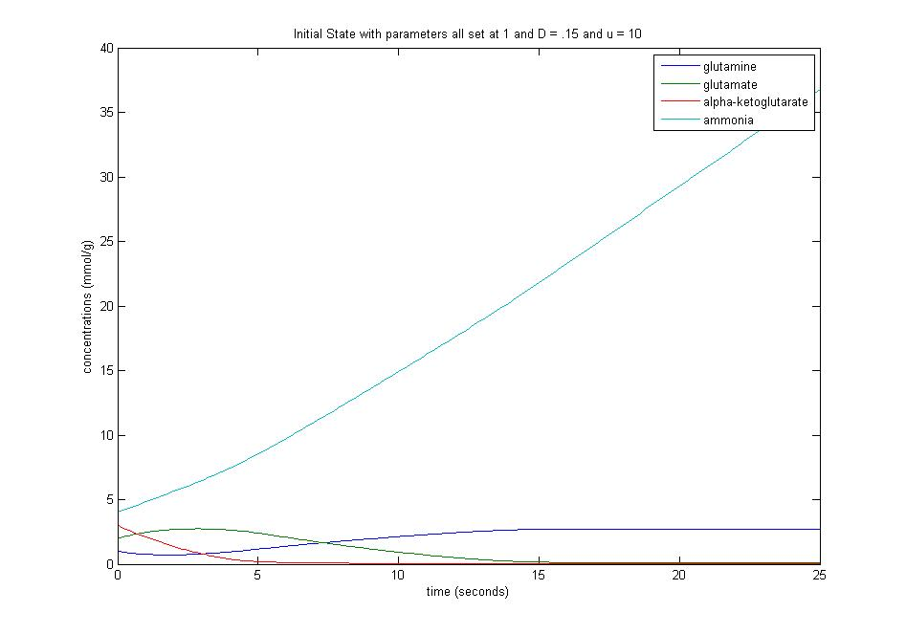
Initial Output
k1=k2=k3=k4=k5=v1=v2=v3=v4=v5=1
D=0.15 u=10
glutamine=1 glutamate=2 alpha-ketoglutarate=3 ammonia=4

Slide 15
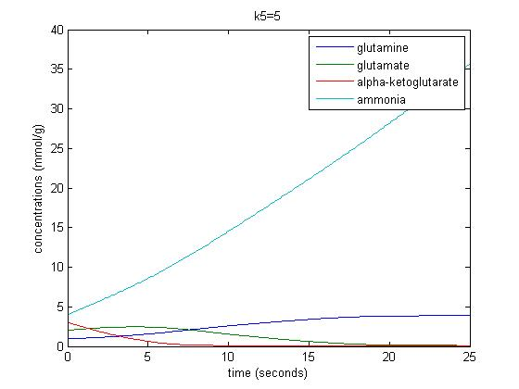
Changing Parameters
Changing the k parameters did not cause a drastic change to the initial parameters.
The state variables had a higher concentration for a longer period of time.

Slide 16
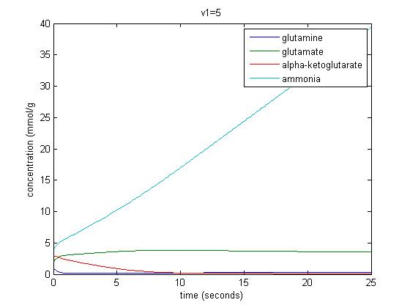
Changing Parameters
Changing the v parameter we see that they tend to fluctuate more from the initial and even between themselves.

Slide 17
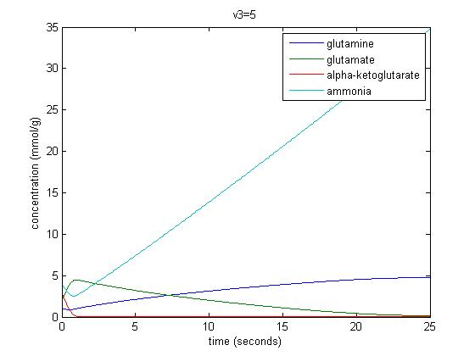
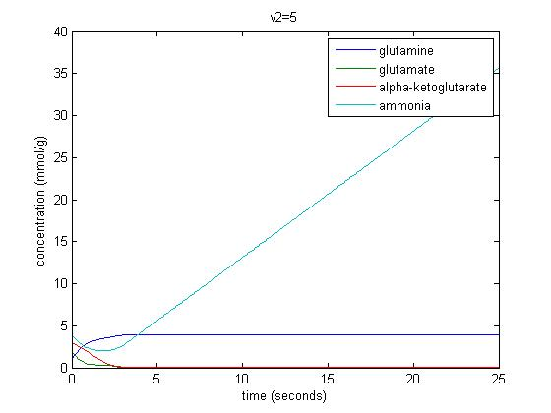
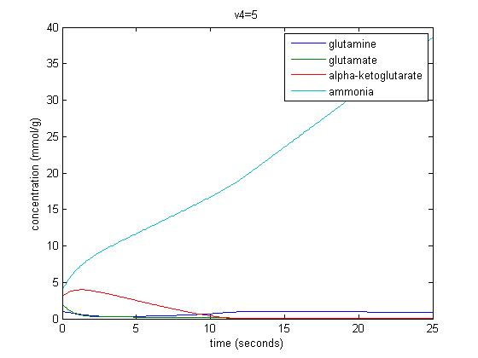
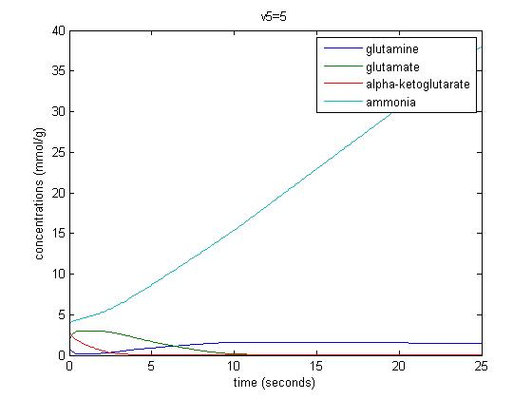
Changing Parameters

Slide 18
Outline
Components of the differential equations
State Variables
Parameters
System of Equations
Glutamine
Glutamate
Alpha-ketoglutarate
Ammonia
Output
Initial
Changing Parameters
Connections
Future

Slide 19
Outline
Components of the differential equations
State Variables
Parameters
System of Equations
Glutamine
Glutamate
Alpha-ketoglutarate
Ammonia
Output
Initial
Changing Parameters
Connections
Future

