Slide 1
Figure Results from First Run
When:
fix_b=1
fix_P=0
iestimate=1
Alpha=.01

Slide 2
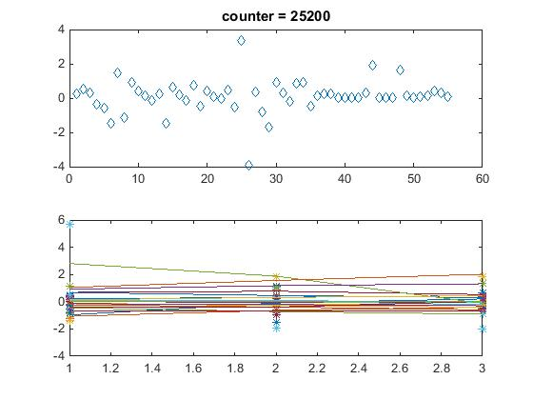
Overall Network Result

Slide 3
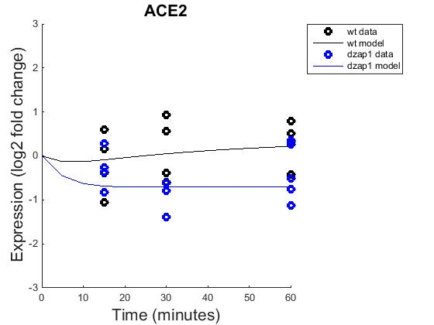
Expression of ACE2 and response to dzap1 and wild type

Slide 4
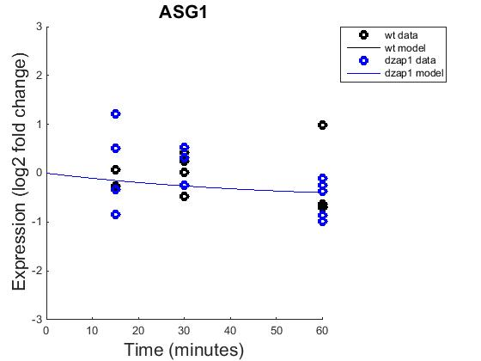
Expression of ASG1 and response to dzap1 and wild type

Slide 5
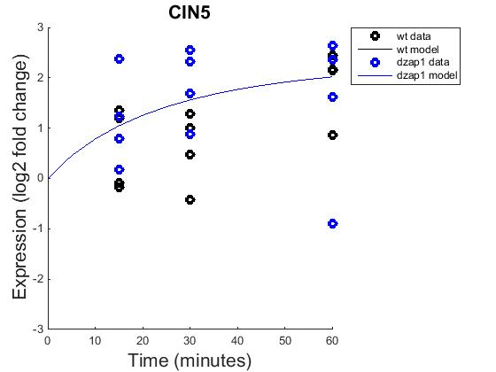
Expression of CIN5 and response to dzap1 and wild type

Slide 6
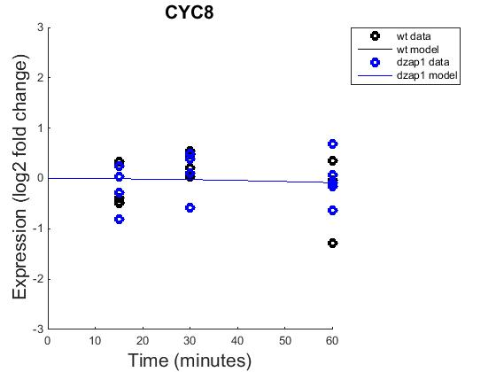
Expression of CYC8 and response to dzap1 and wild type

Slide 7
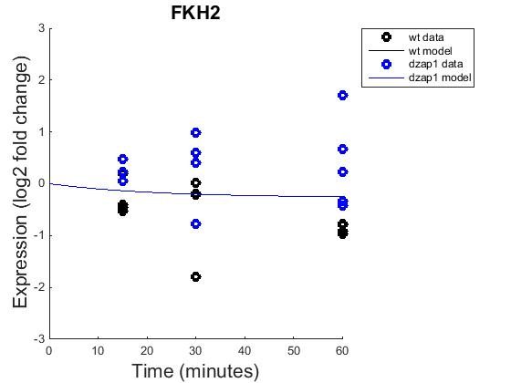
Expression of FKH2 and response to dzap1 and wild type

Slide 8
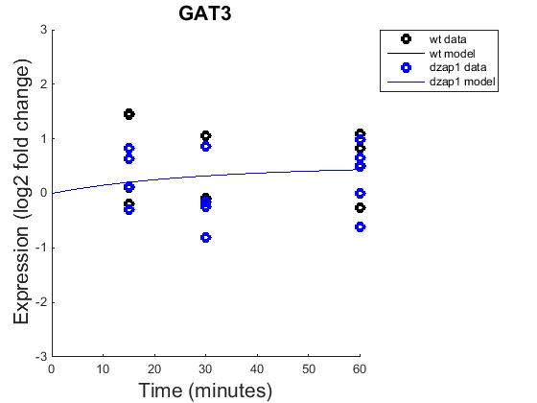
Expression of GAT3 and response to dzap1 and wild type

Slide 9
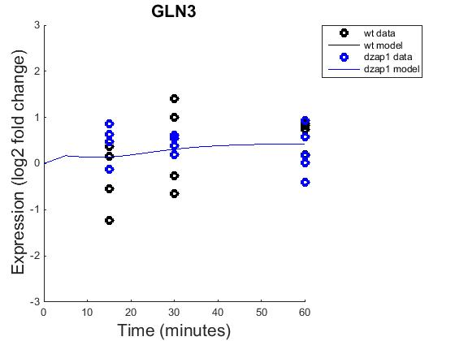
Expression of GLN3 and response to dzap1 and wild type

Slide 10
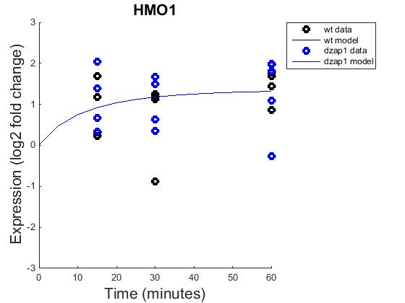
Expression of HMO1 and response to dzap1 and wild type

Slide 11
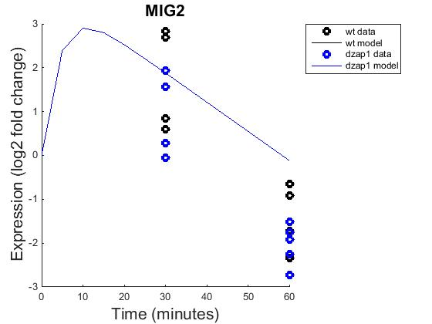
Expression of MIG2 and response to dzap1 and wild type

Slide 12
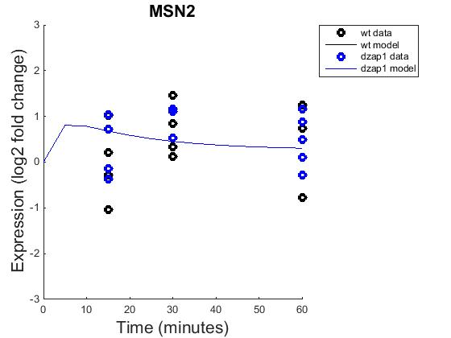
Expression of MSN2 and response to dzap1 and wild type

Slide 13
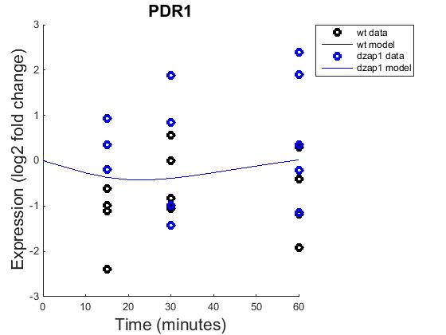
Expression of PDR1 and response to dzap1 and wild type

Slide 14
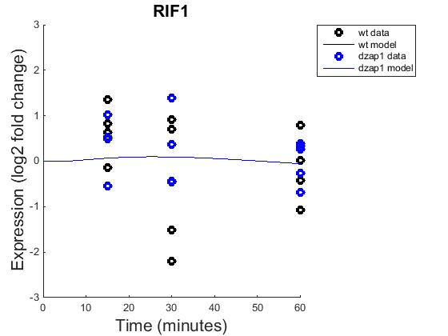
Expression of RIF1 and response to dzap1 and wild type

Slide 15
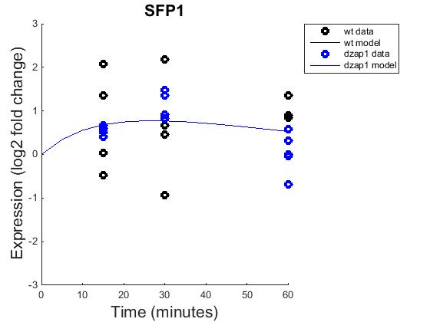
Expression of SFP1 and response to dzap1 and wild type

Slide 16
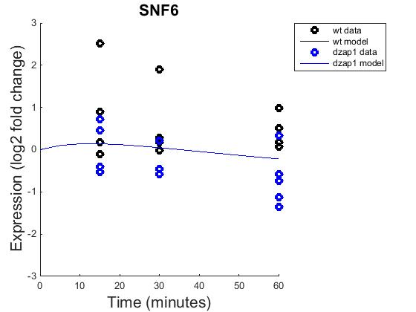
Expression of SNF6 and response to dzap1 and wild type

Slide 17
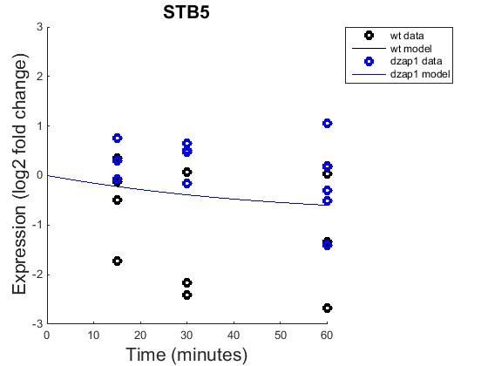
Expression of STB5 and response to dzap1 and wild type

Slide 18
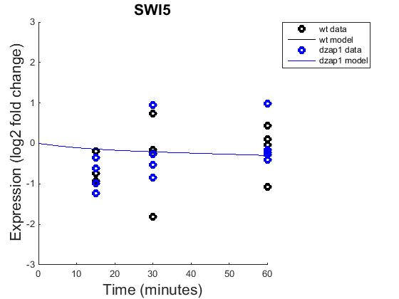
Expression of SWI5 and response to dzap1 and wild type

Slide 19
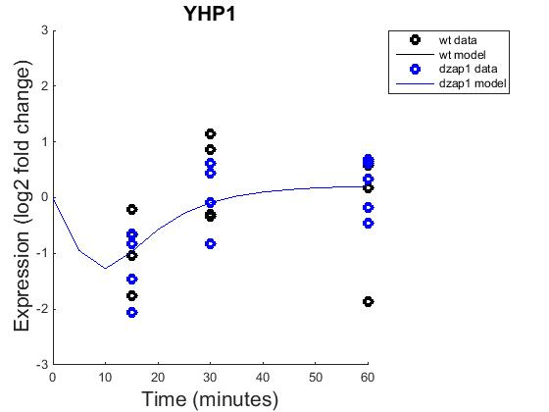
Expression of YHP1 and response to dzap1 and wild type

Slide 20
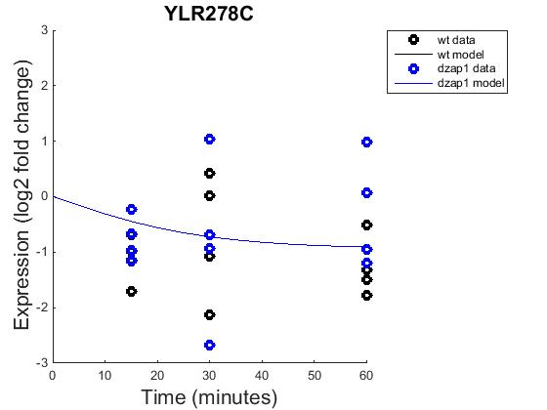
Expression of YLR278C and response to dzap1 and wild type

Slide 21
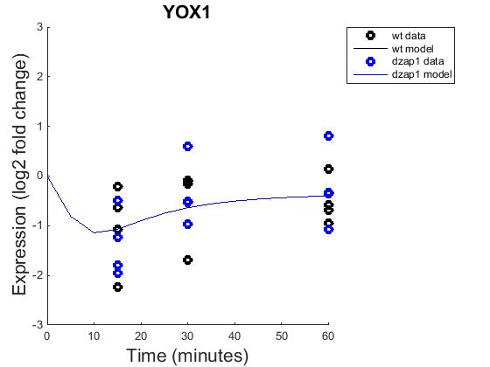
Expression of YOX1 and response to dzap1 and wild type

Slide 22
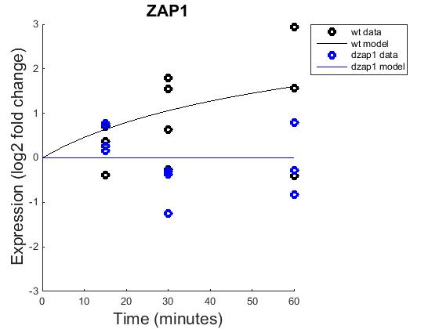
Expression of ZAP1 and response to dzap1 and wild type

