Slide 1
Simplified Mathematical Modeling of the Nitrogen Metabolism
Jeffrey Crosson and William Gendron
Notes:
Wil’s Work: Background, purpose and significance. Discussion of results and how they relate to the ter Schure Paper. Bacteriology Sentence. A list and explanation of state variables needed to model the process of interest. Show differential equations that model the dynamics. Explanation of the terms in your equations
Jeff’s work: A list and explanation of state variables needed to model the process of interest. Variables, Terms. A list and explanation of all the parameters your model requires for numerical simulation. Simulation of the dynamics. Analysis of steady-state.

Slide 2
Outline
Why is the modeling nitrogen metabolism important?
The importance and summary of the nitrogen cycle
The importance of mathematical models
How is the model constructed?
Variables and what they represent
What does the model show?
The model shows the reactions between the enzymes and the substrates.
Only a relative measure of the substrates/products.
How can the model be improved? How does it relate to the paper?
The model does not describe the enzyme concentrations, gene regulation interactions or input/output of this system in a cell.
Model describes the chemical interaction in vitro.
ter Schure paper data is based on all of the underlying cell interactions and the last line is a poor comparison.

Slide 3
The nitrogen cycle is a key limiting factor for growth and an important building block
Nitrogen is a necessary element in cells making up parts of proteins and nucleotides
The cycle and input are key to how much cells grow and function(Ljungdahl et al.)
Knowledge of this allows us to understand how cells grow and react to specific environments.

Slide 4
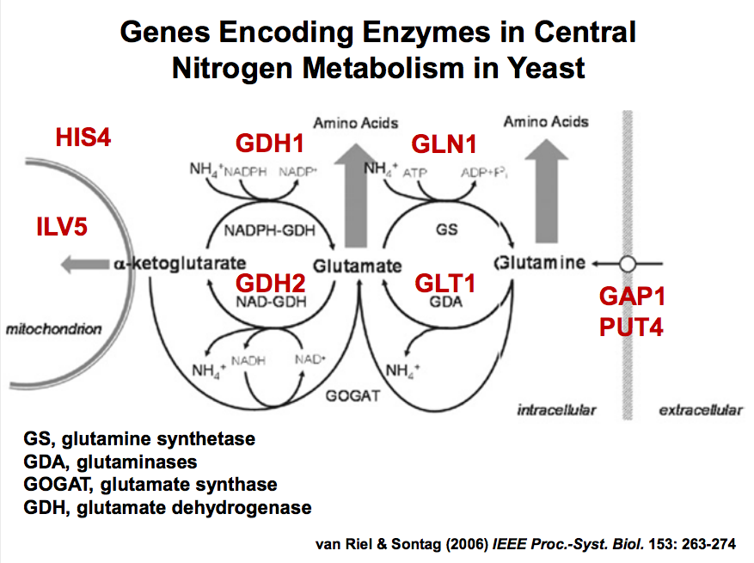
Summary of a portion
of the Nitrogen Cycle

Slide 5
Mathematical Models create a precise understanding of interactions
Through mathematical models, systems can be analyzed with precision.
Full understanding of the system.
Creates the ability to predict outcomes based on inputs.
This can be eventually applied to gain a full understanding of how cells work and interact on a molecular level.

Slide 6
The mathematical model is the first step
to define the system
This is the basic way to simulate interactions.
This is a valuable first step in replicating a system, but it is not complete.

Slide 7
Summary of Nitrogen Cycle

Slide 8
Modeled Reaction
r₁
r₂
A
B
C
r₋₂
r₋₁
r₃

Slide 9
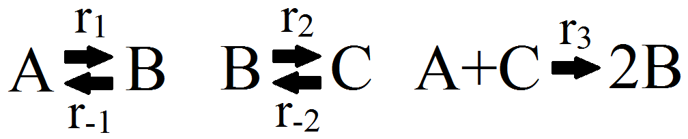
Definition of Variables and Constants
State variables: Metabolite concentrations
A = alpha-ketogluterate
B = glutamate
C = glutamine
Parameters: Enzymatic rate constant
r₁ = GDH1 activity
r₋₁ = GDH2 activity
r₂ = GLN1 activity
r₋₂ = GLT1 activity
r₃ = GOGAT activity

Slide 10
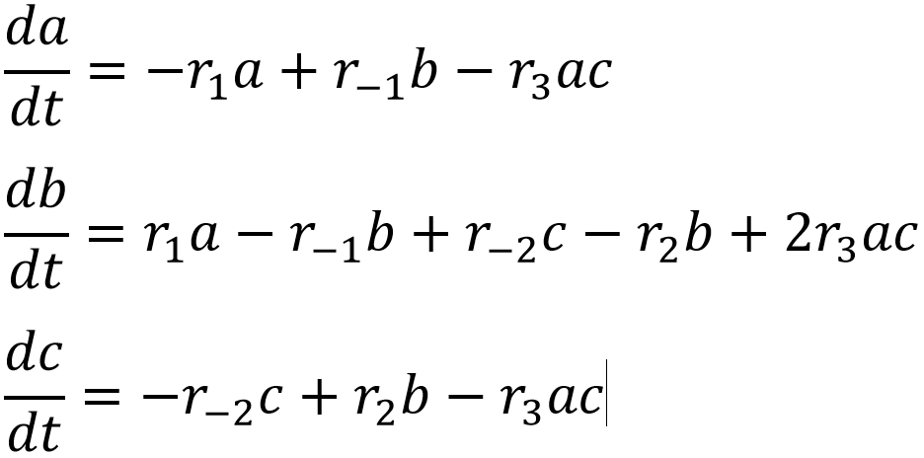
Creating the Differential Equations
The system of differential equations consists of a differential equation for each state variable
The time derivative of each state variable equals the sum of products of parameters and state variables

Slide 11
Meaning of Differential Equations
The system of differential equations are solved for and lead to equilibrium
This is a steady-state condition, meaning that it will stay like this forever
Different initial conditions and parameters lead to different curves

Slide 12
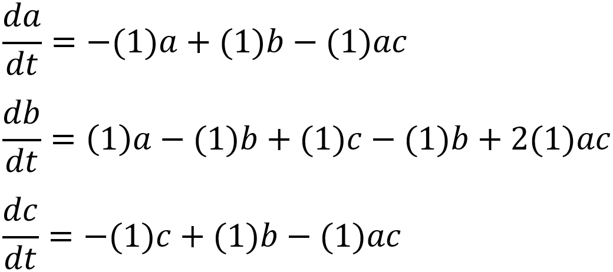
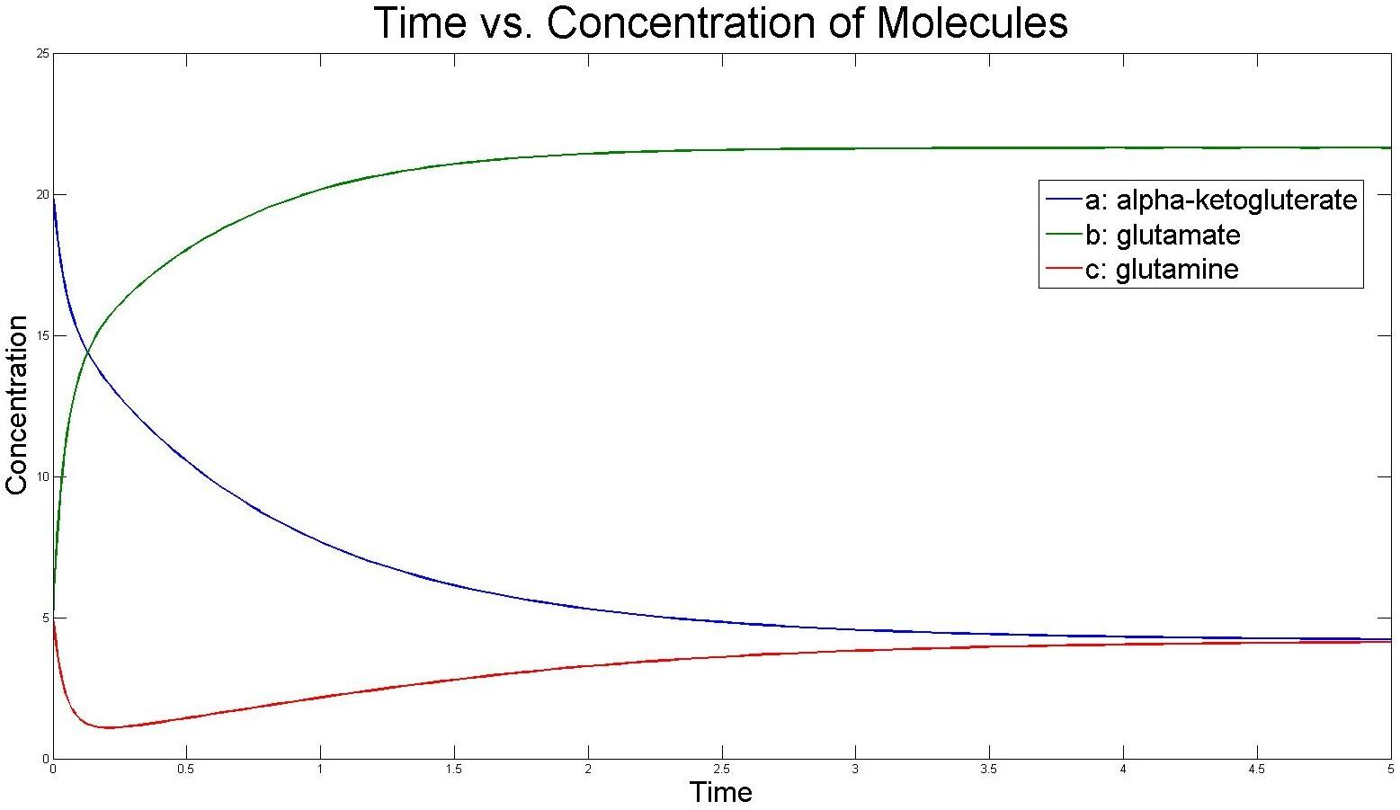
Plugging in Parameters
All parameters were set to 1
a starts at 20
b and c start at 5
They all end in steady state
a and c end at the same small value
b ends at a large value

Slide 13

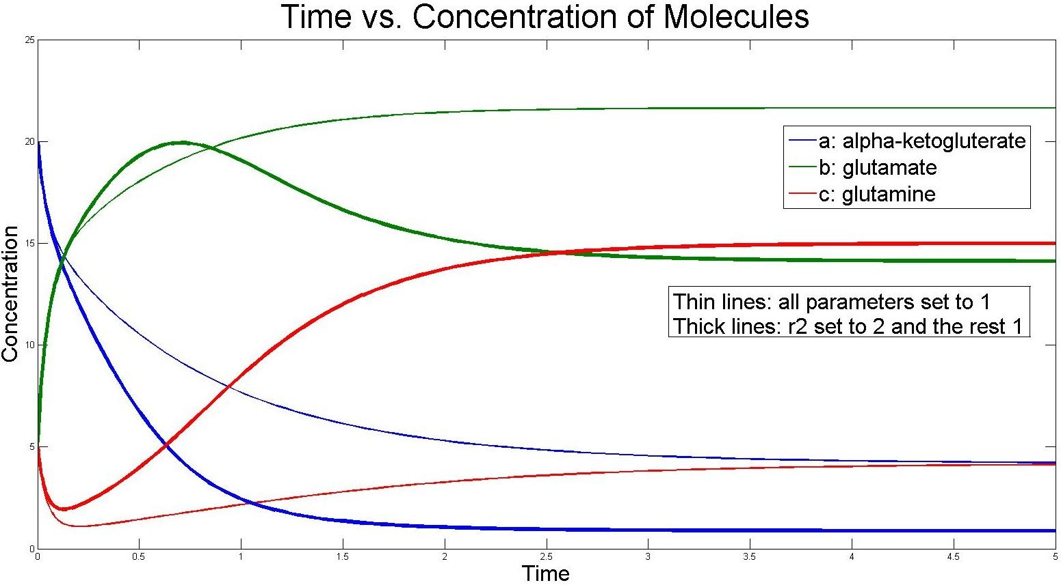
Parameter Modification
Parameter r₂ was set to 2 and the rest were kept at 1
db/dt now has a -2b value
This creates a negative slope for b once b gets large
dc/dt now has +2b value
This creates a greater positive slope for c once b gets large
c ends at a much higher value than before

Slide 14
Steady-State
Steady-state, or equilibrium, occurs when all of the slopes equal zero, which appears as a flat line
Initial conditions and parameters are the only factors that affect the steady-state values
Steady-state always occurs after about 5 units of time
This is a stable system, because it always goes to a steady-state

Slide 15
The mathematical model
represents an in vitro system...
This is only portrays the reaching of equilibrium as if in vitro.
No gene regulation of enzymes or cellular activity.

Slide 16
...with infinite enzymes
This is only portrays the reaching of equilibrium as if in vitro.
No gene regulation of enzymes or cellular activity.
No limitation via enzymes, suggests infinite enzymes
Asymptoting slope would
not be seen if enzyme
was limiting
Only variables are the
metabolites.

Slide 17
If there were limiting
enzymes this and...
Substrate
Enzyme
Substrate
Substrate
Enzyme
Substrate

Slide 18
...and this would have the same rate.
Substrate
Substrate
Substrate
Substrate
Substrate
Substrate
Enzyme
Substrate
Substrate
Enzyme
Substrate
Substrate
Substrate
Substrate
Substrate

Slide 19
With unlimited enzyme, the process will only be limited by the substrate.
Enzyme
Enzyme
Substrate
Enzyme
Enzyme
Substrate
Enzyme
Substrate
Enzyme
Substrate
Enzyme
Enzyme
Enzyme
Enzyme
Enzyme

Slide 20
With unlimited enzyme, the process will only be limited by the substrate.
Substrate
Enzyme
Substrate
Enzyme
Enzyme
Substrate
Enzyme
Substrate
Enzyme
Substrate
Substrate
Enzyme
Substrate
Enzyme
Enzyme
Substrate
Substrate
Enzyme
Enzyme
Enzyme
Substrate

Slide 21
The ter Schure paper’s study a system with many more variables.
The ter Schure paper shows the interaction within cells
Enzymes are regulated by genes and are limited.
Regulation of cellular import and export.
The cell is using the metabolites to fulfill specific processes.
If a model of the information from the paper was to be made, it would require expanding the equation to hold these concepts.

Slide 22
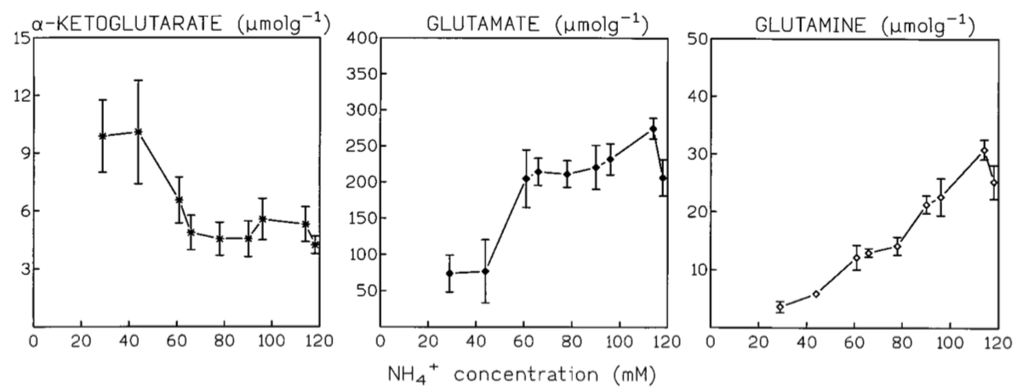
ter Schure Graphs
These are influenced by more than the concentrations of the other metabolites and enzymes.

Slide 23
Yeast have a different ammonia sensor than bacteria
“If the ammonia concentration is the regulator, this may imply that S. cerevisiae has an ammonia sensor which could be a two-component sensing system for nitrogen, as has been found in gram-negative bacteria.”
The statement suggests that it is similar to bacteria which it isn’t.
There are many “sensors” which react to ammonia as well as other nitrogen sources.(depends on strain)
Gap1p, MPR1, MPR2, Gln3, Ure2, TOR proteins etc.
Genetic variation creates different source preferences among yeast
Magasanik et al. (Review)

Slide 24
References
Per O. Ljungdahl and Bertrand Daignan-Fornier. YeastBook - Gene Expression & Metabolism:Regulation of Amino Acid, Nucleotide, and Phosphate Metabolism inSaccharomyces cerevisiae. Genetics March 2012 190:885-929; doi:10.1534/genetics.111.133306
Boris Magasanik, Reversible phosphorylation of an enhancer binding protein regulates the transcription of bacterial nitrogen utilization genes, Trends in Biochemical Sciences, Volume 13, Issue 12, December 1988, Pages 475-479, ISSN 0968-0004, http://dx.doi.org/10.1016/0968-0004(88)90234-4. (http://www.sciencedirect.com/science/article/pii/0968000488902344)
E. G. ter Schure, H H Silljé, A J Verkleij, J Boonstra, and C T Verrips. The concentration of ammonia regulates nitrogen metabolism in Saccharomyces cerevisiae. J. Bacteriol. November 1995 177:22 6672-5.
Boris Magasanik, Chris A Kaiser, Nitrogen regulation in Saccharomyces cerevisiae, Gene, Volume 290, Issues 1–2, 15 May 2002, Pages 1-18, ISSN 0378-1119, http://dx.doi.org/10.1016/S0378-1119(02)00558-9. (http://www.sciencedirect.com/science/article/pii/S0378111902005589)
M. J. MERRICK, R.A. EDWARDS. Nitrogen Control in Bacteria. Microbiological Reviews. December 1995. Pages 604-622

